Slide 1

B.Tech Project Evaluation-2, VIIIth Sem
Project Title----SMART CAR PARKING SYSTEM
Presented by :-
SONI JAIN(2018016478)
SUKRITI SACHAN(2018006901)
AISH AGGARWAL(2018015448)
Under the Supervision of:-
(Mrs. Rani Astya)
Sharda University, Gr. Noida
DEPARTMENT OF COMPUTER SCIENCE & ENGINEERING
SCHOOL OF ENGINEERING AND TECHNOLOGY
02, April, 2022

Slide 2
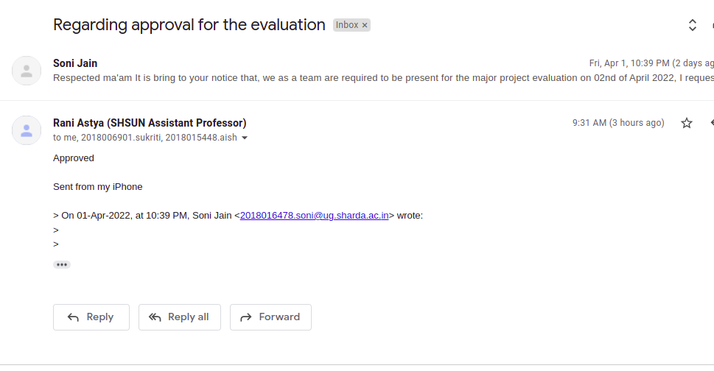
Approval from guide for the evaluation

Slide 3
Contents:
Project overview
Work Distribution of the team
Improvement/Work done from the last evaluation.
Proof of paper accepted or communicated/ Hackathon/ Patent

Slide 4
Project overview:
Smart Car Parking System aims to solve these problems by designing a system to control the parking area using a machine learning-based system.
This system is designed so that it results in faster, flexible, and can meet market needs. And it can also fulfil the total needs for valuable parking which can hold the vehicle very carefully and also with high security.
The proposed approach focuses in the field of image processing as well as machine learning. The objective is to develop an efficient car parking system following certain major steps starting from research in the focused field, thereby collecting testing data for the implementation.
OpenCV is one of the widely used library in the field of detection and so will be using it for the purpose of detection followed by the implementation of confusion matrix in order to detect the efficiency for the algorithm as well.

Slide 5
Workload distribution of the team
Names | Training Classifier | Motion Detection | Algo for marking parking regions | Paper & Ppt. | Publication
Aish |  | * |  | *
Soni |  |  | * | * | *
Sukriti | * |  |  | *

Slide 6
Improvement/Work done from the last evaluation
From the last evaluation, the major input by the panel members were regarding our research paper as it was in progress that time.
As compared to last evaluation, we have improved in respect to the paper writting as well as the publication.
Our review paper has been accepted in more than two journals and conferences and review paper has been communicated , waiting for the response.

Slide 7
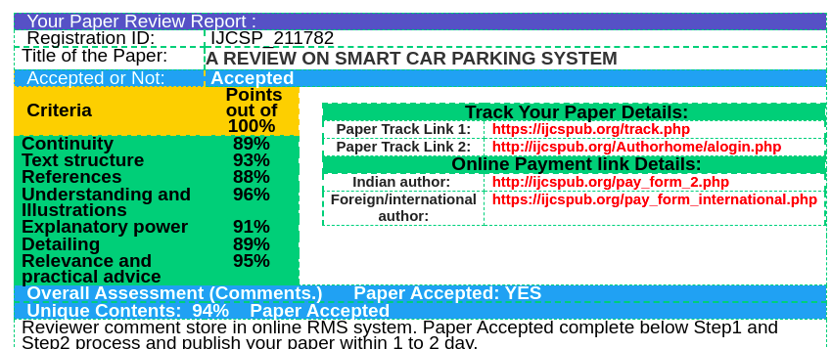
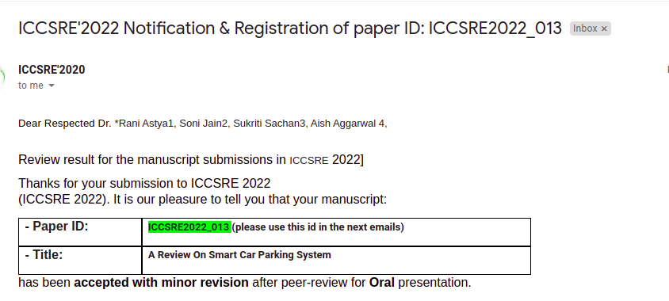
Proof of paper accepted or communicated/ Hackathon/ Patent

Slide 8
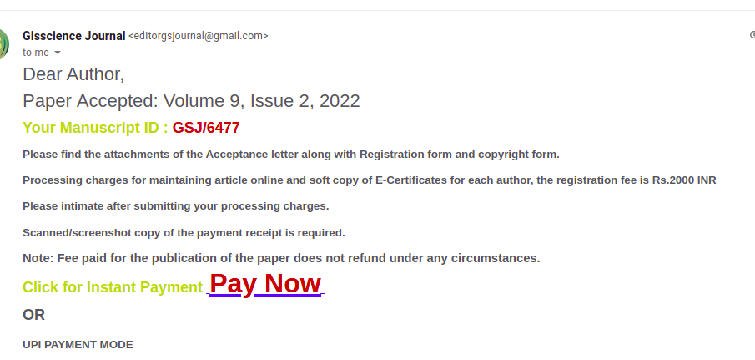
Proof of paper accepted or communicated/ Hackathon/ Patent

Slide 9
Rest of the content discuss with your guide
As per the discussions with our guide, we are trying to get our paper to be published at some good publication and have submitted the paper in IEEE as well. Looking forward for a posiitve response.

