Slide 1

B.Tech Project External Evaluation, VIIIth Sem
SMART CAR PARKING SYSTEM
Presented By :-
Aish Aggarwal, 2018015448
Soni Jain, 2018016478
Sukriti Sachan,2018006901
Under the Supervision of:-
Prof. Rani Astya
Sharda University, Gr. Noida
DEPARTMENT OF COMPUTER SCIENCE & ENGINEERING
SCHOOL OF ENGINEERING AND TECHNOLOGY
May, 2022
1

Slide 2
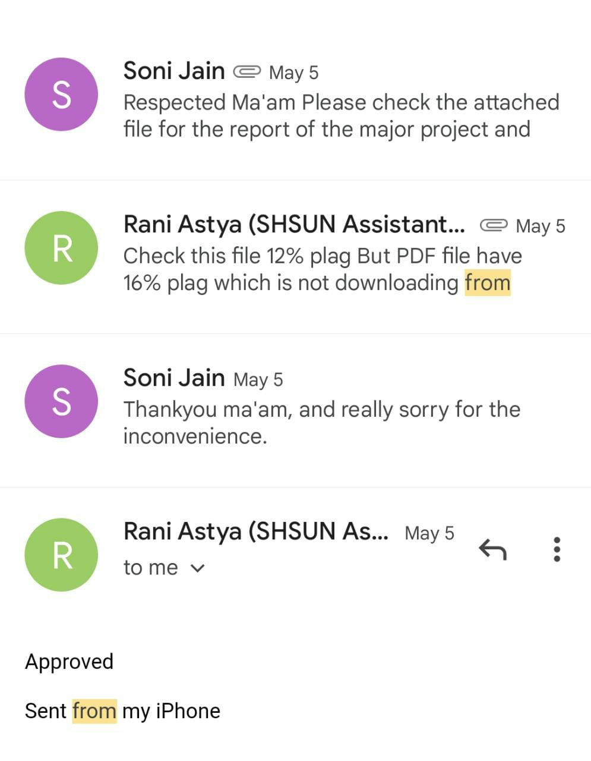
Approval from guide for the evaluation

Slide 3
Contents of the Presentation:
Introduction to the Project
Work Distribution of the team
Flow Chart
Proof of paper accepted.
Conclusion

Slide 4
Introduction to the Project
Smart Car Parking System aims to solve these problems by designing a system to control the parking area using a machine learning-based system.
This system is designed so that it results in faster, flexible, and can meet market needs. And it can also fulfil the total needs for valuable parking which can hold the vehicle very carefully and also with high security.
The proposed approach focuses in the field of image processing as well as machine learning. The objective is to develop an efficient car parking system following certain major steps starting from research in the focused field, thereby collecting testing data for the implementation.
OpenCV is one of the widely used library in the field of detection and so will be using it for the purpose of detection followed by the implementation of confusion matrix in order to detect the efficiency for the algorithm as well.

Slide 5
Work load distribution and Project planning
Names | Training Classifier | Motion Detection | Algo for marking parking regions | Paper & Ppt. | Publication
Aish |  | * |  | *
Soni |  |  | * | * | *
Sukriti | * |  |  | *

Slide 6
Flow Chart
Research & Brainstorming
Calculating Classifier Accuracy
Executing Parking Detection Program
Testing
Verification of final result
Marking Parking Regions & Calculating threshold
Measuring Performance
Collecting Data & Training Classifier

Slide 7
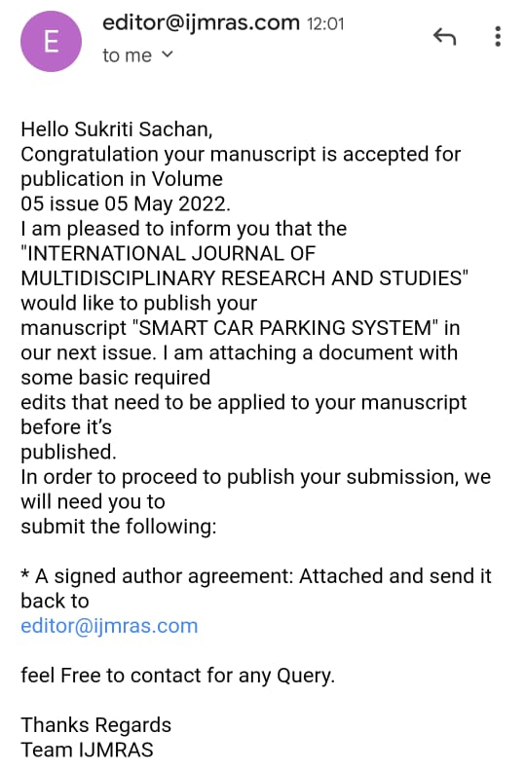
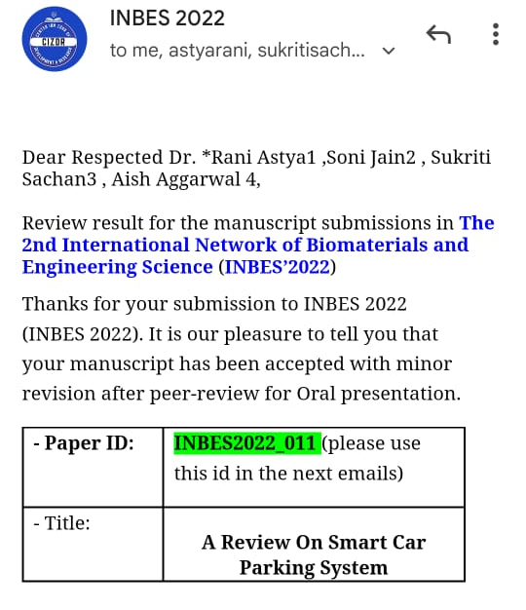
Proof of paper acceptance

Slide 8
CONCLUSION:
With the research study and as per the proposed approach, the conclusion for the Smart Car Parking System-
Existing systems either don’t really use any technology, that is simply user have to find the empty spot for parking thereby wasting time and fuel as well, or most of the smart systems being proposed in multiple literature surveys are either using sensors or IOT based approaches.
Proposed approach focuses to develop an automatic parking system thereby fulfilling the requirements along with working on all the feasibility constraints.
Proposed approach will start with research study followed by implementation, with the help of image processing and other algorithms.

Slide 9
THANKYOU

