Slide 1
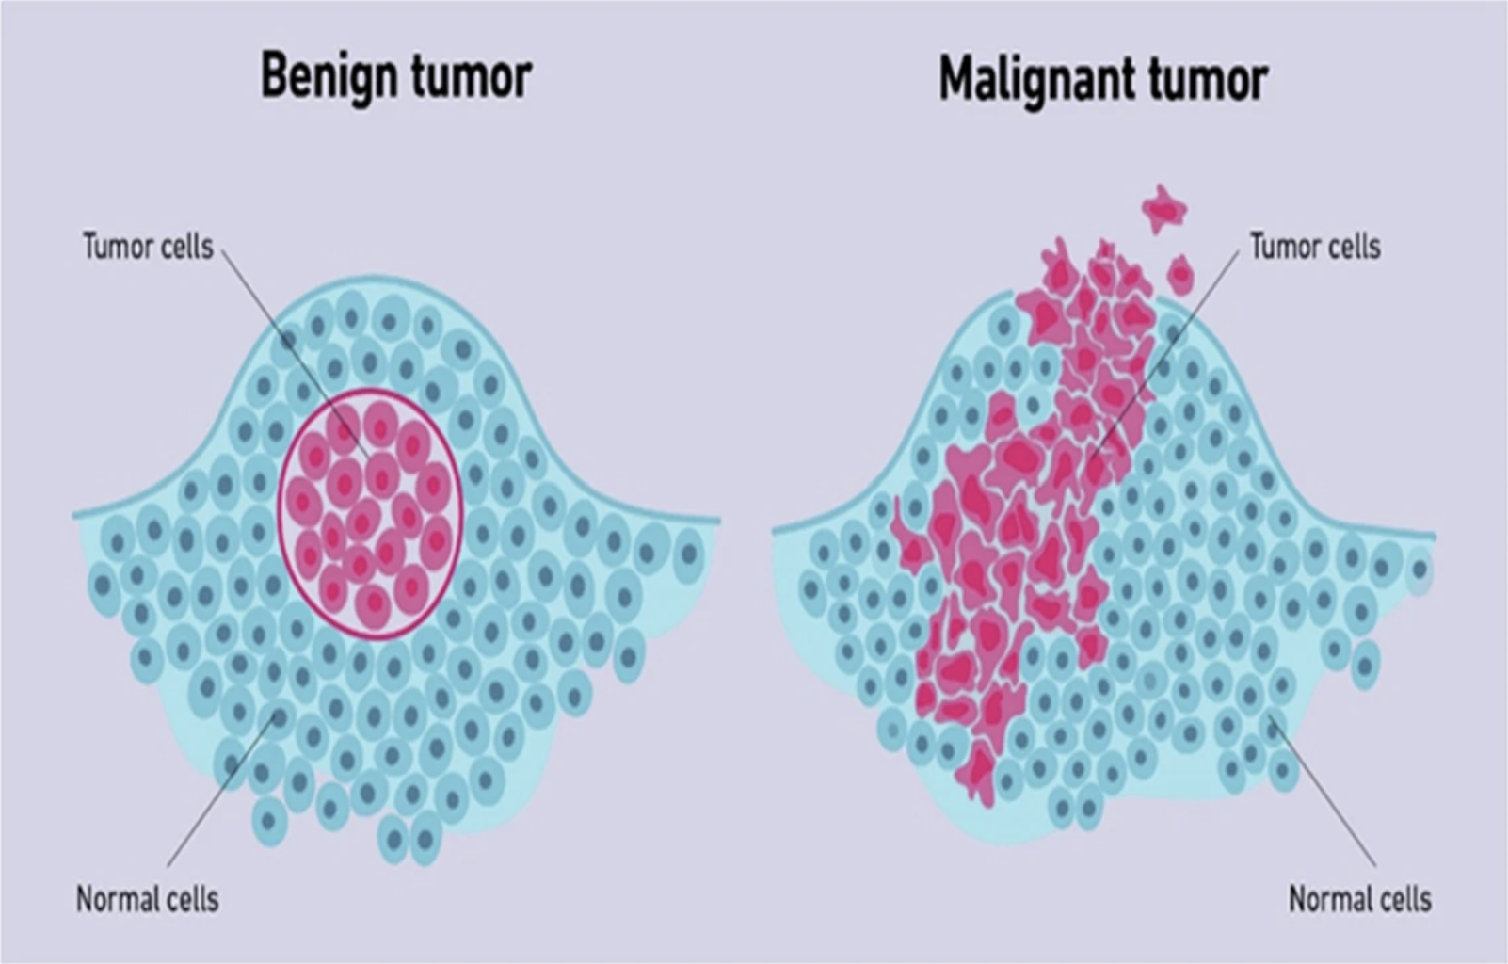
Predicting Breast Cancer Diagnosis
Supervised classification and the kNN bias–variance trade-off
Onyinyechi Sonia Bäckström
DA7067 Computational Mathematics ML exercise
Stockholm University
October 2026

Slide 2
Research question and problem framing
Can benign vs. malignant diagnosis be predicted from numerical cell-nucleus measurements?
This is supervised binary classification: 30 numerical features are used to predict one of two known labels, benign (B) or malignant (M).
The model learns patterns from labelled examples rather than relying on manually written rules.
The report examines predictive performance and how kNN’s k affects generalisation.

Slide 3
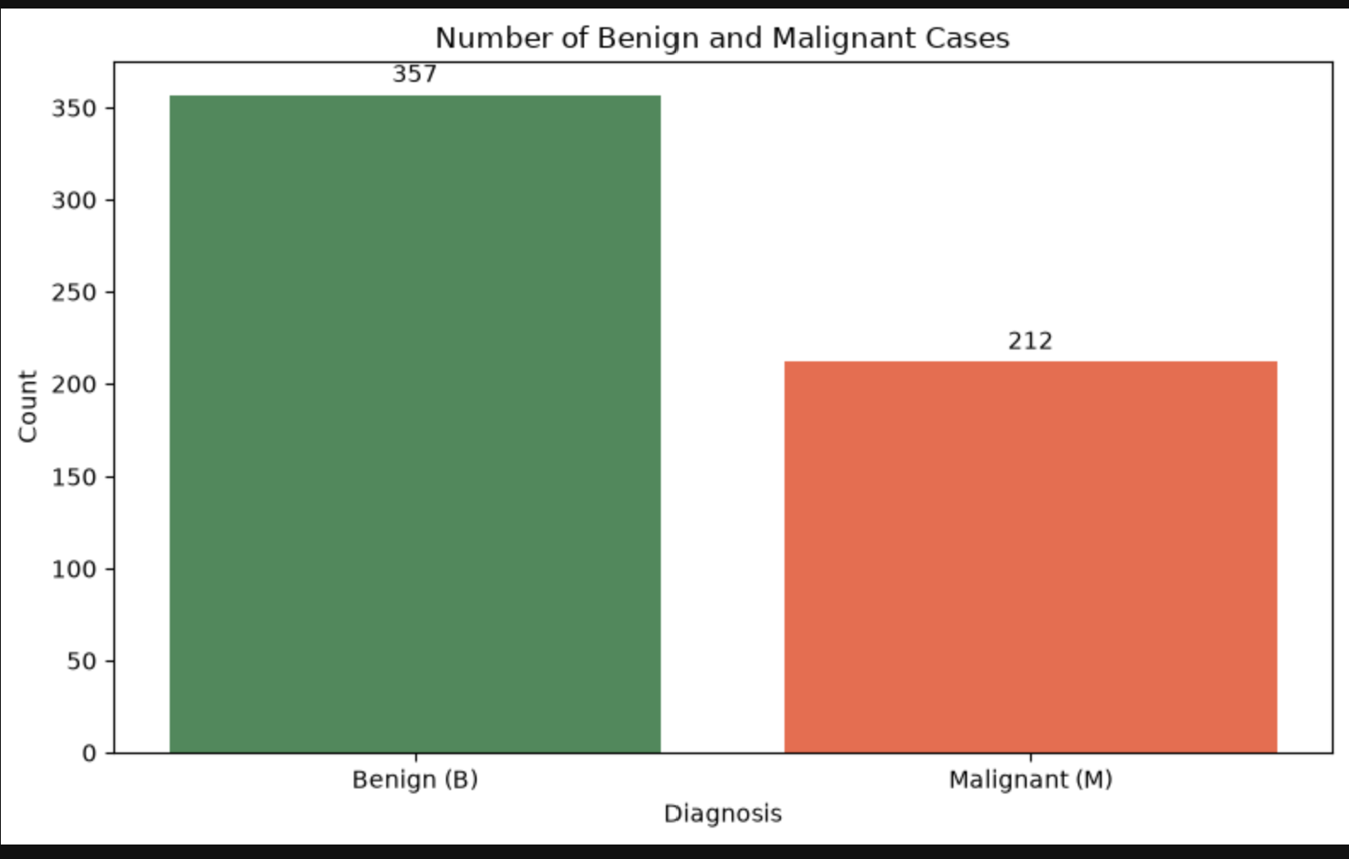
Dataset
Breast Cancer Wisconsin (Diagnostic), UCI Machine Learning Repository; loaded from wdbc.data.
569 samples and 30 numerical features after removing patient ID.
Measurements describe cell-nucleus characteristics as mean, standard error, and worst values.
357 benign (63%) and 212 malignant (37%).

Slide 4
Train/test split and models
Same stratified split used for all methods
• Train: 455 samples (80%); test: 114 samples (20%).
• Stratified split with random_state = 42.
• Baseline predicts the most frequent class from the training set.
• Logistic regression and kNN use standardized features; scaler is fitted only on training data.
• kNN evaluated for k = 1, 2, …, 50.
Dataset
→
Train / test
→
Scale
→
Evaluate

Slide 5
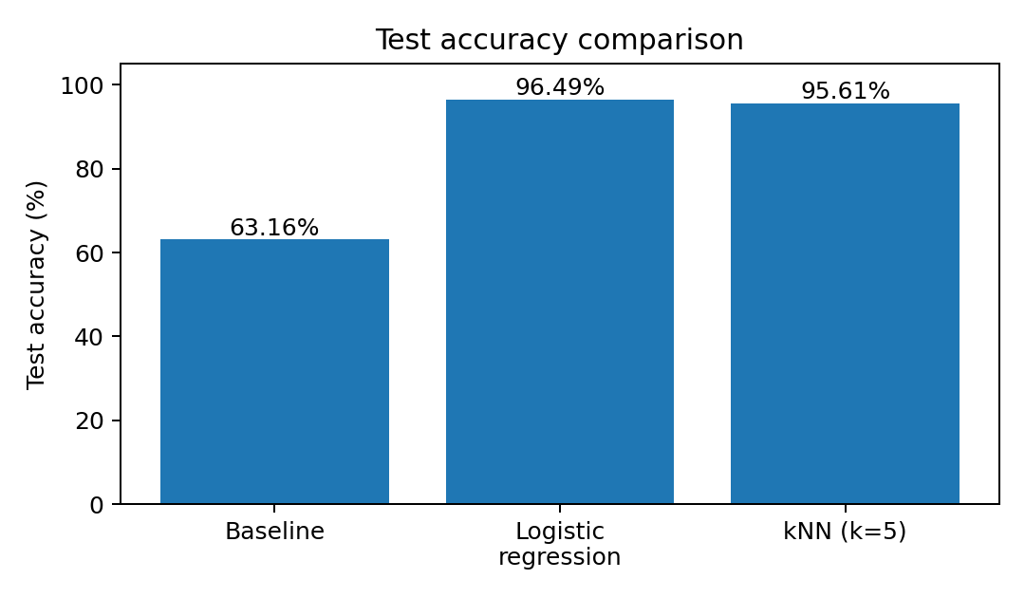
Test-set performance
Baseline (always predicts benign): 63.16% accuracy; 36.84% error.
Logistic regression: 96.49% accuracy; 3.51% error.
kNN (k=5): 95.61% accuracy; 4.39% error.
Logistic regression performed best on this split, though the difference from kNN was small.

Slide 6
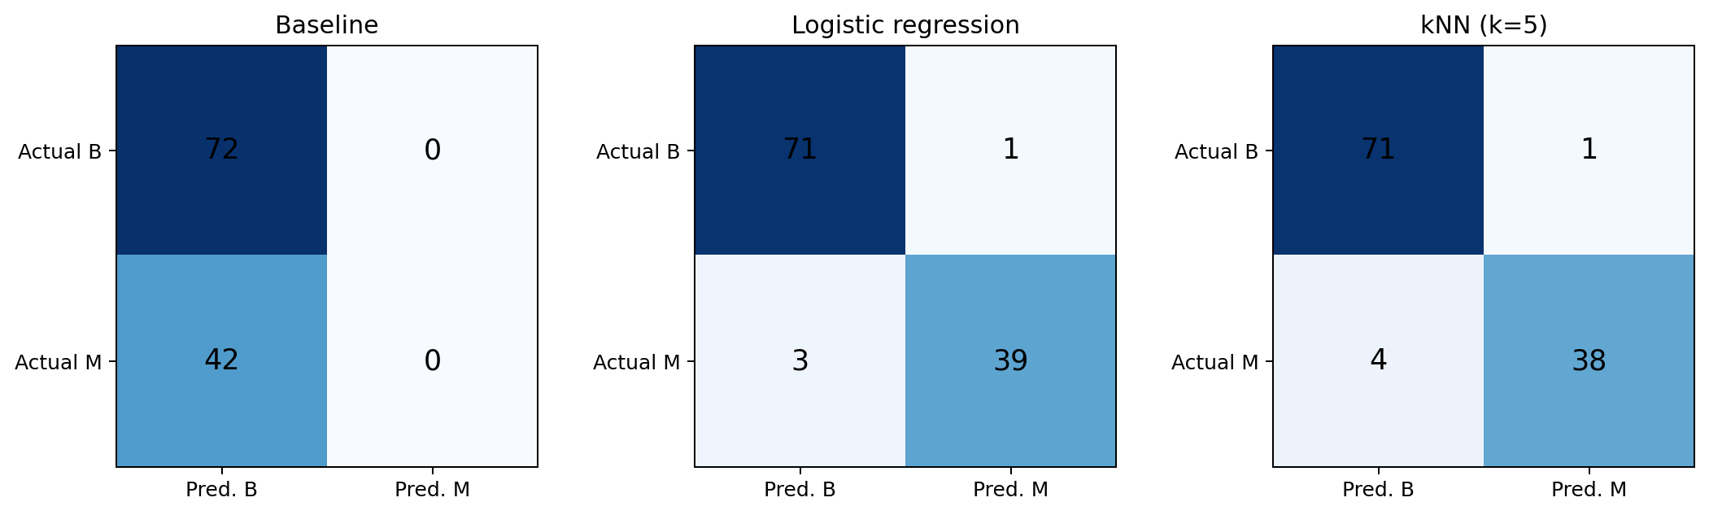
Confusion matrix displays
Logistic regression detected 39/42 malignant cases; kNN detected 38/42. Baseline detected none.
Rows show actual classes; columns show predicted classes.

Slide 7
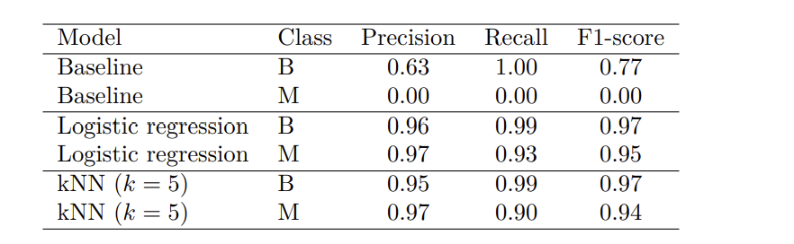
Classification metrics
Benign (B) and Malignant-Class metrics
Model
Precision
Recall
F1-score
Baseline
0.00
0.00
0.00
Logistic regression
0.97
0.93
0.95
kNN (k=5)
0.97
0.90
0.94
Recall is important because a false negative is a malignant case predicted as benign.

Slide 8
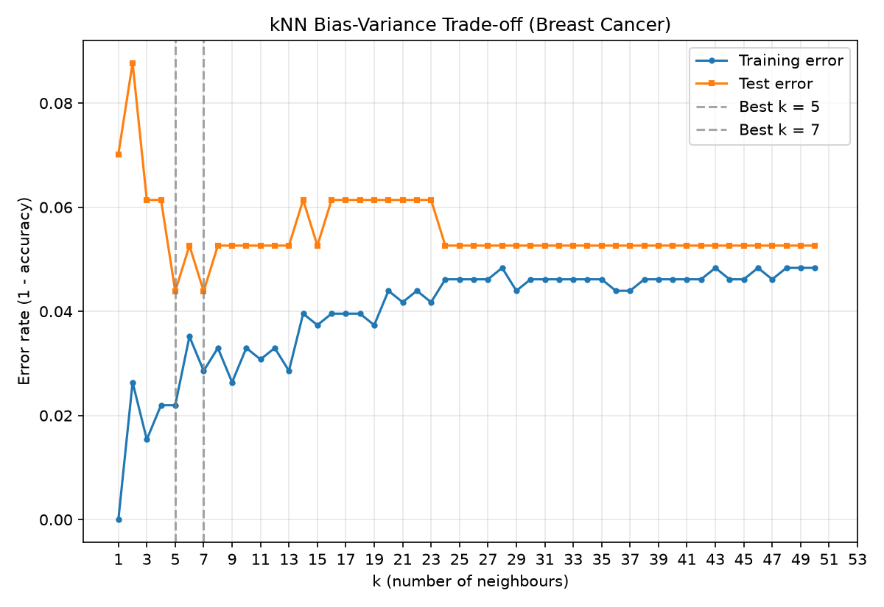
Bias–variance trade-off
kNN evaluated for k = 1, 2, …, 50
k = 1: training error is 0; test error ≈ 0.070- likely overfitting.
k = 2: test error peaks at about 0.088.
For k > 20: training error rises and the errors become closer; risk of underfitting.
Lowest test error ≈ 0.044 at k = 5 and k = 7; choose k = 5 as a tie-break.
Use cross-validation to choose k in a more reliable evaluation.

Slide 9
What I would trust the model to do
Use it as a screening aid to flag likely malignant cases for a clinician to review.
On this test split, accuracy was about 96%; malignant recall was 0.93 for logistic regression and 0.90 for kNN.
It is fast and consistent, but these results do not guarantee clinical performance.
Use predictions to support clinical assessment, not replace a clinician or make diagnoses independently.

Slide 10
What I would not trust it with
I would not trust the model to make medical diagnoses independently. Logistic regression missed 3 of 42 malignant cases, while kNN missed 4.
A missed malignancy can be more serious than a false alarm. Real-world use would require a larger, more diverse dataset and external validation.
I would be cautious about applying the model to patients from different hospitals, scanners, or demographic groups, because differences in data distribution could reduce performance.
I would not interpret model coefficients as evidence of causation. A larger radius may be associated with malignancy, but this does not mean it causes malignancy.

Slide 11
What surprised me and conclusion
Logistic regression slightly outperformed the more flexible kNN model: 96.49% versus 95.61% accuracy. Its malignant-class recall was also higher (0.93 versus 0.90). I expected the more flexible model to do better.
High accuracy alone does not tell the whole story; recall matters when identifying malignant cases.
Training error did not rise smoothly with k: it went from 0.000 at k=1 to 0.026 at k=2, then fell to 0.015 at k=3. Tied neighbour votes may contribute to this irregularity.
Logistic regression was best in this experiment; k=5 or k=7 gave the lowest observed kNN test error.
Results come from one train–test split, so further validation is needed.

Slide 12
Conclusion
Logistic regression performed best in this experiment, while kNN's performance depended on the choice of k.
Both the algorithm and its complexity affect prediction performance.
Results came from one train–test split, so further validation would be needed before drawing conclusions about real-world clinical use.

Slide 13
Thank you !
Questions?

