Slide 1

DYNAMIC PRICE PREDICTION OF AIRLINES
Using Machine Learning

Slide 2
Steps performed
1. Data Definition
2. Exploratory Data Analysis
3. Data Preprocessing
4. Feature Engineering
5. Model Building / Validation / Testing
6. Save Predictive Model

Slide 3
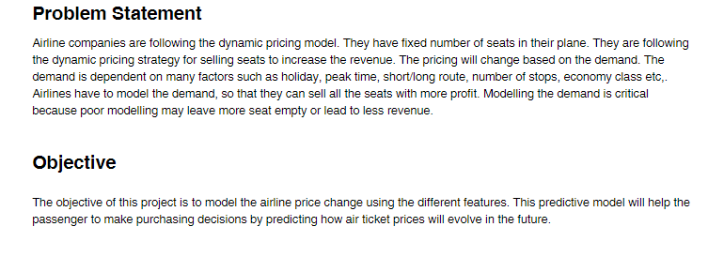
Background

Slide 4
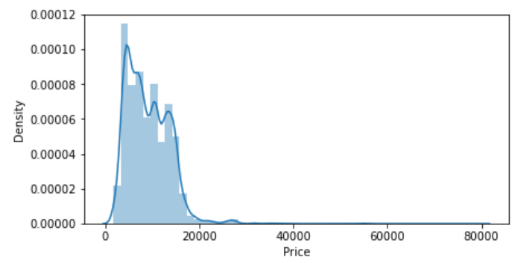
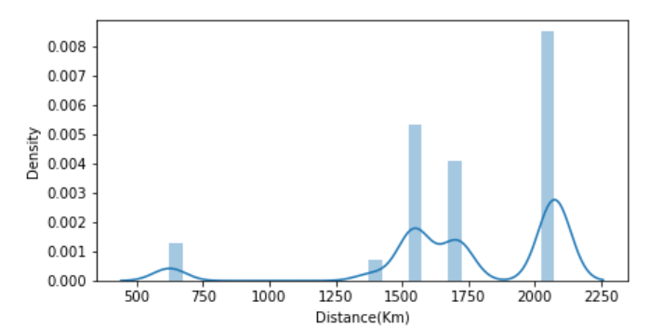
Data Definition
Target variable
Distance detail concated from “air_distance.csv “
Into main dataframe
Feature : Price
Data_type : int64
Skew : 1.802715
Feature : Distance(Km)
Data_type : float64
Skew : -1.429430
Long tailed data , will need transformation

Slide 5
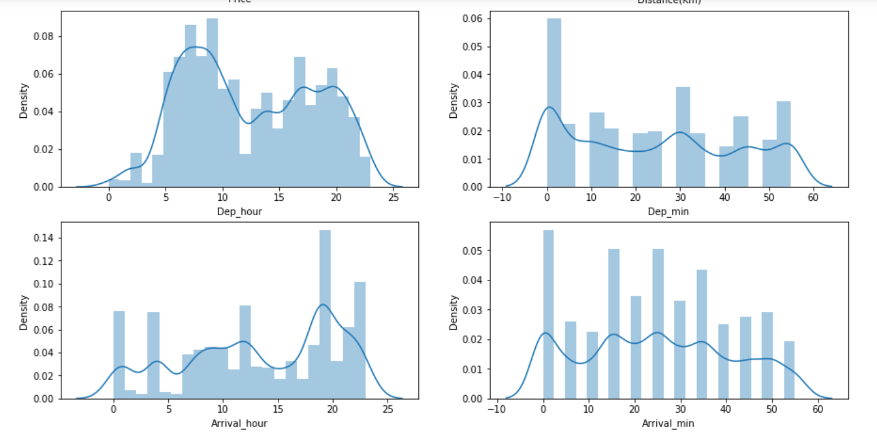
Data Definition
Departure and Arrival date_time converted to Hours and minutes for further analysis

Slide 6
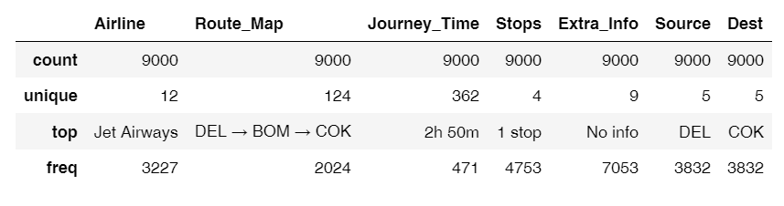
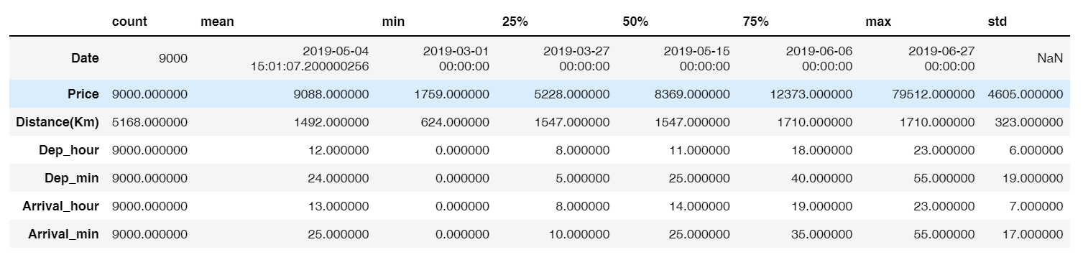
Categorical variables
Numerical variables

Slide 7
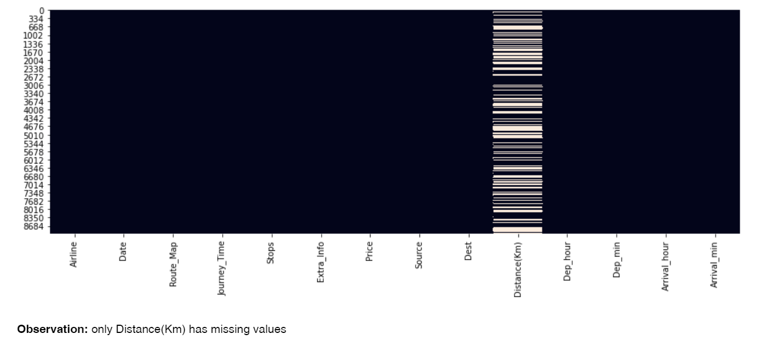
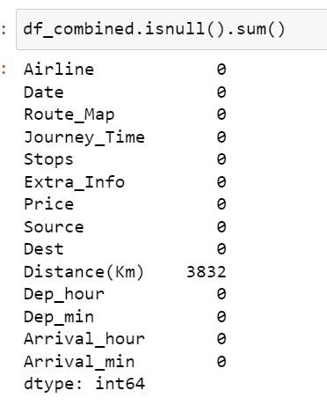
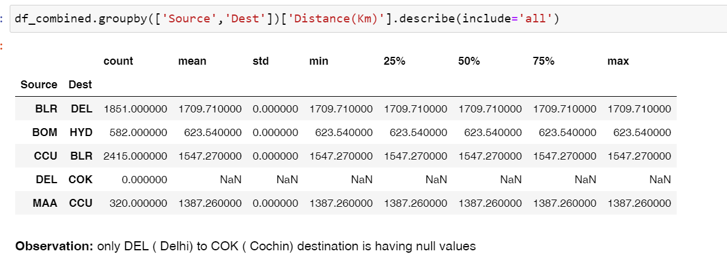
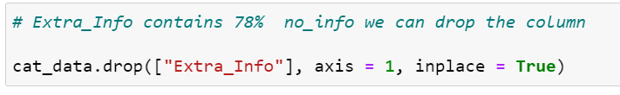
Missing Values
Distance added for most frequently occurring flight path
DEL → BOM → COK
Values imputed
Missing Value Treatment

Slide 8
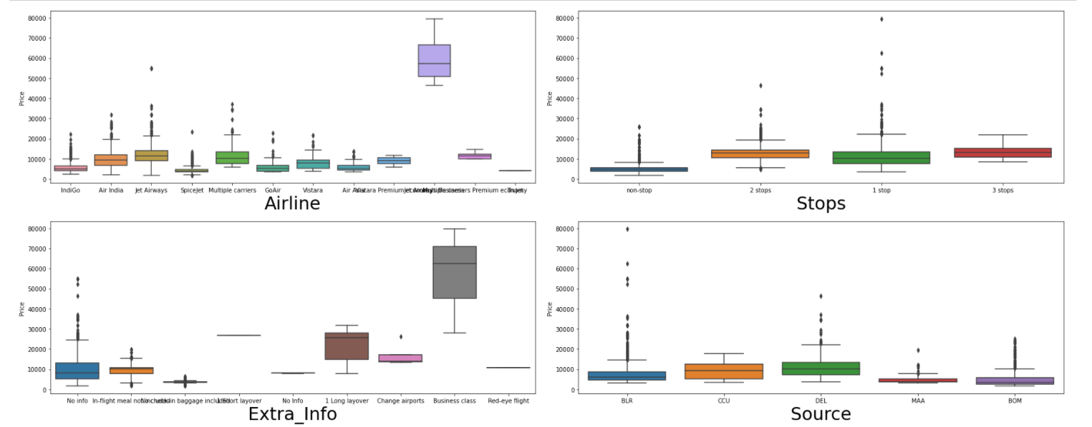
Exploratory Data Analysis
Bivariate analysis of categorical variables against target variable (Price)

Slide 9
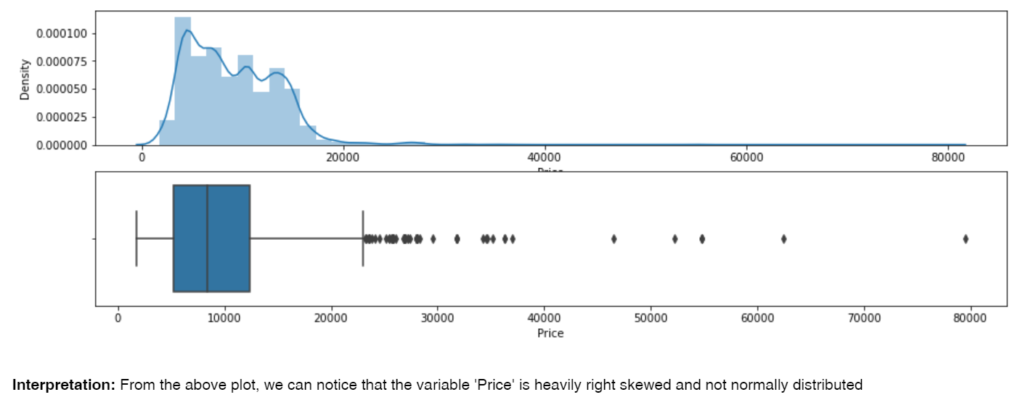
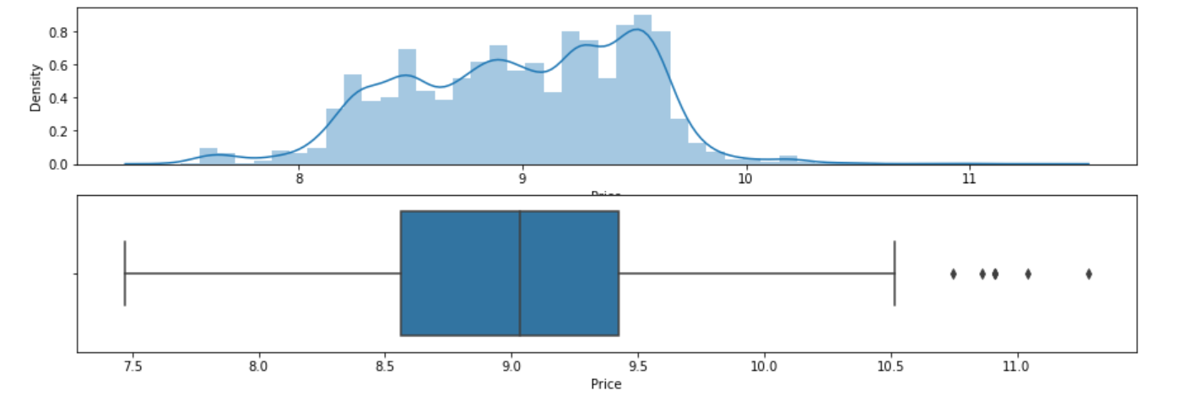
Feature Engineering
Feature Transformation ( Price)
Log Transformed( Price)

Slide 10
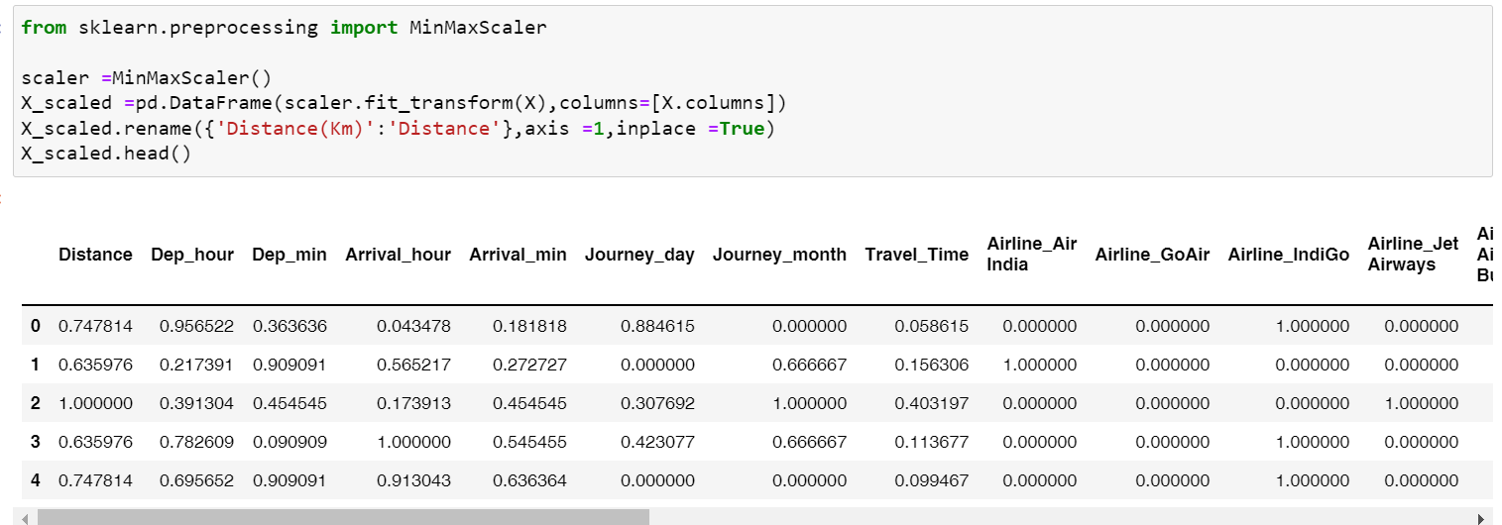
Feature Engineering
Feature Scaling

Slide 11
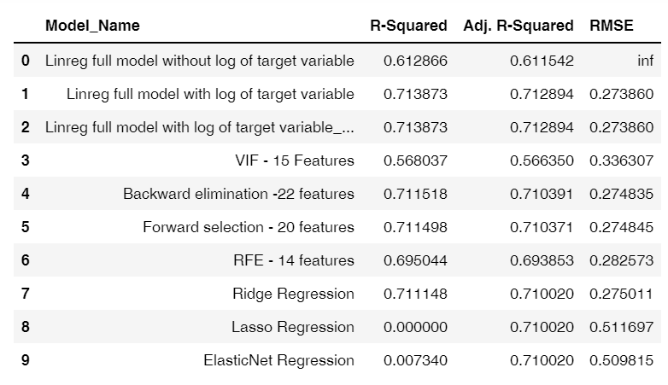
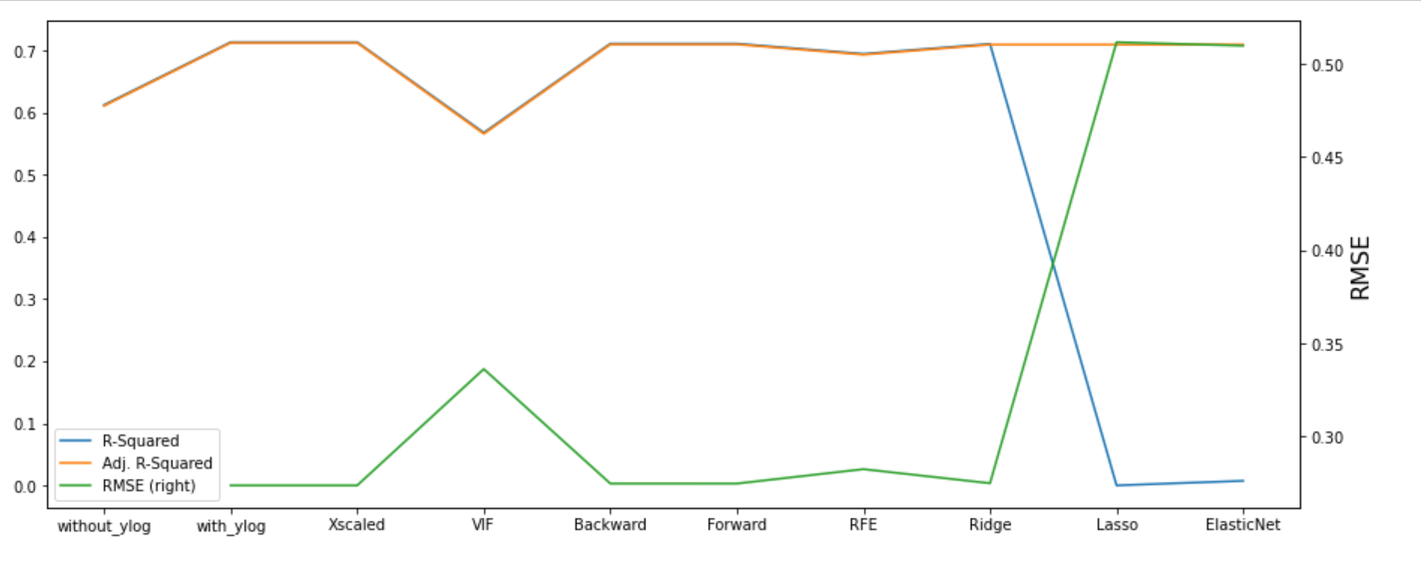
Model Building & Optimization
Linear models built with 10 different algorithms
RFE ( Recursive Feature Elimination ) suggested as most optimal model for this dataset as it has R squared of 69.5% and comparable RMSE with other models
Features Selected [Journey_month, Airline_Air India, Airline_IndiGo, Airline_Jet Airways, Airline_Jet Airways Business, Airline_Multiple carriers, Airline_Premium economy, Airline_SpiceJet, Airline_Trujet, Airline_Vistara Premium economy Airline_Vistara, Source_BOM, Dest_HYD ,Stops]

Slide 12
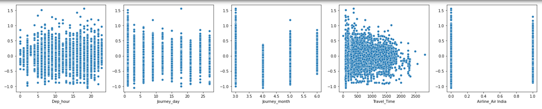
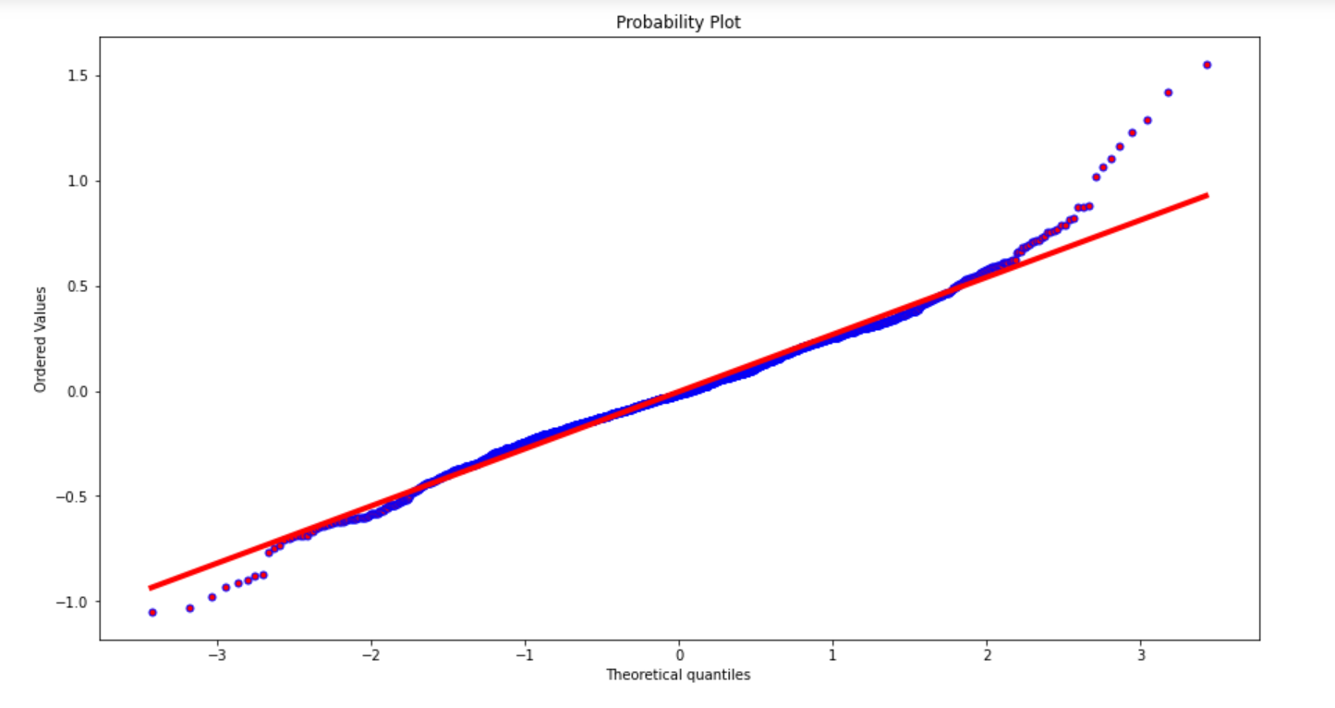
Check the Assumptions of LR
Dependent variable must be continuous numeric
Autocorrelation : Durbin-Watson static is 1.980 (Hence we can conclude that there is no autocorrelation)
Linearity of Residuals
Detecting Heteroskedasticity : Breusch-Pagan test : 'p-value', 1.7092307476106593e-186
Normality of Residuals
Jarque Bera test & QQ Plot
Normality of residuals alone failed , this could be due to outlier values in dependent variable even after log transformation

Slide 13
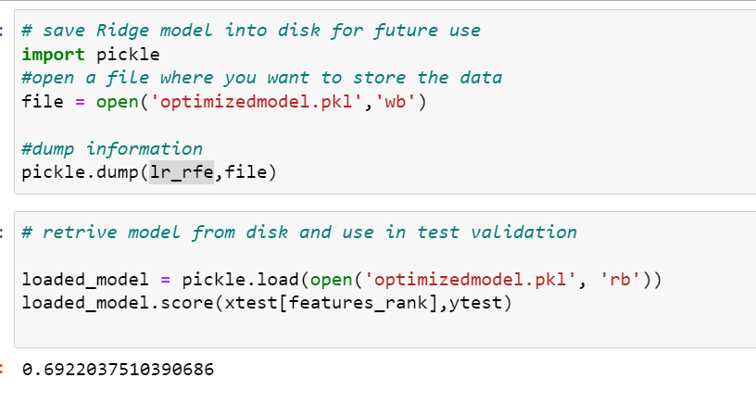
Save Predictive Model

Slide 14

Thank you for your attention

