Slide 1
Cassandra: An Example of NoSQL Databases (IV)

Slide 2
Outline
Introduction
Architecture
Data Model
Installation
Keyspace Operations
Table Operations
Data Operations
CQL Data Types

Slide 3
INTRODUCTION

Slide 4
Target Audience
Who might be interested in learning Cassandra?
A developer working with large-scale, high-volume websites.
An application architect or data architect who needs to understand the available options for high-performance, decentralized, elastic data stores.
A database administrator or database developer currently working with standard relational database systems who needs to understand how to implement a fault-tolerant, eventually consistent data store.
A manager who wants to understand the advantages (and disadvantages) of Cassandra and related columnar databases to help make decisions about technology strategy.
A student, analyst, or researcher who is designing a project related to Cassandra or other non-relational data store options.

Slide 5
Overview
Apache Cassandra is open source, linearly scalable, distributed and fault-tolerant NoSQL database. Designed to handle a huge amount of data.
Its distribution design is based on Amazon’s Dynamo and its data model on Google’s Bigtable.
Cassandra implements a Dynamo-style replication model with no single point of failure, but adds a more powerful “column family” data model.
Cassandra is being used by some of the biggest companies such as Facebook, Twitter, Cisco, Rackspace, ebay, Twitter, Netflix, and more.

Slide 6
Why Casssandra?
While many developers have embraced simpler NoSQL variants (like MongoDB and CouchDB), Cassandra is possibly at the forefront of the NoSQL innovation, providing a level of reliability and fine tuning not found in many of the competitors’ offerings
When it comes to scaling, nothing scales like it, the biggest example being the Facebook which uses Cassandra for storing petabytes of Data
Operational simplicity and easy scale out due to master less architecture
Easy transition from relational to NoSQL databases using Cassandra Query Language
Strong data consistency across distributed cluster

Slide 7
History
Cassandra was first developed at Facebook for inbox search
Facebook open sourced it in July 2008
Apache incubator accepted Cassandra in March 2009
Cassandra is a top level project of Apache since February 2010
The latest version of Apache Cassandra is 3.11.0

Slide 8
Features
Massively Scalable Architecture: Cassandra has a masterless design where all nodes are at the same level which provides operational simplicity and easy scale out.
Masterless Architecture: Data can be written and read on any node.
Linear Scale Performance: As more nodes are added, the performance of Cassandra increases.
No Single point of failure: Cassandra replicates data on different nodes that ensures no single point of failure.
Fault Detection and Recovery: Failed nodes can easily be restored and recovered.

Slide 9
Flexible and Dynamic Data Model: Supports datatypes with Fast writes and reads.
Data Protection: Data is protected with commit log design and build in security like backup and restore mechanisms.
Tunable Data Consistency: Support for strong data consistency across distributed architecture.
Multi Data Center Replication: Cassandra provides feature to replicate data across multiple data center.
Data Compression: Cassandra can compress up to 80% data without any overhead.
Cassandra Query language: Cassandra provides query language that is similar like SQL language. It makes very easy for relational database developers moving from relational database to Cassandra.

Slide 10
Use Cases / Applications
Messaging: Cassandra is a great database for the companies that provides Mobile phones and messaging services. These companies have a huge amount of data, so Cassandra is best for them.
Internet of things Application: Cassandra is a great database for the applications where data is coming at very high speed from different devices or sensors.
Product Catalogs and retail apps: Cassandra is used by many retailers for durable shopping cart protection and fast product catalog input and output.
Social Media Analytics and recommendation engine: Cassandra is a great database for many online companies and social media providers for analysis and recommendation to their customers.

Slide 11
Cassandra v/s HBase
Though both the technologies are the open-source projects running the Apache foundation, but both have own advantages and disadvantages.
Basis of difference | Cassandra | HBase
Foundation | Based on BigTable and DynamoDB | Based on BigTable
Infrastructure | Simple | Complex
Optimized for | Writes | Reads
Read Load Balancing – single Row | Supported | No Supported
Language support | More languages supported | Lesser languages supported

Slide 12
ARCHITECTURE

Slide 13
Cassandra is a distributed, decentralized, fault tolerant, eventually consistent, linearly scalable and column-oriented store.
Cassandra has peer-to-peer distributed system across its nodes, and data is distributed among all the nodes in a cluster.
All the nodes in a cluster play the same role. Each node is independent and at the same time interconnected to other nodes.
Each node in a cluster can accept read and write requests, regardless of where the data is actually located in the cluster.
When a node goes down, read/write requests can be served from other nodes in the network.

Slide 14
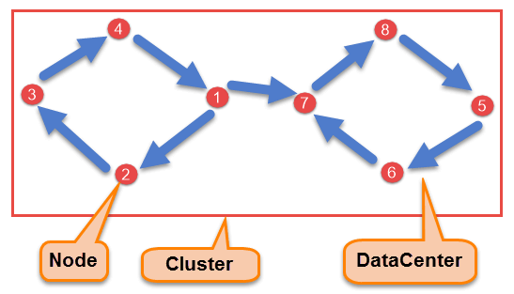
All the nodes exchange information with each other using Gossip protocol. Gossip is a protocol in Cassandra by which nodes can communicate with each other.
Components of Cassandra
There are following components in the Cassandra;

Slide 15
Node: Node is the place where data is stored. It is the basic component of Cassandra.
Data Center: A collection of nodes are called data center. Many nodes are categorized as a data center.
Cluster: The cluster is the collection of many data centers.
Commit Log: Every write operation is written to Commit Log. Commit log is used for crash recovery.
Mem-table: After data written in Commit log, data is written in Mem-table. Data is written in Mem-table temporarily.
SSTable: When Mem-table reaches a certain threshold, data is flushed to an SSTable disk file.

Slide 16
Bloom Filter and Index: They contain information about location of data in SSTable. Each SSTable has one bloom filter and one index associated with it.
Data Replication
As hardware problem can occur or link can be down at any time during data process, a solution is required to provide a backup when the problem has occurred. So data is replicated for assuring no single point of failure.
Cassandra places replicas of data on different nodes based on these two factors.
Where to place next replica is determined by the Replication Strategy.
The total number of replicas placed on different nodes is determined by the Replication Factor.

Slide 17
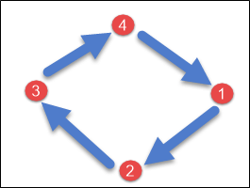
One Replication factor means that there is only a single copy of data while three replication factor means that there are three copies of the data on three different nodes.
For ensuring there is no single point of failure, replication factor must be three.
There are two kinds of replication strategies in Cassandra.
SimpleStrategy
SimpleStrategy is used when you have just one data center. SimpleStrategy places the first replica on the node selected by the partitioner. After that, remaining replicas are placed in clockwise direction in the Node ring.

Slide 18
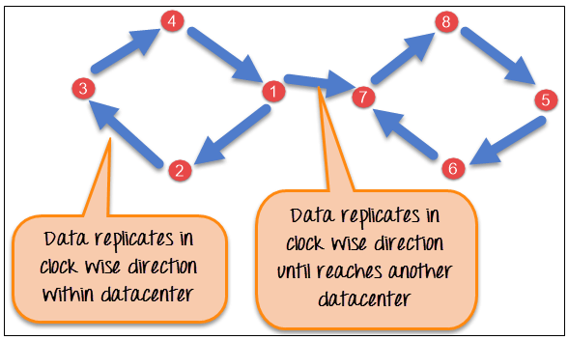
Network Topology Strategy
It is used when you have more than one data centers.
In Network Topology Strategy, replicas are set for each data center separately. Network Topology Strategy places replicas in the clockwise direction in the ring until reaches the first node in another rack.
This strategy tries to place replicas on different racks in the same data center. This is due to the reason that sometimes failure or problem can occur in the rack. Then replicas on other nodes can provide data.

Slide 19
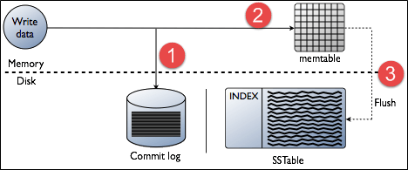
Write Operation
The coordinator sends a write request to replicas. If all the replicas are up, they will receive write request regardless of their consistency level.
Consistency level determines how many nodes will respond back with the success acknowledgment.
The node will respond back with the success acknowledgment if data is written successfully to the commit log and memTable.

Slide 20
Read Operation
There are three types of read requests that a coordinator sends to replicas.
Direct request
Digest request
Read repair request
The coordinator sends direct request to one of the replicas. After that, the coordinator sends the digest request to the number of replicas specified by the consistency level and checks whether the returned data is an updated data.
After that, the coordinator sends digest request to all the remaining replicas. If any node gives out of date value, a background read repair request will update that data. This process is called read repair mechanism.

Slide 21
Cassandra Query Language
Users can access Cassandra through its nodes using Cassandra Query Language (CQL). CQL treats the database (Keyspace) as a container of tables. Programmers use cqlsh: a prompt to work with CQL or separate application language drivers.
Clients approach any of the nodes for their read-write operations. That node (coordinator) plays a proxy between the client and the nodes holding the data.

Slide 22
DATA MODEL

Slide 23
Column Family
A column family is a container for an ordered collection of rows. Each row, in turn, is an ordered collection of columns. The following table lists the points that differentiate a column family from a table of relational databases.
Relational Table | Cassandra column Family
A schema in a relational model is fixed. Once we define certain columns for a table, while inserting data, in every row all the columns must be filled at least with a null value. | In Cassandra, although the column families are defined, the columns are not. You can freely add any column to any column family at any time.
Relational tables define only columns and the user fills in the table with values. | In Cassandra, a table contains columns, or can be defined as a super column family.

Slide 24
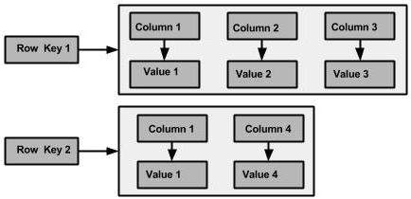
A Cassandra column family has the following attributes −
keys_cached − It represents the number of locations to keep cached per SSTable.
rows_cached − It represents the number of rows whose entire contents will be cached in memory.
preload_row_cache − It specifies whether you want to pre-populate the row cache.
The following figure shows an example of a Cassandra column family.

Slide 25

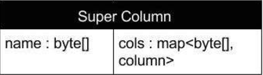
Column
A column is the basic data structure of Cassandra with three values, namely key or column name, value, and a time stamp. Given below is the structure of a column.
SuperColumn
A super column is a special column, therefore, it is also a key-value pair. But a super column stores a map of sub-columns.
Generally column families are stored on disk in individual files. Therefore, to optimize performance, it is important to keep columns that you are likely to query together in the same column family, and a super column can be helpful here.Given below is the structure of a super column.

Slide 26
Data Models of Cassandra and RDBMS
RDBMS | CASSANDRA
RDBMS deals with structured data. | Cassandra deals with unstructured data.
It has a fixed schema. | Cassandra has a flexible schema.
In RDBMS, a table is an array of arrays. (ROW x COLUMN) | In Cassandra, a table is a list of “nested key-value pairs”. (ROW x COLUMN key x COLUMN value)
Database is the outermost container that contains data corresponding to an application. | Keyspace is the outermost container that contains data corresponding to an application.
Tables are the entities of a database. | Tables or column families are the entity of a keyspace.
Row is an individual record in RDBMS. | Row is a unit of replication in Cassandra.
Column represents the attributes of a relation. | Column is a unit of storage in Cassandra.
RDBMS supports the concepts of foreign keys, joins. | Relationships are represented using collections.

Slide 27
Cassandra Data Model Rules
Since data is in distributed fashion, Cassandra does not support joins, group by, OR clause, aggregations, etc. So you have to store your data in such a way that it should be completely retrievable. So these rules must be kept in mind while modelling data in Cassandra.
Maximize the number of writes: In Cassandra, writes are very cheap. Cassandra is optimized for high write performance. So try to maximize your writes for better read performance and data availability. There is a tradeoff between data write and data read. So, optimize your data read performance by maximizing the number of data writes.
Maximize Data Duplication: Data denormalization and data duplication are defacto of Cassandra. Disk space is not more expensive than memory, CPU processing and IOs operation. As Cassandra is a distributed database, so data duplication provides instant data availability and no single point of failure.

Slide 28
Data Modeling Goals
Spread Data Evenly Around the Cluster: You want an equal amount of data on each node of Cassandra cluster. Data is spread to different nodes based on partition keys that is the first part of the primary key. So, try to choose integers as a primary key for spreading data evenly around the cluster.
Minimize number of partitions read while querying data: Partition are a group of records with the same partition key. When the read query is issued, it collects data from different nodes from different partitions.
If there will be many partitions, then all these partitions need to be visited for collecting the query data.
It does not mean that partitions should not be created. If your data is very large, you can’t keep that huge amount of data on the single partition. The single partition will be slowed down. So, try to choose a balanced number of partitions.

Slide 29
Conflicting Rules?
If it's good to minimize the number of partitions that you read from, why not put everything in a single big partition? You would end up violating Rule #1, which is to spread data evenly around the cluster.
The point is, these two goals often conflict, so you'll need to try to balance them.
Model Around Your Queries
The way to minimize partition reads is to model your data to fit your queries. Don't model around relations. Don't model around objects. Model around your queries. Here's how you do that:
Step 1: Determine What Queries to Support

Slide 30
Try to determine exactly what queries you need to support. This can include a lot of considerations that you may not think of at first. For example, you may need to think about:
Grouping by an attribute
Ordering by an attribute
Filtering based on some set of conditions
Enforcing uniqueness in the result set
etc ...
Changes to just one of these query requirements will frequently warrant a data model change for maximum efficiency.

Slide 31
Step 2: Try to create a table where you can satisfy your query by reading (roughly) one partition
In practice, this generally means you will use roughly one table per query pattern. If you need to support multiple query patterns, you usually need more than one table.
To put this another way, each table should pre-build the "answer" to a high-level query that you need to support. If you need different types of answers, you usually need different tables. This is how you optimize for reads.
Remember, data duplication is okay. Many of your tables may repeat the same data.

Slide 32
INSTALLATION

Slide 33
Installing JAVA
Java is the main prerequisite for Cassandra. First of all, you should verify the existence of java in your system using “java -version”. The syntax of java version command is given below.
If everything works fine, it will give you the following output.

Slide 34
If you don’t have Java in your system, then follow the steps given below for installing Java.
Step 1
Update the source list
Step 2
Install oracle java current version

Slide 35
Next, we will create a new directory to store Cassandra.
Now, we will download Cassandra
Then extract the downloaded file

Slide 36
Now, we will create softlink using the command below:
Create Directories: As super-user, create the following directories

Slide 37

Start Cassandra
To start Cassandra, run the following command
Now open a new terminal window (Ctrl+Shift+T). Switch to root user and change directory to /root using following commands:
Enter the cql shell as following

Slide 38
KEYSPACE OPERATIONS

Slide 39

Cassandra provides query language that allows developers to communicate with Cassandra. The syntax of Cassandra query language (CQL) resembles with SQL language.
Cassandra Create Keyspace
A keyspace is an object that holds the column families, user defined types. In Cassandra, Keyspace is similar to RDBMS Database. Keyspace holds column families, indexes, user defined types, data center awareness, strategy used in keyspace, replication factor, etc.
Command "Create Keyspace" is used to create keyspace in Cassandra.
Syntax

Slide 40
Various Components of Cassandra Keyspace
Strategy: While declaring strategy name in Cassandra. There are two kinds of strategies declared in Cassandra Syntax.
Simple Strategy: Simple strategy is used when you have just one data center. In this strategy, the first replica is placed on the node selected by the partitioner. Remaining nodes are placed in the clockwise direction in the ring without considering rack or node location.
Network Topology Strategy: Network topology strategy is used when you have more than one data centers. In this strategy, you have to provide replication factor for each data center separately. Network topology strategy places replicas in nodes in the clockwise direction in the same data center. This strategy attempts to place replicas in different racks.
Replication Factor: Replication factor is the number of replicas of data placed on different nodes. For no failure, 3 is good replication factor. More than two replication factor ensures no single point of failure. Sometimes, the server can be down, or network problem can occur, then other replicas provide service with no failure.

Slide 41
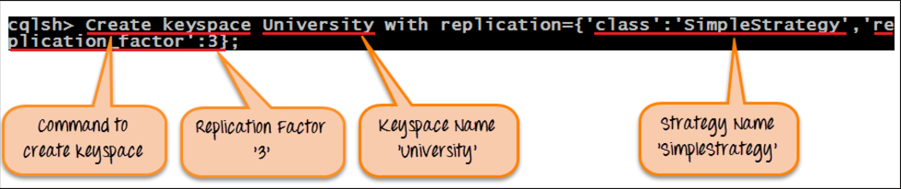
Execution: Here is the snapshot of the executed command "Create Keyspace" that will create keyspace in Cassandra.
After successful execution of command "Create Keyspace", Keyspace University will be created in Cassandra with strategy "SimpleStrategy" and replication factor 3.

Slide 42
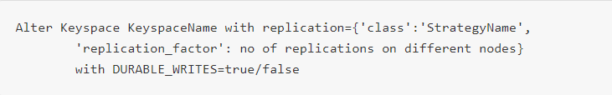
Alter Keyspace
Command "Alter Keyspace" alters the replication factor, strategy name and durable writes properties in created keyspace in Cassandra.
Syntax
Key aspects while altering Keyspace in Cassandra
Keyspace Name: Keyspace name cannot be altered in Cassandra.
Strategy Name: Strategy name can be altered by specifying new strategy name.

Slide 43
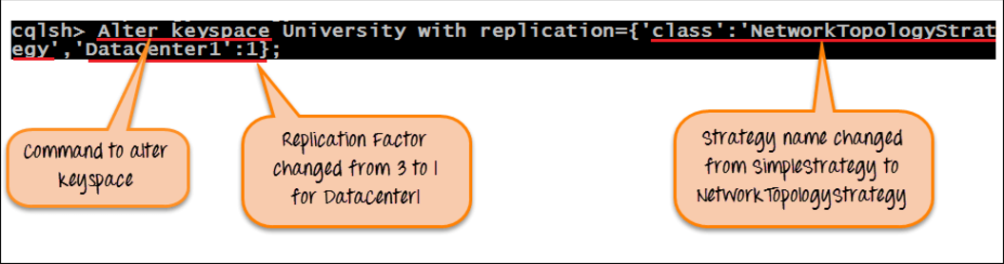
Replication Factor: Replication factor can be altered by specifying new replication factor.
DURABLE_WRITES :DURABLE_WRITES value can be altered by specifying its value true/false. By default, it is true. If set to false, no updates will be written to the commit log and vice versa.
Execution: Here is the snapshot of the executed command "Alter Keyspace" that alters the keyspace strategy from 'SimpleStrategy' to 'NetworkTopologyStrategy' and replication factor from 3 to 1 for DataCenter1.
After successful execution of the command "Alter Keyspace", Strategyname will be changed from 'SimpleStrategy' to 'NetworkTopologyStrategy' and replication factor will be changed from 3 to 1 for 'DataCenter1.'

Slide 44

Drop Keyspace
Command 'Drop Keyspace' drops keyspace including all the data, column families, user defined types and indexes from Cassandra. Before dropping the keyspace, Cassandra takes a snapshot of the keyspace. If keyspace does not exist in the Cassandra, Cassandra will return an error unless IF EXISTS is used.
Syntax

Slide 45
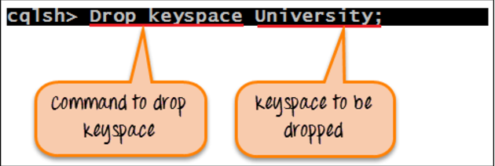
Execution
Here is the snapshot of the executed command 'Drop Keyspace' that will drop keyspace University.
After successful execution of the command 'Drop keyspace University', keyspace University will be dropped from Cassandra with all the data and schema.
Here is the snapshot where the error is returned when tried to access keyspace that does not exist.
Note: There is no difference in drop keyspace and delete keyspace. Drop keyspace is equal to delete keyspace.

Slide 46
TABLE OPERATIONS

Slide 47
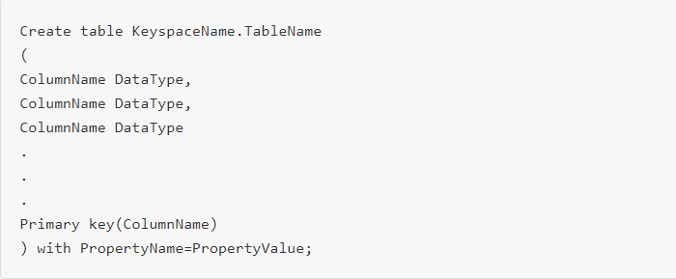
Cassandra Create table
Column family in Cassandra is similar to RDBMS table. Column family is used to store data.
Command 'Create Table' is used to create column family in Cassandra.
Syntax

Slide 48

Primary key: There are two types of primary key.
1. Single Primary Key: Single primary key is specified by the following syntax.
Syntax
In the single primary key, there is only a single column. That column is also called partitioning key. Data is partitioned on the basis of that column. Data is spread on different nodes on the basis of the partition key.
2. Compound Primary Key: Compound primary key is specified by the following syntax.

Slide 49

In above syntax, ColumnName1 is the partitioning key and ColumnName2 is the Clustering key. Data will be partitioned on the basis of ColumnName1 and data will be clustered on the basis of ColumnName2. Clustering is the process that sorts data in the partition.
Compound Partitioning key: It is specified by the following syntax.
In above syntax, ColumnName1 and ColumnName2 are the compound partition key. Data will be partitioned on the basis of both columns ColumnName1 and ColumnName2 and data will be clustered on the basis of the ColumnName3. If you have too much data on the single partition. Then, compound partitioning key is used. Compound partitioning key is used to create multiple partitions for the data.

Slide 50
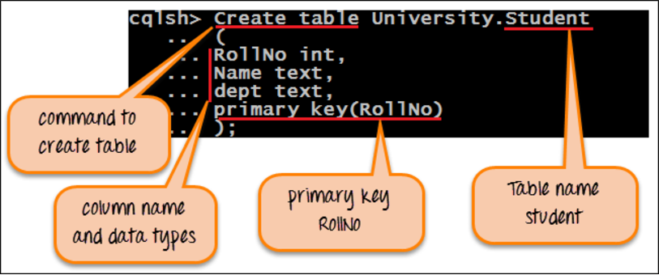
With Clause: "With clause" is used to specify any property and its value for the defined table. For example, if you want to compress Cassandra table data. You can set compression property by specifying compression algorithm property value in "With clause."
Execution
Here is the execution of the command 'Create table' that will create table name 'Student' in the keyspace 'University.’

Slide 51
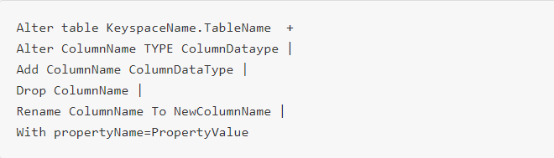
After successful execution of the command 'Create table', table 'Student' will be created in the keyspace 'University' with columns RollNo, Name and dept. RollNo is the primary key. RollNo is also a partition key. All the data will be in the single partition.
Cassandra Alter table
Command 'Alter Table' is used to drop column, add a new column, alter column name, alter column type and change the property of the table.
Syntax

Slide 52
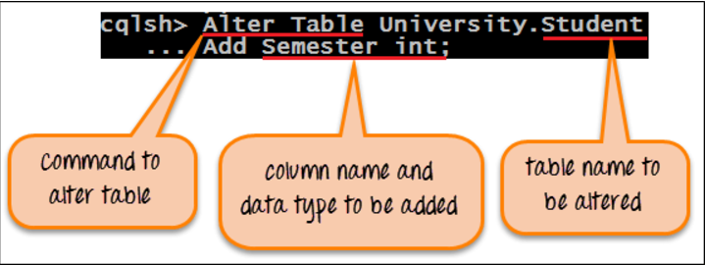
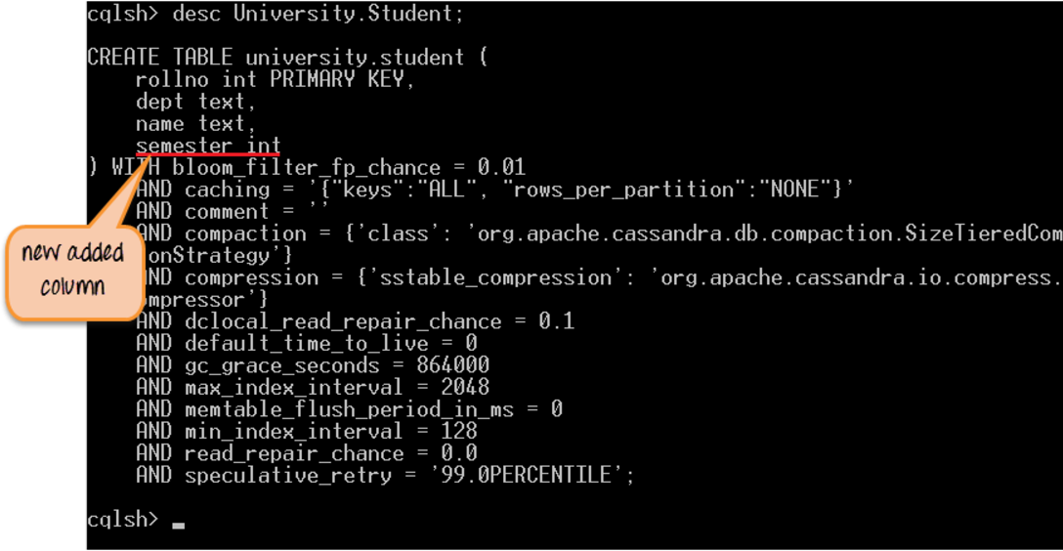
Execution
Here is the snapshot of the command 'Alter Table' that will add new column in the table Student.
After successful execution of the command 'Alter Table', a new column 'Semester' with 'int' data type will be added to the table Student. Screenshot of updated Student table:

Slide 53

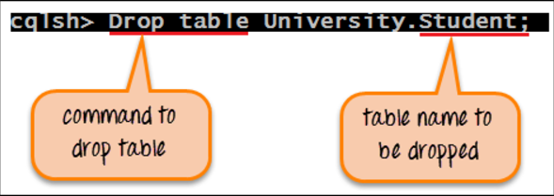
Drop Table
Command 'Drop table' drops specified table including all the data from the keyspace. Before dropping the table, Cassandra takes a snapshot of the data not the schema as a backup.
Syntax
Execution
Here is the snapshot of the executed command 'Drop Table' that will drop table Student from the keyspace 'University’.

Slide 54
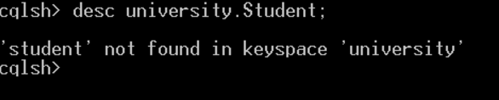
After successful execution of the command 'Drop Table', table Student will be dropped from the keyspace University.
Here is the snapshot that shows the error returned by the Cassandra when tried to access Student table that does not exist.

Slide 55


Truncate Table
Command 'Truncate table' removes all the data from the specified table. Before truncating the data, Cassandra takes the snapshot of the data as a backup.
Syntax
Execution
There are three records in the table Student. These are the records in the table.

Slide 56
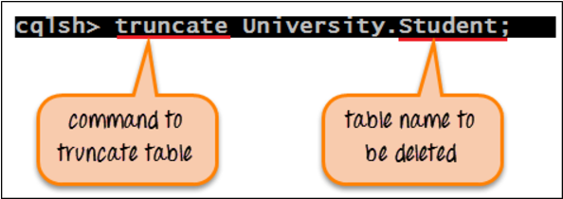

Here is the snapshot of the executed command 'Truncate table' that will remove all the data from the table Student.
After successful execution of the command 'Truncate Table', all the data will be removed from the table Student.
Here is the snapshot of the database state where there are no records in the table Student.

Slide 57
Cassandra Create Index
Command 'Create index' creates an index on the column specified by the user. If the data already exists for the column you want to index, Cassandra creates indexes on the data during the 'create index' statement execution.
After creating an index, Cassandra indexes new data automatically when data is inserted.
The index cannot be created on primary key as a primary key is already indexed.
Indexes on collections are not supported in Cassandra.
Without indexing on the column, Cassandra can't filter that column unless it is a primary key.
That's why, for filtering columns in Cassandra, indexes needs to be created.

Slide 58
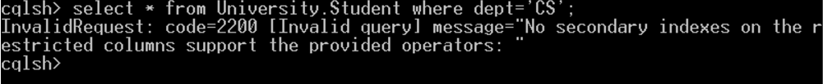
Syntax
Execution
Here is the snapshot where it was tried to filter "dept" column without creating the index. In response, the error was returned.

Slide 59
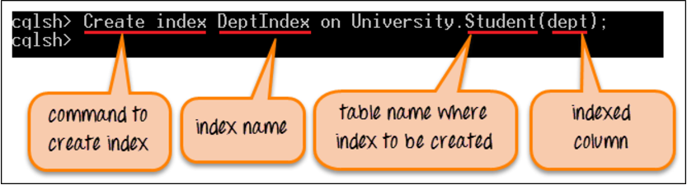
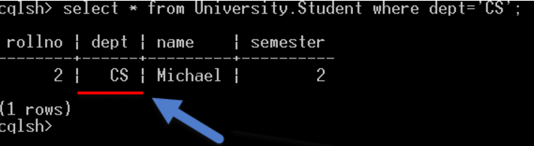
Here is the snapshot where index is created on dept column.
Here is the snapshot where it will be successfully filtered 'dept' column.

Slide 60
Cassandra Drop Index
Command 'Drop index' drops the specified index. If index name was not given during index creation, then index name is TableName_ColumnName_idx.
If the index does not exist, it will return an error unless IF EXISTS is used that will return no-op.
During index creation, you have to specify keyspace name with the index name otherwise index will be dropped from the current keyspace.
Syntax

Slide 61
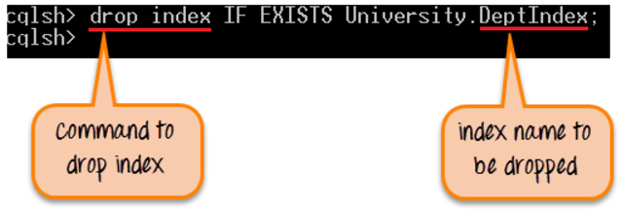
Execution
Here is the snapshot of the executed command 'Drop index' that drops the index DeptIndex.
After successful execution of the command, DeptIndex will be dropped from the keyspace. Now data cannot be filtered by the column dept.

Slide 62
DATA OPERATIONS

Slide 63

Insert Data
Command 'Insert into' writes data in Cassandra columns in row form. It will store only those columns that are given by the user. You have to necessarily specify just the primary key column.
It will not take any space for not given values. No results are returned after insertion.
Syntax
Execution
On the next slide is the snapshot of the executed command 'Insert into' that will insert one record in Cassandra table 'Student'.

Slide 64
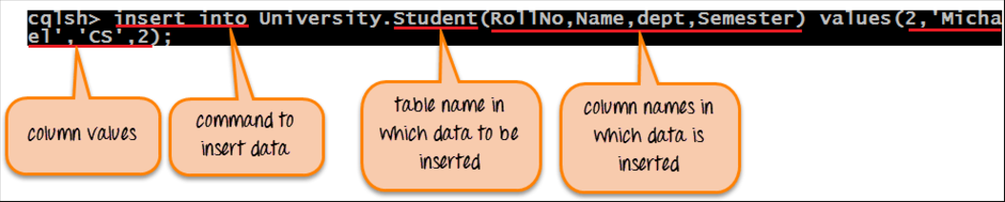
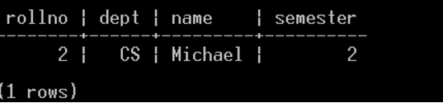
After successful execution of the command 'Insert Into', one row will be inserted in the Cassandra table Student with RollNo 2, Name Michael, dept CS and Semester 2.
Here is the snapshot of the current database state.

Slide 65
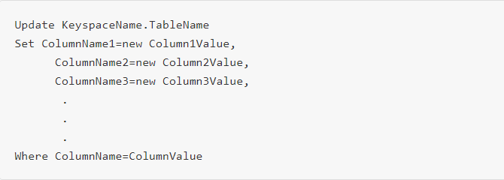
Upsert Data
Cassandra does upsert. Upsert means that Cassandra will insert a row if a primary key does not exist already otherwise if primary key already exists, it will update that row.
Update Data
Command 'Update' is used to update the data in the Cassandra table. If no results are returned after updating data, it means data is successfully updated otherwise an error will be returned. Column values are changed in 'Set' clause while data is filtered with 'Where' clause.
Syntax

Slide 66
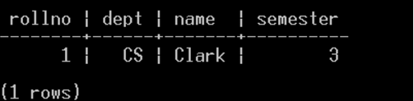
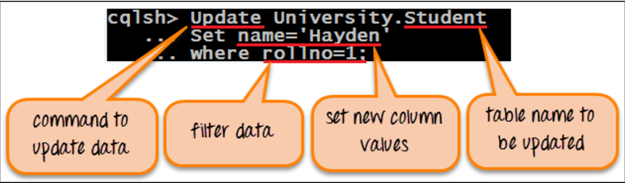
Execution
Here is the screenshot that shows the database state before updating data.
Here is the snapshot of the executed command 'Update' that update the record in the Student table.

Slide 67
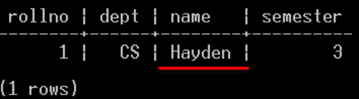
After successful execution of the command 'Update Student', student name will be changed from 'Clark' to 'Hayden' that has rollno 1.
Here is the screenshot that shows the database state after updating data.

Slide 68

Cassandra Delete Data
Command 'Delete' removes an entire row or some columns from the table Student. When data is deleted, it is not deleted from the table immediately. Instead deleted data is marked with a tombstone and are removed after compaction.
Syntax
The above syntax will delete one or more rows depend upon data filtration in where clause.

Slide 69

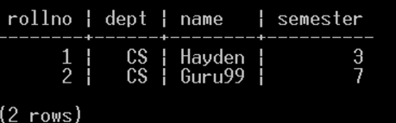
The above syntax will delete some columns from the table.
Execution
Here is the snapshot that shows the current database state before deleting data.

Slide 70
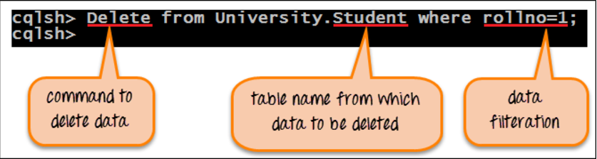
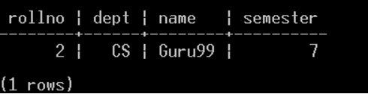
Here is the snapshot of the command that will remove one row from the table Student.
After successful execution of the command 'Delete', one rows will be deleted from the table Student where rollno value is 1.
Here is the snapshot that shows the database state after deleting data.

Slide 71
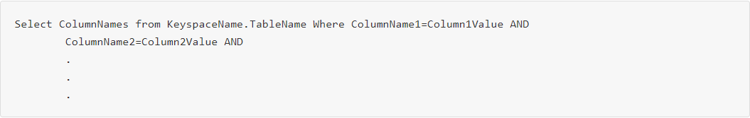
Cassandra Read Data
In Cassandra, data retrieval is a sensitive issue. The column is filtered in Cassandra by creating an index on non-primary key columns.
Syntax

Slide 72
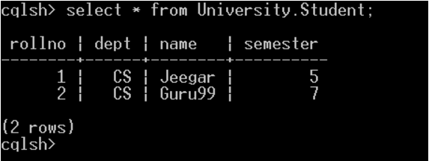
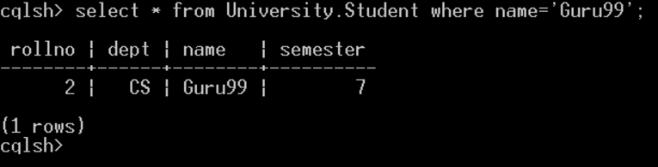
Execution
Here is the snapshot that shows the data retrieval from Student table without data filtration.
Here is the snapshot that shows the data retrieval from Student with data filtration. One record is retrieved. Data is filtered by name column. All the records are retrieved that has name equal to Guru99.

Slide 73
CQL DATA TYPES

Slide 74
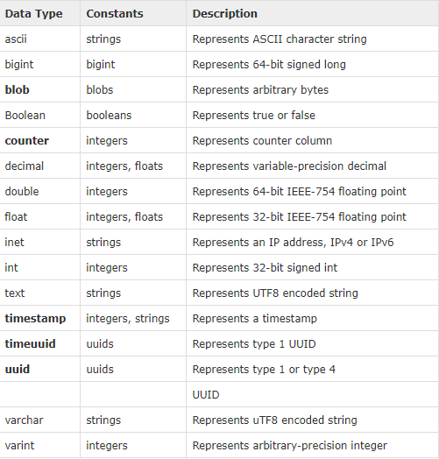
CQL provides a rich set of built-in data types, including collection types. Along with these data types, users can also create their own custom data types. The following table provides a list of built-in data types available in CQL.

Slide 75
User-defined datatypes:
Cqlsh provides users a facility of creating their own data types. Given below are the commands used while dealing with user defined datatypes.
CREATE TYPE - Creates a user-defined datatype.
ALTER TYPE - Modifies a user-defined datatype.
DROP TYPE - Drops a user-defined datatype.
DESCRIBE TYPE - Describes a user-defined datatype.
DESCRIBE TYPES - Describes user-defined datatypes.

Slide 76

Automatic Data Expiration
Cassandra provides functionality by which data can be automatically expired.
During data insertion, you have to specify 'ttl' value in seconds. 'ttl' value is the time to live value for the data. After that particular amount of time, data will be automatically removed.
For example, specify ttl value 100 seconds during insertion. Data will be automatically deleted after 100 seconds. When data is expired, that expired data is marked with a tombstone.
A tombstone exists for a grace period. After data is expired, data is automatically removed after compaction process.
Syntax

Slide 77
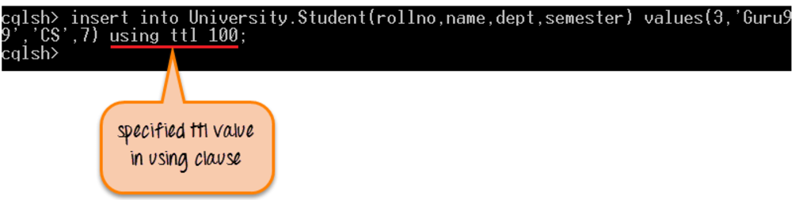
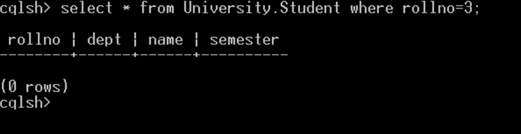
Execution
Here is the snapshot where data is being inserted in Student table with ttl value of 100 seconds.
Here is the snapshot where data is automatically expired after 100 seconds and data is automatically removed.

Slide 78
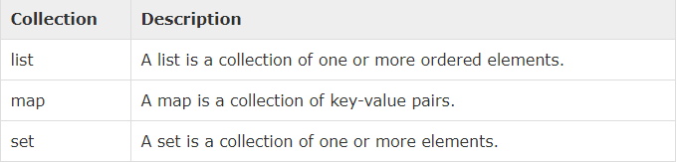
Collection Types
Cassandra Query Language also provides a collection data types. The following table provides a list of Collections available in CQL.

Slide 79
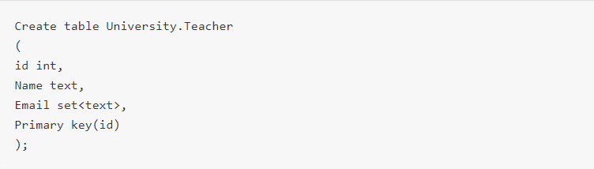
Set: A Set stores group of elements that returns sorted elements when querying.
Syntax
Here is the syntax of the Set collection that store multiple email addresses for the teacher.

Slide 80
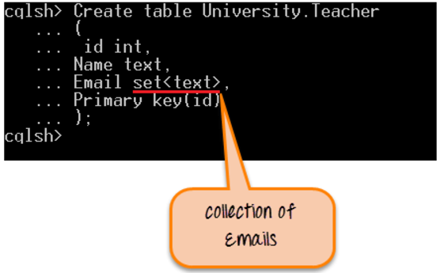
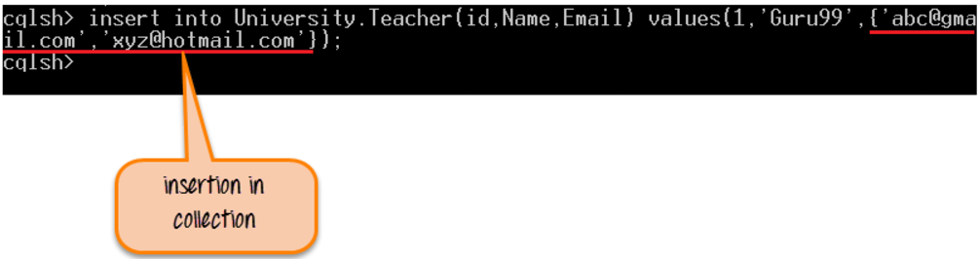
Execution
Here is the snapshot where table "Teacher" is created with "Email" column as a collection.
Here is the snapshot where data is being inserted in the collection.

Slide 81
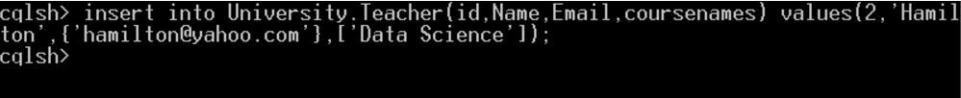
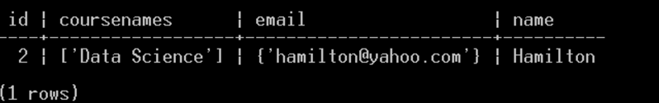
List: When the order of elements matters, the list is used.
Here is the snapshot where column courses of list type id added in table "Teacher.“
Here is the snapshot where data is being inserted in column "coursenames".
Here is the snapshot that shows the current database state after insertion.

Slide 82
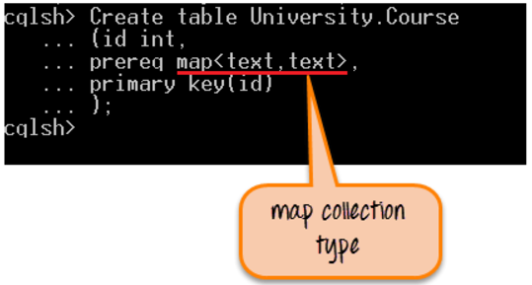
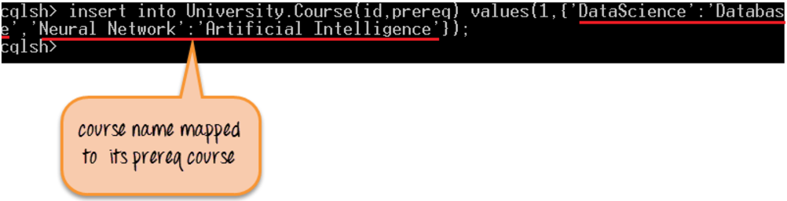
Map: The map is a collection type that is used to store key value pairs. As its name implies that it maps one thing to another. For example, if you want to save course name with its prerequisite course name, map collection can be used.
Here is the snapshot where map type is created for course name and its prerequisite course name.
Here is the snapshot where data is being inserted in map collection type.

