Slide 1
HBase: An Example of NoSQL Databases (III)

Slide 2
Outline
Introduction
Architecture
Installation
HBase - Shell
HBase - Admin API
Table Operations
Data Operations
Security

Slide 3
Introduction

Slide 4
NoSQL databases
Key-value database: Riak, Redius, Memcached DB
Column-family database: Cassandra, HBase, Hypertable, Amazon SimpleDB
Document database: MongoDB
XML database
Graph database: Neo4J
…

Slide 5
HBase
HBase is a distributed column-family oriented database built on top of the HDFS (Hadoop Distributed File System).
It is horizontally scalable.
It is a data model that is similar to Google’s Bigtable designed to provide quick random access to huge amounts of structured data.
It is a part of the Hadoop ecosystem that provides random real-time read/write access to data in the Hadoop File System.

Slide 6
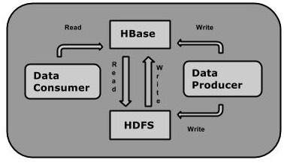
One can store the data in HDFS either directly or through HBase. Data consumer reads/accesses the data in HDFS randomly using HBase. HBase sits on top of the Hadoop File System and provides read and write access.

Slide 7
HDFS and HBase
HDFS | HBase
HDFS is a distributed file system suitable for storing large files. | HBase is database built on top of HDFS.
HDFS does not support fast individual record lookups. | HBase provides fast lookups for larger tables.
It provides high latency batch processing; no concept of batch processing. | It provides low latency access to single rows from billions of records (Random access).
It provides only sequential access of data. | HBase internally uses Hash tables and provides random access, and it stores the data in indexed HDFS files for faster lookups.

Slide 8
Storage Mechanism in HBase
HBase is a column-oriented database and the tables in it are sorted by row.
The table schema defines only column families, which are the key value pairs.
A table have multiple column families and each column family can have any number of columns.
Subsequent column values are stored contiguously on the disk. Each cell value of the table has a timestamp.

Slide 9
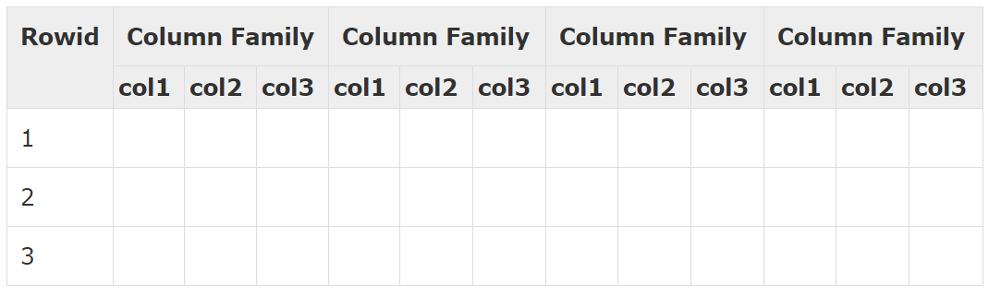
Schema Example
Table is a collection of rows.
Row is a collection of column families.
Column family is a collection of columns.
Column is a collection of key value pairs.

Slide 10
HBase v/s RDBMS
HBase | RDBMS
HBase is schema-less, it doesn't have the concept of fixed columns schema; defines only column families. | An RDBMS is governed by its schema, which describes the whole structure of tables.
It is built for wide tables. HBase is horizontally scalable. | It is thin and built for small tables. Hard to scale.
No transactions are there in HBase. | RDBMS is transactional.
It has de-normalized data. | It will have normalized data.
It is good for semi-structured as well as structured data. | It is good for structured data.

Slide 11
Features of HBase
HBase is linearly scalable.
It has automatic failure support.
It provides consistent read and writes.
It integrates with Hadoop, both as a source and a destination.
It has easy Java API for client.
It provides data replication across clusters.

Slide 12
HBase Architecture

Slide 13
HBase has two type of nodes – Master and RegionServer
Tables are split into regions and are served by the region servers.
Regions are vertically divided by column families into “Stores”.
Stores are saved as files in HDFS.
Region servers can be added or removed as per requirement.

Slide 14
Master Server
Assigns regions to the region servers and takes the help of Apache ZooKeeper for this task.
Handles load balancing of the regions across region servers. It unloads the busy servers and shifts the regions to less occupied servers.
Maintains the state of the cluster by negotiating the load balancing.
Is responsible for schema changes and other metadata operations such as creation of tables and column families.

Slide 15
Regions
Regions are nothing but tables that are split up and spread across the region servers.
They communicate with the client and handle data-related operations.
Regions handle read and write requests for all the regions under it.
They decide the size of the region by following the region size thresholds.

Slide 16
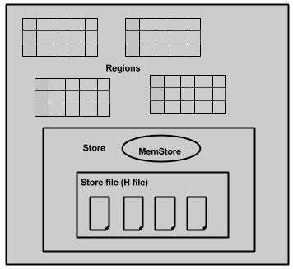
A region server contain regions and stores as shown below:
Memstore is just like a cache memory. Anything that is entered into the HBase is stored here initially. Later, the data is transferred and saved in Hfiles as blocks and the memstore is flushed.

Slide 17
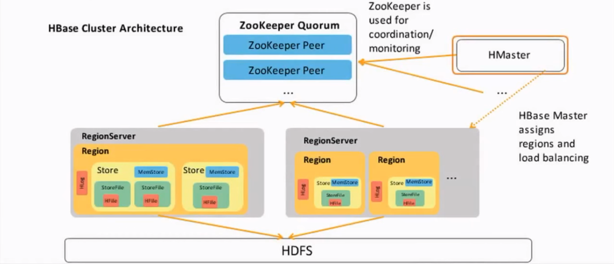

Slide 18
Zookeeper
Zookeeper is an open-source project that provides services like maintaining configuration information, naming, providing distributed synchronization, etc.
Zookeeper has ephemeral nodes representing different region servers. Master servers use these nodes to discover available servers.
In addition to availability, the nodes are also used to track server failures or network partitions.
Clients communicate with region servers via zookeeper.
In pseudo and standalone modes, HBase itself will take care of zookeeper.

Slide 19
INSTALLATION

Slide 20
Installing JAVA
Java is the main prerequisite for Hadoop and HBase. First of all, you should verify the existence of java in your system using “java -version”. The syntax of java version command is given below.
If everything works fine, it will give you the following output.

Slide 21
If JAVA is not installed in your system, then follow the following steps for installing JAVA:
Step 1
Update the source list
sudo apt-get update
Step 2
Download and install jdk
sudo apt-get install openjdk-8-jdk

Slide 22
Step 3
For setting up PATH and JAVA_HOME variables, add the following commands to ~/.bashrc file.
sudo gedit ~/.bashrc
export JAVA_HOME=/usr/lib/jvm/java-8-openjdk-amd64
Now apply all the changes into the current running system with following command:
source ~/.bashrc
Now verify the java -version command from the terminal.

Slide 23
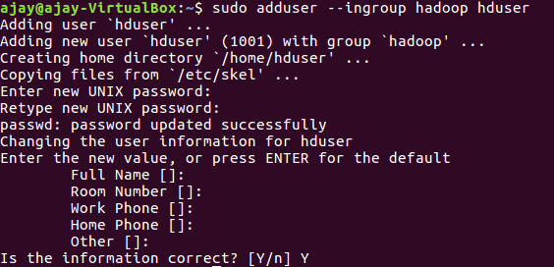
Adding a dedicated Hadoop user

Slide 24
Installing SSH
ssh has two main components:
ssh : The command we use to connect to remote machines - the client.
sshd : The daemon that is running on the server and allows clients to connect to the server.
The ssh is pre-enabled on Linux, but in order to start sshd daemon, we need to install ssh first. Use this command to do that :

Slide 25
Create and Setup SSH Certificates
Hadoop requires SSH access to manage its nodes, i.e. remote machines plus our local machine. For our single-node setup of Hadoop, we therefore need to configure SSH access to localhost.
So, we need to have SSH up and running on our machine and configured it to allow SSH public key authentication.
Hadoop uses SSH (to access its nodes) which would normally require the user to enter a password. However, this requirement can be eliminated by creating and setting up SSH certificates using the following commands. If asked for a filename just leave it blank and press the enter key to continue.

Slide 26
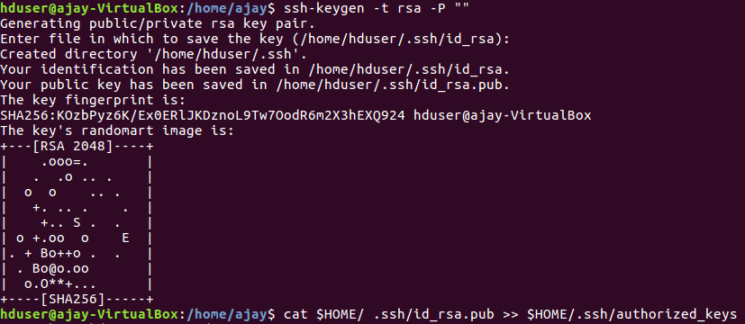
The second command adds the newly created key to the list of authorized keys so that Hadoop can use ssh without prompting for a password.

Slide 27
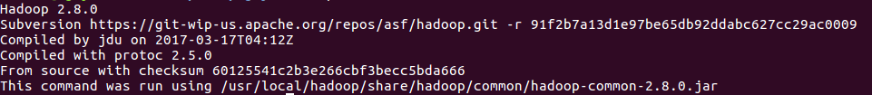
Hadoop Download
After installing java, you have to install Hadoop. First of all, verify the existence of Hadoop using “ Hadoop version ” command as shown below.
If everything works fine, it will give you the following output.

Slide 28
If your system is unable to locate Hadoop, then download Hadoop in your system. Download and extract hadoop-2.8.0 from Apache Software Foundation using the commands on the next slide.
Additionally, before we download Hadoop, we need to add our newly created user ‘hduser’ to the sudoers list so that we can perform operations on that user.
The commands to add ‘hduser’ to sudoers list is also given on the next slide.

Slide 29
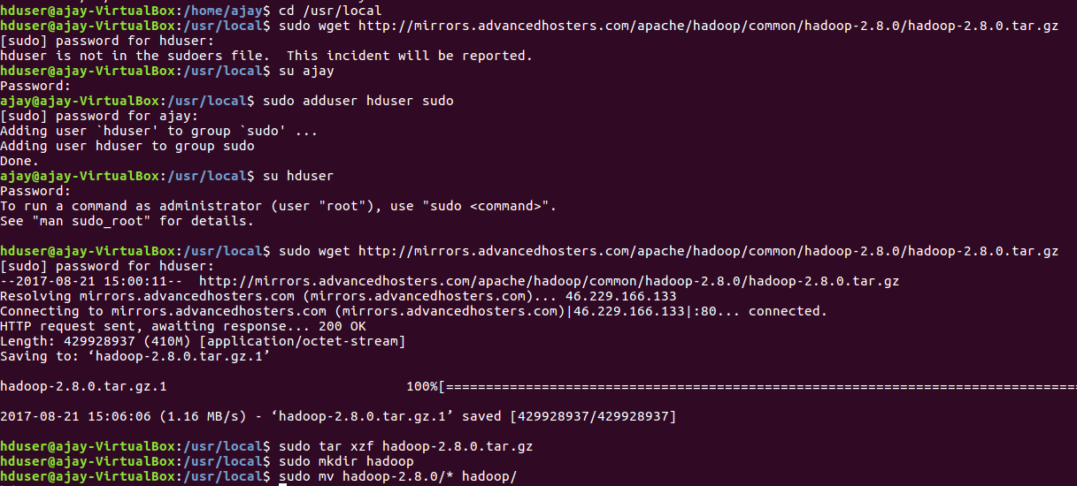

Slide 30
Installing Hadoop
Setup Configuration Files
The following files will have to be modified to complete the Hadoop setup:
~/.bashrc
/usr/local/hadoop/etc/hadoop/hadoop-env.sh
/usr/local/hadoop/etc/hadoop/core-site.xml
/usr/local/hadoop/etc/hadoop/mapred-site.xml.template
/usr/local/hadoop/etc/hadoop/hdfs-site.xml

Slide 31
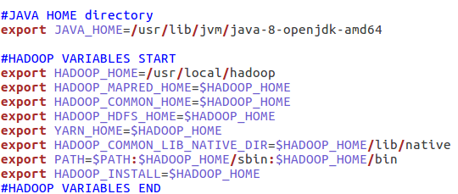
1. ~/.bashrc:
Before editing the .bashrc file in our home directory, we need to find the path where Java has been installed to set the JAVA_HOME environment variable using the following command:
Now we can append the following to the end of ~/.bashrc:

Slide 32
2. /usr/local/hadoop/etc/hadoop/hadoop-env.sh
We need to set JAVA_HOME by modifying hadoop-env.sh file.
Append the following line to the end of the file:
Adding the above statement in the hadoop-env.sh file ensures that the value of JAVA_HOME variable will be available to Hadoop whenever it is started up.

Slide 33
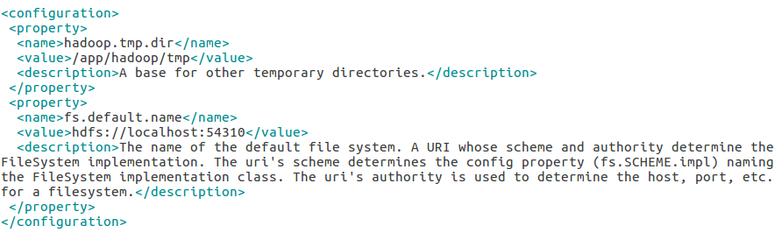
3. /usr/local/hadoop/etc/hadoop/core-site.xml:
The /usr/local/hadoop/etc/hadoop/core-site.xml file contains configuration properties that Hadoop uses when starting up.
This file can be used to override the default settings that Hadoop starts with.
Open the file and enter the following in between the <configuration></configuration> tag:

Slide 34
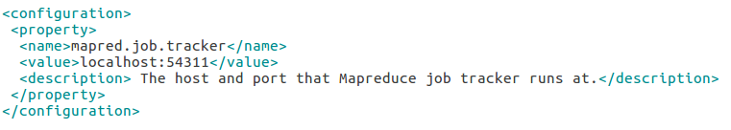
4. /usr/local/hadoop/etc/hadoop/mapred-site.xml
By default, the /usr/local/hadoop/etc/hadoop/ folder contains “/usr/local/hadoop/etc/hadoop/mapred-site.xml.template” file which has to be renamed/copied with the name mapred-site.xml:
The mapred-site.xml file is used to specify which framework is being used for MapReduce. We need to enter the following content in between the <configuration></configuration> tag:

Slide 35
5. /usr/local/hadoop/etc/hadoop/hdfs-site.xml
The /usr/local/hadoop/etc/hadoop/hdfs-site.xml file needs to be configured for each host in the cluster that is being used. It is used to specify the directories which will be used as the namenode and the datanode on that host.
Before editing this file, we need to create two directories which will contain the namenode and the datanode for this Hadoop installation.
This can be done using the following commands:
sudo mkdir –p /usr/local/hadoop_store/hdfs/namenode
sudo mkdir –p /usr/local/hadoop_store/hdfs/namenode
sudo chwn –R hduser:hadoop /usr/local/hadoop_store

Slide 36
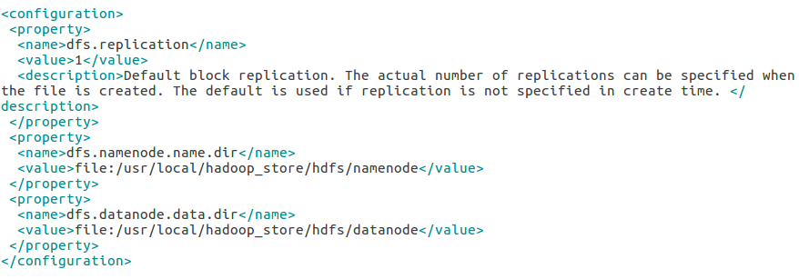
Open the file and enter the following content in between the <configuration></configuration> tag:

Slide 37
Format the New Hadoop Filesystem
Now, the Hadoop file system needs to be formatted so that we can start to use it. The format command should be issued with write permission since it creates current directory under /usr/local/hadoop_store/hdfs/namenode folder:
Note that hadoop namenode -format command should be executed once before we start using Hadoop. If this command is executed again after Hadoop has been used, it'll destroy all the data on the Hadoop file system.
Starting Hadoop
We can use start-all.sh or (start-dfs.sh and start-yarn.sh)

Slide 38
Stopping Hadoop
We run stop-all.sh or (stop-dfs.sh and stop-yarn.sh) to stop all the daemons running on our machine:
Hadoop Web Interface
We can access the web interface of NameNode daemon by typing http://localhost:50070/ in the browser

Slide 39
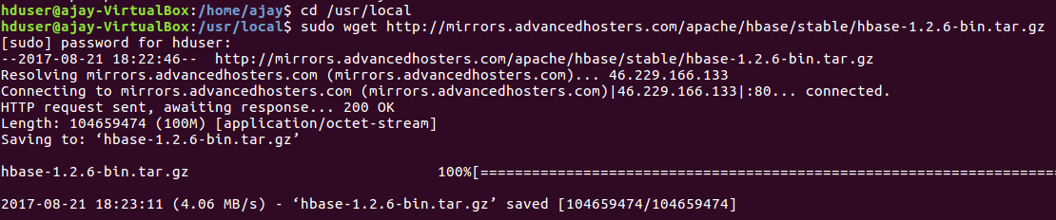
INSTALLING HBase
Download the latest stable version of HBase from http://mirrors.advancedhosters.com/apache/hbase/stable/ using “wget” command, and extract it using the tar “xzf” command. See the following command.

Slide 40
Extract and move contents to a newly created directory:
Configuring HBase
Before proceeding with HBase, you have to edit the following files and configure HBase.
hbase-env.sh
hbase-site.xml

Slide 41
1. hbase-env.sh
Set the java Home for HBase and open hbase-env.sh file from the conf folder. Edit JAVA_HOME environment variable and change the existing path to your current JAVA_HOME variable as shown below.
This will open the env.sh file of HBase. Now replace the existing JAVA_HOME value with your current value as shown below.

Slide 42
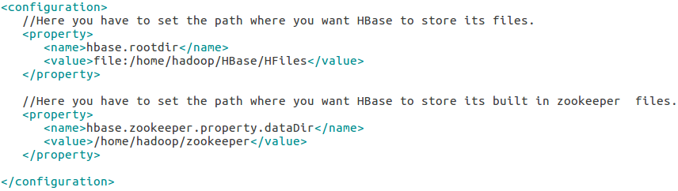
2. hbase-site.xml
This is the main configuration file of HBase. Open the file using following command.
Inside the hbase-site.xml file, you will find the <configuration> and </configuration> tags. Within them, set the HBase directory under the property key with the name “hbase.rootdir” as shown below.
Finally run the following command:

Slide 43
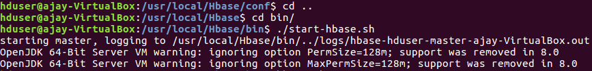
With this, the HBase installation and configuration part is successfully complete.
We can start HBase by using start-hbase.sh script provided in the bin folder of HBase. For that, open HBase Home Folder and run HBase start script as shown below.
If everything goes well, when you try to run HBase start script, it will prompt you a message saying that HBase has started.

Slide 44
Start HBase Shell
You can start HBase shell using the following command.
HBase Web Interface
You can access the web interface of HBase by typing http://localhost:60010 in the browser.
This interface lists your currently running Region servers, backup masters and HBase tables.

Slide 45
HBase - Shell

Slide 46
HBase contains a shell using which you can communicate with HBase.
HBase uses the Hadoop File System to store its data. It will have a master server and region servers. The data storage will be in the form of regions (tables). These regions will be split up and stored in region servers.
The master server manages these region servers and all these tasks take place on HDFS.

Slide 47


GENERAL COMMANDS
status: This command returns the status of the system including the details of the servers running on the system. Its syntax is as follows:
If you execute this command, it returns the following output.

Slide 48

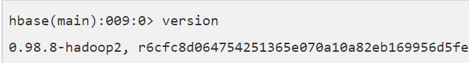
version: This command returns the version of HBase used in your system. Its syntax is as follows:
If you execute this command, it returns the following output.

Slide 49

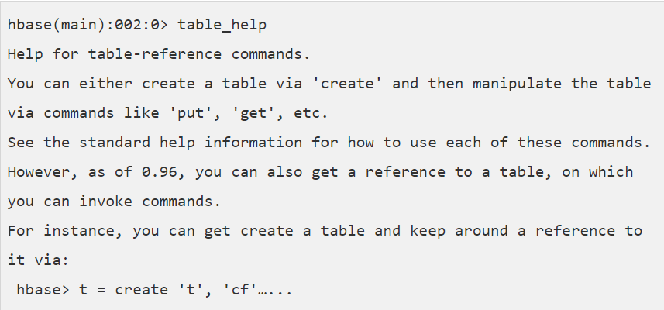
table_help: This command guides you what and how to use table-referenced commnads. Its syntax is as follows:
When you use this command, it shows help topics for table-related commands. Given below is the partial output of this command.

Slide 50
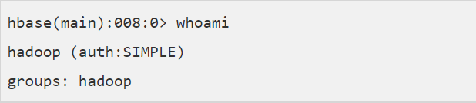
whoami: This command returns the user details of HBase. If you execute this command, returns the current HBase user as shown below:

Slide 51
Data Definition Language
create - Creates a table.
list - Lists all the tables in HBase.
disable - Disables a table.
is_disabled - Verifies whether a table is disabled.
enable - Enables a table.
is_enabled - Verifies whether a table is enabled.
describe - Provides the description of a table.

Slide 52
alter - Alters a table.
exists - Verifies whether a table exists.
drop - Drops a table from HBase.
drop_all - Drops the tables matching the ‘regex’ given in the command.
Java Admin API - Prior to all the above commands, Java provides an Admin API to achieve DDL functionalities through programming. Under org.apache.hadoop.hbase.client package, HBaseAdmin and HTableDescriptor are the two important classes in this package that provide DDL functionalities.

Slide 53
Data Manipulation Language
put - Puts a cell value at a specified column in a specified row in a particular table.
get - Fetches the contents of row or a cell.
delete - Deletes a cell value in a table.
deleteall - Deletes all the cells in a given row.
scan - Scans and returns the table data.
count - Counts and returns the number of rows in a table.
truncate - Disables, drops, and recreates a specified table.

Slide 54
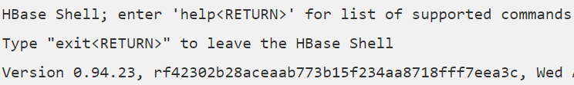
Starting HBase Shell
To access the HBase shell, you have to navigate to the HBase home folder. You can start the HBase interactive shell using “hbase shell” command as shown below.
If you have successfully installed HBase in your system, then it gives you the HBase shell prompt as shown below.
To exit the interactive shell command at any moment, type exit or use <ctrl+c>. Check the shell functioning before proceeding further.

Slide 55
Use the list command for this purpose. List is a command used to get the list of all the tables in HBase.
First of all, verify the installation and the configuration of HBase in your system using this command as shown below.
When you type this command, it gives you the following output.

Slide 56
HBase - Admin API

Slide 57
HBase is written in java, therefore it provides java API to communicate with HBase. Java API is the fastest way to communicate with HBase. Given below is the referenced java Admin API that covers the tasks used to manage tables.
Class HBaseAdmin
HBaseAdmin is a class representing the Admin. This class belongs to the org.apache.hadoop.hbase.client package. Using this class, you can perform the tasks of an administrator. You can get the instance of Admin using Connection.getAdmin() method.
Next we will discuss some methods and their functions

Slide 58
METHODS | DESCRIPTION
void createTable(HTableDescriptor desc) | Creates a new table.
void createTable(HTableDescriptor desc, byte[ ][ ] splitKeys) | Creates a new table with an initial set of empty regions defined by the specified split keys.
void deleteColumn(byte[] tableName, String columnName) | Deletes a column from a table.
void deleteColumn(String tableName, String columnName) | Delete a column from a table.
void deleteTable(String tableName) | Deletes a table.

Slide 59
Class Descriptor
This class contains the details about an HBase table such as:
the descriptors of all the column families,
if the table is a catalog table,
if the table is read only,
the maximum size of the mem store,
when the region split should occur,
co-processors associated with it, etc.

Slide 60
TABLE OPERATIONS

Slide 61
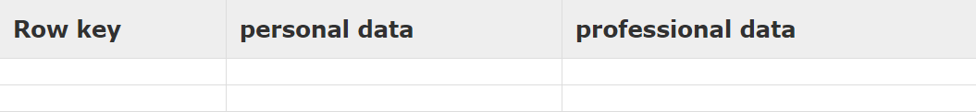
Creating a Table using HBase Shell
You can create a table using the create command, here you must specify the table name and the Column Family name. The syntax to create a table in HBase shell is shown below.
Given below is a sample schema of a table named emp. It has two column families: “personal data” and “professional data”.
You can create this table in HBase shell as shown below.

Slide 62
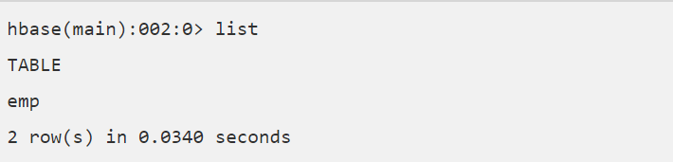
Verification
You can verify whether the table is created using the list command as shown below. Here you can observe the created emp table.

Slide 63

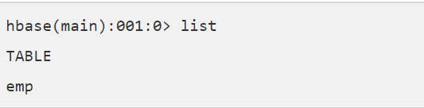
Listing a Table using HBase Shell
list is the command that is used to list all the tables in HBase. Given below is the syntax of the list command.
When you type this command and execute in HBase prompt, it will display the list of all the tables in HBase as shown below.
Here you can observe a table named emp.

Slide 64


Disabling a Table using HBase Shell
To delete a table or change its settings, you need to first disable the table using the disable command. You can re-enable it using the enable command.
Given below is the syntax to disable a table:
Given below is an example that shows how to disable a table.

Slide 65
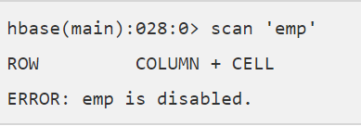

Verification
After disabling the table, you can still sense its existence through list and exists commands. You cannot scan it. It will give you the following error.
is_disabled
This command is used to find whether a table is disabled. Its syntax is as follows.

Slide 66
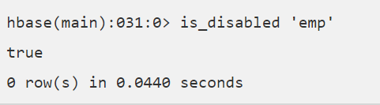

The following example verifies whether the table named emp is disabled. If it is disabled, it will return true and if not, it will return false.
disable_all
This command is used to disable all the tables matching the given regex. The syntax for disable_all command is given below.

Slide 67
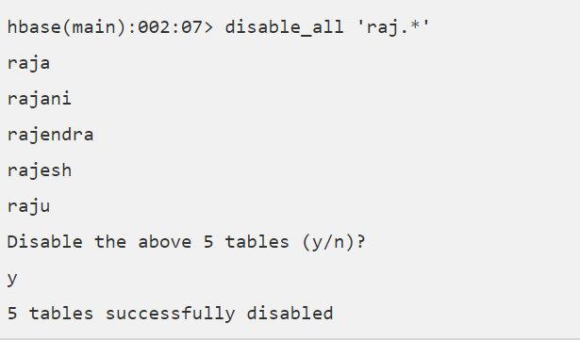
Suppose there are 5 tables in HBase, namely raja, rajani, rajendra, rajesh, and raju. The following code will disable all the tables starting with raj.

Slide 68


Enabling a Table using HBase Shell
Syntax to enable a table:
Given below is an example to enable a table:
Verification
After enabling the table, scan it. If you can see the schema, your table is successfully enabled.

Slide 69

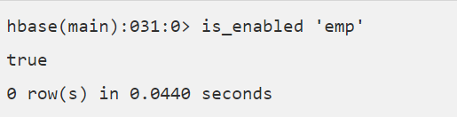
is_enabled
This command is used to find whether a table is enabled. Its syntax is as follows:
The following code verifies whether the table named emp is enabled. If it is enabled, it will return true and if not, it will return false.

Slide 70

Describing a Table
‘describe’ command returns the description of the table. Its syntax is as follows:
The output of the describe command on the emp table is given on the next page.

Slide 71
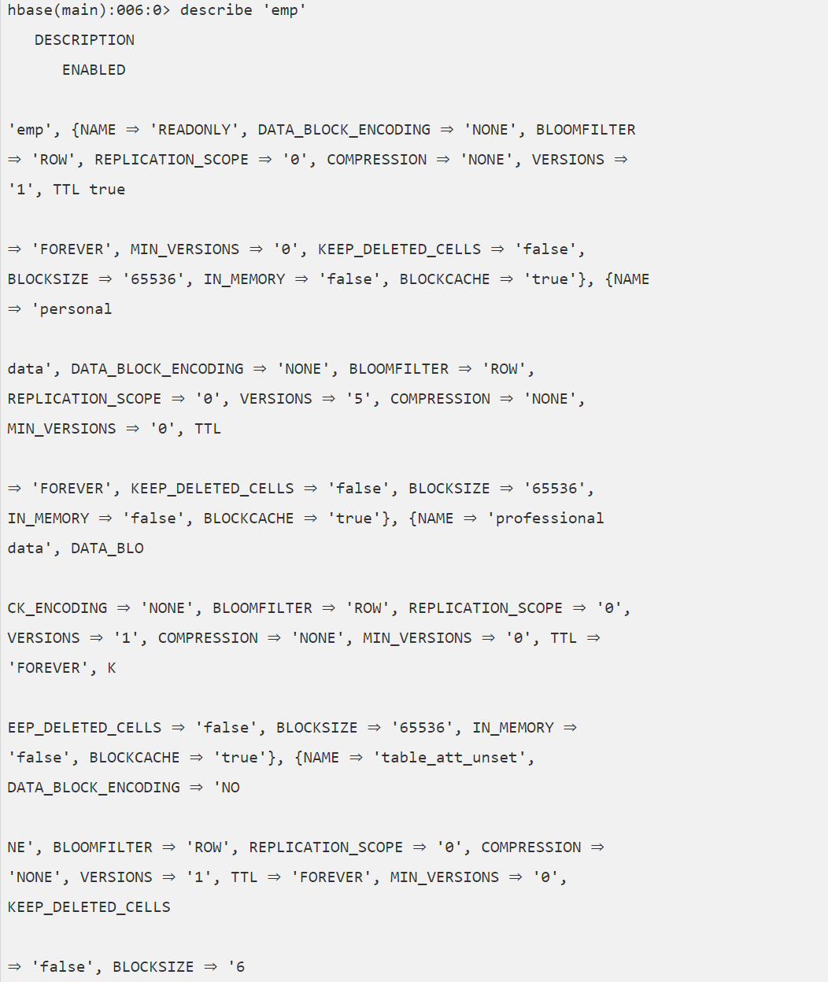

Slide 72
alter
Alter is the command used to make changes to an existing table. Using this command, you can change the maximum number of cells of a column family, set and delete table scope operators, and delete a column family from a table.
Changing the Maximum Number of Cells of a Column Family
Given below is the syntax to change the maximum number of cells of a column family.

Slide 73
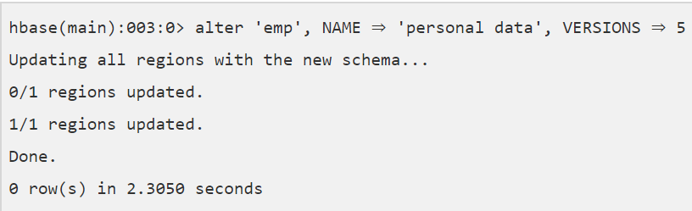
In the following example, the maximum number of cells is set to 5.
Table Scope Operators
Using alter, you can set and remove table scope operators such as MAX_FILESIZE, READONLY, MEMSTORE_FLUSHSIZE, DEFERRED_LOG_FLUSH, etc.

Slide 74

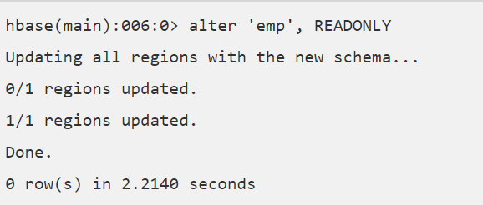
Setting Read Only
Below given is the syntax to make a table read only.
In the following example, we have made the emp table read only.

Slide 75
Removing Table Scope Operators
We can also remove the table scope operators. Given below is the syntax to remove ‘MAX_FILESIZE’ from emp table.
Deleting a Column Family
Using alter, you can also delete a column family. Given below is the syntax to delete a column family using alter.

Slide 76
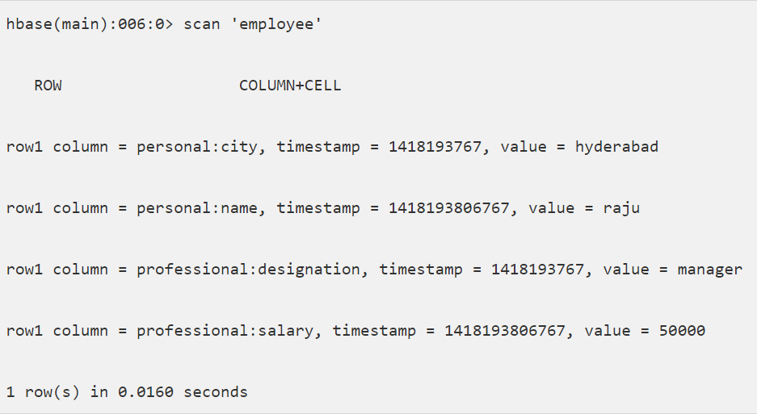
Given below is an example to delete a column family from the ‘emp’ table. Assume there is a table named employee in HBase. It contains the following data:

Slide 77
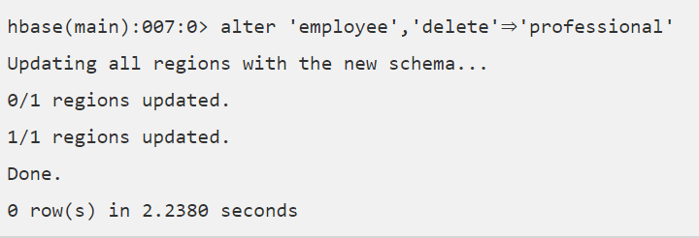
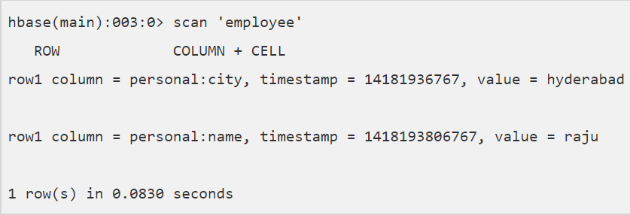
Now let us delete the column family named professional using the alter command.
Now verify the data in the table after alteration. Observe the column family ‘professional’ is no more, since we have deleted it.

Slide 78
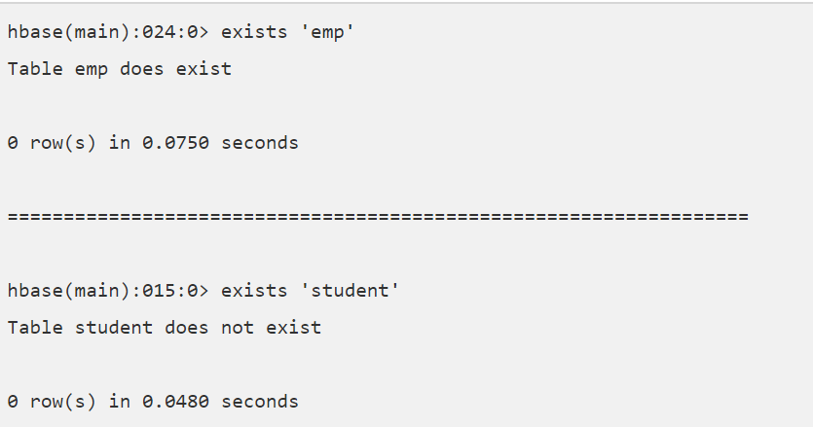
Existence of Table using HBase Shell
You can verify the existence of a table using the exists command. The following example shows how to use this command.

Slide 79
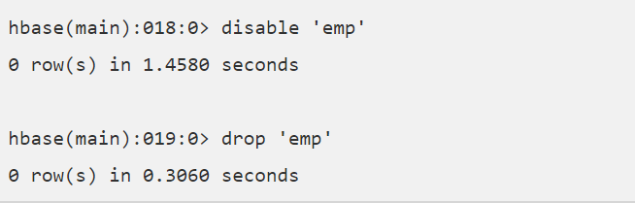
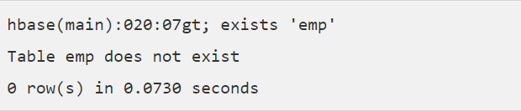
Dropping a Table using HBase Shell
Using the drop command, you can delete a table. Before dropping a table, you have to disable it.
Verify whether the table is deleted using the exists command.

Slide 80

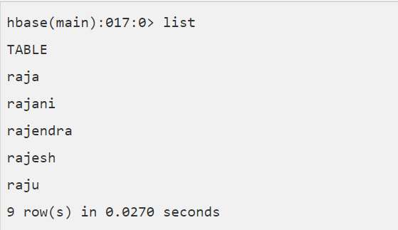
drop_all
This command is used to drop the tables matching the “regex” given in the command. Its syntax is as follows:
Example
Assume there are tables named raja, rajani, rajendra, rajesh, and raju.

Slide 81
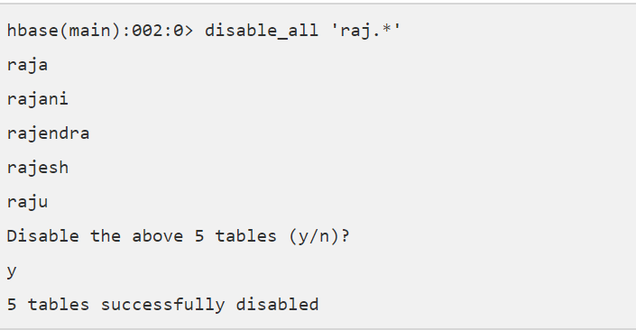
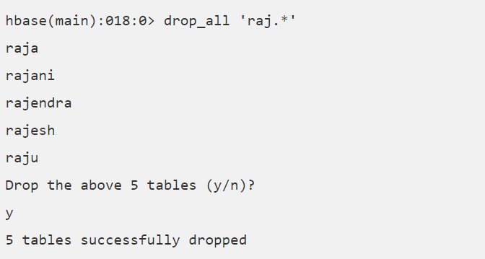
All these tables start with the letters raj. First of all, let us disable all these tables using the disable_all command as shown below.
Now you can delete all of them using the drop_all command as given below.

Slide 82
DATA OPERATIONS

Slide 83
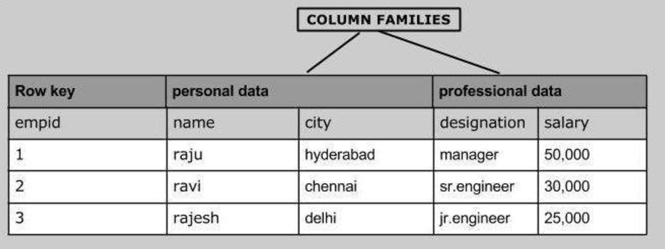
Inserting Data using HBase Shell
To create data in an HBase table, the following commands and methods are used:
put command
add() method of Put class
put() method of HTable class.
As an example, we are going to create the following table in HBase.

Slide 84
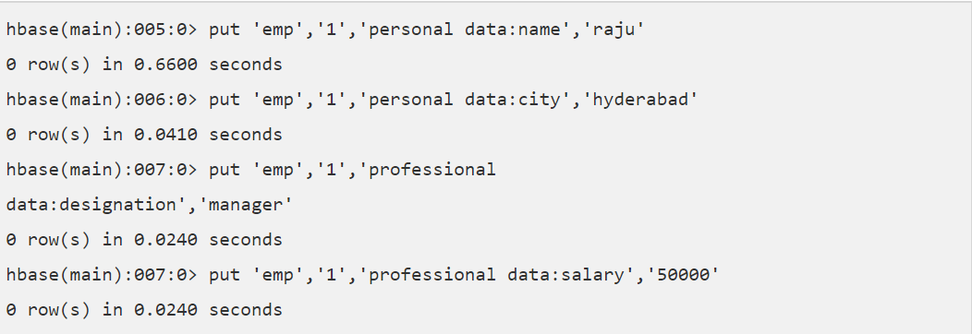
Using put command, we can insert rows into a table. Its syntax is as follows:
Inserting the First Row
Let us insert the first row values into the emp table as shown below.

Slide 85
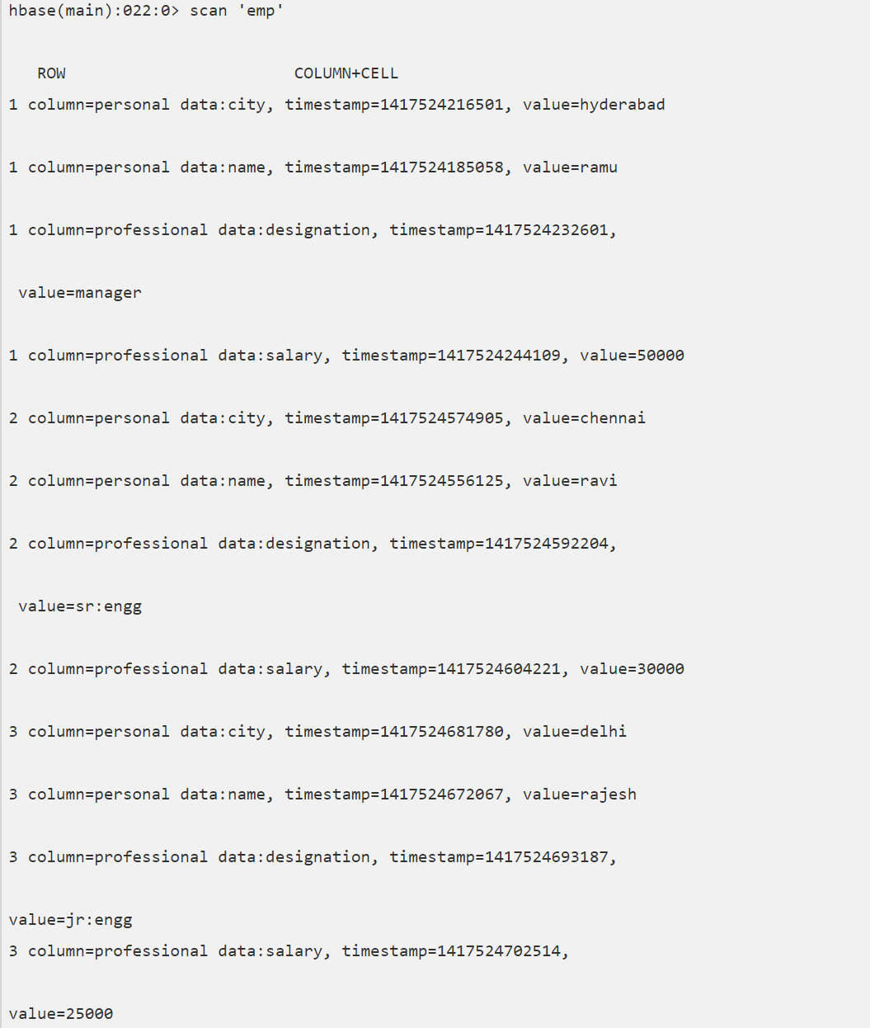
Insert the remaining rows using the put command in the same way. If you insert the whole table, you will get the following output.

Slide 86
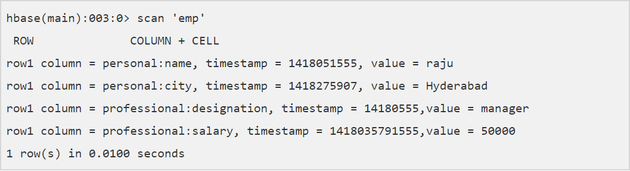
Updating Data using HBase Shell
We can update an existing cell value using the put command. To do so, just follow the same syntax and mention your new value as shown below.
The newly given value replaces the existing value, updating the row.
Example
Suppose there is a table in HBase called emp with the following data.

Slide 87
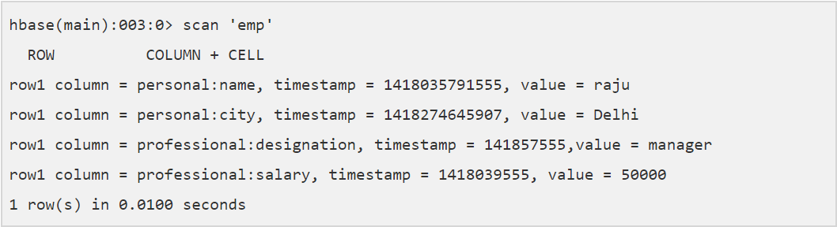
The following command will update the city value of the employee named ‘Raju’ to Delhi.
The updated table looks as follows where you can observe the city of Raju has been changed to ‘Delhi’.

Slide 88
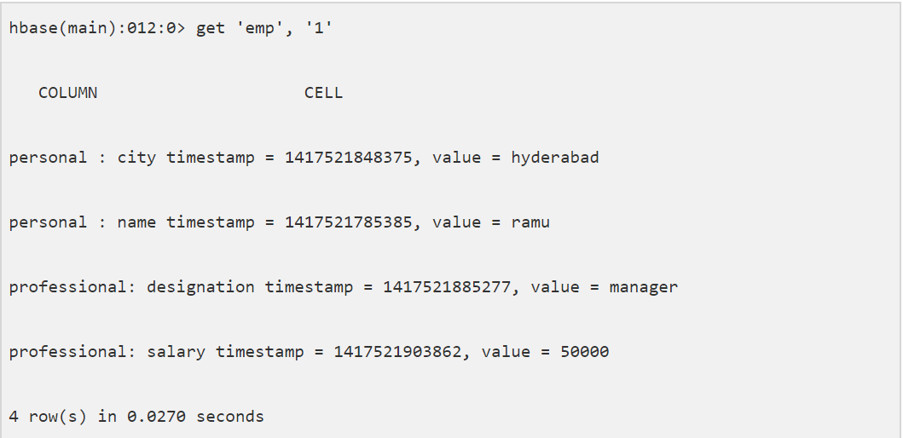
Reading Data using HBase Shell
The get command and the get() method of HTable class are used to read data from a table in HBase. Using get command, you can get a single row of data at a time. Its syntax is as follows:
Example
The following example shows how to use the get command. Let us scan the first row of the emp table.

Slide 89
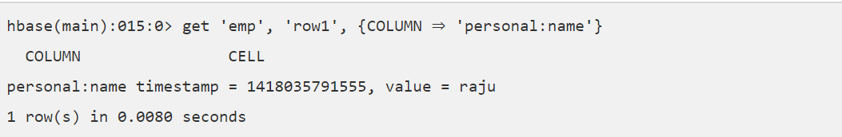
Reading a Specific Column
Given below is the syntax to read a specific column using the get method.
Example
Given below is the example to read a specific column in HBase table.

Slide 90
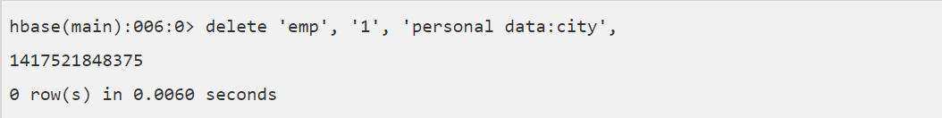
Deleting a Specific Cell in a Table
Using the delete command, you can delete a specific cell in a table. The syntax of delete command is as follows:
Example
The following example shows how to delete a specific cell. Here we are deleting the salary.

Slide 91
Deleting All Cells in a Table
Using the “deleteall” command, we can delete all the cells in a row. Given below is the syntax of deleteall command.
Example
Here is an example of “deleteall” command, where we are deleting all the cells of row1 of emp table.

Slide 92
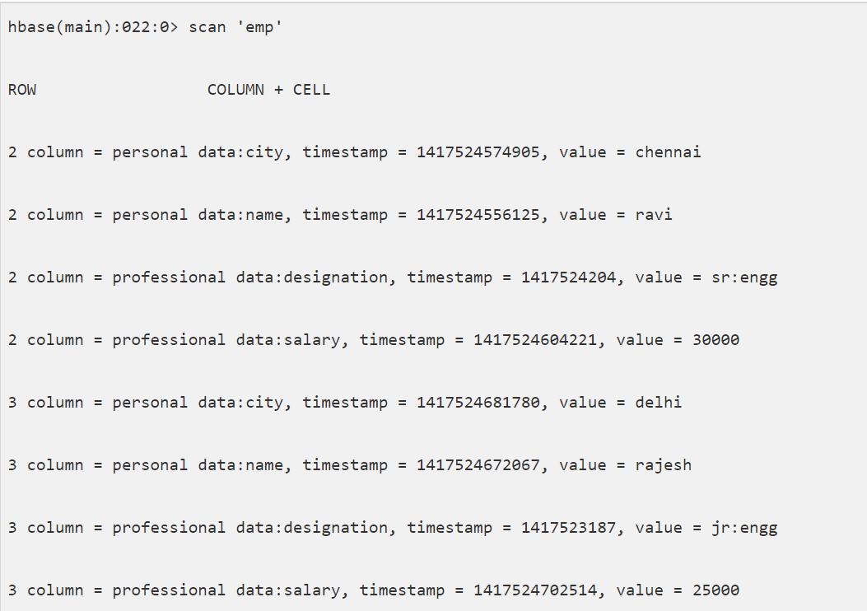
Verify the table using the scan command. A snapshot of the table after deleting the table is given below.

Slide 93
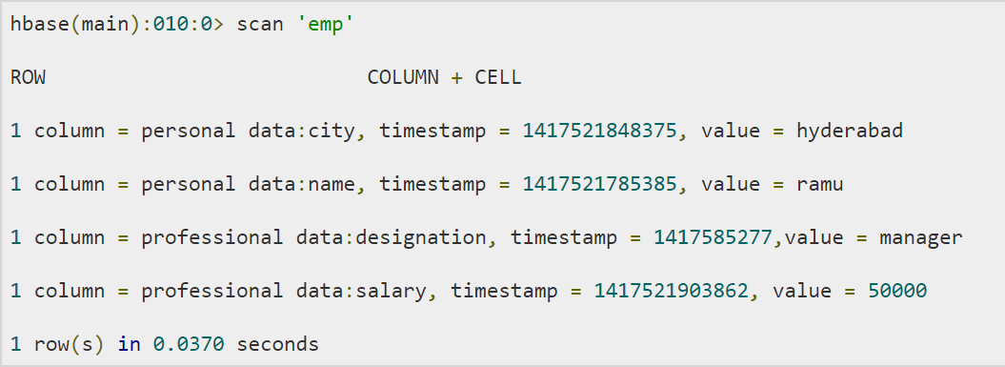
Scanning using HBase Shell
The scan command is used to view the data in HTable. Using the scan command, you can get the table data. Its syntax is as follows:
Example
The following example shows how to use read data from a table using the scan command. Here we are reading the emp table.

Slide 94
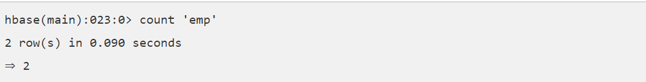
count
You can count the number of rows of a table using the count command. Its syntax is as follows:
After deleting the first row, emp table will have two rows. Verify it as shown below.
truncate
This command disables drops and recreates a table. The syntax of truncate is as follows:

Slide 95
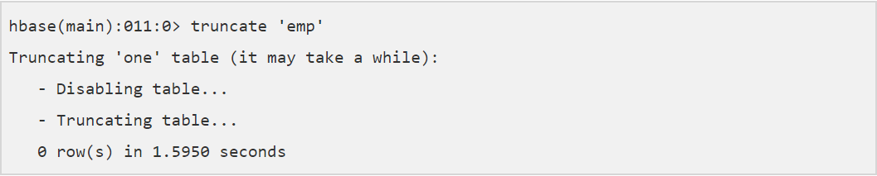

Example
Given below is the example of truncate command. Here we have truncated the emp table.
After truncating the table, use the scan command to verify. You will get a table with zero rows.

Slide 96
SECURITY

Slide 97
We can grant and revoke permissions to users in HBase. There are three commands for security purpose: grant, revoke, and user_permission.
grant
The grant command grants specific rights such as read, write, execute, and admin on a table to a certain user. The syntax of grant command is as follows:
We can grant zero or more privileges to a user from the set of RWXCA, where
R - represents read privilege.
W - represents write privilege.

Slide 98
X - represents execute privilege.
C - represents create privilege.
A - represents admin privilege.
revoke
The revoke command is used to revoke a user's access rights of a table. Its syntax is as follows:

Slide 99
user_permission
This command is used to list all the permissions for a particular table. The syntax of user_permission is as follows:
The following code lists all the user permissions of ‘emp’ table.

