Slide 1
MongoDB: An Example of NoSQL Databases (I)

Slide 2
Outline
Introduction
Installation
Create/Drop a database
Create/Drop a collection (in RDBS, table)
Insert/Delete documents (in RDBS, record)
Query documents
Update documents
Aggregation (including map reduce)

Slide 3
I. Introduction

Slide 4
NoSQL databases
Key-value database: Riak, Redius, Memcached DB
Column-family database: Cassandra, HBase, Hypertable, Amazon SimpleDB
Document database: MongoDB, XML database
Graph database: Neo4J
…

Slide 5
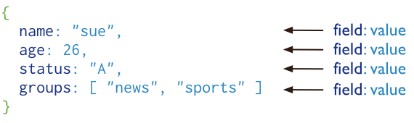
MongoDB
MongoDB is an open-source and cross-platform document database that provides high performance, high availability, and automatic scaling.
MongoDB is written by C++. It supports for multiple storage engines and pluggable storage engine API.
A record in MongoDB is a document, which is a data structure composed of field and value pairs.
The values of fields may include other documents, arrays, and arrays of documents.

Slide 6
Why using document
Documents (i.e. objects) correspond to native data types in many programming languages.
Embedded documents and arrays reduce need for expensive joins.

Slide 7
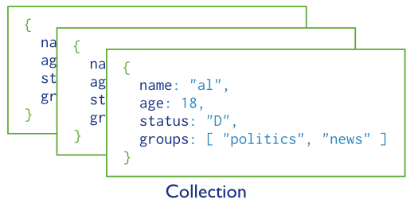
Database and collection
MongoDB stores BSON documents, i.e. data records, in collections.
In MongoDB, databases hold collections of documents.
MongoDB stores documents in collections. Collections are analogous to tables in relational databases.

Slide 8
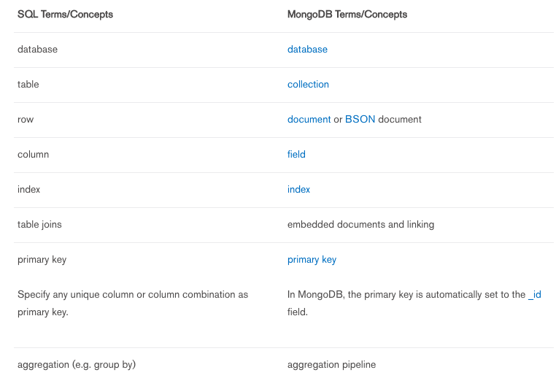
SQL V.S. MongoDB

Slide 9
II. Installation

Slide 10

Installation - Windows
Before installation, you should know:
Starting in version 2.2, MongoDB does not support Windows XP. Please use a more recent version of Windows to use more recent releases of MongoDB.
If you are running any edition of Windows Server 2008 R2 or Windows 7, please install a hotfix to resolve an issue with memory mapped files on Windows
Check your Windows system
Run Command Line in Windows
Type “wmic os get caption” to obtain your version

Slide 11
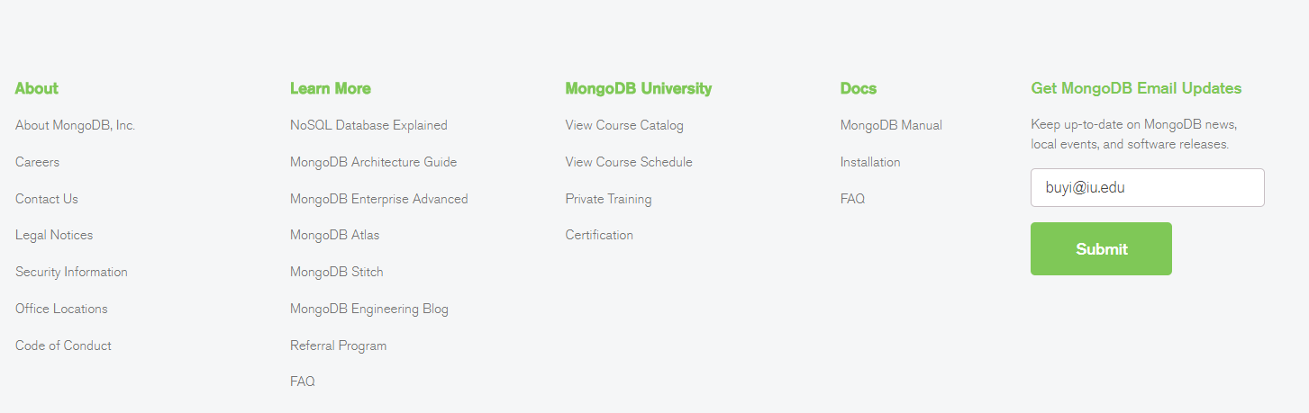
Installation – Windows (cont.)
Go to https://www.mongodb.com/download-center#community/
Go to the bottom of your page, and click “Installation”

Slide 12
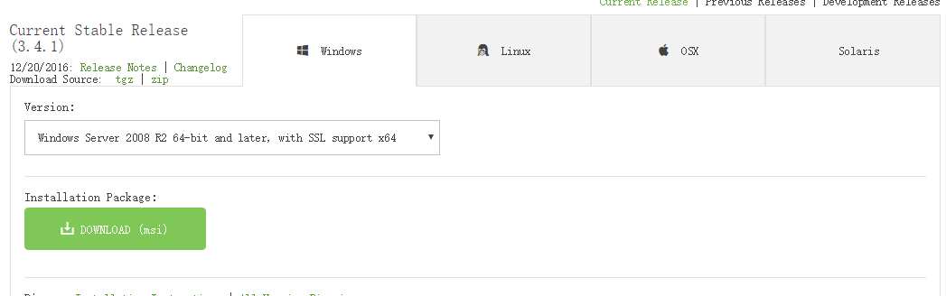
Installation – Windows (cont.)
In your right, click “Download now”
Download MongoDB suitable for your computer
You can download .msi, .tgz., or .zip format file.

Slide 13
Installation – Windows (cont.)
Now extract your downloaded file to c:\ drive or any other locations.
Make sure name of the extracted folder is mongodb-win32-i386-[version] or mongodb-win32-x86_64-[version]. Here [version] is the version of MongoDB download. Click on the file you have just extracted and follow the instruction to install the MongoDB.

Slide 14
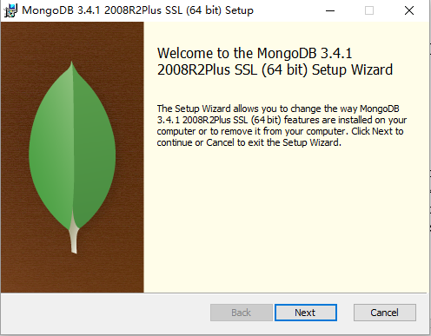
Installation – Windows (cont.)

Slide 15
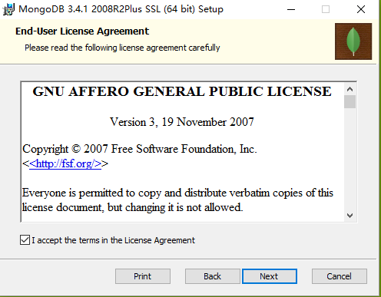
Installation – Windows (cont.)

Slide 16
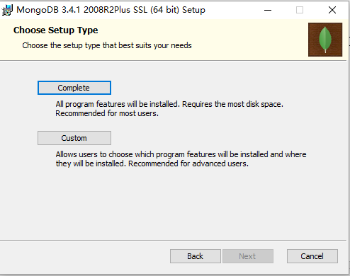
Installation – Windows (cont.)
You can use “Complete”, but I use “Custom” to set up another location for MongoDB.

Slide 17
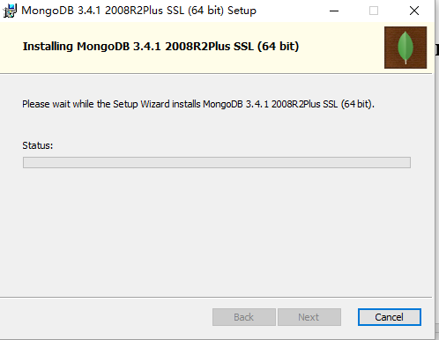
Installation – Windows (cont.)

Slide 18
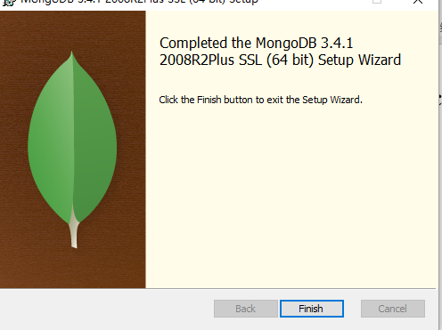
Installation – Windows (cont.)

Slide 19
Installation – Windows (cont.)
Note: By default you have installed MongoDB to C:\Program Files\MongoDB\Server\3.x\
Mine is D:\MongoDB
MongoDB is self-contained and does not have any other system dependencies. You can run MongoDB from any folder you choose. You may install MongoDB in any folder (e.g. D:\test\mongodb).

Slide 20
[Optional] Install MongoDB GUI
MongoDB does not include a GUI-style administrative interface. Instead most administration is done from command line tools such as the mongo shell. However some UI’s are available as separate community projects and are listed below. Some are focused on administration, while some focus on data viewing.
We encourage you all to explore them and try to use them in your group project and future work!
Some examples are: Mongoclient, Mongo-express, adminMongo. See also: https://docs.mongodb.com/ecosystem/tools/administration-interfaces/

Slide 21
[Optional] Install Mongoclient
Webpage: http://www.mongoclient.com/
GitHub: https://github.com/rsercano/mongoclient
Desktop application download page: https://github.com/rsercano/mongoclient/releases/tag/1.2.2 https://github.com/rsercano/mongoclient https://github.com/rsercano/mongoclient/wiki
Browser GUI download page: https://github.com/rsercano/mongoclient/wiki

Slide 22
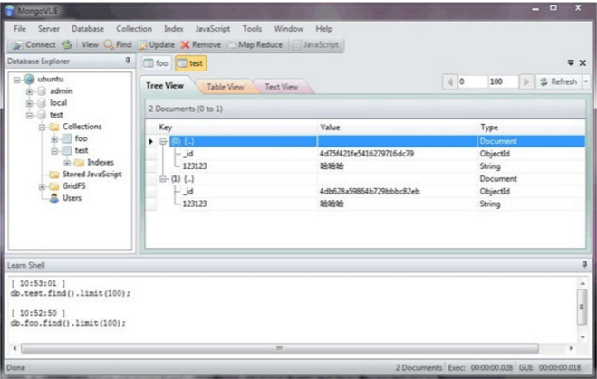
[Optional] Install other MongoDB GUIs
MongoUVE: http://www.mongovue.com/

Slide 23
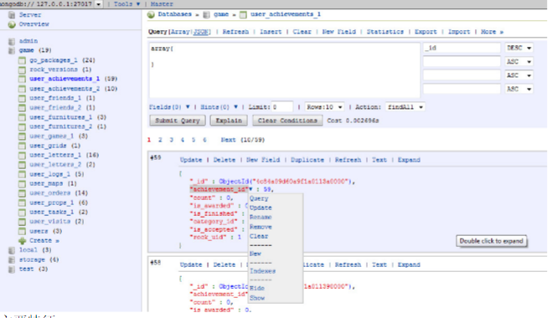
[Optional] Install other MongoDB GUIs (cont.)
RockMongo: http://code.google.com/p/rock-php/
Notes:
Navigate

Slide 24
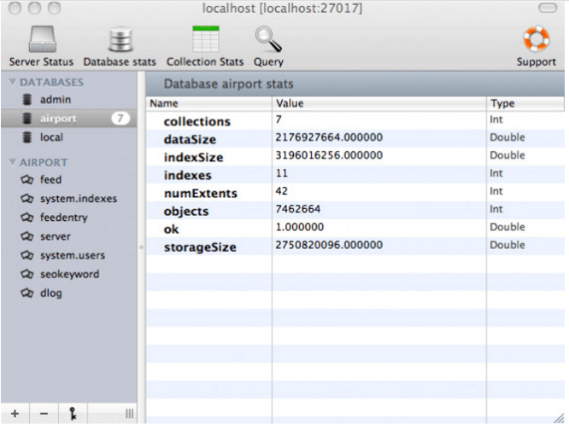
[Optional] Install other MongoDB GUIs (cont.)
For Mac platform, you can use MongoHub: https://github.com/bububa/MongoHub

Slide 25
III. Create/drop a database
Notes:
Collection=table in RDB, document=record in RDB

Slide 26
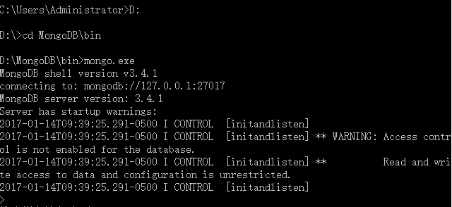
[Always do this first!] Start connection
Open you Command Prompt
Run your mongo.exe file which is in the bin folder under your installed location:

Slide 27
[Optional] If you cannot start connection…
If you fail to start the connection, there might be many reasons. Here we provide one potential solution.
New two folders named “data” and “log” respectively parallel to your “MongoDB” folder.
Delete “mongo.lock” or “mongod.lock” file in “data” folder if there exists one.
New a txt file (mongo.txt) containing these words:
Modify the txt file into a config file (mongo.config)
dbpath=D:\MongoDB\data
logpath=D:\MongoDB\log\mongo.log

Slide 28
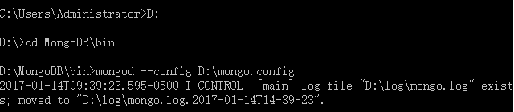
[Optional] If you cannot start connection… (cont.)
Open your cmd, and type these (subjective to the location of your file, make sure your file is under D: if you are the same as my case):
Open another cmd and try to connect the server again (do not shut the first cmd).

Slide 29

Create a database
“use [DBname]” is used to create database. The command will create a new database, if it doesn't exist; otherwise it will return the existing database.
use Employee

Slide 30

Create a database (cont.)
To check your currently selected database use the command “db”.
db

Slide 31
Create a database (cont.)
If you want to check your databases list, then use the command “show dbs”.
Your created database (i.e., “Employee”) will not appear in the list. To display database you need to insert at least one document (one record) into it.

Slide 32

Drop a database
The process of deleting a database is called database drop. MongoDB “db.dropDatabase()” command is used to drop a existing database.
To delete any database, first select it by typing “use [databasename]” then type the drop command. Let’s delete the “Employee” database.

Slide 33
Stop connection
If you want to stop connection, type the followings in your cmd. We always recommend stopping connection instead of force MongoDB directly. Forcing it may cause locked problem.
use admin
db.shutdownServer()
exit

Slide 34
IV. Create/drop a collection
Notes:
Collection=table in RDB, document=record in RDB

Slide 35
Create a collection
MongoDB “db.createCollection(name, options)” is used to create collection.
In the command, name is name of collection to be created. Options is a document and used to specify configuration of collection
Options parameter is optional, so you need to specify only name of the collection. (see some options parameters in the next slide)

Slide 36
Create a collection (cont.)
Field | Type | Description
capped | Boolean | (Optional) If true, enables a capped collection. Capped collection is a fixed size collection that automatically overwrites its oldest entries when it reaches its maximum size. If you specify true, you need to specify size parameter also.
autoIndexID | Boolean | (Optional) If true, automatically create index on _id field.s Default value is false.
size | number | (Optional) Specifies a maximum size in bytes for a capped collection. If capped is true, then you need to specify this field also.
max | number | (Optional) Specifies the maximum number of documents allowed in the capped collection.

Slide 37
An example of the “capped” parameter
https://docs.mongodb.com/manual/core/capped-collections/

Slide 38

Create a collection (cont.)
While inserting the document, MongoDB first checks size field of capped collection, then it checks max field.
use Employee
db.createCollection("EmployeePay")

Slide 39

Create a collection (cont.)
You can check the created collection by using the command show collections:

Slide 40


Drop a collection
Basic syntax of drop() command is as follows: “db.COLLECTION_NAME.drop()”
Do not miss “(” and “)” here!!
Notes:
Do not miss pa’renthesis here!

Slide 41
Data type
String: This is most commonly used datatype to store the data. String in MongoDB must be UTF-8 valid.
Integer: This type is used to store a numerical value. Integer can be 32 bit or 64 bit depending upon your server.
Boolean: This type is used to store a Boolean (true/false) value.
Double: This type is used to store floating point values.
Arrays: This type is used to store arrays or list or multiple values into one key.
Object: This datatype is used for embedded documents.
Notes:
Do not miss () here!

Slide 42
Data type (cont.)
Null: This type is used to store a Null value.
Date: This datatype is used to store the current date or time in UNIX time format. You can specify your own date time by creating object of Date and passing day, month, year into it.
Object ID: This datatype is used to store the document’s ID.
Code: This datatype is used to store JavaScript code into document.
Regular expression: This datatype is used to store regular expression.
Notes:
Do not miss () here!

Slide 43
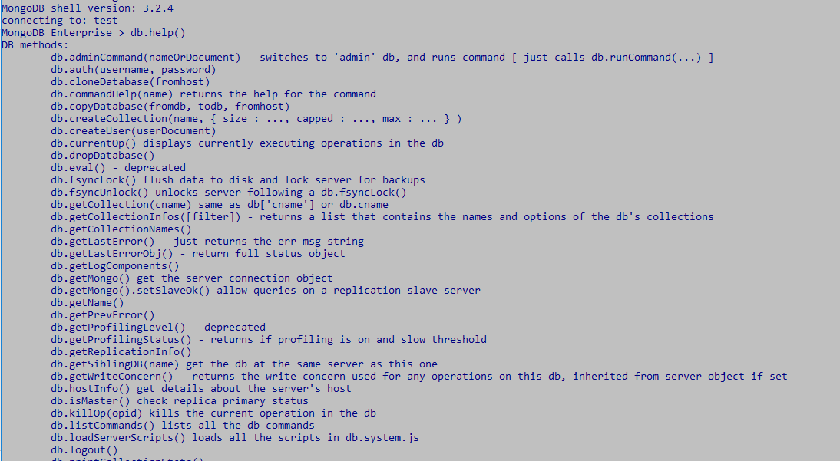
[Optional] MongoDB Help
To get list of commands type db.help() in MongoDB client. This will give you list of commands as follows
Notes:
In the above command db represents the instance of data base to which user has logged in. By default, there is a test data base.

Slide 44
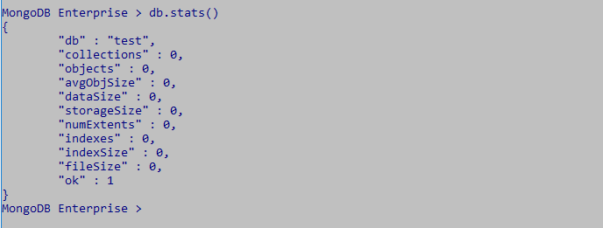
[Optional] MongoDB Statistics
To get stats about MongoDB database/collection type the command db.stats() in MongoDB client. This will show the database name, number of collection, and documents in the database. Output of the command is shown below.

Slide 45
V. Insert/delete documents
Notes:
Document = record (raw)

Slide 46

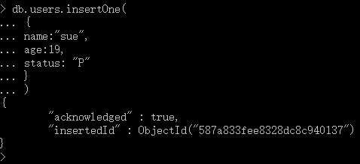
Insert single document
db.createCollection("users")
First, create a new collection for inserting documents in it.
“db.collection.insertOne()” inserts a single document into a collection. The method returns a document with the status of the operation.
db.users.insertOne(
{
name: "sue",
age: 19,
status: "P"
}
)

Slide 47
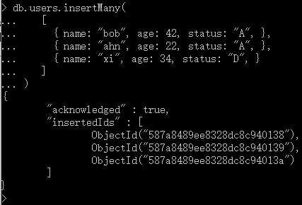
Insert multiple documents
“db.collection.insertMany()” inserts multiple documents into a collection. The method returns a document with the status of the operation.
db.users.insertMany(
[
{ name: "bob", age: 42, status: "A", },
{ name: "ahn", age: 22, status: "A", },
{ name: "xi", age: 34, status: "D", }
]
)

Slide 48
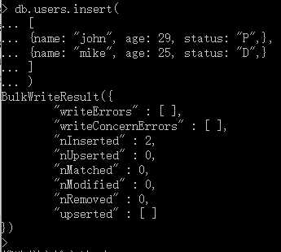
Insert one or more documents
db.users.insert(
[
{ name: "john", age: 29, status: "P", },
{ name: "mike", age: 25, status: "D", }
]
)
“db.collection.insert()” inserts a single document or multiple documents into a collection.
To insert a single document, pass a document to the method; to insert multiple documents, pass an array of documents to the method. The method returns a BulkWriteResult object with the status of the operation.

Slide 49

Delete one document
To delete at most a single document that match a specified filter, even though multiple documents may match the specified filter, use either the “db.collection.deleteOne()” method or the “db.collection.remove()” method with the <justOne> parameter set to true or 1.
The following example aims to delete the first document where status is "D".
db.users.deleteOne( { status: "D" } )
Notes:
deletion criteria: (Optional) deletion criteria according to which documents will be removed.
justOne : (Optional) if set to true or 1, then remove only one document.

Slide 50

Delete one document (cont.)
Alternatively, the following example uses the db.collection.remove() with the <justOne> parameter set to 1 to delete the first document where status is “D”.
db.users.remove( { status: "D" }, 1)
Notes:
deletion criteria: (Optional) deletion criteria according to which documents will be removed.
justOne : (Optional) if set to true or 1, then remove only one document.

Slide 51

Delete all documents that match one condition
To delete all documents that match a deletion criterion, pass a filter parameter to either “db.collection.deleteMany()” method or the “db.collection.remove()” method.
The following example uses “db.collection.deleteMany()” to remove all documents from the users collection where the status field equals “A":
db.users.deleteMany({ status : "A" })

Slide 52

Delete all documents that match one condition (cont.)
Alternatively, the following example uses “db.collection.remove()” to remove all documents from the users collection where the status field equals "P":
db.users.remove( { status : "P" } )

Slide 53
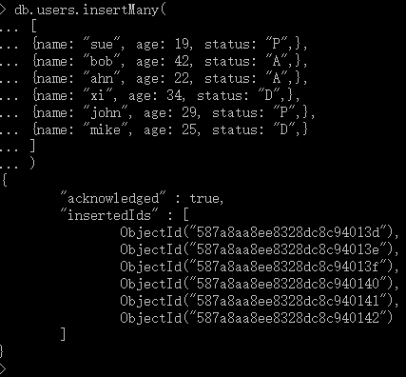
To prepare for the next section, we insert all of the records we have deleted (if there are some errors when you directly copy and paste it to MongoDB, try type them manually:
db.users.insertMany(
[
{ name: "sue", age: 19, status: “P", },
{ name: "bob", age: 42, status: "A", },
{ name: "ahn", age: 22, status: "A", },
{ name: "xi", age: 34, status: "D", },
{ name: "john", age: 29, status: “P", },
{ name: "mike", age: 25, status: “D", }
]
)

