Slide 1
MongoDB V: H1B Dataset (with Command Line)

Slide 2
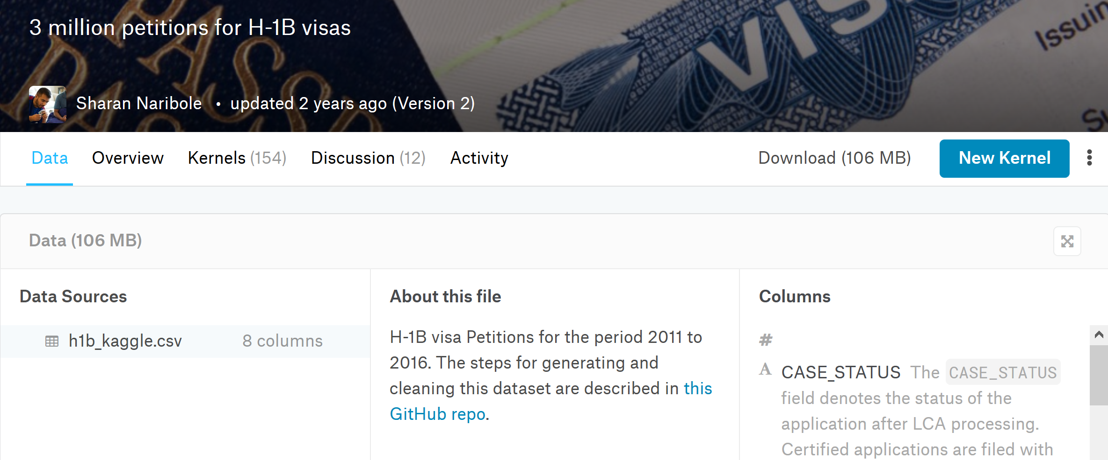
Kaggle H1B dataset
https://www.kaggle.com/nsharan/h-1b-visa

Slide 3
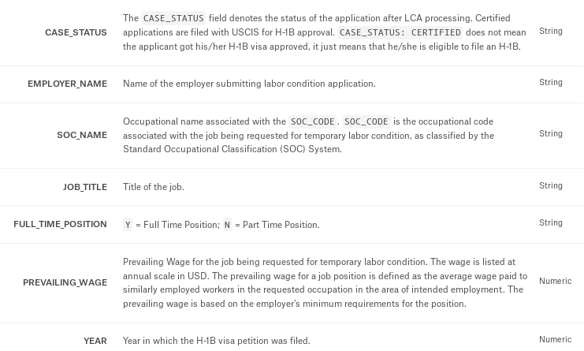

Slide 4
Importing Dataset Into MongoDb
Create “test” database and “h1b” collection
Queries for above:
Use test
db.createCollection("h1b")
Run below query to import dataset from your shell prompt
mongoimport -d test -c h1b --type csv --drop --file h1b_kaggle.csv --headerline

Slide 5
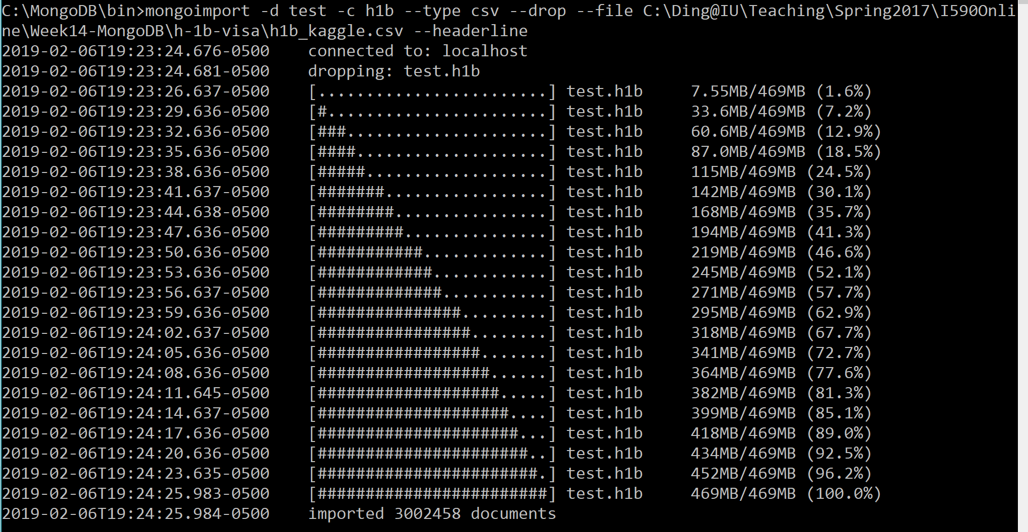
Importing Dataset Into MongoDb

Slide 6
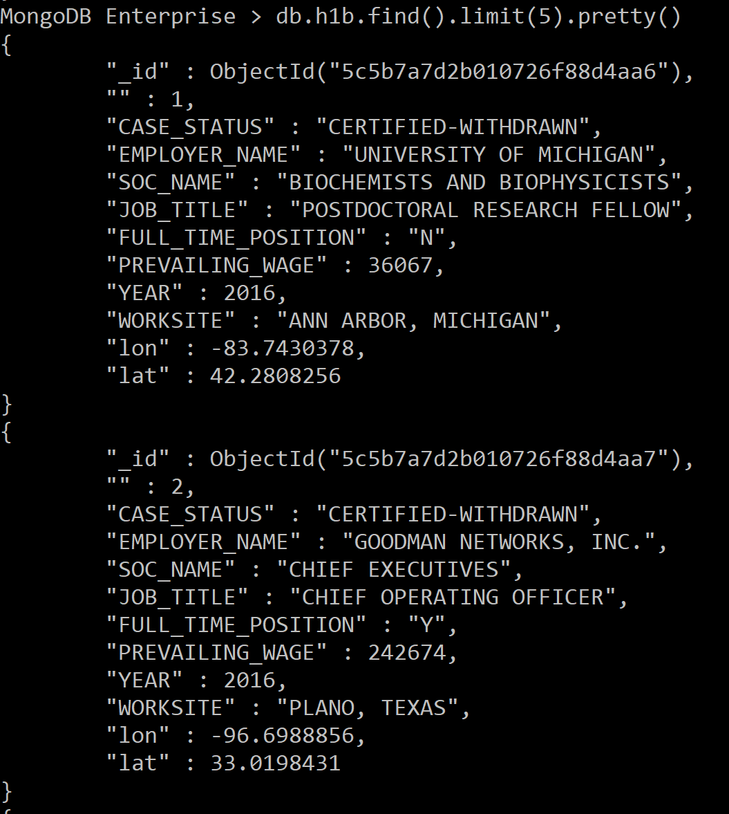
H1B Data

Slide 7
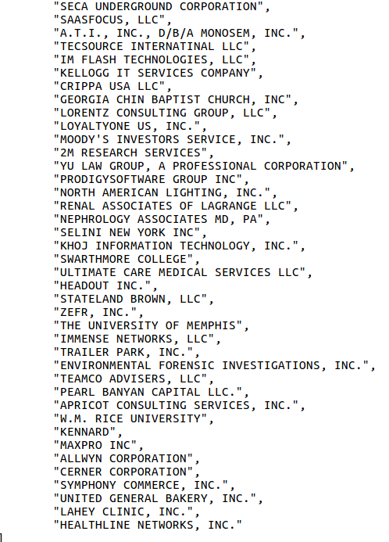
Distinct Companies who file H1b
db.h1b.distinct(‘EMPLOYER_NAME’)

Slide 8
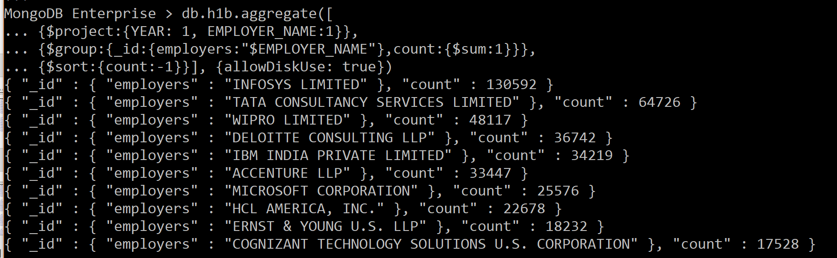
Which companies are filing H1B
db.h1b.aggregate([
{$project:{YEAR: 1, EMPLOYER_NAME:1}},
{$group:{_id:{employers:"$EMPLOYER_NAME"},count:{$sum:1}}},
{$sort:{count:-1}}], {allowDiskUse: true})

Slide 9
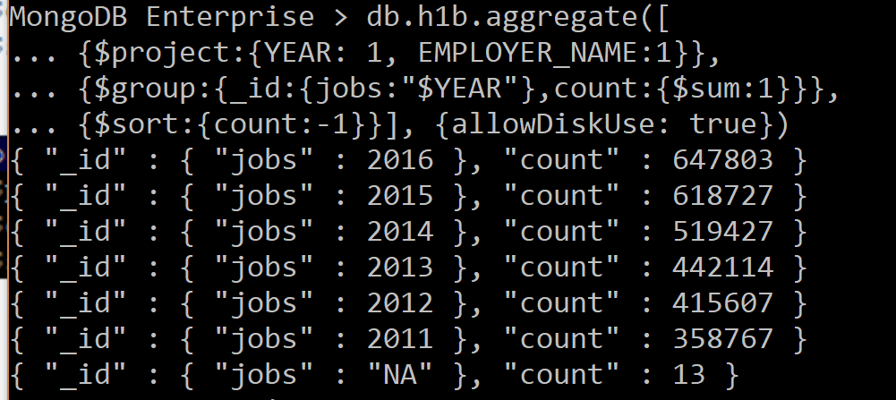
Each year how many H1B filing
db.h1b.aggregate([
{$project:{YEAR: 1, EMPLOYER_NAME:1}},
{$group:{_id:{jobs:"$YEAR"},count:{$sum:1}}},
{$sort:{count:-1}}], {allowDiskUse: true})

Slide 10
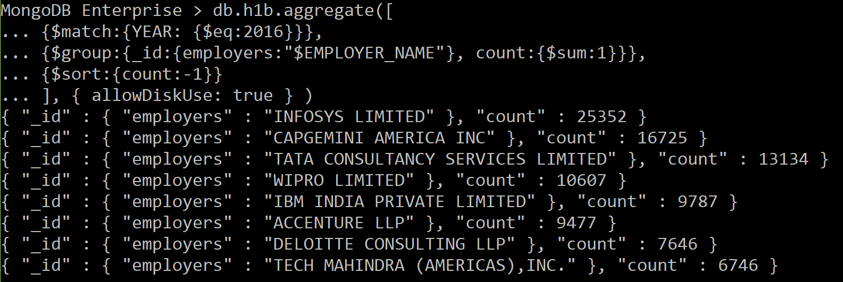
Which companies are filing H1B in 2016
db.h1b.aggregate([
{$match:{YEAR: {$eq:2016}}},
{$group:{_id:{employers:"$EMPLOYER_NAME"}, count:{$sum:1}}},
{$sort:{count:-1}}], { allowDiskUse: true } )

Slide 11
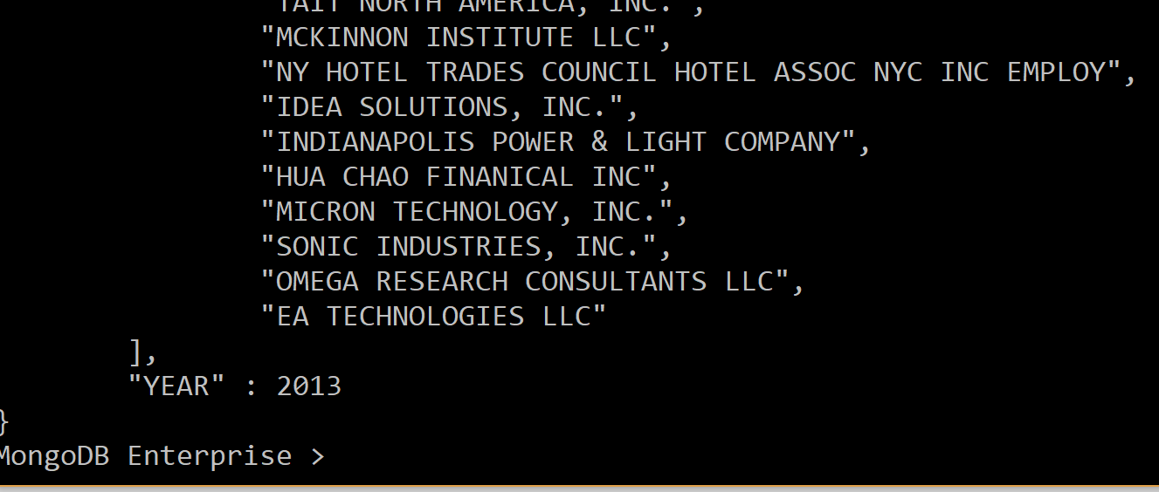
Distinct Companies filing H1B per year
db.h1b.aggregate([
{$project:{YEAR: 1, EMPLOYER_NAME:1}},
{$group:{_id:"$YEAR", EMPLOYER_NAME: { $addToSet : "$EMPLOYER_NAME" }}},
{$project:{_id: 0, YEAR: "$_id", EMPLOYER_NAME: 1}},
{$limit:1}], { allowDiskUse: true } ).pretty()

Slide 12
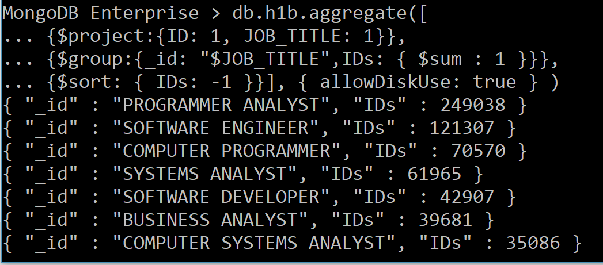
Filing H1B for what kinds of jobs
db.h1b.aggregate([
{$project:{ID: 1, JOB_TITLE: 1}},
{$group:{_id: "$JOB_TITLE",IDs: { $sum : 1 }}},
{$sort: { IDs: -1 }}], { allowDiskUse: true } )

Slide 13
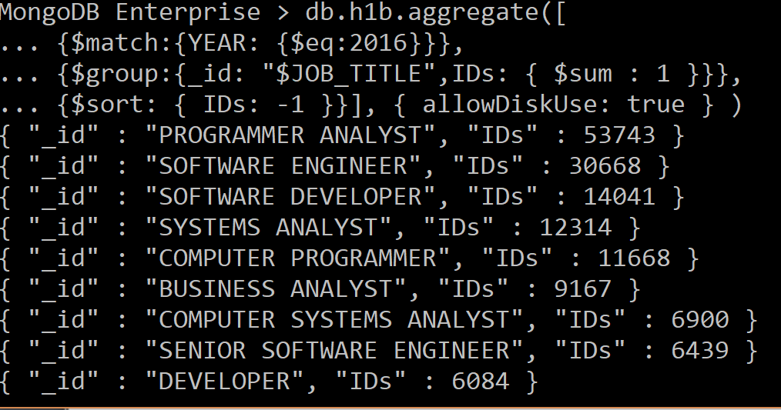
Jobs in 2016 filing for H1B
db.h1b.aggregate([
{$match:{YEAR: {$eq:2016}}},
{$group:{_id: "$JOB_TITLE",IDs: { $sum : 1 }}},
{$sort: { IDs: -1 }}], { allowDiskUse: true } )

Slide 14
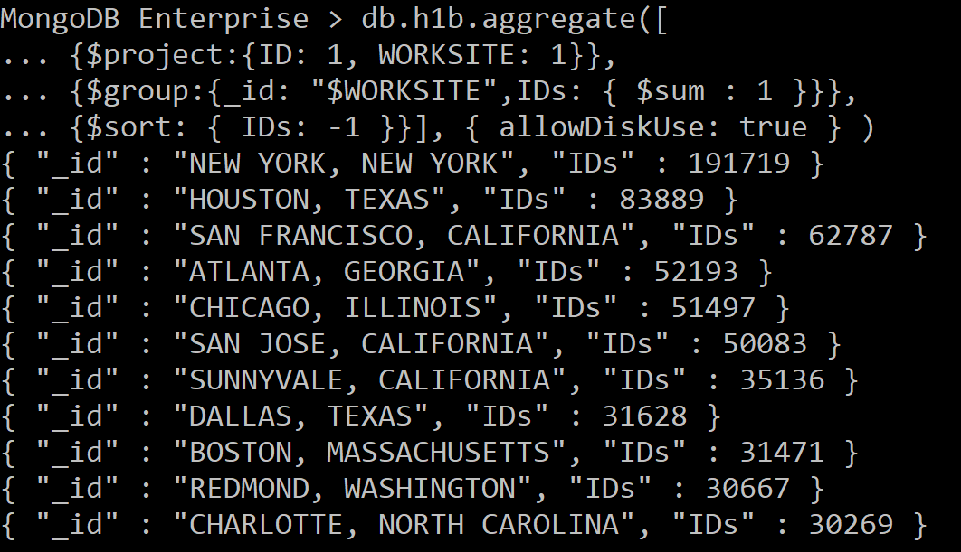
Which cities have the most H1B filings
db.h1b.aggregate([
{$project:{ID: 1, WORKSITE: 1}},
{$group:{_id: "$WORKSITE",IDs: { $sum : 1 }}},
{$sort: { IDs: -1 }}], { allowDiskUse: true } )

Slide 15
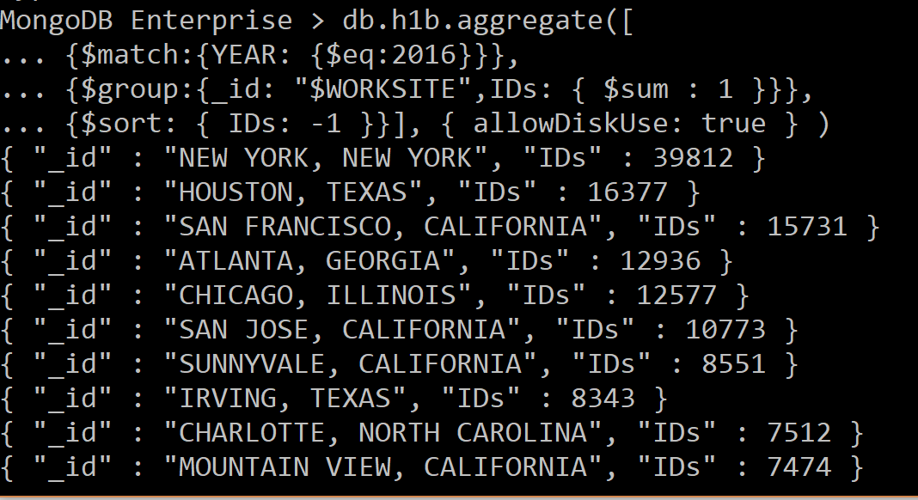
Which cities have the most H1B filings in 2016
db.h1b.aggregate([
{$match:{YEAR: {$eq:2016}}},
{$group:{_id: "$WORKSITE",IDs: { $sum : 1 }}},
{$sort: { IDs: -1 }}], { allowDiskUse: true } )

Slide 16
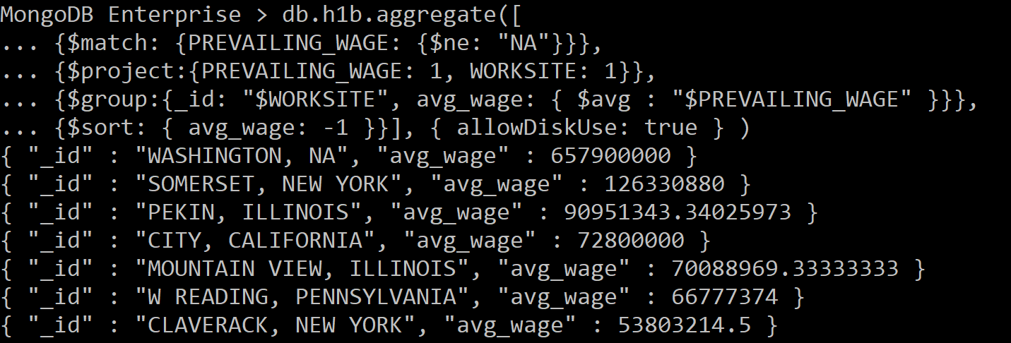
Average wage of H1B jobs, weird
db.h1b.aggregate([
{$match: {PREVAILING_WAGE: {$ne: "NA"}}},
{$project:{PREVAILING_WAGE: 1, WORKSITE: 1}},
{$group:{_id: "$WORKSITE", avg_wage: { $avg : "$PREVAILING_WAGE" }}},
{$sort: { avg_wage: -1 }}], { allowDiskUse: true } )

Slide 17
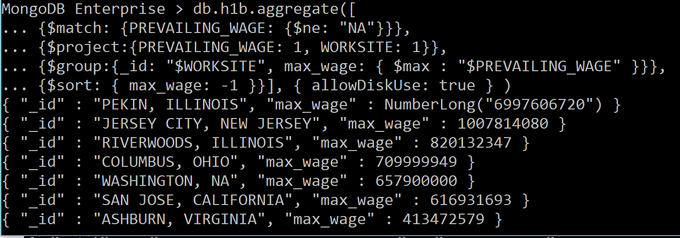
Max wage of H1B jobs, weird
db.h1b.aggregate([
{$match: {PREVAILING_WAGE: {$ne: "NA"}}},
{$project:{PREVAILING_WAGE: 1, WORKSITE: 1}},
{$group:{_id: "$WORKSITE", max_wage: { $max : "$PREVAILING_WAGE" }}},
{$sort: { max_wage: -1 }}], { allowDiskUse: true } )

Slide 18
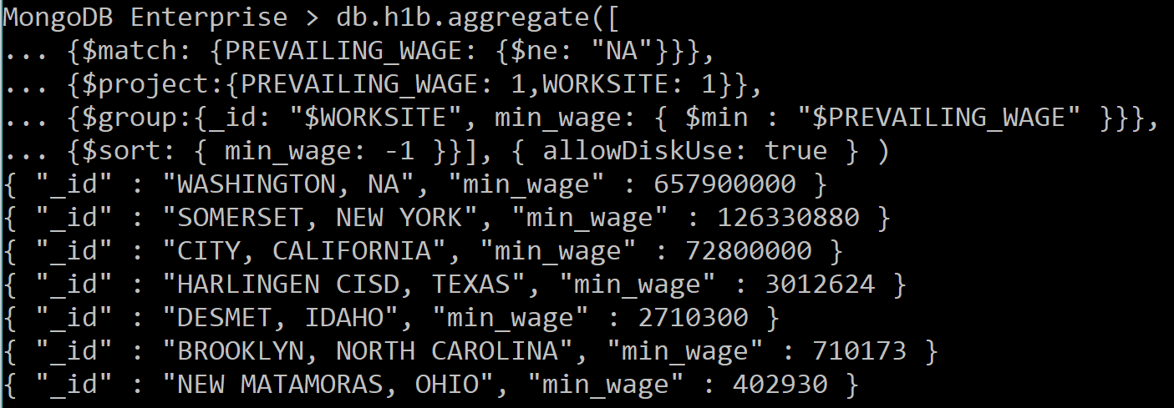
Min wage of H1B jobs, weird
db.h1b.aggregate([
{$match: {PREVAILING_WAGE: {$ne: "NA"}}},
{$project:{PREVAILING_WAGE: 1, WORKSITE: 1}},
{$group:{_id: "$WORKSITE", min_wage: { $min : "$PREVAILING_WAGE" }}},
{$sort: { min_wage: -1 }}], { allowDiskUse: true } )

Slide 19
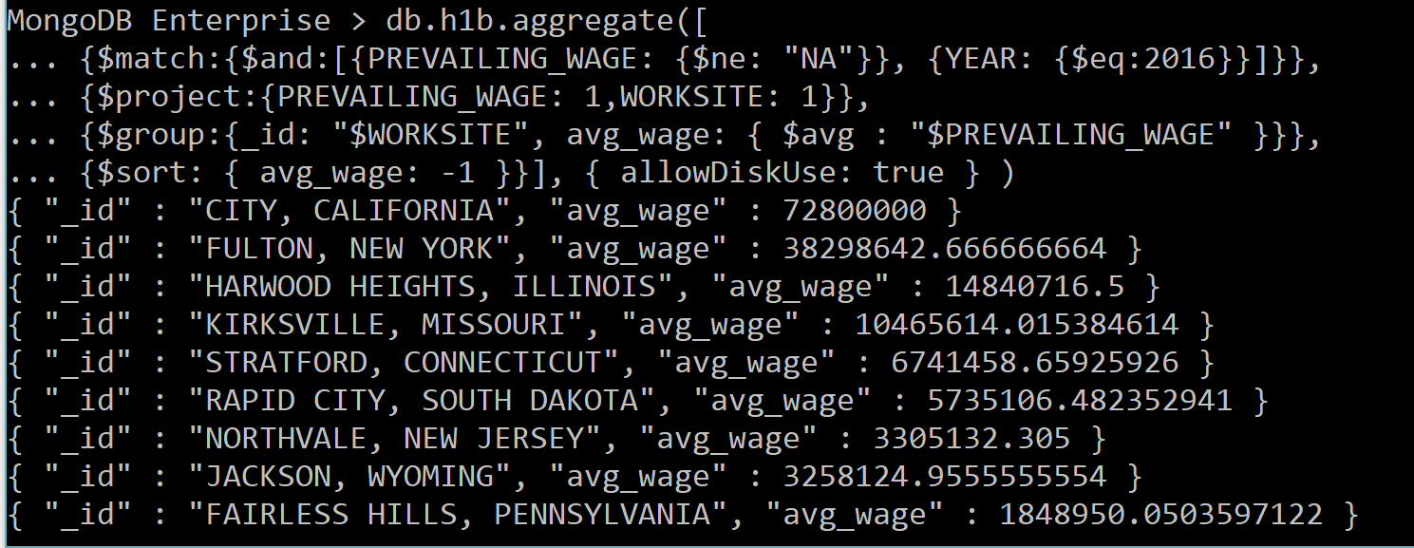
avg wage of H1B jobs in 2016, weird
db.h1b.aggregate([
{$match:{$and:[{PREVAILING_WAGE: {$ne: "NA"}}, {YEAR: {$eq:2016}}]}},
{$project:{PREVAILING_WAGE: 1, WORKSITE: 1}},
{$group:{_id: "$WORKSITE", avg_wage: { $avg : "$PREVAILING_WAGE" }}},
{$sort: { avg_wage: -1 }}], { allowDiskUse: true } )

Slide 20
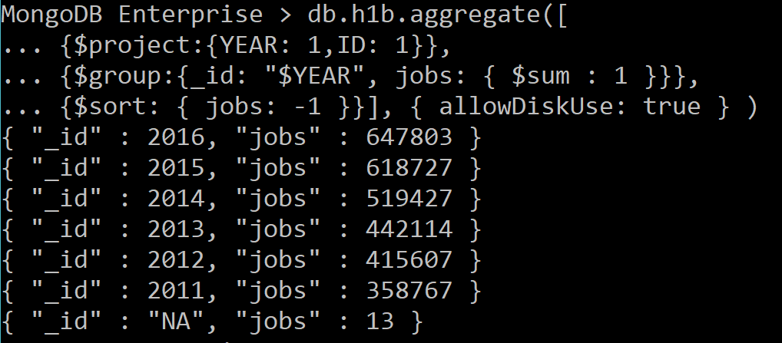
# H1B jobs
db.h1b.aggregate([
{$project:{YEAR: 1,ID: 1}},
{$group:{_id: "$YEAR", jobs: { $sum : 1 }}},
{$sort: { jobs: -1 }}], { allowDiskUse: true } )

Slide 21
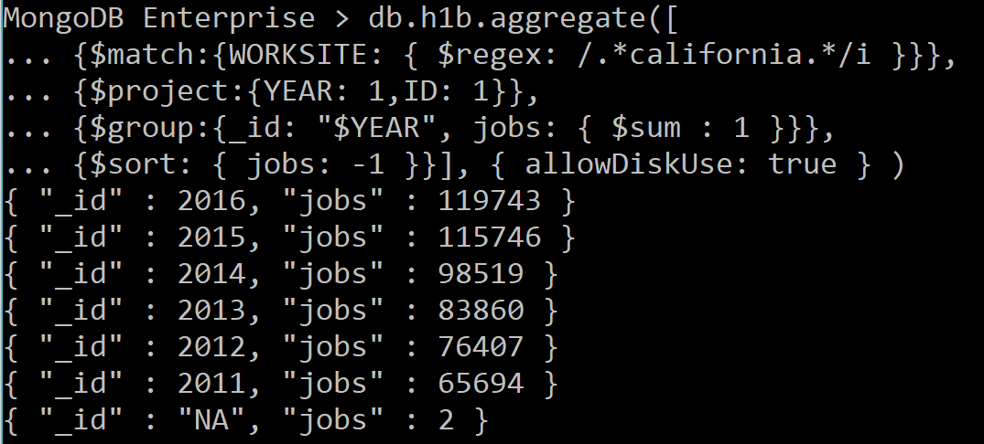
# H1B jobs in California
db.h1b.aggregate([
{$match:{WORKSITE: { $regex: /.*california.*/i }}},
{$project:{YEAR: 1,ID: 1}},
{$group:{_id: "$YEAR", jobs: { $sum : 1 }}},
{$sort: { jobs: -1 }}], { allowDiskUse: true } )

Slide 22
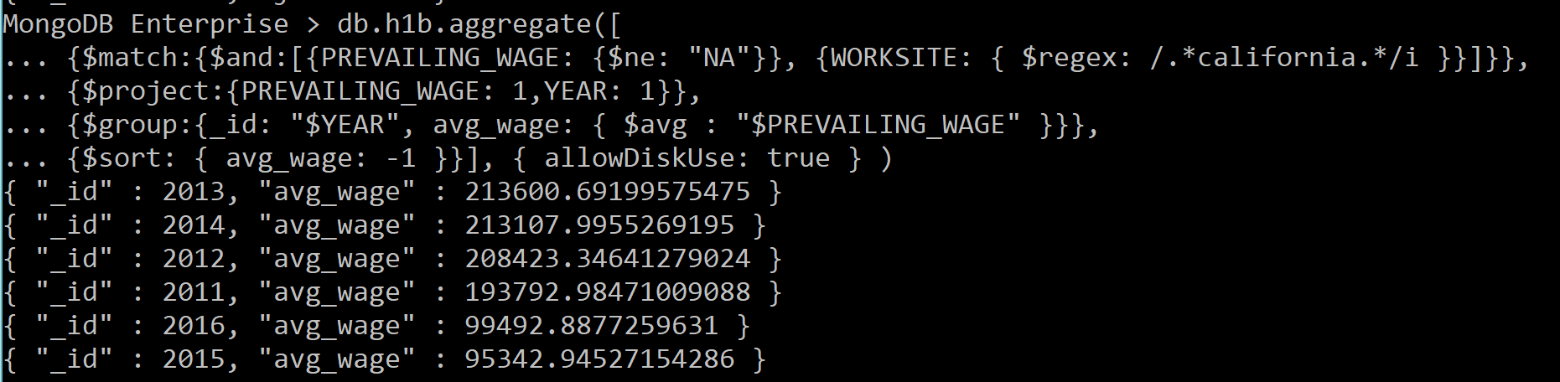
# average wage of H1B jobs in California
db.h1b.aggregate([
{$match:{$and:[{PREVAILING_WAGE: {$ne: "NA"}}, {WORKSITE: { $regex: /.*california.*/i }}]}},
{$project:{PREVAILING_WAGE: 1, YEAR: 1}},
{$group:{_id: "$YEAR", avg_wage: { $avg : "$PREVAILING_WAGE" }}},
{$sort: { avg_wage: -1 }}], { allowDiskUse: true } )

Slide 23
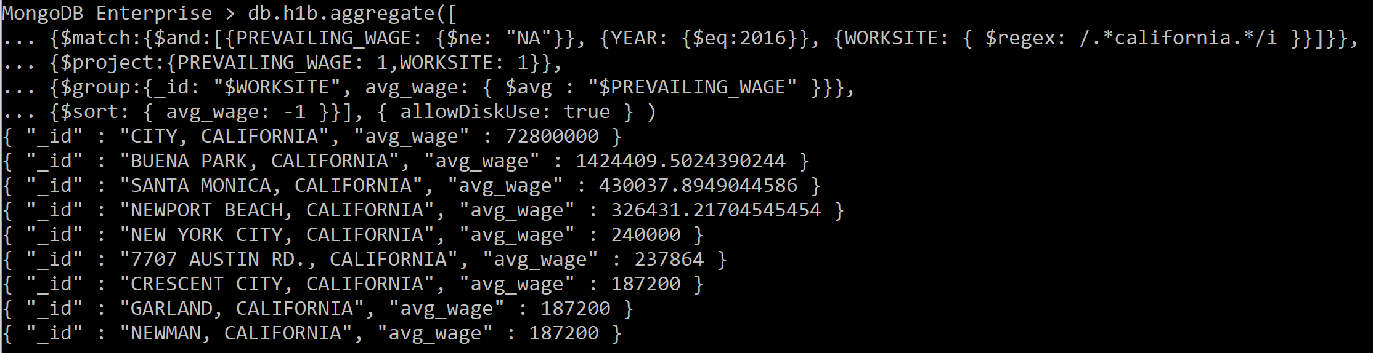
# average wage of H1B jobs in 2016 in California
db.h1b.aggregate([
{$match:{$and:[{PREVAILING_WAGE: {$ne: "NA"}}, {YEAR: {$eq:2016}}, {WORKSITE: { $regex: /.*california.*/i }}]}},
{$project:{PREVAILING_WAGE: 1, WORKSITE: 1}},
{$group:{_id: "$WORKSITE", avg_wage: { $avg : "$PREVAILING_WAGE" }}},
{$sort: { avg_wage: -1 }}], { allowDiskUse: true } )

Slide 24
THANK YOU

