Slide 1


Slide 2
Course Outline
Introduction
Companies using Redis
Installation (Windows & MacOS)
Configuration
Databases in Redis
Redis Keys
Redis Data Structures
Publication and Subscriptions
Redis Transactions
Using Redis Desktop Manager
Redis with Python

Slide 3
Introduction

Slide 4
What is Redis?
REmote DIctionary Server (Redis) is an open-source in-memory NoSQL database project implementing a distributed, in-memory key-value store with optional durability.
The project is mainly developed by Salvatore Sanfilippo and is currently sponsored by Redis Labs.
Mainly rely on main memory to store data
In-memory database V.S. disk storage database
Applications where response time is critical (running telecommunications network equipment, mobile advertising networks

Slide 5
Features
Exceptionally Fast Read/Write:
Around 100,000 Operations per second take
place in memory.
Durable and Scalable:
Uses Master Slave Replication to create multiple instances.
Creating Redis instances is relatively cheap in terms of memory and CPU requirements but depends totally upon the memory available.
Direct data access:
No intermediate data structures required before data storage like JSON in MongoDB or Database Schema in any SQL database.
Allows Algorithmic interaction with your data.

Slide 6
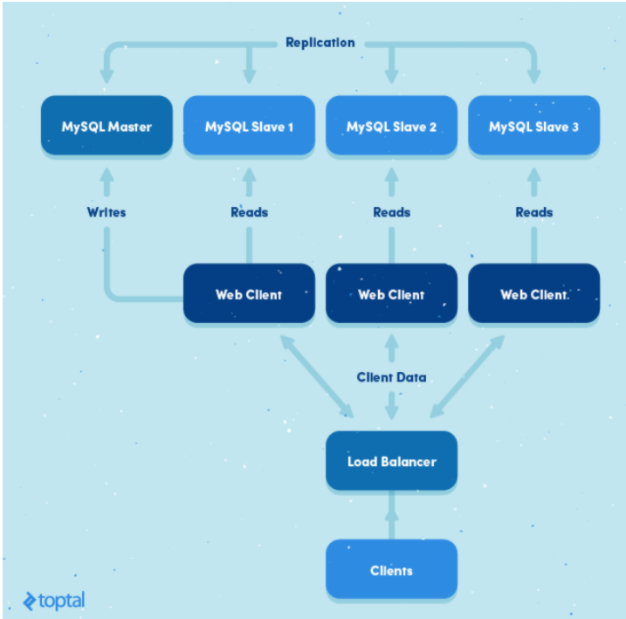

Slide 7
Redis vs other SQL/NoSQL DBs
Benchmarked as the fastest database in the world.
Used in case high performance is priority.
Is commonly used in conjunction with other SQL / NoSQL databases in most companies rather than standalone .
Can be utilized if the database has a stable or predictable size.
Best suited for applications that require real time data.

Slide 8
Companies using Redis

Slide 9
Redis at StackOverflow
At StackOverflow Redis is used as a caching layer for entire network.
It has 3 caches at each site and two of them use Redis.
A Site cache which stores hot question id list and user acceptance rates in a distinct Redis DB.
A Global cache which stores inboxes, API usage quotas etc in DB0.
At any one point time there are around 1,300,000 keys in their Redis cache and this number is increasing.
Go to this link for more details.

Slide 10
Redis at Flickr
Currently events are happening all over Flickr, uploads and updates (around 100/s depending on the time of day), all of them being inserting tasks, and the task system grabbing each event and adding it to a queue, in the form of a Redis list.
Redis sets are used to manage the updates and figure out mapping of users (the contacts who upload photos) to endpoints (i.e. subscribers).
Go to this link for more details

Slide 11
Some more Companies using Redis
Twitter
Github
Snapchat
Pinterest
Craigslist
Airbnb
For more details go to this link.
Source: https://redis.io/topics/whos-using-redis

Slide 12
Installation

Slide 13
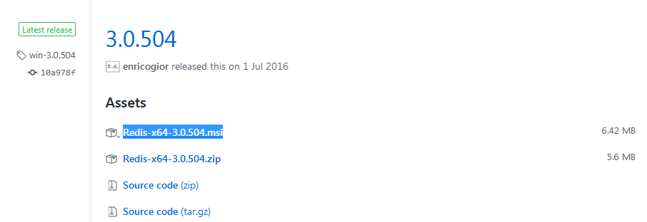
For Windows
Open your web browser and Go to https://github.com/MicrosoftArchive/redis/releases
Go to 3.0.504 and select Redis-x64-3.0.504.msi as show in figure.

Slide 14
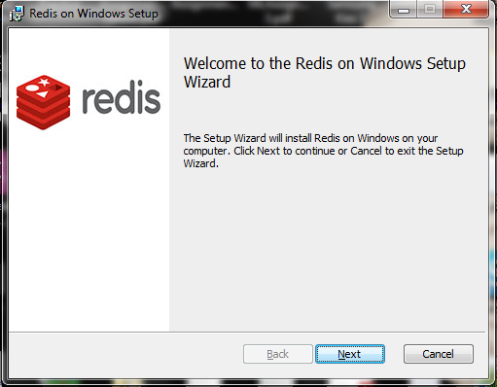
Contd.
Open the downloaded file Redis-x64-3.0.504.msi .
Click on Next.

Slide 15
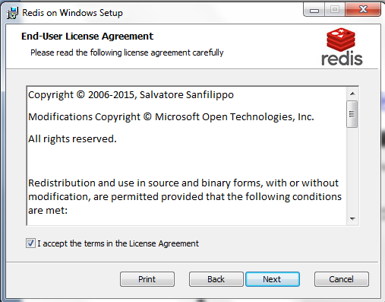
Contd.
Select the checkbox I accept and click on Next.

Slide 16
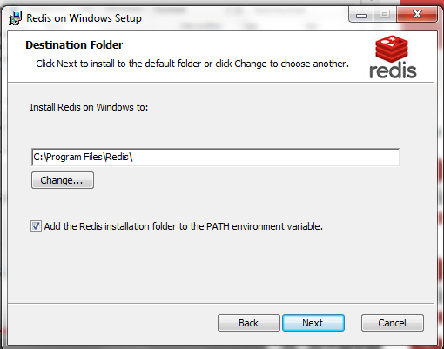
Contd.
Set path where you want to install Redis.
Select checkbox to set PATH environment variable and click Next.

Slide 17
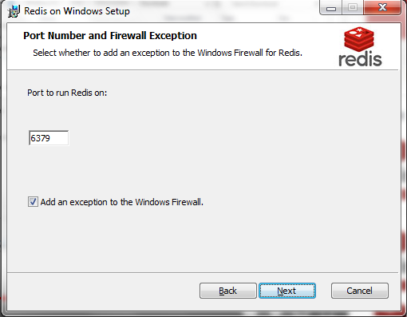
Contd.
Select port number you want to use and click Next.

Slide 18
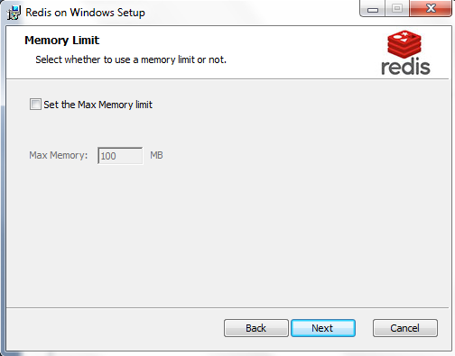
Contd.
Set the memory limit as per your requirement. I will keep it default here and click on Next.

Slide 19
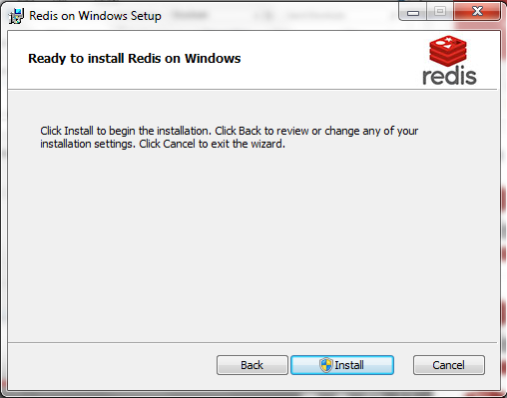
Contd.
Click Install button. Redis will be installed on your machine.

Slide 20
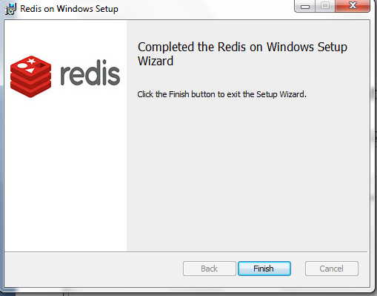
Contd.
Click on Finish to finish with the installation.

Slide 21
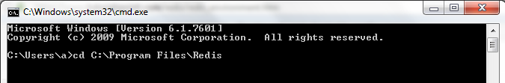
Is Redis Working?
Open command line on your PC.
Go to the folder where Redis is saved using the following command.
E.g.
Type redis-cli.exe . This will open Redis prompt as shown below:

Slide 22
Contd.
Type ping in the Redis prompt. If you get the response PONG as shown below Redis has been successfully installed.

Slide 23
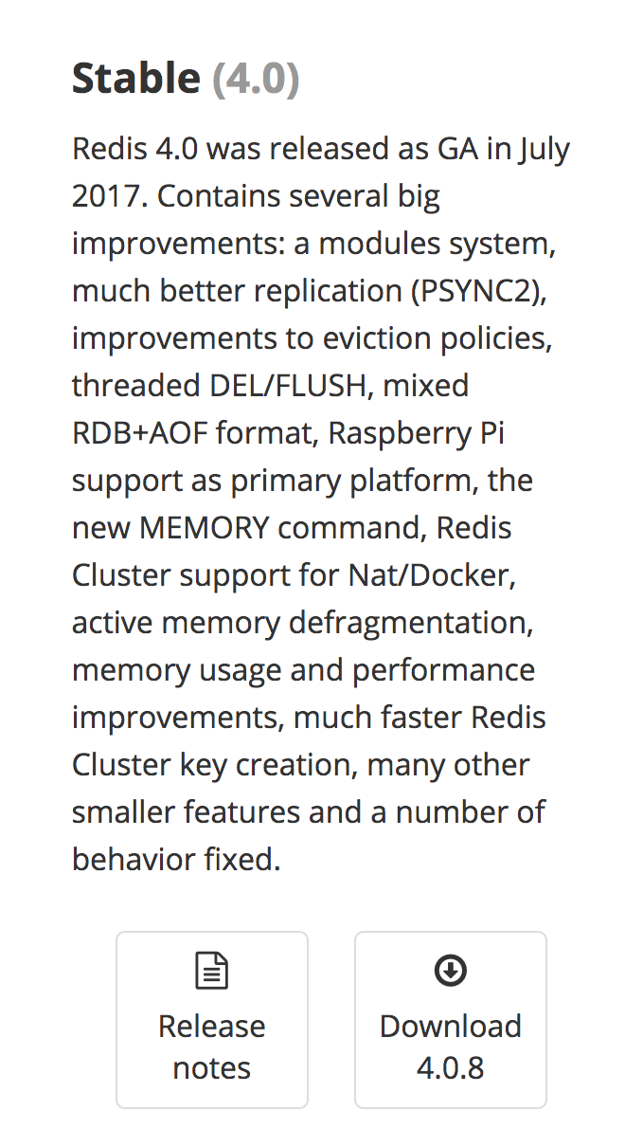
For Mac OS
Go to https://redis.io/download and select download button under the Stable heading as shown below:
The Redis setup files will get downloaded to your machine.

Slide 24
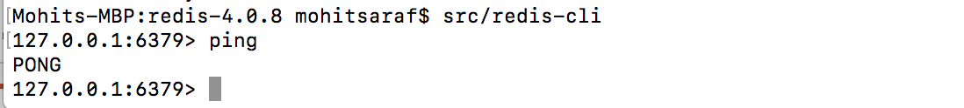
Contd.
Open Terminal on your machine.
Now extract and compile Redis using the following command:
All the compiled binaries are available in src directory.
Now start Redis server using the following command:
Once the server starts open Redis client using the following command:
Once the Redis client starts type ping and if you get PONG as response Redis is ready to use on your machine now.

Slide 25
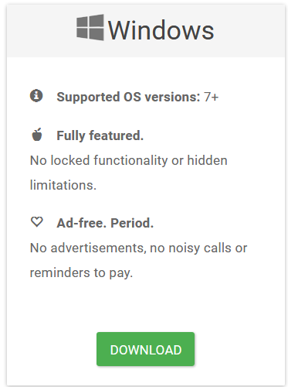
Redis Desktop Manager(Optional)
Interactive UI for managing Redis Databases.
Go to https://redisdesktop.com/download in your browser and download the Windows version.

Slide 26
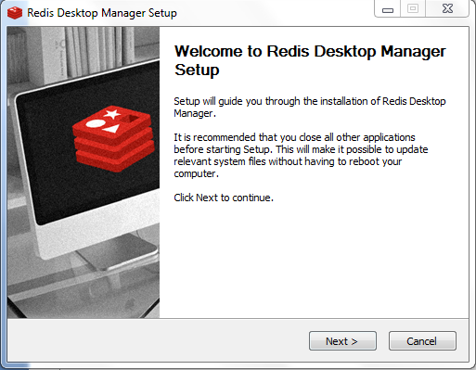
Contd.
Open the downloaded file and click on Next.

Slide 27
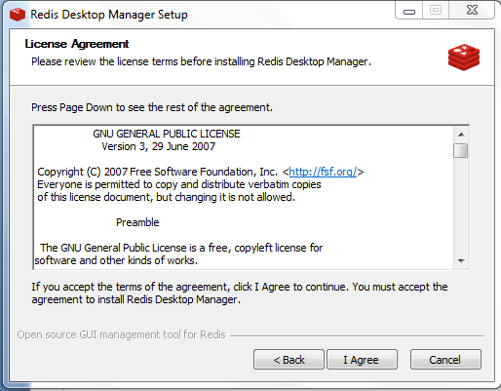
Contd.
Click on I Agree button.

Slide 28
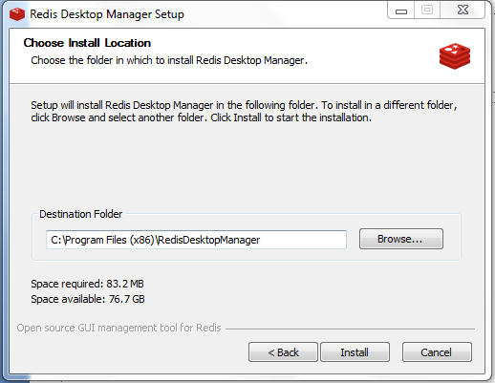
Contd.
Click on Install.

Slide 29
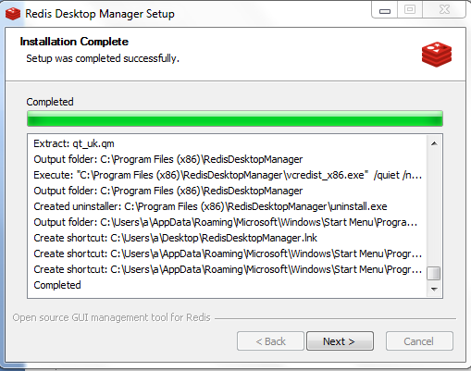
Contd.
Click on Next.

Slide 30
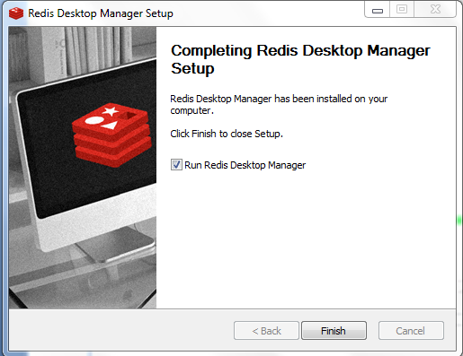
Contd.
Click on Finish.
The Redis Desktop manager will be launched.

Slide 31
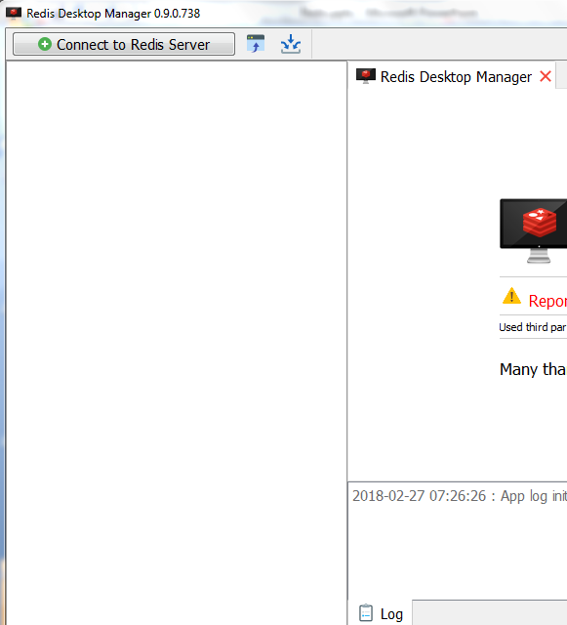
Is the GUI Client working?
Once the GUI client is open click on Connect to Redis Server button.

Slide 32
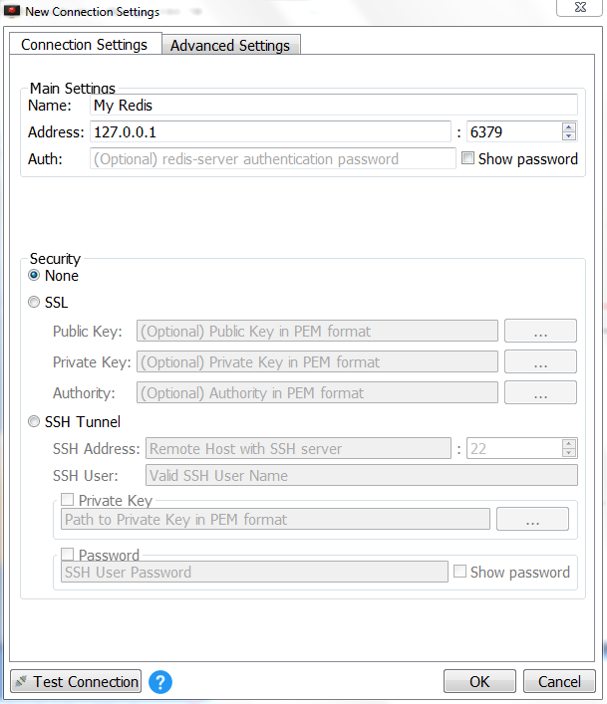
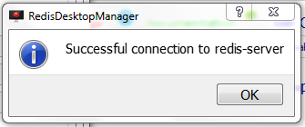
Contd.
Enter Connection name as per your choice in Name field and click on Test Connection.

Slide 33
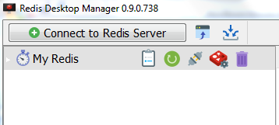
Contd.
Click on Ok on the popup once it shows connection to Server is successful.
Then click on Ok button in the New connections window shown in the previous slide and new connection My Redis has been created as shown below.
Your GUI client is successfully working and ready to use.

Slide 34
Databases in Redis

Slide 35
Selecting a Database
In Redis, databases are identified by an integer index, not by a database name.
By default, a client is connected to database 0.
With the SELECT command you can switch to a different database.
Syntax: Select index
E.g.
All subsequent commands will now use database 3, until another Select is executed.

Slide 36

Contd.
The number of databases available can be configured in redis.conf.
By default, it is set to 16. We can check using the following command:
Syntax: Config get databases
E.g.
If you want to create more databases more than 16, refer to here: https://groups.google.com/forum/#!topic/redis-db/u1IgtiWN0Ww

Slide 37
Dropping a Database
We can drop the current database using the following command:
Syntax: FLUSHDB
E.g.
We can drop all the databases at once using the following command:
Syntax: FLUSHALL
E.g.

Slide 38
Redis Keys

Slide 39
Keys
In Redis everything is stored in form of Key-Value pairs.
There are various commands available in Redis for manipulating these keys.
Syntax: Command Key_Name
Most commonly used commands in Redis are SET and GET used for setting and retrieving the value of Key.

Slide 40
Different Redis Key commands
SET : Sets the value of Key.
Syntax: SET Key Value
E.g.
GET: Gets the value of Key.
Syntax: GET Key
E.g.

Slide 41


Contd.
DEL: This deletes the key if it exists.
Syntax: DEL key
E.g.
Expire: Expires the key after specified time in seconds.
Syntax: Expire key time
E.g.

Slide 42

Contd.
Move: Moves key from current database to other. It returns 1 if key is moved else 0.
Syntax: Move key db
E.g. In this we move key to database 2.

Slide 43


Contd.
Rename: This renames key to a new key.
Syntax: Rename key newkey
E.g.
Type: Returns data type of the value associated with the key.
Syntax: Type key
E.g.

Slide 44


Contd.
Pattern: Search keys based on patterns.
Syntax: Keys Pattern
E.g.
Exists: Checks if key exists or not. Returns 0 if not present and 1 if present.
Syntax: Exists key
E.g.
Notes:
Regular expression

Slide 45
Redis Data Structures

Slide 46
Data Structures
There are five types of Data Structures available in Redis:
Strings
Hashes
Lists
Sets
SortedSets

Slide 47
Strings
Most basic data structure in Redis
Similar to strings in other languages and key-value stores.
We can perform a number of operations on string values in Redis.

Slide 48


String Commands
GetRange: Returns substring of a string stored at a key.
Syntax: GetRange key start end
E.g.
GetSet: Returns the old value and sets new value to the key.
Syntax: GetSet key newValue
E.g.

Slide 49


Contd.
MGET: Returns value of all the keys .
Syntax : MGET key1 [key2][key3]……
E.g.
MSET : Sets multiple keys to multiple values.
Syntax: MSET key1 value1 [key2 value2][key3 value3]
E.g.

Slide 50


Contd.
Strlen: Returns the length of value stored in the key.
Syntax: Strlen key
E.g.
SetRange: Overwrites the part of the string of a key starting at specified offset.
Syntax: SetRange key offset value
E.g.

Slide 51

Contd.
INCR: Increments integer value of key by 1.
Syntax: INCR key
INCRBY: Increments integer value of key by given integer.
Syntax: INCRBY key increment
E.g.

Slide 52

Contd.
DECR: Decrements integer value of key by 1.
Syntax: DECR key
DECRBY: Decrements integer value of key by given integer.
Syntax: DECRBY key decrement
E.g.

Slide 53

Contd.
Append: Appends a value to existing value of the key.
Syntax: Append key value
E.g.

Slide 54
SetBit and GetBit
SetBit: It is used to set the bit value at the offset in the string value of the key.
Syntax : SetBit key offset bitvalue
GetBit: It is used to get the bit value at the offset in the string value of the key.
Syntax : GetBit key offset
Here we take an example of counting the number of unique visitors for a webpage.
Lets assume the key unique_visitors to be a string variable and offset represent the user_id. We set the user_id i.e. the offset as 1 if user with user_id visits the webpage else it is set to 0.
We then count the number of 1’s in the key to get the count of unique visitors using command:
BITCOUNT unique_visitors

Slide 55
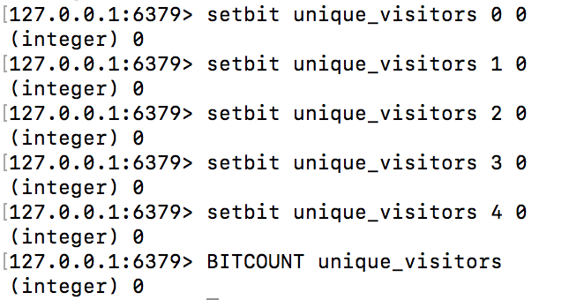
Contd.
In this we first set the default value of each user_id i.e. offset as 0 in unique _visitors key.
Thus there is no visitor i.e. no 1 yet to the website and hence BITCOUNT returns 0.
It can be visually represented as below:

Slide 56
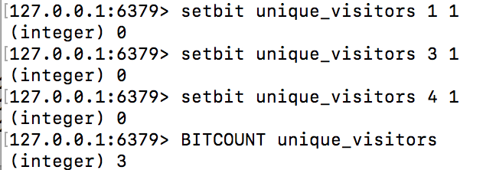
Contd.
Now lets assume that user_id 1, 3 and 4 visits the webpage. Therefore we will set offset 1, 3 and 4 for unique_visitors as 1 as shown below:
Now since we have three visitors i.e. three 1’s BITCOUNT returns 3 which is the no of unique visitors to our webpage.
It can be visually explained as below:

Slide 57
Contd.
There’s a wonderful post (http://blog.getspool.com/2011/11/29/fast-easy-realtime-metrics-using-redis-bitmaps/ ) on how Spool uses the Getbit/SetBit commands similarly to efficiently calculate the number of unique visitors everyday.
Similarly for calculating the unique visitors for 128 million users a laptop generates the answer in less than 50ms and takes only 16MB of memory.

Slide 58
Hashes
Redis Hashes are maps between string fields and string values.
They are the perfect data structure to represent objects.
e.g. A User with a number of fields like name, surname, age etc.
A hash with a few fields is stored in a way that takes very little space, so you can store millions of objects in a small Redis instance.
Source: https://redis.io/topics/data-types

Slide 59
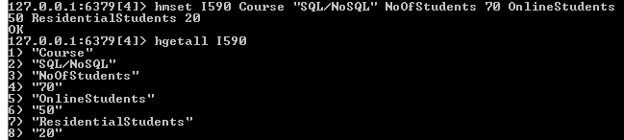
Hash Example
In this example we created hash “I590” with fields (Course, NoOfStudents , OnlineStudents , ResidentialStudents) and set value for each of the fields.

Slide 60
Redis Hash Commands
HMSET: Used to set multiple values to multiple fields in a Hash.
Syntax: HMSET key field1 value1 field2 value2
E.g.

Slide 61
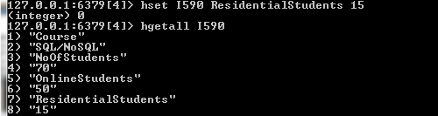
Contd.
HSET: Sets the string value of a Hash Field.
Syntax: HSET key Field Value
E.g. In previous example we would like to update ResidentialStudents field value from 20 to 15 we can use this command as following:

Slide 62
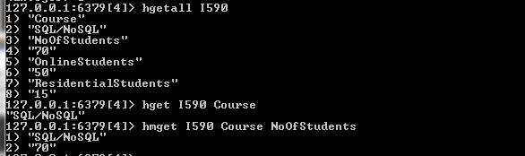
Contd.
HMGET: Gets value of all given hash fields.
Syntax: HMGET key Field1 Field2 ……
HGET: Gets values of given hash field.
Syntax: HGET key Field
HGETALL: Gets all the fields and values in a hash at specified key.
E.g.

Slide 63


Contd.
HDEL: Delete one or more hash fields.
Syntax: HDEL key Field1 Field2
HEXISTS: Checks whether a hash field exists or not. Returns 1 if field exists else 0.
Syntax: HEXISTS key Field
HLEN: Gets the number of fields in a Hash.
Syntax: HLEN key
E.g.

Slide 64


Contd.
HKEYS: Gets all fields in the Hash.
Syntax: HKEYS key
E.g.
HVALS: Gets all the values in the Hash fields.
Syntax: HVALS key
E.g.

Slide 65
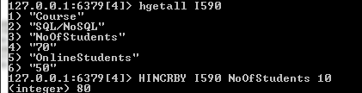
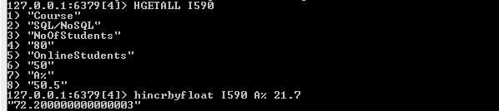
Contd.
HINCRBY: It is used to increment Integer value of a Hash field by a given value.
Syntax: HINCRBY key field increment
E.g.
HINCRBYFLOAT: It is used to increment Float value of a Hash field by a given value.
Syntax: HINCRBYFLOAT key field increment
E.g.

Slide 66
Redis Lists
Redis Lists are simple lists of strings, sorted by insertion order.
It is possible to add elements to a Redis List pushing new elements on the head (on the left) or on the tail (on the right) of the list.
The LPUSH command inserts a new element on the head, while RPUSH inserts a new element on the tail.
A new list is created when one of this operations is performed against an empty key.
Similarly the key is removed from the key space if a list operation will empty the list.
Source: https://redis.io/topics/data-types

Slide 67
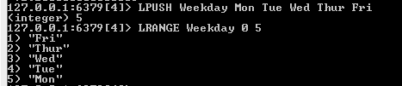
List Example
In this example we create a list Weekday and insert elements into the list from left side or head of the list using LPUSH and display the list using LRANGE command.
An application can be modelling the timeline of a social network where LPUSH can be used to add events to timeline and LRANGE to retrieve a few recent timeline events.

Slide 68

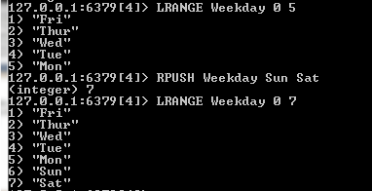
Redis List Commands
LPUSH: Prepends one or multiple elements in a list.
Syntax: LPUSH key value1 [value2] [value3]
E.g.
RPUSH: Appends one or multiple elements in a list.
Syntax: RPUSH key value1 [value2] [value3]
E.g.

Slide 69
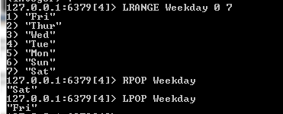
Contd.
LPOP: Removes and gets the first element of the list.
Syntax: LPOP key
RPOP: Removes and gets the last element of the list.
Syntax: RPOP key
E.g.

Slide 70
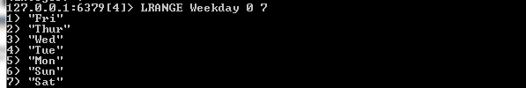
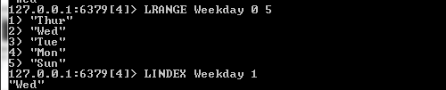
Contd.
LRANGE : Gets a range of elements from the list.
Syntax: LRANGE key start end
E.g.
LINDEX: Gets element from a list by Index.
Syntax: LINDEX key index
E.g.

Slide 71

Contd.
LLEN: Returns the length of the List.
Syntax: LLEN key
E.g.
LTRIM: Trims a list to a specified range.
Syntax: LTRIM key start end
E.g.

Slide 72
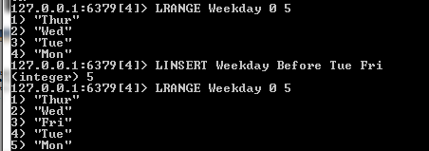
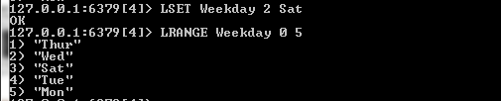
Contd.
LINSERT: Inserts an element before or after another given element.
Syntax: LINSERT key Before | After pivot value
E.g.
LSET: Set value of element in list by its index.
Syntax: LSET key index value
E.g.

Slide 73
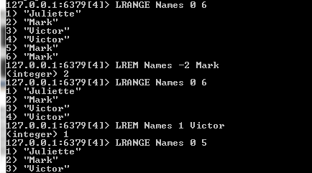
Contd.
LREM: Removes the first occurrence of an element value given from a list stored at a key. The operation is influenced by count:
Syntax: LREM key count value
If count >0 removes first count occurrence of element equal to value moving from head to tail.
If count <0 removes first count occurrence of element equal to value moving from tail to head.
If count = 0 removes all occurrences of elements equal to value.
E.g.
Notes:
Note that non-existing keys are treated like empty lists, so when key does not exist, the command will always return 0.

Slide 74
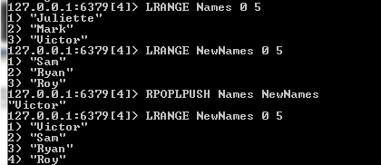
Contd.
RPOPLPUSH: It removes the last element in a list and adds to another list’s first (the left) element.
Syntax: RPOPLPUSH Source Destination
E.g.

Slide 75
Sets
Redis Sets are an unordered collection of Strings.
It is possible to add, remove, and test for existence of members in O(1) (constant time regardless of the number of elements contained inside the Set).
Redis Sets have the desirable property of not allowing repeated members. Adding the same element multiple times will result in a set having a single copy of this element.
A very interesting thing about Redis Sets is that they support a number of server side commands to compute sets starting from existing sets, so you can do unions, intersections, differences of sets in very short time.
Source: https://redis.io/topics/data-types

Slide 76
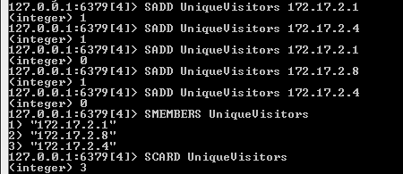
Set Example
In this example we track unique ip addresses visiting a given Blog or a website.
In this SADD command adds each visiting ip address to Set UniqueVisitors.
SCARD command gives us the total number of members in the set or the number of unique visitors.

Slide 77
Redis Set Commands
SADD: Adds one or more member to set.
Syntax: SADD key Member1 [Member2]
SMEMBERS: Displays all members of the set.
Syntax: SMEMBERS key
SCARD: Returns number of members in the set.
Syntax: SCARD key
E.g.

Slide 78
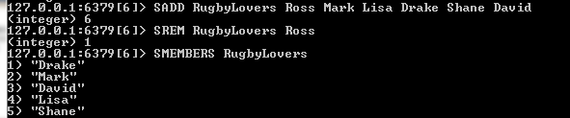
Contd.
SREM: Removes one or more members of a set.
Syntax: SREM key member1 [member2]
E.g.
SISMEMBER: Checks if given value is member of a set. Returns 1 if value is a member else 0.
Syntax: SISMEMBER key Member
E.g.

Slide 79
Contd.
SPOP: Removes and returns one or more random members from a set based on count.
Syntax: SPOP key count
E.g.
SRANDMEMBER: Gets one or multiple random members from a set based on count.
Syntax: SRANDMEMBER key count
E.g.
Notes:
E.G., lucky draw

Slide 80
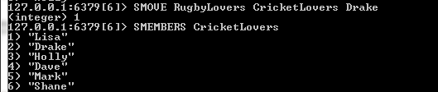
Contd.
SMOVE: Moves member from one set to another.
Syntax: SMOVE source destination member
E.g.

Slide 81
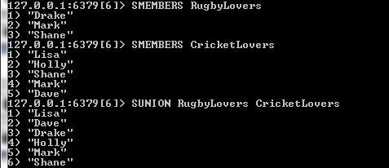

Set Operations
SUNION: Returns addition of multiple sets.
Syntax: SUNION key1 [key2][key3]
SINTER: Returns intersection of multiple sets.
Syntax: SINTER key1 [key2][key3]
SDIFF: Returns difference of multiple sets.
Syntax: SDIFF key1 key2
E.g.

Slide 82
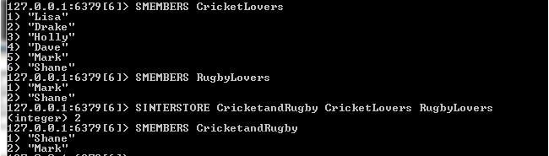
Contd.
SINTERSTORE: Stores the intersection of multiple sets in a key.
Syntax: SINTERSTORE destination key1 [key2]
E.g.

Slide 83

Contd.
SUNIONSTORE: Stores the union of multiple sets in a key.
Syntax: SUNIONSTORE destination key1 [key2]
E.g.

Slide 84
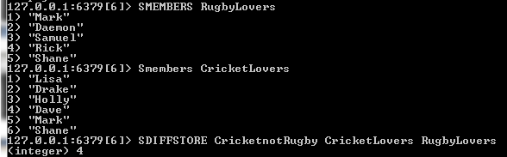
Contd.
SDIFFSTORE: Stores the difference of multiple sets in a key.
Syntax: SDIFFSTORE destination key1 [key2]
E.g.

Slide 85
Sorted Sets
Redis Sorted Sets are non repeating collections of Strings similar to Redis Sets.
In this every member of a Sorted Set is associated with a score, that is used in order to take the sorted set ordered, from the smallest to the greatest score.
Members are unique just like Sets though scores may be repeated.
Source: https://redis.io/topics/data-types

Slide 86
Contd.
Operations like add, remove, or update on sorted sets are very fast (can be performed in a time proportional to the logarithm of the number of elements).
Since elements are taken in order and not ordered afterwards, you can also get ranges by score or by rank (position) in a very fast way.
In short, with sorted sets you can do a lot of tasks with great performance that are really hard to model in other kind of databases.
Source: https://redis.io/topics/data-types

Slide 87

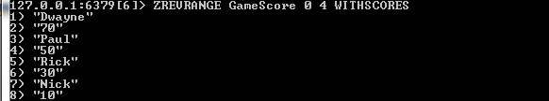
Sorted Set Example
In this example we have Game Scoreboard in which updated score is added using ZADD command and users with top scores can be retrieved by using ZREVRANGE command with highest scores on top and lowest on bottom.

Slide 88
Redis Sorted Set Commands
ZADD : Adds one or more members to the sorted set or update its score if it exists.
Syntax: ZADD key score1 member1 [score2] [member2]
E.g.
ZSCORE : Gets score associated with the given member in sorted set.
Syntax: ZSCORE key member
E.g.

Slide 89
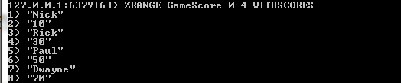

Contd.
ZRANGE: Returns a range of members in the sorted set by their index.
Syntax: ZRANGE key start stop [WITHSCORES]
E.g.
ZRANGEBYSCORE: Returns a range of members in the sorted set with their score between min and max.
Syntax: ZRANGEBYSCORE key min max [WITHSCORES] [LIMIT offset count]
E.g.
Notes:
ZRANGEBYSCORE: The elements are considered to be ordered from low to high scores.
ZRANGEBYSCORE myzset -inf +inf
3.
ZRANGEBYSCORE zset (1 5 Will return all elements with 1 < score <= 5 while:
ZRANGEBYSCORE zset (5 (10 Will return all the elements with 5 < score < 10 (5 and 10 excluded).

Slide 90
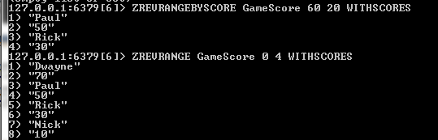
Contd.
ZREVRANGE: Returns a range of members in the sorted set by their index in reverse order.
Syntax: ZREVRANGE key start stop [WITHSCORES]
ZREVRANGEBYSCORE: Returns a range of members in the sorted set with their score between min and max.
Syntax: ZREVRANGEBYSCORE key max min [WITHSCORES] [LIMIT offset count]
E.g.

Slide 91
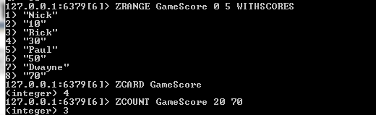
Contd.
ZCARD: Gets the number of members in a sorted set.
Syntax: ZCARD key
ZCOUNT: Gets the number of members in a sorted set with scores between min and max.
Syntax: ZCOUNT key max min
E.g.

Slide 92
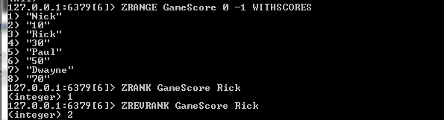
Contd.
ZRANK: Returns the index of a member in the sorted set.
Syntax: ZRANK key member
ZREVRANK: Returns the index of a member in the sorted set starting from High to Low.
Syntax: ZREVRANK key member

Slide 93
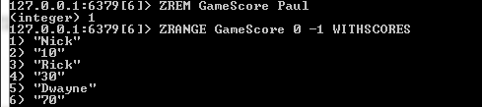

Contd.
ZREM: Removes one or more members in a sorted set.
Syntax: ZREM key member1 [member2] [member3]
E.g.
ZREMRANGEBYSCORE: Removes members in a sorted set with scores between min and max.
Syntax : ZREMRANGEBYSCORE key min max
E.g.

Slide 94


Contd.
ZREMRANGEBYRANK: Removes all members in a sorted set within the given indices.
Syntax: ZREMRANGEBYRANK key start stop
E.g.
ZINCRBY: Increments the score of member in a sorted set.
Syntax: ZINCRBY key increment member
E.g.

Slide 95

Contd.
ZINTERSTORE : Computes the intersection of two or more sorted sets and stores it at a destination.
Syntax: ZINTERSTORE destination numkeys key1 key2 key3 [WEIGHTS [weight1][weight2]] [AGGREGATE SUM|MIN|MAX]
E.g.
Notes:
If destination already exists, it is overwritten.

Slide 96

Contd.
ZUNIONSTORE : Adds multiple sorted sets and stores it at a destination.
Syntax: ZUNIONSTORE destination numkeys key1 key2 key3 [WEIGHTS [weight1][weight2]] [AGGREGATE SUM|MIN|MAX]
E.g.
Notes:
This option defaults to SUM, where the score of an element is summed across the inputs where it exists

Slide 97
Some Important points regarding ZINTERSTORE and ZUNIONSTORE
By default, the resulting score of an element is the sum of its scores in the sorted sets where it exists.
Using the WEIGHTS option, it is possible to specify a multiplication factor for each input sorted set. This means that the score of every element in every input sorted set is multiplied by this factor before being passed to the aggregation function.
When WEIGHTS is not given, the multiplication factors default to 1.
With the AGGREGATE option, it is possible to specify how the results of the union are aggregated.
This option defaults to SUM, where the score of an element is summed across the inputs where it exists. When this option is set to either MIN or MAX, the resulting set will contain the minimum or maximum score of an element across the inputs where it exists.
Source: https://redis.io/commands/zunionstore

Slide 98
Publication and Subscriptions

Slide 99
What is Publish/Subscribe?
Redis implements the Publish/Subscribe messaging paradigm where senders (publishers) are not programmed to send their messages to specific receivers (subscribers).
Rather, published messages are characterized into channels, without knowledge of what subscribers may be available.
Subscribers express interest in one or more channels, and only receive messages that are of interest, without knowledge of which publishers exist.
This can allow for greater scalability and a more dynamic network topology.
Source: https://redis.io/topics/pubsub

Slide 100


Redis Pub/Sub Example
In this example the client in the left snapshot subscribes to “News” channel using subscribe command.
The two clients in the right snapshot publish messages to “News” channel using publish command which is pushed by Redis to all subscribed clients.
Redis-cli will not accept any commands once in subscribed mode except quitting the mode with Ctrl-C.

Slide 101


Pub/Sub Commands
SUBSCRIBE : Listens for messages published to given channels.
Syntax: SUBSCRIBE channel1 [channel2] [channel3]
E.g.
PUBLISH: Publishes a message to the channel .
Syntax: PUBLISH channel message
E.g.

Slide 102


Contd.
PSUBSCRIBE : Subscribes to the channels matching the given patterns.
Syntax: PSUBSCRIBE pattern1 [pattern2]
E.g. In this we subscribe to all channels *News pattern.

Slide 103
Contd.
UNSUBSCRIBE: Unsubscribes the client from the given channels, or from all of them if none is given.
Syntax: UNSUBSCRIBE [channel1] [channel2] [channel3]
PUNSUBSCRIBE: Unsubscribes the client from the channels matching given patterns .
Syntax: PUNSUBSCRIBE pattern1 [pattern2]
In Redis while working on command line the client in Subscriber state does not accept any commands thus on pressing Ctrl-C it unsubscribes all channels automatically.
But you can use the punsubscribe/unsubscribe command while using Redis pub/sub in your application code in any language E.g. Python

Slide 104
Redis Transactions

Slide 105
Transactions in Redis
Redis transactions allow execution of a group of commands in a single step.
All the commands in a transaction are serialized and executed sequentially.
It can never happen that a request issued by another client is served in the middle of the execution of a Redis transaction.
This guarantees that the commands are executed as a single isolated operation.
Source: https://redis.io/topics/transactions

Slide 106
Atomicity
Either all of the commands or none are processed, so a Redis transaction is also atomic.
The EXEC command triggers the execution of all the commands in the transaction
If a client loses the connection to the server in the context of a transaction before calling the MULTI command; none of the operations are performed. Instead if the EXEC command is called, all the operations are performed.
Source: https://redis.io/topics/transactions

Slide 107


Redis Transaction Commands
MULTI: It marks the start of a transaction block.
E.g.
EXEC: It executes all commands issued after MULTI.
E.g.

Slide 108

Contd.
DISCARD: It flushes the transaction queue and will exit the transaction discarding all commands after MULTI.
E.g.

Slide 109
Redis Configuration

Slide 110
Configuration in Redis
Redis.conf is the Redis configuration file that can be used to configure various aspects of Redis.
A well-documented redis.conf file is available for each release of Redis.
The sample file contains the default configuration options, which is useful to both understand what the settings do and what their defaults are.

Slide 111

How to configure Redis?
The config set command can be used to set individual values in config file.
Syntax: config set CONFIG_SETTING_NAME
E.g.
The config get command which displays the value of a setting.
Syntax: config get CONFIG_SETTING_NAME
E.g.
Notes:
slowlog-log-slower-than tells Redis what is the execution time, in microseconds

Slide 112

Contd.
You can view all the settings available in Redis.conf using the following command:
E.g. config get *
Here 1,3,5…. Are the keys or setting name whereas 2,4,6…. Are the values of the settings 1,3,5….

Slide 113
Using Redis Desktop Manager

Slide 114
Getting Started
The Redis Desktop Manager provides an easy to use GUI for accessing databases in Redis and performing some basic operations.
We can also execute shell commands in the terminal that comes integrated with the GUI.
It can also be used to keep a track on server statistics like memory used, number of clients connected,Uptime, etc.

Slide 115

Selecting a Database
In the previous slides we already
saw how to install and start a new
connection in Redis Desktop Manager.
Once the connection is successful
established we can start accessing
our databases in Redis in the
following way.
Here My Redis is our connection name.
We can view all the databases related
by expanding it.
We can select any one of the 16
databases that we want to work upon by clicking on it.

Slide 116


Adding Data
We can add data by selecting the add New key sign corresponding to the database as below.
We can then enter the key name
in Key field and select the data
type of key along with its value
in the Value field and click on
Save to add the data.

Slide 117


Example
This example shows adding
a new key with Name as
Key and Rock as Value with
data type as string.
We can see that the key gets
created under db3 and we
can view the value by clicking
on the key.

Slide 118


Contd.
Similarly we can add
a key team with list
as data type and value
as Rick.
We can add a key Name
with set data type and
Mark as value in the
same way.

Slide 119


Contd.
In this we create a key Name
with zset (sortedset) as
data type with score as 40
and value as Steve.
Similarly we can create a key
(Hash Name) Details with
hash as data type with Key
name as Id and Value as 201.

Slide 120
Updating data
In order to make changes to our keys we can select the key under database and perform the following update operations:
Add row
Delete Row
Rename
Delete
Update key/Value

Slide 121



Contd.
We select add row button to add new row in the List Team in the following way:

Slide 122



Contd.
We select delete row button to remove existing row in the List Team in the following way:

Slide 123



Contd.
We can rename the key using Rename button in the following way:

Slide 124



Contd.
We can delete the key using the delete button corresponding to the key name in the following way:

Slide 125



Dropping the database
We can drop the whole database using the flush DB button corresponding to the database name in the following way:

Slide 126


Using Shell within Redis Desktop Manager
We can use the shell console within the Redis Desktop manager and perform all the commands that we performed previously using the command prompt terminal .
Click on the open console
button corresponding to the
connection name.
We can see the console in the
the bottom part of the
window.

Slide 127

Example
In this example I am demonstrating a simple get/set command in the console window.
You can similarly explore other commands as well in the console on your own.

Slide 128
Redis with Python (An Example)

Slide 129

Installaing Python Redis Client
To install Redis-py simply execute any of the following commands in your command line window:
Syntax1 : pip install redis
Syntax2 : easy_install redis

Slide 130

Getting Started
To get started with Redis in python :
First, Open python in your command line by typing python like shown below:
Try importing Redis in the python environment using
import redis command as shown below (make sure it is “redis” instead of “Redis”):

Slide 131

Get/Set Commands
We previously worked with Get/Set commands on Redis Client.
We will implement these commands using python client now as follows:
Here we are creating an object “red” for which the parameters have been set in the StrictRedis() function.
This object is used to perform get/set operations on Python Redis Client.

Slide 132
Some more examples
We implement the pub/sub model here using python.
redis-py includes a PubSub object that subscribes to channels and listens for new messages.
We instantiate a pubsub object which will be our subscriber. In this case sub is our pubsub object.
Now sub subscribes to “News” channel using subscribe() method.
Now publisher publishes on the ‘News’ channel using
publish () method.

Slide 133
Contd.
Subscriber will check this message using the get_message() method.
While using Redis client we mentioned that unsubscribe can be performed using programming language client like Python. We can unsubscribe the channel using unsubscribe () method.

Slide 134
Explore
Feel Free to explore more functionalities of Redis using Python or any other language you are comfortable with.
These links might be helpful for the same.
Python: https://pypi.python.org/pypi/redis
Java: https://github.com/xetorthio/jedis
and Many More at https://redis.io/clients

Slide 135
Summary
Introduction: What is Redis ? , Features , Redis vs other SQL/NoSQL DBs , Organizations using Redis.
Companies using Redis: Stack Overflow, Flickr and many more.
Installation: Redis-cli command line (Windows/Mac), Redis Desktop Manager.
Redis Configuration: How to configure Redis ?
Databases in Redis: Selecting Database , Dropping Database.
Redis Keys: What are Redis Keys? , Redis Key Commands.
Redis Data Structures: Strings, Hashes, Lists , Sets , Sorted Sets.
Publications/Subscriptions: What is Publish/Subscribe ?, Pub/Sub commands.
Redis Transactions: What are Redis Transactions? , Atomicity , Redis Transaction Commands.
Using Redis Desktop Manager :Managing databases , working with terminal.
Redis with Python: Setup, Basic commands, Some examples

Slide 136
Useful Resources
Redis documentation available at https://redis.io/documentation is the one stop solution for all your Redis Queries .
Feel free to explore https://redis.io/modules and explore the Redis modules for any small project.
For reference tutorials: https://www.tutorialspoint.com/redis/index.htm

Slide 137
THANK YOU

