Slide 1
MongoDB: An Example of NoSQL Databases (II)

Slide 2
Outline
Introduction
Installation
Create/Drop a database
Create/Drop a collection (in RDBS, table)
Insert/Delete documents (in RDBS, record)
Query documents
Update documents
Aggregation (including map reduce)

Slide 3
VI. Query documents
Notes:
Document = record (raw)
Just like SQL part in RDBS

Slide 4
db.collection.find() method
MongoDB provides the “db.collection.find()” method to read documents from a collection. The “db.collection.find()” method returns a cursor to the matching documents. db.collection.find( <query filter>, <projection> )
For this method, you can specify the following optional fields: (1) a query filter to specify which documents to return; and (2) a query projection to specify which fields from the matching documents to return. The projection limits the amount of data that MongoDB returns to the client over the network.
Notes:
The instructor should refer to “projection” in relational algebra here.

Slide 5
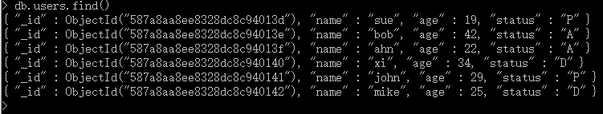
Query all documents in a collection (i.e., show documents)
db.collection.find( <query filter>, <projection> )
An empty query filter document ({}) selects all documents in the collection:
db.users.find( {} )
db.users.find()

Slide 6

Specify equality condition
db.users.find( { status: "A" } )
A query filter document can specify equality condition with <field>:<value> expressions to select all documents that contain the <field> with the specified <value>:
Exercise: Please rewrite this query in a SQL style, given a relational database system.

Slide 7
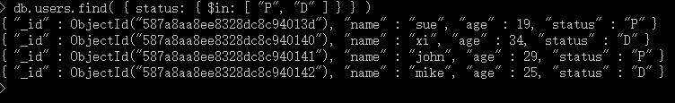
Specify conditions using query operators
A query filter document can use the query operators to specify conditions in the following form:
{ <field1>: { <operator1>: <value1> }, ... }
db.users.find( { status: { $in: [ "P", "D" ] } } )

Slide 8
Specify AND Conditions
A compound query can specify conditions for more than one field in the collection’s documents. Implicitly, a logical AND conjunction connects the clauses of a compound query so that the query selects the documents in the collection that match all the conditions.
The following example retrieves all documents in the users collection where the status equals "A" and age is less than ($lt) 30:
db.users.find( { status: "A", age: { $lt: 30 } } )

Slide 9
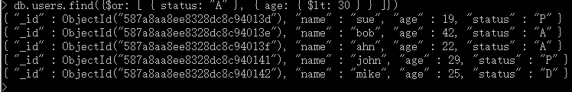
Specify OR Conditions
Using the $or operator, you can specify a compound query that joins each clause with a logical OR conjunction so that the query selects the documents in the collection that match at least one condition.
The following example retrieves all documents in the collection where the status equals "A" or age is less than ($lt) 30:
db.users.find({$or: [ { status: "A" }, { age: { $lt: 30 } } ]})

Slide 10
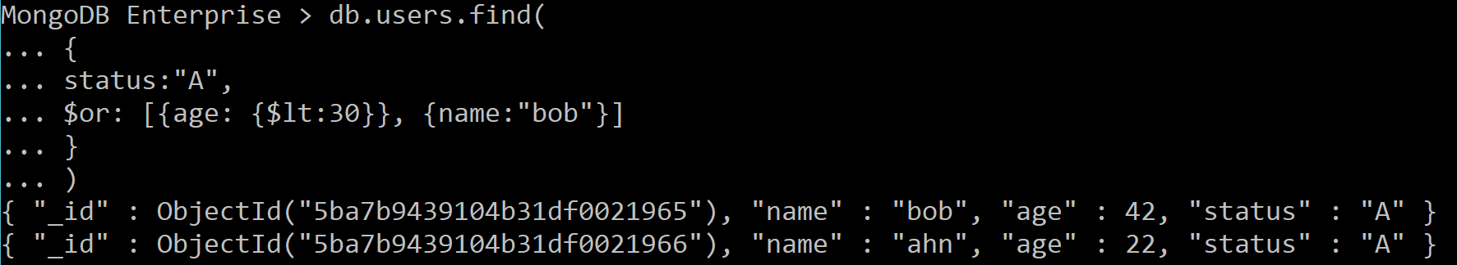
Specify AND and OR Conditions
db.users.find(
{
status: "A“,
$or: [ { age: { $lt: 30 } }, { name: “bob” } ]
}
)
With additional clauses, you can specify precise conditions for matching documents.
In the following example, the compound query document selects all documents in the collection where the “status” equals “A” and either age is less than ($lt) 30 or name equals “bob”

Slide 11
Commonly-used operations
Operation | Syntax | Example | RDBMS Equivalent
Equality | {<key>:<value>} | db.mycol.find({"by":"tutorials point"}).pretty() | where by = 'tutorials point'
Less Than | {<key>:{$lt:<value>}} | db.mycol.find({"likes":{$lt:50}}).pretty() | where likes < 50
Less Than Equals | {<key>:{$lte:<value>}} | db.mycol.find({"likes":{$lte:50}}).pretty() | where likes <= 50
Greater Than | {<key>:{$gt:<value>}} | db.mycol.find({"likes":{$gt:50}}).pretty() | where likes > 50
Greater Than Equals | {<key>:{$gte:<value>}} | db.mycol.find({"likes":{$gte:50}}).pretty() | where likes >= 50
Not Equals | {<key>:{$ne:<value>}} | db.mycol.find({"likes":{$ne:50}}).pretty() | where likes != 50

Slide 12
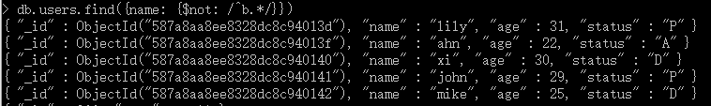
Regular expression (regex)
Query those whose name do not start with “b”.
db.users.find({name: {$not: /^b.*/}})
Notes:
Escape character

Slide 13
Number of documents
db.users.find().count()
Query the number of documents in “user” collection.
Exercise: What is the corresponding function in SQL? Can you write it down?

Slide 14
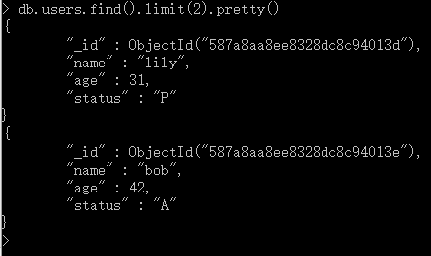
Limit your results
To limit the records in MongoDB, we need to use “limit()” method. “limit() method” accepts one number type argument, which is number of documents that we want to displayed. Basic syntax of “limit()” method is as follows: db.COLLECTION_NAME.find().limit(NUMBER)
For example, If we want to see first two documents only, then we can write following query for that:
db.users.find().limit(2)
db.users.find({}).limit(2).pretty()

Slide 15
Limit your results (cont.)
Apart from “limit()” method, there is one more method “skip()” which also accepts number type argument and used to skip number of documents. Basic syntax of “skip()” method is as follows:
db.COLLECTION_NAME.find().limit(NUMBER).skip(NUMBER)

Slide 16
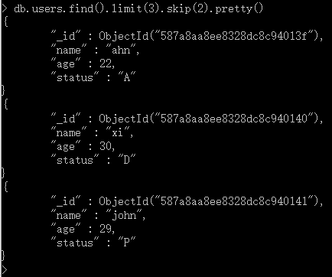
Limit your results (cont.)
Suppose we want to display 3 documents after first 2nd document i.e. 3rd ,4th and 5th. We can do so by below query:
db.users.find().limit(3).skip(2).pretty()

Slide 17
Sorting your results
To sort documents in MongoDB, you need to use “sort()” method. “sort()” method accepts a document containing list of fields along with their sorting order. To specify sorting order 1 and -1 are used.
1 is used for ascending order
-1 is used for descending order.

Slide 18
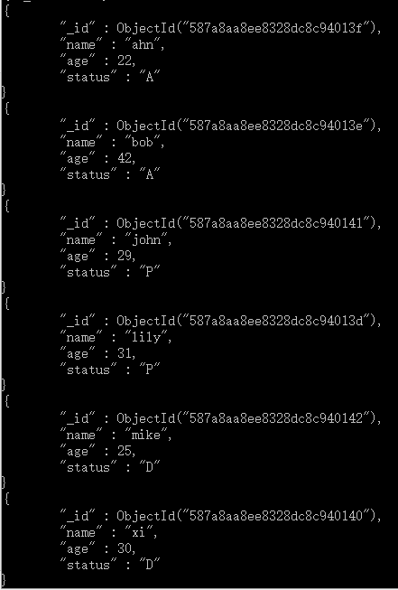
Sorting your results (cont.)
Basic syntax of sort() method is as follows: db.COLLECTION_NAME.find().sort({KEY:1})
Please note if we don't specify the sorting preference, then “sort()” method will display documents in ascending order.
Suppose we want to display “users” based on name alphabetic order:
db.users.find().sort({"name":1}).pretty()

Slide 19
Sorting your results (cont.)
We can sort based on multiple fields as well.
Suppose we want to sort by age (ascending order) and by status (descending order):
db.users.insert({name:”lily”, age:22, status:”P”})
db.users.find().sort({"age":1, "status":-1}). pretty()

Slide 20
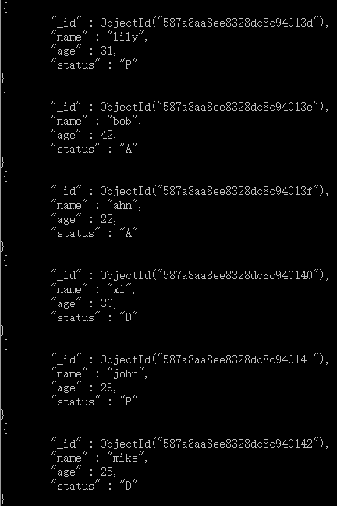
Cursor in MongoDB
When the db.collection.find () function is used to search for documents in the collection, the result returns a pointer to the collection of documents returned which is called a cursor.
for( var c = db.users.find(); c.hasNext(); ) { printjson( c.next()); }
OR
db.users.find().forEach( function(u) { printjson(u); })
Attention: There is a space after “(“!!

Slide 21

Function
You can write such function in SQL: function addNumbers( x,y ) { return x+y; }
Similarly, in MongoDB, you can also create functions. In MongoDB, all functions are established by JavaScript and are stored in “db.system.js” collection.
You can write a function in MongoDB as: db.system.js.save({_id:"addNumbers", value:function(x, y){ return x + y; }});
You can use the functions as: db.eval(‘addNumbers(3,4)’);

Slide 22
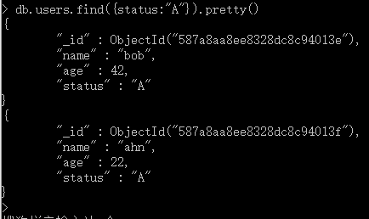
[Optional] db.collection.find().pretty() method
“find()” method will display all the documents in a non-structured way.
To display the results in a formatted way, we can use “pretty()” method.
db.users.find( { status: "A" } ).pretty()

Slide 23
Recap: db.collection.find() method
MongoDB provides the “db.collection.find()” method to read documents from a collection. The “db.collection.find()” method returns a cursor to the matching documents. db.collection.find( <query filter>, <projection> )
For this method, you can specify the following optional fields: (1) a query filter to specify which documents to return; and (2) a query projection to specify which fields from the matching documents to return. The projection limits the amount of data that MongoDB returns to the client over the network.
Notes:
In mongodb, the projection meaning is selecting only necessary data rather than selecting whole of the data of a document. If a document has 5 fields and we need to show only 3, then select only 3 fields from them. MongoDB's find() method accepts second optional parameter that is list of fields that we want to retrieve. In MongoDB when we execute find() method, then it displays all fields of a document. To limit this, we need to set list of fields with value 1 or 0. 1 is used to show the field while 0 is used to hide the field.

Slide 24
Projection document
By default, queries in MongoDB return all fields in matching documents. To limit the amount of data that MongoDB sends to applications, you can include a projection document in the query operation.
The projection document limits the fields to return for all matching documents. The projection document can specify the inclusion of fields or the exclusion of field and has the following form: { field1: <value>, field2: <value> ... }
The <value> can be any of the following:
1 or true to include the field in the return documents.
0 or false to exclude the field.
Expression using a Projection Operators.
Notes:
In mongodb, the projection meaning is selecting only necessary data rather than selecting whole of the data of a document. If a document has 5 fields and we need to show only 3, then select only 3 fields from them. MongoDB's find() method accepts second optional parameter that is list of fields that we want to retrieve. In MongoDB when we execute find() method, then it displays all fields of a document. To limit this, we need to set list of fields with value 1 or 0. 1 is used to show the field while 0 is used to hide the field.

Slide 25

Projection document: Return the specified fields and the _id field only
A projection can explicitly include several fields. In the following operation, the “db.collection.find()” method returns all documents that match the query. In the result set, only the name, status and, by default, the _id fields return in the matching documents.
db.users.find( { status: "A" }, { name: 1, status: 1 } )

Slide 26

Projection document: Return all but the excluded field
To exclude a field or multiple fields, instead of listing the fields to include in the matching document, you can use a projection to exclude specific fields as in the following example:
db.users.find( { status: "A" }, { name: 0, status: 0 } )

Slide 27
VII. Update documents
Notes:
Document = record (raw)
Just like SQL part in RDBS

Slide 28
Update documents
The update() method updates values in the existing document. Basic syntax of update() method is as follows: db.COLLECTION_NAME.update(SELECTIOIN_CRITERIA, UPDATED_DATA)
For example, we would like to update the “xi”’s age into 30. (You can then check whether they are updated by using “db.users.finding()” method).
db.users.update({"name": "xi" }, {$set: {"age": 30 }})

Slide 29
Update one document
The following example uses the “db.collection.updateOne()” method on the “users” collection to update the first document that matches the filter status equals "P".
db.users.updateOne({"status": "P" },{$set: {"name": "andy", "age": 31 }})

Slide 30
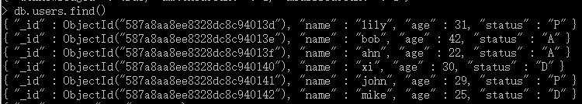
Update many documents
The following example uses the “db.collection.updateMany()” method on the “users” collection to update all documents that matches the filter “age” equals 31.
Let’s check using “db.users.find()” method:
db.users.updateMany({"age": 31 },{$set: {"name": "lily"}})

Slide 31
[Optional] Other related methods
These methods are also related to delete documents from a collection. As a simple exercise, you can explore them in your MongoDB database.
db.collection.findOneAndReplace();
db.collection.findOneAndUpdate();
db.collection.findOneAndDelete();
db.collection.findAndModify();
db.collection.save(); and
db.collection.bulkWrite().
You can refer to some materials listed at the end of this tutorial.

Slide 32
VIII. Aggregation

Slide 33
Preparation for aggregation
To prepare for the next section, we create a new collection (table) and insert some documents (records) in it.
Create a new collection named “orders”: db.createCollection("orders")
Insert several documents: db.orders.insertMany( [ { _id: 1, cust_id: "abc1", ord_date: ISODate("2012-11-02T17:04:11.102Z"), status: "A", amount: 50, }, { _id: 2, cust_id: "xyz1", ord_date: ISODate("2013-10-01T17:04:11.102Z"), status: "A", amount: 100, }, { _id: 3, cust_id: "xyz1", ord_date: ISODate("2013-10-12T17:04:11.102Z"), status: "D", amount: 25, }, { _id: 4, cust_id: "xyz1", ord_date: ISODate("2013-10-11T17:04:11.102Z"), status: "D", amount: 125, }, { _id: 5, cust_id: "abc1", ord_date: ISODate("2013-11-12T17:04:11.102Z"), status: "A", amount: 25, } ] )
You can also try to use “MongoImport” tool to import the data, see details here: https://docs.mongodb.com/manual/reference/program/mongoimport/#bin.mongoimport

Slide 34
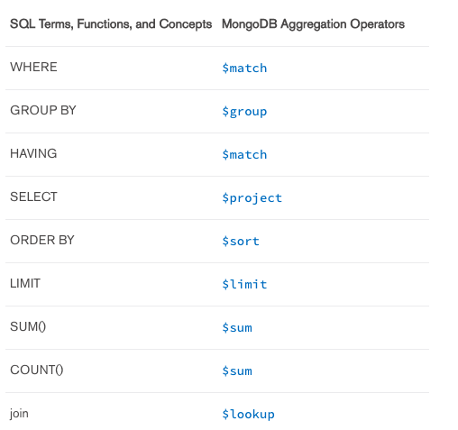
SQL V.S. MongoDB aggregation

Slide 35
Aggregation
Aggregation operations process data records and return computed results.
Aggregation operations group values from multiple documents together, and can perform a variety of operations on the grouped data to return a single result.
MongoDB provides three ways to perform aggregation:
the aggregation pipeline;
the map-reduce function; and
single purpose aggregation methods.

Slide 36
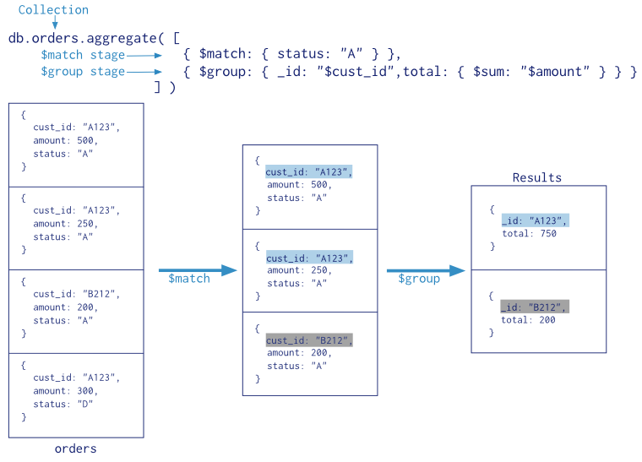
Aggregation pipeline
The aggregation pipeline is a framework for data aggregation modeled on the concept of data processing pipelines. Documents enter a multi-stage pipeline that transforms the documents into aggregated results.

Slide 37
Aggregation pipeline (cont.)
MongoDB provides the “db.collection.aggregate()” and the aggregate command for aggregation pipeline.
An aggregation pipeline consists of stages with each stage processing the documents as they pass along the pipeline. Documents pass through the stages in sequence.
$sort, $match, $limit, $group, $skip….
Exercise: Check more aggregation pipeline operators here: https://docs.mongodb.com/manual/reference/operator/aggregation/

Slide 38
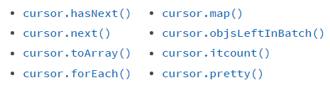
Aggregation and cursor
Exercise: How did you use cursor in SQL databases?
In the mongo shell, if the cursor returned from the “db.collection.aggregate()” is not assigned to a variable using the var keyword, then the mongo shell automatically iterates the cursor up to 20 times.
Cursors returned from aggregation only supports cursor methods that operate on evaluated cursors (i.e. cursors whose first batch has been retrieved), such as the following methods:

Slide 39
Group
{ $group: { _id: <expression>, <field1>: { <accumulator1> : <expression1> }, ... } }
The _id field is mandatory; however, you can specify an _id value of null to calculate accumulated values for all the input documents as a whole.
The remaining computed fields are optional and computed using the <accumulator> operators.

Slide 40
Example: Group
db.createCollection("sales")
db.sales.insertMany([
{ "_id" : 1, "item" : "abc", "price" : 10, "quantity" : 2, "date" : ISODate("2014-03-01T08:00:00Z"), },
{ "_id" : 2, "item" : "jkl", "price" : 20, "quantity" : 1, "date" : ISODate("2014-03-01T09:00:00Z"), },
{ "_id" : 3, "item" : "xyz", "price" : 5, "quantity" : 10, "date" : ISODate("2014-03-15T09:00:00Z"), },
{ "_id" : 4, "item" : "xyz", "price" : 5, "quantity" : 20, "date" : ISODate("2014-04-04T11:21:39.736Z"), },
{ "_id" : 5, "item" : "abc", "price" : 10, "quantity" : 10, "date" : ISODate("2014-04-04T21:23:13.331Z"), }
])
db.sales.aggregate(
[
{
$group : {
_id : { month: { $month: "$date" }, day: { $dayOfMonth: "$date" }, year: { $year: "$date" } },
totalPrice: { $sum: { $multiply: [ "$price", "$quantity" ] } },
averageQuantity: { $avg: "$quantity" },
count: { $sum: 1 }
}
}
]
)

Slide 41
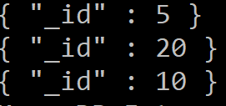
Example: Group
db.sales.aggregate(
[
{
$group : {
_id : null,
totalPrice: { $sum: { $multiply: [ "$price", "$quantity" ] } },
averageQuantity: { $avg: "$quantity" },
count: { $sum: 1 }
}
}
]
)
db.sales.aggregate( [ { $group : { _id : "$price" } } ] )

Slide 42

Example: Group
db.createCollection("books")
db.books.insertMany([
{ "_id" : 8751, "title" : "The Banquet", "author" : "Dante", "copies" : 2, },
{ "_id" : 8752, "title" : "Divine Comedy", "author" : "Dante", "copies" : 1, },
{ "_id" : 8645, "title" : "Eclogues", "author" : "Dante", "copies" : 2, },
{ "_id" : 7000, "title" : "The Odyssey", "author" : "Homer", "copies" : 10, },
{ "_id" : 7020, "title" : "Iliad", "author" : "Homer", "copies" : 10, },
])
db.books.aggregate(
[
{ $group : { _id : "$author", books: { $push: "$title" } } }
]
)
db.books.aggregate(
[
{$group : {_id:"$author", totalCopy: { $sum: "$copies"}}},
{$sort:{totalCopy:-1} }
]
)

Slide 43
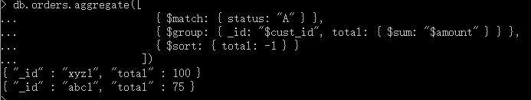
Aggregation pipeline (cont.)
The following aggregation operation selects documents with status equal to "A", groups the matching documents by the cust_id field and calculates the total for each cust_id field from the sum of the amount field, and sorts the results by the total field in descending order:
db.orders.aggregate([
{ $match: { status: "A" } },
{ $group: { _id: "$cust_id", total: { $sum: "$amount" } } },
{ $sort: { total: -1 } }
])
Notes:
The operation returns a cursor with the following documents

Slide 44
Aggregation pipeline (cont.)
The following aggregation operation sets the option explain to true to return information about the aggregation operation.
The operation returns a cursor with the document that contains detailed information regarding the processing of the aggregation pipeline.
db.orders.aggregate(
[
{ $match: { status: "A" } },
{ $group: { _id: "$cust_id", total: { $sum: "$amount" } } },
{ $sort: { total: -1 } }
],
{
explain: true
}
)
Notes:
For example, the document may show, among other details, which index, if any, the operation used.
If the orders collection is a sharded collection, the document would also show the division of labor between the shards and the merge operation, and for targeted queries, the targeted shards.

Slide 45
[Exercise] Using User Preference dataset to exercise on aggregation
Use the database: use Employee
Create a new collection named “interest” under “Employee” database. db.createCollection(“interest”)
Insert several documents in this collection:
db.interest.insertMany(
[
{ _id: "jane", joined : ISODate("2011-03-02"), likes: ["golf", "racquetball"],},
{_id : "joe", joined : ISODate("2012-07-02"), likes: ["tennis", "golf", " swimming"],}
]
)

Slide 46
[Exercise] Using User Preference dataset to exercise on aggregation
Try following queries by yourselves:
Return Usernames Ordered by Join Month
Return Total Number of Joins per Month

Slide 47

[Exercise] Using User Preference dataset to exercise on aggregation(cont.)
Return Usernames Ordered by Join Month (write in SQL and NoSQL environments separately)
db.interest.aggregate(
[
{ $project :
{
month_joined : { $month : "$joined" },
name : "$_id",
_id : 0
}
},
{ $sort : { month_joined : 1 } }
]
)

Slide 48

[Exercise] Using User Preference dataset to exercise on aggregation(cont.)
Return Total Number of Joins per Month (write in SQL and NoSQL environments separately)
db.interest.insertMany(
[
{ _id: "john", joined : ISODate("2011-03-06"), likes: ["golf", "basketball"],},
{_id : "mike", joined : ISODate("2012-07-31"), likes: ["tennis"],}
]
)
db.interest.aggregate(
[
{ $project : { month_joined : { $month : "$joined" } } } ,
{ $group : { _id : {month_joined:"$month_joined"} , number : { $sum : 1 } } },
{ $sort : { "_id.month_joined" : 1 } }
]
)

Slide 49
Map-reduce
Similar to “Group by” in SQL.
In general, map-reduce operations have two phases:
a map stage that processes each document and emits one or more objects for each input document, and
reduce phase that combines the output of the map operation.
Optionally, map-reduce can have a finalize stage to make final modifications to the result. Like other aggregation operations, map-reduce can specify a query condition to select the input documents as well as sort and limit the results.
Map-reduce can operate on a sharded collection. Map reduce operations can also output to a sharded collection.

Slide 50
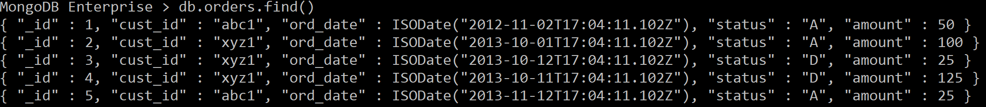
Map-reduce (cont.)
In the mongo shell, the “db.collection.mapReduce()” method is a wrapper around the mapReduce command. The following examples use the “db.collection.mapReduce()” method:
Consider the following map-reduce operations on a collection orders that contains documents of the following prototype:

Slide 51
Map-reduce – example
Return the Total Amount Per Customer
Perform the map-reduce operation on the orders collection to group by the cust_id, and calculate the sum of the amount for each cust_id

Slide 52
Map-reduce – example (cont.)
1. Define the map function to process each input document:
In the function, “this” refers to the document that the map-reduce operation is processing.
The function maps the amount to the cust_id for each document and emits the cust_id and amount pair.
var mapFunction = function() {
emit(this.cust_id, this.amount);
};

Slide 53
Map-reduce – example (cont.)
2. Define the corresponding reduce function with two arguments keyCustId and valuesPrices::
The valuesPrices is an array whose elements are the price values emitted by the map function and grouped by keyCustId.
The function reduces the valuesPrice array to the sum of its elements.
var reduceFunction = function(cust_id, amount) {
return Array.sum(amount);
};

Slide 54
Map-reduce – example (cont.)
3. Perform the map-reduce on all documents in the orders collection using the mapFunction1 map function and the reduceFunction1 reduce function.
This operation outputs the results to a collection named map_reduce_example. If the map_reduce_example collection already exists, the operation will replace the contents with the results of this map-reduce operation:
db.orders.mapReduce(
mapFunction,
reduceFunction,
{ out: “totalamounts" }
)
For more details of mapReduce() method, see here:
https://docs.mongodb.com/manual/reference/method/db.collection.mapReduce/

Slide 55
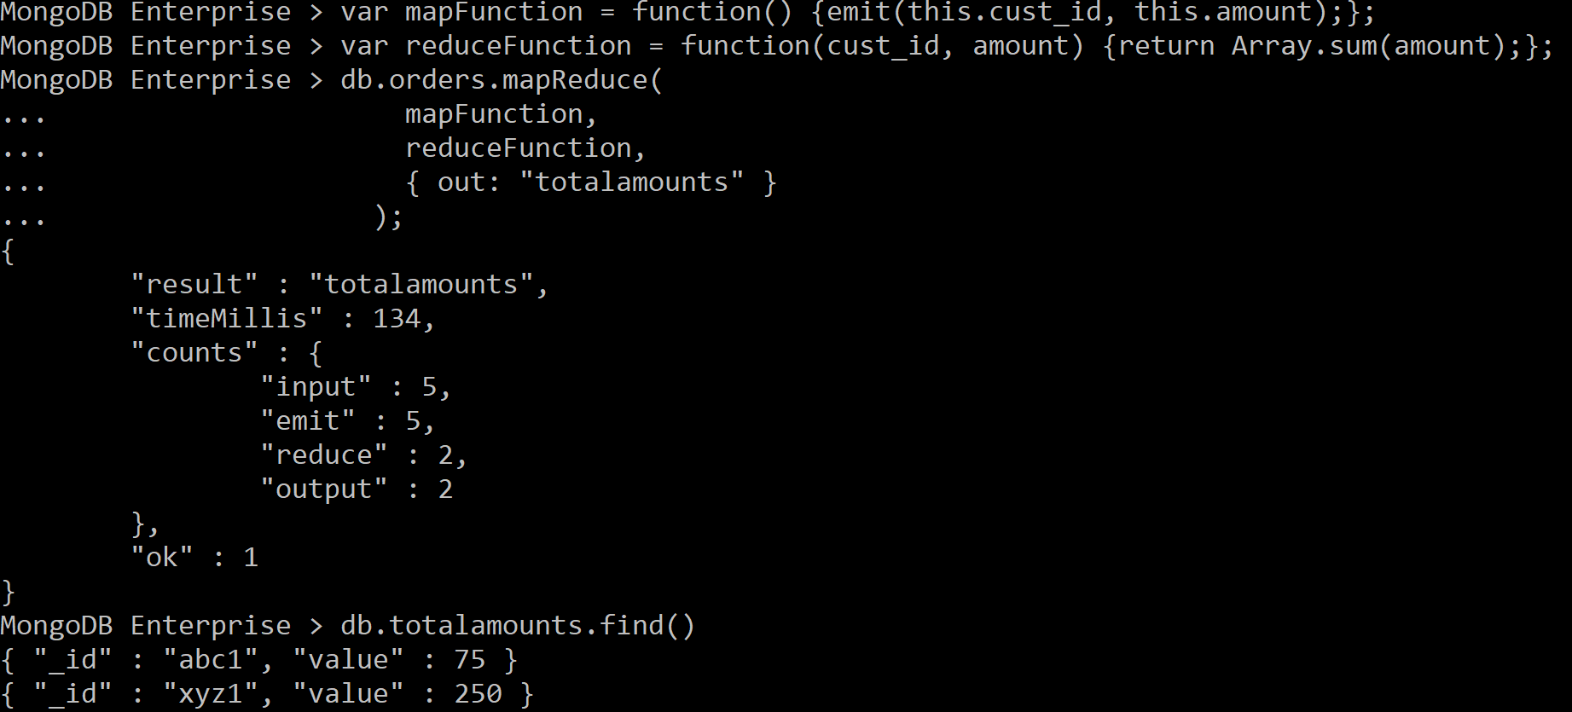
Map-Reduce Example
var mapFunction = function() {emit(this.cust_id, this.amount);};
var reduceFunction = function(cust_id, amount) {return Array.sum(amount);};
db.orders.mapReduce(
mapFunction,
reduceFunction,
{ out: "totalamounts" }
);
Result is in totalamounts collection

Slide 56
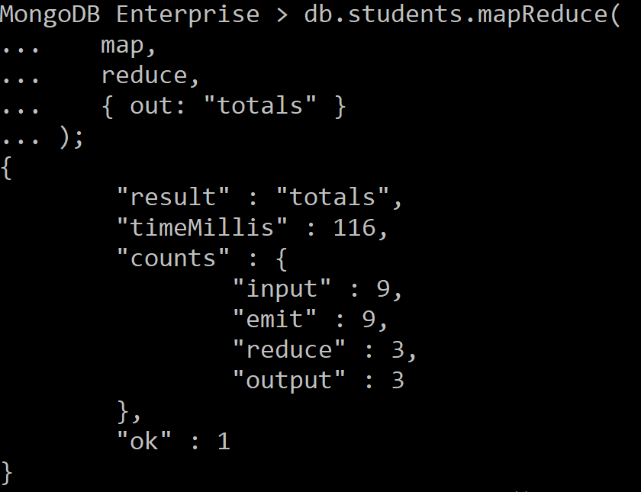
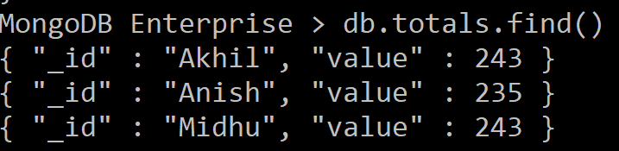
Map-Reduce Example
db.createCollection("students")
db.students.insertMany([
{ "_id" : ObjectId("5a1f9ce431c157f3ec2aec39"), "name" : "Midhu", "subject" : "science", "marks" : 68, },
{ "_id" : ObjectId("5a1f9ce431c157f3ec2aec3a"), "name" : "Midhu", "subject" : "maths", "marks" : 98, },
{ "_id" : ObjectId("5a1f9ce431c157f3ec2aec3b"), "name" : "Midhu", "subject" : "sports", "marks" : 77, },
{ "_id" : ObjectId("5a1f9ce431c157f3ec2aec3c"), "name" : "Akhil", "subject" : "science", "marks" : 67, },
{ "_id" : ObjectId("5a1f9ce431c157f3ec2aec3d"), "name" : "Akhil", "subject" : "maths", "marks" : 87 ,},
{ "_id" : ObjectId("5a1f9ce431c157f3ec2aec3e"), "name" : "Akhil", "subject" : "sports", "marks" : 89, },
{ "_id" : ObjectId("5a1f9ce431c157f3ec2aec3f"), "name" : "Anish", "subject" : "science", "marks" : 67, },
{ "_id" : ObjectId("5a1f9ce431c157f3ec2aec40"), "name" : "Anish", "subject" : "maths", "marks" : 78, },
{ "_id" : ObjectId("5a1f9ce431c157f3ec2aec41"), "name" : "Anish", "subject" : "sports", "marks" : 90, },
])
var map = function() {emit(this.name,this.marks);};
var reduce = function(name,marks) {return Array.sum(marks);};
db.students.mapReduce(
map,
reduce,
{ out: "totals" }
);
Results is in totals collection

Slide 57
IX. Summary
Notes:
Document = record (raw)

Slide 58
Summary
Introduction
Installation
Create/Drop a database
Create/Drop a collection (in RDBS, table)
Insert/Delete documents (in RDBS, record)
Query documents
Update documents
Aggregation and map-reduce

Slide 59
[Optional] Data structure
The key decision in designing data models for MongoDB applications revolves around the structure of documents and how the application represents relationships between data.
There are two tools that allow applications to represent these relationships: references and embedded documents.

Slide 60
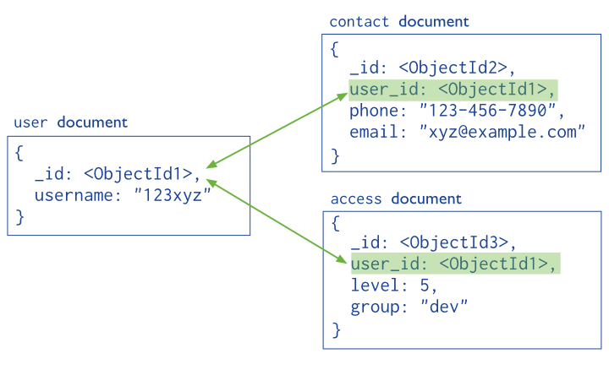
[Optional] Reference
References store the relationships between data by including links or references from one document to another. Applications can resolve these references to access the related data. Broadly, these are normalized data models.

Slide 61
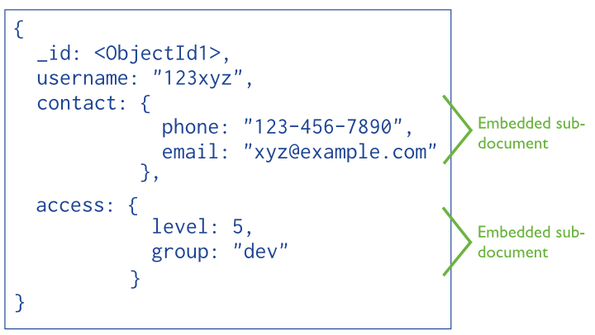
[Optional] Embedded data
Embedded documents capture relationships between data by storing related data in a single document structure. MongoDB documents make it possible to embed document structures in a field or array within a document. These de-normalized data models allow applications to retrieve and manipulate related data in a single database operation.

Slide 62
[Optional] Other points that need to be explored…
Here are several materials for interesting points in MongoDB. We encourage you to explore them in your individual assignments, group projects, and future work:
Data Modeling: https://docs.mongodb.com/v3.4/core/data-modeling-introduction/
Index: https://docs.mongodb.com/v3.4/indexes/
Security: https://docs.mongodb.com/v3.4/security/
Sharding: https://docs.mongodb.com/v3.4/sharding/
Text search: https://docs.mongodb.com/v3.4/text-search/

Slide 63
[Optional] Other points that need to be explored… (cont.)
Using MongoDB with Python: http://api.mongodb.com/python/current/tutorial.html
Using MongoDB with Java: https://www.mongodb.com/blog/post/getting-started-with-mongodb-and-java-part-i
Capped collection (why MongoDB can be used for big data!!): https://docs.mongodb.com/manual/core/capped-collections/
GridFS (how big files are stored and browsed in MongoDB!!): https://docs.mongodb.com/manual/core/gridfs/

Slide 64
Resources for MongoDB
https://www.tutorialspoint.com/mongodb/
https://docs.mongodb.com/v3.4/tutorial/

