Slide 1
MongoDB IV: Retail Dataset (PyMongo)

Slide 2
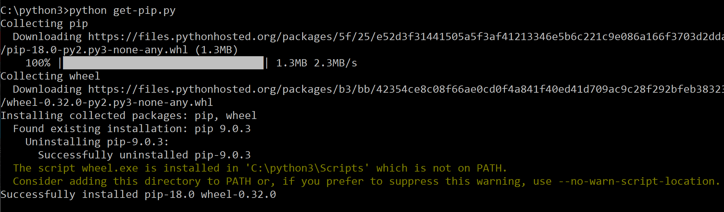
Introduction to PyMongo
PyMongo is a Python distribution containing tools for working with MongoDB
We can use pip (Python Installer) to install PyMongo
pip install pymongo
Download get-pip.py at: https://pip.pypa.io/en/stable/installing/
To get a specific version of PyMongo: pip install pymongo==3.5.1
To install using conda on Anaconda:
conda install -c anaconda pymongo
We will further demostrate an example for PyMongo using Jupyter Notebook

Slide 3

Jupyter Notebook
Jupyter Notebook is an open-source web application that allows you to create and share documents that contain live code, equations, visualizations and narrative text.
Uses include: data cleaning and transformation, numerical simulation, statistical modeling, data visualization, machine learning, and much more.
Jupyter Notebook can be used via Anaconda on Windows or Mac PCs.

Slide 4
Introduction to PyMongo
You should have PyMongo installed in your system as a prerequisite to using MongoDB in Python
To check the following query should run without any error in Jupyter Notebook
import pymongo
Before running the ‘import pymongo’ from your python file you should run an instance of MongoDB on the default host and port (as explained in the MongoDB slides)

Slide 5
Example: Retail Dataset
Here, we discuss the ‘retail’ dataset example using PyMongo.
We will implement majority of the queries discussed for the retail dataset on PyMongo.
Additionally, we will convert the PyMongo collection to a Pandas dataframe and implement some regression algorithms on the same.
Please access the code and datasets at the given link: PyMongo-Examples (https://github.com/Neha41093/PyMongo-Examples)

Slide 6
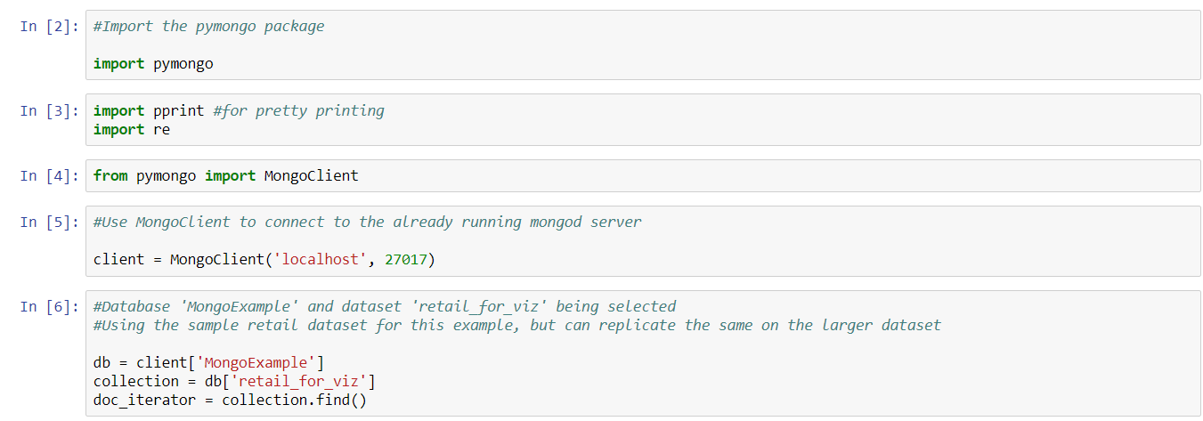
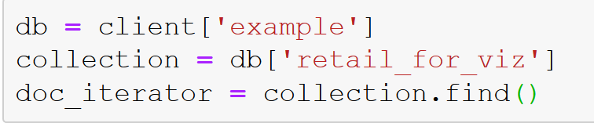
Example: Retail Dataset
We first import some relevant libraries and use the MongoClient instance to connect to multiple databases in MongoDB
We import the pymong package along with other packages like pprint (for pretty printing) and re (for using regular expressions).
We specify ‘localhost’ and the port number 27017 to connect.
We access the database ‘MongoExample’ and the collection ‘retail_for_viz’ as shown above.

Slide 7
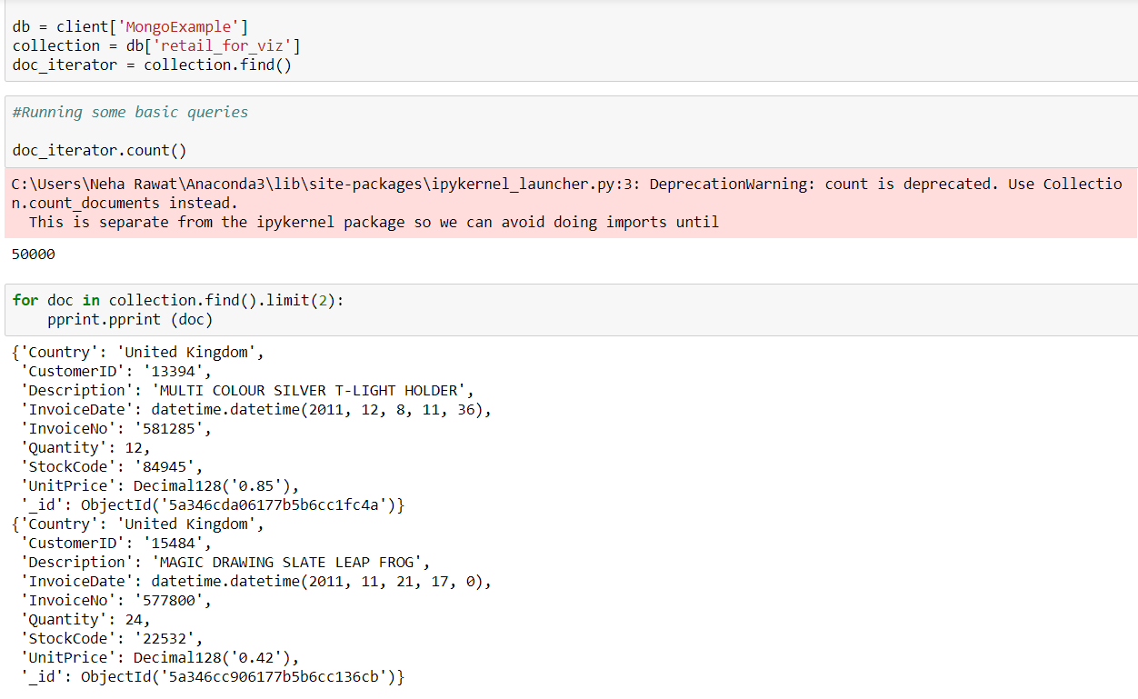
Example: Retail Dataset
We then use the .find() operator to select all documents in the collection and return a cursor to the same (which is assigned to a variable : doc_iterator).
We can use this iterator variable to use different operations on all documents in the collection.
For example, doc_iterator.count() is equivalent to counting all documents in the collection.

Slide 8
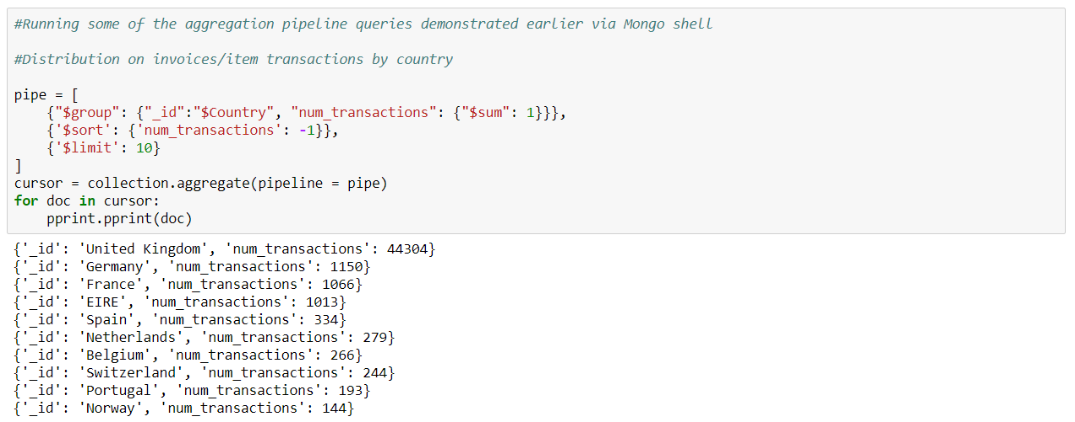
Example: Retail Dataset
pipe = [
{"$group": {"_id":"$Country", "num_transactions":{"$sum":1}}},
{"$sort": {"num_transactions": -1}},
{"$limit":10}
]
cursor = collection.aggregate(pipeline = pipe)
for doc in cursor:
pprint.pprint(doc)
We now execute the aggregation pipeline queries we had implemented earlier in Mongo shell.
Here we use the query to get the distribution of invoice/item transactions by country.
We see that we can use a variable to store the cursor to this pipeline and can iterate using the same over all the selected documents.
pprint is used to print the documents in a pretty format (similar to .pretty())

Slide 9
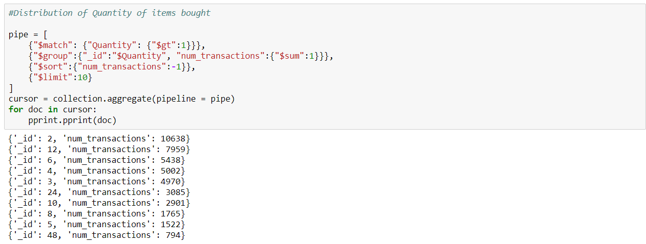
Example: Retail Dataset
pipe = [
{"$match":{"Quantity": {"$gt":1}}},
{"$group":{"_id":"$Quantity", "num_transactions":{"$sum":1}}},
{"$sort":{"num_transactions":-1}},
{"$limit":10}
]
cursor = collection.aggregate(pipeline = pipe)
for doc in cursor: pprint.pprint(doc)
Here we implement the query to get the distribution of quantity of items bought.
We can observe that there is no change in how the aggregation stages are defined.

Slide 10
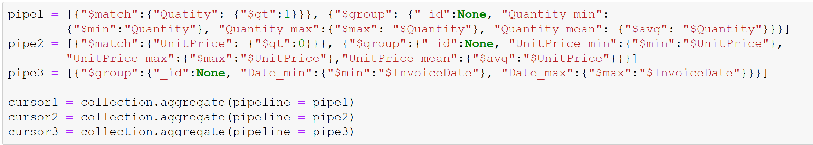
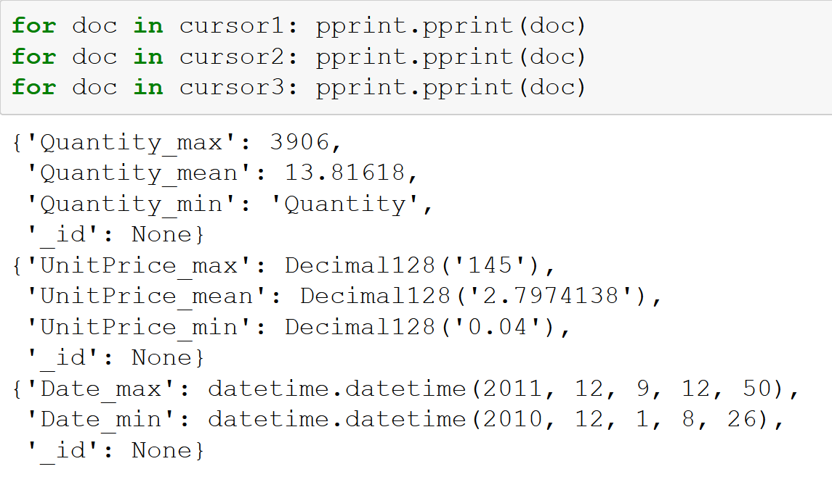
Example: Retail Dataset
pipe1 = [{"$match":{"Quantity": {"$gt":1}}}, {"$group": {"_id":None, "Quantity_min":
{"$min":"$Quantity"}, "Quantity_max":{"$max": "$Quantity"}, "Quantity_mean": {"$avg": "$Quantity"}}}]
pipe2 = [{"$match":{"UnitPrice": {"$gt":0}}}, {"$group":{"_id":None, "UnitPrice_min":{"$min":"$UnitPrice"}, "UnitPrice_max":{"$max":"$UnitPrice"},"UnitPrice_mean":{"$avg":"$UnitPrice"}}}]
pipe3 = [{"$group":{"_id":None, "Date_min":{"$min":"$InvoiceDate"}, "Date_max":{"$max":"$InvoiceDate"}}}]
cursor1 = collection.aggregate(pipeline = pipe1)
cursor2 = collection.aggregate(pipeline = pipe2)
cursor3 = collection.aggregate(pipeline = pipe3)
for doc in cursor1: pprint.pprint (doc)
for doc in cursor2: pprint.pprint (doc)
for doc in cursor3: pprint.pprint (doc)
We obtain the minimum, maximum and average unit price and quantity values.
We also obtain the minimum and maximum dates in the collection.

Slide 11
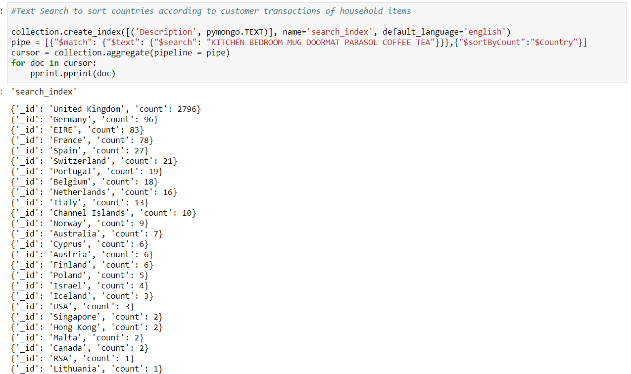
Example: Retail Dataset
collection.create_index([('Description', pymongo.TEXT)], name='search_index',default_language='english')
pipe = [{"$match":{"$text":{"$search":"KITCHEN BEDROOM MUG DOORMAT PARASOL COFFEE TEA"}}},{"$sortByCount":"$Country"}]
cursor = collection.aggregate(pipeline = pipe)
for doc in cursor: pprint.pprint(doc)
We can also implement the text search feature in PyMongo as shown above.
We create the text index using create_index and name it as search_index.
Then, similar to before we assign the results of the aggregation pipeline to a variable and iterate over the selected documents to print them in a pretty format.

Slide 12
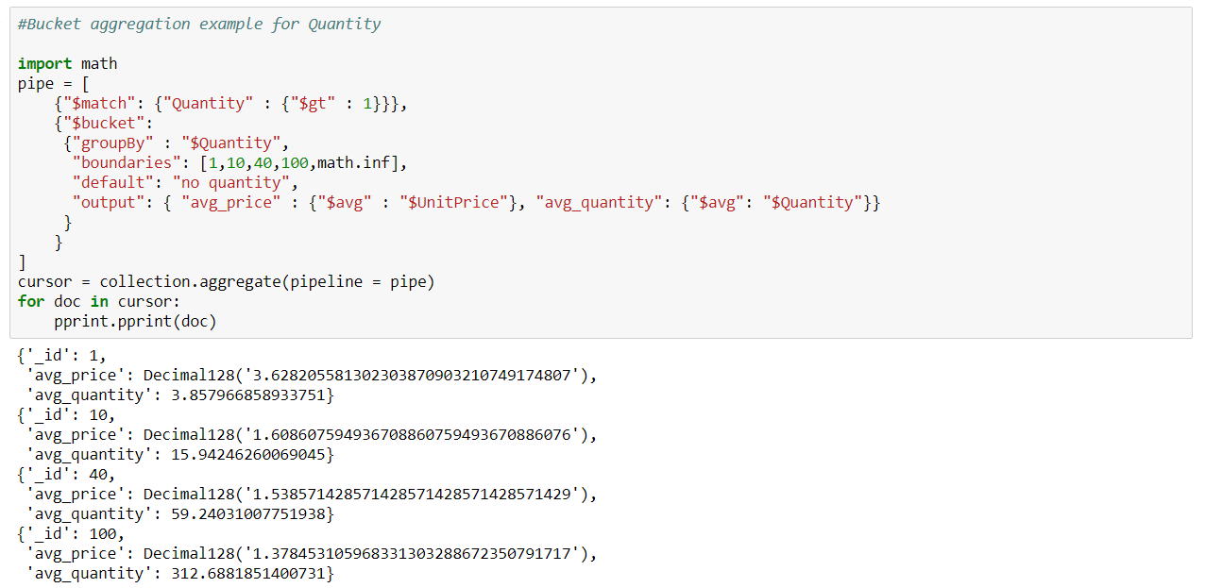
Example: Retail Dataset
import math
pipe = [
{"$match":{"Quantity":{"$gt":1}}},
{"$bucket":
{"groupBy": "$Quantity",
"boundaries":[1,10,40,100, math.inf],
"default": "no quantity",
"output": {"avg_price": {"$avg":"$UnitPrice"}, "avg_quantity":{"$avg":"$Quantity"}}}}
]
cursor = collection.aggregate(pipeline = pipe)
for doc in cursor: pprint.pprint(doc)
Here, we implement the bucket aggregation stage via PyMongo.
We see that the syntax is similar to the MongoDB query for the same.
We use math.inf to represent Infinity in Python.

Slide 13
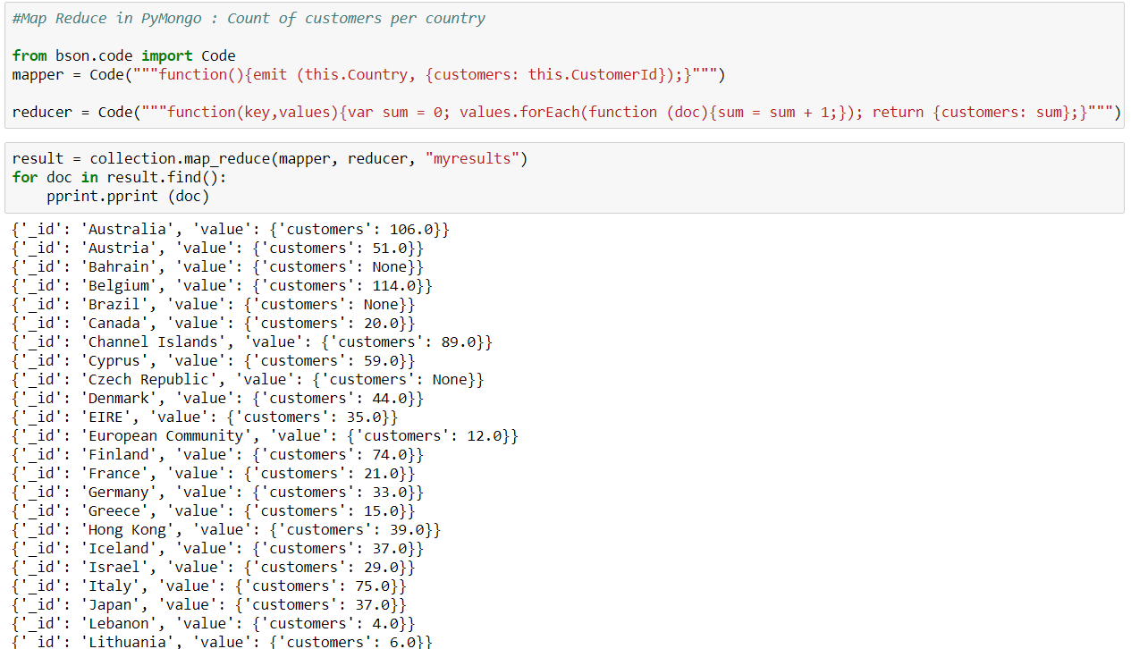
Example: Retail Dataset
from bson.code import Code
mapper = Code("""function(){emit (this.Country, {customers:this.CustomerId});}""")
reducer = Code("""function(key,values){var sum=0; values.forEach(function (doc){sum=sum+1;});
return{customers:sum};}""")
result=collection.map_reduce(mapper, reducer, "myresults")
for doc in result.find():pprint.pprint (doc)
Here, we implement the map reduce code using the map_reduce function for PyMongo.
We use the bson package to define the map and reduce functions.
The results are output as the collection ‘myresults’. The variable ‘result’ is used to iterate over the documents in the output.
* Do not install the bson package separately. It is included within the pymongo package.

Slide 14
Other examples
Converting mongo data into Pandas
Data Analytics using the retail data

Slide 15
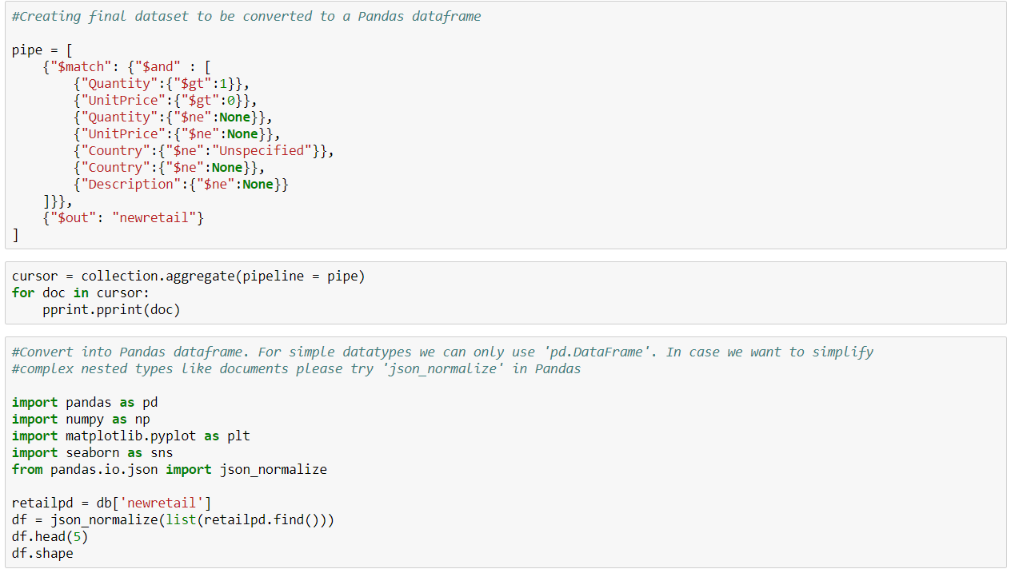
Example: Retail Dataset
Finally, we convert the MongoDB collection to a Pandas dataframe for easier analysis in Python.
Pandas is a library providing high-performance, easy-to-use data structures and data analysis tools for the Python programming language.
We can use the function pandas.DataFrame or json_normalize (included in Pandas especially for JSON documents) to do the same.

Slide 16
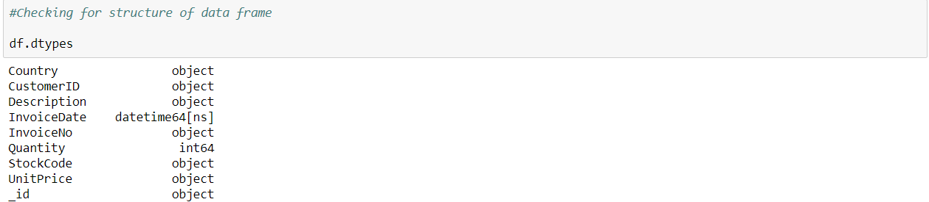
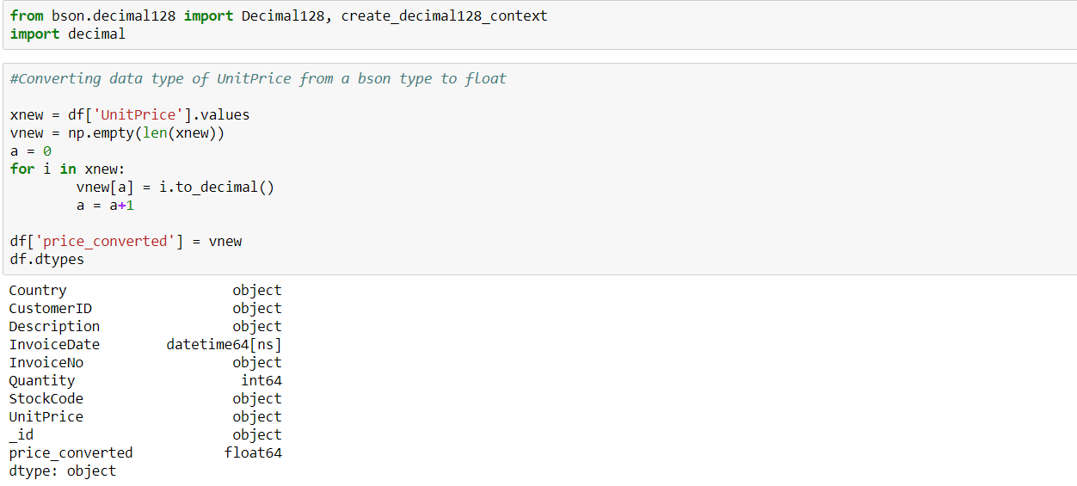
Example: Retail Dataset
After converting the MongoDB collection to a Pandas dataframe, we attempt to get all the fields in a Python-friendly format.
Therefore, we use the bson package again to generate a new field ‘price_converted’ which contains the ‘UnitPrice’ field values, but in a float/decimal format as opposed to the Decimal128 precision format in which it is stored in MongoDB.

Slide 17
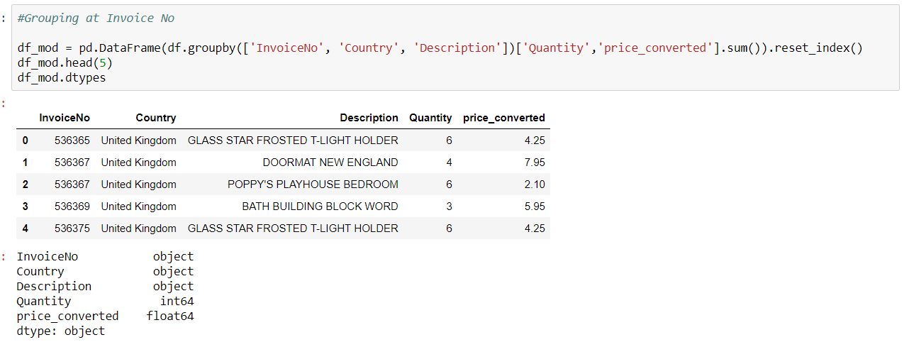
Example: Retail Dataset
We further reduce the data frame by grouping the quantity and unit price values at the invoice level.

Slide 18
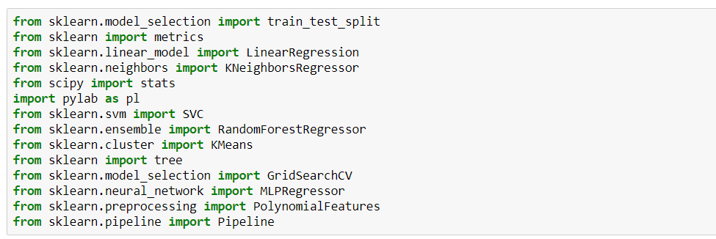
Example: Retail Dataset
We now import Python libraries for data preprocessing, analysis and evaluation.
One major library used in Python for this is scikit-learn/sklearn.
It provides simple and efficient tools for data mining and data analysis and is most prominently used for machine learning in Python.

Slide 19
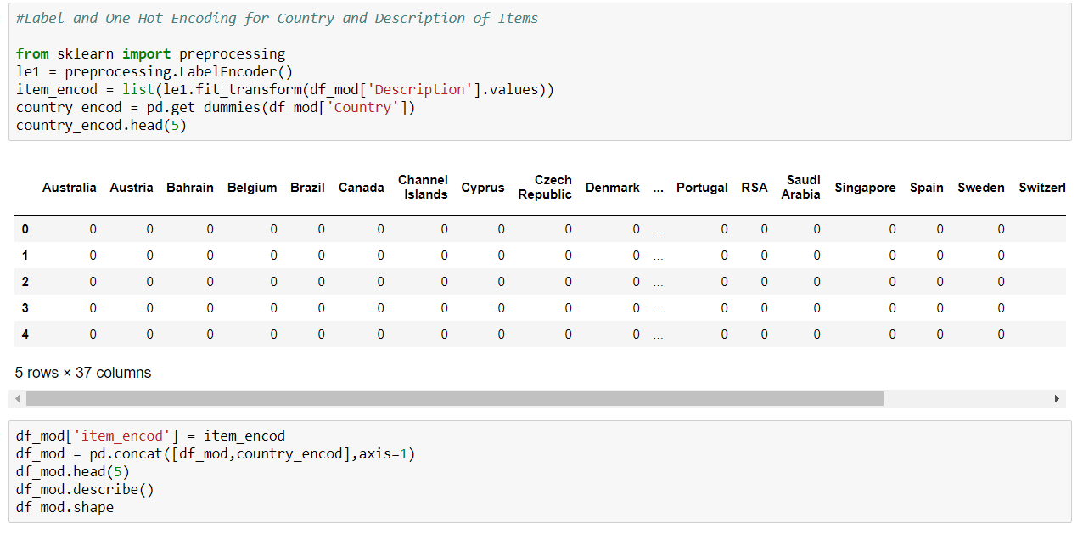
Example: Retail Dataset
We can further simplify the data by encoding the categorical variables – the item description and country names.
Two common encodings that can be used are one-hot encoding (creating 1/0 based dummies for the categorical variable) or label encoding (creating numerical labels for the different levels in the categorical field).
Other possible encodings for categorical variables can also be explored.

Slide 20
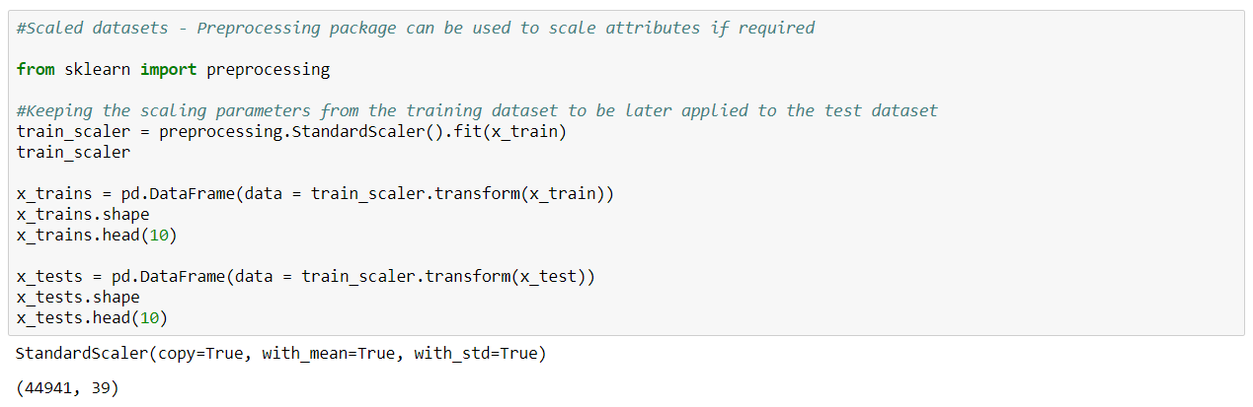
Example: Retail Dataset
Another preprocessing methodology which can be employed is scaling our data.
This can be accomplished by using the StandardScaler function in sklearn.
It standardizes features by removing the mean and scaling to unit variance.

Slide 21
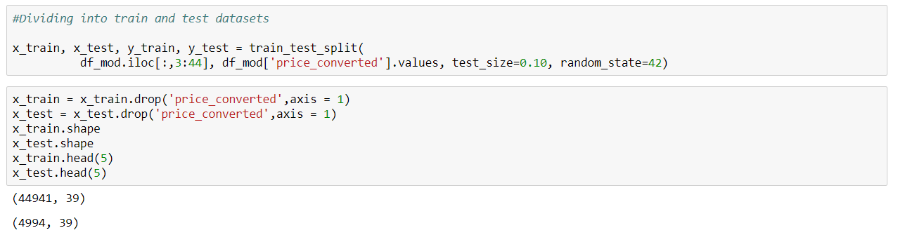
Example: Retail Dataset
We can now use the preprocessed datasets to implement a regression task for price of items.
To do the same, we first divide our dataset into training and testing subsets.
We do this using the train_test_split function in sklearn.

Slide 22
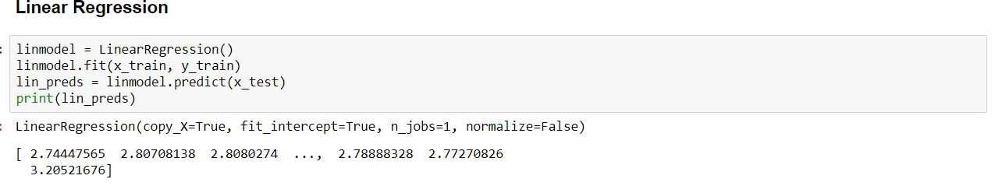
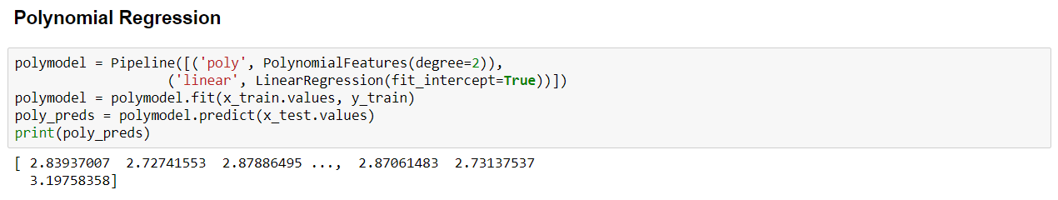
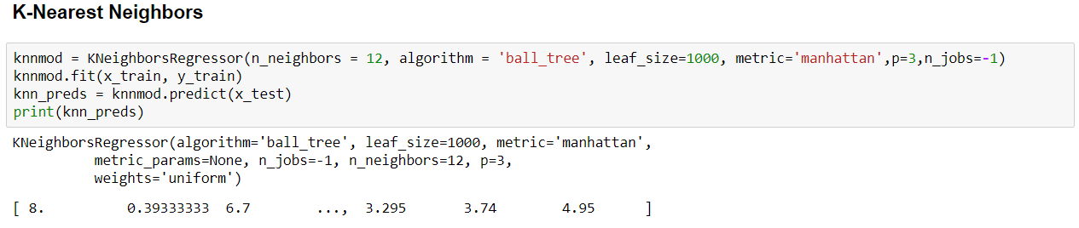
Example: Retail Dataset
Now, we can implement a variety of regression models using this dataset.
In this example, we train and evaluate linear regression, polynomial regression, K-Nearest Neighbor, Random Forest and Multi-Layer Perceptron models.

Slide 23
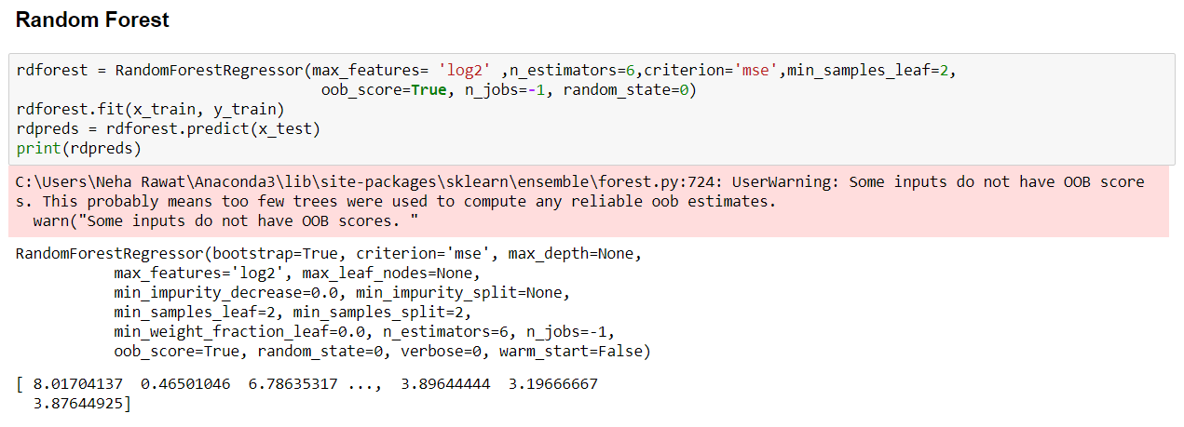
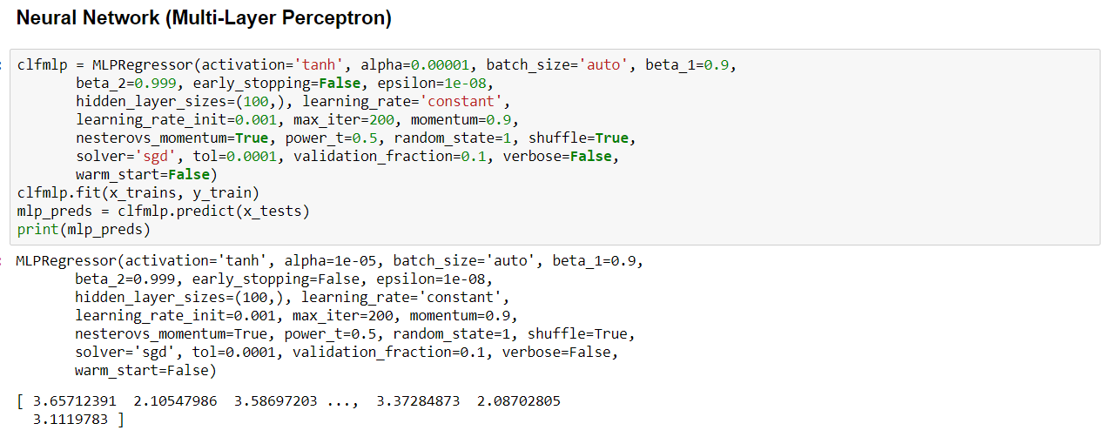
Example: Retail Dataset
To learn more about these models and the parameters used, please read the sklearn documentation: http://scikit-learn.org/stable/ (also included in Appendix)

Slide 24
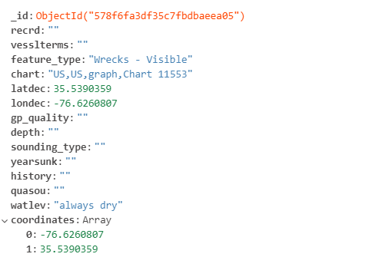
Example: Geospatial Data
In this section we use the ‘shipwrecks’ collection (document structure in figure) in order to demonstrate how to view geospatial data using PyMongo.
We can do the same using ‘folium’ package in Python.
Folium makes it easy to visualize data that’s been manipulated in Python on an interactive leaflet map. It enables both the binding of data to a map for choropleth visualizations as well as passing rich vector/raster/HTML visualizations as markers on the map.
To install folium via Anaconda use: conda install -c conda-forge folium
To read more about folium visit: https://python-visualization.github.io/folium/

Slide 25
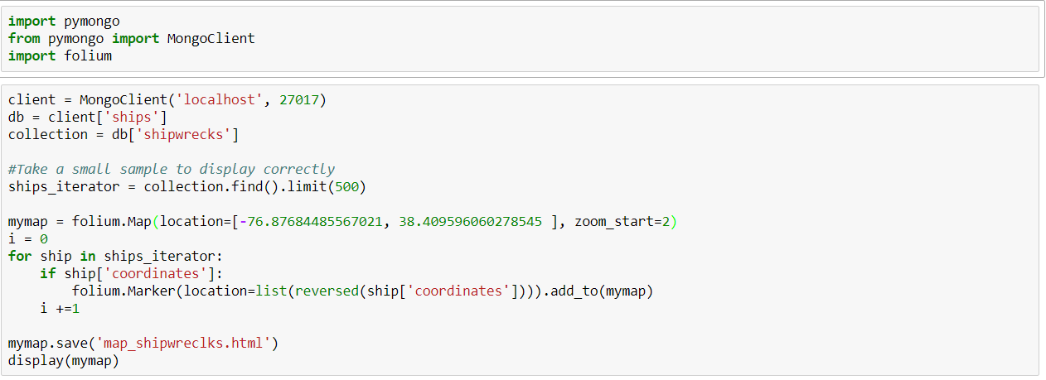
Example: Geospatial Data
We first import the required packages and connect to the MongoDB databases via MongoClient.
Post that, we take a small sample of the shipwrecks collection to display on the map.
Then, we add markers on our folium map (as per the coordinates in the collection) as shown above.

Slide 26
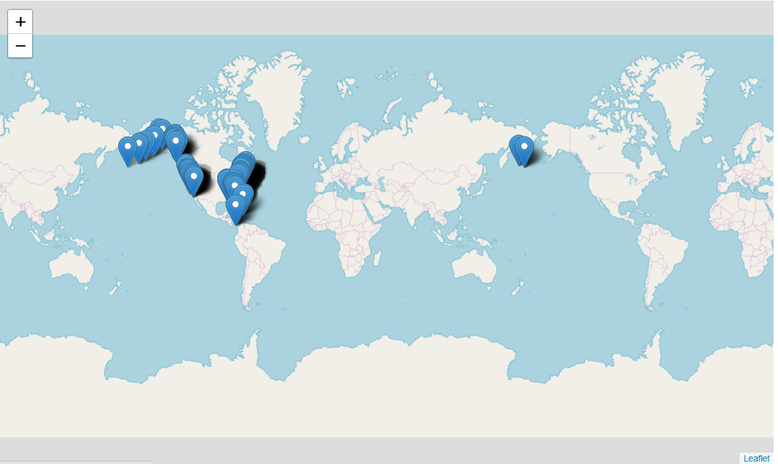
Example: Geospatial Data
We can now see the markers at the specified locations on the world map.

Slide 27
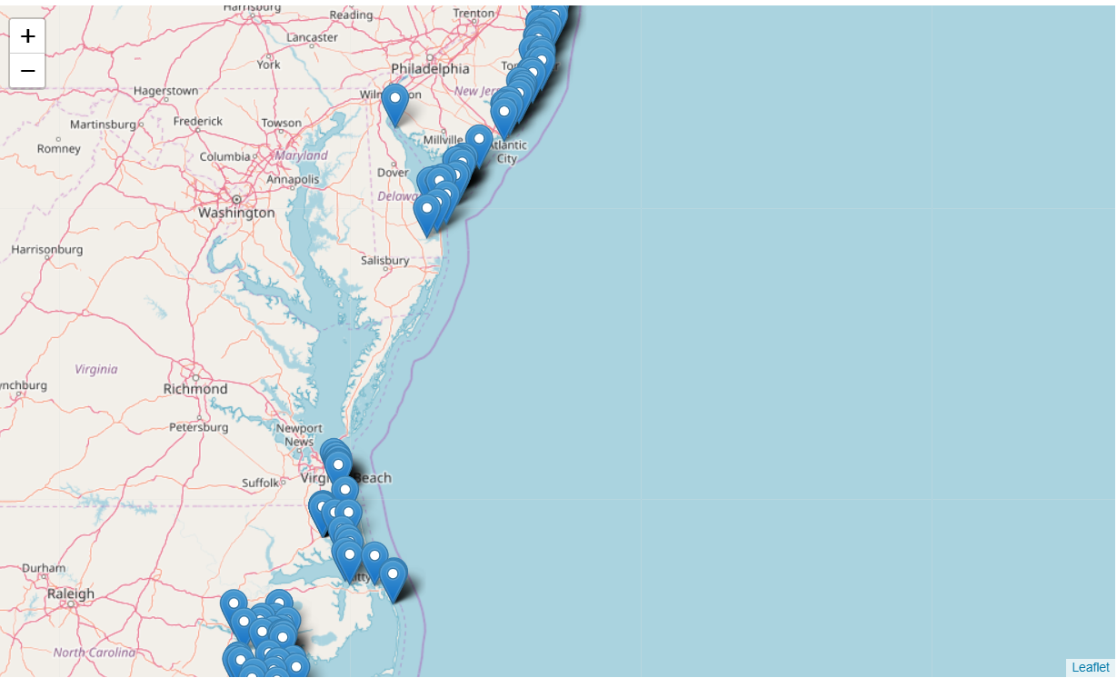
Example: Geospatial Data
We can zoom in further by double clicking on the markers to see specific locations.

Slide 28
References
MongoDB documentation: https://docs.mongodb.com/manual/
PyMongo documentation: https://api.mongodb.com/python/current/index.html
Pandas documentation: http://pandas.pydata.org/pandas-docs/stable/
Scikit-learn documentation: http://scikit-learn.org/stable/
Folium documentation: https://python-visualization.github.io/folium/
Wikipedia: https://www.wikipedia.org/

Slide 29
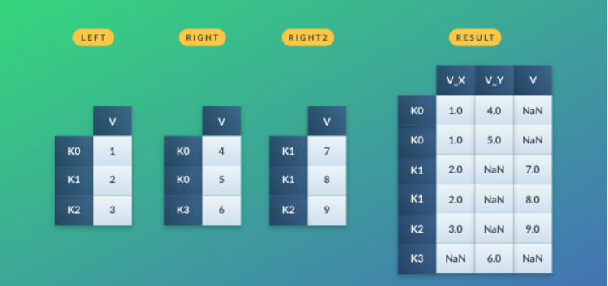
Appendix
Pandas
Pandas is an open source data analysis library for providing easy-to-use data structures and data analysis tools.
Pandas dataframes:
Pandas offers data frames as a way to store data in rectangular grids that can easily be overviewed. Each row of these grids corresponds to measurements or values of an instance, while each column is a vector containing data for a specific variable.
*Source: https://www.datacamp.com/community/tutorials/pandas-tutorial-dataframe-python

Slide 30
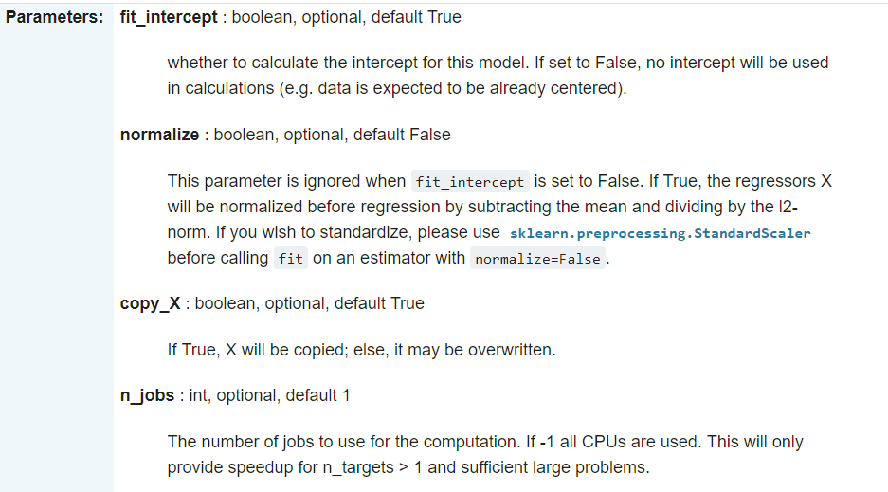
Appendix
Linear Regression:
This is a linear approach to modelling the relationship between a dependent variable and one or more explanatory variables.
The model takes the following form:
Sklearn parameters:

Slide 31
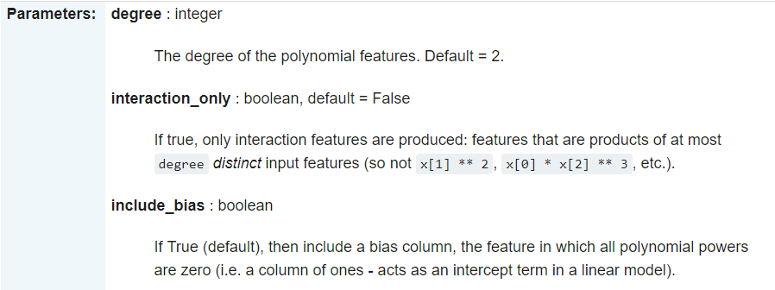
Appendix
Polynomial Regression:
This is a form of regression analysis in which the relationship between the independent variable x and the dependent variable y is modelled as an nth degree polynomial in x.
The model takes the following form:
This can be modeled as polynomial regression using PolynomialFeatures in sklearn.

Slide 32
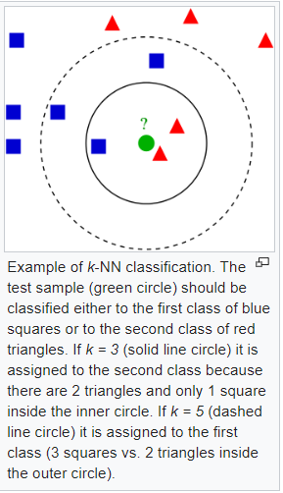
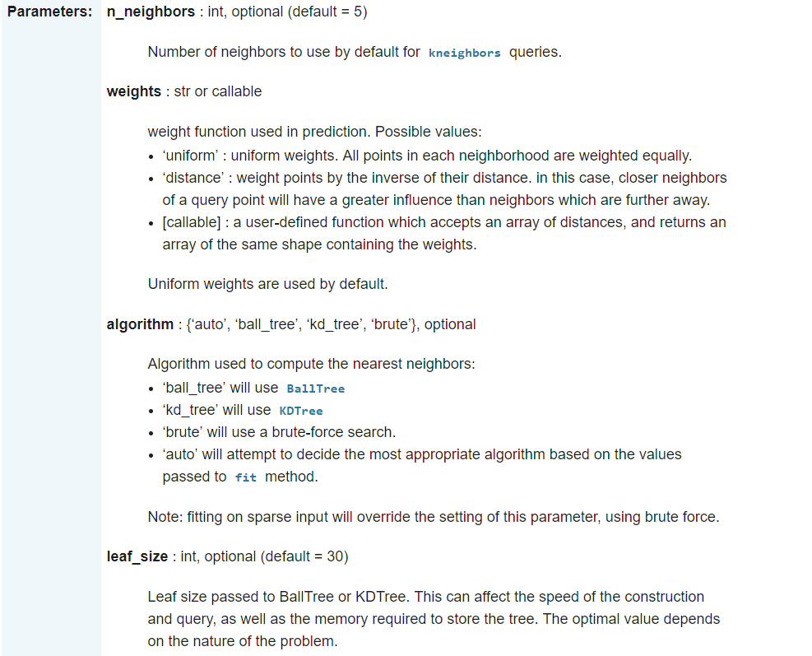
Appendix
K-Nearest Neighbors
In KNN, the target is predicted by local interpolation of the targets associated of the ‘k’ nearest neighbors in the training set.
Sklearn parameters:

Slide 33
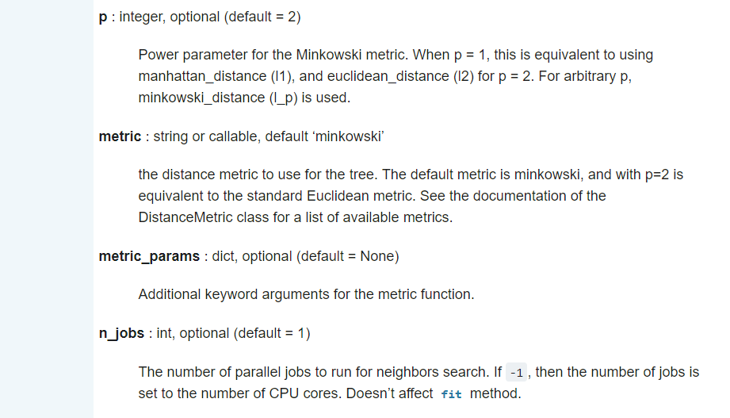
Appendix
K-Nearest Neighbors
Sklearn parameters:

Slide 34
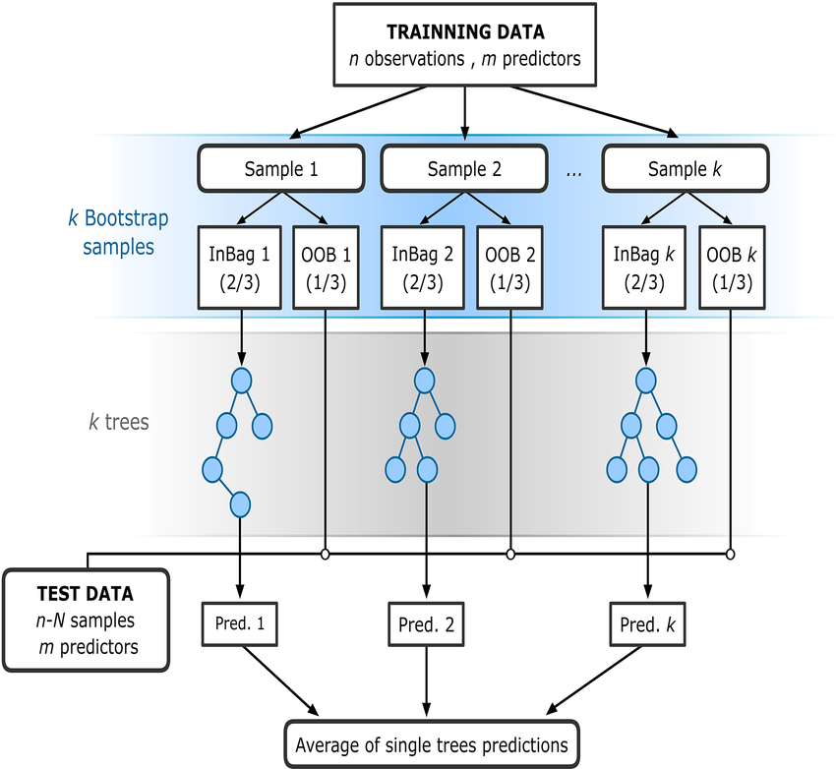
Appendix
Random Forest
A random forest is an estimator that fits a number of classifying decision trees on various sub-samples of the dataset and uses averaging to improve the predictive accuracy and control over-fitting.
OOB: Out-of-bag sample
*Source: https://www.researchgate.net/figure/The-flowchart-of-random-forest-RF-for-regression-adapted-from-Rodriguez-Galiano-et_fig3_303835073

Slide 35
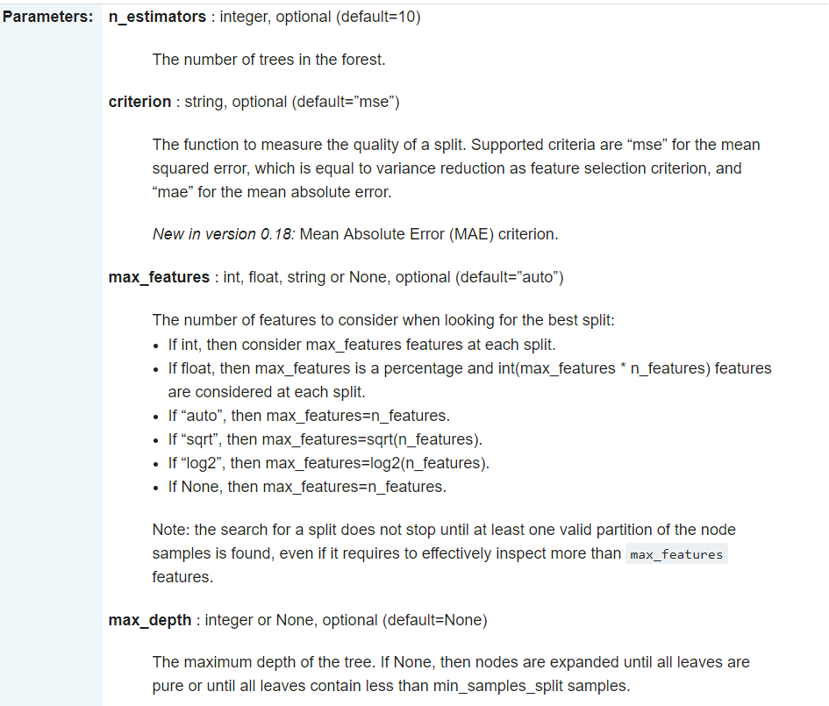
Appendix
Random Forest
Sklearn parameters:

Slide 36
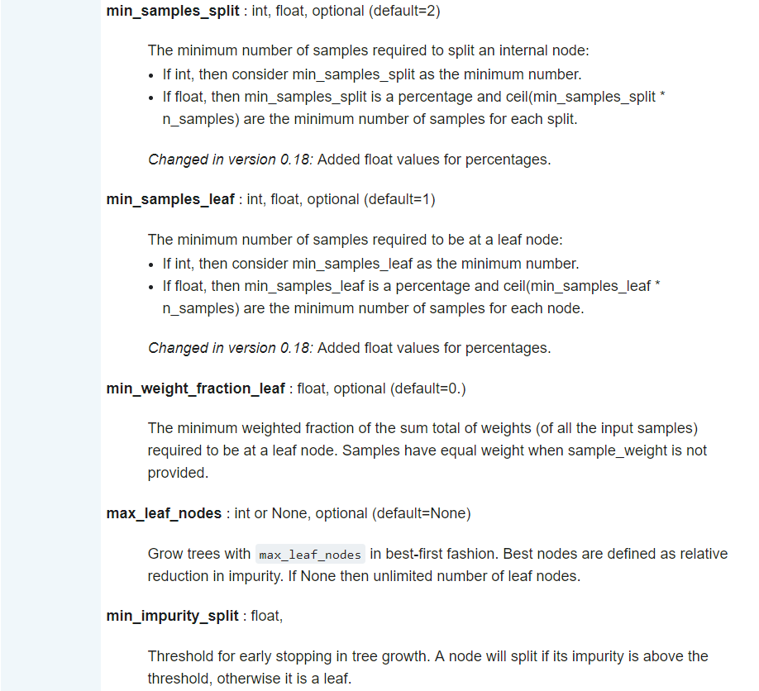
Appendix
Random Forest
Sklearn parameters:

Slide 37
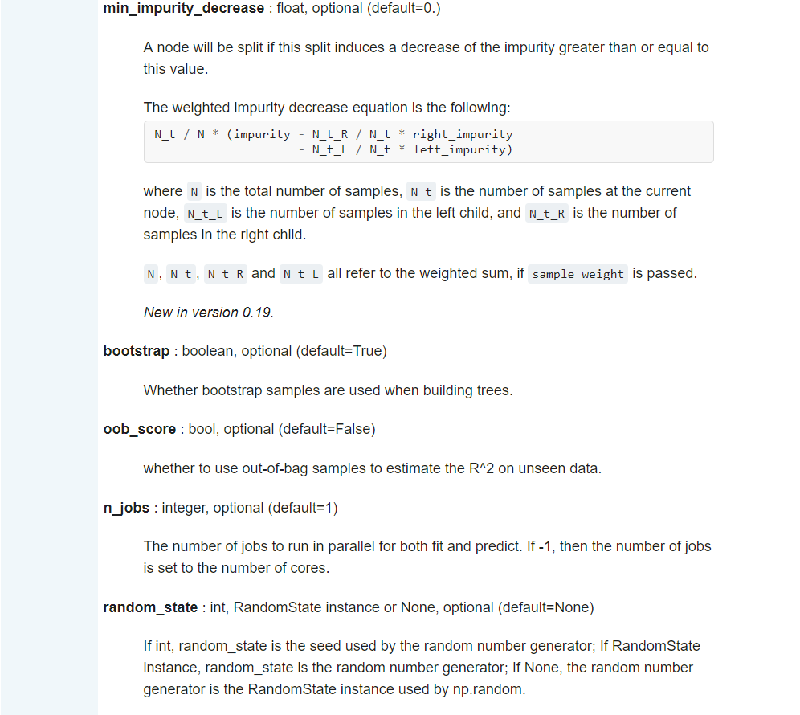
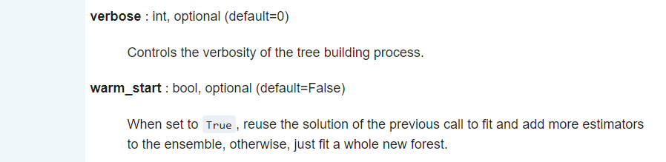
Appendix
Random Forest
Sklearn parameters:

Slide 38

Appendix
Multi-Layer Perceptron
A multilayer perceptron (MLP) is a class of feedforward artificial neural network. An MLP consists of at least three layers of nodes.
Except for the input nodes, each node is a neuron that uses a nonlinear activation function.
MLP utilizes a supervised learning technique called backpropagation for training.
If a multilayer perceptron has a linear activation function in all neurons, then linear algebra shows that any number of layers can be reduced to a two-layer input-output model.
The two common activation functions (hyperbolic tangent and logistic function) are both sigmoids, and are described by

Slide 39
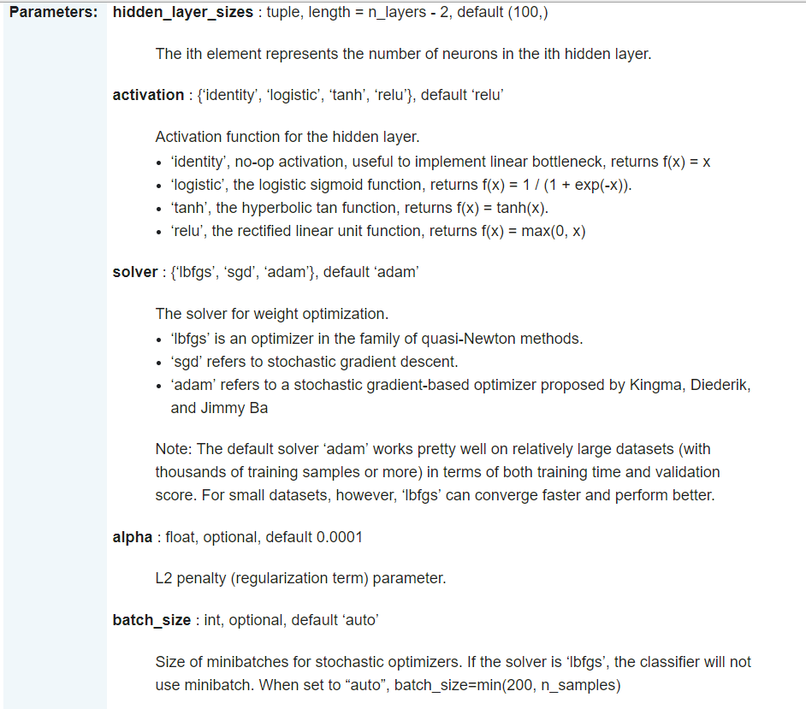
Appendix
Multi-Layer Perceptron
Sklearn parameters:

Slide 40
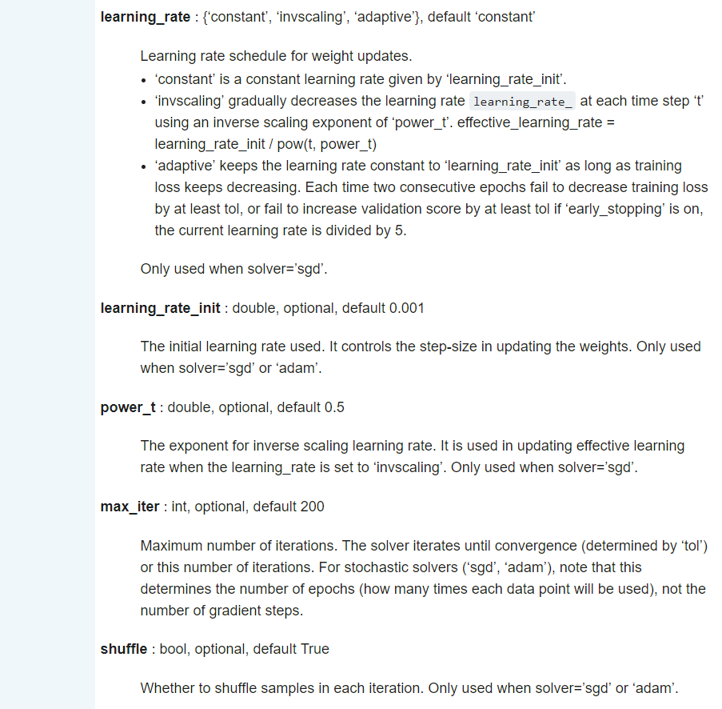
Appendix
Multi-Layer Perceptron
Sklearn parameters:

Slide 41
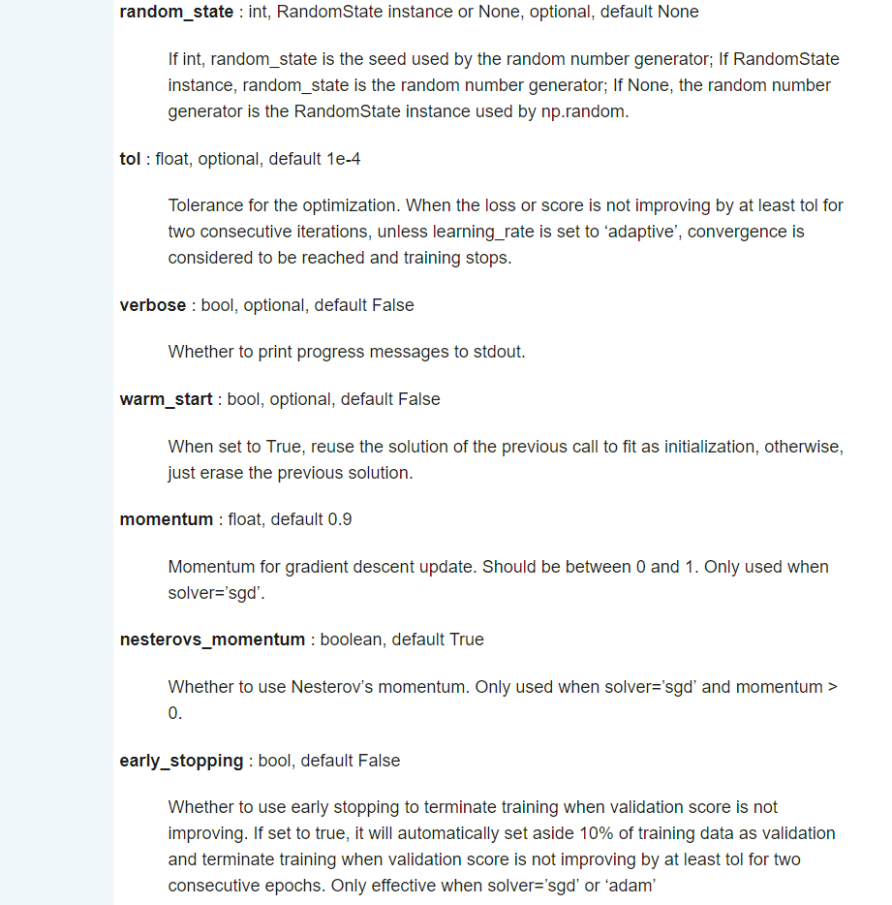
Appendix
Multi-Layer Perceptron
Sklearn parameters:

Slide 42
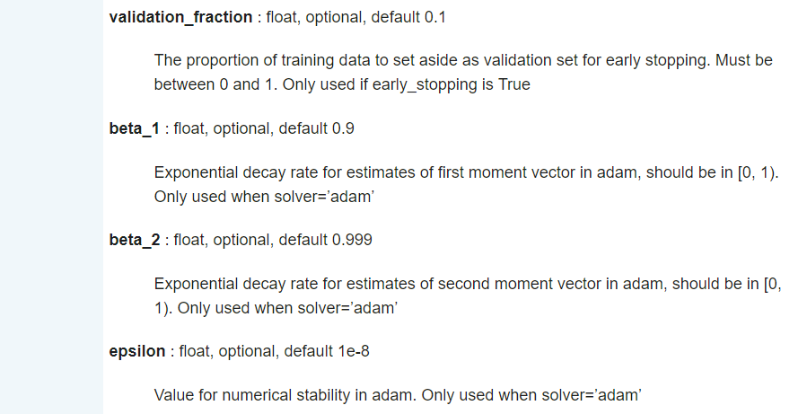
Appendix
Multi-Layer Perceptron
Sklearn parameters:

Slide 43
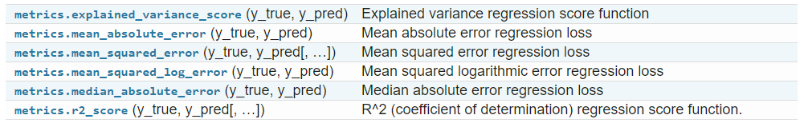
Appendix
Evaluation Metrics for Regression (Sklearn)
Explained Variance Score
Mean Absolute Error
Mean Squared Error
Mean Squared Log Error
Median Absolute Error
R-Squared Score
Please visit the sklearn site and view the User Guide and documentation for details.

