Slide 1
MongoDB VI: H1B dataset (with PyMongo)

Slide 2
Recap: Introduction to PyMongo
PyMongo is a Python distribution containing tools for working with MongoDB
We can use pip (Python Installer) to install PyMongo
pip install PyMongo
To get a specific version of pymongo:
pip install pymongo==3.5.1

Slide 3
Introduction to working with MongoDB and PyMongo
You should have PyMongo installed in your system as a prerequisite to using MongoDB in Python
To check the following query should run without any error in python shell
import pymongo

Slide 4
Before running the ‘import pymongo’ from your python file you should run an instance of MongoDB on the default host and port.
You can start an instance of MongoDB by running the following command from your terminal
mongod
Be careful to execute the above command from your terminal not the mongodb’s shell prompt

Slide 5
Establishing Connection with MongoClient from your Python code
First step to work with PyMongo is to create a Mongo Client to the mongodb instance
Follow below code snippet for MongoDB client creation
>>>>from pymongo import MongoClient >>>> client = MongoClient()

Slide 6
Connecting to MongoDB Database
We can use MongoClient instance to connect to multiple databases in MongoDB
We can use the below code snipped
>>>>client = MongoClient()
>>>>db = client[‘name_of_your_db’]

Slide 7
Connecting to Collections
Getting a collection in PyMongo works the same as getting a database
We can use the below code snipped to connect to the collection
>>> collection = db['name_of_your_collection']
Note that the ‘db’ object was created while we connected to the MongoDB database. The same object is used to access the collection

Slide 8
Documents in MongoDB
Data in MongoDB is represented using JSON
In PyMongo we use dictionaries to represent documents.
Let’s consider an example
person = { "name": "Rohan", "age": “24",
“Degree” :” Masters”, "Major": “Computer Science”
}

Slide 9
“db.collection.find()” method
Selects documents in a collection or view and returns a cursor to the selected documents.
The find method takes two optional parameters: query and projection
Parameter | Type | Description
query | document | Optional. Specifies selection filter using query operators. To return all documents in a collection, omit this parameter or pass an empty document ({}).
projection | document | Optional. Specifies the fields to return in the documents that match the query filter. To return all fields in the matching documents, omit this parameter.

Slide 10
Continued….
db.collection.find() method returns a cursor to the documents that match the query criteria.
When the find() method “returns documents,” the method is actually returning a cursor to the documents.

Slide 11
Basic Queries
Find All Documents in a Collection
The find() method with no parameters returns all documents from a collection and returns all fields for the documents.
db.collection.find()
Find Documents that Match Query Criteria
To find documents that match a set of selection criteria, call find() with the <criteria> parameter.

Slide 12
db.collection.find( { parameter_name: { $gt: 50 } } )
Returns all the documents whose value for given parameter is greater than 50
Query for Equality
The following operation returns documents in the given collection where _id equals 100:
db.collection.find( { _id: 100 } )

Slide 13
Query for Ranges
Combine comparison operators to specify ranges. The following operation returns documents with field between value1 and value2:
db.collection.find( { field: { $gt: value1, $lt: value2 } } );
Query a Field that Contains an Array
If a field contains an array and your query has multiple conditional operators, the field as a whole will match if either a single array element meets the conditions or a combination of array elements meet the conditions.
db.collection.find( { parameter_name: { $gt: lower_bound, $lt: upper_bound } } )

Slide 14
Projection parameter
The projection parameter determines which fields are returned in the matching documents.
The projection parameter takes a document of the following form:
{ field1: <value>, field2: <value> ... }
The <value> can be any of the following:
1 or true to include the field in the return documents.
0 or false to exclude the field.

Slide 15
Projection (Continued)
For the _id field, you do not have to explicitly specify _id: 1 to return the _id field. The find() method always returns the _id field unless you specify _id: 0 to suppress the field.
A projection cannot contain both include and exclude specifications, except for the exclusion of the _id field. In projections that explicitly include fields, the _id field is the only field that you can explicitly exclude.

Slide 16
Example of Projection
The following operation returns all the documents from the products collection where qty is greater than 25 and returns only the _id, item and qty fields:
db.products.find( { qty: { $gt: 25 } }, { item: 1, qty: 1 } )
Explicitly Exclude Fields
db.collection.find( { }, { attribute_name:0 } )
Explicitly exclude the _id Field
db.collection.find({},{_id:0})

Slide 17
How to iterate over the returned Cursor?
The find() method returns a cursor to the results.
In the mongo shell, if the returned cursor is not assigned to a variable using the var keyword, the cursor is automatically iterated to access up to the first 20 documents that match the query. You can set the DBQuery.shellBatchSize variable to change the number of automatically iterated documents.
To manually iterate over the results, assign the returned cursor to a variable with the var keyword
With Variable Name
The following example uses the variable myCursor to iterate over the cursor and print the matching documents:
var myCursor = db.bios.find( );

Slide 18
With next() Method
The following example uses the cursor method next() to access the
documents:
var myCursor = db.bios.find( );
var myDocument = myCursor.hasNext() ? myCursor.next() : null;
if (myDocument) {
var myName = myDocument.name;
print (tojson(myName));
}

Slide 19
With forEach() Method
The following example uses the cursor method forEach() to iterate the cursor and access the documents:
var myCursor = db.bios.find( );
myCursor.forEach(printjson);

Slide 20
Modify the behaviour of cursor
The mongo shell and the drivers provide several cursor methods that call on the cursor returned by the find() method to modify its behavior.
Order Documents in the Result Set
The sort() method orders the documents in the result set. The following operation returns documents in the students collection sorted in ascending order by the name field:
db.students.find().sort( { name: 1 } )

Slide 21
Limit the Number of Documents to Return
The limit() method limits the number of documents in the result set.
The following operation returns at most 5 documents in the students collection:
db.students.find().limit(5)
limit() corresponds to the LIMIT statement in SQL.
Set the Starting Point of the Result Set
The skip() method controls the starting point of the results set. The following operation skips the first 5 documents in the students collection and returns all remaining documents: db.students.find().skip( 5 )

Slide 22
Combine Cursor Methods
The following statements chain cursor methods limit() and sort():
db.bios.find().sort( { name: 1 } ).limit( 5 )
db.bios.find().limit( 5 ).sort( { name: 1 } )
The two statements are equivalent; i.e. the order in which you chain the limit() and the sort() methods is not significant. Both statements return the first five documents, as determined by the ascending sort order on ‘name’.

Slide 23
Queries using PyMongo
Next slide……………..

Slide 24
Find Distinct Companies who file for H1B
The purpose of this query is to find the distinct list of employers operating in the United States who file H1B for their employees
This statistics can be used by the job seekers to choose right or more appropriate company with respect to their future prospects

Slide 25
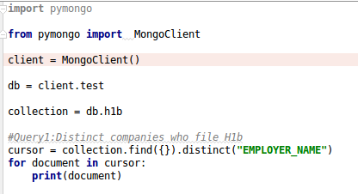
Code for Query 1

Slide 26
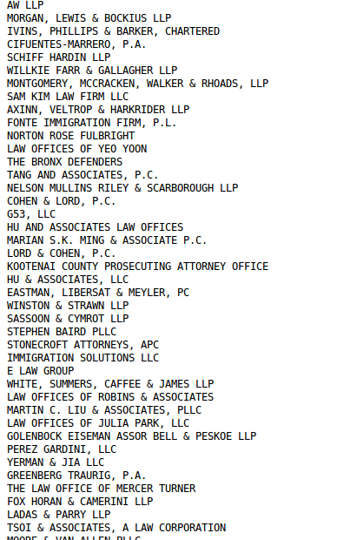
Output for Query 1

Slide 27
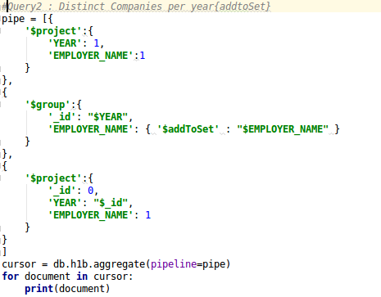
Find distinct companies per year who file H1b

Slide 28


Slide 29
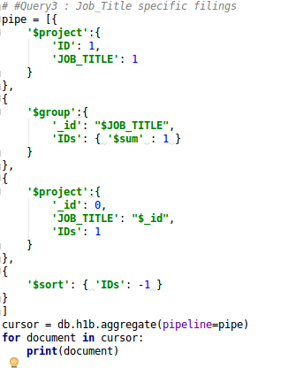
Find Job_title specific filings

Slide 30


Slide 31
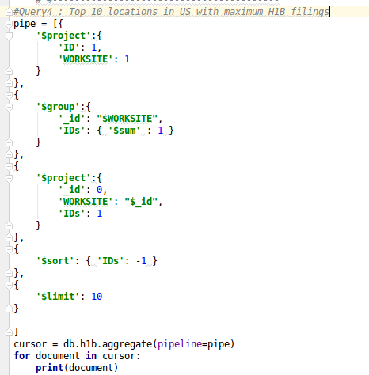
Top 10 locations in US with maximum H1B filings

Slide 32
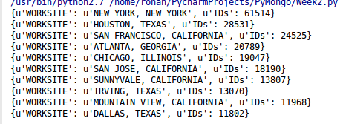

Slide 33
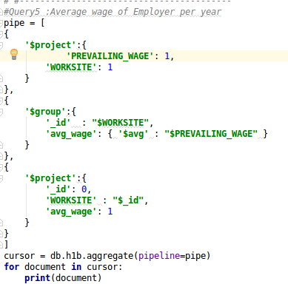
Finding average wage of Employer per yearr

Slide 34
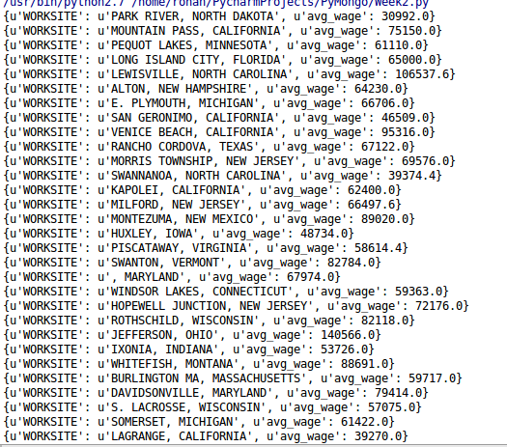
& so on

Slide 35
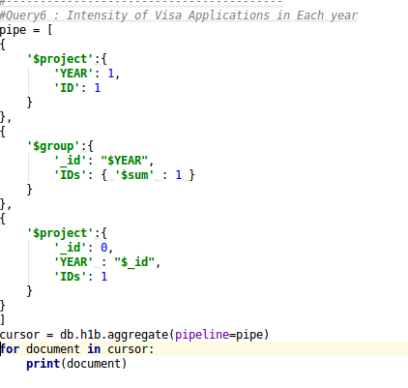

Intensity of Visa Applications in Each Year

Slide 36
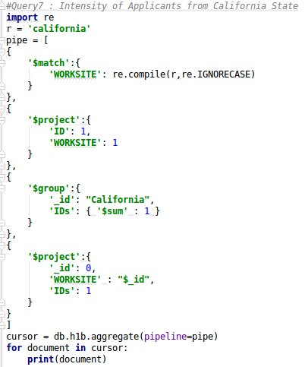
Intensity of Applicants from California State

Slide 37
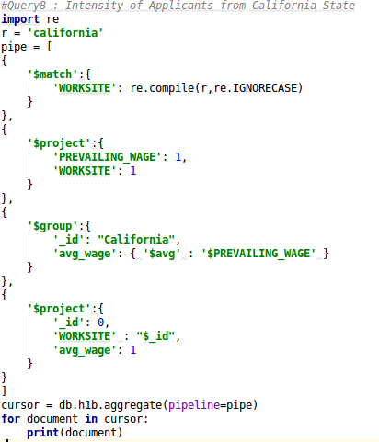
Finding average wage in California

Slide 38
THANK YOU

