Slide 1
Noe4j: Graph Databases

Slide 2
Outline
Introduction
Installation
Graph Database
Cypher
Properties & Relationships
Order By, Limit, and Skip
Predicates and Conditions
Indexing and Labels
Aggregation
Importing Data

Slide 3
I. Introduction

Slide 4
Neo4j
Neo4j is a highly scalable, native graph database purpose-built to leverage not only data but also its relationships.
Graphs – i.e., networks – are the most efficient and intuitive way of working with data, mimicking the interconnectedness of ideas in the human mind. Neo4j is built from the ground up to harness the power of graphs for real-time, bottom-line insights.
It follows an intuitive adaptable data modeling technique.
Uses Cypher, the graph query language

Slide 5
Advantages
The native property graph model captures data as it naturally occurs, with both nodes and relationships having properties.
No need for schema migrations as the data model flexes agilely with new business requirements.
Traverse graph with Cypher, a declarative query language which defines graph patterns using ASCII-art for Graphs
Support for replication with master re-election and failover to keep your data safe and reliable

Slide 6
Neo4j vs. Relational Databases (RDBMS)
 | Relational Database | Neo4j, Native Graph Database
Data Storage | Storage in fixed, pre-defined tables with rows and columns with connected data often disjointed between tables | Graph storage structure with index-free adjacency results in faster transactions and processing for data relationships.
Data Modeling | Since data types and sources must be known ahead of time, any changes require weeks of downtime for implementation. | Data types and sources can be added or changed at any time, leading to dramatically shorter development times and true agile iteration.
Query Performance | Data processing performance suffers with the number and depth of JOINs (or relationships queried). | Graph processing ensures zero latency and real-time performance, regardless of the number or depth of relationships.
Query Language | SQL: A query language that increases in complexity with the number of JOINs needed for connected data queries. | Cypher: A native graph query language that provides the most efficient and expressive way to describe relationship queries.

Slide 7
Neo4j vs. Other NoSQL Databases
 | Other NoSQL Databases | Neo4j, Native Graph Database
Data Storage | No support for connected data at the database level. Performance and data trustability degrade with scale and complexity of connections. | Native graph storage structure with index-free adjacency results in faster transactions and processing for data relationships.
Data Modeling | Data model not suitable for enterprise architectures as wide columns and document stores do not offer control at the design level. Puts undue pressure on the application level to catch and solve problems. | Flexible, "whiteboard-friendly" data model allows for fine-grained control of data architecture. Intuitive data model eases communication between developers, architects and DBAs.
Query Performance | No graph processing capability for data relationships, thus all relationships have to be created at the application level. | Native graph processing ensures zero latency and real-time performance, regardless of the number or depth of relationships.

Slide 8
II. Installation

Slide 9
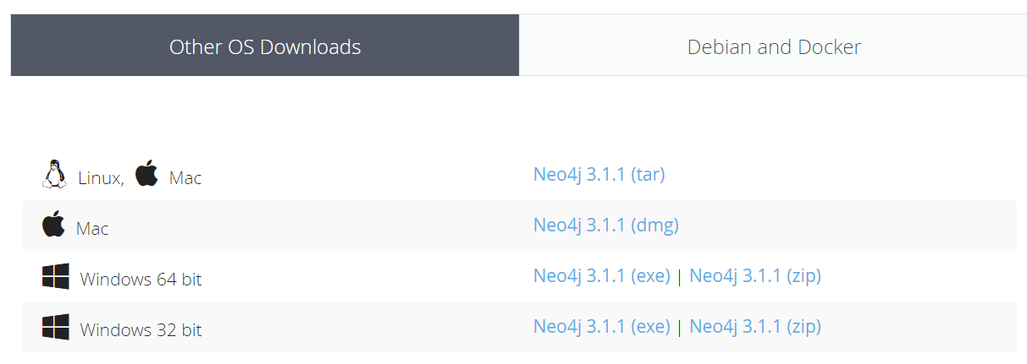
Installing Neo4j
https://neo4j.com/download/
Download the Community Edition with appropriate version:
Run the installer

Slide 10
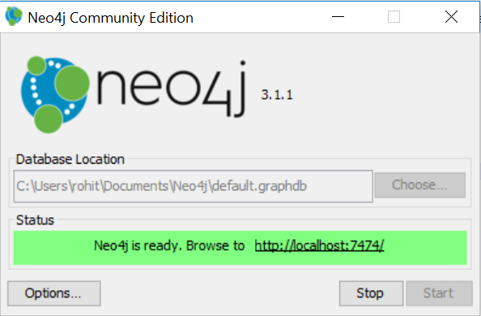
Running the local server
The installer setup will create a local directory containing practice graph datasets
After starting the database, open the Neo4j Browser on http://localhost:7474/

Slide 11
III. Graph Database

Slide 12
What is a Graph?
A graph is composed of two elements: a node and a relationship.
Each node represents an entity (a person, place, thing, category or other piece of data)
Each relationship represents how two nodes are associated. For example, the two nodes cake and dessert would have the relationship is a type of pointing from cake to dessert.

Slide 13
What Is a Graph Database?
A graph database is an online database management system with Create, Read, Update and Delete (CRUD) operations working on a graph data model
Graph databases are generally built for use with On line transaction processing (OLTP) systems
Unlike other databases, relationships take first priority in graph databases. This means the application doesn’t have to infer data connections using foreign keys or out-of-band processing, such as MapReduce.

Slide 14
What is Neo4j?
Neo4j is a Database - use it to reliably store information and find it later
Neo4j’s data model is a Graph, in particular a Property Graph
Cypher is Neo4j’s graph query language (SQL for graphs!)
Cypher is a declarative query language: it describes what you are interested in, not how it is acquired.
Cypher is meant to be very readable and expressive

Slide 15
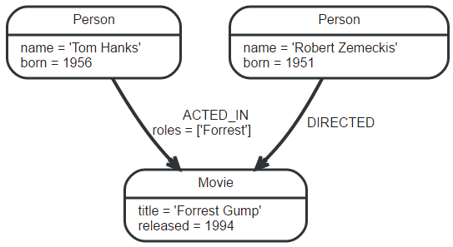
Example Graph Database

Slide 16


Nodes
Nodes are often used to represent entities, but depending on the domain relationships may be used for that purpose as well.
The simplest possible graph is a single Node. A Node can have zero or more named values referred to as properties.
Node that has a single property named “title”:
Nodes with multiple properties:

Slide 17

Relationships
A relationship connects two nodes, and is guaranteed to have valid start and end nodes.
Just like nodes, relationships can have properties
Relationships allow a graph to resemble a list, a tree, a map, or a compound entity
Below is an "ACTED_IN" relationship, with the "Tom Hanks" node as start node and "Forrest Gump" as end node.

Slide 18

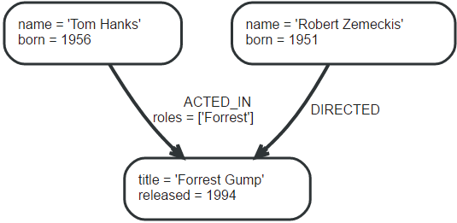
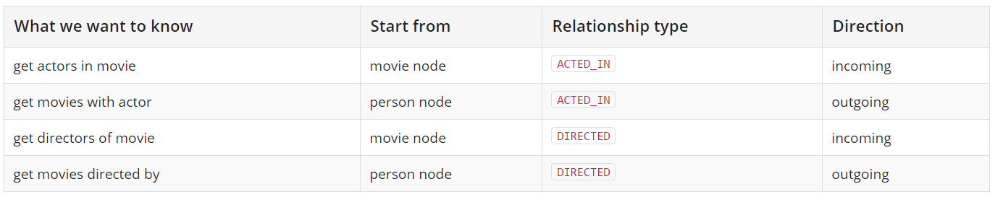
More on Relationships
A node can have relationships to itself:
All relationships have a relationship type
For example, for the following graph,
direction and types are in the table below:

Slide 19
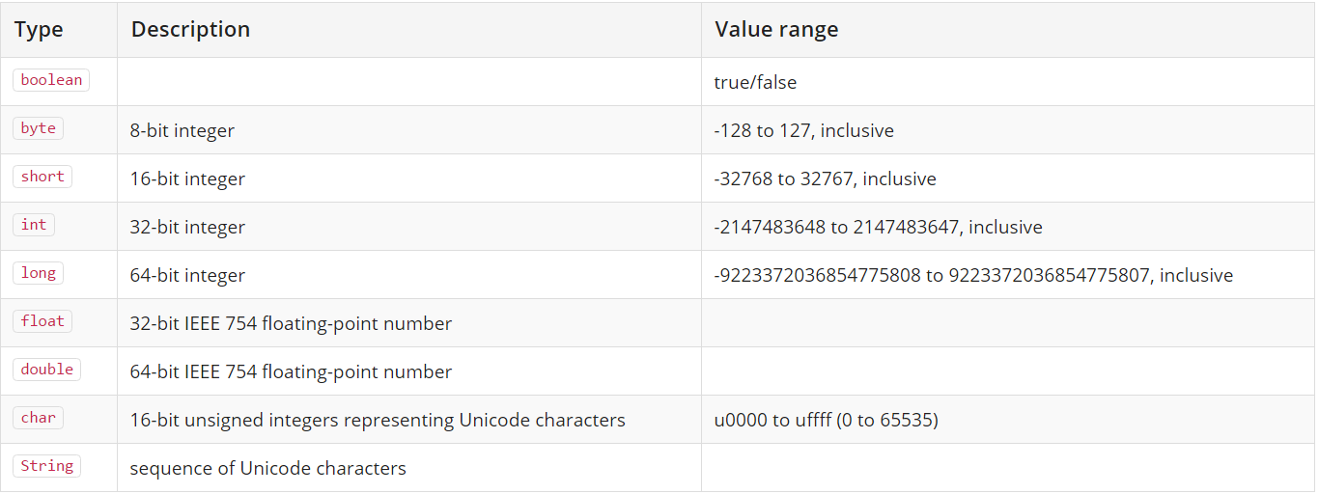
Properties
Properties are named values where the name is a string. The supported property values are:
Numeric values, String values, Boolean values, Lists of any other type of value
Property value types:

Slide 20
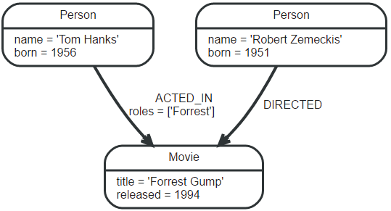
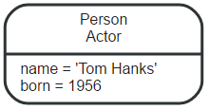
Labels
A label is a named graph construct that is used to group nodes into sets; all nodes labeled with the same label belongs to the same set.
In our example, we’ll add “Person”
and “Movie” labels to our graph:
A node can have multiple labels,
let’s add an Actor label to the
Tom Hanks node.

Slide 21
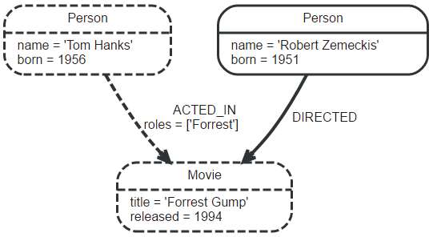
Traversal
A traversal navigates through a graph to find paths.
A traversal is how you query a graph, navigating from starting nodes to related nodes.
If we want to find out which movies Tom Hanks acted in according to our example database, the traversal would start from the Tom Hanks node, follow any ACTED_IN relationships connected to the node, and end up with Forrest Gump as the result (see the dashed lines):

Slide 22


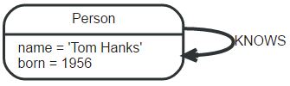
Paths
A path is one or more nodes with connecting relationships, typically retrieved as a query or traversal result.
In the previous example, the result can be a path with length one:
The shortest possible path has length zero — that is,
it contains only a single node and no relationships:
This path has length one:

Slide 23
IV. Cypher

Slide 24
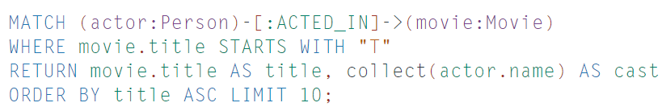
What is Cypher?
Cypher is a declarative graph query language that allows for expressive and efficient querying and updating of the graph store.
Cypher borrows its structure from SQL — queries are built up using various clauses.
Here is a simple example of a Cypher query (cast of movies starting with “T”):

Slide 25
The Movie Database Example
We will use a example data model to work with and understand Cypher queries
The model include nodes with three different labels (each with their own properties), and six different types of relationships (one of which has its own property).
In brief, the graph is made up of “Person”, “Movie”, and “Genre” nodes that are related to each other in various ways.
After logging in to the database, run “:play movie graph” from the command line

Slide 26
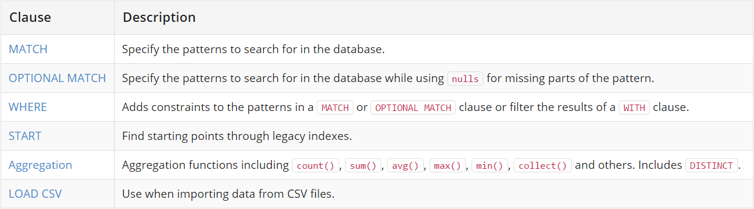
Cypher – Read Clauses

Slide 27
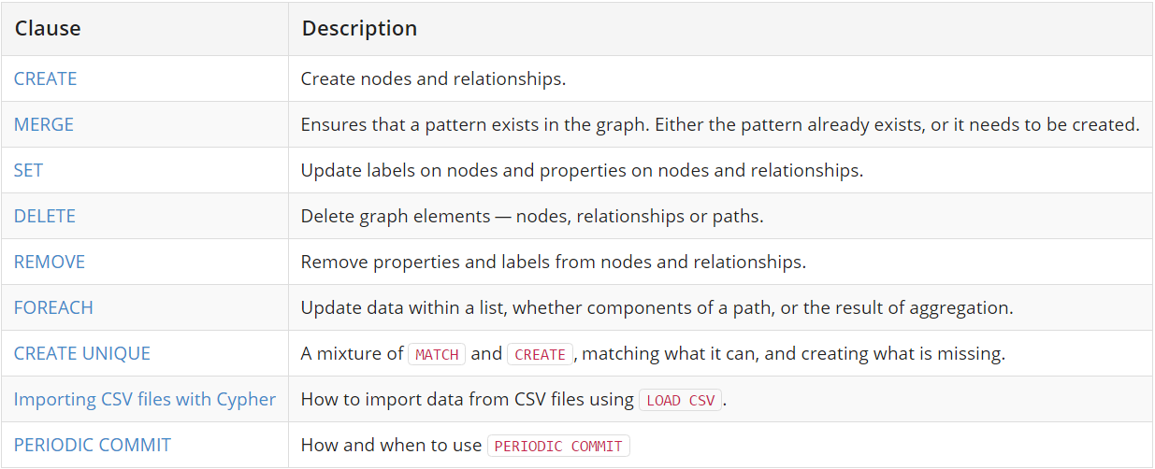
Cypher – Write Clauses

Slide 28
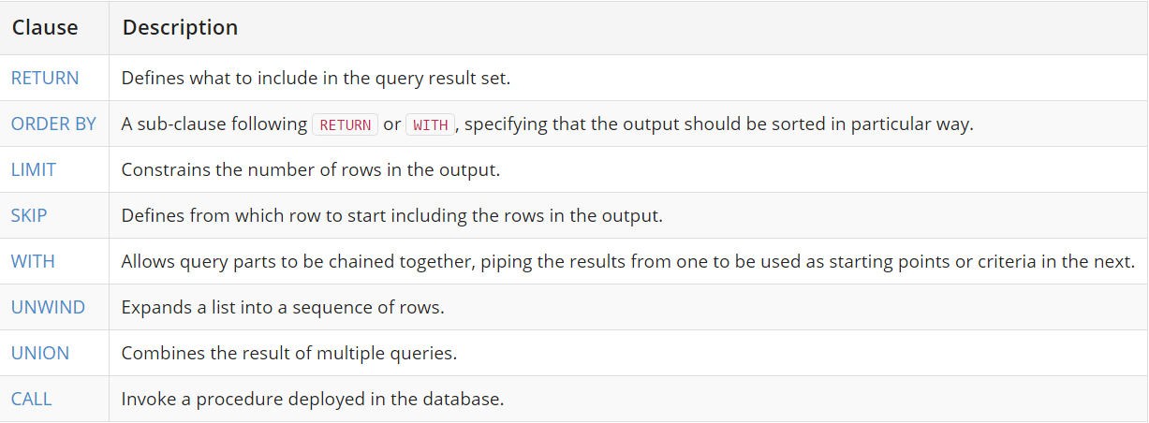
Cypher – General Clauses

Slide 29
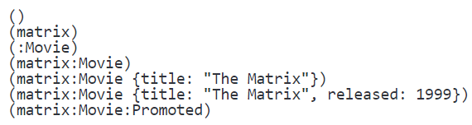
Cypher - Nodes
Cypher uses a pair of parentheses (usually containing a text string) like (), (foo) to represent a node, i.e. an entity of your domain.
The simplest form, (), represents an anonymous, uncharacterized node.
Refer to a node elsewhere, add a variable: (matrix)
The Movie label (prefixed in use with a colon) declares the node’s type or role.
Properties can be used to store information and/or restrict patterns. For example, we could MATCH and RETURN nodes whose title is "The Matrix".

Slide 30


Cypher - Labels
Labels allow us to group our nodes
For example, to distinguish movies from people or animals, both of whom act in films:
Labels are usually used as follows:
Cypher uses labels to make better decisions on how to optimize a query

Slide 31


Cypher - Relationships
Relationships are arrows pointing from one node to another, much like --> or <--. But we can add detail about them as needed within a pair of square brackets.
For example, If we wanted to retrieve everyone who had acted in a movie, we would describe the pattern to retrieve only nodes that has a relationship type ACTED_IN with other nodes:
Generally:

Slide 32
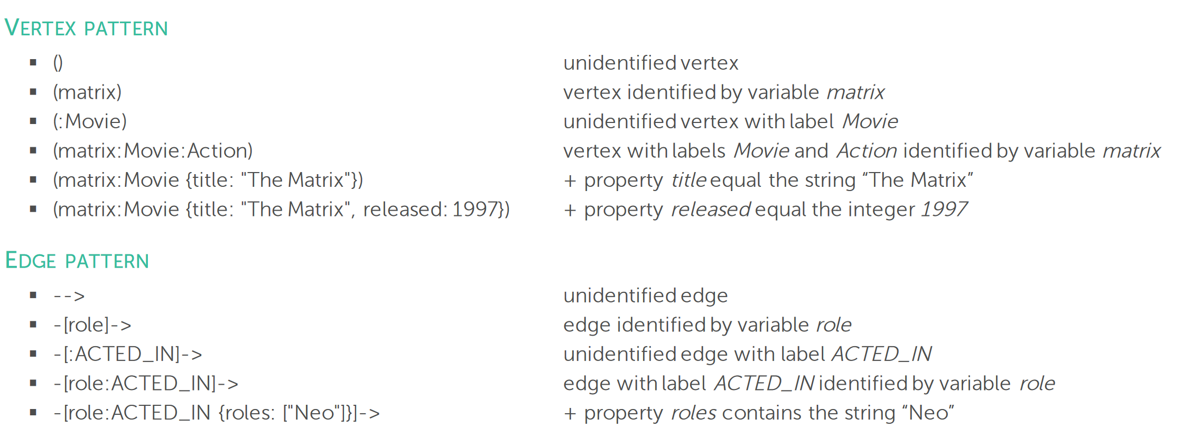
Nodes and Edges
Cite: http://cs.ulb.ac.be/conferences/ebiss2016/files/Neo4jExercise.pdf

Slide 33
V. Properties & Relationships

Slide 34
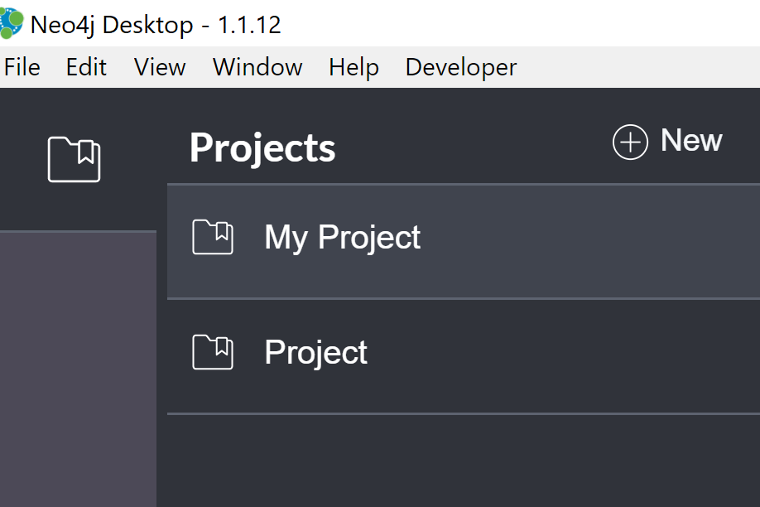
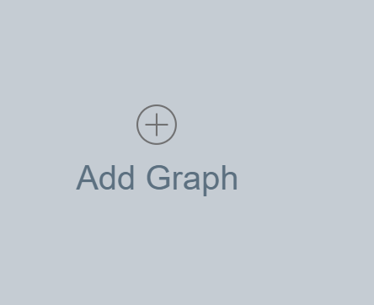
Create Movie Graph
Go to Neo4j Desktop→My Project→add Graph

Slide 35
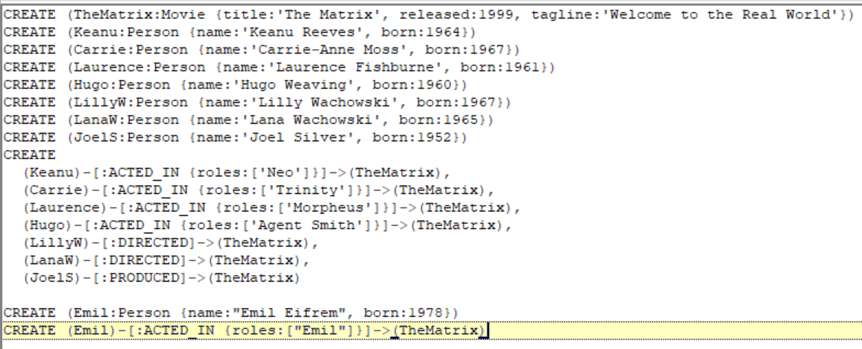
Create Movie Graph
Moviedata.txt

Slide 36
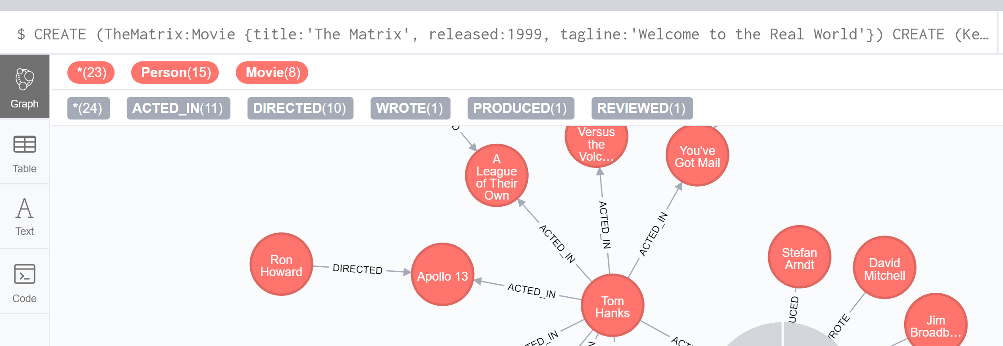
Create Movie Graph
Copy moviedata.txt to the query block and run this query, a movie graph will be generated.

Slide 37


Create a Node
Query to create a Node of a name give in quotes. For example:
Check the created Node:
Return all nodes in the graph:
Return all relationships
MATCH (n) RETURN n
MATCH ()-[r]->()
RETURN r

Slide 38
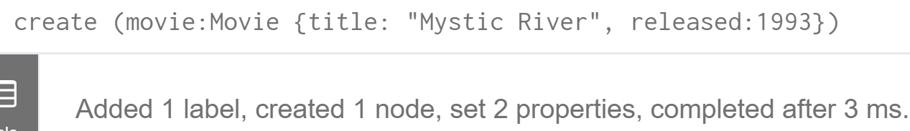
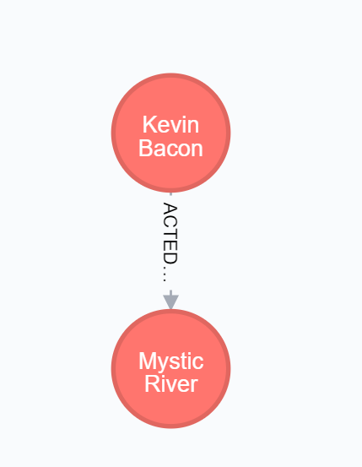
Adding Properties
To add a property to a node, for example add the movie “Mystic River” to our sample database:
Use Case: Find the actor Kevin Bacon and the movie Mystic River and add the relationship between the movie and the actor to the dataset.
create (movie:Movie {title: "Mystic River", released:1993})
match (kevin:Person) WHERE kevin.name="Kevin Bacon"
match (mystic:Movie) where mystic.title="Mystic River"
create (kevin)-[r:ACTED_IN {roles:["Sean"]}]->(mystic)
return mystic, r, kevin

Slide 39
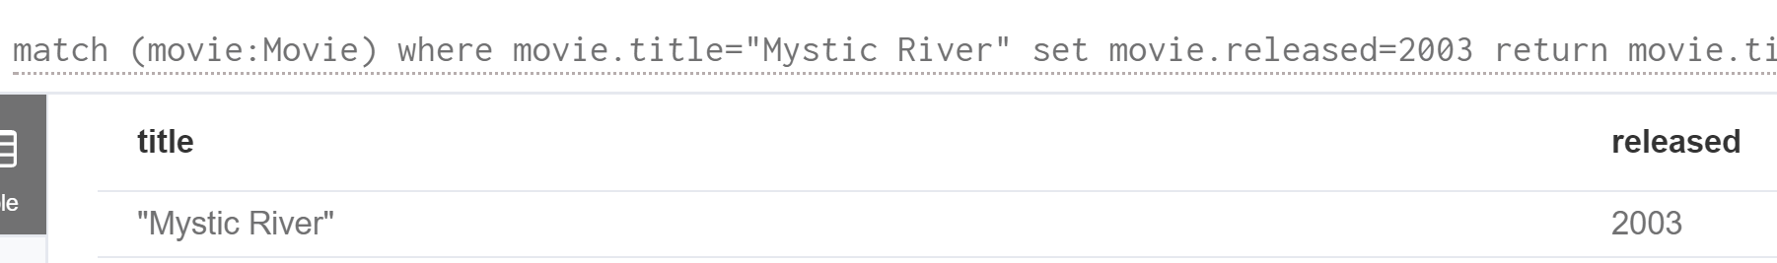
Updating a Property
Example, if the release year of Mystic Rivers is to be updated from 1993 to 2003:
The syntax is the same for updating or adding a property. You SET a property. If the property exists, SET will update it. If the property doesn’t exist, SET will add it.
match (movie:Movie)
where movie.title="Mystic River"
set movie.released=2003
return movie.title as title, movie.released as released

Slide 40

Adding a Relationship
Adding a relationship is similar to adding a node, but we CREATE the relationship with the relationship syntax.
Creating a relationship to our sample database:
Use Case: Rate the movie Mystic River

Slide 41

Deleting Nodes
To remove both the node and relationship created earlier, we run:
Delete all nodes and relationships
Delete a node with all its relationships
MATCH (n)
DETACH DELETE n
MATCH (me { name: ‘My Name' }) DETACH DELETE me

Slide 42

Deleting both Nodes and Relationships
This query statement will delete both the relationship and the node, even though there may be no relationships.
The first MATCH is obvious, it finds the node we’re looking for. The WHERE statement belongs to the first MATCH.
The second is an OPTIONAL MATCH. It tries to find nodes matching the pattern, if it doesn’t find anything it returns a single row with null values. But it will always return at least one row. You can also filter the optional match with a WHERE statement.

Slide 43
VI. Order By, Limit, and Skip

Slide 44
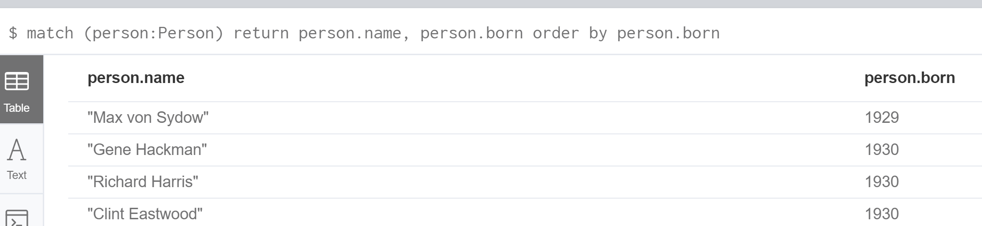
ORDER BY
In Cypher it’s easy to order results using an ORDER BY command. Let’s say we wanted to display the oldest people in our database. We could use the following query:
The query returns every actor ordered by their year of birth, so it will display the oldest (smallest a.born) first.
match (person:Person)
return person.name, person.born
order by person.born

Slide 45
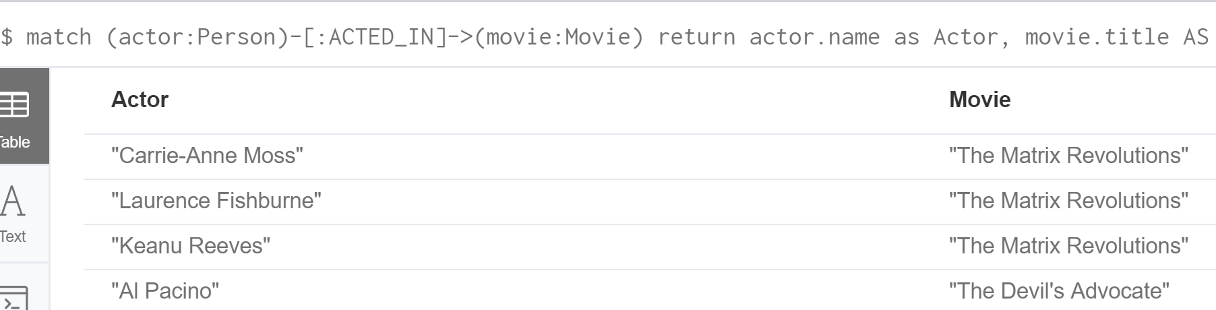
LIMIT and SKIP
Cypher supports easy pagination of record sets. It uses LIMIT and SKIP statements to reduce the number of records returned and to allow for paging through the results.
Example: Display the second page of 10 actors and movies they played in
We could also just use LIMIT if we only want the top-n elements within the result.
match (actor:Person)-[:ACTED_IN]->(movie:Movie)
return actor.name as Actor, movie.title AS Movie
skip 10 limit 10

Slide 46
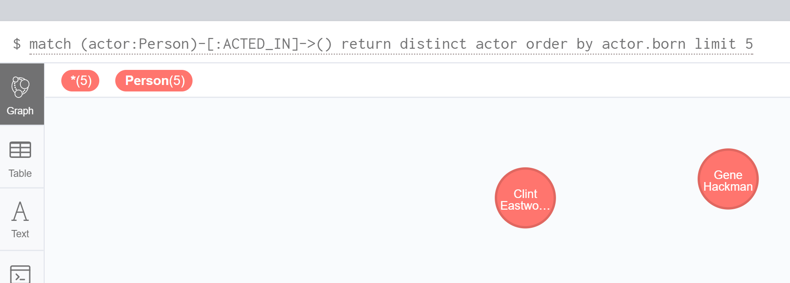
Using DISTINCT
Often we are required to return only distinct results for a query
For example, let’s look at the list of the oldest actors
match (actor:Person)-[:ACTED_IN]->()
return distinct actor
order by actor.born
limit 5

Slide 47
VII. Predicates and Conditions

Slide 48
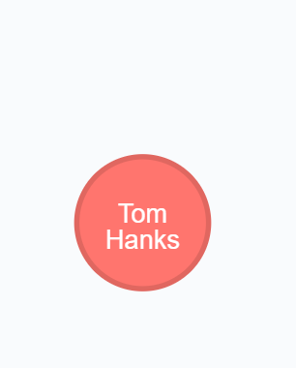
Using WHERE
Cypher provides a number of mechanisms for reducing the number of matching patterns returned in a result set
Example:
This will look through all the nodes in the graph with a label of Person, and if one has the name "Tom Hanks", it will RETURN that node.
match (person:Person)
where person.name="Tom Hanks"
return person

Slide 49
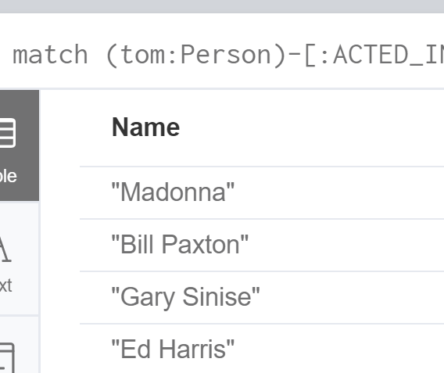
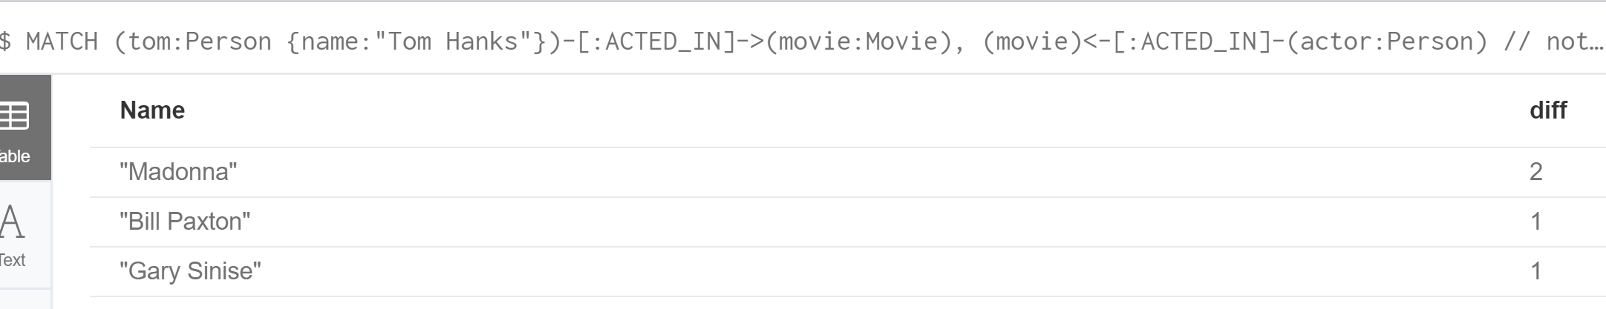
Filtering
We can also filter by comparing properties of different nodes
For example, we could RETURN all of the actors who acted with Tom Hanks and are older than him:
match (tom:Person)-[:ACTED_IN]->()<-[:ACTED_IN]-(actor:Person)
where tom.name="Tom Hanks"
and actor.born<tom.born
return actor.name as Name
MATCH (tom:Person {name:"Tom Hanks"})-[:ACTED_IN]->(movie:Movie),
(movie)<-[:ACTED_IN]-(actor:Person) // note how the line break doesn't break the query
WHERE actor.born < tom.born
RETURN DISTINCT actor.name AS Name, (tom.born - actor.born) AS diff

Slide 50
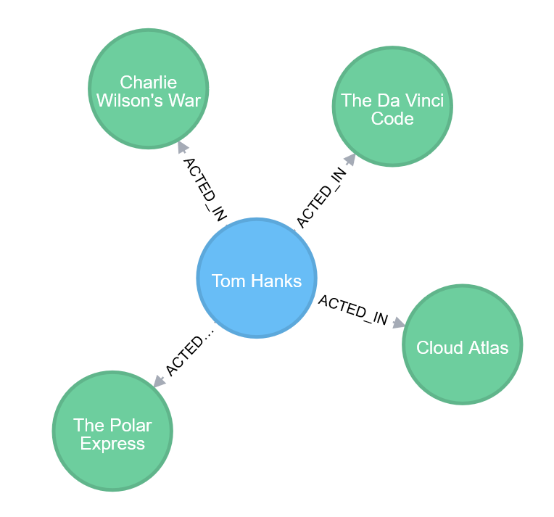
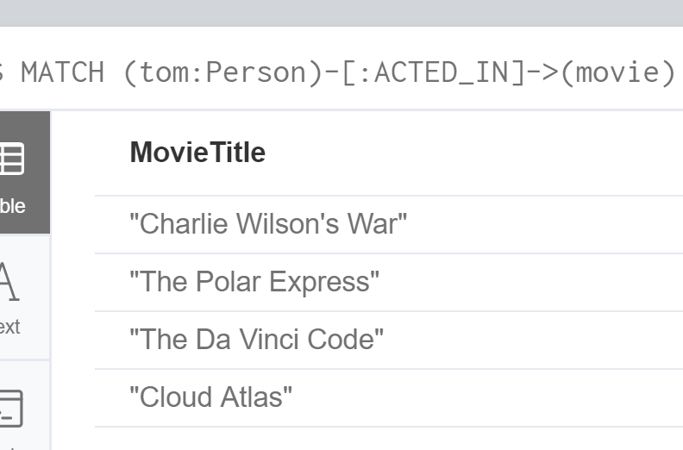
Filtering
MATCH (tom:Person)-[:ACTED_IN]->(movie)
WHERE tom.name="Tom Hanks"
AND movie.released > 2000
RETURN movie.title AS MovieTitle

Slide 51
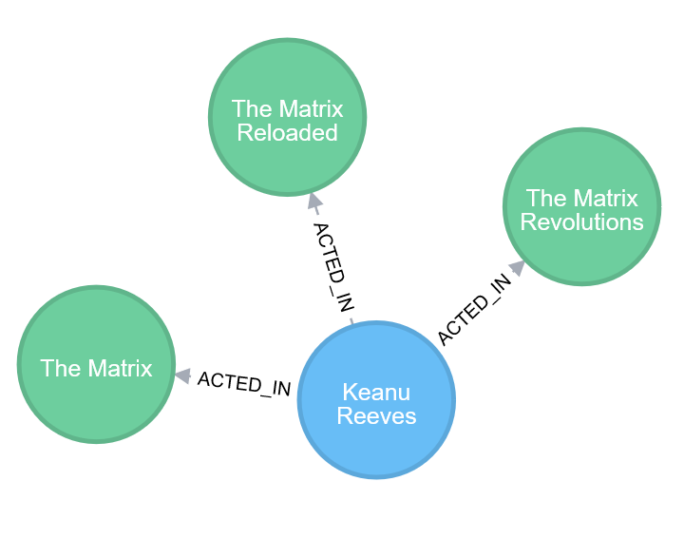
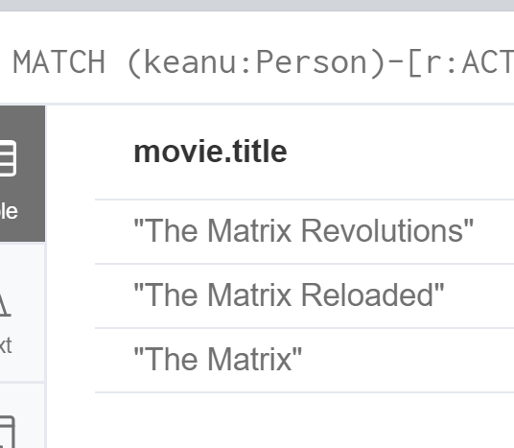
Filtering
MATCH (keanu:Person)-[r:ACTED_IN]->(movie)
WHERE keanu.name="Keanu Reeves"
AND "Neo" IN r.roles
RETURN movie.title

Slide 52
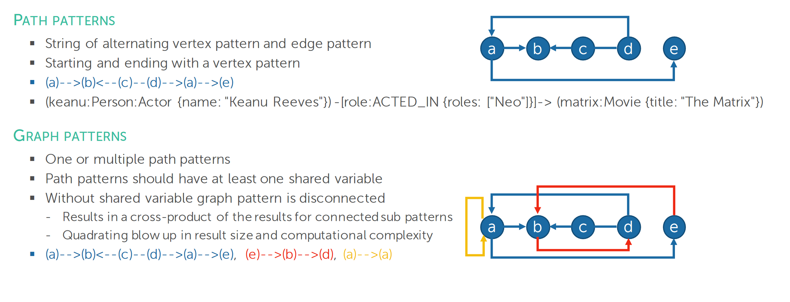
Path Patterns
Cite: http://cs.ulb.ac.be/conferences/ebiss2016/files/Neo4jExercise.pdf

Slide 53
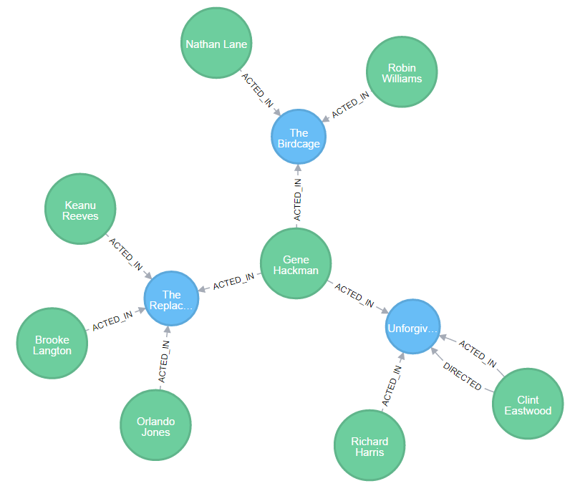
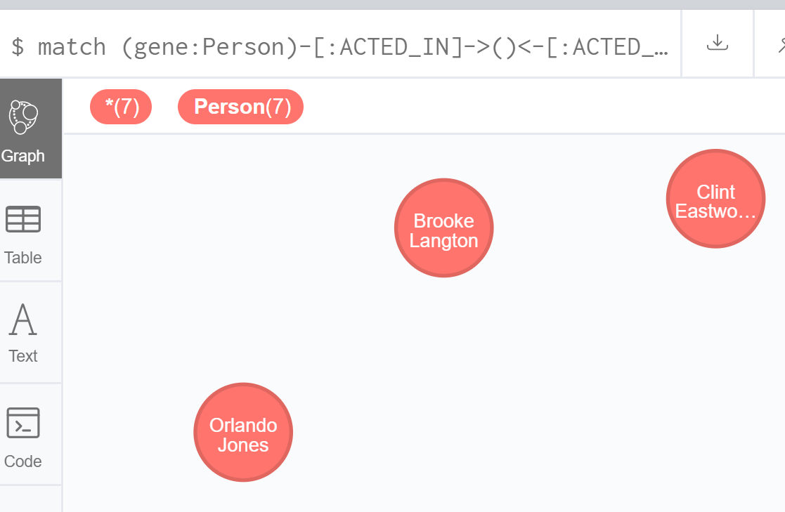
Path Patterns
To find actors who worked with Gene Hackman in the following graph
Query:
match (gene:Person)-[:ACTED_IN]->()<-[:ACTED_IN]-(other:Person)
where gene.name="Gene Hackman"
return distinct other

Slide 54
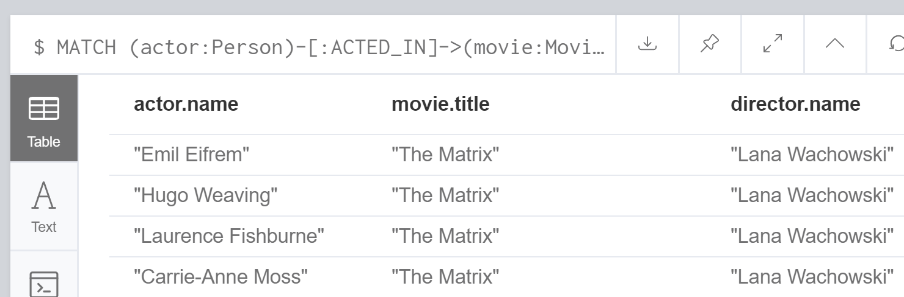
Path Patterns
MATCH (actor:Person)-[:ACTED_IN]->(movie:Movie)<-[:DIRECTED]-(director:Person)
RETURN actor.name, movie.title, director.name;
MATCH (actor:Person)-[:ACTED_IN]->(movie:Movie),
(movie)<-[:DIRECTED]-(director:Person)
RETURN actor.name, movie.title, director.name;
MATCH (actor:Person)-[:ACTED_IN]->(movie:Movie),(director:Person)-[:DIRECTED]->(movie)
RETURN actor.name, movie.title, director.name;

Slide 55
Variable Path Lengths
Relationships that traverse any depth are: (a)-[*]->(b)
Specific depth of relationships are represented like (a)-[*depth]->(b) to find all paths exactly depth steps long.
Relationships from one to four levels deep are represented like so: (a)-[*1..4]->(b)
Relationships of type KNOWS at 3 levels distance: (a)-[:KNOWS*3]->(b)
Relationships of type KNOWS or LIKES from 2 levels distance: (a)-[:KNOWS|:LIKES*2..]->(b)

Slide 56
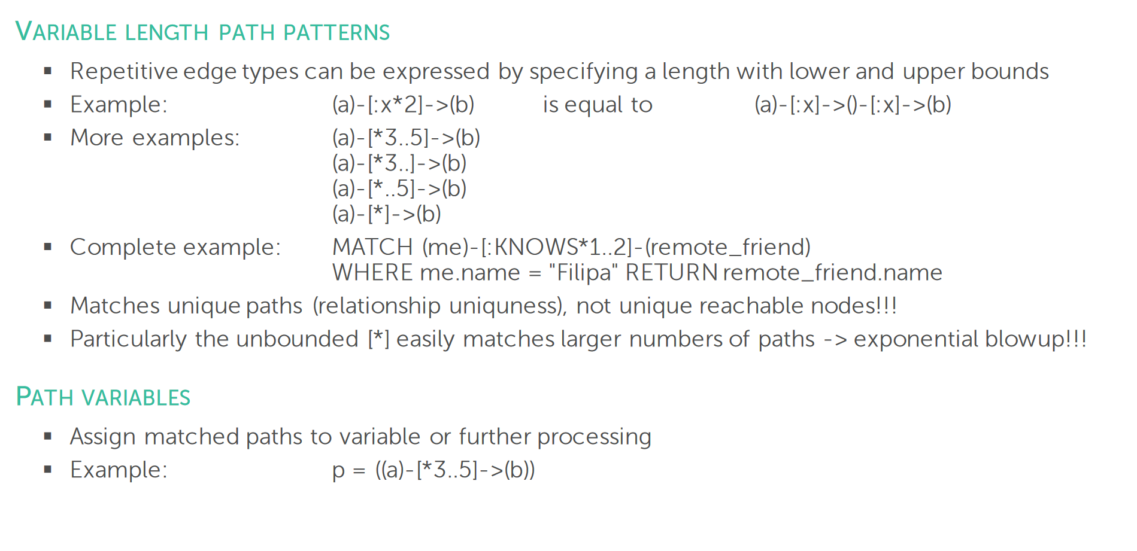
Cite: http://cs.ulb.ac.be/conferences/ebiss2016/files/Neo4jExercise.pdf

Slide 57
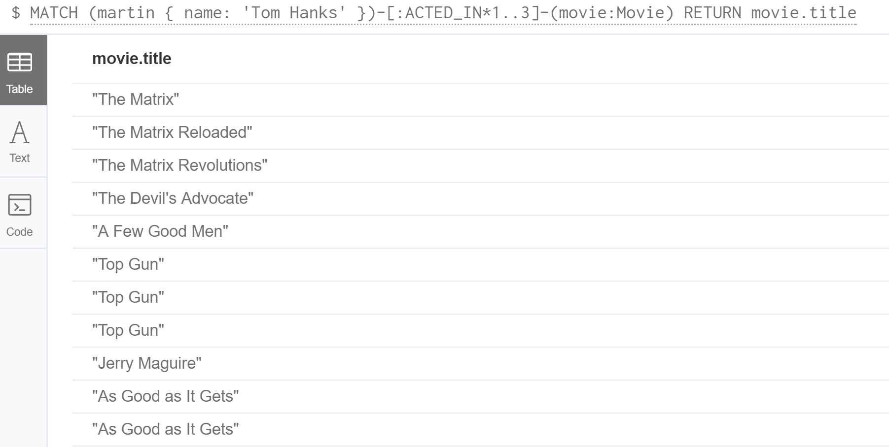
Variable Path Lengths
MATCH (martin { name: "Tom Hanks" })-[:ACTED_IN*1..3]-(movie:Movie) RETURN movie.title

Slide 58
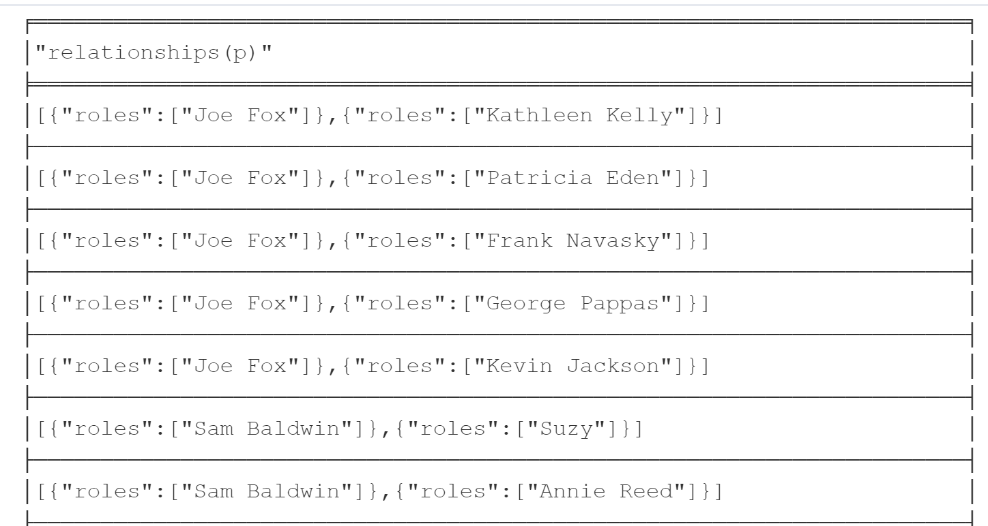
Variable Path Lengths
MATCH p =(actor { name: 'Tom Hanks' })-[:ACTED_IN*2]-(co_actor)
RETURN relationships(p)

Slide 59
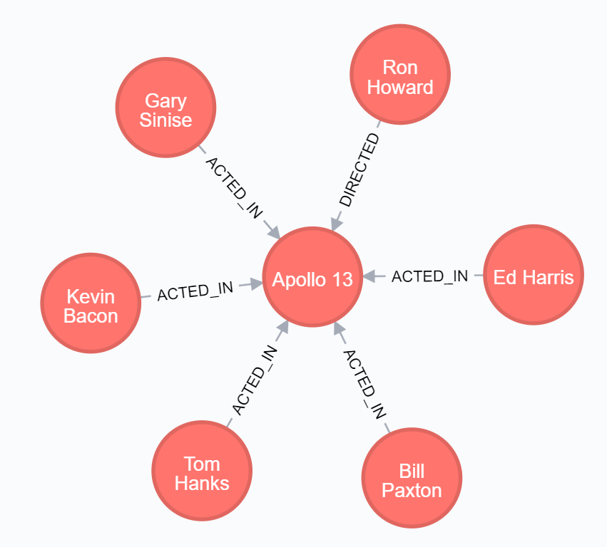
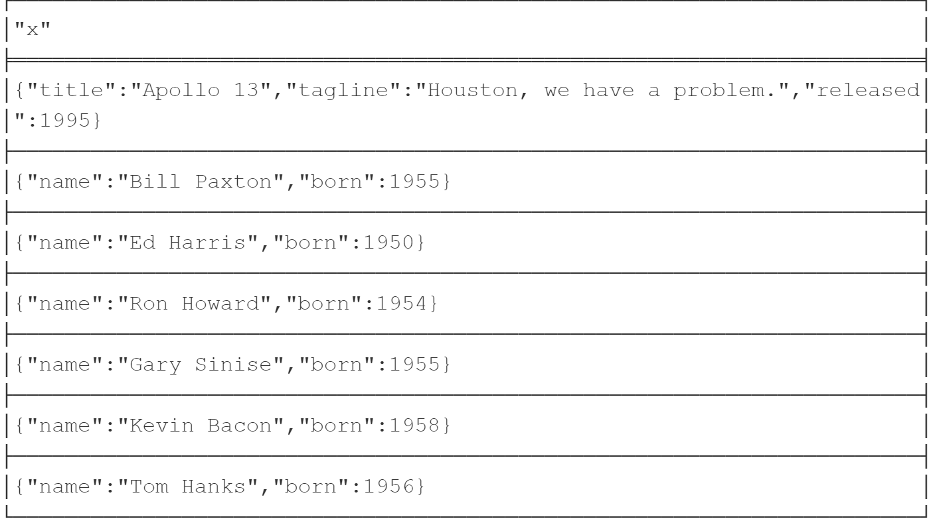
Variable Path Lengths
MATCH (apollo:Movie { title: 'Apollo 13' })-[*0..1]-(x)
RETURN x

Slide 60
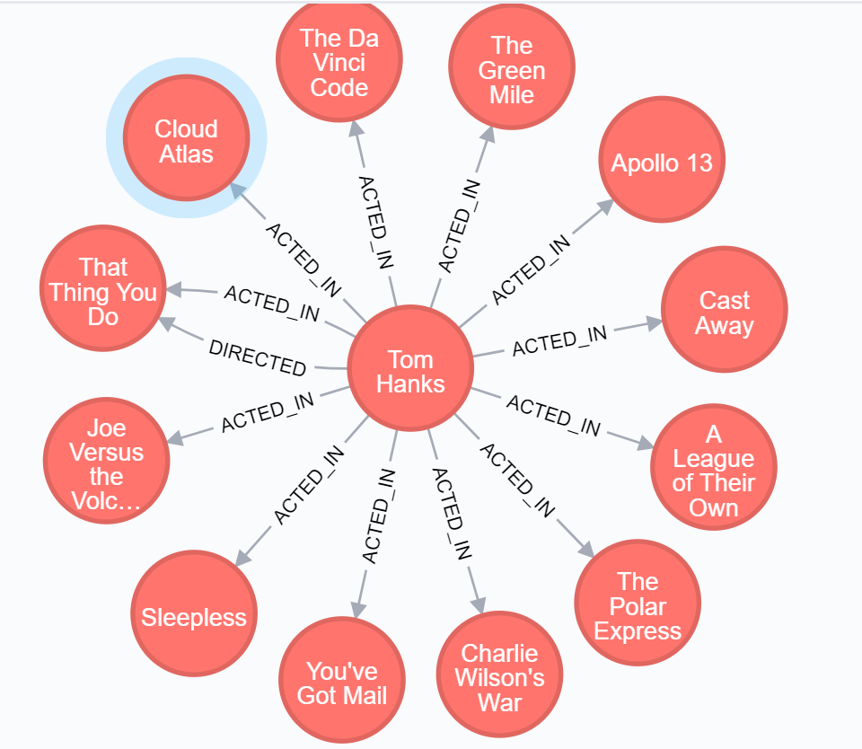
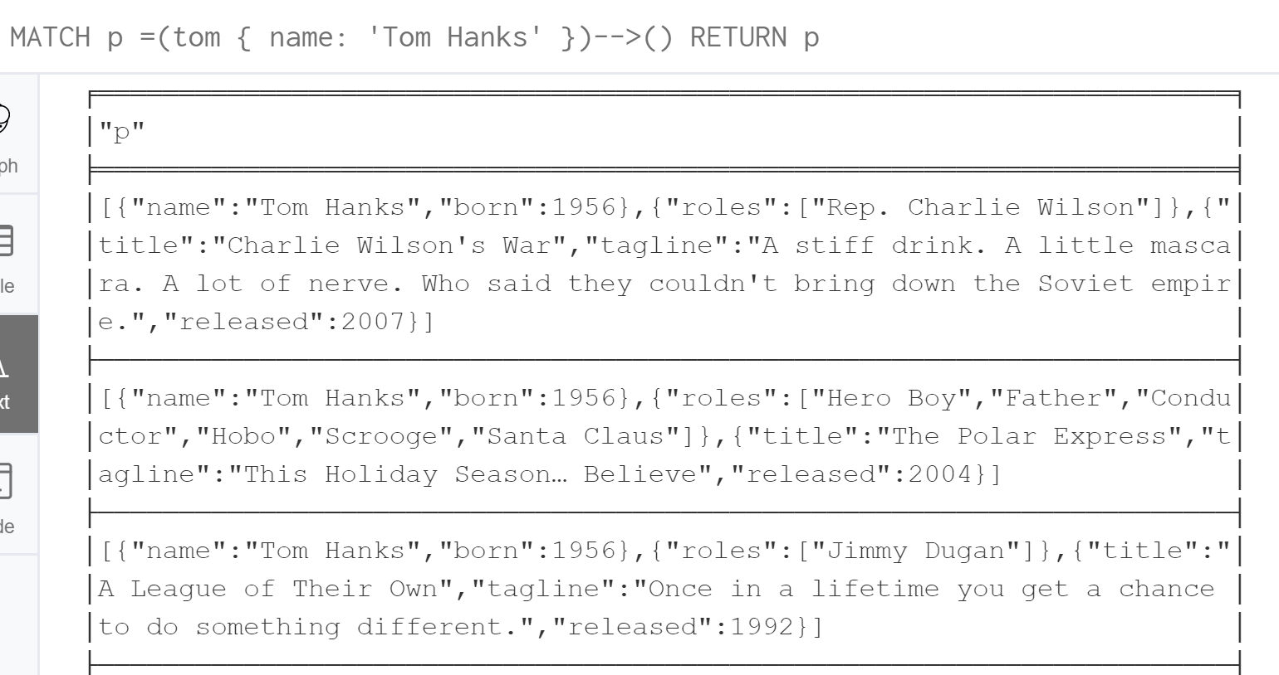
Variable Path Lengths
MATCH p =(tom { name: 'Tom Hanks' })-->()
RETURN p

Slide 61
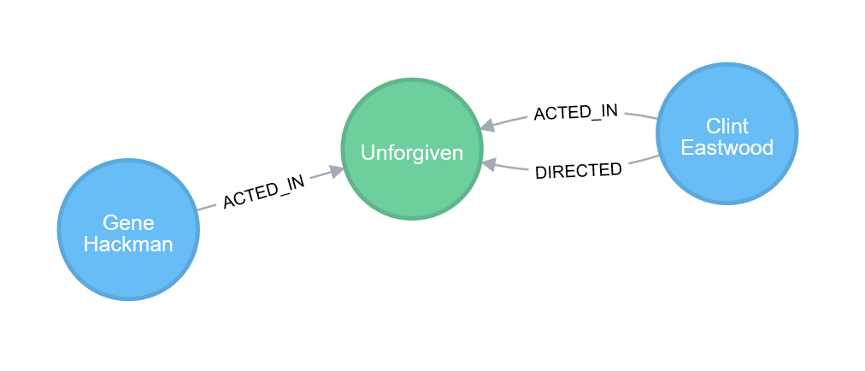
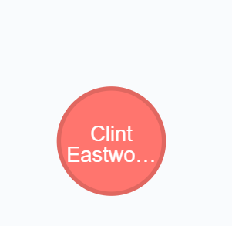
Path Patterns
MATCH (gene:Person)-[:ACTED_IN]->()<-[:ACTED_IN]-(other:Person)
WHERE gene.name="Gene Hackman"
AND exists( (other)-[:DIRECTED]->() )
RETURN DISTINCT other

Slide 62
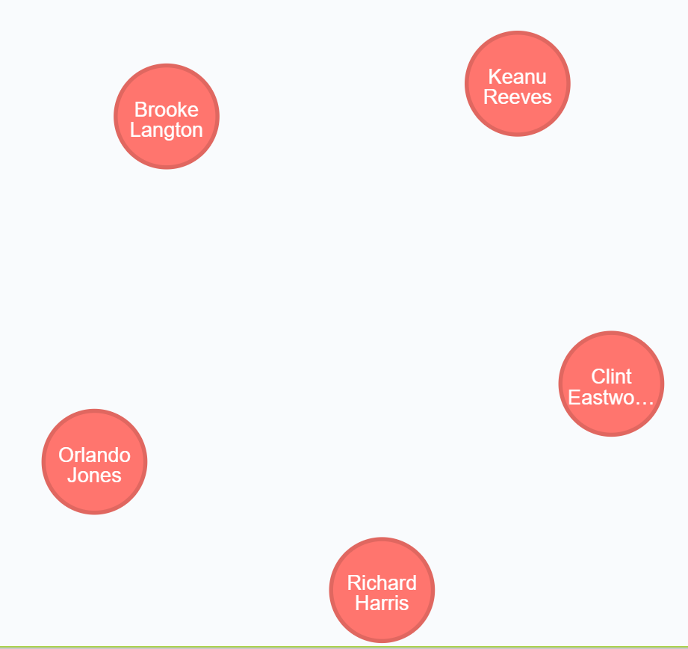
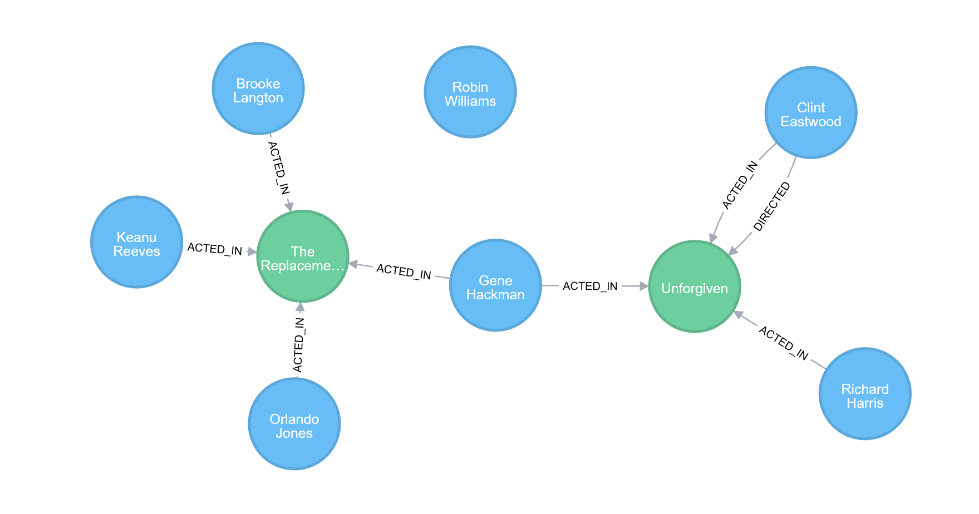
Path Patterns
MATCH (gene:Person {name:"Gene Hackman"})-[:ACTED_IN]->(movie:Movie),
(other:Person)-[:ACTED_IN]->(movie),
(robin:Person {name:"Robin Williams"})
WHERE NOT exists( (robin)-[:ACTED_IN]->(movie) )
RETURN DISTINCT other

Slide 63
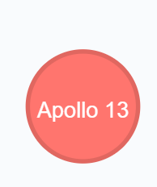
Path Patterns
Consider this example: Return movies featuring both Tom Hanks and Kevin Bacon
One or more nodes of your pattern in the graph can be anchored by constraining their properties to a single fitting node.
The pattern matching works much faster as Cypher doesn’t have to scan the whole graph to apply the patterns.
match (tom:Person)-[:ACTED_IN]->(movie:Movie), (kevin:Person)-[:ACTED_IN]->(movie)
where tom.name="Tom Hanks" and kevin.name="Kevin Bacon"
return distinct movie

Slide 64
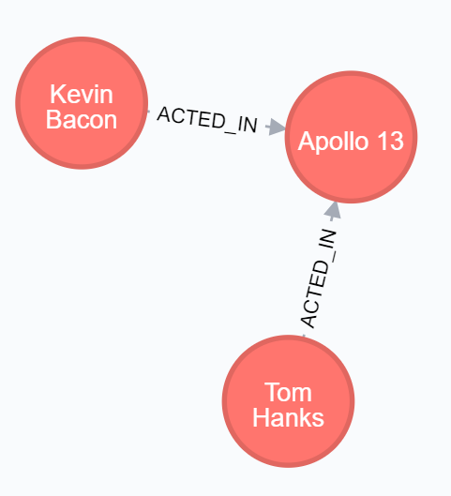
Shortest Path
MATCH (tom:Person { name: 'Tom Hanks' }),(kevin:Person { name: 'Kevin Bacon' }), p = shortestPath((tom)-[*..15]-(kevin))
RETURN p

Slide 65
Shortest Path
MATCH (tom:Person { name: 'Tom Hanks' }),(kevin:Person { name: 'Kevin Bacon' }), p = allShortestPaths((tom)-[*..15]-(kevin))
RETURN p

Slide 66
VIII. Indexing and Labels

Slide 67


Indexes
Neo4j doesn’t use indexes to speed up JOIN operations
Useful for finding starting points by value, textual prefix or range
A label specific index is created as indexes are bound to a concrete label-property combination
Example: To search Movies efficiently based on their title
To remove the index, use the following Cypher command

Slide 68

Create a Label-Specific Index
Create an index on nodes labeled Person, indexing by the property name:
Create an index on nodes labeled Movie, indexing by the property title:

Slide 69
IX. Aggregation

Slide 70

Aggregate functions
Cypher provides support for a number of aggregate functions:

Slide 71

Aggregation: Collect
Let’s say we wanted to display all movie titles that an actor participated in:
For every Person who has acted in at least one movie, the query will RETURN their name and an array of strings containing the movie titles.
match (person:Person)-[:ACTED_IN]->(movie:Movie)
return person.name, collect(movie.title)

Slide 72

Aggregation: Top n
To fetch top n results, use a count aggregation
Example: If we were interested in the top ten actors who acted in the most movies, the query would look like this
match (person:Person)-[:ACTED_IN]->(movie:Movie)
return person.name, count(movie)
order by count(movie) desc

Slide 73
X. Importing Data

Slide 74
Importing Normalized Data using LOAD CSV
The LOAD CSV clause parses a local or remote file into a stream of rows which represent maps (with headers) or lists
Use whichever Cypher operations to either CREATE nodes or relationships or to MERGE with the existing graph structures
As CSV files usually represent either node- or relationship-lists, multiple passes are run to create nodes and relationships separately.
Example: Query to CREATE Movie nodes using the data from movies.csv as properties

Slide 75

Importing Denormalized Data
The same file can be run with multiple passes to load denormalized data as well
The use of MERGE to create nodes and relationships uniquely may be required
For Example:

Slide 76
References
https://neo4j.com/online_training/graphdatabases/?aliId=Um9oaXQgRGFuZG9uYS9yZGFuZG9uYUB1bWFpbC5pdS5lZHU%3D#_importing_data
http://neo4j.com/docs/developer-manual/current/introduction/

