Slide 1
Normalization

Slide 2
Normalization of DB Tables
Normalization
Process for evaluating and correcting table structures
determines the optimal assignments of attributes to entities
Normalization provides micro view of entities
focuses on characteristics of specific entities
may yield additional entities
Works through a series of stages called normal forms
1NF → 2NF → 3NF → 4NF (optional)
Higher the normal form, slower the database response
more joins are required to answer end-user queries
Why normalize?
Reduce uncontrolled data redundancies
Help eliminate data anomalies
Produce controlled redundancies to link tables

Slide 3
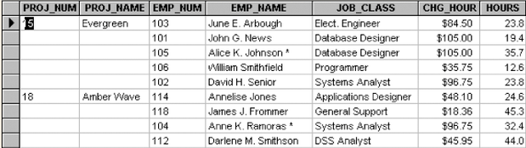
Example: Need for Normalization
PRO_NUM is intended to be primary key but contain nulls
Table entries invite data inconsistencies
e.g. “Elect. Engineer”, “Elect.Eng.”, “EE”
Table displays data redundancies that can cause data anomalies
Update anomalies
Modifying JOB_CLASS could require many alterations (all the rows for the same EMP_NUM)
Insertion anomalies
New employee must be assigned a project
Deletion anomalies
If employee quits and a row deleted, other vital data may get lost
Database Systems: Design, Implementation, & Management: Rob & Coronel

Slide 4
Normalization: First Normal Form
First Normal Form (1NF)
All the primary key attributes are defined
There are no repeating groups
All attributes are dependent on the primary key
Conversion to 1NF
Objective
Develop a proper primary key
Steps
Eliminate repeating groups
fill in the null cells with appropriate data value
Identify primary key
identify attribute(s) that uniquely identifies each row
Identify all dependencies
make sure all attributes are dependent on the primary key

Slide 5
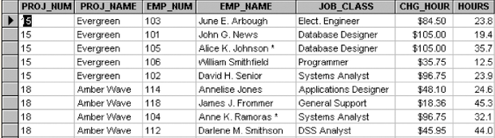
Normalization: 1NF example
Eliminate repeating groups - Fill in the null cells to make each row define a single entity
Identify the primary key - Make sure all attributes are dependent on the primary key
Database Systems: Design, Implementation, & Management: Rob & Coronel

Slide 6
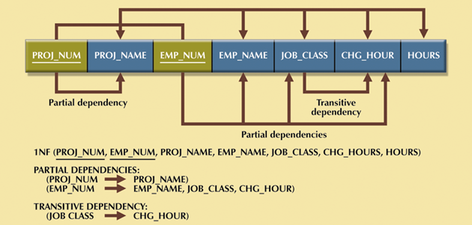
Normalization: 1NF example
Identify all dependencies (in a Dependency Table)
Desirable dependencies (arrows above)
based on primary key (functional dependency)
Less desirable dependencies (arrows below)
Partial dependency
based on part of composite primary key
Transitive dependency
one nonprime attribute depends on another nonprime attribute
Subject to data redundancies and anomalies
Database Systems: Design, Implementation, & Management: Rob & Coronel

Slide 7
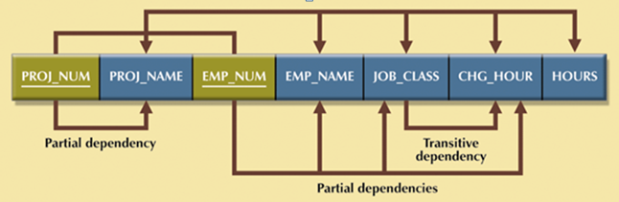
Normalization: Second Normal Form
Second Normal Form (2NF)
It is in 1NF
There are no partial dependencies
Conversion to 2NF
Objective
Eliminate partial dependencies
Steps
Start with 1NF format
Write each key component (w/ partial dependency) on separate line
Write original (composite) key on last line
Each component is new table
Write dependent attributes after each key
1NF (PROJ_NUM, EMP_NUM, PROJ_NAME, EMP_NAME, JOB_CLASS, CHG_HOUR, HOURS)
↓
PROJECT (PROJ_NUM, PROJ_NAME)
EMPLOYEE (EMP_NUM, EMP_NAME, JOB_CLASS, CHG_HOUR)
ASSIGN (PROJ_NUM, EMP_NUM, HOURS)

Slide 8
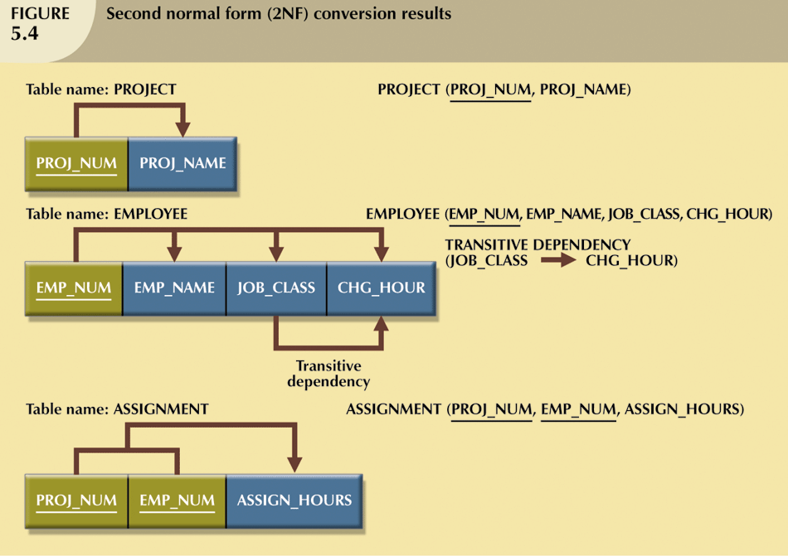
Normalization: 2NF example
Database Systems: Design, Implementation, & Management: Rob & Coronel

Slide 9
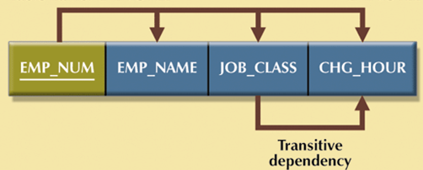
Normalization: Third Normal Form
Third Normal Form (3NF)
It is in 2NF
There are no transitive dependencies
Conversion to 3NF
Objective
Eliminate transitive dependencies (TP)
Steps
Start with 2NF format
Break off the TP pieces and create separate tables
EMPLOYEE (EMP_NUM, EMP_NAME, JOB_CLASS, CHG_HOUR)
↓
EMPLOYEE (EMP_NUM, EMP_NAME, JOB_CLASS)
JOB (JOB_CLASS, CHG_HOUR)

Slide 10
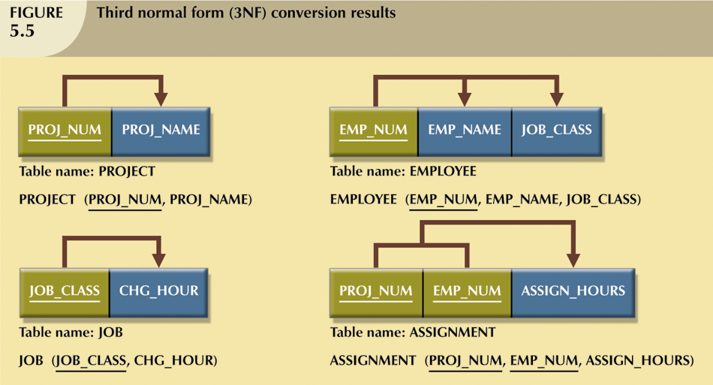
Normalization: 3NF example
Database Systems: Design, Implementation, & Management: Rob & Coronel

Slide 11
Normalization: Fourth Normal Form
Forth Normal Form (4NF)
It is in 3NF
There are no multiple sets of independent multi-valued dependencies
Infrequently needed
e.g. COURSE has multiple texts and multiple instructors (texts for a course are not decided by instructor)
Conversion to 4NF
Identify multiple multi-valued attributes
Create separate tables containing each of multi-valued attributes
COURSE | CRS_TEXT
S511 | DB design
S511 | Inside Access 2007
COURSE | CRS_TEXT | CRS_INSTRUCTOR
S511 | DB design | Jones
S511 | DB design | Smith
S511 | Inside Access 2007 | Jones
S511 | Inside Access 2007 | Smith
COURSE | CRS_INSTRUCTOR
S511 | Jones
S511 | Smith

Slide 12
Additional Table Enhancement
Adhere to naming conventions
Use transaction code instead of composite primary key when appropriate
e.g. ASG_NUM in ASSIGN
Use simple attributes
e.g. EMP_LNAME, EMP_FNAME, EMP_INIT in EMPLOYEE
Add attributes to facilitate information extraction
e.g. EMP_NUM in PROJECT to indicate project manager
e.g. ASG_CHG_HR in ASSIGN for historical accuracy of data
Allow data controlled data redundancies
e.g. ASG_CHG_AMOUNT in ASSIGN (derived attribute)
PROJECT (PROJ_NUM, PROJ_NAME)
JOB (JOB_CLASS, CHG_HOUR)
ASSIGN (PROJ_NUM, EMP_NUM, HOURS)
EMPLOYEE (EMP_NUM, EMP_NAME, JOB_CLASS)
↓
PROJECT (PROJ_NUM, PROJ_NAME, EMP_NUM)
JOB (JOB_CODE, JOB_DESCRIPTION, JOB_CHG_HR)
ASSIGN (ASG_NUM, ASG_DATE, PROJ_NUM, EMP_NUM, ASG_HRS, ASG_CHG_HR, ASG_CHG_AMOUNT)
EMPLOYEE (EMP_NUM, EMP_LNAME, EMP_FNAME, EMP_INIT, EMP_HIREDATE, JOB_CODE)

Slide 13
Denormalization
Normalization is one of many database design goals.
However, normalized tables result in:
additional processing
loss of system speed
When normalization purity is difficult to sustain due to conflict in:
design efficiency
information requirements
processing speed
Denormalize by
use of lower normal form
use of controlled data redundancies

Slide 14
ACID
ACID stands for: Atomicity, Consistency, Isolation, Durability
ACID is the standard in computer science to judge the reliability of a transaction. In the context of databases, it is for data transaction.

Slide 15
Atomicity
“all or nothing”
If a transaction fails in the middle, it will be no transaction.
If a transaction is aborted, this transaction does not happen
If a transaction is committed, the entire transaction should be completed
Example
Money transfer from one bank to another bank.
Buying the same book in an online bookstore

Slide 16
Consistent
Any transaction must be valid according to all pre-defined rules (e.g., constraints, triggers).
Any transaction violates the defined rules will not be committed.
Example
Applying for loan.

Slide 17
Isolation
Determines how transaction integrity is visible to other users and systems.
Can many users access the same data at the same time?
Will one transaction block another transaction?
Example
Watching a video, can two users access the video at the same time?
Withdrawing money, can you and your family member withdraw money from the same bank account?

Slide 18
Durability
It guarantees that transactions that have committed will survive permanently, even during the power loss and other emergent situations.
Transaction logs are used to enforce the durability.
Example
Booking a flight ticket online: even the system crashes, the ticket if committed for booking, will be booked.

