Slide 1
XML

Slide 2
Mark-up Languages
Digitalizing information
  Content
  Format
SGML
HTML
XML
RDF
OWL …

Slide 3
SGML
SGML (Standard Generalized Markup Language)
  Language to define content and format of online information
  Mother of all markup languages
  Existing earlier than the Web
Originated from GML (IBM, 1969) which is used to solve heterogeneous problem of document formats
Becomes ISO Standard, and renamed as SGML
Allows user-defined markup tags
Platform-free, structure, extendable

Slide 4
SGML Components
Grammar definition
  Defines grammer for document type and document instances
Document type defintion (DTD)
  Defines logical structure and item type for document instances
Document instances
  Contains all the instance data
  the main part of SGML file

Slide 5
From SGML to HTML
SGML is too complicate and hard to master
Write a browser for processing SGML becomes difficult
  W3C propose HTML

Slide 6
HTML
Hyper Text Markup Language
Subset of SGML
No user-defined tags
No DTD
Easy to learn
Easy to write browser

Slide 7
From HTML to XML
No user-defined tags
Describes only data format, no content
Lack of compatibility with other popular browsers
Too many incorrect HTML files (wrong HTML grammer)
  XML

Slide 8
XML
eXtensible Markup Language
Data format and data content
User-defined tags
Has its own grammer
Describe structured and unstructured data
  Structured: database, table,
  Unstructured: webpage, eCommerce document, etc.
Platform for storing and sharing data (Oracle, IBM, Microsoft)

Slide 9
More about XML
Simplified SGML
describing data format and content
Storing structured and unstructured data
Extensible (user-defined tag)
Platform-free
Text-based (any text editor), Unicode-based (language free)

Slide 10
XML Example
<?xml version="1.0" encoding=“UTF-8"?>
<customertable>
<customer>
<company>Northeast Invention Inc.</company>
<contact>Alice Heath</contact>
<photo file="alice.gif"/>
<position>Marketing Director</position>
<address>East Avenue 52</address>
<tel>493 972904</tel>
</customer>
<customer>
<company>Insight Inc.</company>
<contact>Tom Hepp</contact>
<photo/>
<position>Sales Representative</position>
<address>Sundown Avenue 30</address>
<tel>676 873201</tel>
</customer>
</customertable>

Slide 11
XML Grammer
XML file structure
Key components
Properties
Namespace
Valid XML document

Slide 12
XML File Structure
Containing two main parts:
  Prolog
    XML declaration (XML version and the encoding used)
  Root element
<?xml version=”1.0” encoding=”UTF-8” standalone=”yes”?>
<customertable>
<customer>
<name> ....</name>
...
</customer>
...
</customertable>

Slide 13
XML Declaration
<?xml
  Shows the beginning of xml document
?>
  Shows the end of the declaration
version=“1.0”
  Shows xml version information, which states that this xml document follow W3C XML1.0 Standard.
encoding=“UTF-8”
  Allows to use different encodings, such as UTF-8, UTF-16, GB2312
  By default: UTF-8
standalone=“yes”
  DTD is included in the xml document
  “no” means external dtd will be referenced here.
  Default: no

Slide 14
XML: Comments
Comments are a special set of tags that start with <!-- and end with -->
All data written between these two tags is ignored by the XML processor.
Comments are usually used to make small notes inside the XML document or to comment out entire sections of XML code
<!-- I HAVE TO GET GUSTAVS EMAIL
<employee name=”Gustav Sielmann” >
<email/>
</employee>
-->

Slide 15
XML Element
Tag must have starting tag and ending tag.
Attributes can be put in starting tag
Case sensitive
Tag name cannot have space in between
<tag>data</tag>

Slide 16
XML Element
Non empty element
Empty element
<customer>
<company>Northeast Invention Inc.</company>
<contact>Alice Heath</contact>
<position>Marketing Director</position>
<address>East Avenue 52</address>
<tel>493 972904</tel>
</customer>
<resume></resume>
BR (add enter),
<resume name=”Ying Ding” gender=”female” />

Slide 17
Nested XML Element
Only one root element
Other elements are all nested under root element
  parent element
  child element
  sub-element
Nesting rule is strict, if it is wrong, then parser shows the wrong information (while html does not)

Slide 18
Strict Nesting Rule
Right nesting
Wrong nesting
<customer>
<company>Northeast Invention Inc.</company>
<contact>Alice Heath</contact>
<position>Marketing Director</position>
<address>East Avenue 52</address>
<tel>493 972904</tel>
</customer>
<customer>
<company>Northeast Invention Inc.</customer>
</company>

Slide 19
XML Attribute
User can define his own attribute
Attribute has to stay in the beginning tag
  Non empty element
  Empty element
<tagname attributename=“value” attributename=“value” attributename=“value” ...>data</tagname>
<tagname attributename=“value” attributename=“value” attributename=“value” .../>

Slide 20
XML Attribute
One element can have many attributes,
Use space to separate each attribute
Attribute name and value should appear in pair, using “=“ to link them
Name convention for attribute is the same as for element
One element cannot have more than one attribute with the same name.
Attribute value must use ‘’ or “” (while HTML does not need that)

Slide 21
Balancing attribute and element
<customer>
<contact gender=“female” birthday=“18/05/1978”>
Alice Heath</contact>
</customer>
<customer>
<contact>Alice Heath</contact>
<gender>female</gender>
<birthday>18/05/1978</birthday>
</customer>

Slide 22
Attribute definition
attributename=“attributevalue”
Attribute value must be quoted using “” or ‘’
Attribute value can not contain: “<“, “>”, “&”, “ ’ ”, “ “ ”
<contact middlename=“”Y””>
<media type=“<CD>”>
<weather forecast=“cold & windy”>

Slide 23
XML: Entity References
Entity references are used to reference data that is not directly in the structure (not available on your computer keyboards)
  "ñ" = "&#241;" → "España" = "Espa&#241;a",
Pre-built entity references are used to represent special characters, such as
& &amp; (ampersand) < &lt; > &gt; “ &quot; ‘ &apos;
or character-References: &#211; (decimal), &#xF3; (hex)
New entities can be declared in DTDs
e.g. the string Peter&Tom(“Don‘t cry for me“) would be written:
Peter&amp;Tom(&quot;Don&apos;t cry for me&quot;)

Slide 24
XML reserved characters
Special Character | Char code | Decimal code
& | &amp; | &#38;
< | &lt; | &#60;
> | &gt; | &#62;
“ | &quot; | &#34;
‘ | &apos; | &#39
Notes:
& ampersand, ‘ apostrophe,

Slide 25
XML Namespace
Allow to reuse existing defined markup vocabulary
Solve the problem of “same element name and same attribute name” from different software packages
  <name> can be book name, person name, company name, etc.
One namespace corresponds to one DTD
Using URI (Uniform Resource Identifier) to define namespace, which can be URL (Uniform Resource Locator) or URN (Uniform Resource Name)

Slide 26
Namespace definition
It is defined in the starting tag of one element.
Namespacename should be unique, cannot be xml, html, xsl, xmlns
Element and attribute can have namespace
<tagname xmlns:namespacename=“URI”>

Slide 27
Namespace example
<?xml version=“1.0” encoding=“UTF-8”?>
<!– file name: namespace1.xml -->
<customertable xmlns:cus=“http://www.aaa.com/customer.dtd” xmlns:emp=“http://www.aaa.com/employee.dtd”>
<cus:customer>
<cus:contact>Thomas Luger</cus:contact>
<cus:tel>493 972904</cus:tel>
<emp:company>Martin Tony Brother</emp:company>
<emp:address>East Avenue 52</emp:address>
</cus:customer>
</customertable>

Slide 28
Default namespace
The same as other namespaces, but without namespacename
Scope covers the element with the namespace defined in the starting tag and all its subelements.
For attribute, there is no default namespace
<tagname xmlns=“URI”>

Slide 29
Default namespace example
<?xml version=“1.0” encoding=“UTF-8”?>
<!– file name: namespace1.xml -->
<customertable xmlns=“http://www.aaa.com/customer.dtd” xmlns:emp=“http://www.aaa.com/employee.dtd”>
<customer>
<contact>Thomas Luger</contact>
<tel>493 972904</tel>
<emp:company>Martin Tony Brother</emp:company>
<emp:address>East Avenue 52</emp:address>
</customer>
</customertable>

Slide 30
XML and HTML
Using namespace, you can write html code within xml document
<?xml version=“1.0” encoding=“UTF-8”?>
<?xml-stylesheet href=“first.css” type=“text/css” ?>
<!– file name: namespace2.xml -->
<data xmlns:HTML=“http://www.w3.org/TR/XHTML1”>
<book>
<title>XML Introduction</title>
<HTML:a href=“mailto:aa@yahoo.com”>
<author>Tom</author>
</HTML:a>
<picture>
<HTML:img src=“xml.gif” width=“80” height=“80”>
</HTML:img>
</picture>
</book>
</data>
namespace2.xml

Slide 31
XML document Validation
User defined tag and attribute must follow the regulations.
If one XML document fulfill the tag and attribute definition regulations, and without using corresponding DTD, then this XML document is well-formed XML document
If one well-formed XML document uses corresponding DTD and passes DTD validation, then it is a valid XML document

Slide 32
Well-formed XML document
In more details:
  First is xml declaration (xml version)
  Only has one root element, other elements are all the sub-element of root element
  Tags must be correctly closed.
  Correctly nested
  Attribute has to use single or double quotation marks
  Case sensitive
  Character entity reference (if necessary)

Slide 33
Summary of XML Syntax rule
All XML elements must have a closing tag
XML tags are case sensitive
XML elements must be properly nested
XML documents must have one and only one root element
XML attribute values must be quoted (single quotation mark or double qutoation mark)

Slide 34
Reference
W3C Schools
http://www.w3schools.com/xml/default.asp
W3C XML
http://www.w3.org/TR/2006/REC-xml-20060816/
XML.com
A Technical Introduction to XML http://www.xml.com/pub/a/98/10/guide0.html

Slide 35
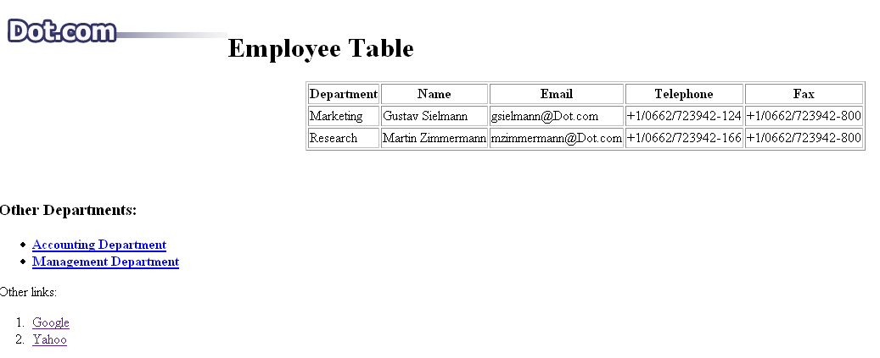
XML Exercise

Slide 36
XML Exercise
Write the HTML file of above webpage
Use XML to represent the data in the table
Answer:
dot.html
dot.xml

