Slide 1
Entity Relationship Modeling

Slide 2
Outline
Data Modeling: Big picture
E-R Model
Attributes
types
Relationships
connectivity, cardinality
strength, participation, degree
Entities
composite entity
supertype/subtype
Table Normalization
normal forms
1NF, 2NF, 3NF

Slide 3
S511 RDB Project Lifecycle
Study Database Environment ↓ Define Database Objectives
Planning
&
Analysis
Implementation
Design
Realize data model in DBMS (tables, forms, queries, reports) ↓ Populate database ↓ Test, Debug, & Evaluate
Data Analysis & Requirements ↓ Data Modeling & Verification
Notes:
data analysis
- what data is available
- what information is needed
- how to transform given data to desired info?
-- identify queries & processes
data modeling
- identify entities, attributes, relationships
- draw E-R diagram
- normalize to reduce data redundancies
verification
- will the model support processes that can satisfy database objectives?

Slide 4
Basic Modeling Concepts
Model
“Description or analogy used to visualize something that cannot be directly observed” -Webster’s Dictionary -
Data Models
Relatively simple representation of complex real-world data structures
Facilitate communication & enhance understanding
Degrees of data abstraction
Conceptual Model
global view of data
Internal Model
DBMS view of data
External Model
end-user view of data
Physical Model
machine view of data

Slide 5
Degrees of Data Abstraction
Conceptual
Global view of data
identify and describe main data items
e.g. E-R diagram
Hardware and software independent
Internal
Representation of database as seen by DBMS
adapt conceptual model to specific DBMS
e.g. Access tables
Software dependent
External
Users’ views of data environment
group requirements & constraints subsets into functional modules
e.g. student registration module, class scheduling module
Facilitates development & revalidates the conceptual model
Physical
Lowest level of abstraction
determine of physical storage devices and access methods
software and hardware dependent

Slide 6
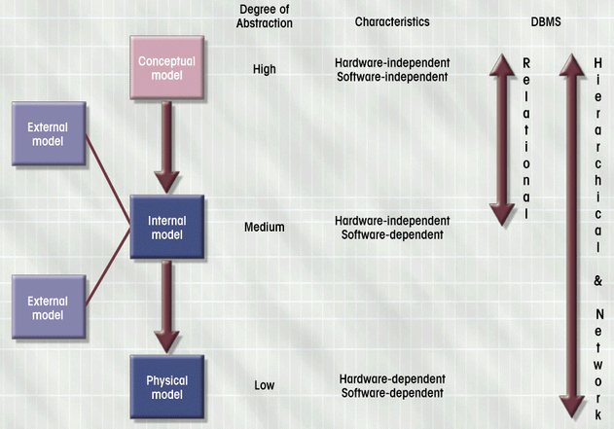
Data Abstraction Models
Database Systems: Design, Implementation, & Management: Rob & Coronel

Slide 7
Entity Relationship Model
Main components of the ER Model
Entities
entity set (table)
entity name (noun) is usually written in capital letters
Attributes
characteristics of entities
attribute domain = set of possible values
Relationships
association between entities
Entity Relationship Diagram (ERD)
ER model forms the basis of an ER diagram
ERD represents the conceptual view of the database

Slide 8
E-R Model: Attributes
Simple
Cannot be subdivided
e.g. age, sex, marital status
Composite
Can be subdivided into additional attributes
e.g. address  street, city, zip
Replace with multiple simple attributes
Single-valued
Can have only a single value
e.g. ssn ← person has one social security number
Multi-valued
Can have many values
e.g. college degree ← person may have several college degrees
Avoid if possible
Derived
Can be derived with algorithm
e.g. age = (current date - date of birth)/365
Stored vs. Computed
store to save CPU cycles & keep track of historical data
compute to save storage & use current data

Slide 9
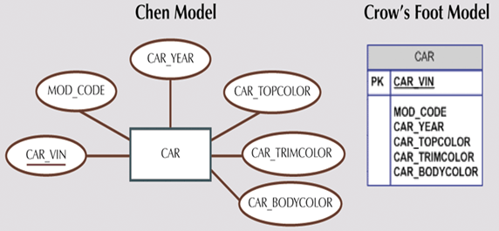
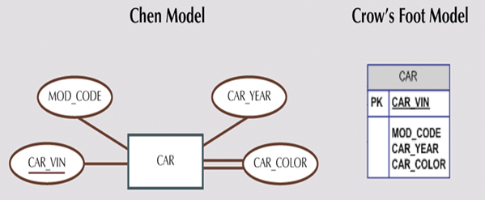
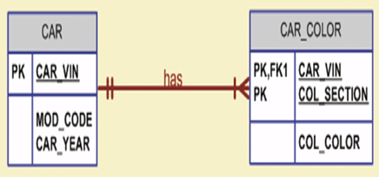
E-R Model: Attributes
Multi-valued attributes
Replace with multiple single-valued attributes.
Car_Color  Car_TopColor, Car_TrimColor, Car_BodyColor, Car_InteriorColor
could be problematic
Create a new entity composed of original multi-valued attribute’s components
Car_Color  CAR_COLOR (Car_Vin, Col_Section, Col_Color)
Database Systems: Design, Implementation, & Management: Rob & Coronel

Slide 10
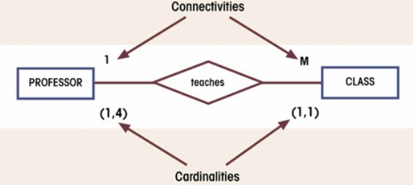
E-R Model: Relationships
Relationship = Association between entities
Connectivity & Cardinality are established by business rules.
Connectivity
Type/Classification of Relationships
1:1, 1:M, M:N
Cardinality
(min, max) = minimum/maximum number of occurrences of the related entity
Database Systems: Design, Implementation, & Management: Rob & Coronel

Slide 11
Relationship Strengths
Existence Dependence
Entity’s existence depends on the existence of related entities.
Existence-independent entities can exist apart from related entities.
e.g. EMPLOYEE claims DEPENDENT
A dependent cannot exist without an employee.
DEPENDENT is existence-dependent on EMPLOYEE.
Weak (non-identifying) Relationship
PK of related entity does not contain PK component of parent entity
One entity is existence-independent on another.
e.g. COURSE (CRS_CODE, DEPT_CODE, CRS_DESCRIPTION, CRS_CREDIT) CLASS (CLASS_CODE, CRS_CODE, CLASS_SECT, CLASS_TIME, …)
Strong (identifying) Relationship
PK of related entity contains PK component of parent entity
One entity is existence-dependent on another
e.g. COURSE(CRS_CODE, DEPT_CODE, CRS_DESCRIPTION, CRS_CREDIT) CLASS(CRS_CODE, CLASS_SECT, CLASS_TIME, …)

Slide 12
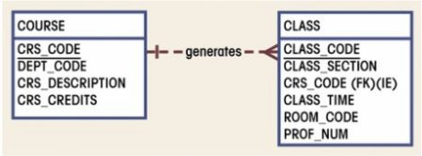
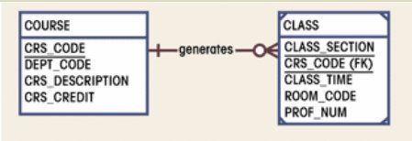
Relationship Strengths
weak relationship
strong relationship
Database Systems: Design, Implementation, & Management: Rob & Coronel
Crow’s Foot model
Dashed relationship line to indicate weak relationship.
Solid relationship line & “clipped” corners to indicate strong relationship.
Double-walled entity in Chen’s model
Database designer often determine the nature of relationship.
Best suited for database transaction, efficiency, and information requirements
Based on business rules

Slide 13
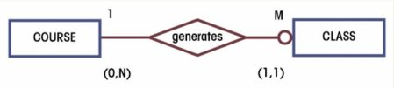
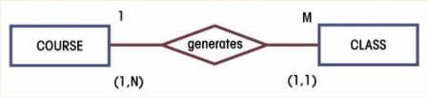
Relationship Participation
Optional Participation
Entity occurrence does not require a corresponding occurrence in related entity.
e.g. COURSE generates CLASS (some course may not generate a class)
Minimum cardinality of the optional entity is 0.
Mandatory Participation
Entity occurrence requires corresponding occurrence in related entity.
e.g. COURSE generates CLASS (each course generates one or more classes)
Minimum cardinality of the mandatory entity is 1.
CLASS is optional to COURSE
CLASS is mandatory to COURSE
Database Systems: Design, Implementation, & Management: Rob & Coronel

Slide 14
Relationship: Strength vs. Participation
Relationship Strength
Depends on the formulation of primary key.
Relationship Participation
Depends on the business rule.
Examples
EMPLOYEE has DEPENDENT
Strong & Optional
A dependent cannot exist without an employee
DEPENDENT is existence-dependent on EMPLOYEE
An employee may not have a dependent
DEPENDENT is optional to EMPLOYEE
PHD_STUDENT teaches CLASS
Weak & Mandatory
A class can exist without a doctoral student
CLASS is existence-independent on PHD_STUDENT
A doctoral student must teach at least one class
CLASS is mandatory to PHD_STUDENT

Slide 15
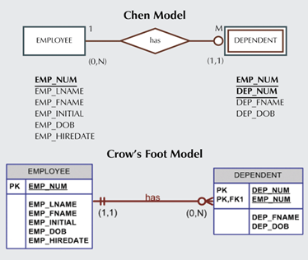
Relationship: Weak Entities
Database Systems: Design, Implementation, & Management: Rob & Coronel
Strong vs. Weak entities
Strong Entity = existence-independent entity
Weak Entity
existence-dependent entity in a strong relationship
inherits all or part of its primary key from parent entity
entity w/ clipped corners in CF model, double-walled in Chen model

Slide 16
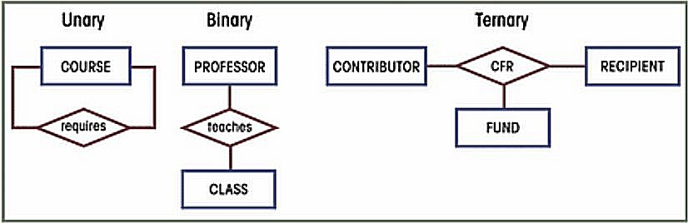
Relationship Degree
Relationship Degree indicates the number of associated entities.
Unary Relationship
Relationship exists between occurrences of same entity set
e.g., Recursive relationship
Binary Relationship
Two entities associated
Most common
higher-order relationships are often decomposed into binary relationships
Ternary
Three entities associated
e.g., CONTRIBUTOR, RECIPIENT, FUND
need ternary relationship for a recipient to identify the source of fund
Database Systems: Design, Implementation, & Management: Rob & Coronel
Notes:
Unary
- a course is a prerequisite for another course (M:N)
Ternary
- CONTRIBUTOR donate money to research FUND (M:N)
- RECIPIENT researchers are funded $ from FUND (M:N)

Slide 17
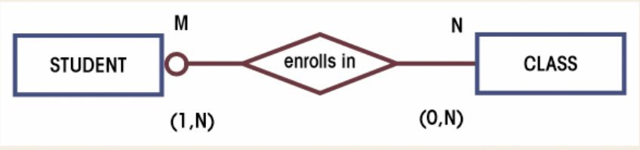
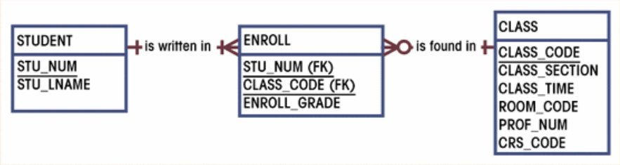
Composite Entities
Composite Entity (i.e., Bridge Entity)
Transforms a M:N relationship into two 1:M relationships
Contains primary keys of the “bridged” entities
May also contain additional attributes that play no role in connective process
Typically has strong relationships with the “bridged” entities
Database Systems: Design, Implementation, & Management: Rob & Coronel

Slide 18
M:N to 1:M Conversion
STUDENT
CLASS
STU_ID | STU_NAME | CLS_ID
1234 | John Doe | 10012
1234 | John Doe | 10014
2341 | Jane Doe | 10013
2341 | Jane Doe | 10014
2341 | Jane Doe | 10023
CLS_ID | CRS_NAME | CLS_SECT | STU_ID
10012 | L546 | 1 | 1234
10013 | L546 | 2 | 2341
10014 | L548 | 1 | 1234
10014 | L548 | 1 | 2341
10023 | L571 | 1 | 2341
STU_ID | STU_NAME
1234 | John Doe
2341 | Jane Doe
CLS_ID | STU_ID | ENR_GRD
10012 | 1234 | B
10013 | 2341 | A
10014 | 1234 | C
10014 | 2341 | A
10023 | 2341 | A
CLS_ID | CRS_NAME | CLS_SEC
10012 | L546 | 1
10013 | L546 | 2
10014 | L548 | 1
10023 | L571 | 1
STUDENT
CLASS
ENROLL
Move the foreign key columns to create a bridge table & add attributes if needed.
Collapse the duplicate records in remaining tables.

Slide 19
Entity Supertypes & Subtypes
Problem:
Unshared characteristics of certain entity subtypes
e.g. PILOT vs. EMPLOYEE
Solution:
Generalization hierarchy
higher-level Supertype (parent) and lower-level Subtype (child) entities
Supertype and Subtype maintain 1:1 relationship
Supertype
has shared attributes
Subtypes
have unique attributes
inherit attributes and relationships of the supertype
often comprise of unique and disjoint entities (‘G’ symbol)
e.g. EMPLOYEE  PILOT, MECHANIC, ACCOUNTANT
sometimes comprise of overlapping entities (‘Gs’ symbol)
e.g. EMPLOYEE  PROFESSOR, ADMINISTRATOR

Slide 20
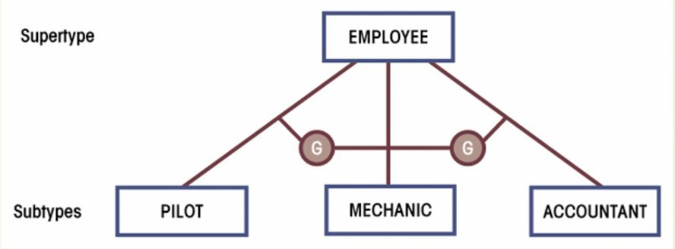
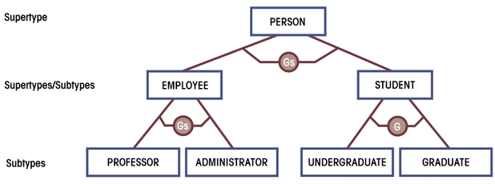
Subtypes: Overlapping vs. Non-overlapping
Non-overlapping (Disjoint)
Overlapping
Database Systems: Design, Implementation, & Management: Rob & Coronel

Slide 21
Developing ERD
Iterative Process
Create detailed narrative of organization’s description of operations
Identify business rules based on description of operations
Identify main entities and relationships from business rules
Develop initial ERD
Identify attributes and primary keys that adequately describe entities
Revise and review ERD

Slide 22
ERD Example: Narrative
Narrative of operational environment
Tiny College is divided into several schools
Each school is composed of several departments
Each school is administered by a dean
Each dean is a member of administrators group
A dean is also a professor and may teach classes
Administrators and professors are employees
Each department offers several courses
Each course may have several sections (classes)
Each department has many professors and students
One of the professors chairs the department
Each professor may teach up to 4 classes
A student may enroll in several classes
Each student has an advisor in his/her department
Each student belongs to only one department

Slide 23
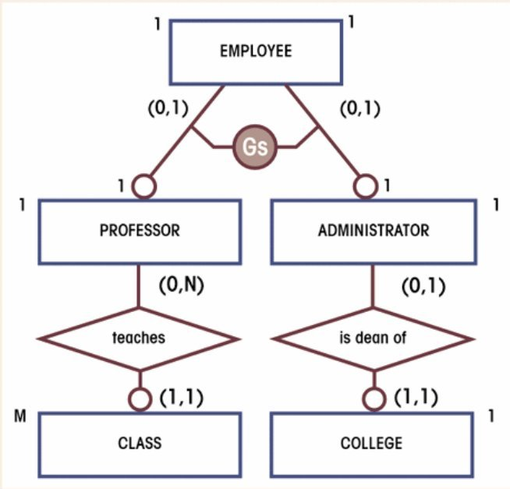

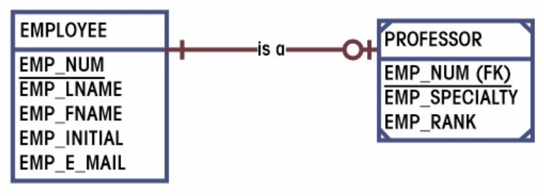
ERD Example: Supertype/Subtype
- Each school is administered by a dean
- Each dean is a member of administrators group
- A dean is also a professor and may teach classes
- Administrators and professors are employees
Database Systems: Design, Implementation, & Management: Rob & Coronel
Professors and administrators have unique characteristics not present in other employees
EMPLOYEE supertype, PROFESSOR & ADMINISTRATOR (overlapping) subtypes
Professors and administrators have same set of characteristics
collapse PROFESSOR and ADMINISTRATOR entities

Slide 24
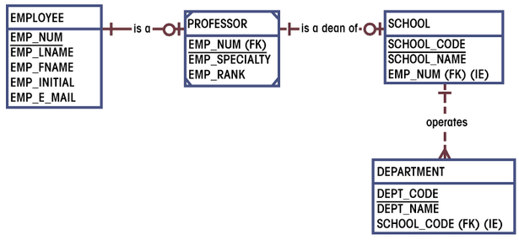
ERD Example: ERD segment 1
Database Systems: Design, Implementation, & Management: Rob & Coronel
Professors are employees
A professor may be a dean
Each school is administered by a dean
Each school is composed of several departments

Slide 25
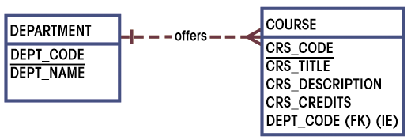
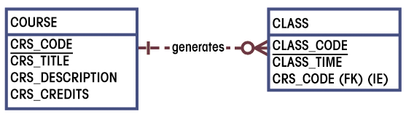
ERD Example: ERD segment 2 & 3
Database Systems: Design, Implementation, & Management: Rob & Coronel
Each department offers several courses
Each course may have several sections (classes)

Slide 26
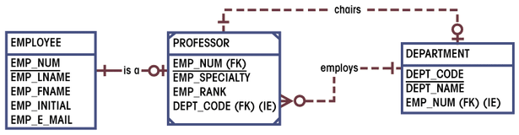
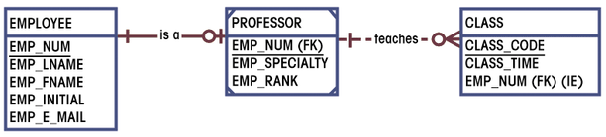
ERD Example: ERD segment 4 & 5
Database Systems: Design, Implementation, & Management: Rob & Coronel
Each department has many professors
One of the professors chairs the department
Each professor may teach up to 4 classes

Slide 27
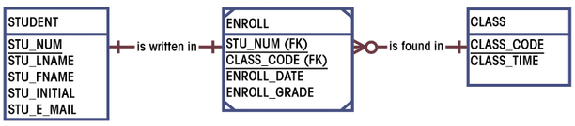
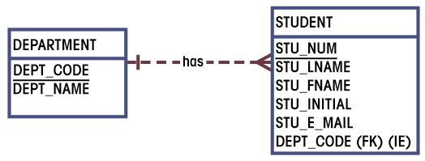
ERD Example: ERD segment 6 & 7
Database Systems: Design, Implementation, & Management: Rob & Coronel
A student may enroll in several classes
Each department has many students
Each student belong to only one department

Slide 28
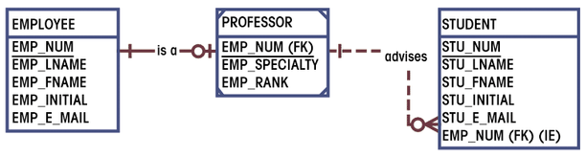
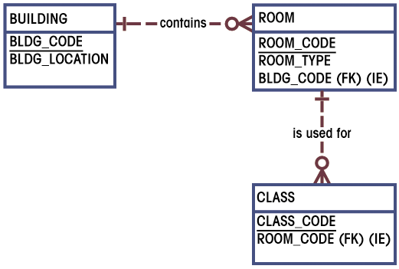
ERD Example: ERD segment 8 & 9
Database Systems: Design, Implementation, & Management: Rob & Coronel
Each student has an advisor
Class is held in class rooms

Slide 29
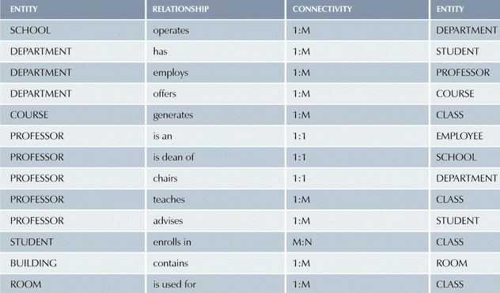
ERD Example: ERD components
Database Systems: Design, Implementation, & Management: Rob & Coronel

Slide 30
ERD Example: Merging ERD segments

Slide 31
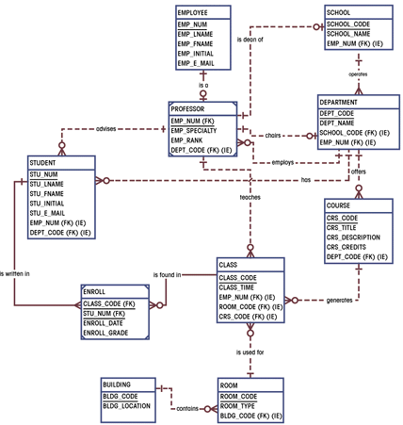
ERD Example: Completed ERD
Database Systems: Design, Implementation, & Management: Rob & Coronel

