Slide 1
Relational Database Model

Slide 2
Outline
Relational database concepts
Tables
Integrity Rules
Relationships
Relational Algebra

Slide 3
Logical View of Data
Entity
a person, place, event, or thing about which data is collected.
e.g. a student
Entity Set
a collection of entities that share common characteristics
named to reflect its content
e.g. STUDENT
Attributes
characteristics of the entity.
e.g. student number, name, birthdate
named to reflect its content
e.g. STU_NUM, STU_NAME, STU_DOB
Tables
contains a group of related entities or entity set
2-dimensional structure composed of rows and columns
also called relations

Slide 4
Table Characteristics
2-dimensional structure with rows & columns
Rows (tuples)
represent single entity occurrence
Columns
represent attributes
have a specific range of values (attribute domain)
each column has a distinct name
all values in a column must conform to the same data format
Row/column intersection represents a single data value
Rows and columns orders are inconsequential
Each table must have a primary key.
Primary key is an attribute (or a combination of attributes) that uniquely identify each row
Relational database vs. File system terminology
Rows == Records, Columns == Fields, Tables == Files

Slide 5
Table Characteristics
Table and Column names
Max. 8 & 10 characters in older DBMS
Cannot use special charcters (e.g. */.)
Use descriptive names (e.g. STUDENT, STU_DOB)
Column characteristics
Data type
number, character, date, logical (Boolean)
Format
999.99, Xxxxxx, mm-dd-yy, Yes/No
Range
0-4, 35-65, {A,B,C,D}

Slide 6
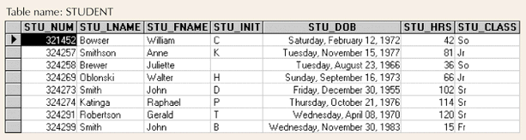
Example: Table
Database Systems: Design, Implementation, & Management: Rob & Coronel
8 rows & 7 columns
Row = single entity occurrence
row 1 describes a student named William Bowser
Column = an attribute
has specific characteristics (data type, format, value range)
STU_CLASS: char(2), {Fr,Jr,So,Sr}
all values adhere to the attribute characteristics
Each row/column intersection contains a single data value
Primary key = STU_NUM

Slide 7
Keys in a Table
Consists of one or more attributes that determine other attributes
given the value of a key, you can look up (determine) the value of other attributes
Composite key
composed of more than one attribute
Key attribute
any attribute that is part of a key
Superkey
any key that uniquely identifies each row
Candidate key
superkey without redundancies
Primary Key
a candidate key selected as the unique identifier
Foreign Key
an attribute whose values match primary key values in the related table
joins tables to derive information
Secondary Key
facilitates querying of the database
restrictive secondary key → narrow search result
e.g. STU_LNAME vs. STU_DOB

Slide 8
Keys in a Table
Superkey
attribute(s) that uniquely identifies each row
STU_ID; STU_SSN; STU_ID + any; STU_SSN + any; STU_DOB + STU_LNAME + STU_FNAME?
Candidate Key
minimal superkey
STU_ID; STU_SSN; STU_DOB + STU_LNAME + STU_FNAME?
Primary Key
candidate key selected as the unique identifier
STU_ID
Foreign Key
primary key from another table
DEPT_CODE
Secondary Key
attribute(s) used for data retrieval
STU_LNAME + STU_DOB
DEPT_CODE | DEPT_NAME
243 | Astronomy
245 | Computer Science
423 | Sociology
STU_ID | STU_SSN | STU_DOB | STU_LNAME | STU_FNAME | DEPT_CODE
12345 | 111-11-1111 | 12/12/1985 | Doe | John | 245
12346 | 222-22-2222 | 10/10/1985 | Dew | John | 243
12348 | 123-45-6789 | 11/11/1982 | Dew | Jane | 423

Slide 9
Integrity Rules
Entity Integrity
Each entity has unique key
primary key values must be unique and not empty
Ensures uniqueness of entities
given a primary key value, the entity can be identified
e.g., no students can have duplicate or null STU_ID
Referential Integrity
Foreign key value is null or matches primary key values in related table
i.e., foreign key cannot contain values that does not exist in the related table.
Prevents invalid data entry
e.g., James Dew may not belong to a department (Continuing Ed), but cannot be assigned to a non-existing department.
Most RDBMS enforce integrity rules automatically.
STU_ID | STU_LNAME | STU_FNAME | DEPT_CODE
12345 | Doe | John | 245
12346 | Dew | John | 243
22134 | Dew | James
DEPT_CODE | DEPT_NAME
243 | Astronomy
244 | Computer Science
245 | Sociology

Slide 10
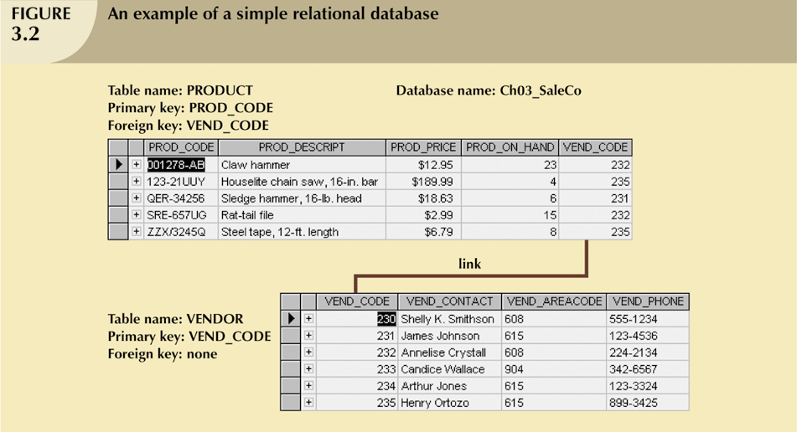
Example: Simple RDB
Database Systems: Design, Implementation, & Management: Rob & Coronel

Slide 11
Relationships in RDB
Representation of relationships among entities
By shared attributes between tables (RDB model)
primary key ⬄ foreign key
E-R model provides a simplified picture
One-to-One (1:1)
Could be due to improper data modeling
e.g. PILOT (id, name, dob) to EMPLOYEE (id, name, dob)
Commonly used to represent entity with uncommon attributes
e.g. PILOT (id, license) to EMPLOYEE (id, name, dob, title)
One-to-Many (1:M)
Most common relationship in RDB
Primary key of the One should be the foreign key in the Many
Many-to-Many (M:N)
Should not be accommodated in RDB directly
Implement by breaking it into a set of 1:M relationships
create a composite/bridge entity

Slide 12
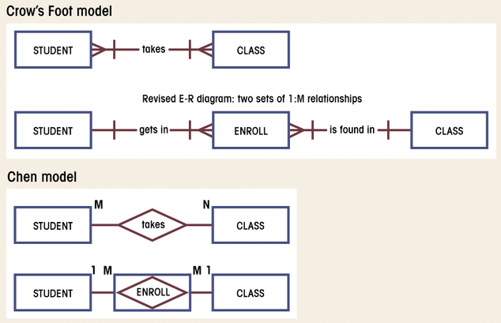
M:N to 1:M Conversion
Database Systems: Design, Implementation, & Management: Rob & Coronel

Slide 13
M:N to 1:M Conversion
STU_ID | STU_NAME | CLS_ID
1234 | John Doe | 10012
1234 | John Doe | 10014
2341 | Jane Doe | 10013
2341 | Jane Doe | 10014
2341 | Jane Doe | 10023
CLS_ID | STU_ID | CRS_NAME | CLS_SEC
10012 | 1234 | S511 | 1
10013 | 2341 | S511 | 2
10014 | 1234 | S517 | 1
10014 | 2341 | S517 | 1
10023 | 2341 | S534 | 1
STU_ID | STU_NAME
1234 | John Doe
2341 | Jane Doe
CLS_ID | STU_ID | ENR_GRD
10012 | 1234 | B
10013 | 2341 | A
10014 | 1234 | C
10014 | 2341 | A
10023 | 2341 | A
CLS_ID | CRS_NAME | CLS_SEC
10012 | S511 | 1
10013 | S511 | 2
10014 | S517 | 1
10023 | S534 | 1
Composite Table:
must contain at least the primary keys of original tables
contains multiple occurrences of the foreign key values
additional attributes may be assigned as needed

Slide 14
Data Integrity
Redundancy
Uncontrolled Redundancy
unnecessary duplication of data
e.g. repeated attribute values in a table
derived attributes (can be derived from existing attributes)
proper use of foreign keys can reduce redundancy
e.g. M:N to 1:M conversion
Controlled Redundancy
shared attributes in multiple tables
makes RDB work (e.g. foreign key)
designed to ensure transaction speed, information requirements
e.g. account balance = account receivable - payments
e.g. INV_PRICE records historical product price
PRD_ID | PRD_NAME | PRD_PRICE
1234 | Chainsaw | $100
2341 | Hammer | $10
INV_ID | PRD_ID | INV_PRICE
121 | 1234 | $80
122 | 2341 | $5

Slide 15
Data Integrity
Nulls
No data entry
a “not applicable” condition
non-existing data
e.g., middle initial, fax number
an unknown attribute value
non-obtainable data
e.g., birthdate of John Doe
a known, but missing, attribute value
uncollected data
e.g., date of hospitalization, cause of death
Can create problems
when functions such as COUNT, AVERAGE, and SUM are used
Not permitted in primary key
should be avoided in other attributes

Slide 16
Indexes
Composed of an index key and a set of pointers
Points to data location (e.g. table rows)
Makes retrieval of data faster
each index is associated with only one table
ACTOR_NAME | ACTOR_ID
James Dean | 12
Henry Fonda | 23
Robert DeNiro | 34
 | MOVIE_ID | MOVIE_NAME | ACTOR_ID
1 | 231 | Rebel without Cause | 12
2 | 352 | Twelve Angry Men | 23
3 | 455 | Godfather 2 | 34
4 | 460 | Godfather II | 34
5 | 625 | On Golden Pond | 23
index key (ACTOR_ID) | pointers
12 | 1
23 | 2, 5
34 | 3, 4

Slide 17
Data Dictionary & Schema
Data Dictionary
Detailed description of a data model
for each table in a database
list all the attributes & their characteristics
e.g. name, data type, format, range
identify primary and foreign keys
Human view of entities, attributes, and relationships
Blueprint & documentation of a database
design & communication tool
Relational Schema
Specification of the overall structure/organization of a database
e.g. visualization of a structure
Shows all the entities and relationships among them
tables w/ attributes
relationships (linked attributes)
primary key ⬄ foreign key
relationship type
1:M, M:N, 1:1

Slide 18
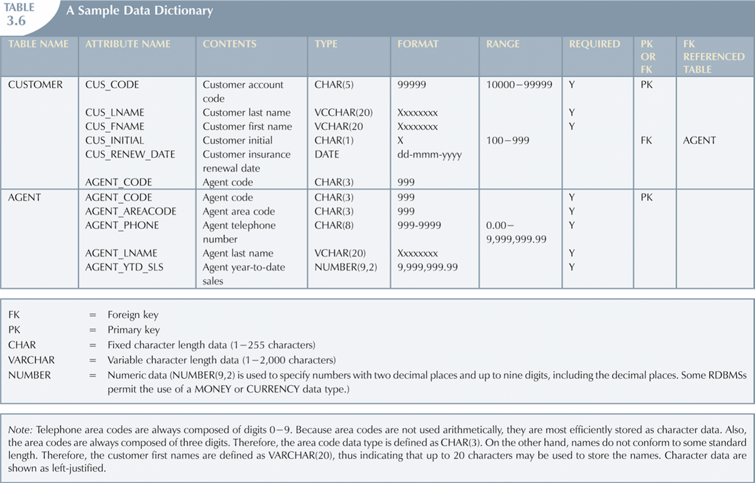
Data Dictionary
Lists attribute names and characteristics for each table in the database
record of design decisions and blueprint for implementation
Database Systems: Design, Implementation, & Management: Rob & Coronel

Slide 19
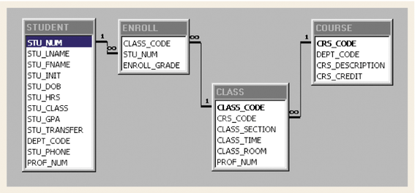
Relational Schema
A diagram of linked tables w/ attributes
Database Systems: Design, Implementation, & Management: Rob & Coronel

Slide 20
Relational Algebra
Method of manipulating table contents
uses relational operators
Key relational operators
SELECT
PROJECT
JOIN
Other relational operators
INTERSECT
UNION
DIFFERENCE
PRODUCT
DIVIDE

Slide 21
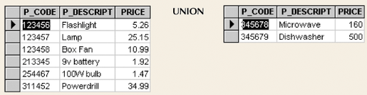
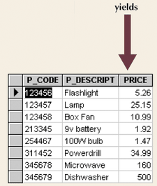
UNION: T1 ∪ T2
combines all rows from two tables
duplicates rows are compress into a single row
tables must be union-compatible
union-compatible = tables have identical attributes
Database Systems: Design, Implementation, & Management: Rob & Coronel

Slide 22
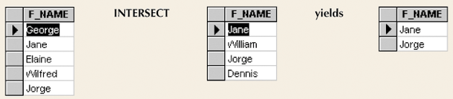
INTERSECT: T1 ∩ T2
yields rows that appear in both tables
tables must be union-compatible
e.g. attribute F_NAMEs must be of all same type
Database Systems: Design, Implementation, & Management: Rob & Coronel

Slide 23
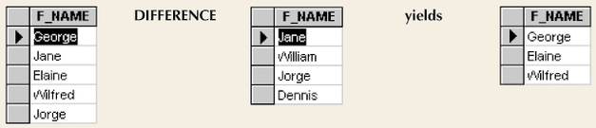
DIFFERENCE: T1 – T2
yields rows not found in the other table
tables must be union-compatible
Database Systems: Design, Implementation, & Management: Rob & Coronel

Slide 24
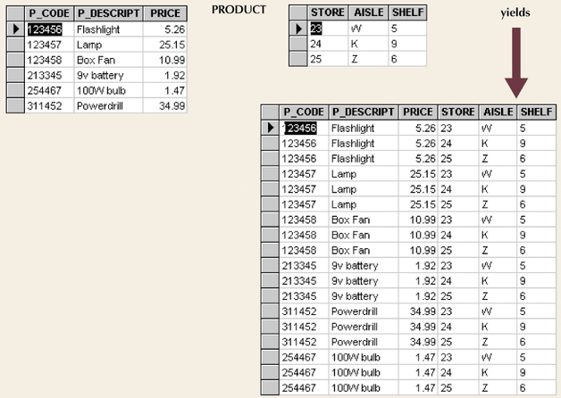
PRODUCT: T1 X T2
yields all possible pairs of rows from two tables
Cartesian product: produces m*n rows
Database Systems: Design, Implementation, & Management: Rob & Coronel

Slide 25
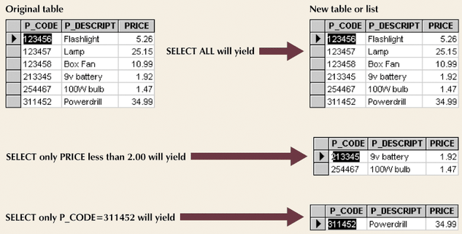
SELECT: σ _{a1<comparison>v1(T1)}
yields a row subset based on specified criterion
operates on one table to produce a horizontal subset
Database Systems: Design, Implementation, & Management: Rob & Coronel
Notes:
sigma

Slide 26
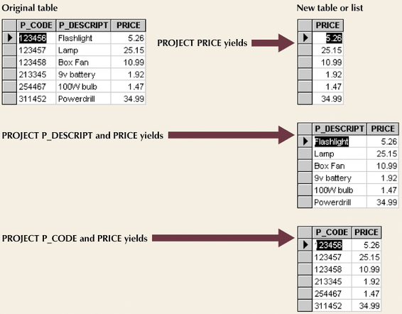
PROJECT: π _{a1,a2(T1)}
yields all values for selected columns
operates on one table to produce a vertical subset
Database Systems: Design, Implementation, & Management: Rob & Coronel
Notes:
pi

Slide 27
JOIN: T1 |X|_{<join condition>} T2
combines “related” rows from multiple tables
Product operation restricted to rows that satisfy join condition
Join = Product + Select
Join types
Theta Join
T1 |X|_{<a1θ b1>} T2
EquiJoin
T1 |X|_{<a1= b1>} T2
Natural Join
T1 |X| T2
EquiJoin + Project
Outer Join
left outer join: T1 ]X| T2
right outer join: T1 |X[ T2
Notes:
pi

Slide 28
Theta JOIN: T1 |X|_{<a1θb1>} T2
Product + Selection_{<a1θ b1>}
EMP_NAME | EMP_AGE
Einstein | 67
Newton | 74
RET_AGE | RET_TYPE
60 | Early
70 | Full
75 | Extended
|X|_{<EMP_AGE >= RET_AGE>}
EMP_NAME | EMP_AGE | RET_AGE | RET_TYPE
Einstein | 67 | 60 | Early
Newton | 74 | 60 | Early
Newton | 74 | 70 | Full
Notes:
pi

Slide 29
EquiJOIN: T1 |X|_{<a1=b1>} T2
Product + Selection_{<a1= b1>}
PAY_LVL | PAY_AMT
12 | $100,000
15 | $150,000
21 | $200,000
EMP_SSN | EMP_NAME | EMP_LVL
123-45-6789 | Einstein | 21
987-65-4321 | Newton | 12D
|X|_{<EMP_LVL=PAY_LVL>}
EMP_SSN | EMP_NAME | EMP_LVL | PAY_LVL | PAY_AMT
123-45-6789 | Einstein | 21 | 21 | $200,000
PAY_LVL | PAY_AMT
12 | $100,000
15 | $150,000
21 | $200,000
EMP_SSN | EMP_NAME | PAY_LVL
123-45-6789 | Einstein | 21
987-65-4321 | Newton | 12D
|X|_{<PAY_LVL=21>}
EMP_SSN | EMP_NAME | PAY_LVL | PAY_LVL | PAY_AMT
123-45-6789 | Einstein | 21 | 21 | $200,000
Notes:
pi

Slide 30
Natural Join: T1 |X| T2
Product + Select (T1.a1 = T2.a1) + Project
Equi-join by common attribute with duplicate column removal
EMP_SSN | EMP_NAME | PAY_LVL
123-45-6789 | Einstein | 21
987-65-4321 | Newton | 12
|X|
PAY_LVL | PAY_AMT
12 | $100,000
15 | $150,000
21 | $200,000
EMP_SSN | EMP_NAME | PAY_LVL | PAY_AMT
123-45-6789 | Einstein | 21 | $200,000
987-65-4321 | Newton | 12 | $100,000
Notes:
pi

Slide 31
Left Outer JOIN: T1 ]X| T2
Keep all rows from the left table with added columns from the right table
good tool for finding referential integrity problems
EMP_SSN | EMP_NAME | PAY_LVL
123-45-6789 | Einstein | 12
987-65-4321 | Newton | 21D
PAY_LVL | PAY_AMT
12 | $100,000
15 | $150,000
21 | $200,000
]X|
EMP_SSN | EMP_NAME | PAY_LVL | PAY_AMT
123-45-6789 | Einstein | 12 | $100,000
987-65-4321 | Newton | 21D | ?
Notes:
pi

Slide 32
Right Outer JOIN: T1 |X[ T2
Keep all rows from the right table with added columns from the left table
EMP_SSN | EMP_NAME | PAY_LVL
123-45-6789 | Einstein | 12
987-65-4321 | Newton | 21D
PAY_LVL | PAY_AMT
12 | $100,000
15 | $150,000
21 | $200,000
|X[
EMP_SSN | EMP_NAME | PAY_LVL | PAY_AMT
123-45-6789 | Einstein | 12 | $100,000
 |  | 15 | $150,000
 |  | 21 | $200,000
Notes:
pi

Slide 33
DIVIDE: T1 % T2
“Divides” T1 into a row subset by shared attribute(s)
result is a table with unshared attributes from T1
Select rows from T1, whose shared attribute values match all of T2 values
Project unshared attributes
JUDGE
1
2
3
GRADE
A
JUDGE | GRADE
1 | A
2 | A
3 | A
1 | B
2 | B
3 | A
%
JUDGE
1
2
GRADE
A
B
%
Database Systems: Design, Implementation, & Management: Rob & Coronel
Notes:
pi

Slide 34
Relational Algebra: Overview
union
intersect
difference
select
project
a
1
a
2
b
1
b
2
natural join
left outer join
right outer join
product
divide

