Slide 1
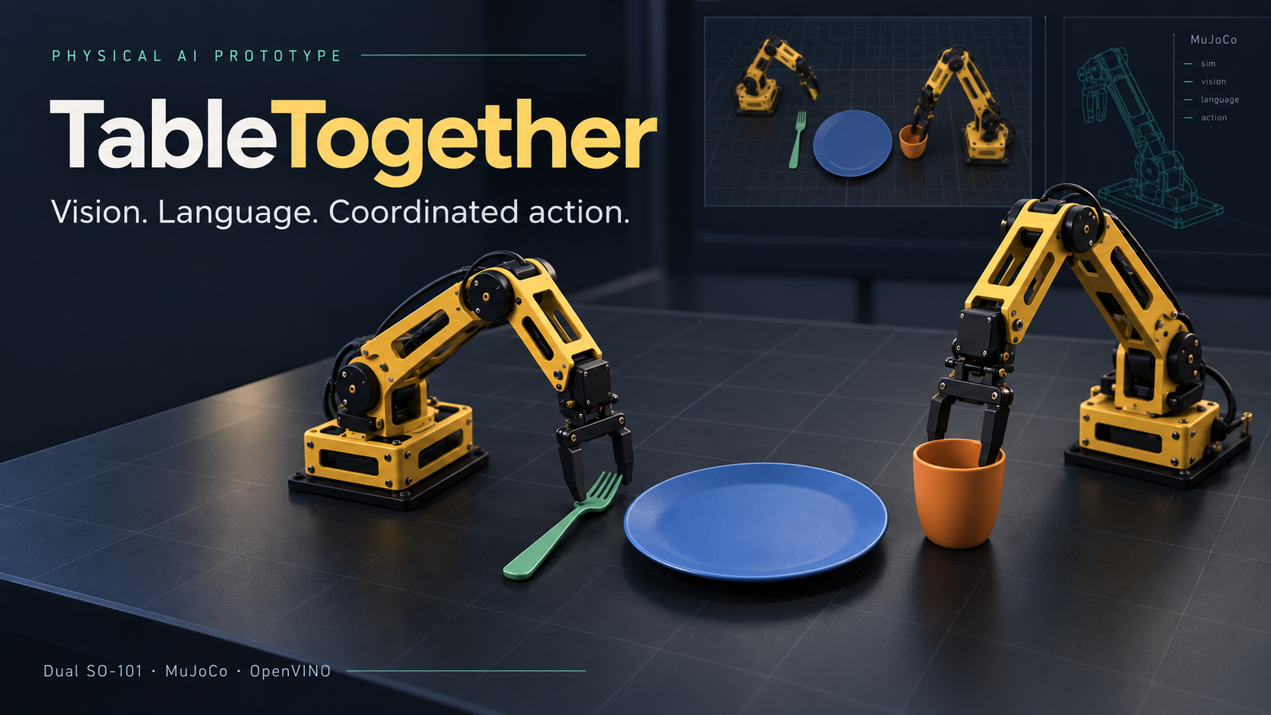
Notes:
TableTogether hackathon prototype. Cover is AI-generated concept artwork, not a photograph of hardware execution. The following slides show actual simulation evidence.

Slide 2
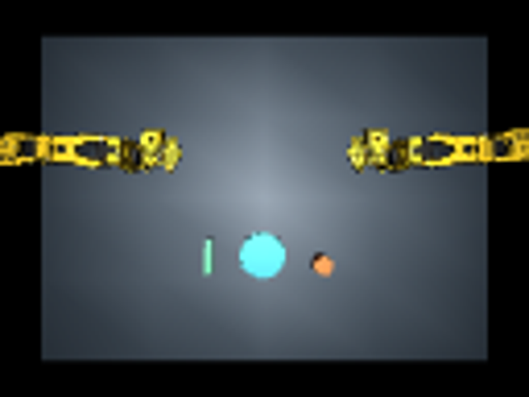
A table-setting assistant in simulation
“Set the table.
Start with the cup.”
Two SO-101 arms place a cup and utensil beside an existing plate.
The user can request either order.
The app shows live frames and placement checks.
Actual MuJoCo camera view
02
Notes:
Application: potential assistive and service robotics. Current proof of concept covers one existing plate and two simple proxy objects. Source: robotics/scene.py and learning/rollout.py in https://github.com/SoniaLong/table-together

Slide 3
The learned perception-to-action policy
INPUTS
LEARNED OUTPUT
128 × 96 overhead RGB
Ordered instruction tokens
Twelve measured joint positions
Current action index
CNN and language encoder predict joint targets and durations over 18 keyframes.
MuJoCo actuators execute the targets through physical contacts.
Sequential complementary arm actions. No expert fallback during learned execution.
03
Notes:
Sources: robotics/learning/policy.py, rollout.py and README.md. A task-specific keyframe imitation policy with a strong demonstration-derived trajectory prior. No foundation VLA or arbitrary natural-language reasoning claim.

Slide 4
Training improved validation accuracy
Measure | Original | Revised
Successful demonstrations | 43 | 75
Training keyframes | 774 | 1,350
Validation joint MAE | 0.002598 rad | 0.001933 rad
Complete validation episodes | 6/8 | 7/8
25.6% lower joint-target error on validation observations
Separate validation seeds. Fresh test scenes determine task reliability.
04
Notes:
Source: learning/checkpoints/experiment.json and RESULTS.md. Improved run uses separate keyframe output heads, brightness augmentation 0.85–1.15 and joint observation noise of 0.001 rad. Adam 0.0002, 5,000 iterations, 288.08 s. Validation chooses iteration 4,200 by normalized action error. MAE is not task success.

Slide 5
Fresh tests passed half the episodes
OpenVINO CPU condition | Successful episodes
Cup first | 5/10
Utensil first | 5/10
Ten fresh scenes, two instruction orders
Object positions vary independently by ±8 mm.
Cup placement remains a frequent failure.
Better validation accuracy has not established reliable task completion.
05
Notes:
Source: learning/evaluations/ten-seed-final/summary.json and final-utensil-first/summary.json. Frozen SHA256 f2f60dde4d383f845b91e9033afe51a691ece023a1bf53a6e29452e53dbb6bc3. CPU OpenVINO. Seeds 600–609 were not used for training or selection. Both placements require <30 mm error plus upright cup, undisturbed plate, correct first arm.

Slide 6
Robustness beyond object placement
Scene condition | Success
Standard positions | 6/10
Lighting and background | 4/10
Mass and friction | 6/10
Horizontal object size | 7/10
Combined variations | 6/10
50 additional episodes. Unfamiliar shapes and recovery remain untested.
06
Notes:
Source: robotics/ROBUSTNESS.md and learning/evaluations/robustness-improved/summary.json. PyTorch, paired seeds 700–709, ten episodes per profile. Light RGB 0.55–1.0; table RGB 0.10–0.28. Mass 70–130% of 35 g; friction 0.7–1.3. Horizontal size 90–110%, fixed height. No test-based tuning.

Slide 7
Intel deployment: measured and expected
VERIFIED LOCALLY
TARGET HARDWARE
Core Ultra 5 125U
Series 1
Core Ultra
Series 2 / 3
MuJoCo simulation and OpenVINO CPU inference run locally.
All 112 model graph operations pass the CPU support query.
Intel’s CPU support matrix supports compatibility in principle.
Actual target execution and performance remain unverified.
No full-policy NPU or GPU execution claim
07
Notes:
Sources: https://github.com/SoniaLong/table-together/blob/main/robotics/COMPATIBILITY.md; https://docs.openvino.ai/2026/about-openvino/release-notes-openvino/system-requirements.html; https://mujoco.readthedocs.io/en/stable/programming/index.html. Intel lists Core Ultra Series 1/2/3 for CPU support. Local query supports all 112 graph operations. FP16 refers to weight compression with FP32 CPU computation. Benchmark ran alongside other jobs and cannot substantiate target performance.

Slide 8
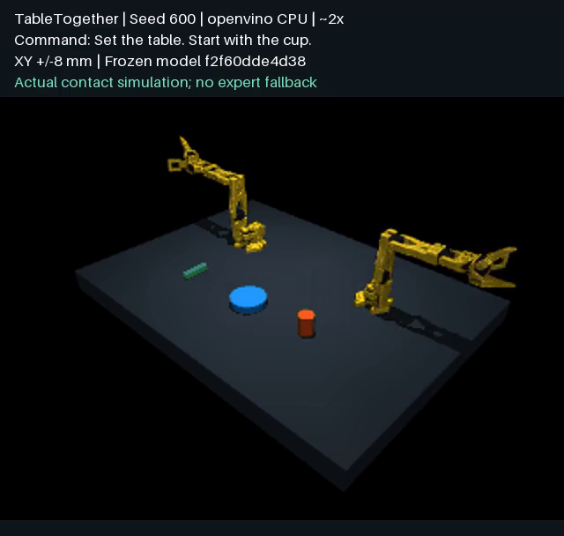
The complete ten-seed demonstration
2 minutes 37 seconds
All ten consecutive seeds
Every success and failure
Visible command and model identity
Watch the recorded demonstration
Open the source repository
08
Notes:
Actual recorded video: https://github.com/SoniaLong/table-together/blob/main/robotics/learning/evaluations/ten-seed-final/TableTogether-ten-seeds.mp4. Duration 157 seconds. Shows every seed, instruction, checkpoint prefix and final result, including failures. Playback about 2× simulation speed. All execution is local Series 1.

Slide 9
Next steps toward a qualifying submission
Improve contact reliability
Collect failure-recovery demonstrations and evaluate closed-loop correction.
Validate on Series 2 or Series 3
Run simulation, record hardware identity, and benchmark the complete policy.
github.com/SoniaLong/table-together
Source, training data, model weights and evaluation evidence are public.
09
Notes:
Current limits and future work, not claims of implemented functionality. Public source: https://github.com/SoniaLong/table-together. The repository excludes the earlier unrelated project.

