Slide 1
Attribute-Based-Encryption in Disruption Tolerant Military Networks to secure data access
A Wireless Network based Scheme
Project Guide –
Mr. V. Hemakumar , Assistant Professor,
Department of CSE.
Project by –
Sonia. M,
Final Year , CSE-B .

Slide 2
Network Security deals with applying the security policies to the network that help to protect the computer systems, to ensure security of its assets and the resources from unauthorized entity and malicious components.
Wireless devices carried by soldiers to communicate with each other require confidentiality for accessing the information or command reliably.
I forecast a new technique to generate secret keys to the soldiers through which they can access data.

Slide 3
ISSUES
Key Revocation – Updation of user Attributes in case of repositioning.
Key Escrow – Information may be leaked if the Central Authority is compromised.
Coordination of Attributes – Key generation is dependant on multiple authority . Coordinating the Central Authorities is necessary to generate keys.
Forward Secrecy – A revoked user will be able to access data until expiration time even if he does not hold the required attribute.
Backward Secrecy – A user who holds the new attribute might be able to access the previously encrypted data.

Slide 4
PROBLEM STATEMENT
Military nodes in hostile networks are subjected to frequent disruptions , the threats of information leak by the centralized authority , Key Revocation delay and Key Escrow problem.
The existing system suggests about using multiple authorities for key generation which has complications in the coordination of authorities.
I propose an alternate method for key generation.

Slide 5
Objective –
The objective of the study is to provide secured data access in Military Networks which suffer from the threats of information leakage using an efficient ABE(Attribute-Based-Encryption) method.
Scope –
The ABE(Attribute-Based-Encryption) method can be further used in other hostile networks and private concerns like Hospitals , Research Centre to preserve data.

Slide 6
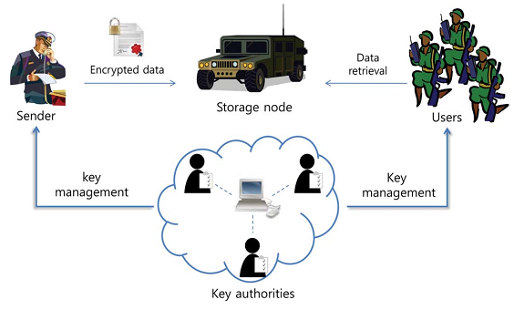

Slide 7
Literature Survey

Slide 8
Identity-Based Encryption with Outsourced Revocation in Cloud Computing
Author : Jin Li, Jingwei Li, Xiaofeng Chen, Chunfu Jia, and Wenjing Lou, Senior Member, IEEE
Identity-Based Encryption (IBE) which simplifies the public key and certificate management at Public Key Infrastructure (PKI) is an important alternative to public key encryption.
Drawback -
Overhead computation at Private Key Generator (PKG) during user revocation.

Slide 9
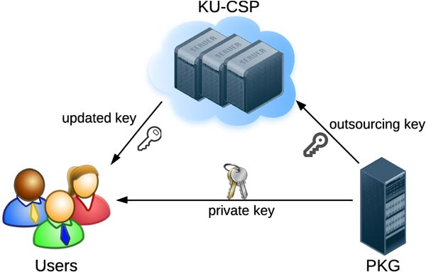

Slide 10
Ciphertext-Policy Attribute-Based Encryption
Author : Bethencourt, Carnegie Mellon Univ., Pittsburgh, Sahai, Waters
In several distributed systems a user should only be able to access data if a user posses a certain set of credentials or attributes.
By using ciphertext-policy attribute-based encryption techniques the encrypted data can be kept confidential even if the storage server is untrusted.
Issue discussed -
In KP-ABE, the key authority chooses a policy for each user that determines which ciphertexts he can decrypt and issues the key to each user by embedding the policy into the user’s key.

Slide 11
Attribute-Based Encryption With
Verifiable Outsourced Decryption
Author : Jin Junzuo Lai, Robert H. Deng, Chaowen Guan, and Jian Weng
Attribute-based encryption (ABE) is a public-key-based encryption that allows users to encrypt and decrypt data based on user attributes.
A promising application of ABE is flexible access control of encrypted data stored in the cloud, using access polices and ascribed attributes associated with private keys and ciphertexts.
Issues discussed–
One of the main drawbacks of the existing ABE schemes is that decryption involves expensive pairing operations and the number of such operations grows with the complexity of the access policy.

Slide 12
Improving Security and Efficiency in Attribute-Based Data Sharing
Author : Junbeom Hur
Adoption of data sharing paradigm in distributed systems have increased the demands and concerns for distributed data security. Here the data is being stored in external storages.
Ciphertext policy attribute-based encryption (CP-ABE) enables data owners to define their own access policies over user attributes and enforce the policies on the data to be distributed.
Concept used –
CP-ABE in Data Sharing Systems.

Slide 13
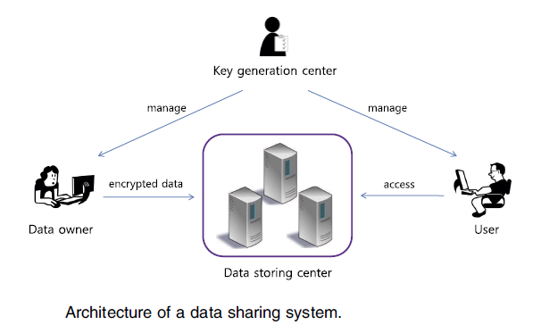

Slide 14
Scalable and Secure Sharing of Personal Health Records in Cloud Computing Using Attribute-Based Encryption
Author : Ming Li, Member, IEEE, Shucheng Yu, Member, IEEE, Yao Zheng, Student Member, IEEE, Kui Ren, Senior Member, IEEE, and Wenjing Lou, Senior Member, IEEE
Personal health record (PHR) is an emerging patient-centric model of health information exchange, which is often outsourced to be stored at a third party, such as cloud providers.
However, there have been wide privacy concerns as personal health information could be exposed to those third party servers and to unauthorized parties. We leverage attribute-based encryption (ABE) techniques to encrypt each patient's PHR file.
Suggestion-
Break-glass access under emergency scenarios.

Slide 15
CP-ABE With Constant-Size Keys for
Lightweight Devices
Author : Fuchun Guo, Yi Mu, Senior Member, IEEE, Willy Susilo, Senior Member, IEEE, Duncan S. Wong, and Vijay Varadharajan, Senior Member, IEEE
Lightweight devices, such as radio frequency identification tags, have a limited storage capacity, which has become a bottleneck for many applications, especially for security applications.
Ciphertext-policy attribute-based encryption (CP-ABE) is a promising cryptographic tool, where the encryptor can decide the access structure that will be used to protect the sensitive data.
Proposal –
A novel CP-ABE scheme with constant-size decryption keys independent of the number of attributes. The size can be as small as 672 bits.

Slide 16
Efficient Privacy-Preserving Ciphertext-Policy Attribute-Based-Encryption and Broadcast Encryption
Author : Zhibin Zhou, Member, IEEE, Dijiang Huang, Senior Member, IEEE, and Zhijie Wang
PP-AB-BE, an encryptor has the flexibility to encrypt the broadcasted data either with or without the exact information of intended receivers.
For example,
Alice can specify a hidden access policy: “CS” AND “Student” to restrict the broadcast message to all CS students without specifying the receivers explicitly.
Issue
Privacy Preserving Constant CP-ABE (denoted as PP-CP-ABE) that significantly reduces the ciphertext to a constant size with any given number of attributes.

Slide 17
Privacy-Preserving Decentralized Key-Policy Attribute-Based Encryption
Author : Jinguang Han, Student Member, IEEE, Willy Susilo, Senior Member, IEEE,
Yi Mu, Senior Member, IEEE, and Jun Yan
Decentralized attribute-based encryption (ABE) is a variant of a multi-authority ABE scheme where each authority can issue secret keys to the user independently without any cooperation and a central authority.
Advantage -
Multiple authorities need not be online and setup the system interactively.

Slide 18
Furthermore, every authority can join or leave the system freely without the necessity of reinitializing the system.
Issue discussed –
In contemporary multiauthority ABE schemes, a user’s secret keys from different authorities must be tied to his global identifier (GID) to resist the collusion attack.

Slide 19
TCP incast avoidance based on connection
serialization in data centre networks
Author : Kajita, K. ; Fukushima, Y. ; Yokohira, T
In distributed file systems, a well-known congestion collapse called TCP Incast occurs because many servers send data to the same client and then many packets overflow the port buffer of the client link.
Suggestion –
By the serialization, the number of packets in the port buffer becomes very small, which leads to Incast avoidance.

Slide 20
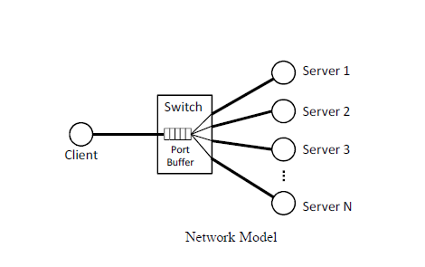

Slide 21
Secure, selective group broadcast in
vehicular networks using dynamic
attribute based encryption
Author : Nanxi Chen, Dijiang Huang and Mario Gerla
Ciphertext-policy attribute-based encryption (CP-ABE) provides an encrypted access control mechanism for broadcasting messages.
Basically, a sender encrypts a message with an access control policy tree which is logically composed of attributes; receivers are able to decrypt the message when their attributes satisfy the policy tree.
A user's attributes stand for the properties that he currently owns.
Suggestion –
Fading function for Key Revocation, which renders attributes “dynamic” and allows users to update each attribute separately.

Slide 22
METHODOLOGY
Setup() – Connection establishment.
Encrypt(M,A) – The encryption algorithm takes as input the message M, and an access structure A over the universe of attributes.
KeyGeneration(MK, S) – The key generation algorithm takes as input the master key MK and a set of attributes S that describe the key. It outputs a private key SK.
Decrypt(PK,CT, SK) – The decryption algorithm takes as input the ciphertext CT, which contains an access policy A, and a private key SK, which is a private key for a set S of attributes.
MemSer() – Performs serialization of the data.

Slide 23
References
[1]. IEEE Transaction on “Secure, selective group broadcast in vehicular networks using dynamic attribute based encryption”.
[2]. IEEE Journal on “TCP incast avoidance based on connection serialization in data centre networks”.
[3]. IEEE Transaction on “Privacy-Preserving Decentralized Key-PolicyAttribute-Based Encryption”.
[4]. IEEE Transaction on “Efficient Privacy-Preserving Ciphertext-Policy Attribute-Based-Encryption and Broadcast Encryption” .
[5]. IEEE Transaction on “CP-ABE With Constant-Size Keys for Lightweight Devices”.
[6]. IEEE Transaction on “Scalable and Secure Sharing of Personal Health Records in Cloud Computing Using Attribute-Based Encryption”.

Slide 24
References
[7]. IEEE Transaction on “Improving Security and Efficiency in Attribute-Based Data Sharing”.
[8]. IEEE Transaction on “Attribute-Based Encryption With Verifiable Outsourced Decryption”.
[9]. IEEE Transaction on “Ciphertext-Policy Attribute-Based Encryption”.
[10]. IEEE Transaction on “Identity-Based Encryption with Outsourced Revocation in Cloud Computing”.
[11]. IEEE Journal on “Secure sharing of personal health records using multi authority attribute based encryption in cloud computing” .

