Slide 1
Attribute-Based-Encryption in Disruption Tolerant Military Networks to secure data access
A Wireless Network based Scheme
Project Guide –
Mr. V. Hemakumar , Assistant Professor,
Department of CSE.
Project by –
Sonia. M,
Final Year , CSE-B.

Slide 2

Wireless devices carried by soldiers in hostile areas or battle fields are likely to suffer the threats of information leaks and disruptions in connectivity.
Disruption-tolerant network (DTN) technologies allow wireless devices carried by soldiers to communicate with each other and access the confidential information or command reliably by exploiting external storage nodes.
Some of the most challenging issues in this scenario are the enforcement of authorization policies and the policies update for secure data retrieval.

Slide 3
CipherText Policy- Attributes Based Encryption
Ciphertext-policy ABE (CP-ABE) provides a scalable way of encrypting data such that the encryptor defines the attribute set that the decryptor needs to possess in order to decrypt the ciphertext.
Thus, different users are allowed to decrypt different pieces of data per the security policy.
However, the problem of applying CP-ABE in decentralized DTNs introduces several security and privacy challenges with regard to the attribute revocation, key escrow, and coordination of attributes issued by authority.

Slide 4
 | Existing System | Proposed System
1 | Multiple Key Authorities | Single Authority
2 | User Key is generated by Key Authority | User Key is generated by Sender
3 | Diffie- Hellman Key agreement Protocol | RSA Algorithm
4 | Secret Key is generated by Central Authority | Private and Public Keys are generated by Sender
5 | Symmetric Encryption | Asymmetric Encryption
6 | A single secret key is shared between Sender and User | Private and Public keys are different and form a pair
7 | Decentralized | Centralized
8 | The message can be accessed any number of times. | The message can be accessed only once.

Slide 5
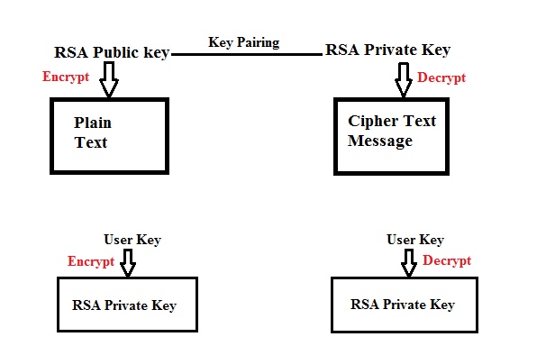

Slide 6
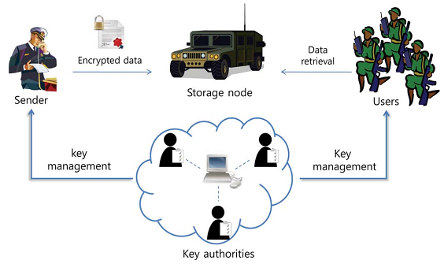
Existing System

Slide 7
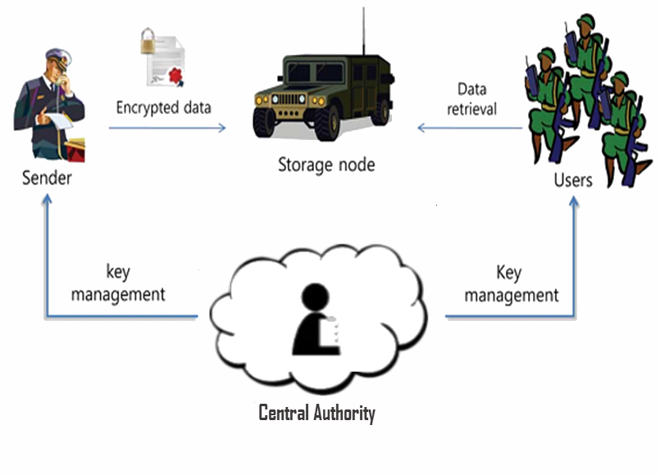
Proposed System

Slide 8
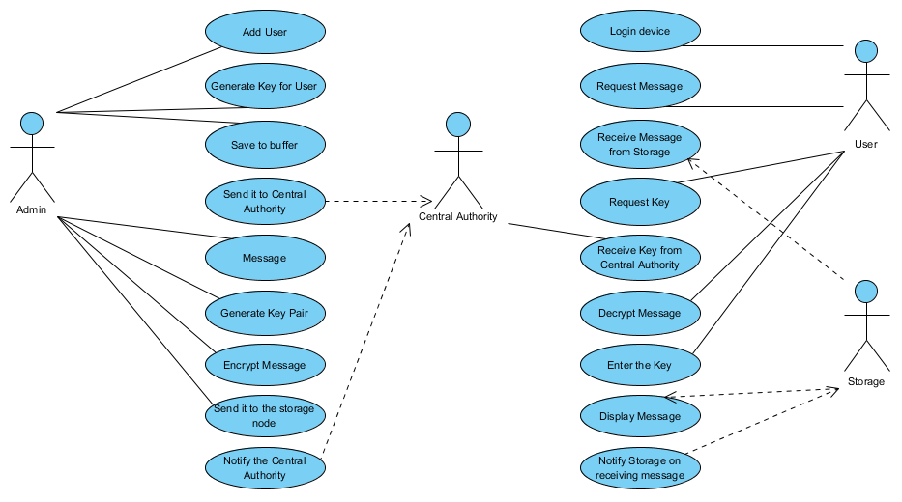

Slide 9
Modules
1) Central Authority(Key Authority): The role of central authority is to track the reliability of the key and message generated and reaching the users at the exact time.
2) Storage node: This is an entity that stores data from senders and provide corresponding access to users. It may be mobile or static. Similar to the previous schemes, we also assume the storage node to be semi-trusted, that is honest-but-curious.
Since the key authorities are semi-trusted, they should be deterred from accessing plaintext of the data in the storage node; meanwhile, they should be still able to issue secret keys to users.

Slide 10
3) Sender(Admin): This is an entity who owns confidential messages or data (e.g., a commander) and wishes to store them into the external data storage node for ease of sharing or for reliable delivery to users in the extreme networking environments.
A sender is responsible for defining (attribute based) access policy and enforcing it on its own data by encrypting the data under the policy before storing it to the storage node.
The sender generates the one-time key for the particular user and passes it through the central authority.
4) User: This is a mobile node who wants to access the data stored at the storage node (e.g., a soldier).
If a user possesses a set of attributes satisfying the access policy of the encrypted data defined by the sender, and is not revoked in any of the attributes, then he will be able to decrypt the ciphertext and obtain the data.

Slide 11

Admin(Sender)

Slide 12
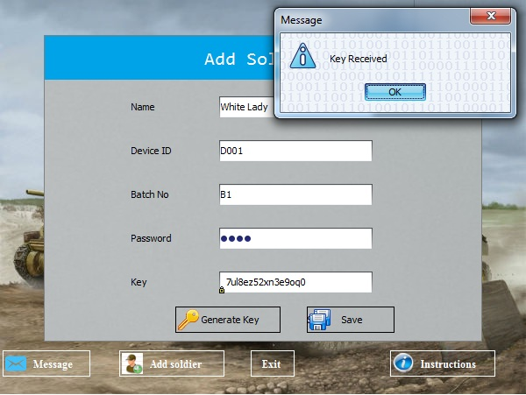

Slide 13
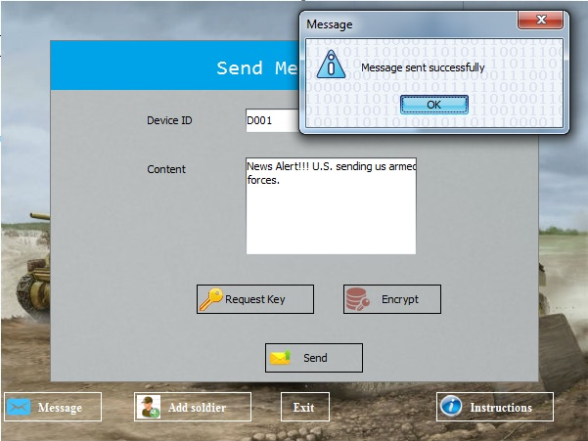

Slide 14
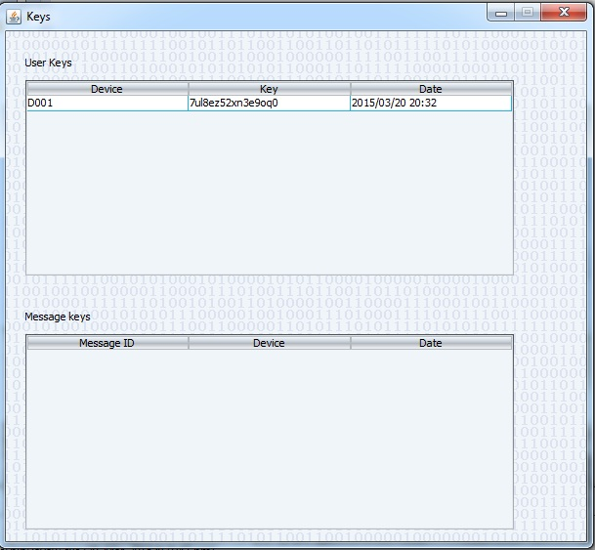
Key Authority

Slide 15
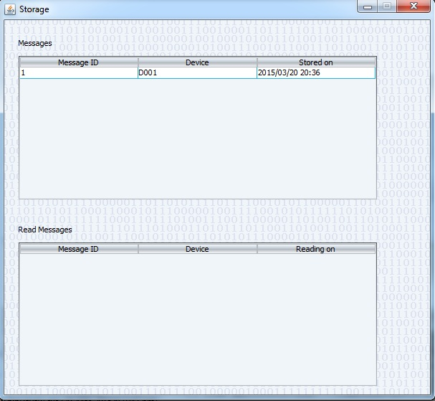
Storage Node

Slide 16
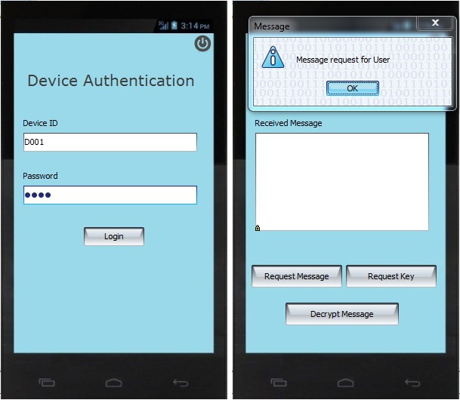

Slide 17
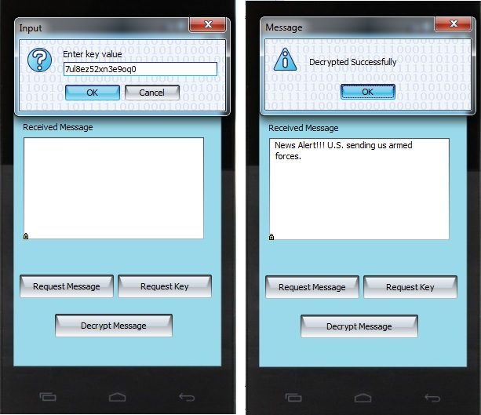

Slide 18
Thank You

