Slide 1
WELCOME
Presented by:
Aaradhya Gupta

Slide 2
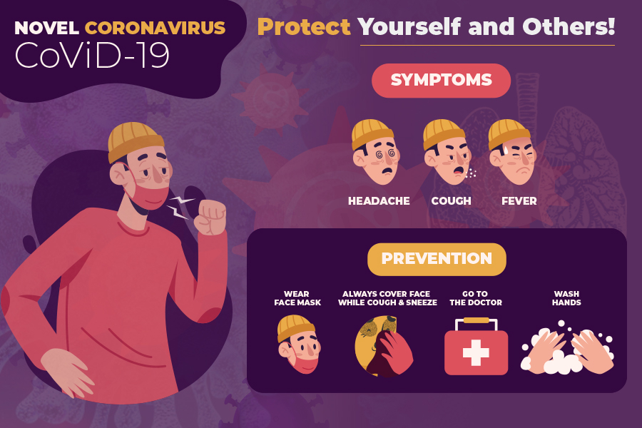
Corona virus outbreak

Slide 3
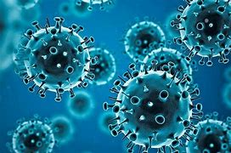
What Is COVID-19?
A coronavirus is a kind of common virus that causes an infection in your nose, sinuses, or upper throat. Most coronaviruses aren't dangerous.
In early 2020, after a december 2019 outbreak in china, the world health organization identified sars-cov-2 as a new type of coronavirus.

Slide 4
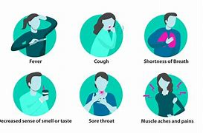
Symptoms of COVID-19
The main symptoms include:
Fever
Coughing
Shortness of breath
Trouble breathing
Fatigue
Body aches
Diarrhea
Headache
Sore throat
Congestion/runny nose
Loss of smell or taste
Nausea

Slide 5
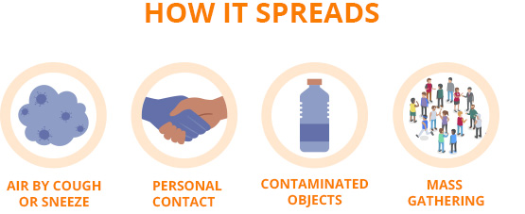
How does the coronavirus spread?
Mainly spreads from person to person.
It spreads when a sick person coughs or sneezes.
The virus spreads from touching a surface or object.

Slide 6
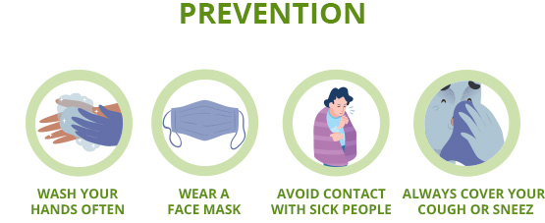
Coronavirus Prevention
Clean and disinfect.
Wash your hands often with soap and water or clean them with an alcohol-based sanitizer.
Practice social distancing at least 6 feet away from others.
Cover your nose and mouth in don’t touch your face

Slide 7
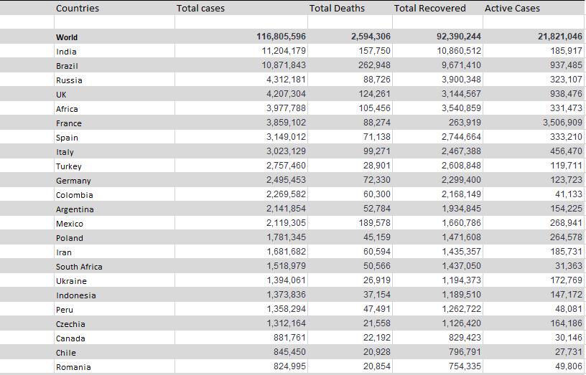
Data representing COVID-19 cases across the world:-

Slide 8
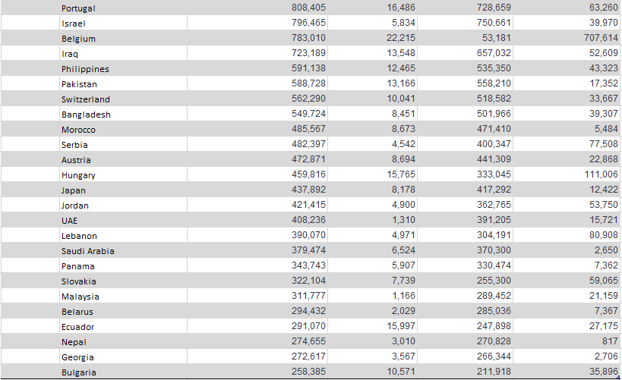

Slide 9
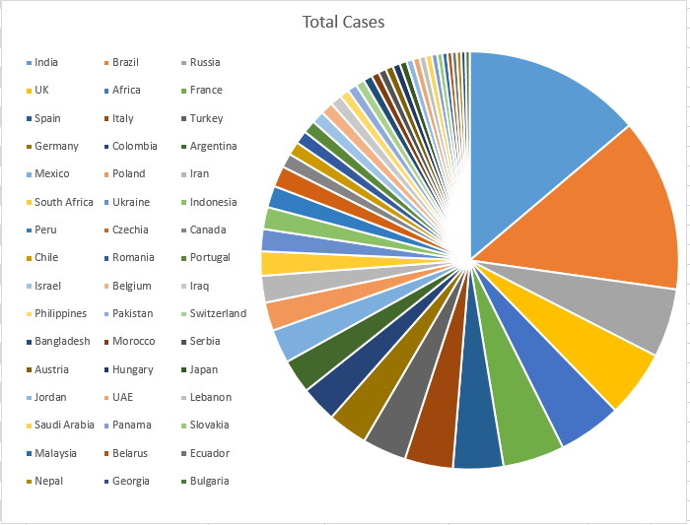
Pie chart representing Total Cases across the world

Slide 10
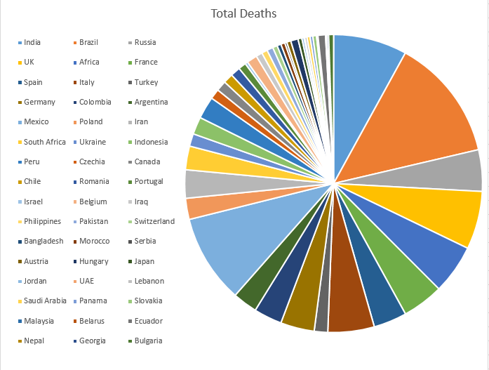
Pie chart representing Total Deaths across the world

Slide 11
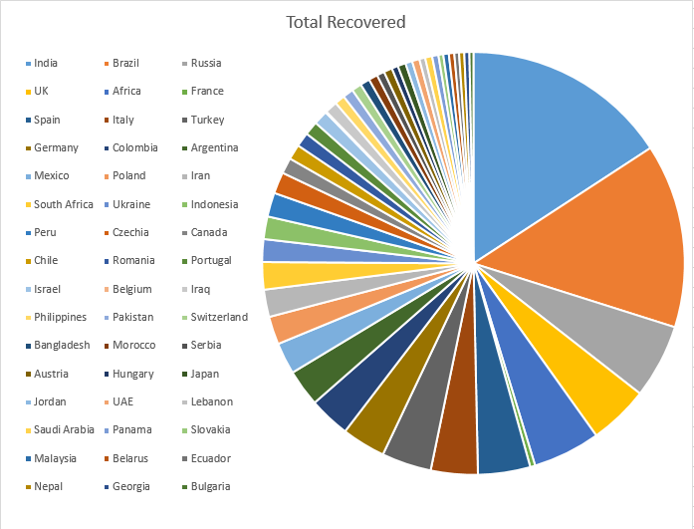
Pie chart representing Total Recovered across the world

Slide 12
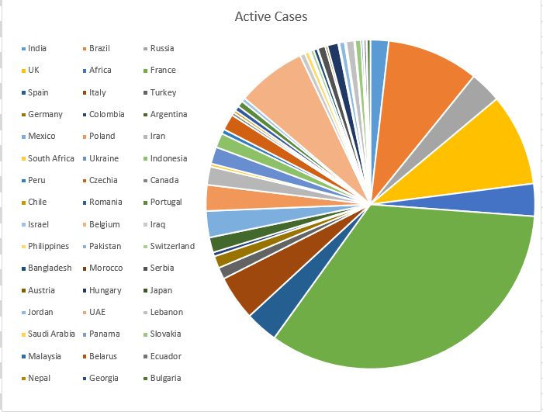
Pie chart representing Total Cases across the world

Slide 13
Table representing Total Cases across India

Slide 14
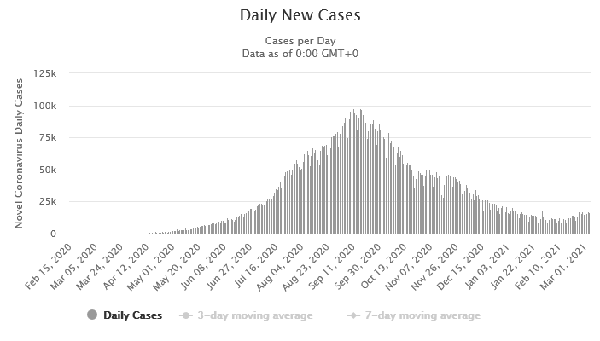
Bar graph representing daily new cases in India

Slide 15
Corona virus vaccines
three vaccines are authorized and recommended to prevent COVID-19:
Pfizer-BioNTech
Moderna
Johnson & Johnson / Janssen

Slide 16


