Slide 1

Visual Data Analytics using Tableau

Slide 2
Topic Selected :
Is there any product category that is making or losing money?

Slide 3

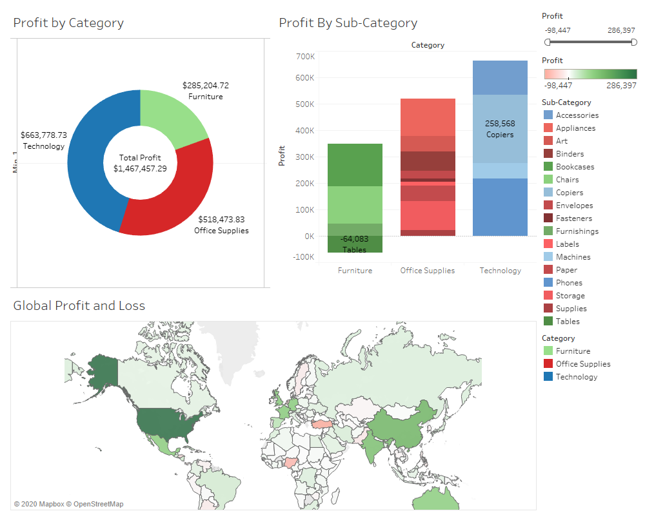
Findings
Technology is making the most profit, especially Copiers (258,568 USD)
Furniture is making the least profit, especially Tables (-64,083 USD)

Slide 4

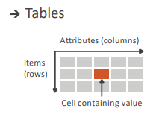
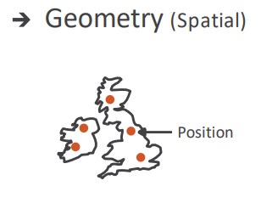
The What
-What is the dataset type?
Table ( Contains Attributes and Items)
Geometry (Contains Position)
-What is the data type?
Items
Attributes
Positions
-What is the attribute type?
Qualitative
Categorical ( Product Name/ Category)
Quantitative
Continuous (Profit, Discount, Quantity, Sales, Shipping cost)

Slide 5

The Why
Visualization Showcase:
Most/least profitable Category.
Most/least profitable Sub Category.
Actions:
Analyze :
Even though technology sells the least quantity with the least discount offered, its making the most profit in comparison to the other two categories.
Search :
Copiers in technology are making the most profit with the least amount of items sold, while tables are making a loss in furniture.
Query :
Cannon image class 2200 copiers are making the most profit, while Bevis round tables are causing the most loss
-

Slide 6
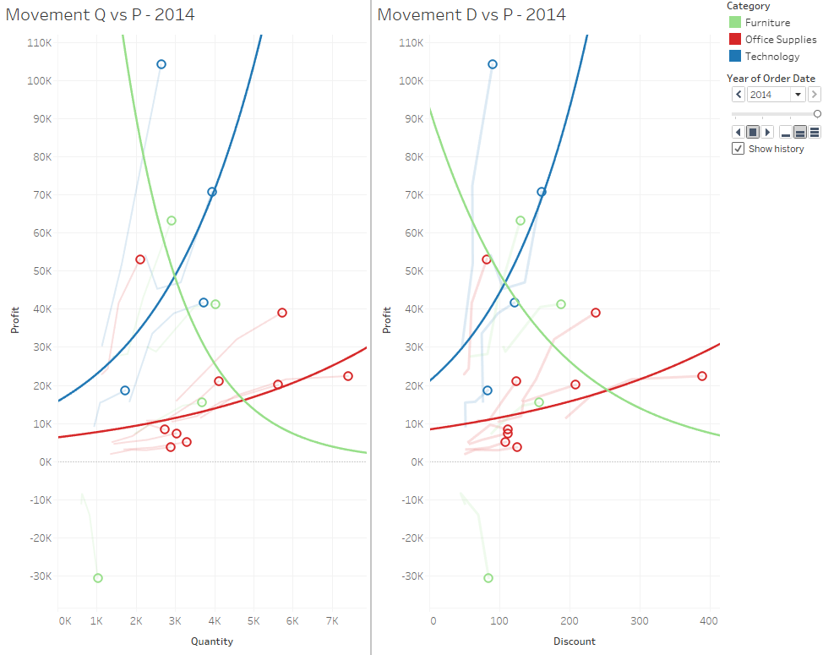
The Why
Targets
Data
Trends
By looking at an Exponential curve, we can see that there is an rapid exponential increase in technology profit wise, while that doesn’t reflect in other categories
Attribute
There is no correlation between profit and quantity.
There is a correlation between profit and quantity for technology

Slide 7

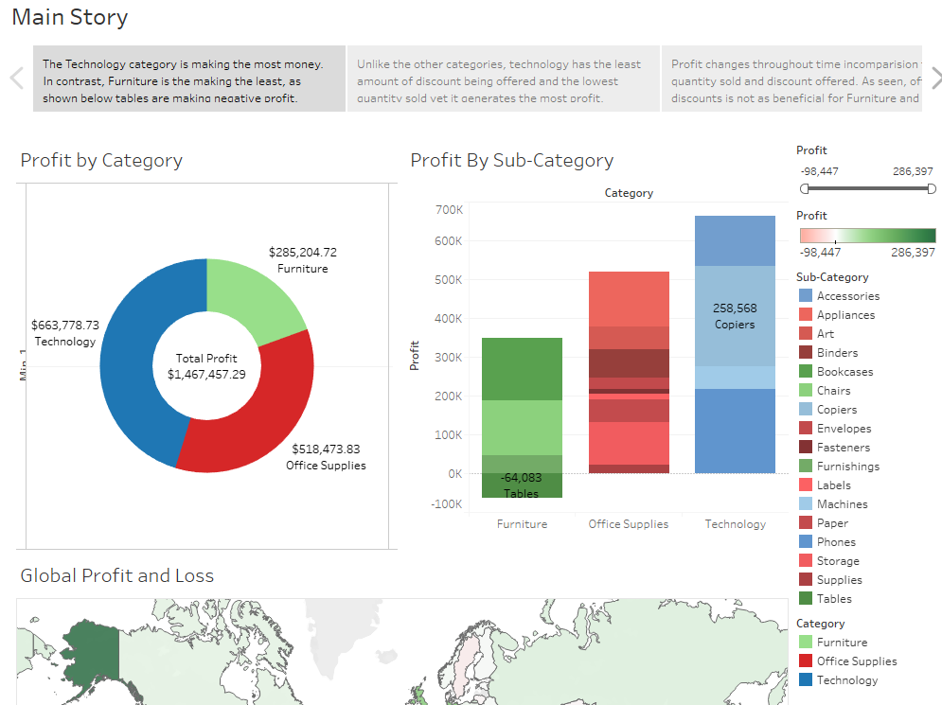
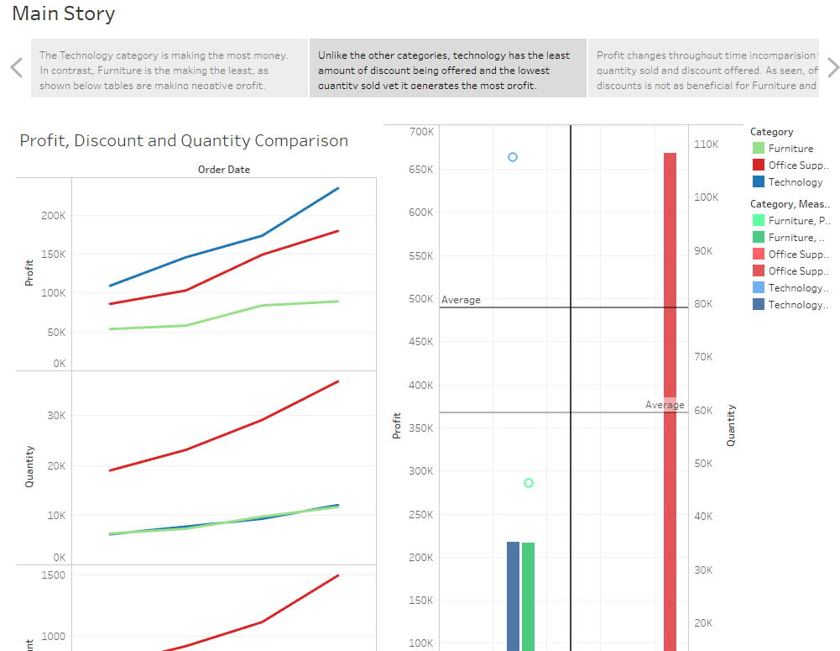
The how
Story:
Drill-down approach for finding out the root cause for Technology making the most profit as compared to the other categories.
Dashboard:
The Technology category is making the most money. In contrast, Furniture is the making the least, as shown below tables are making negative profit.
Charts
Donut Chart (Profit Comparison)
Stacked Bar Chart (Cross Category Comparison)
Maps (Country Profitability)
Dynamic Filters
Profit
Categories
Sub-categories
Countries

Slide 8


