Slide 1



FIRE ALARM SYSTEM
Sumayyah Khan (EE-1639)
Safa Mirza (EE-1633)
Sonia Azhar Siddiqui (EE-1667)
Ashhad Siddique (EE-1641)
SEMESTER 1 EE-B2
LINEAR CIRCUIT ANALYSIS

Slide 2
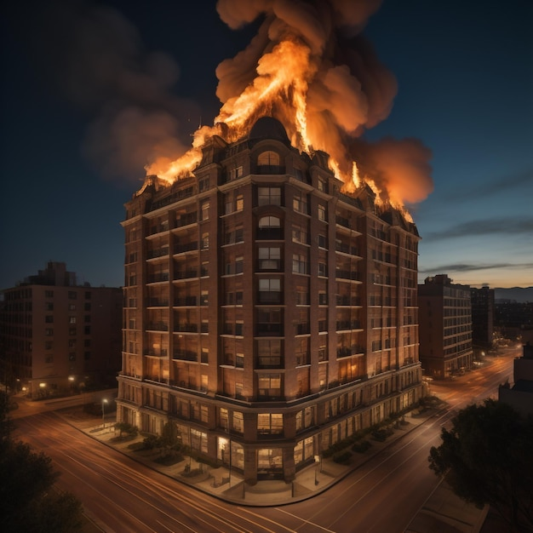
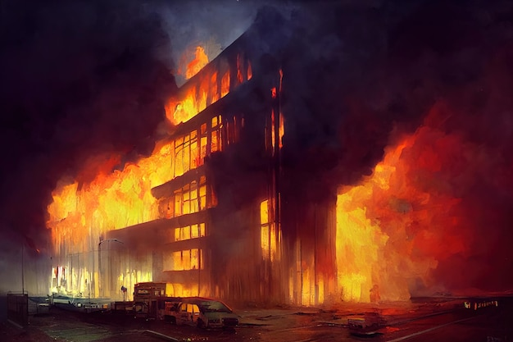

DETECT, DETERMINE AND DETER DANGER

Slide 3
GOALS
REDUCE PROPERTY DAMAGE
ALERTING THE OCCUPANTS
EARLY FIRE DETECTION

Slide 4


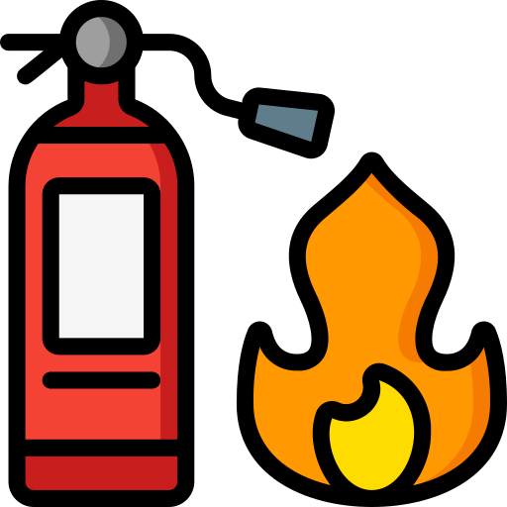
EARLY FIRE DETECTION
Early fire detection can give us the opportunity to control and extinguish the fire before it can cause health or property damage.
REDUCE PROPERTY DAMAGE
Fire accidents can cause extensive damage to buildings, equipment, and valuable assets. Early fire detection and control can help minimize financial losses for individuals, businesses, and communities.
ALERTING THE OCCUPANTS
Alerting the occupants can help facilitate prompt evacuation and intervention which ultimately reduces the risk of injuries and fatalities

Slide 5
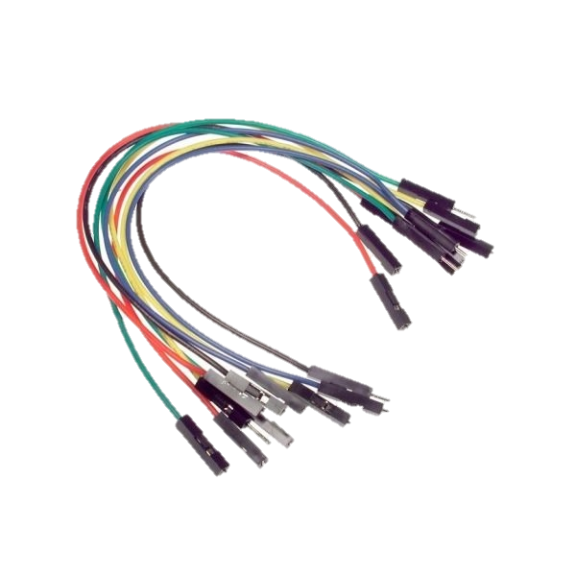
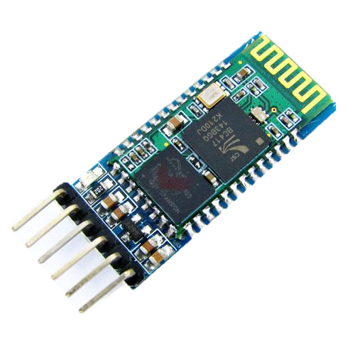
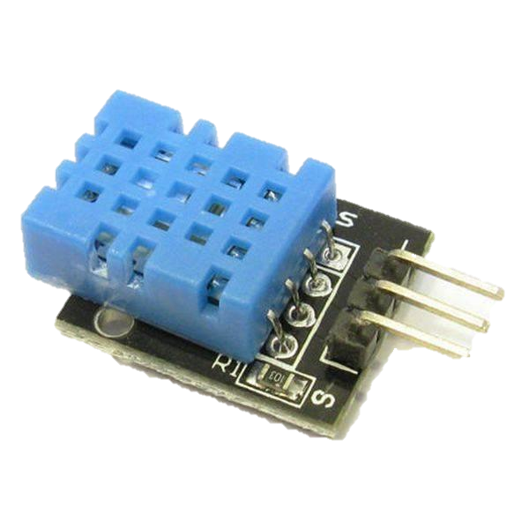
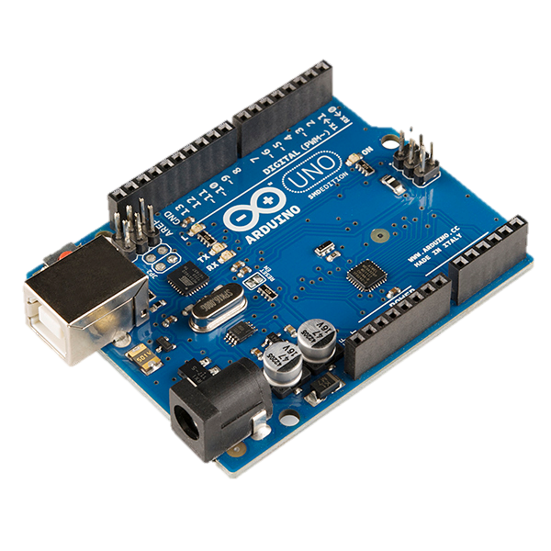
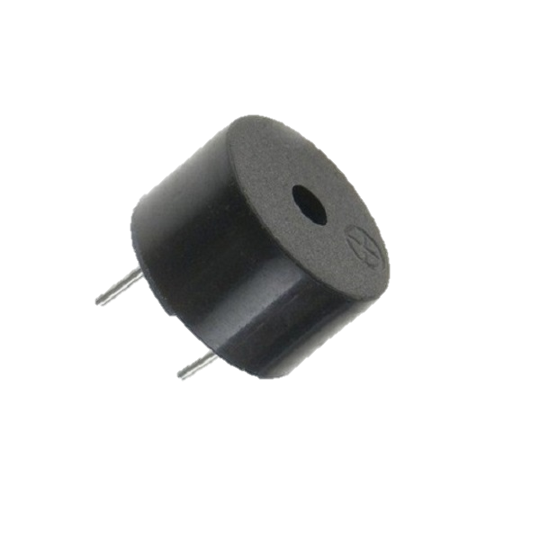
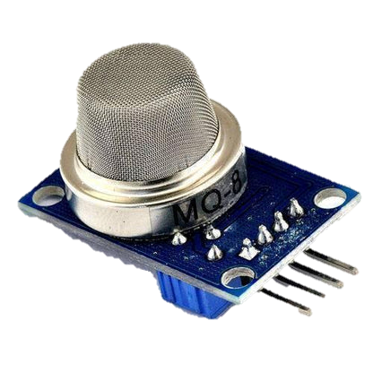
CIRCUIT COMPONENTS
Jumper Wires
DHT 11
Arduino Bluetooth Sensor HC 05
Buzzer
Arduino
UNO
MQ2 Smoke Sensor

Slide 6
DETAILS
Buzzer
Positive side: digital pin 8
Negative side: ground
DHT 11
VCC: 5V pin
Ground: Gnd pin
D0: digital pin 4
A0: NA
Arduino Bluetooth Sensor HC 005
VCC: 5V pin
Ground: Gnd pin
RX: digital pin 3
TX: digital pin 2
State: NA
ENABLE: NA
MQ2 Smoke Sensor
VCC: 5V pin
Ground: Gnd pin
A0: Analogue pin 1

Slide 7
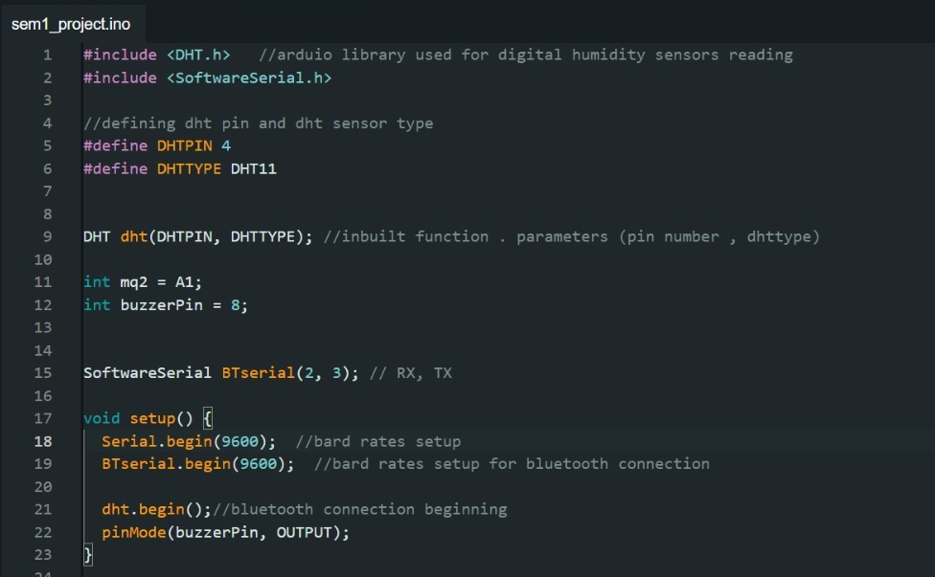
ARDUINO CODE

Slide 8
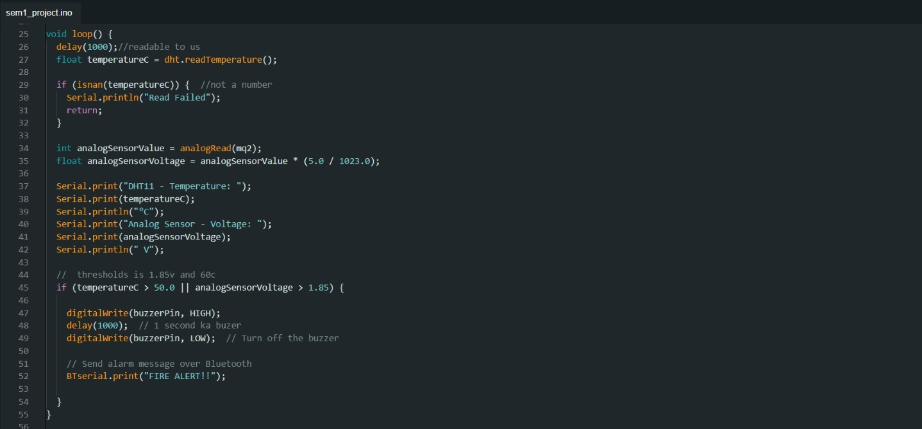

Slide 9
EXPLANATION
Libraries:
DHT.h: for DHT sensor
SoftwareSerial.h: for communication with Bluetooth module HC-05
Baud rate: (for serial communication) 9600 bits per second
Conditions:
If temperature exceeds 50C
If analog sensor voltage exceeds 1.85V
Then buzzer is activated for 1 second
And “FIRE ALERT!!” message is sent over bluetooth

Slide 10
BUDGET ANALYSIS
COMPONENT | PRICE IN PKR
MQ2 Smoke Sensor | 350
Arduino Bluetooth Sensor HC 05 | 700
Buzzer | 50
Connecting wires | 300
Arduino Uno | 1500
DHT 11 | 300
Miscellaneous | 500
Total | 3800 (approx.)

Slide 11
EXPLANATION
Bought extra components:
3 temperature sensors
2 buzzers
Extra jumper wires
Miscellaneous charges:
Cost of paper
Fuel for travel
Lighter

Slide 12


