Slide 1



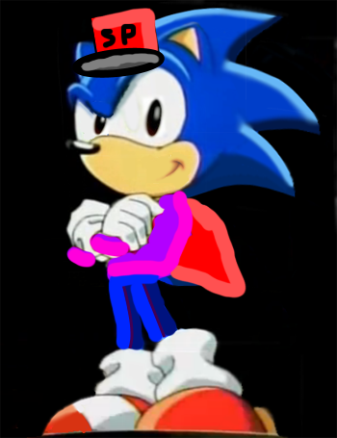


SonicDroid
Discuss
New!
SPsite
DavTube
Netflix
SPmenu
Games
Old Google
Roblox
L.A.P.
Minecraft
S.P.R.S.
Pilkey Books
iSonic 93 CD
C.J.
AumSum Website
Insert Disc
T.S. Startup
SPsearch
Google
BS254 Scratch
Crotch
Scratch
Windows Update
No Disc Found

