Slide 1
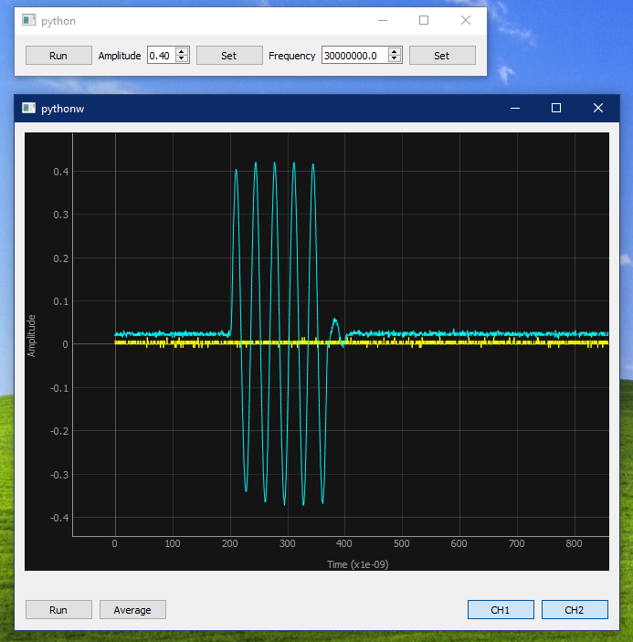
PyQt5
pyVisa
Numpy

Slide 2
