Slide 1
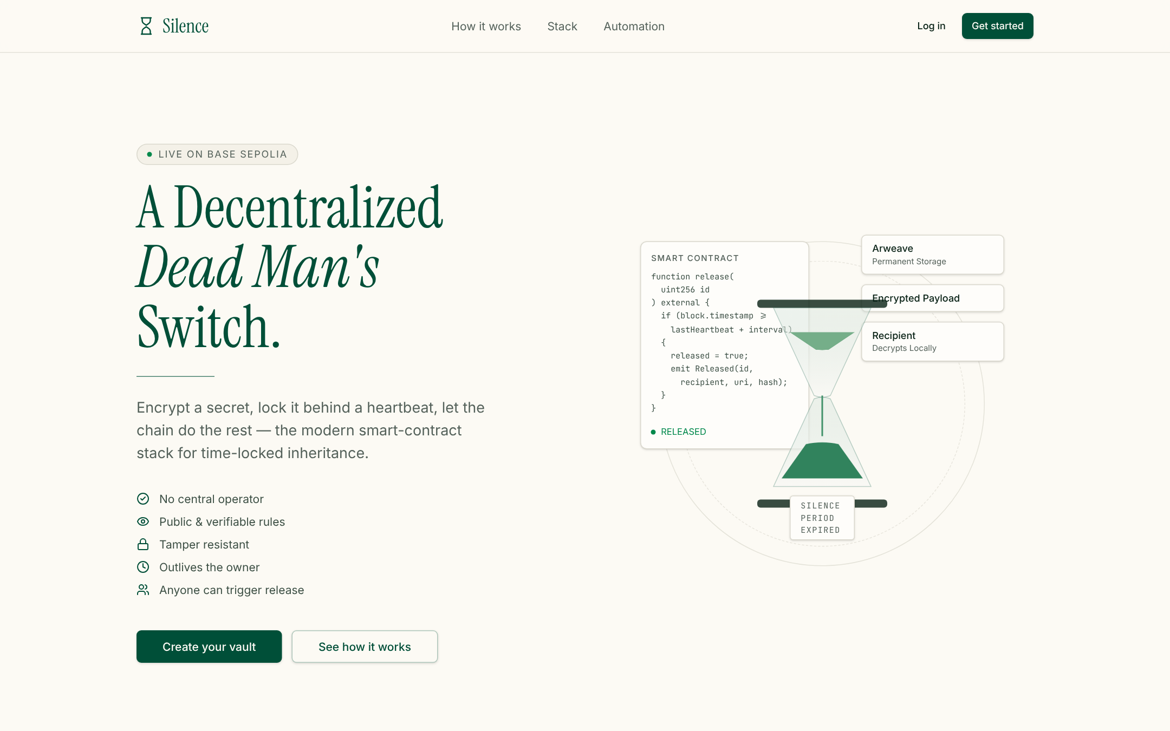
Silence
A Decentralized Dead Man's Switch
PROJECT DEEP-DIVE · ARCHITECTURE
Client-side encryption · IPFS · Solidity on Sepolia · Chainlink Automation
React 19 · ethers v6 · Supabase · Pinata · Vercel
Notes:
Silence is a trustless dead man's switch. An owner encrypts a secret in the browser, pins the ciphertext to IPFS, and locks ETH plus the IPFS CID in a Solidity contract. If the owner stops sending heartbeats for longer than the chosen interval, the contract releases the ETH to the beneficiary, who then decrypts the payload locally with a passphrase. This deck walks through the architecture component by component, with screenshots of each screen.

Slide 2



Secrets need a plan for when their owner goes silent
Keys die with their holder
Human executors are a single point of failure
Silence itself should be the trigger
Seed phrases, passwords and final letters are lost if nobody can reach them after an accident or death.
A lawyer, friend or server can forget, refuse, be compromised, or simply go offline.
If the owner stops proving they are alive, release should happen automatically and verifiably.
Silence's answer: lock an encrypted secret and ETH behind a heartbeat. Stop pinging, and the blockchain itself releases the funds and makes the ciphertext claimable. No operator can block or rush it.
Notes:
The core idea: replace a trusted human executor with code. Liveness is proven by on-chain heartbeats; absence of a heartbeat for a configured interval is a deterministic event anyone can verify.

Slide 3
What this deck covers
01
System architecture
04
User journeys
Components, tech stack, trust boundaries, module map
Every screen, from sign-in to the beneficiary decrypting
02
Smart contract
05
Review & roadmap
Data model, state machine, Chainlink Automation, safety patterns
Strengths, known gaps, deployment, next steps
03
Cryptography & storage
Screenshots were captured from a local build of this repository with demo data (mocked wallet, Supabase and IPFS responses).
PBKDF2 + AES-256-GCM pipeline, IPFS, Supabase index

Slide 4
System architecture
01
Five moving parts: the browser, the wallet, the contract, IPFS and Supabase, plus an automation network that never needs trusting.

Slide 5







High-level architecture
Browser · React SPA
Vite build served by Vercel
Chainlink
Automation network
UI layer
TanStack Router · shadcn/ui · TanStack Query
checkUpkeep() / performUpkeep()
Owner
arms & pings
Web Crypto
PBKDF2 + AES-256-GCM, never leaves the tab
DeadMansSwitch
ethers v6
MetaMask
lib/vault-chain.ts · lib/wallet.ts
EIP-1193 signer
Solidity ^0.8.24 on Sepolia. Holds ETH, CID, timer; releases funds.
Pinata client
Pinata IPFS
Beneficiary
lib/pinata.functions.ts
ciphertext JSON, public
Arrows show data flow. The browser is the only place plaintext exists; every value transfer is a MetaMask-signed transaction.
claims & decrypts
Supabase JS
Supabase
lib/auth.ts · vaults table
Auth + Postgres index
Notes:
The browser does all the sensitive work. Web Crypto encrypts locally; the Pinata client pins only ciphertext; ethers sends signed transactions through MetaMask to the DeadMansSwitch contract on Sepolia; Supabase holds accounts and a convenience index of vaults. Chainlink Automation polls checkUpkeep and calls performUpkeep when a vault is due, so release happens without any server we control.

Slide 6
Layered tech stack
Layer | Technology | Where in the code | Responsibility
Presentation | React 19, TanStack Router, Tailwind v4, shadcn/ui (Radix), framer-motion | src/routes, src/components/vault | Landing, auth, owner & beneficiary views
Data fetching | TanStack Query with 10–15 s polling | Dashboard.tsx, BeneficiaryPanel.tsx | Keeps on-chain state live
Identity | Supabase Auth: email/password, Google OAuth | lib/auth.ts, routes/auth.tsx | Sessions, profiles, roles
Cryptography | Web Crypto: PBKDF2-SHA256 → AES-256-GCM | lib/crypto-utils.ts | Encrypt / decrypt in browser
Storage | Pinata IPFS (pinJSONToIPFS + gateway) | lib/pinata.functions.ts | Persist ciphertext
Wallet & RPC | MetaMask (EIP-1193) + ethers v6 | lib/wallet.ts, lib/vault-chain.ts | Sign and send transactions
Contract | Solidity ^0.8.24, Sepolia testnet | contracts/DeadMansSwitch.sol | Custody, timer, release
Automation | Chainlink Automation interface | checkUpkeep / performUpkeep | Trustless trigger
Hosting | Vite build on Vercel, SPA rewrite | vercel.json | Static delivery
Notes:
Each row is a layer of the system and points to the file that implements it, so the deck doubles as a map of the repository.

Slide 7

Trust boundaries: who sees what
Component | Plaintext | Passphrase | Ciphertext | CID | Controls ETH
Owner's / beneficiary's browser tab | Yes | Yes | Yes | Yes | Signs only
Pinata / IPFS (public) | — | — | Yes | Yes | —
Sepolia contract (public) | — | — | — | Yes | Yes, by rules
Supabase database | — | — | — | Yes | —
Chainlink Automation | — | — | — | — | Trigger only
Zero-knowledge by design
Only a browser tab ever holds the plaintext or passphrase.
Everything public (IPFS, chain) is ciphertext or a pointer to it.
Chainlink can only trigger a release the contract already allows.
Notes:
This is the most important architectural property: the trust boundary is the browser tab. IPFS and the chain are public, so they only ever see ciphertext and the CID. Chainlink can call performUpkeep, but releaseFunds re-checks the deadline, so it cannot release early.

Slide 8
Frontend module map
Routes
Components
lib/ services
External
/ (index)
Hero · HowItWorks · StackStrip
auth.ts
Supabase
/auth
WalletBar
wallet.ts
MetaMask
/_authenticated (guard)
ContractSettings
contract.ts
Sepolia contract
/_authenticated/app
SetupForm
vault-chain.ts
Web Crypto API
Dashboard + Countdown
crypto-utils.ts
Pinata IPFS
BeneficiaryPanel
pinata.functions.ts
Wallet and contract config are tiny external stores read with useSyncExternalStore; the contract address persists in localStorage so one build can target any deployment.
Notes:
Routes are file-based (TanStack Router). The _authenticated layout route runs beforeLoad, calls supabase.auth.getUser and redirects to /auth if there is no user. Components never talk to external services directly; they go through the lib layer.

Slide 9
Smart contract
02
DeadMansSwitch.sol: one vault per owner, a block-timestamp timer, and a release path anyone can call.

Slide 10



Vault data model
One vault per owner address
struct Vault {
address owner;
address beneficiary;
uint256 amount; // locked wei
uint64 lastPing; // last heartbeat
uint64 timeout; // seconds of silence
string cid; // IPFS ciphertext
bool released;
bool cancelled;
bool exists;
}
mapping(address => Vault) _vaults;
address[] _owners; // for upkeep scan
Keyed by msg.sender. A released or cancelled vault can be re-registered.
Timer = lastPing + timeout
Due when block.timestamp ≥ deadline. No browser clock is trusted.
Bounded intervals
MIN_TIMEOUT = 60 s, MAX_TIMEOUT = 365 days. Beneficiary ≠ 0x0 and ≠ owner.
Enumerable owners
_owners[] lets checkUpkeep find due vaults on-chain.
Notes:
The contract stores only what it needs to enforce the rules: who owns, who receives, how much ETH, when the last heartbeat was, how long silence may last, and the CID of the ciphertext. The CID is stored on-chain so the beneficiary can always find the payload even without Supabase.

Slide 11
Contract state machine
Released
releaseFunds(owner)
now ≥ lastPing + timeout
any caller
No vault
register() payable
Armed
Re-registration is allowed once a vault is Released or Cancelled.
Cancelled
cancelAndWithdraw()
owner only, refund
ping() · deposit()
Function | Caller | Effect
register | anyone | Create vault, lock msg.value
ping | owner | lastPing = now
deposit | owner | amount += msg.value
cancelAndWithdraw | owner | Refund, mark cancelled
releaseFunds | anyone | Pay beneficiary if due
getVault / isDue | view | Read state
Notes:
Armed is the only active state. ping and deposit keep it Armed. Two exits: the owner cancels and gets a refund, or the deadline passes and anyone can release funds to the beneficiary. The onlyActiveOwner modifier guards ping, deposit and cancel.

Slide 12




Chainlink Automation: release without a server
checkUpkeep()
performData
performUpkeep()
releaseFunds()
Run off-chain by Automation nodes every block. Scans _owners for the first vault past its deadline.
Returns (true, abi.encode(owner)) when a vault is due; (false, "") otherwise.
Submitted on-chain by the network. Decodes the owner and calls releaseFunds(owner).
Re-checks the deadline, zeroes amount, sets released, pays the beneficiary, emits Released.
Manual fallback
releaseFunds is public, so the beneficiary's "Trigger release" button works even if no upkeep is registered.
Why a permissionless performUpkeep is safe
Any caller can submit any performData, but releaseFunds reverts with NotDue until the deadline, so nobody can release early.
Notes:
Automation is what makes the switch fire with nobody online. The contract implements the minimal AutomationCompatibleInterface inline instead of importing Chainlink packages. Note that checkUpkeep loops over every owner, which is fine for a demo but grows linearly.

Slide 13
Events, errors and safety patterns
Events (indexed)
Custom errors
Safety patterns
VaultRegistered(owner, beneficiary, amount, timeout, cid)
Heartbeat(owner, at)
Deposited(owner, amount)
Released(owner, beneficiary, amount)
Cancelled(owner, refunded)
VaultExists · NoVault · NotOwner
Inactive · BadTimeout
BadBeneficiary · NotDue
TransferFailed
Checks-effects-interactions: amount zeroed and flags set before the ETH call
Low-level call with explicit revert on failure
No admin, owner or upgrade keys
Custom errors are cheaper than revert strings
Notes:
Events give off-chain observers an auditable history. The Released and Cancelled paths follow checks-effects-interactions, which protects against re-entrancy on the ETH transfer.

Slide 14
Cryptography & storage
03
The secret is encrypted before it leaves the tab. IPFS stores the ciphertext, the chain stores the CID, and Supabase stores an index.

Slide 15





Encryption pipeline (owner side)
Secret + passphrase
PBKDF2-SHA256
AES-256-GCM
JSON envelope
Pin to IPFS
register()
typed in SetupForm
150,000 iterations, 16-byte random salt
12-byte random IV, auth tag
{ v, alg, salt, iv, ct } base64
Pinata returns the CID
CID + ETH on-chain
150k
256-bit
96-bit
{
"v": 1,
"alg": "AES-GCM+PBKDF2",
"salt": "<base64 16 B>",
"iv": "<base64 12 B>",
"ct": "<base64 ciphertext+tag>"
}
PBKDF2 iterations
AES-GCM key
random IV per secret
Source: src/lib/crypto-utils.ts (encryptSecret / decryptSecret).
Notes:
Everything up to the JSON envelope runs inside the browser using the SubtleCrypto API. Fresh random salt and IV per secret mean the same secret and passphrase never produce the same ciphertext. The envelope is self-describing, so the beneficiary needs only the CID and the passphrase.

Slide 16

Decryption pipeline (beneficiary side)
1
Read CID
From the Supabase vault row, also stored on-chain in getVault()
2
Fetch ciphertext
GET gateway.pinata.cloud/ipfs/<cid>; CID format checked with zod
Authenticated encryption
GCM's 128-bit tag means a wrong passphrase cannot silently return garbage.
Any change to salt, IV or ciphertext on IPFS is detected.
The UI shows one error for both cases, so it leaks nothing about which failed.
Plaintext is rendered only in the tab and never sent anywhere.
3
Validate envelope
zod schema: v = 1, alg literal, size limits on salt, iv, ct
4
Derive key
PBKDF2 with the stored salt and the passphrase shared out-of-band
5
Decrypt + verify
AES-GCM fails loudly on a wrong passphrase or tampered bytes
Notes:
The beneficiary path mirrors the owner path in reverse. The passphrase is the one secret that must be shared outside the system, through any secure channel the owner chooses.

Slide 17
Off-chain index: Supabase schema
profiles
user_roles
vaults
Why an off-chain index?
id (auth user)
email
display_name
wallet_address
user_id
role: owner | beneficiary
owner_id · owner_address
beneficiary_address
contract_address · chain_id
ipfs_cid · timeout_seconds
deposit_wei · tx_hash
status · created_at
The contract maps owner → vault only. It has no beneficiary → vaults lookup.
BeneficiaryPanel queries vaults with ilike(beneficiary_address) to find what is addressed to the connected wallet.
The chain stays the source of truth: every card re-reads getVault() every 10 s.
How the index is used
SetupForm inserts a row after register() confirms
BeneficiaryPanel finds rows for the connected wallet
Each VaultCard re-reads getVault() on-chain
Notes:
Supabase provides authentication and a discovery index. Losing a Supabase row does not lose funds: the contract still releases to the beneficiary, and the CID is readable from getVault.

Slide 18
User journeys
04
Screen by screen: landing, sign-in, arming a vault, heartbeats, release, and the beneficiary decrypting.

Slide 19
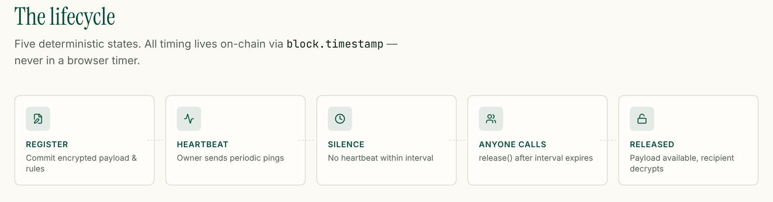
Landing page
Hero pitches the product with an animated hourglass and contract snippet.
Lifecycle strip explains the five states: Register, Heartbeat, Silence, Anyone calls, Released.
Calls to action route to /auth, then to the protected /app.
Lifecycle section further down the page
Route / · Hero, StackStrip and HowItWorks components

Slide 20
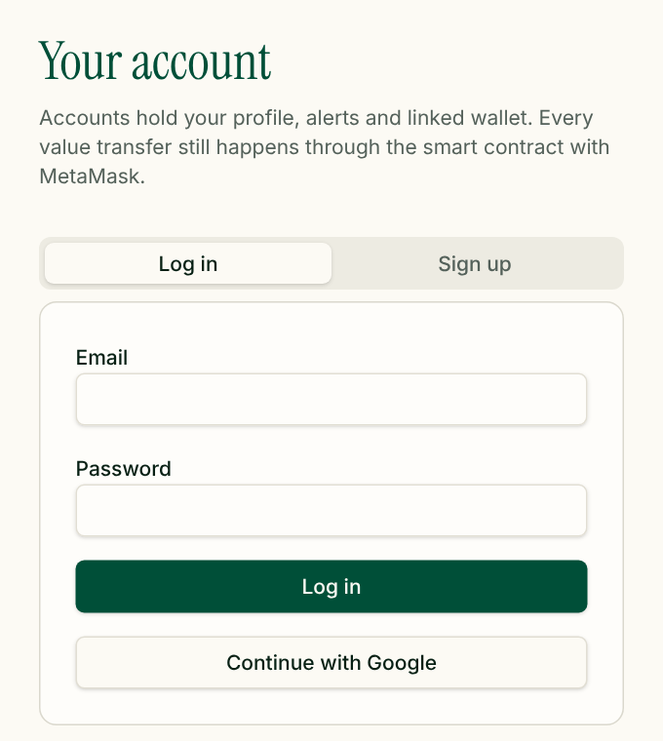


Sign-in, route guard and wallet linking
Supabase Auth
Email/password via signInWithPassword / signUp, or Google OAuth.
Route guard
/_authenticated runs beforeLoad → supabase.auth.getUser(); no user redirects to /auth.
Connect MetaMask
eth_requestAccounts; account and chain changes are tracked live.
Link wallet
Address saved to profiles.wallet_address; wrong chain shows a Switch button.
Route /auth
Notes:
Accounts carry profile and roles. Value transfer never depends on Supabase: it always goes through MetaMask and the contract.

Slide 21
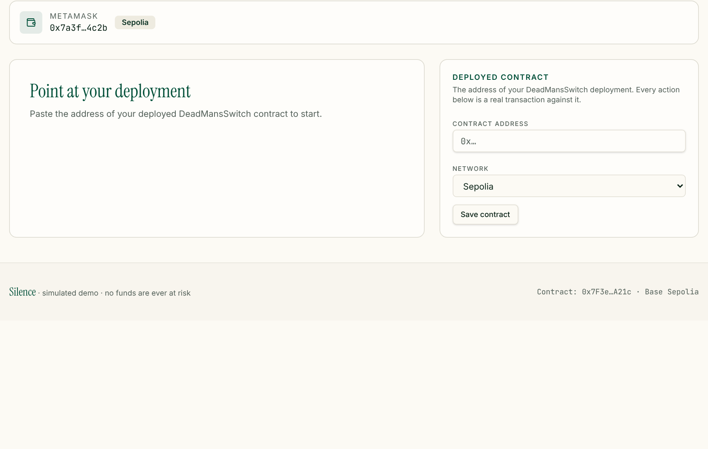
Pointing the app at a deployment
Address comes from VITE_VAULT_CONTRACT_ADDRESS or is pasted here by the owner.
Saved to localStorage, so one static build can target any DeadMansSwitch deployment.
Supported networks: Sepolia (default, chain 11155111), Base Sepolia, Base, Ethereum.
Explorer links for each transaction are built from the chosen network.
Owner view before a contract address is set

Slide 22
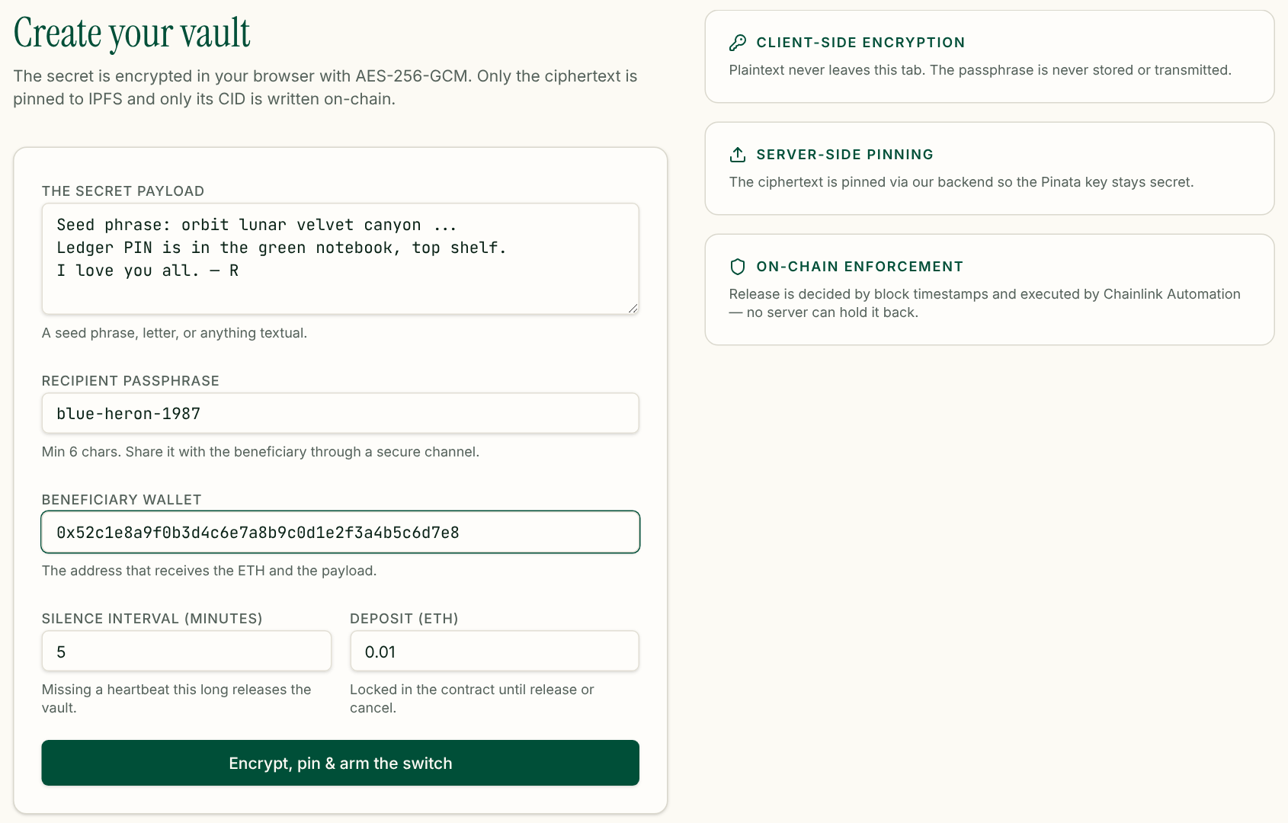
Owner arms a vault
Button progress states
1
Encrypting locally… (AES-256-GCM)
2
Pinning ciphertext to IPFS…
3
Confirm the transaction in MetaMask… register(beneficiary, timeout, cid) with the deposit
4
Saving vault record… (Supabase vaults row)
5
Toast: “Vault armed on-chain”; secret and passphrase cleared from state
SetupForm with demo data
Validation: passphrase ≥ 6 chars, valid beneficiary ≠ owner, interval ≥ 1 min.

Slide 23
Sequence: arming a vault end to end
Owner
Browser
Pinata IPFS
MetaMask
Contract
Supabase
secret + vault settings
encryptSecret(): PBKDF2 → AES-GCM
pinJSONToIPFS(envelope)
IpfsHash (CID)
register(beneficiary, timeout, cid) + value
signed transaction
VaultRegistered event, receipt
insert vaults row (status: armed)
Notes:
The ordering matters: encryption first, then pinning, then the on-chain registration, then the Supabase index. If the Supabase insert failed, the vault would still exist and still release; only discovery in the beneficiary UI would be affected.

Slide 24
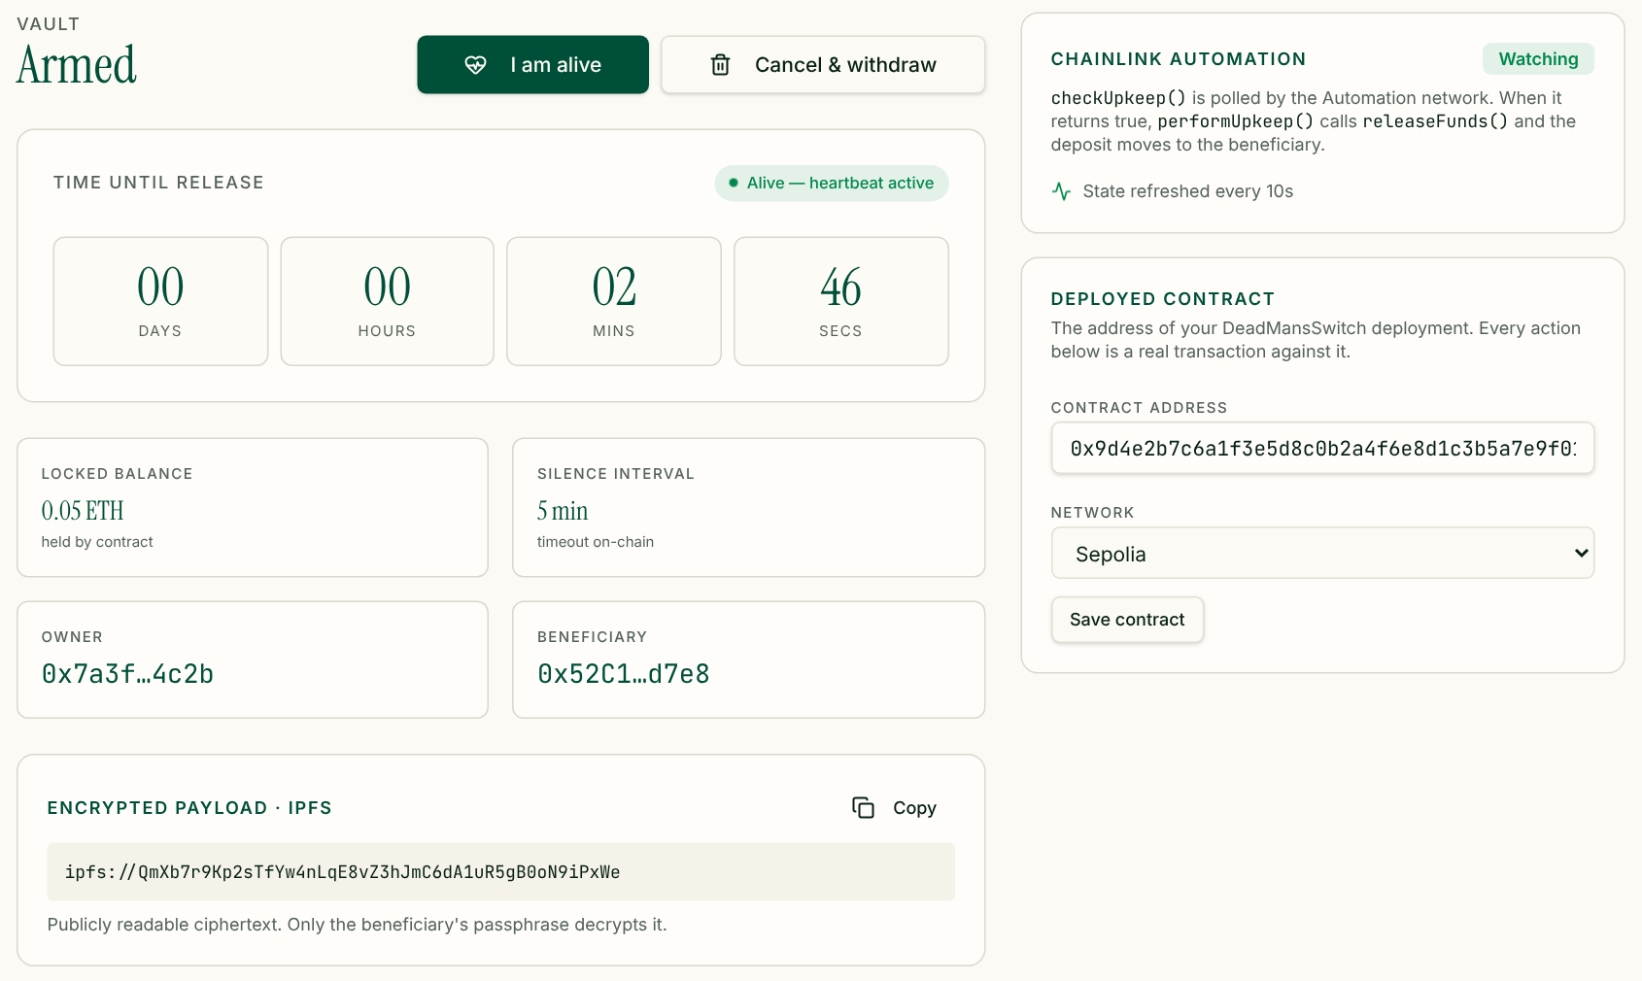



Owner dashboard: heartbeat and countdown
“I am alive”
Sends ping(); lastPing resets to the block timestamp.
Countdown
Deadline = lastPing + timeout, read from getVault().
Cancel & withdraw
cancelAndWithdraw() refunds the deposit and disarms.
Live state
TanStack Query refetches the vault every 10 s.
Dashboard with an armed vault

Slide 25

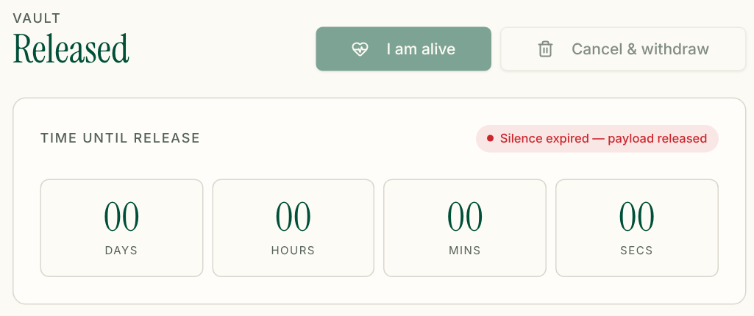
When the owner goes silent
Two ways to fire
Automatic: Chainlink's checkUpkeep spots the due vault and performUpkeep releases it.
Manual: the beneficiary clicks “Trigger release”, which calls releaseFunds(owner).
Either way, ETH moves to the beneficiary and the vault is marked released.
The owner's buttons disable and the badge reads “Silence expired”.
Beneficiary view after the interval elapses
Owner view after release

Slide 26
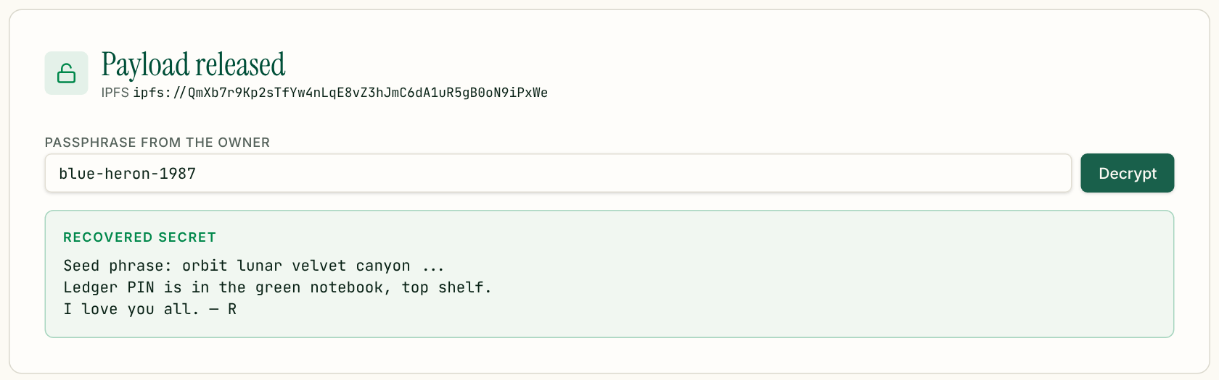
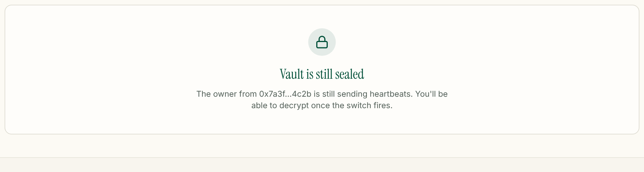
Beneficiary recovers the secret
What happens on Decrypt
fetchEncryptedPayload({ cid }) reads the envelope from the IPFS gateway.
decryptSecret(payload, passphrase) derives the key and opens the AES-GCM box.
The recovered secret is shown only in this tab.
A wrong passphrase shows a single generic error.
Released vault, decrypted in the browser
Before release: vault still sealed

Slide 27




The full lifecycle at a glance
Register
Heartbeat
Silence
Anyone calls
Released
register()
ping()
block.timestamp
releaseFunds()
decryptSecret()
Encrypt, pin, lock ETH + CID
Owner proves liveness
Deadline passes unanswered
Chainlink or beneficiary
ETH paid, secret decrypted
All timing lives on-chain via block.timestamp, never in a browser timer. The UI countdown is only a view of the contract's deadline.

Slide 28
Review & roadmap
05
What the design gets right, where the current code falls short, and how to take it further.

Slide 29


Security review: strengths and known gaps
Strengths
Known gaps in the current code
Plaintext and passphrase never leave the browser
Authenticated encryption (AES-GCM) catches tampering
No admin keys; rules are public and immutable
Release is permissionless and deadline-checked
Checks-effects-interactions on every ETH transfer
Chain is the source of truth; Supabase is only an index
Pinata JWT in the client bundle: VITE_PINATA_JWT is readable by anyone, although the UI says pinning runs on a backend.
Weak passphrases: minimum is 6 chars and the ciphertext is public, so offline guessing is possible.
checkUpkeep is O(n): it scans every owner; cost grows with users.
One vault per address, one beneficiary per vault.
Copy drift: landing mentions Base Sepolia / Arweave; the code uses Sepolia + Pinata.
No contract tests are in the repository yet.
Notes:
The design is sound; the gaps are mostly implementation details. The most urgent is moving the Pinata JWT out of the client bundle, since Vite inlines every VITE_ variable into public JavaScript.

Slide 30



Deployment and configuration
Variable | Used by | Purpose
VITE_SUPABASE_URL | integrations/supabase/client.ts | Supabase project URL
VITE_SUPABASE_PUBLISHABLE_KEY | integrations/supabase/client.ts | Public anon key
VITE_PINATA_JWT | lib/pinata.functions.ts | Pinning auth (move server-side)
VITE_VAULT_CONTRACT_ADDRESS | lib/contract.ts | Default deployment
VITE_VAULT_CHAIN_ID | lib/contract.ts | Default chain, 11155111
Deploy contract
scripts/deploy_with_ethers.ts uses a MetaMask signer and ContractFactory.
Register upkeep
Create a custom-logic upkeep on Chainlink Automation for the address.
Configure app
Set env vars or paste the address in the UI.
Every VITE_ variable is inlined into the public JS bundle at build time.
Supported chains (lib/contract.ts)
Ship frontend
Sepolia 11155111 (default) · Base Sepolia 84532 · Base 8453 · Ethereum 1
vite build on Vercel; vercel.json rewrites all paths to index.html.

Slide 31






Roadmap
Server-side pinning
Public-key encryption
Richer vaults
Move Pinata calls into a Supabase Edge Function so the JWT stays secret.
Encrypt to the beneficiary's key (ECIES) instead of a shared passphrase, or use a stronger KDF such as Argon2.
Multiple vaults per owner, several beneficiaries, Shamir secret splitting.
Scalable upkeep
Test suite
Reminders
Paginated or per-vault upkeeps instead of scanning every owner.
Foundry tests for every state transition and the timing edge cases.
Email alerts before a deadline so owners don't trigger by accident.

Slide 32



Silence turns inactivity into a verifiable on-chain event
Zero-knowledge
Only ciphertext ever leaves the tab
Deterministic
block.timestamp decides, not a server
Encrypt in the browser. Store on IPFS. Let the contract keep time.
Unstoppable
Chainlink or anyone can trigger release

