Slide 1
Project
Predicting the City Taxi Trip Duration
Made By:
SONIT SINGH

Slide 2
Challenge
Business Goal: To improve the efficiency of electronic taxi dispatching systems it is important to be able to predict how long a driver will have his taxi occupied. If a dispatcher knew approximately when a taxi driver would be ending their current ride, they would be better able to identify which driver to assign to each pickup request.
ML Goal: To build a model that predicts the total ride duration of taxi trips in New York City
Data: The taxi trip records include fields capturing pick-up and drop-off dates/times, pick-up and drop-off locations, trip distances, itemized fares, rate types, payment types, and driver-reported passenger counts. The data used in the attached datasets were collected and provided to the NYC Taxi and Limousine Commission (TLC) by technology providers authorized under the Taxicab & Livery Passenger Enhancement Programs (TPEP/LPEP).
Data Source: https://www1.nyc.gov/site/tlc/about/tlc-trip-record-data.page

Slide 3
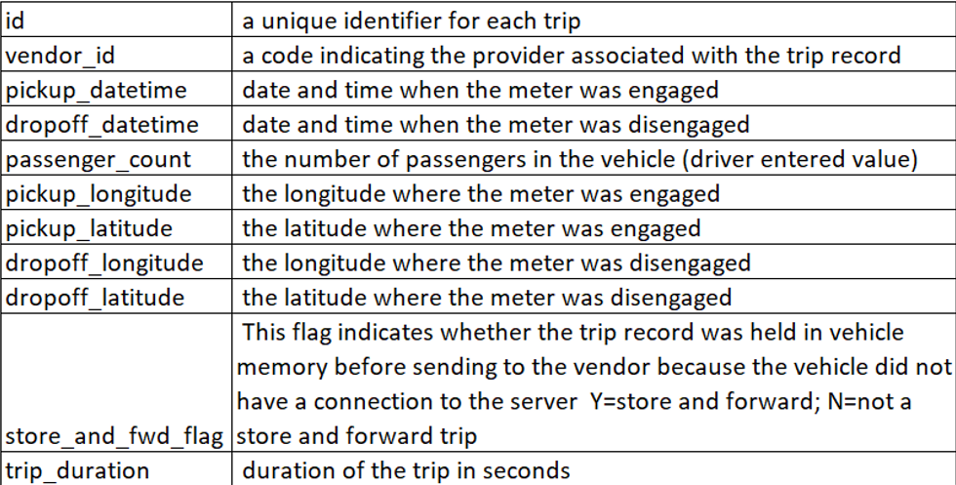
About Data

Slide 4
Data Gathering
Data Gathering
First we will import all the necessary packages from scikit-learn library and the datasets are we are using is provided in this link.
train.csv: https://drive.google.com/file/d/1__eB5gUp7Ap3CHPzsn75kYRgAHmf8XqY/view
test.csv:
https://drive.google.com/file/d/1GcrhqniKObyqeTJMxKabld0CSGmZ2o92/view

Slide 5
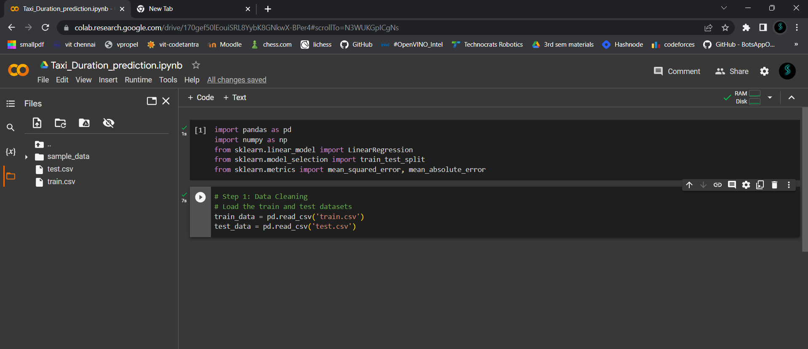

Slide 6
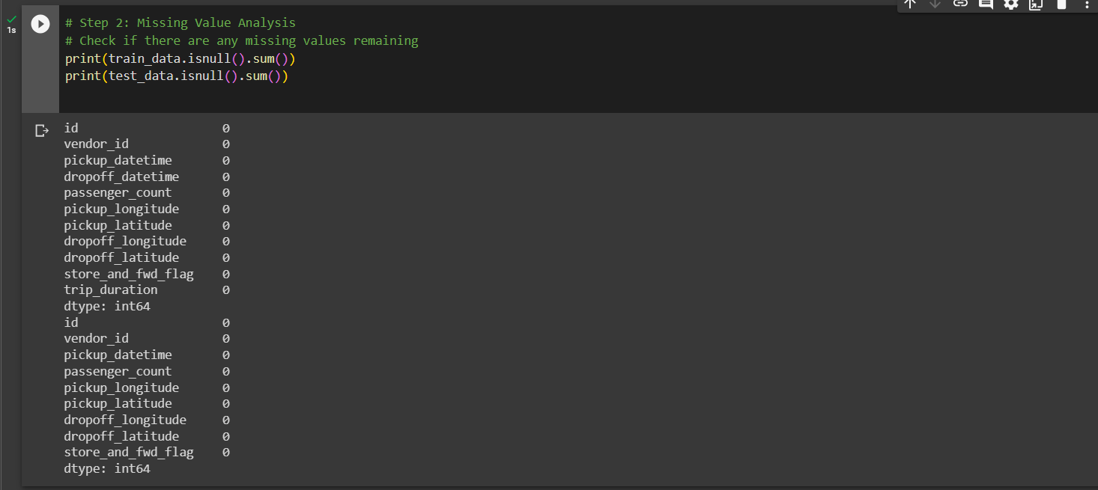
Data Pre-Processing
Data Cleaning:
Missing Value Analysis:

Slide 7
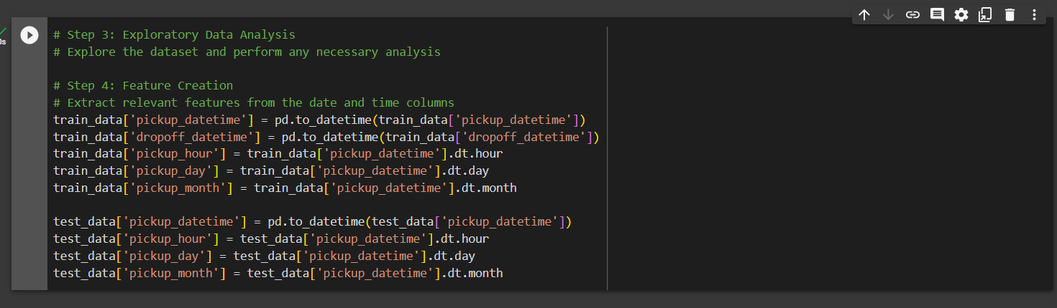
Data Pre-Processing
Exploratory-Data Analysis and Feature Creation:

Slide 8
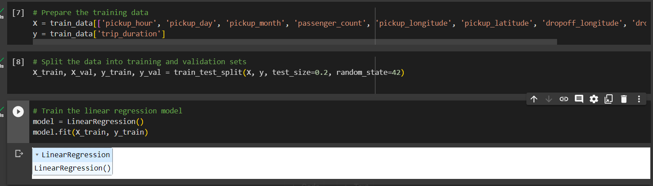
Train Model
Now we will start training our data using Linear Regression from that we imported from scikit-learn library.

Slide 9
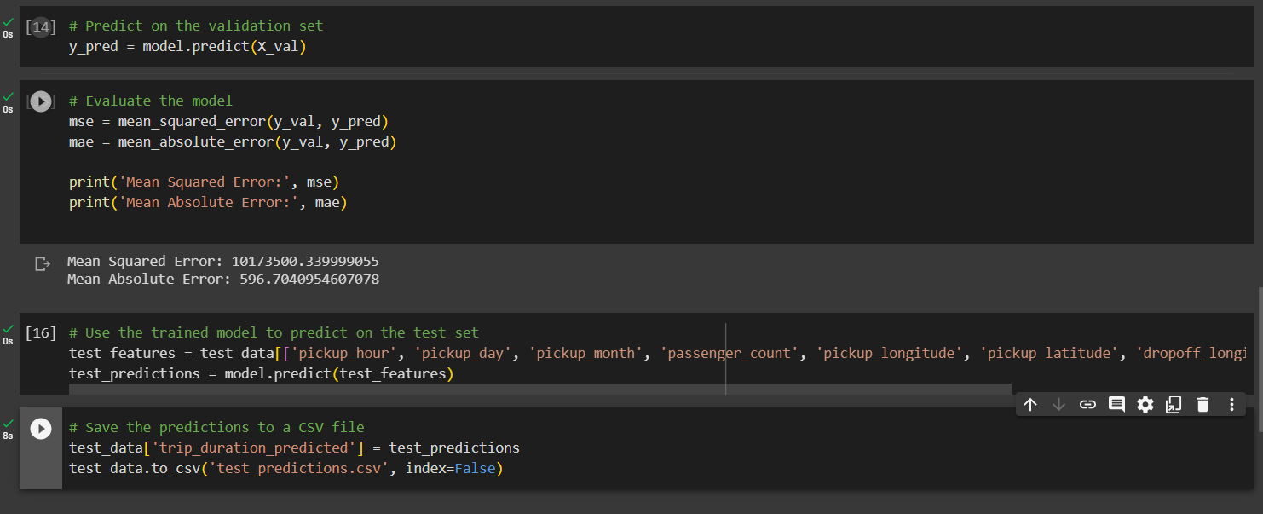
Test model
Now we will start validating and testing our data as shown below.

Slide 10
ACKNOWLEDGEMENTS
I would like to express my gratitude to the Capabl. Team for collecting NYC Taxi and Limousine Commission (TLC) and providing the valuable taxi trip records dataset used in this project. This dataset forms the foundation of our research on predicting city taxi trip duration.
I would like to thank the open-source community for developing and maintaining the necessary libraries and tools that were used in this project. In particular, I would like to acknowledge the efforts of the pandas, numpy, matplotlib, and scikit-learn teams for their contributions to the data processing, analysis, and machine learning aspects of my work.
I would also like to express my gratitude to my Capabl. mentor and advisors for their guidance and support throughout the project. Their expertise and insights have been invaluable in shaping my understanding and approach.

Slide 11
references
Datasets from Capabl :
https://drive.google.com/file/d/1__eB5gUp7Ap3CHPzsn75kYRgAHmf8XqY/view
https://drive.google.com/file/d/1GcrhqniKObyqeTJMxKabld0CSGmZ2o92/view
Google Collab
scikit-learn Documentation: https://scikit-learn.org/stable/documentation.html

