Slide 1
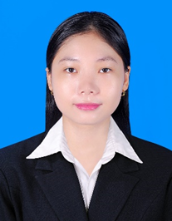






HEANG SONITA
Video Content Creator
Professional Profile
As a young professional content creator, I have gain valuable experiences through the projects, focusing on concept development, scriptwriting, filming, editing that resonates with target audiences. With a strong grasp of communication and problem solving. I am eager to apply my technical skills and passion to the video content creator team of S.E.A.T.S inc.
0979956345
Experience
sonitaheangpretty@gmail.com
Content Creator
Boeung Tumpun1, Mean Chey,
Phnom Penh
2024 – present
Scriptwriting
Manage contents, video editing, social media platforms
Education
Bachelor of Software Engineering
Jan 2023-
Mar 2023
Beltei International University
Limkokwing University of Creative Teachnology
Volunteer at BELTEI INTERNATIONAL UNIVERSITY position office assistant.
Do a charity to help the rural area students
2024-Present
Secondary high-school
Beltei International School
2021- 2022
2020-2022
received certificate for my public speaking contest
Worked as a seller of beauty products
Expertise
Public Speaking
Manage Contents
Editing Videos
filming
MOSC Math Competition
2021- 2022
received 2 certificates as an outstanding student in math
Language
References
Khmer: Native Language
English: Fairly good (writing, listening, reading and speaking)
Ms. Rolitess Galam Hourng
Dr. Rathny Suy
Communication Skills Lecturer
Limkokwing University of Creative Technology
Marketing Lecturer
Limkokwing University of Creative Technology
Email :
rolitessgalam@limkokwing.edu.kh
Email :
suyrathny@limkokwing.edu.kh

