Slide 1
SecureAI
CSCE 5560 Secure E-Commerce
Group 6
Praveen Deshamone
Soniya Kodipunjula
Vyshnav Poojari
Anvitha Kanukuntla

Slide 2
Introduction
Overview: SecureAI is a web application designed to detect and prevent phishing attacks and malware threats in real-time, enhancing e-commerce security.
Problem Addressed:
Rise in phishing and malware attacks on online platforms
Need for real-time, AI-enhanced threat detection during user interaction

Slide 3
Project Structure Design
Client: HTML + Flask templates (index.html)
Server: Flask-based backend (app.py) for route and logic handling
Detection Modules: Phishing via phishing_model.pkl, Malware via SHA256 hash validation
Deployment: Secure cloud hosting using Render with render.yaml

Slide 4
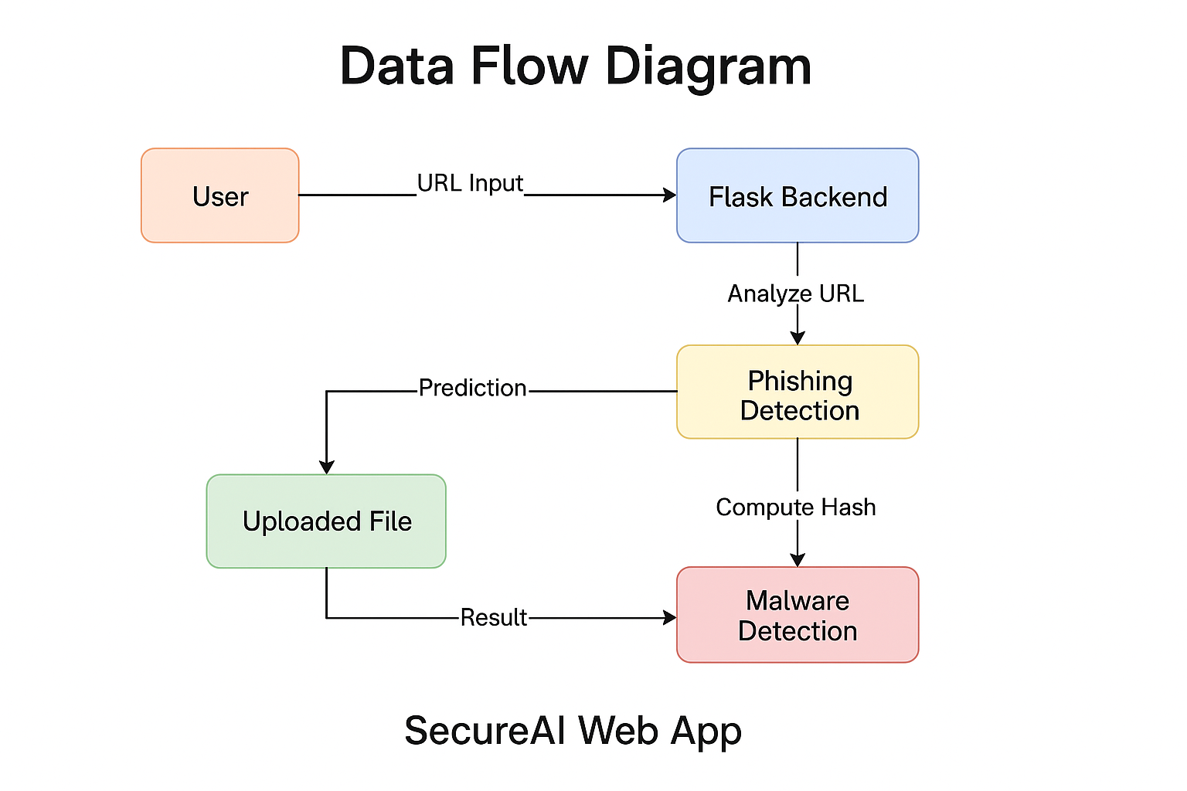
Data Flow Diagram
Flow:
User inputs → Flask backend
URL analyzed → Model predicts → Response rendered
File upload → Hash computed → Malware checked

Slide 5
Github Integration PraveenDeshamoniL/SecureAI-WebApp Secure Cloud hosting SecureAI Login

Slide 6
DEMO
https://drive.google.com/file/d/1NAGQaLKGcBnCV4Ak3sFS2wAQqWQPlljC/view?usp=drive_link

Slide 7
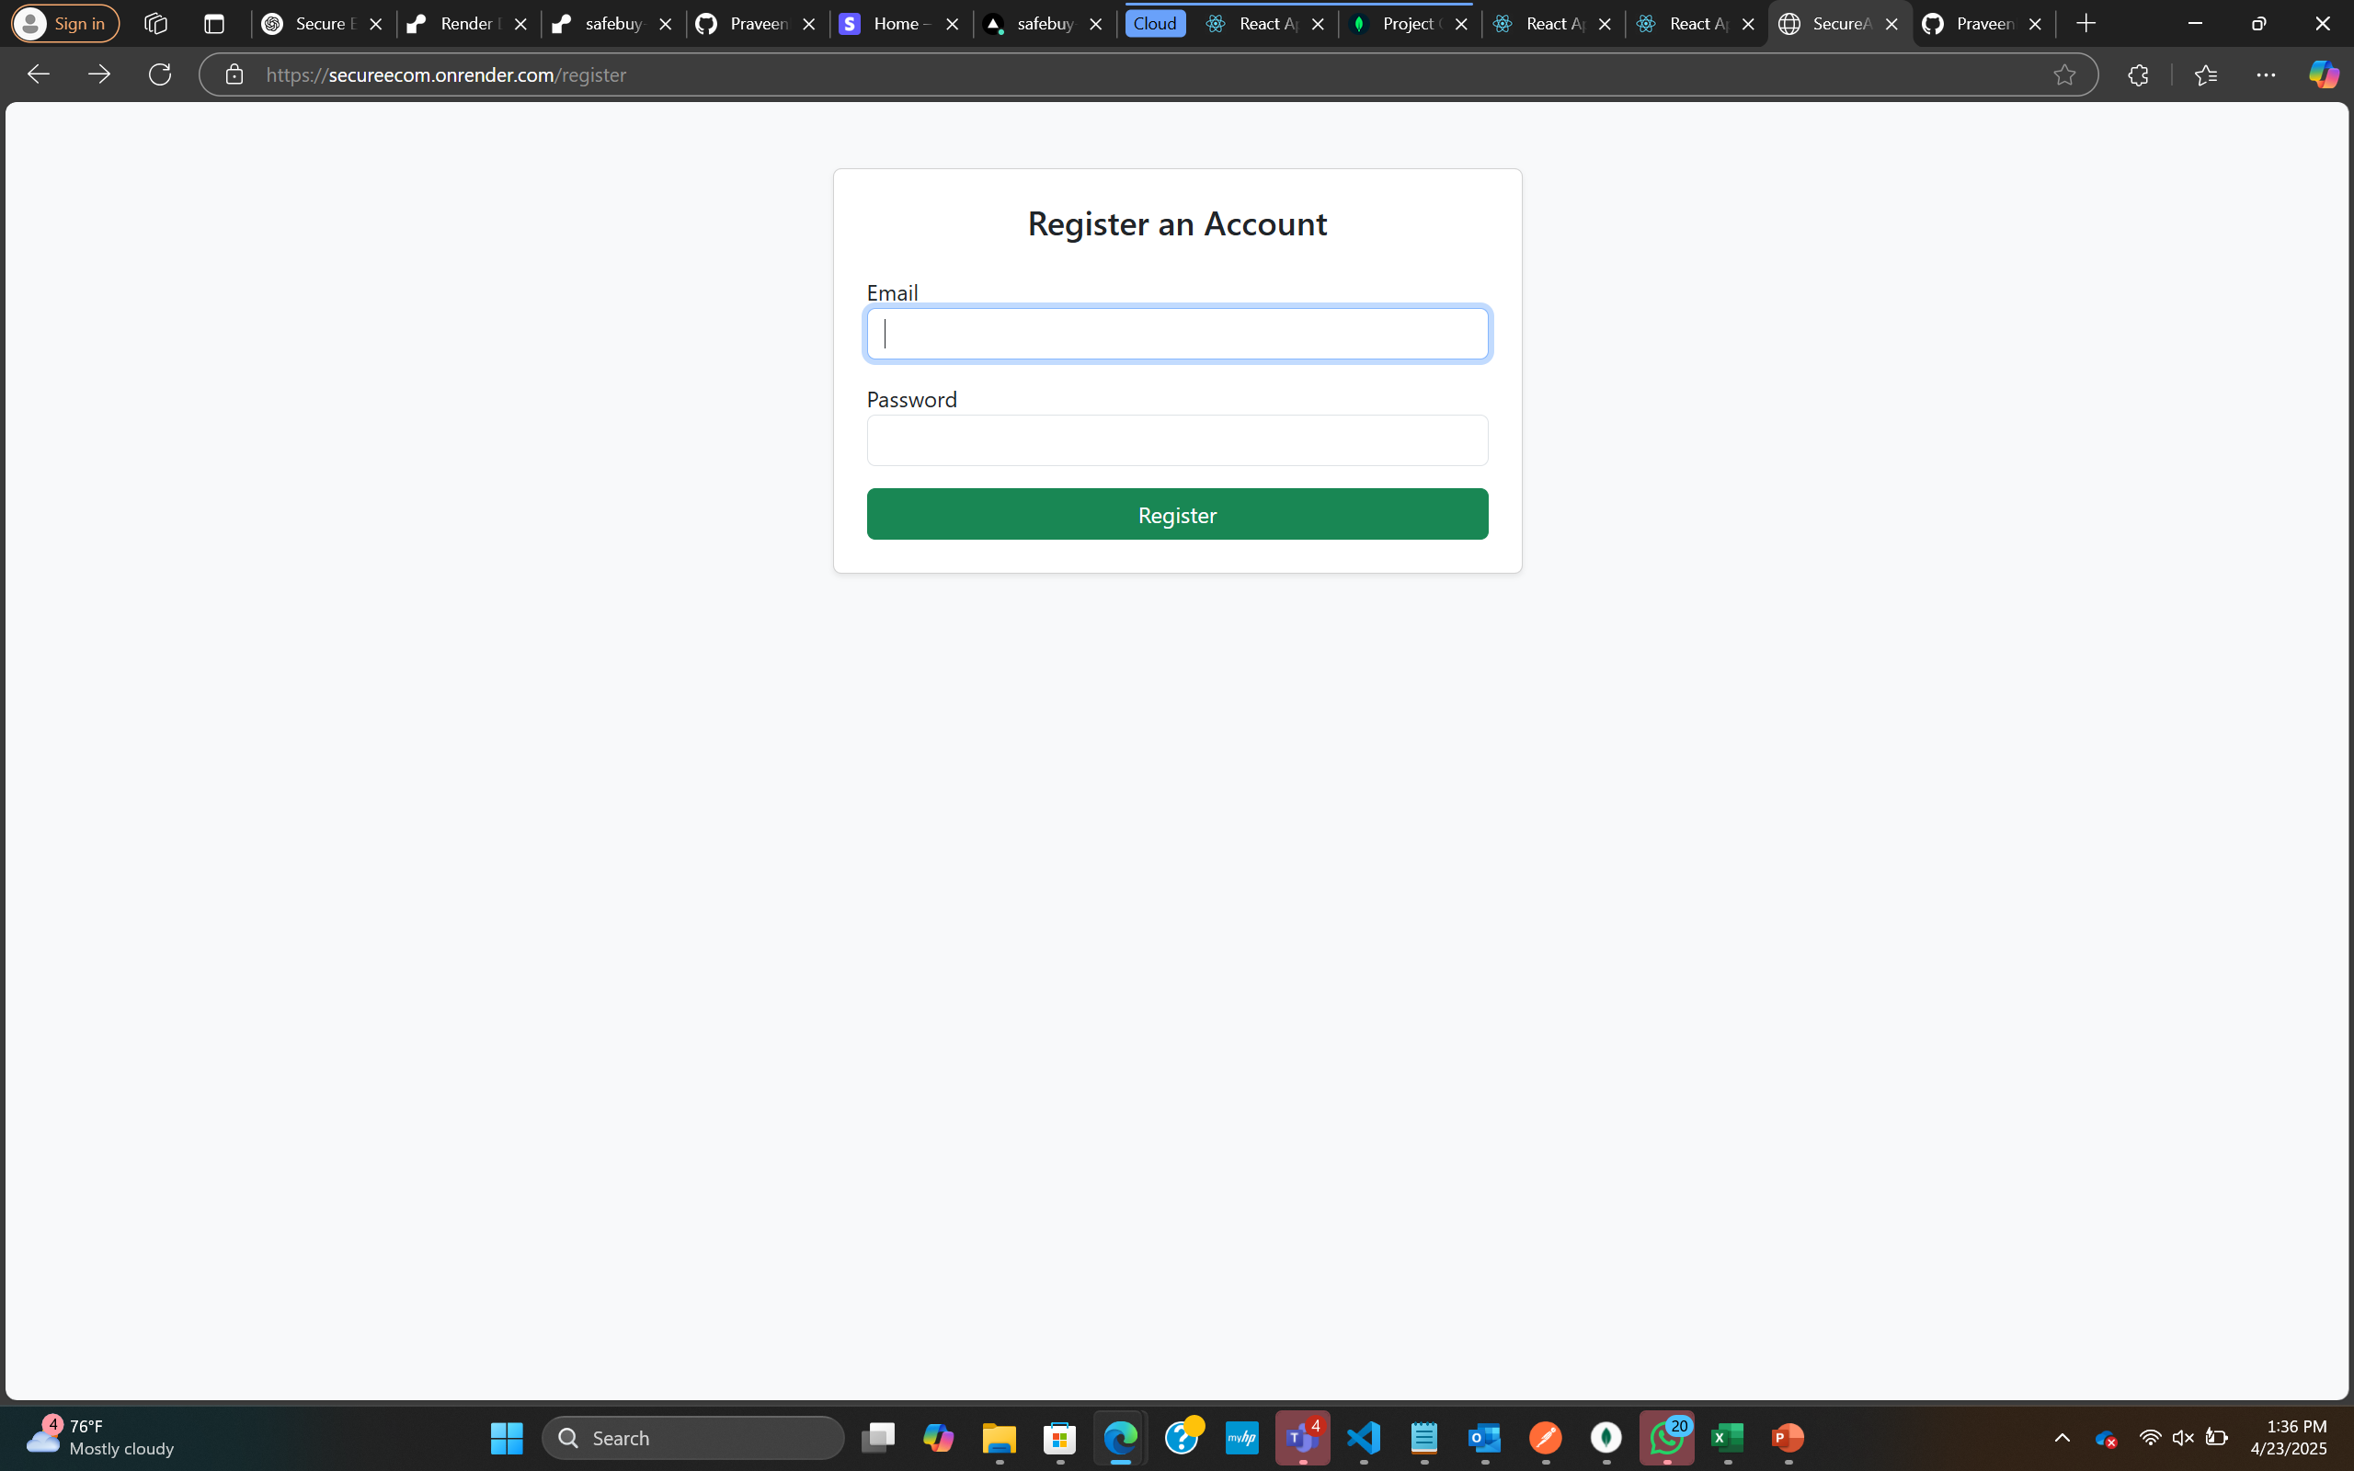
Register Page

Slide 8
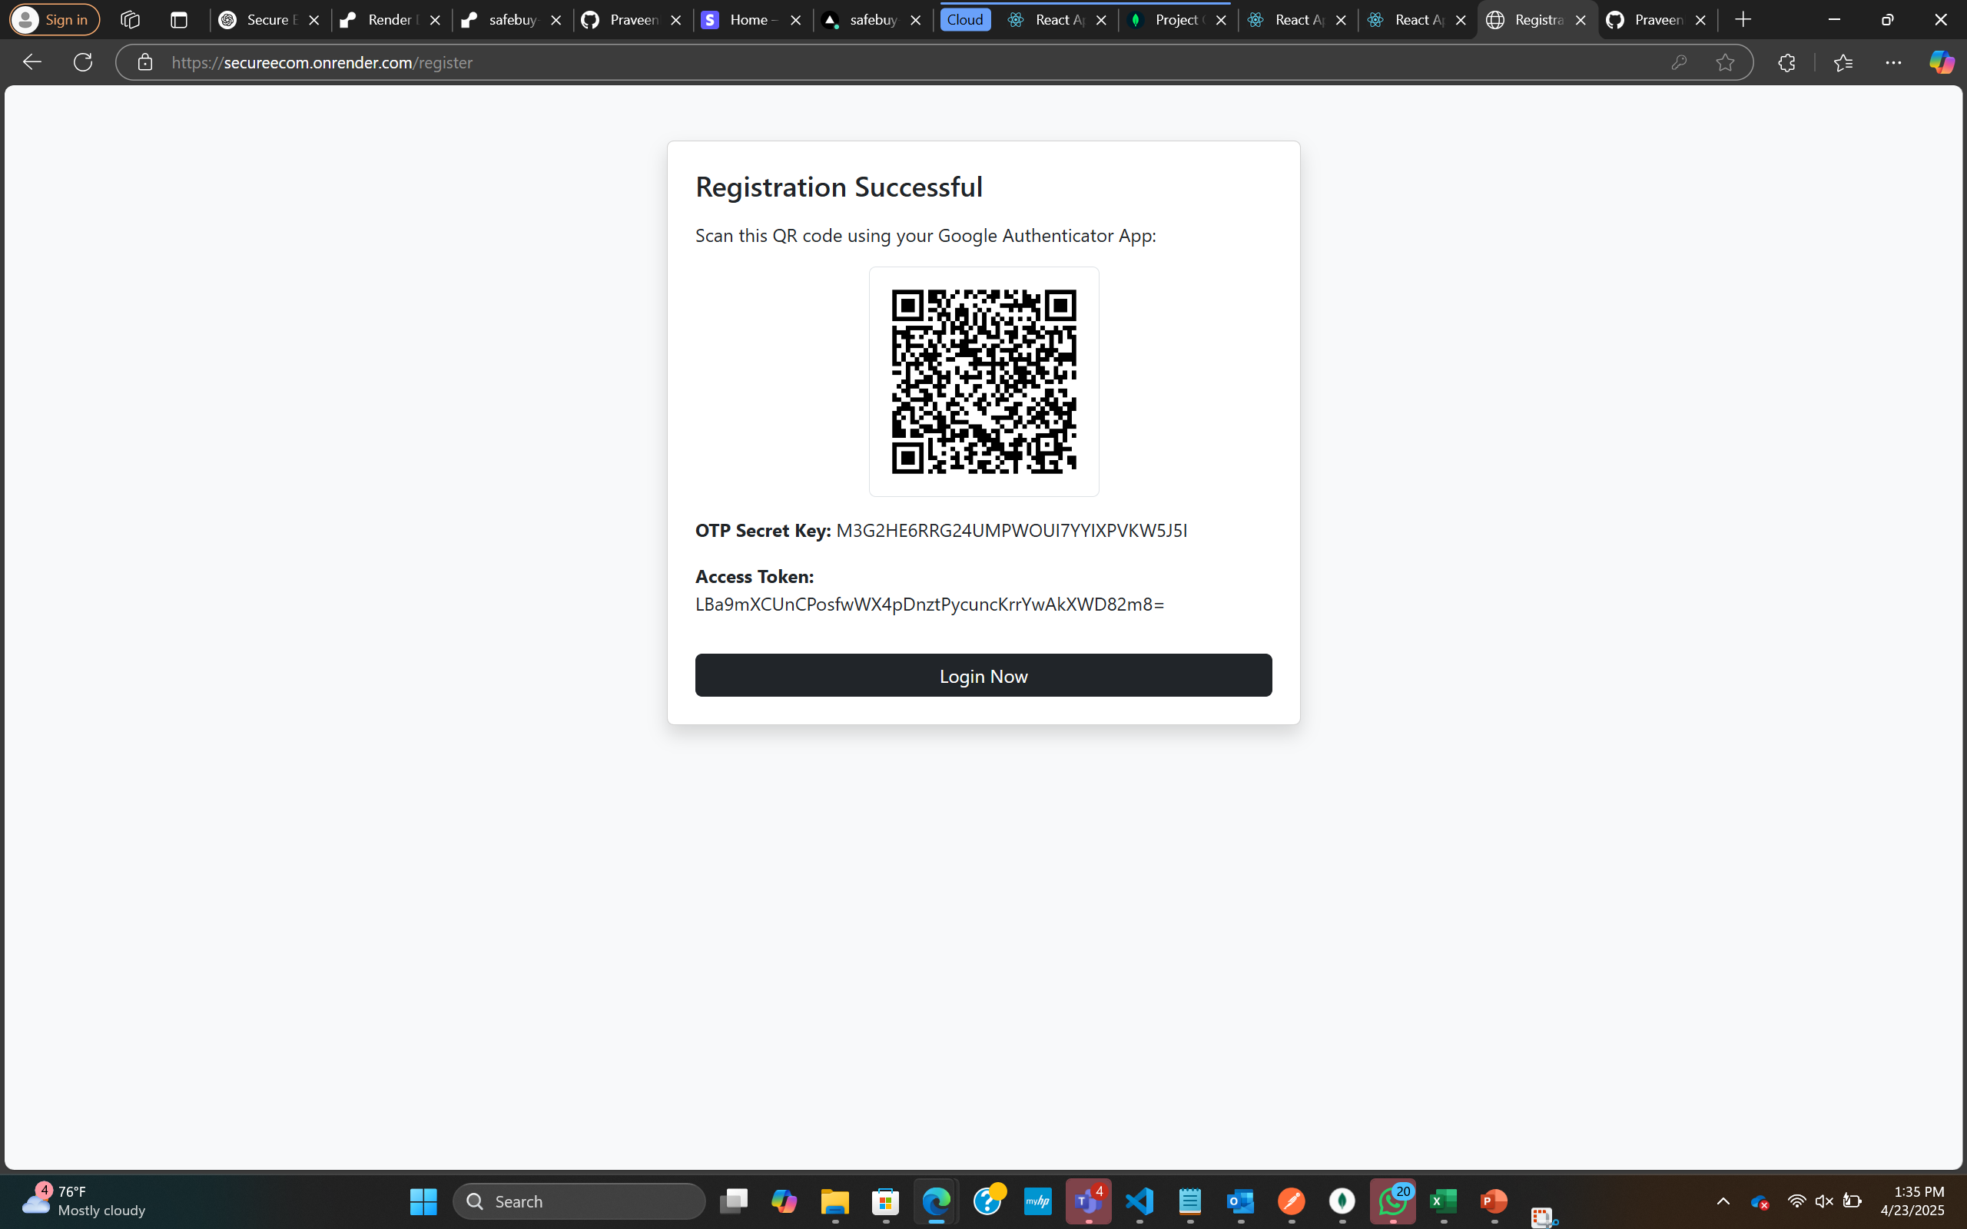
MFA Authentication page

Slide 9
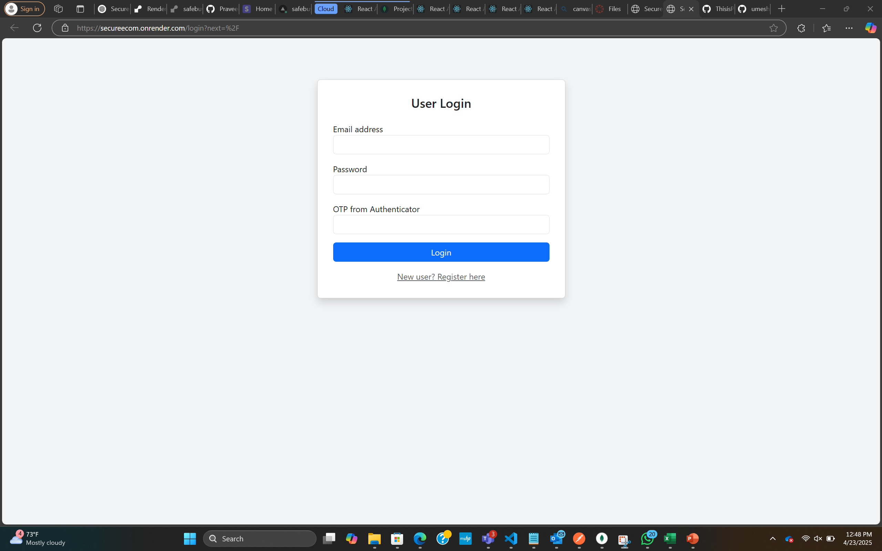
User Login page

Slide 10
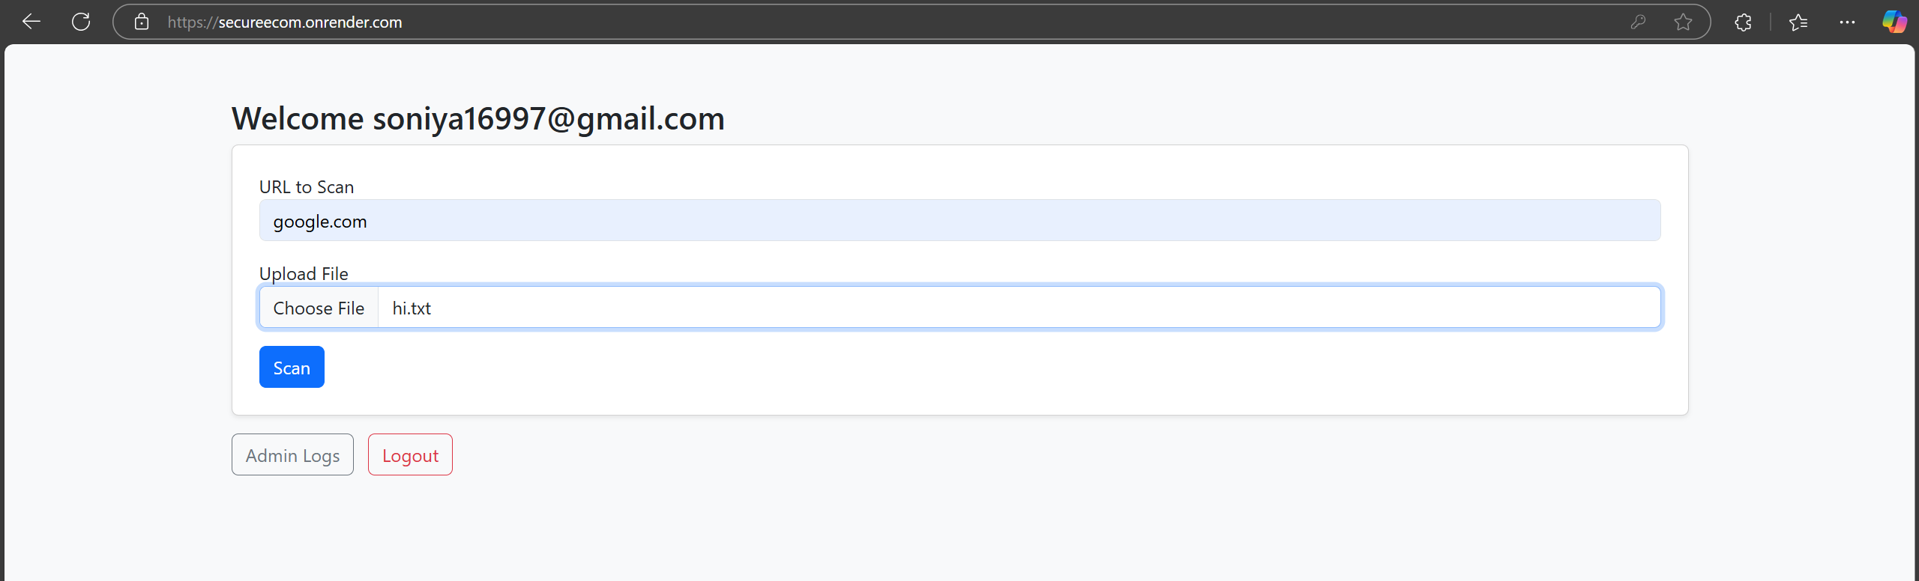
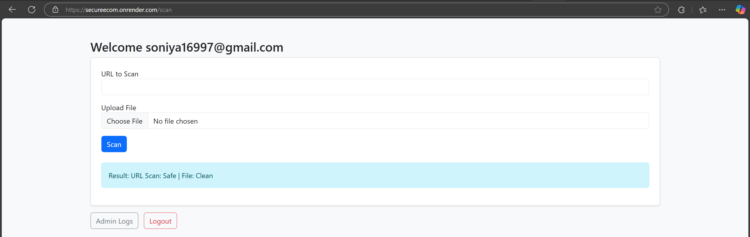
Malware detection & Phishing detection

Slide 11
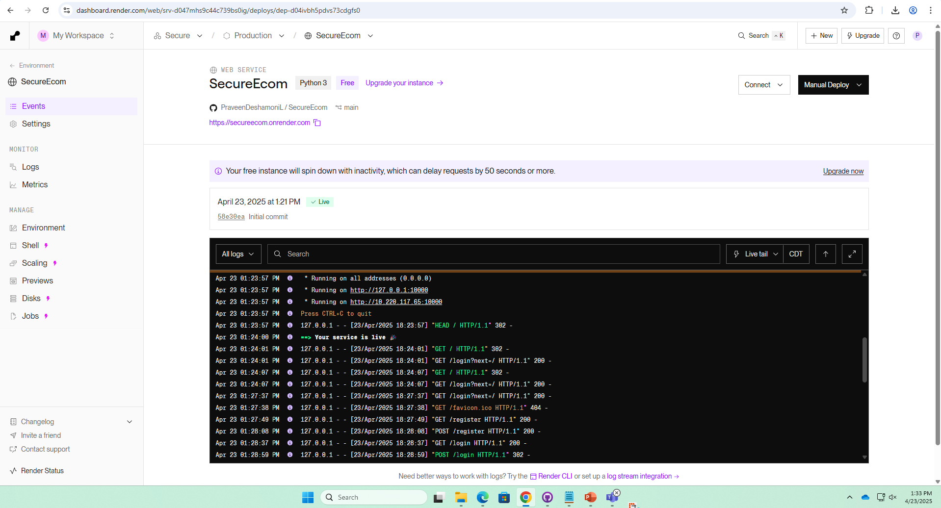
Successful Hosting page with request logs

Slide 12
Tools used
Nessus: Scans systems for known vulnerabilities and misconfigurations.
Nikto: Checks web servers for outdated software and common issues.
ZAP: Finds web app vulnerabilities like XSS and SQLi.

Slide 13
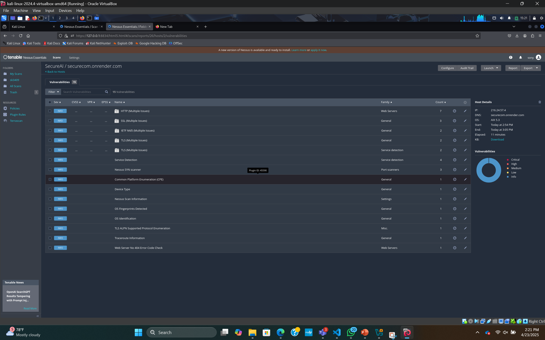
Nessus Scan

Slide 14
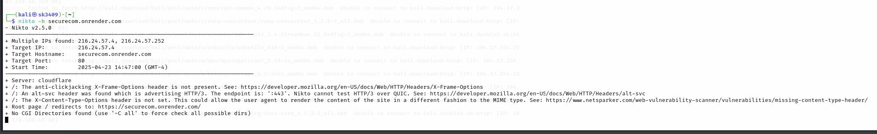
Nikto Scan on SecureAI

Slide 15
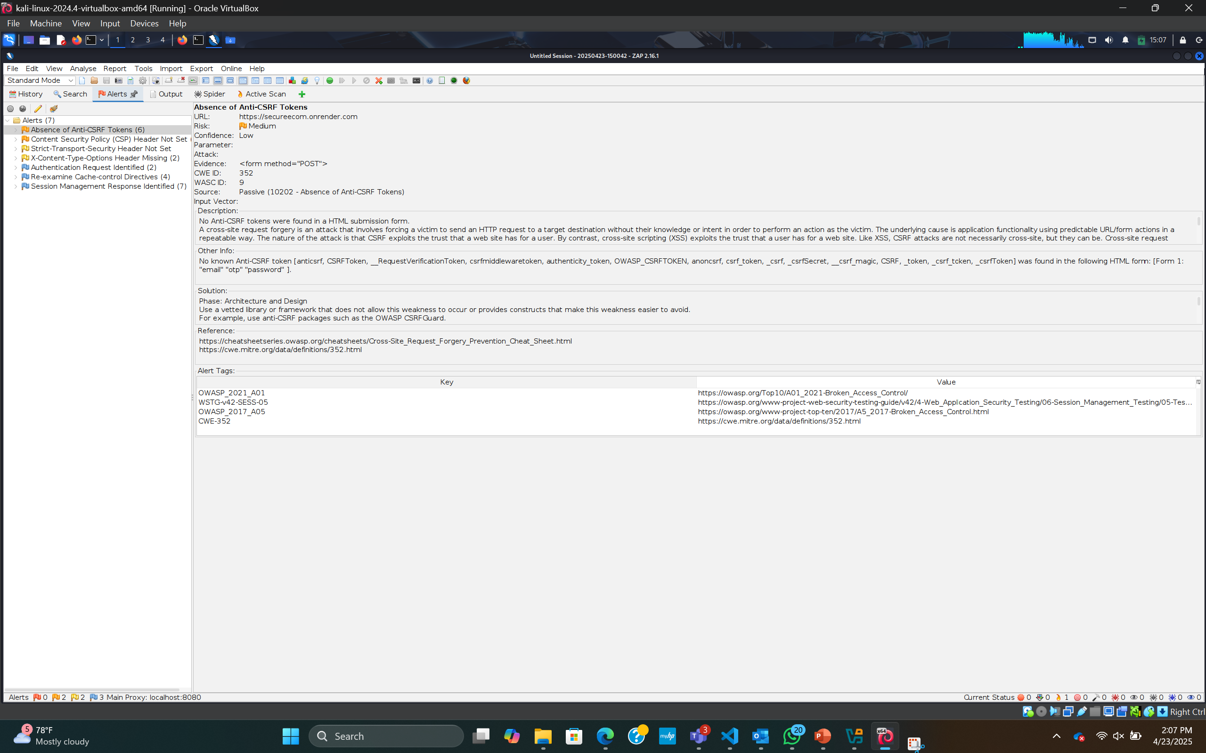
ZAP Scan

Slide 16
Findings
HTTPS enforced via Flask
No reflected XSS or SQLi issues found
File size limited to 5 MB to prevent DoS
Clean input validation and secure upload handling

Slide 17
Conclusions
Designed and deployed a AI based security application
Integrated model-based threat detection and manual file scan
Hands-on use of cybersecurity tools to validate system robustness

Slide 18
Future Implementations
Implementation VAPT module
Increased dataset and efficiency for Phishing and Malware Detection.

Slide 19
References
Flask & Flask-Talisman documentation
Tools: Nessus, Nikto, & OWASP ZAP
GitHub: PraveenDeshamoniL/SecureAI-WebApp

