Slide 1
MEASURING SUCCESS IN TALENT MANAGEMENT

Slide 2
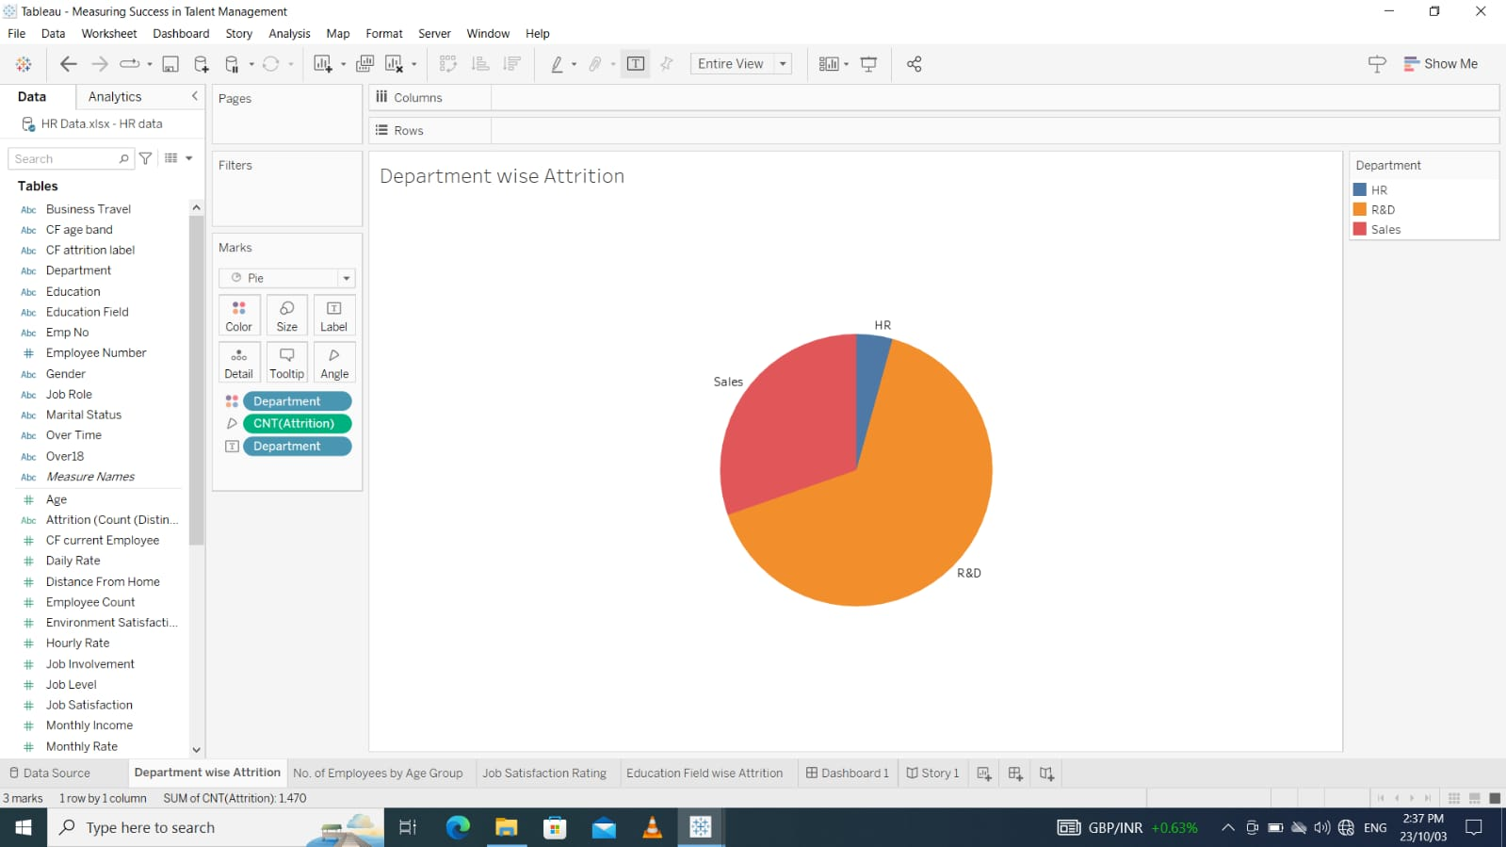
DEPARTMENT WISE ATTRITION

Slide 3
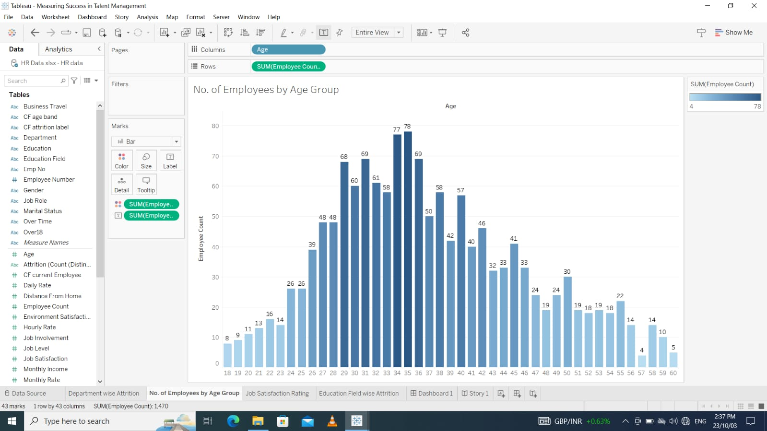
NO.OF EMPLOYEES BY AGE GROUP

Slide 4
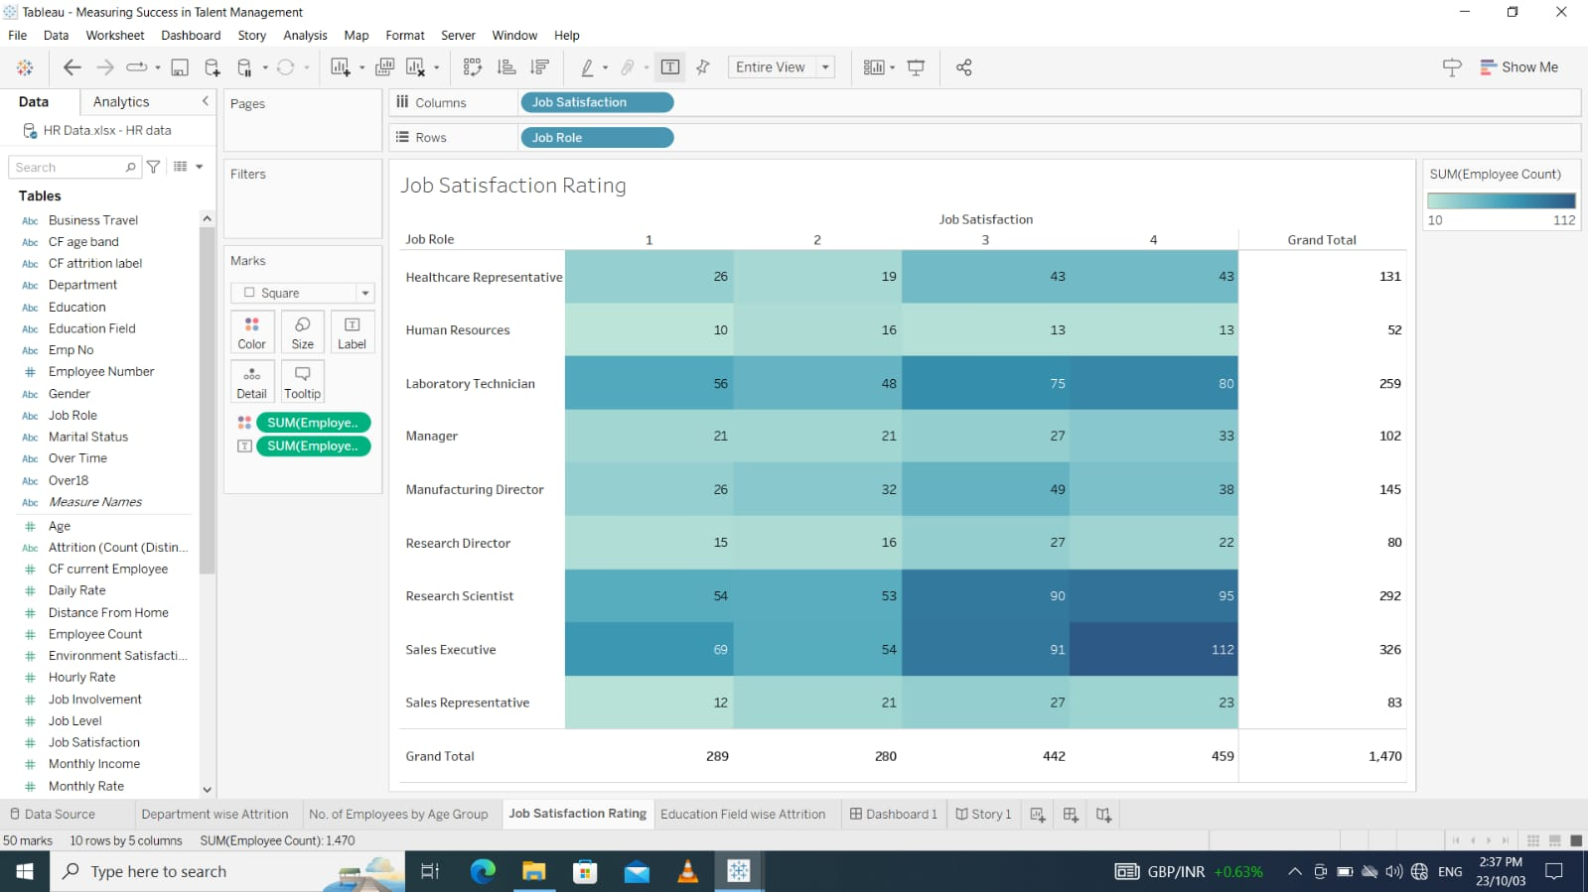
JOB SATISFACTION RATING

Slide 5
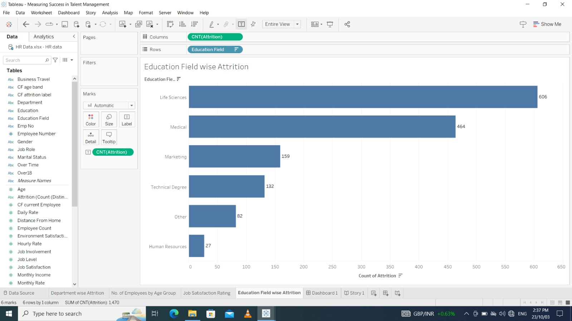
EDUCATION FIELD WISE ATTRITION

Slide 6
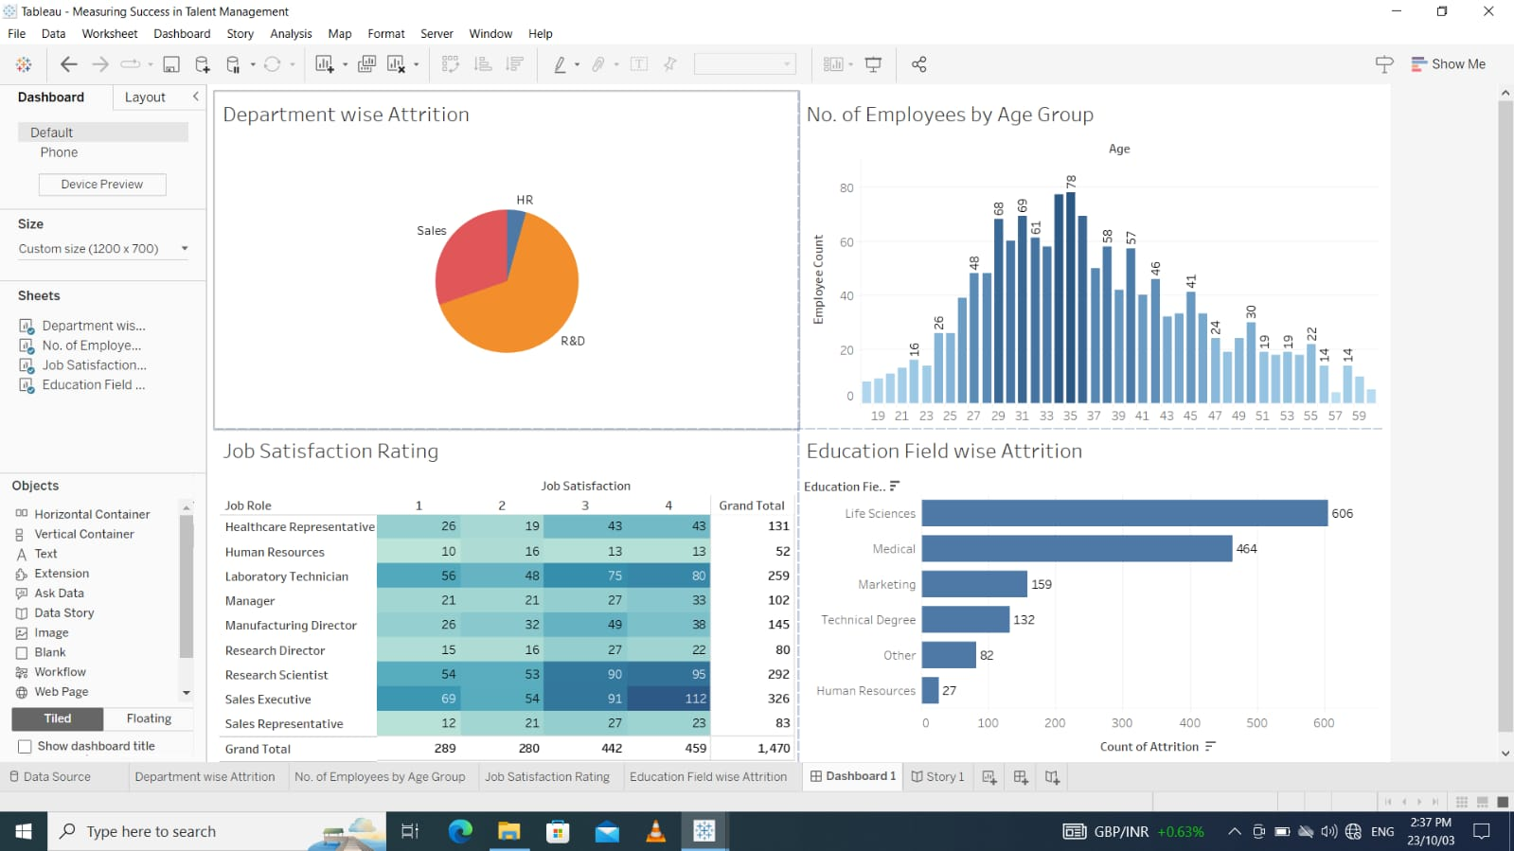
DASHBOARD

Slide 7
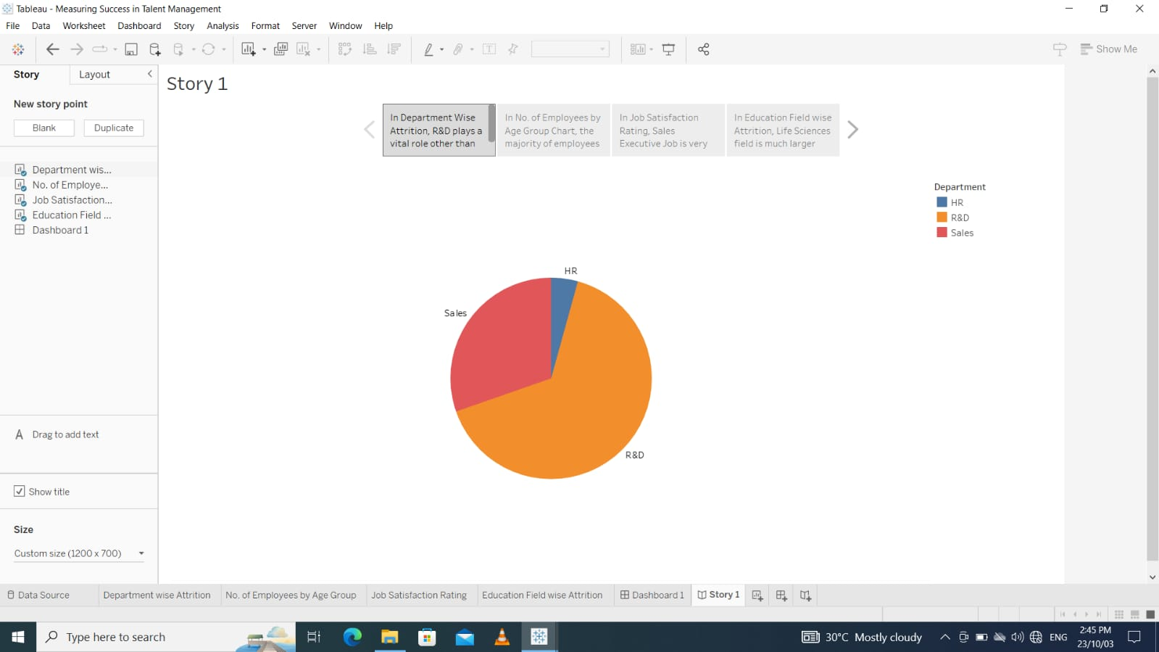
STORY 1

Slide 8
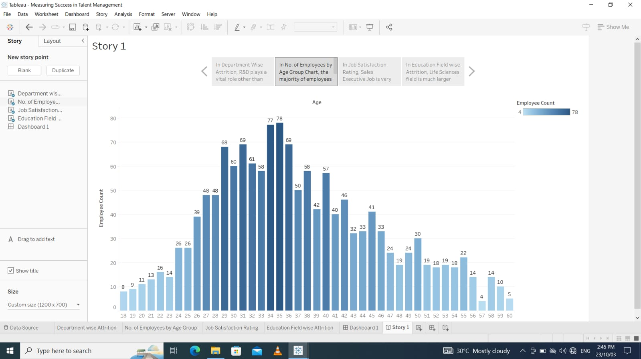
STORY 1

Slide 9
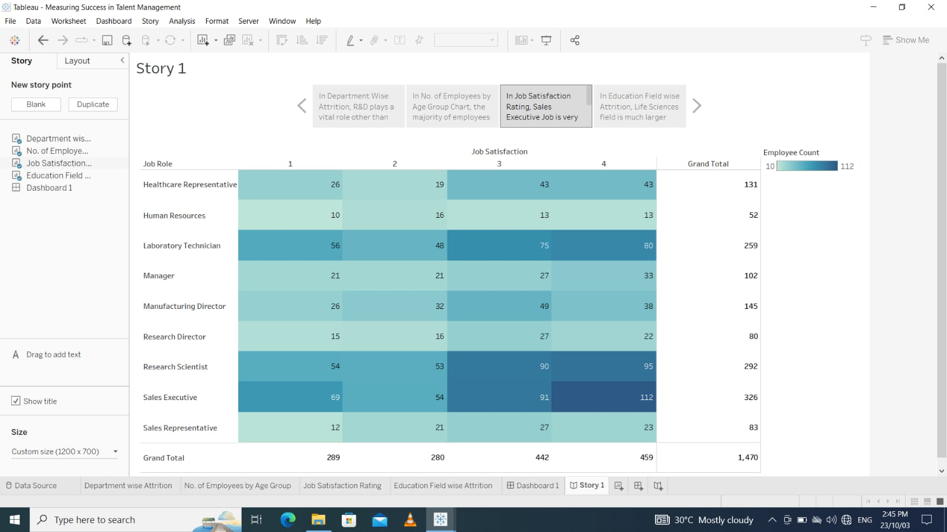
STORY 1

Slide 10
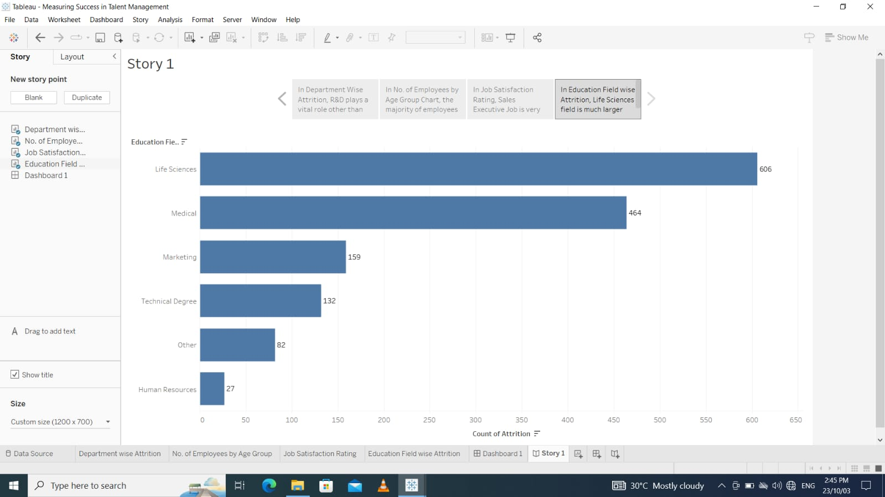
STORY 1

