Slide 1

Final Presentation
HEALTHCARE - PERSISTENCY OF A DRUG
Group Name: DS_SS
Name: SONIYA SUNNY
Email: soniyasunny1210@gmail.com
Country: Canada
Company: Data Glacier
Specialization: Data Science

Slide 2

Agenda
Executive Summary
Problem Statement
Approach
Data Cleaning
EDA
EDA Summary
Models
Recommendations

Slide 3
Problem Statement
To identify the persistency of a drug, a pharmaceutical company approached to develop a model based on data analysis.
Factors that affect the persistence of drugs should be identified, along with data insights with predictive analytics, to help the company for their smooth and efficient functioning, with the help of dataset provided by the company.

Slide 4
Approach
Collect data
Analyze the data
Detect outliers
Combine datasets
Curate the data
Feature engineering
Detect correlations
Analyze patterns
Provide insights
Tools used – Microsoft Excel, Python, Microsoft Power BI

Slide 5

Data Cleaning
Dataset details:
File name: Healthcare_dataset.xlsx
No. of rows = 3424
No. of columns = 69
Target variable = ‘Persistency_Flag’
There were no null values in the dataset.
Some variables have large number of value counts, which is reduced by grouping same names, treating “Unknown” values, etc.
A new dataset was created after data curation steps, with 2942 rows & 66 columns.

Slide 6
Exploratory Data Analysis
Basic Data Exploration
Demographic Analysis
Gender
Age
Race
Region
Ethnicity
Clinical Factors’ Analysis
T score
Risk Segment
Glucocorticoid Recency
Fragility Fracture Recency
Disease/Treatment Factors’ Analysis
Comorbidity
Risk factors
Concomitancy

Slide 7
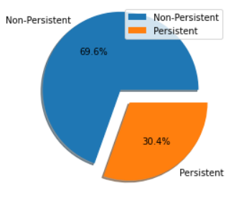
Target Variable Analysis

Slide 8
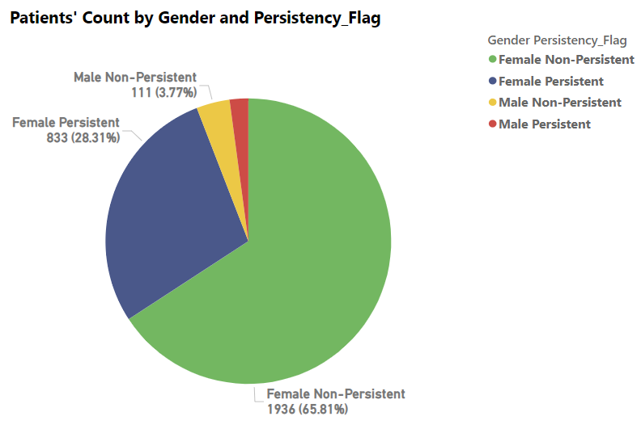
Gender Analysis

Slide 9
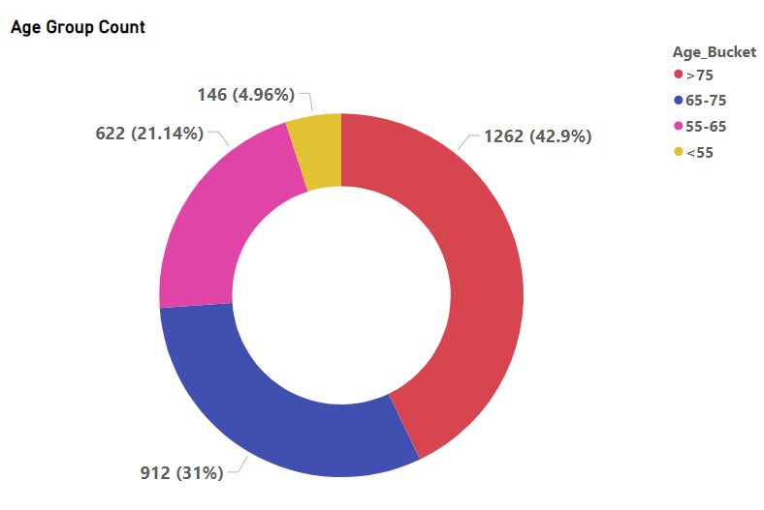
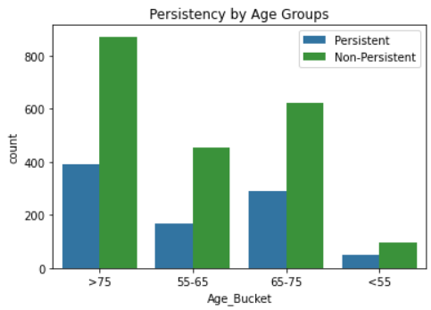
Age Group Analysis

Slide 10
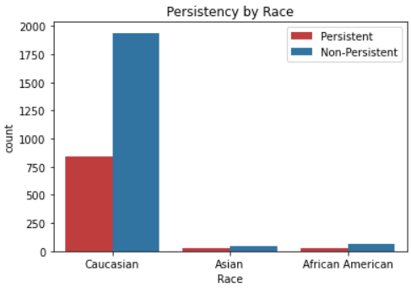
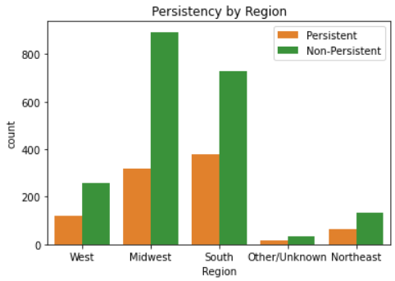
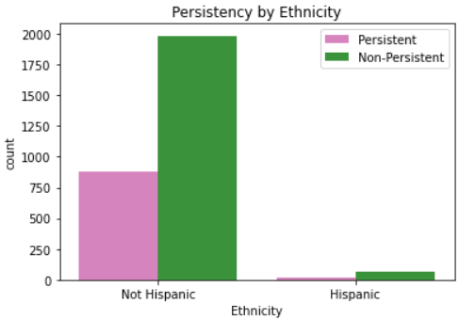
Race, Region & Ethnicity

Slide 11
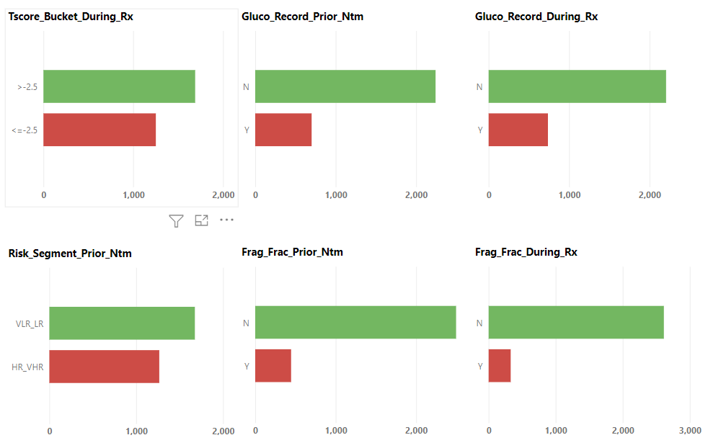
Clinical Factors

Slide 12
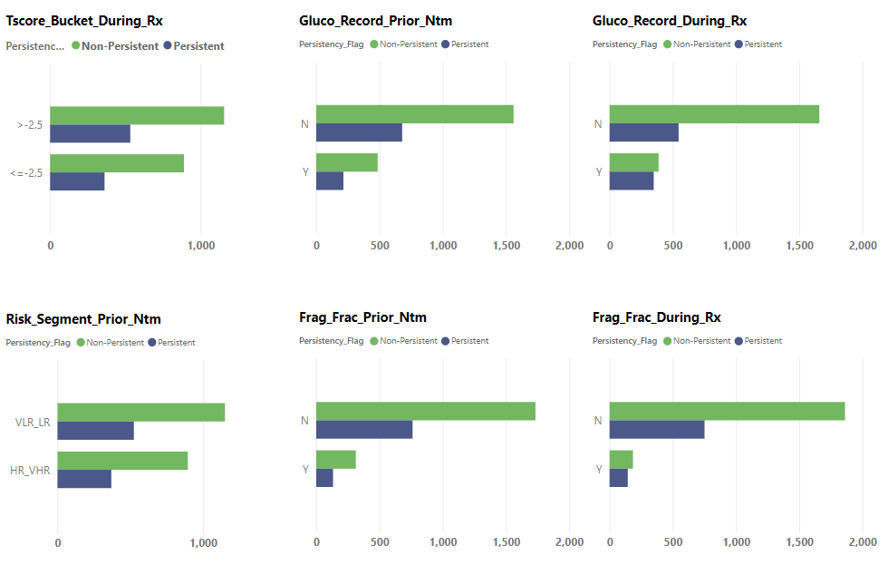
Clinical Factors - Persistency

Slide 13
Disease/Treatment Factors
NTM-Comorbidity: Comorb_Disorders_of_lipoprotein_metabolism_and_other_lipidemias has highest influence.
NTM-Risk Factors: Risk_Vitamin_D_Insufficiency has highest influence.
NTM-Concomitancy: Concom_Narcotics has highest influence.

Slide 14
EDA Summary
Drug Persistency is affected by many factors
Patients older than 65 years show more persistency
T-square also has influence in persistency
Disease/Treatment factors:
Comorbidity
Risk factors
Concomitancy

Slide 15
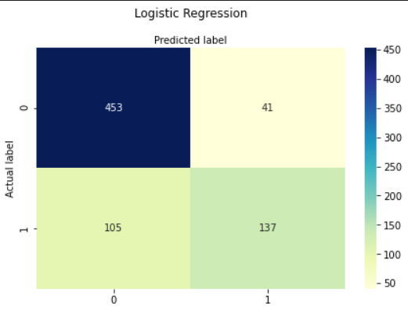
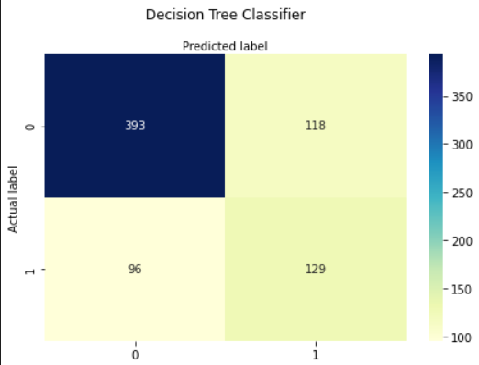
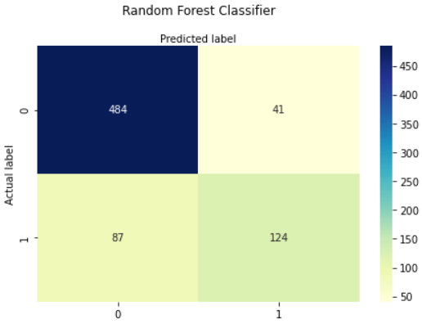
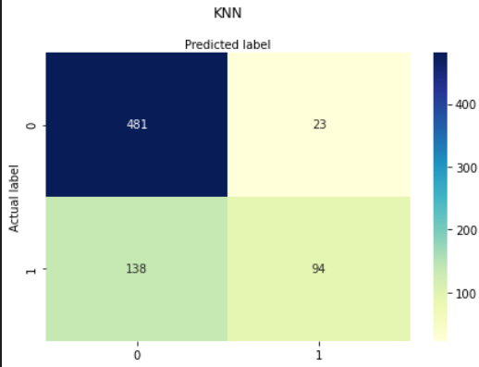
Models

Slide 16
Models
Model | Accuracy Score
1. Logistic Regression | 80.16%
2. Decision Tree Classifier | 70.92%
3. Random Forest Classifier | 82.61%
4. k-Nearest Neighbors (kNN) | 78.13%

Slide 17
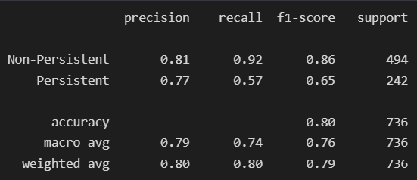
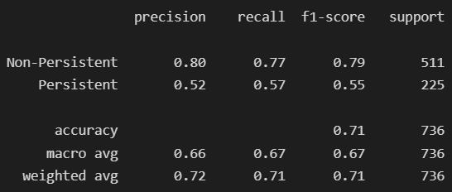
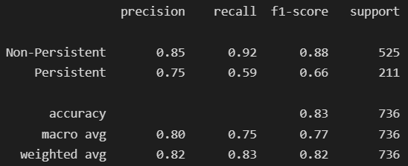
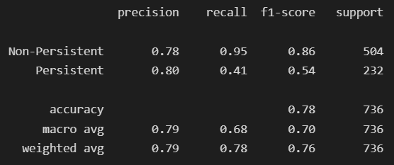
Classification Reports
1. Logistic Regression | 2. Decision Tree Classifier
3. Random Forest Classifier | 4. KNN

Slide 18
Recommendations
Classifier algorithms tend to produce more effective results
These models help to categorize patients based on certain factors
Random Forest Classifier produced most accurate results
Factors that affect comorbidity, risks and concomitancy were also found out

Slide 19
Thank You

