Slide 1

Exploratory Data Analysis
G2M INSIGHT FOR CAB INVESTMENT FIRM
Submitted by,
Soniya Sunny
Data Science Intern
LISUM10: 30
Submitted on,
June 18, 2022

Slide 2

Agenda
Executive Summary
Problem Statement
Approach
EDA
EDA Summary
Recommendations

Slide 3
Executive Summary
XYZ, a private investment firm in the US, planning to expand business in Cab industry.
They need to get some data insights about the ongoing cab investment market.
From the data analytics, they need to figure out which company they should invest in, to achieve maximum profit.
The objective is to provide relevant recommendations to make the right decisions in Cab Investments, that support their Go-to-Market (G2M) strategy.

Slide 4
Problem Statement
Investment in Cab industry is a better decision, but the problem lies in which company they should invest in.
The current competitions in the cab industry point towards the necessity of keen observations and research about the market before putting money into it.
It is essential to collect sufficient data from various sources, analyze it properly, compare various competitors, figure out the factors that affect the market, understand the features that promotes the business and finally, choose the right company.

Slide 5
Approach
Collect data
Analyze the data
Detect outliers
Combine datasets
Curate the data
Feature engineering
Detect correlations
Analyze patterns
Provide insights
Tools used – Microsoft Excel, Python, Microsoft Power BI

Slide 6

Exploratory Data Analysis
Datasets used:
Cab_Data.csv – Details of transaction for 2 cab companies
Customer_ID.csv – Mapping table that contains a unique identifier which links the customer’s demographic details
Transaction_ID.csv – Mapping table that contains transaction to customer mapping and payment mode
City.csv – List of US cities, their population and number of cab users
US_Holiday_Dates_(2004-2021).csv - List of US holiday dates

Slide 7
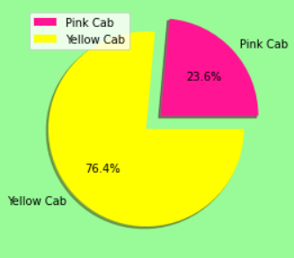
Exploratory Data Analysis
Yellow Cab is about three-fourth of the Cab Industry as compared to Pink Cab.

Slide 8
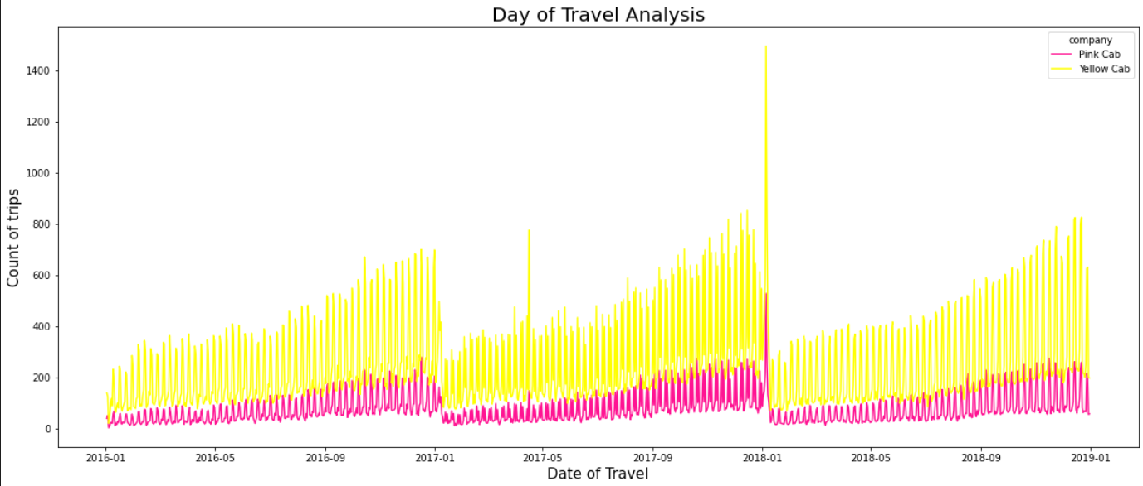
Seasonality: Date of Travel Analysis
* The overall time analysis of data shows the seasonality of trips.
* We can see a pattern for each year.
* The count of trips is increasing throughout the year, from January to December.
* The pattern repeats each year

Slide 9
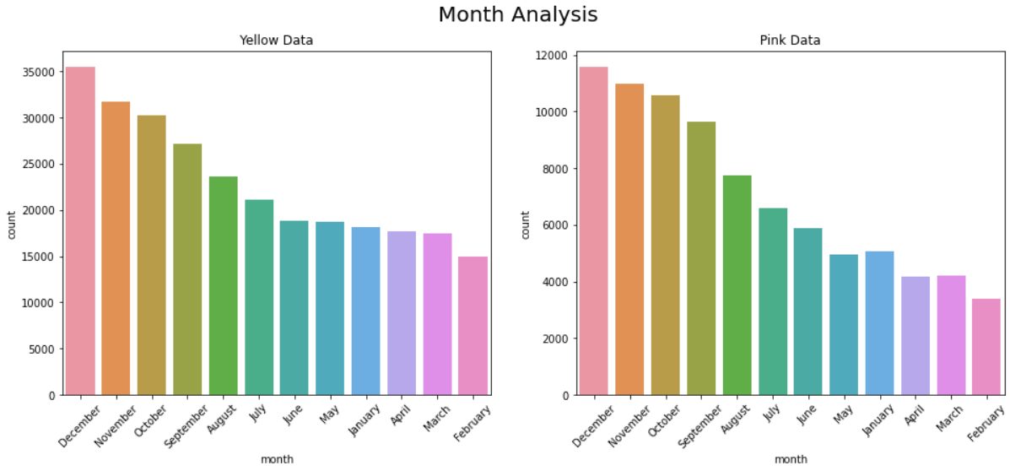
Seasonality: Date of Travel Analysis
December has the greatest number of trips for both cabs.
February has the least.

Slide 10
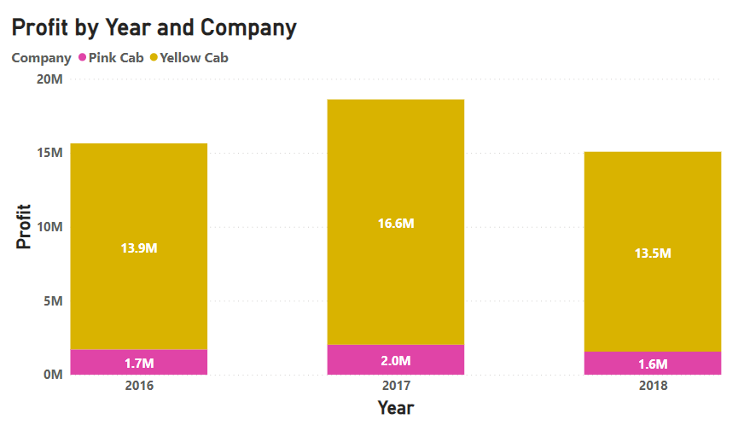
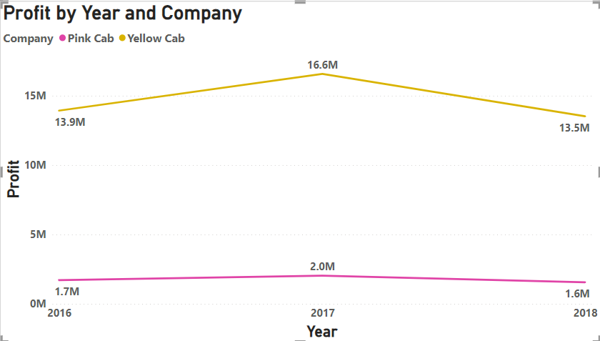
Profit Analysis
Yellow cab has more profit in all the given years than pink cab

Slide 11
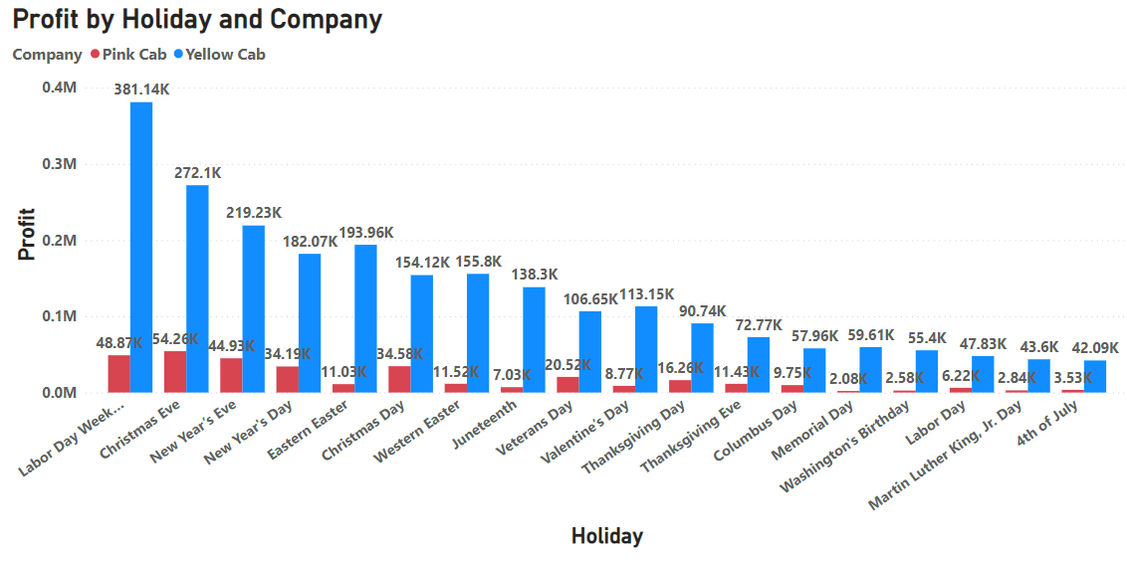
Profit Analysis by Holidays
Labor Day Weekend generated more profits for both cabs.
Christmas Eve, New Year Eve, New Year Day and Christmas Day also generated higher profits

Slide 12
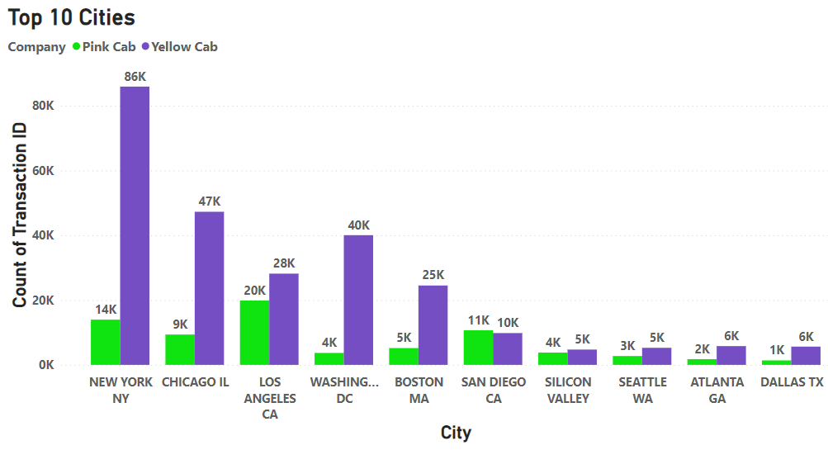
City Analysis
New York has more transactions.
In New York, Yellow Cab is more popular.

Slide 13
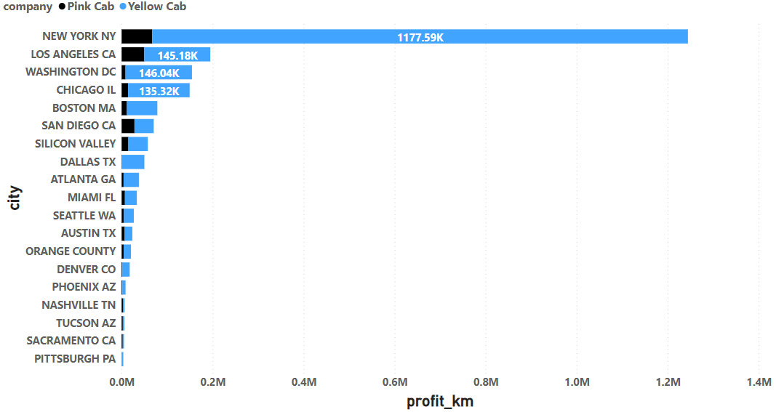
Profit/km Analysis by Cities
New York city gives more profit per kilometers for both cabs.
Yellow cab provides comparatively more profit/km.

Slide 14
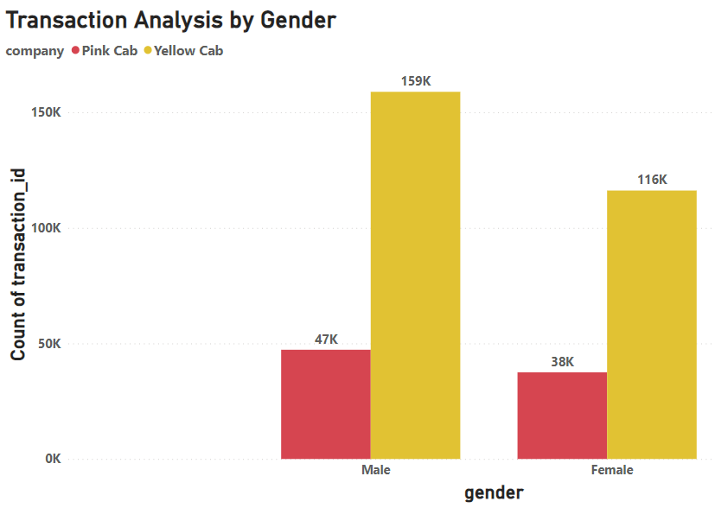
Transaction Analysis by Gender
Yellow Cab gets more rides irrespective of gender.

Slide 15
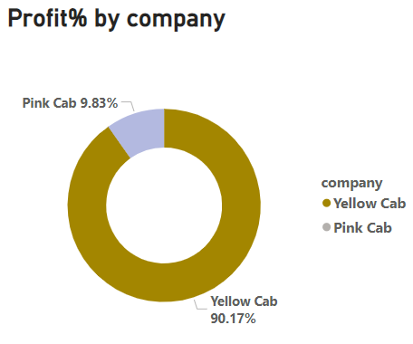
Profit % Analysis
Yellow Cab has 90.17% when profit percentage is considered.

Slide 16
EDA Summary
Seasonality:
Cab services have direct influence from dates of travel
Influence of Geography / cities
Profit Analysis
Holiday Analysis
Age, gender, income analysis

Slide 17
Recommendations
Yellow Cab is the best choice for investment.
It has more customers, more trips, in the analysis if daily, monthly and yearly basis.
The general trend is towards yellow cab in all the cities.
Profit generated by yellow cab is more than pink.
Irrespective of holidays, gender or age, customers prefer yellow cab, hence it will be the better decision.

Slide 18
Thank You

