Slide 1






SONJA MORRIS
DATA ANALYST
GAMECO
REGIONAL SALES
Final Project Presentation

Slide 2
DATA OVERVIEW
DATA AND COMPANY CONTEXT
This project is based on a dataset of 16,598 video game records compiled from global sales figures. Each record represents a single video game title, including attributes such as name, platform, genre, publisher, release year, and regional sales performance.
GameCo is a fictitious video game publisher that develops and distributes video games on multiple platforms and is currently planning its 2017 global marketing budget.
GameCo’s executive board believes that sales distribution among the four regions has remained stable over time. This analysis examines whether that assumption holds true by exploring sales trends, regional shares, and per-title performance from 2006 to 2016.
The data covers video game sales across four key geographic regions:
North America (NA)
Europe (EU)
Japan (JP)
Other regions (including markets in South America, Africa, and Oceania)
A total of 16,598 data rows were analyzed, filtered by year and region, to identify shifts in market dominance and provide evidence-based recommendations for the company’s future marketing strategy.
Current understanding: the mix of video game sales across regions (North America, EU, Japan, Other) has been stable over time
THE 2017 MARKETING PLAN ASSUMES NO MAJOR CHANGE

Slide 3



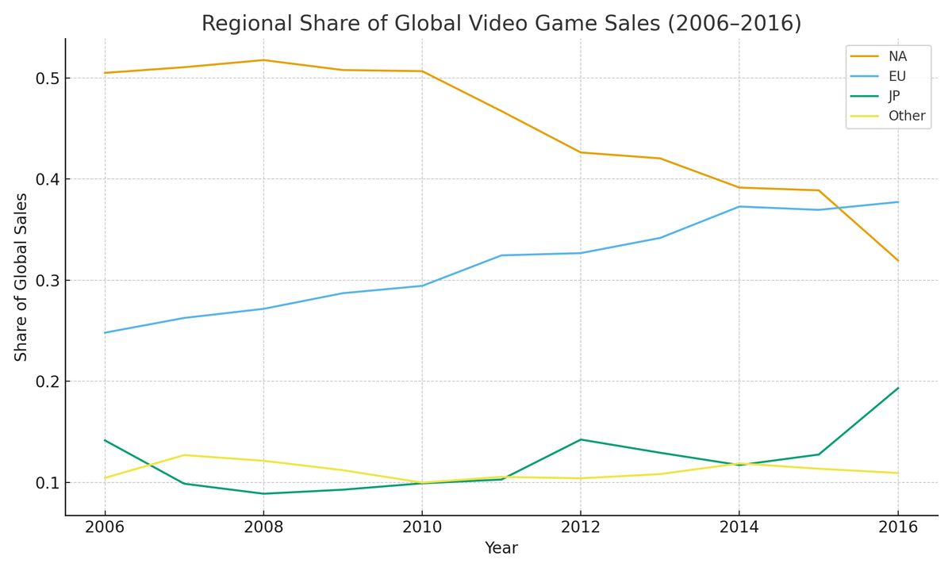


SHARE OF GLOBAL SALES
REGIONAL SHARE OF GLOBAL SALES 2006–2016
REGIONAL SHARE OF GLOBAL SALES
2006–2016
INTERPRETATION:
NORTH AMERICA’s share has steadily declined since 2007, EU’s share has risen and now leads, and Japan´s share shows an uptick in 2016. Other remains broadly stable.
General AI
AI capable of performing diverse, human-like tasks.

Slide 4

MAIN INSIGHT
GameCo’s assumption that the regional mix is unchanged is not supported by the data.
2016
By 2016, Europe overtakes North America in share of global sales (EU ≈ 37.7% vs NA ≈ 31.9%), with Japan’s relative share also higher than prior years.
2017
Therefore, 2017 marketing allocations should reflect a stronger European focus than previous years.

Slide 5



REVISED UNDERSTANDING
AS OF 2016
Regional shares shift over time;
they are not static.
Japan´s share has strengthened in 2016;
Other remains ~10–12%.
EU now slightly leads North America in share of global sales.
Budgets should be responsive to these shifts to maximize ROI

Slide 6

RECOMMENDATION
FOR 2017 BUDGET
Increase EU allocation relative to North America to reflect 2016 share leadership
Keep Other steady; test localized campaigns where cost‑effective
Maintain a targeted Japan program (platform/genre‑specific) given 2016 uptick
Revisit allocations quarterly in 2017 using updated sales mix data

Slide 7
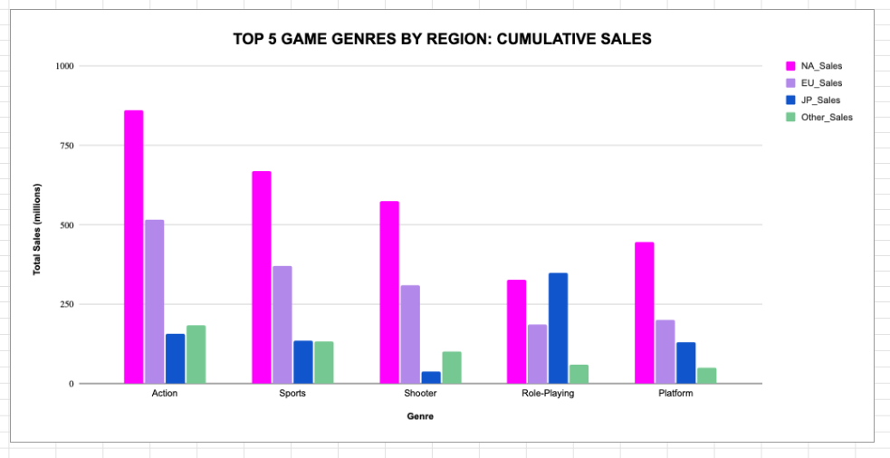
TOP 5 GENRES BY REGION
2006–2016 CUMULATIVE SALES:
KEY INSIGHT
While Action remains the most consistently popular genre worldwide, regional variations are strong. Western markets lean toward competitive and sports-based gameplay, while Japan dominates in story-driven RPGs and fighting titles. Recognizing these distinctions helps GameCo tailor marketing and development investments for each regional audience.
North America (NA)
Action
Shooter
Sports
Platform
Racing
North American players favor high-intensity, competitive titles, especially first-person shooters and sports franchises like Call of Duty and Madden NFL.
Europe (EU)
Action
Shooter
Sports
Racing
Role-Playing (RPG)
Europe mirrors North America but shows stronger interest in Racing and RPGs, reflecting the popularity of franchises such as FIFA and Gran Turismo.
Japan (JP)
Role-Playing (RPG)
Action
Fighting
Platform
Shooter
The Japanese market stands apart with a clear preference for RPGs (e.g., Final Fantasy, Pokémon) and Fighting games, showing the enduring strength of narrative-driven, character-based genres.
Other Regions
Action
Sports
Shooter
Racing
Platform
These markets broadly align with global patterns but maintain more balanced shares among genres, indicating a diverse but less concentrated demand.

Slide 8
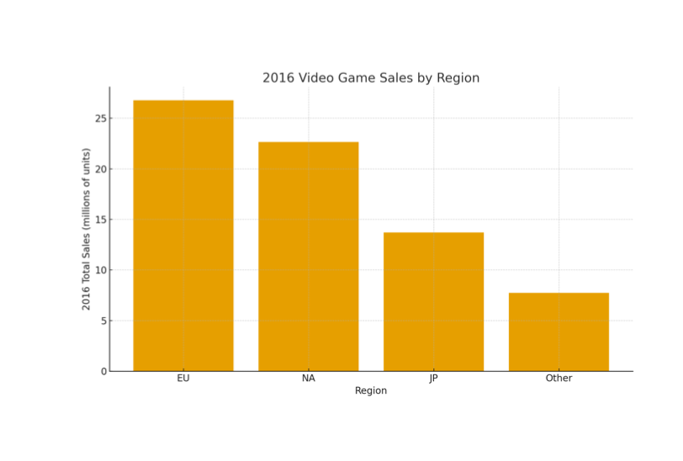
2016 REGIONAL TOTALS MILLIONS OF UNITS
EUROPE OVERTAKES NORTH AMERICA IN 2016 WITH ~27M UNITS SOLD COMPARED TO ~23M IN NA. JAPAN (~14M) AND OTHER REGIONS (~8M) REMAIN SMALLER BUT MEANINGFUL. THIS CONFIRMS THE TREND THAT EU IS NOW GAMECO’S LARGEST REGIONAL MARKET, CHALLENGING THE ASSUMPTION THAT NA ALWAYS LEADS

Slide 9
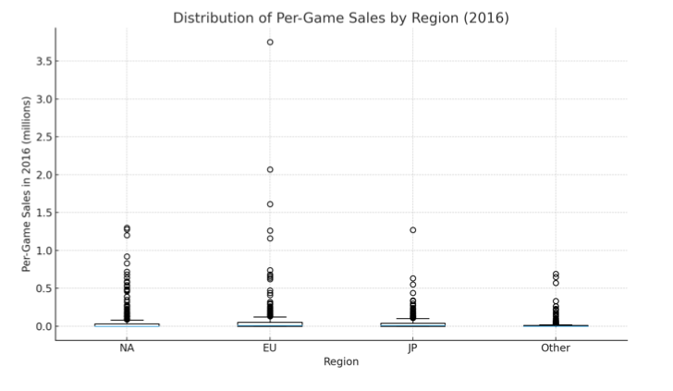
APPENDIX:
PER‑GAME SALES DISTRIBUTION BY REGION 2016
MOST TITLES SELL ONLY MODESTLY, BUT A FEW BLOCKBUSTERS ACCOUNT FOR A DISPROPORTIONATE SHARE OF UNITS ACROSS REGIONS. EUROPE AND NA SHOW THE WIDEST SPREAD OF OUTCOMES, WHILE JAPAN’S DISTRIBUTION IS MORE CONSISTENT. THIS LONG-TAIL PATTERN HIGHLIGHTS THE NEED TO BUDGET FOR BROAD COVERAGE WHILE STAYING AGILE TO BACK BREAKOUT HITS QUICKLY.

