Slide 1
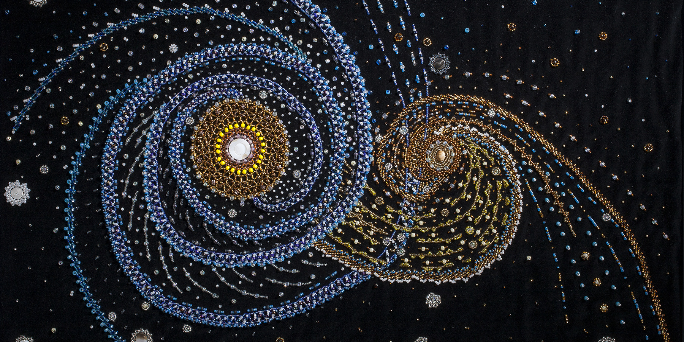
Heterogeneous Networks and Pan-Ethnic Organization: Indian Termination Policy and the Origins of Red Power G. Sonja Castañeda

Slide 2
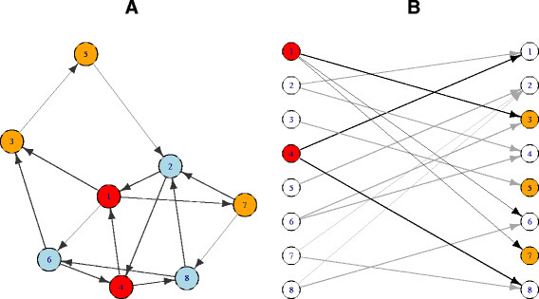
Network Analysis
Nodes/Vertices
Edges/Links
Directed, Undirected

Slide 3
Reservation/Non-Reservation

Slide 4
Network of Committees

Slide 5
Cliques
plot(ceb, net_committees, edge.width = 1,
vertex.size=5, vertex.size2 = 3,
vertex.label.cex=0.5, asp = .9,
margin = -0.1
)

Slide 6
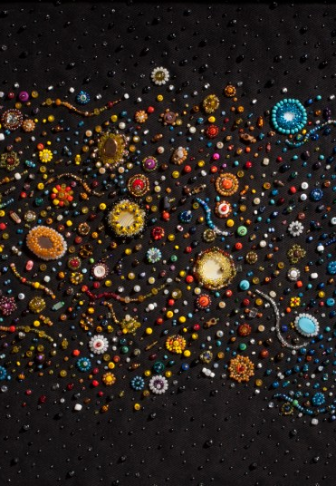
igraph
My advice for learning networks from igraph or other online networks tutorial:
BYO DATA!
small –> directed
Small – undirected
Large <– directed
Large - undirected

