Slide 1
COMP 1017 02 – Introduction to HTML
James Grieve

Slide 2
HTML – HyperText Markup Language
As the name suggests, HTML (HyperText Markup Language) is a markup language. This means that it uses tags to provide structure to content.
Typical HTML tags are opened with <tag> and closed with </tag>, where tag is the name of the tag you wish to use.
A piece of content enclosed by a tag is referred to as an “element”, or more specifically a “Document Object Model (DOM) Element”.

Slide 3
Basic Text Formatting Elements
The first elements we will be learning are the heading and paragraph tags.
Headings come in 6 sizes (and orders of importance): h1, h2, h3, h4, h5 and h6
<h1>This is a Heading!</h1>
Paragraphs are more generic, and only come in one type: p
<p>This is a paragraph. It could say few or many things. It usually has at least a few sentences.</p>

Slide 4
Block vs Inline Elements
Elements come in two main varieties, block-level elements and inline elements.
Block level elements will always start a new line and will expand to fill the width of their parent element.
Inline elements do not start their own line and only take up as much space as they need to.
Headings and paragraphs are both block-level elements.

Slide 5
Let’s Markup Some Text

Slide 6
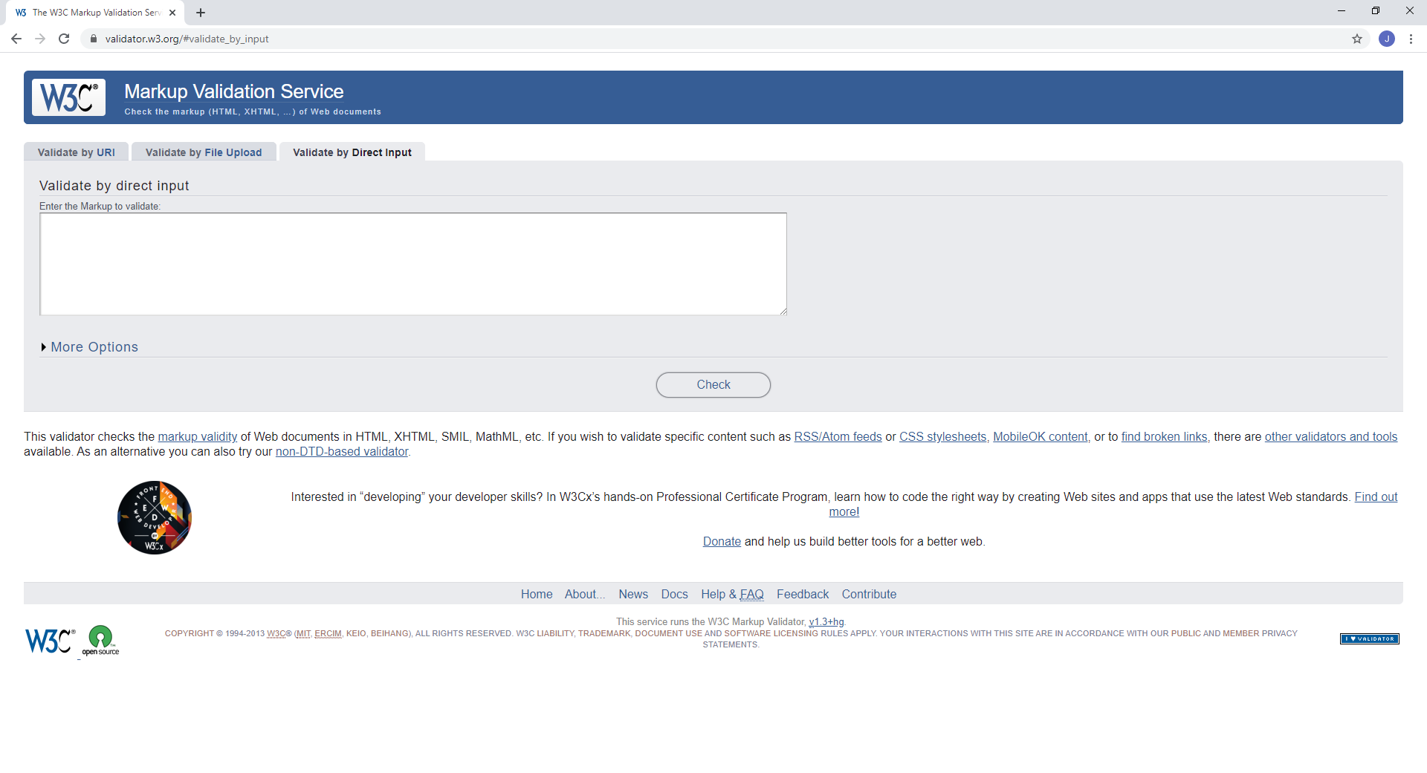
The HTML Validator
The W3 HTML validator is available on Moodle.
You can paste your HTML code into the “Validate by Direct Input” tab, or upload an HTML file to “Validate by File Upload”, and it will tell you if your file has any errors.

Slide 7
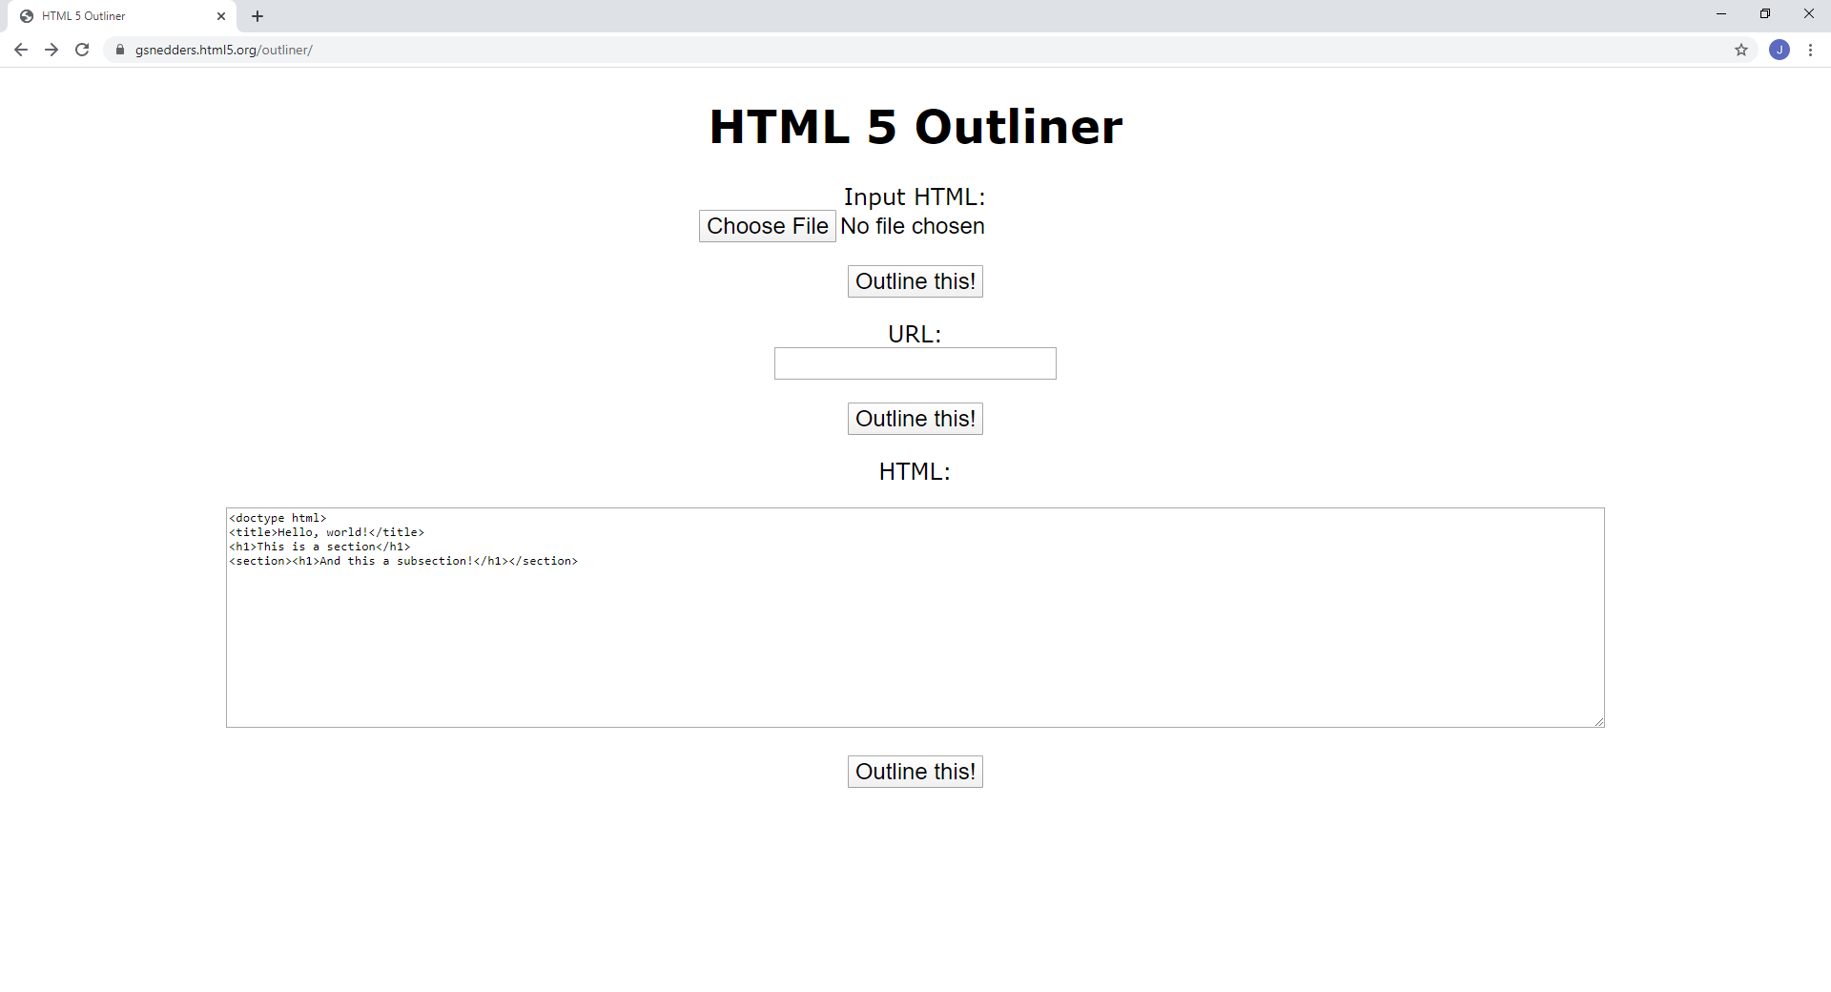
The HTML Outliner
The HTML outliner is also available on Moodle.
You can paste your HTML code into the “HTML” box, or upload an HTML file to “Input HTML”, and it will show you how your document will look as an outline.

