Slide 1
COMP 1017 04 – More Elements
James Grieve

Slide 2
Basic Elements Table Introduction
The table element allow you to create and format tables in your HTML pages.
The table element has a sub element called tr (table row).
The tr element has two sub elements called tr (table heading) and td (table data).
The number of tr elements in your table determines the number of rows the table will have.
The number of th and td elements in your tr’s determines the number of columns your table will have.
Generally you’ll want the same number of either th or td elements in each tr (even if they’re empty) to preserve formatting.

Slide 3
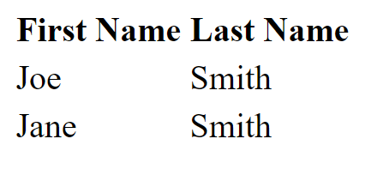
Basic Elements Table Example
<table>
<tr>
<th>First Name</th>
<th>Last Name</th>
</tr>
<tr>
<td>Joe</td>
<td>Smith</td>
</tr>
<tr>
<td>Jane</td>
<td>Smith</td>
</tr>
</table>

Slide 4
Basic Elements Figures & Image Links
The figure element can be used to caption an image.
<figure>
<img src=“img/camping.png” alt=“Picture of me camping.” />
<figcaption>Camping in the mountains.</figcaption>
</figure>
An image link can be created by wrapping an image with an anchor.
<a href=“http://google.ca”><img src=“img/google.png” alt=“Google” /></a>

Slide 5
Let’s Practice

