Slide 1
COMP 1017 04 – Semantic Elements
James Grieve

Slide 2
Semantic Elements Header, Main & Footer
The first 3 semantic elements are the header, main and footer. Each page will typically have one of each, but might be missing a header, footer or both. The header is DIFFERENT from the head.
<header></header> is typically used to enclose a banner at the top of the page, and usually includes things like a company logo, navigation, and maybe an <h1></h1>
<main></main> usually encloses all of the main content on the page, the stuff the user is actually visiting the page to find.
<footer></footer> is typically used to enclose a banner at the bottom of the page, and will usually have contact information, social media links and maybe another navigation menu.
Formatting wise, they don’t serve a large purpose (although they can be styled with CSS), it is primarily to provide structure to your content.

Slide 3
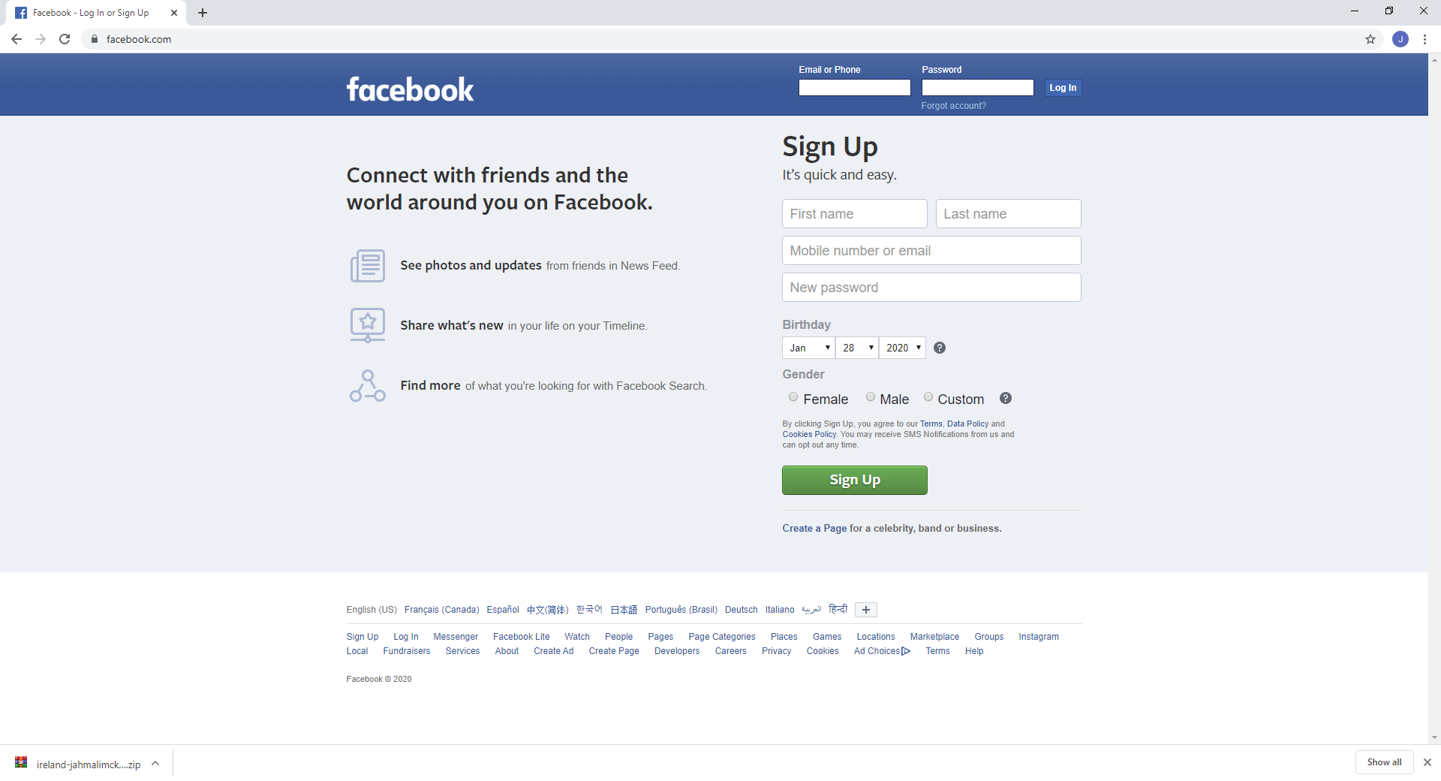
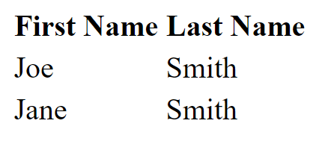
Semantic Elements Header, Main & Footer Example
Header
<header>
</header>
<main>
</main>
<footer>
</footer>
Main
Footer

Slide 4
Semantic Elements Navigation
The navigation or <nav></nav> element is used to enclose navigation links, whether it be a navigation menu, or a breadcrumb list.
We’ll talk more about navigation in the future.

Slide 5
Semantic Elements Section, Article & Aside
The <section></section> element is used to enclose a set of content that all relates to the same topic or theme. Sections can be nested inside of one another for sub-topics.
The <article></article> element is used to enclose a set of content that could be removed and redistributed, and still make sense.
The <aside></aside> element is used to enclose side content that may not make sense on another page and isn’t verbose enough to qualify for a full article.
Formatting wise, they don’t serve a large purpose (although they can be styled with CSS), it is primarily to provide structure to your content. Each one of these elements typically has a heading associated with it.

Slide 6
Let’s Practice

