Slide 1
COMP 1017 06 – Introduction to CSS
James Grieve

Slide 2
Cascading Style Sheets Introduction
Cascading style sheets, or CSS, are a way to change the way HTML elements appear in a web browser.
Every element has many different properties that determine how it is rendered / displayed in a browser.
Every browser has a set of default properties that are used if a given property is not defined, but some of them vary between browsers, leading pages to look different if not explicitly styled.
Properties are applied using CSS selectors, which determine what elements are to have their properties modified.
CSS is written by first stating the selectors for a property set, and then enclosing the property set in a pair of braces. Each property is delimited by a semicolon.

Slide 3
Cascading Style Sheets Element Selectors
The most basic CSS selector is the element selector. It will select every instance of a given element on a page.
Example:
p
{
color: chartreuse;
}
Element Selector (Paragraph)
Property
Value

Slide 4
Cascading Style Sheets Element Selectors
Multiple element selectors can be chained together with commas. This, for example, will change the colour of all paragraphs, first-degree headings and second-degree headings:
p, h1, h2
{
color: chartreuse;
}

Slide 5
Cascading Style Sheets Basic Properties
Some basic properties that can be applied are:
color: sets the foreground colour (typically the text colour)
background-color: sets the background colour
margin-*: sets the margin around elements
border-*-width: sets the width of border
border-*-color: sets the colour of border
border-*-style: sets the type of border
padding-*: sets the padding within elements
width, height: forces the size of an element
* - replace with direction (top, bottom, left, right)

Slide 6
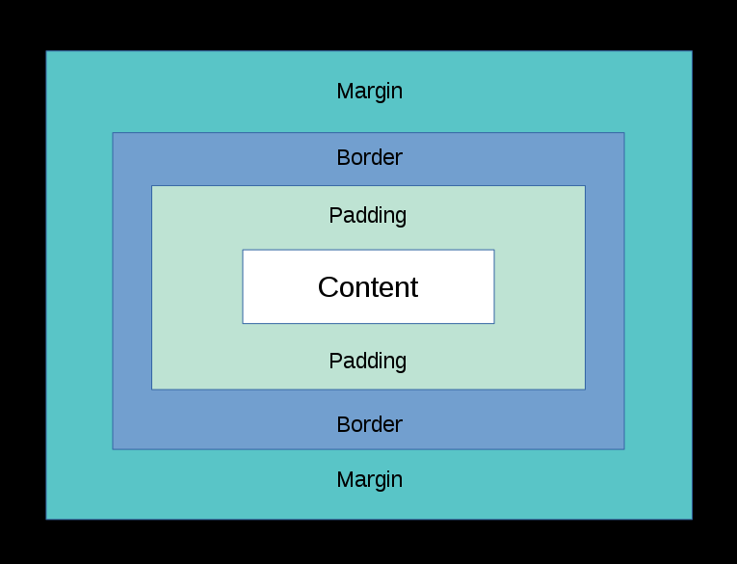
Cascading Style Sheets The Box Model
When setting the sizes of things, it is important to remember that margin, border and padding (by default) add onto the set width and height.
This means that if you’re trying to fit 3 items with a width of 100px in a space of 300px, and they have padding, border or margin, they will not fit!

Slide 7
Cascading Style Sheets Margin Collapse
One other thing to remember is that sometimes when you’ve set the bottom margin of an element, and the top margin of an element below it, the margins will merge.
This is called margin collapse, and it’s something you will likely encounter by accident while styling pages this semester.

Slide 8
Let’s Practice

