Slide 1
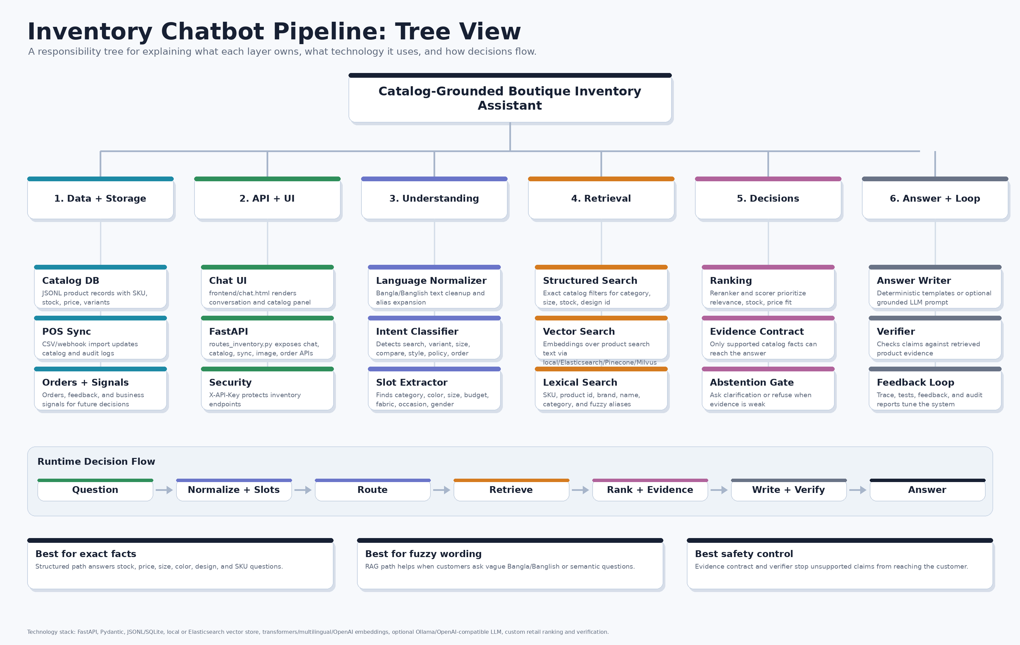
Inventory RAG Pipeline: Full Tree View
The bot is not one prompt. It is a layered system: catalog facts -> retrieval -> decisions -> grounded answer.
7-layer map
Data and catalog facts are deterministic.
Retrieval finds candidates before generation.
Decision logic chooses what may be said.
Prompts only write or reason inside bounded evidence.
Verification and feedback close the loop.
Inventory RAG chatbot | catalog-grounded retail assistant
1

Slide 2
Layer 1: DB Setup + Catalog Ground Truth
Where product truth lives before the model ever sees a question.
What It Does
Technology Used
Stores products as structured facts: product_id, SKU, name, category, price, stock, status, attributes, tags.
Keeps catalog, order, feedback, policy, and sync audit data separate so each source has a clear responsibility.
Treats catalog/POS facts as the source of truth; the LLM cannot invent product availability.
JSONL catalog: data/inventory/catalog.jsonl.
Optional SQLite mirror: data/inventory/inventory_mirror.sqlite3.
Pydantic schemas validate product/order/API objects.
Pipeline tree reference
Logic
Every item must carry searchable attributes like color, size, design_id, gender, fabric, occasion, and stock.
include_in_rag/status decide whether a product should appear in answers.
Hard fields beat natural language: exact stock, price, SKU, and size are never guessed.
Inventory RAG chatbot | catalog-grounded retail assistant
2

Slide 3
Layer 2: Ingest, Sync + Search Document Build
How raw shop data becomes searchable evidence.
What It Does
Technology Used
Imports or updates products from manual JSONL, POS CSV-style imports, or webhook payloads.
Normalizes fields and writes audit records so stock/catalog changes can be traced.
Turns each product into searchable text plus exact metadata for filters.
FastAPI sync endpoints under inventory routes.
Pydantic validation and Python ingestion logic.
Audit storage: data/inventory/sync_audit.jsonl.
Pipeline tree reference
Logic
Merge/update by product_id or SKU to avoid duplicate inventory records.
Build search text from name, category, brand, attributes, tags, and description.
Use deterministic IDs so rebuilds replace old vector records cleanly.
Inventory RAG chatbot | catalog-grounded retail assistant
3

Slide 4
Layer 3: Query Understanding
How Bangla, Banglish, and English questions become structured shopping intent.
What It Does
Technology Used
Detects whether the user wants product search, size check, same-design color, styling, policy, order, or small talk.
Extracts slots: category, color, fabric, size, brand, budget, occasion, gender, and in-stock intent.
Reads recent conversation when the customer says follow-up phrases like 'same design blue ache?'.
Regex and alias dictionaries for deterministic retail terms.
Banglish normalizer and fuzzy corrector for typo-heavy customer text.
Optional Ollama qwen3:8b prompts for intent, slot extraction, and conversation planning.
Pipeline tree reference
Logic
Deterministic extraction wins for hard fields; LLM output fills gaps only when useful.
Low-confidence or vague questions trigger one clarifying question instead of random recommendations.
Memory/context helps resolve references to last shown products and prior preferences.
Inventory RAG chatbot | catalog-grounded retail assistant
4

Slide 5
Layer 4: Retrieval + Ranking
How the system finds the right products from the catalog.
What It Does
Technology Used
Runs structured filters for exact requirements: category, size, color, design_id, price, gender, stock.
Runs semantic/vector search for flexible questions like 'elegant eid saree under 5000'.
Combines lexical, semantic, and retail-fit signals before choosing candidates.
Embedding layer: transformers/multilingual/deterministic/OpenAI-compatible modes.
Vector store: local JSONL by default; Elasticsearch adapter exists for dense vector + filter search.
BM25/lexical search catches exact product names, SKUs, brands, and categories.
Pipeline tree reference
Logic
Structured filters protect hard correctness; embeddings help recall but do not override facts.
Reranking rewards exact category/slot match, stock fit, budget fit, and product-name match.
Optional LLM reasoner can select only from bounded retrieved candidates, not the whole world.
Inventory RAG chatbot | catalog-grounded retail assistant
5

Slide 6
Layer 5: Evidence Contract + Decision Plan
The anti-hallucination layer between retrieval and final answer.
What It Does
Technology Used
Turns retrieved products into an evidence package: allowed facts, missing facts, risks, tradeoffs, and product roles.
Builds an answer plan: primary product, alternatives, cross-sells, exclusions, caveats, next question.
Decides answer vs clarify vs abstain when evidence is weak or unsupported.
Pydantic evidence contract models.
Deterministic planner, verifier, and policy gates.
Optional answer_plan enrichment before natural language writing.
Pipeline tree reference
Logic
Primary and alternative products must come from retrieved catalog evidence.
Cross-sell products are add-ons only, never replacements.
Excluded or out-of-stock products cannot be pitched as available.
Inventory RAG chatbot | catalog-grounded retail assistant
6

Slide 7
Layer 6: Answer Writing, UI + Feedback Loop
How the final response reaches the customer and improves over time.
What It Does
Technology Used
Writes a human-friendly answer in the customer's language style: Bangla, Banglish, or English.
Serves the chat UI, hideable catalog panel, product actions, order flow, and API docs.
Stores thumbs up/down, comments, trace IDs, failed cases, and response evidence for tuning.
FastAPI backend: /frontend/chat.html and /docs.
Plain HTML/CSS/JavaScript frontend.
Optional Ollama/OpenAI-compatible natural writer plus deterministic fallback templates.
Pipeline tree reference
Logic
Strict writer prompt follows answer_plan and writer_contract; it returns structured JSON.
Answer critic/verifier checks product names, prices, stock, exclusions, and unsupported claims.
Feedback should create new eval cases; it should not directly rewrite production behavior without tests.
Inventory RAG chatbot | catalog-grounded retail assistant
7

