Slide 1
Current Inventory RAG Pipeline
Catalog-grounded boutique retail chatbot for customer query answering
Core idea: the LLM does not own truth. Catalog data, retrieval, decision rules, evidence contracts, and verification control what the bot can safely say.
Catalog
Understand
Retrieve
Decide
Write
Verify
Built for sarees, bags, cosmetics, jewelry, watches, shoes, panjabi, shirts, pants, perfumes, and other boutique catalog items.
Handles Bangla, Banglish, English, and mixed customer wording.
Answers exact inventory questions without inventing product facts.
Inventory RAG Pipeline | bangla-tax-rag | slide 1

Slide 2
What The Bot Can Do Now
Customer-facing capabilities in the current architecture
Catalog Questions
Shopping Help
Operations
Availability: do you have this item?
Price, stock, SKU, product details
Same design in another color
Size availability
Budget-based product search
Occasion-based suggestions
Styling advice and accessory match
Compare products or fabrics
Delivery/payment/refund/exchange policy QA
Order/cart workflow hooks
Image-search pathway
Feedback and trace capture
Best current use case: answering boutique customer questions from current inventory with grounded, human-friendly replies.
Inventory RAG Pipeline | bangla-tax-rag | slide 2

Slide 3
Architecture Positioning
This is not a prompt-only chatbot
What Owns Truth
What Owns Search
What The LLM Owns
Catalog JSONL / SQLite mirror
Pydantic product schemas
Policy JSON
Order and sync records
Evidence contract
Structured filters
Bangla/Banglish normalization
Vector retrieval
Lexical/SKU search
Reranking and scoring
Optional intent/slot JSON extraction
Optional conversation planning
Optional candidate reasoning
Natural answer writing
Optional answer critique
Inventory RAG Pipeline | bangla-tax-rag | slide 3

Slide 4
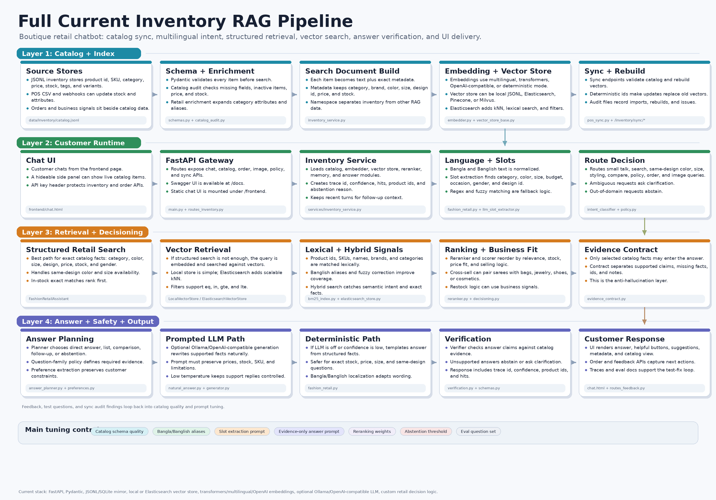
Full Pipeline Diagram
End-to-end flow from catalog setup to verified customer answer
Inventory RAG Pipeline | bangla-tax-rag | slide 4

Slide 5
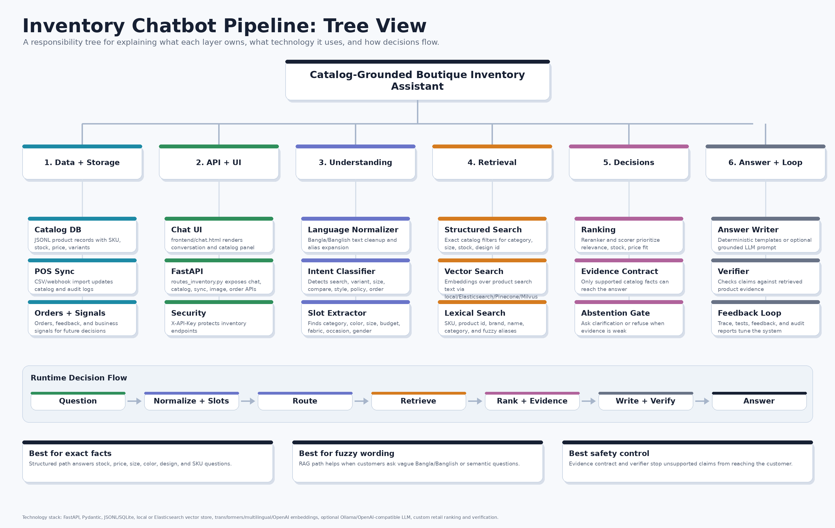
Tree View
Responsibility boundaries by subsystem
Inventory RAG Pipeline | bangla-tax-rag | slide 5

Slide 6
Layer 1: Data And Storage
How catalogs are saved and trusted
Catalog DB
Mirror Store
Sync
data/inventory/catalog.jsonl
InventoryItemRecord in app/core/schemas.py
Fields: product_id, SKU, category, price, stock, attributes, tags, status
This is the source of truth for product facts
app/inventory/storage.py
JSONL default; SQLite mirror available
Pydantic validation before persistence
Business signals stored separately from catalog facts
app/inventory/pos_sync.py
CSV and webhook import
Merge by product id/SKU
Audit logs and rebuild status track drift
Inventory RAG Pipeline | bangla-tax-rag | slide 6

Slide 7
Layer 2: Query Understanding
How the bot reads Bangla, Banglish, English, and mixed text
Normalization
Intent
Slots
banglish_normalizer.py
fuzzy_corrector.py
Bangla digit translation
Alias and typo expansion before slot extraction
intent.py deterministic classifier
llm_intent_classifier.py optional JSON classifier
intent_planner.py optional multi-turn planner
Outputs confidence and ambiguity reason
fashion_retail.py regex and aliases
llm_slot_extractor.py optional JSON extraction
Finds category, color, size, budget, fabric, occasion, gender, design id
Regex wins when safer
Inventory RAG Pipeline | bangla-tax-rag | slide 7

Slide 8
Layer 3: Retrieval
Three retrieval paths, each solving a different failure mode
Structured Search
Vector Search
Lexical Search
Best for exact catalog facts
Filters category, color, size, budget, design id, stock
Handles same design and size availability
No prompt involved
embedder.py builds query/product vectors
local_store.py for local JSONL vector storage
elasticsearch_store.py for kNN + filters
Pinecone and Milvus adapters available
BM25/lexical matching
SKU, product id, brand, category, exact name
Elasticsearch multi_match path
Protects against embedding fuzziness
Inventory RAG Pipeline | bangla-tax-rag | slide 8

Slide 9
Layer 4: Decisions And Evidence
Where recommendations become controlled decisions
Ranking
Answer Plan
Evidence Contract
reranker.py computes ecommerce fit
Signals: semantic, lexical, exact SKU/name, category, brand, product type
Price fit, stock fit, metadata/spec fit
Penalizes unrelated and out-of-stock candidates
planner.py enriches the recommendation plan
Chooses primary, alternatives, cross-sells, next question
Adds risk notes and tradeoffs
Defines what the writer may say
evidence_contract.py is the safety boundary
Allowed claims, missing facts, contradictions
Rejected candidate ids
Prevents fluent hallucination
Inventory RAG Pipeline | bangla-tax-rag | slide 9

Slide 10
Layer 5: Answer Writing And Verification
How a safe answer becomes human-friendly
Deterministic Writer
Natural Writer
Verifier
fashion_retail.py templates
Safe for exact stock, price, size, color, design id
Works when LLM is unavailable
Bangla/Banglish localization support
natural_answer.py
inventory_service._build_inventory_answer_messages()
Ollama/OpenAI-compatible writer
Must obey answer_plan and writer_contract
verifier.py checks final answer
answer_critic.py optional LLM critic
Rejects unsupported products, prices, stock claims
Allows one cautious retry
Inventory RAG Pipeline | bangla-tax-rag | slide 10

Slide 11
Prompt Registry
Where prompts exist and what each prompt is allowed to decide
Understanding Prompts
Decision Prompts
Writing Prompts
llm_intent_classifier.py: JSON intent, slots, confidence
llm_slot_extractor.py: JSON shopping slots
intent_planner.py: multi-turn plan and constraints
llm_reasoner.py: pick product ids only from candidates
Never invent products
Can return none_fit
natural_answer.py: warm boutique answer
inventory_service.py: strict ecommerce writer contract
answer_critic.py: quality review
Prompt governance rule: prompts may interpret or phrase, but they cannot override catalog facts, selected product roles, excluded product ids, or verification.
Inventory RAG Pipeline | bangla-tax-rag | slide 11

Slide 12
Technology Stack
What technology is used at each stage
Backend
Retrieval
Generation
FastAPI
Pydantic
PyYAML settings
httpx
pytest
JSONL / SQLite mirror
rank-bm25
Transformers / multilingual / OpenAI embeddings
Local vector store
Elasticsearch / Pinecone / Milvus adapters
Ollama qwen3:8b prompts
OpenAI-compatible chat client
Deterministic fallback templates
Evidence contract
Final verifier
Inventory RAG Pipeline | bangla-tax-rag | slide 12

Slide 13
Runtime Endpoints
How to demo and inspect the system
User UI
API Docs
Core Calls
http://127.0.0.1:4849/frontend/chat.html
Chat with the bot
Open/close catalog panel
Send feedback and order actions
http://127.0.0.1:4849/docs
Manual endpoint testing
Inventory ask/search/sync routes
Order, feedback, image routes
GET /inventory/items
POST /inventory/ask
POST /inventory/search
POST /inventory/sync/rebuild
GET /inventory/chat-traces/{trace_id}
Inventory RAG Pipeline | bangla-tax-rag | slide 13

Slide 14
Safeguards And Failure Handling
What prevents bad customer answers
If the catalog has no matching product, the bot should abstain or ask a focused clarification.
If the answer writer tries to add unsupported stock, price, policy, product, or discount claims, verifier catches it.
If Ollama or an LLM prompt fails, the deterministic pipeline still produces a safer answer.
Risk
Control
Outcome
Vague customer query
Weak retrieval
LLM overclaims
Clarification gate
Evidence contract
Verifier
Ask a better question
Return supported facts
Abstain if unsafe
Inventory RAG Pipeline | bangla-tax-rag | slide 14

Slide 15
Honest Limitations
Important to say clearly to an expert engineer
Image matching exists as a pathway, but production-grade visual similarity needs a stronger image embedding/index pipeline.
Customer memory exists, but profile memory should be privacy-scoped and consent-aware before serious deployment.
Real-time POS sync is currently import/webhook style; true POS integration needs source-specific connectors and conflict policy.
Large multi-brand catalogs require stronger taxonomy governance, synonym management, and monitoring for stale vectors.
The answer quality ceiling depends heavily on catalog completeness: missing sizes, colors, variants, or policies cannot be invented safely.
Inventory RAG Pipeline | bangla-tax-rag | slide 15

Slide 16
Recommended Next Build Priorities
A pragmatic roadmap toward a production-grade human-like assistant
1. Data Quality
2. Retrieval Quality
3. Conversation Quality
Normalize variant groups and design ids
Require size/color/fabric fields by category
Add policy coverage tests
Add catalog quality dashboard
Use real multilingual embeddings
Benchmark Elasticsearch vs local vector store
Add synonym/taxonomy management
Expand multilingual eval set
Improve customer profile memory
Use stronger answer writer evals
Add image-based matching tests
Run build-test-fix loop weekly
Inventory RAG Pipeline | bangla-tax-rag | slide 16

