Slide 1
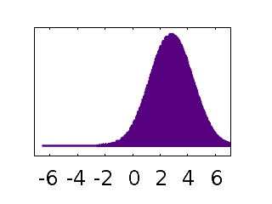


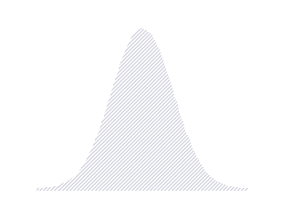




Important Distributions (Particle Filter)
Observation Model:
Motion Model:
$$p\left(z_{t} | x_{t}\right)$$
$$p\left(x_{t+1} | x_{t}\right)$$
Likelihood of observation given state
Continuous Gaussian around real depth
Probability of new state given old one
Continuous Gaussian
Posterior:
Prior:
$$p\left(x_{t} | z_{0:t}\right)$$
$$p\left(x_{t+1} | z_{0:t}\right)$$
Probability of state given previous and current observations
Continuous, represented as set of Samples (Particles)
Probability of state given only previous observations
Continuous, represented as set of Samples (Particles)

Slide 2
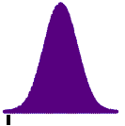

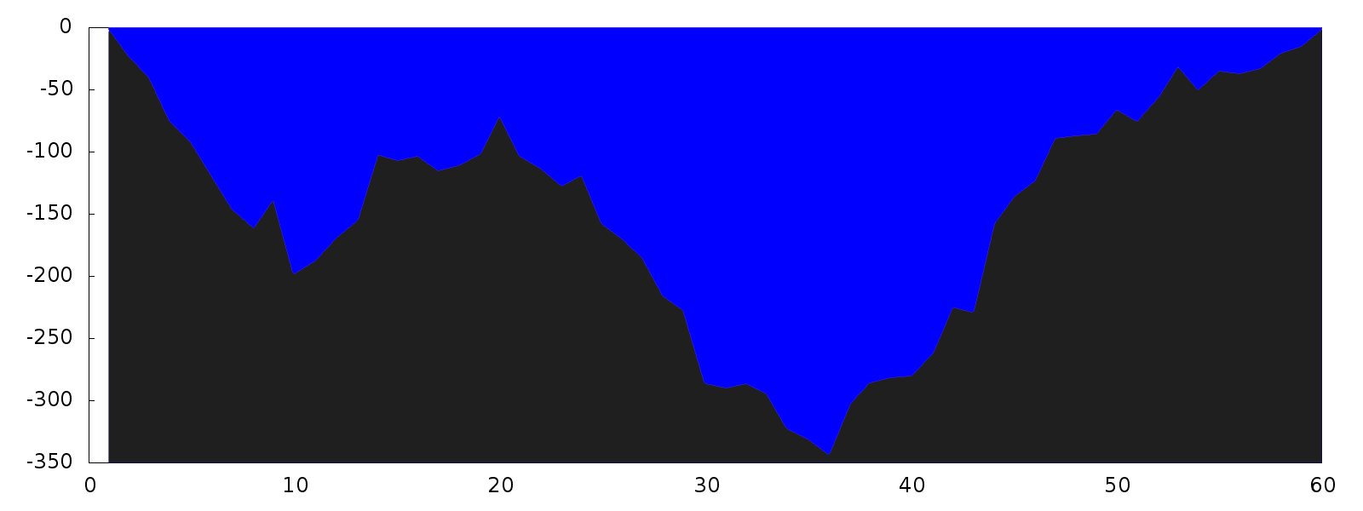
Particle Filter

Slide 3
Discrete Bayes Filter vs. Particle Filter
Discrete Bayes Filter:
Particle Filter:
1. Make observation
1. Make observation
2. Calculate likelihood for every position
2. Calculate likelihood for every sample -> weights
3. Multiply with last prior and normalize
3. Resampling according to weights
4. Convolution with motion model
4. Randomly move samples according to motion model (Sampling)
5. Go to 1.
5. Go to 1.

Slide 4
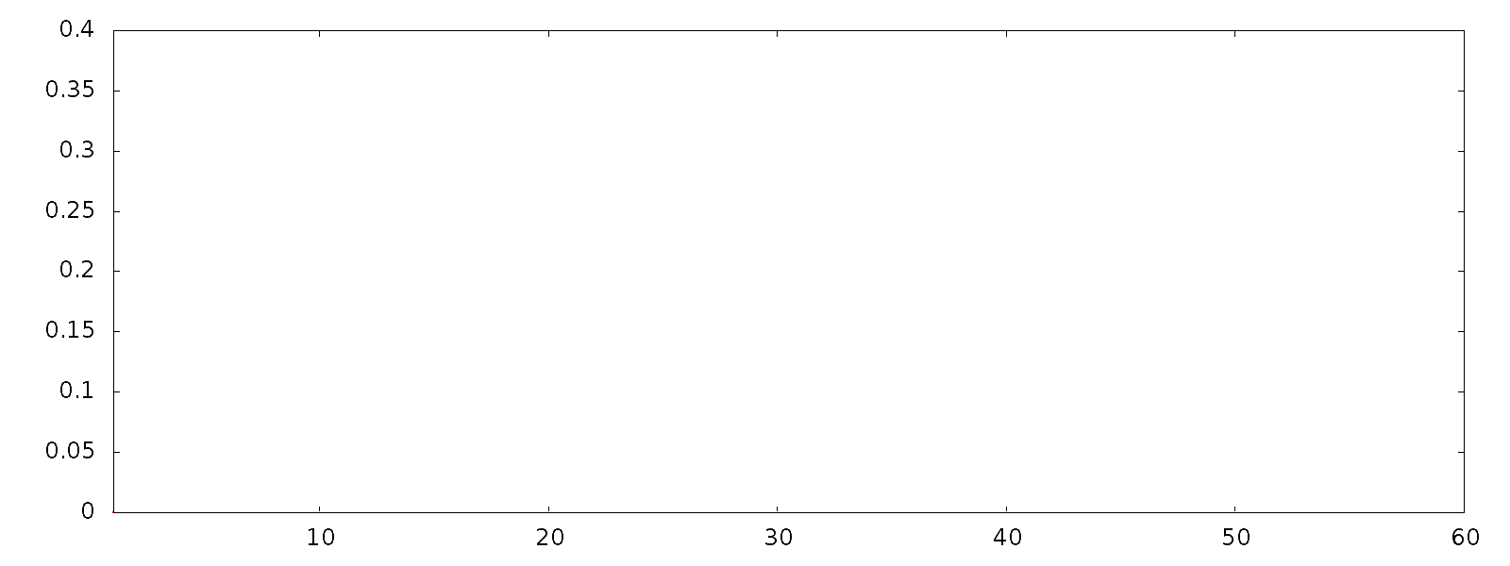
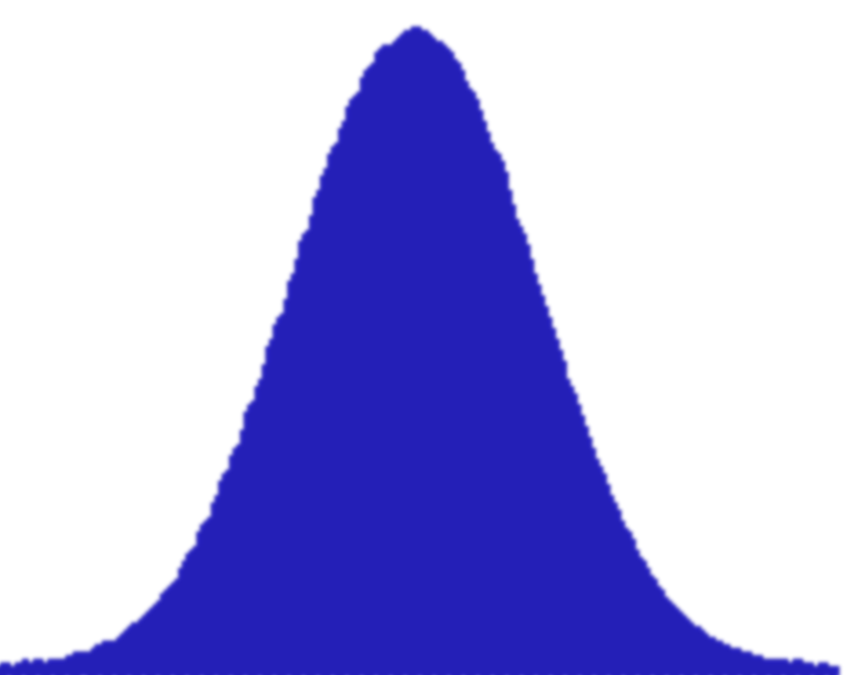


The Bayes Filter / Convolute and Multiply
$$t=0$$
Represent continuous prior with particles ${\tilde{x}}_{t}^{1} ,…,$ ${\tilde{x}}_{t}^{n}$
Make measurement: $z_{t}$

Slide 5

Particle Filter / Resampling
Calculate weight${ w}_{t}^{i}=p(z_{t}|{x_{t}=\tilde{x}}_{t}^{i})$ for every particle ${\tilde{x}}_{t}^{i}$:

Slide 6

Particle Filter / Resampling
$$t=0$$
Draw samples $x_{t}^{1} ,…,$ $x_{t}^{n}$ from posterior by resampling from ${\tilde{x}}_{t}^{1} ,…,$ ${\tilde{x}}_{t}^{n}$ using the weights ${ w}_{t}^{i}$
Reducing uncertainty

Slide 7
Particle Filter / Resampling
$$t=0$$
Draw samples $x_{t}^{1} ,…,$ $x_{t}^{n}$ from posterior by resampling from ${\tilde{x}}_{t}^{1} ,…,$ ${\tilde{x}}_{t}^{n}$ using the weights ${ w}_{t}^{i}$
Reducing uncertainty
random
random
random

Slide 8
Particle Filter / Resampling
$$t=0$$
Draw samples $x_{t}^{1} ,…,$ $x_{t}^{n}$ from posterior by resampling from ${\tilde{x}}_{t}^{1} ,…,$ ${\tilde{x}}_{t}^{n}$ using the weights ${ w}_{t}^{i}$
Reducing uncertainty

Slide 9
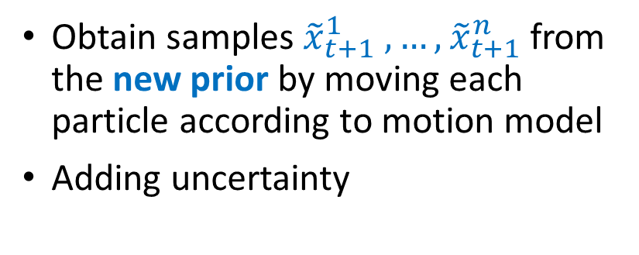
Particle Filter / Sampling
$$t=0$$
Obtain samples ${\tilde{x}}_{t+1}^{1} ,…,$ ${\tilde{x}}_{t+1}^{n}$ from the new prior by moving each particle according to motion model
Adding uncertainty
0

Slide 10
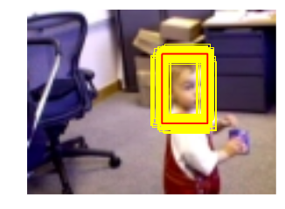
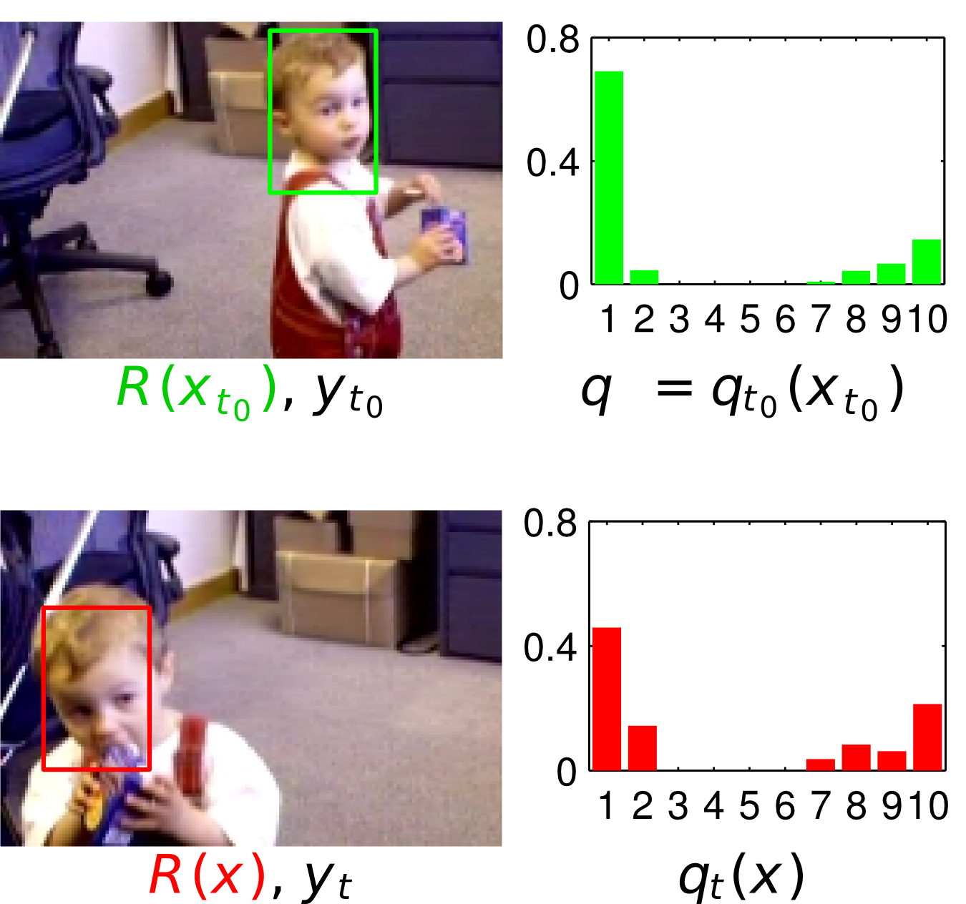
Particle Filter (Tracking application)
Tracking an object in a video sequence [Perez at al. 2002]
States:
2D windows (location and size)
Gaussian motion
Observations:
Color histograms

Slide 11
Your Task
Draw the particles and the mean particle into the image (0p)
You still have to do it get other points
Implement the MotionModel class and move particles in the processFramefunction:
Gaussian distribution around last position (1p)
Gaussian distribution around extrapolated position (1p)
(Based on previous motion of each particle)
Implement the ObservationModel class and calculate the weights and the mean particle (avg. x/y position and avg. window size) in the processFrame function. (1p)
Implement the resampleParticlesfunction. There are different ways to do this:
Either naïve way (1p)
Or smarter way: binary search or std::map (2p)
(extra task) parallelize your code with openMP. Can you increase FPS? You might have to use multiple random number engines for multiple threads. (up to 1p)

