Slide 1
RiskNarrative - QA Automation

Slide 2
RiskNarrative - QA Automation Framework
Written in pure Java and Selenium. No other dependencies.
Abstracts the above such that testers need no Java / Selenium knowledge to write
automation tests.
LN / RN now have automation coders that can automate RN UI without any previous Java
experience.
Pre-requisites :
- Basic knowledge of HTML Markup - assumed
- Knowledge of an IDE e.g. Intellij 2 days
- Training in NCore Framework 3 days
So, from precedent, the above can be achieved in around 5 days with dedicated training.

Slide 3
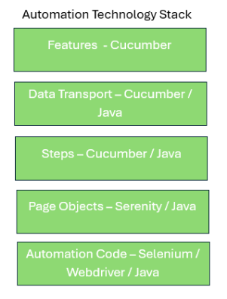
RiskNarrative - QA Automation

Slide 4
RiskNarrative - QA Automation
Standardisation

Slide 5
RiskNarrative - QA Automation
NCore

Slide 6
RiskNarrative - QA Automation
NCore
Provenance :
Developed in-house in 2024
Aim : To simplify and standardise Automation programming and make test coding accessible to non-technical test staff with minimal training.

Slide 7
RiskNarrative - QA Automation
);
Contract Based
Toolbox : Commands
                interface CommonPageInterface {
                void fullScreen();
                void scroll(By by);
                void scroll();
                void maximise();
                void position(int x, int y);
                void open();
                void go(String url);
                void go(Enums.Direction direction);
                void refresh();
                void close();
                void quit();
                void focus(Target target);
                void focus(int waitTime);
                void depart(Target target);
                void absent(Target target);

Slide 8
RiskNarrative - QA Automation
);
Contract-Based
Toolbox : Locators
                interface CommonPageInterface {
                void fullScreen();
                void scroll(By by);
                void scroll();
                void maximise();
                void position(int x, int y);
                void open();
                void go(String url);
                void go(Enums.Direction direction);
                void refresh();
                void close();
                void quit();
                void focus(By by, Enums.ExpectedCondition expectedCondition);
                void focus(By by);
                void focus(Target target);
                void focus(int waitTime);
                void depart(Target target);
                void absent(By by);

Slide 9
RiskNarrative - QA Automation
);
Contract-Based
Toolbox : Targets
                attribute(String attribute, String value)
                className(String className )
                classNames(String classNames )
                id(String value)
                name(String value)
                value(String value)
                text(String value)
                partialText(String value)
                tagWithText(common.Enums.Tag tag, String text)
                tag(common.Enums.Tag tag)
                linkText(String linkText)
                partialLinkText (String )
                xpartialLinkTextpath(String xpath)
                root()
                leaf()
                children()
                siblings()

Slide 10
RiskNarrative - QA Automation
);
Login Code :
Before NCore
                public <T extends Actor> void performAs(T actor) {
                BrowseTheWeb.as(theActorInTheSpotlight()).getDriver().navigate().refresh();
                theActorInTheSpotlight().attemptsTo(
                WaitUntil.the(USERNAME_FIELD, isCurrentlyVisible()).forNoMoreThan(15).seconds(),
                SendKeys.of(authenticated(actor).username()).into(USERNAME_FIELD),
                Click.on(NEXT_BUTTON),
                WaitUntil.the(PASSWORD_FIELD, isCurrentlyVisible()).forNoMoreThan(15).seconds(),
                SendKeys.of(authenticated(actor).password()).into(PASSWORD_FIELD),
                WaitUntil.the(LOGIN_BUTTON, isCurrentlyVisible()).forNoMoreThan(15).seconds(),
                Click.on(LOGIN_BUTTON)

Slide 11
RiskNarrative - QA Automation
);
Login Code :
With NCore
                focus(INPUT_USER).compose(userName);
                focus(INPUT_PASSWORD).compose(password);
                focus(BUTTON_LOGIN).click();

Slide 12
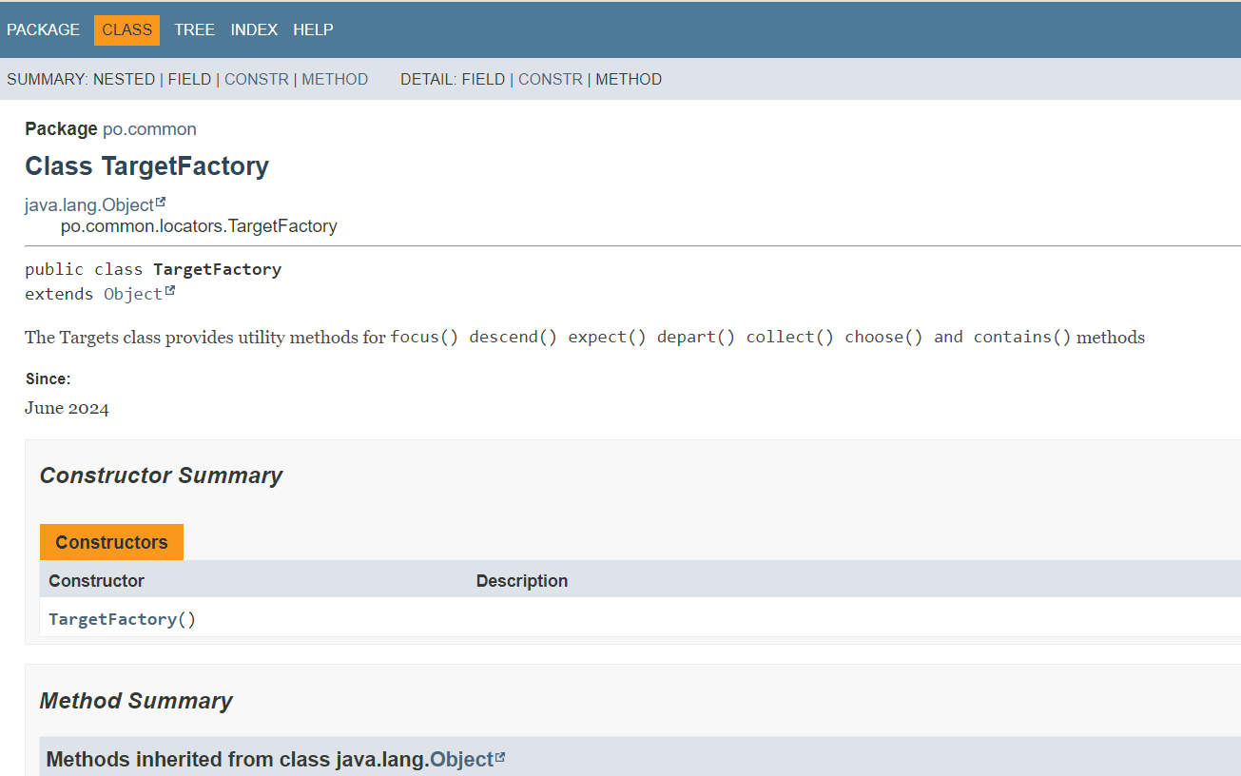
RiskNarrative - QA Automation
);
NCore Online Documentation

