Slide 1
RiskNarrative - QA Automation
Technical Session

Slide 2
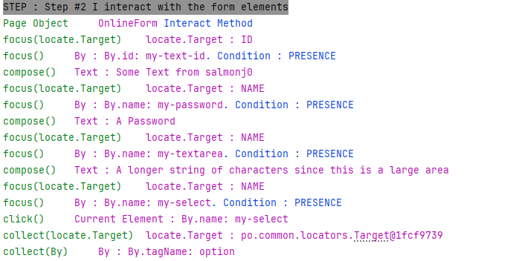
QA Automation
Technical Session
Running Tests Directly in Intellij
Running tests directly in Intellij means that the
console logs are visible

Slide 3
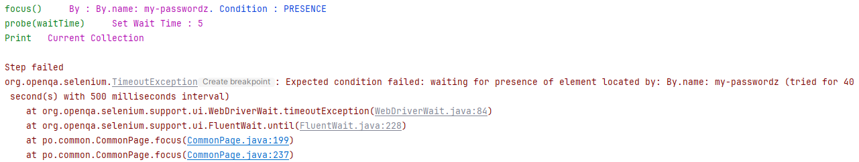
QA Automation
Technical Session
Running Tests Directly in Intellij
Running tests directly in Intellij means that errors are clearly identified

Slide 4
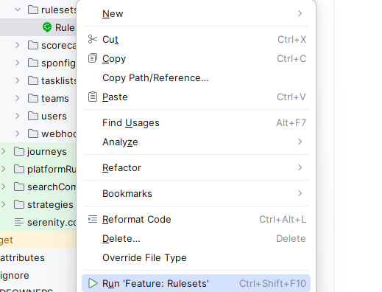
QA Automation
Technical Session
Running Features in Intellij
1 ) Run the Feature by right-clicking the feature name :

Slide 5

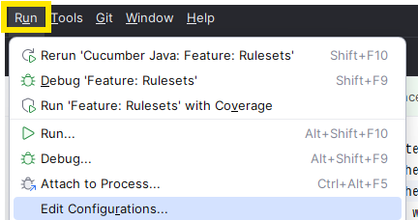
QA Automation
Technical Session
Running Features in Intellij
2 ) Stop the run after a few seconds.
Intellij will create a new run configuration which we can then edit.
3 ) Edit the newly-created configuration :

Slide 6
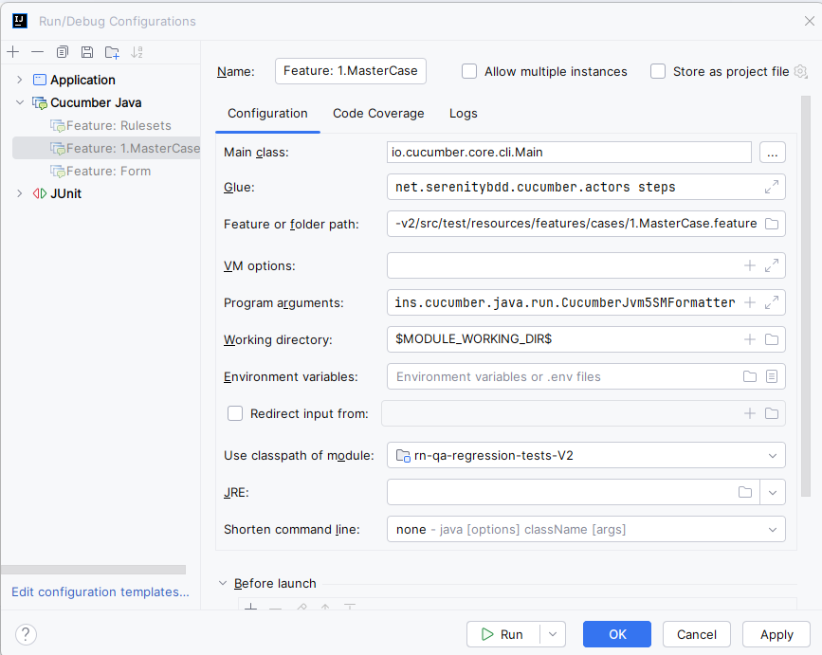
QA Automation
Technical Session
Running Features in Intellij
Update the
Feature Run
Configuration

Slide 7
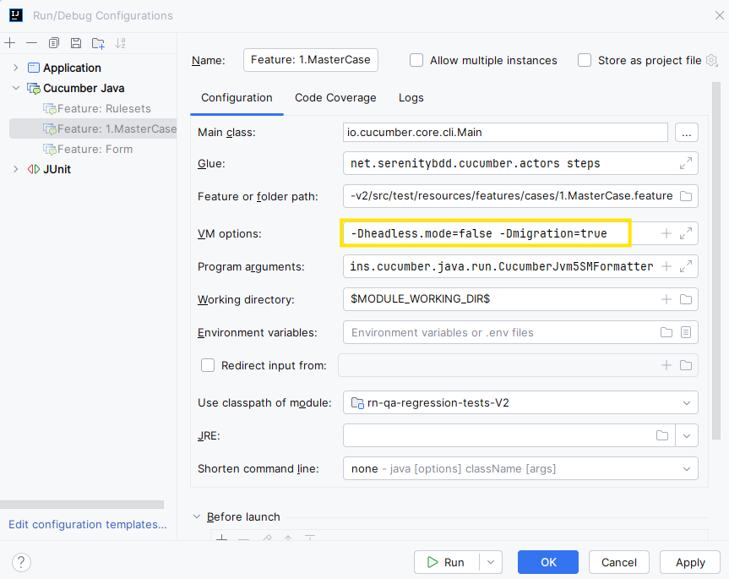
QA Automation
Technical Session
Running Features in Intellij
Update the
Feature Run
Configuration
-Dheadless.mode=false
-Dmigration=true

Slide 8
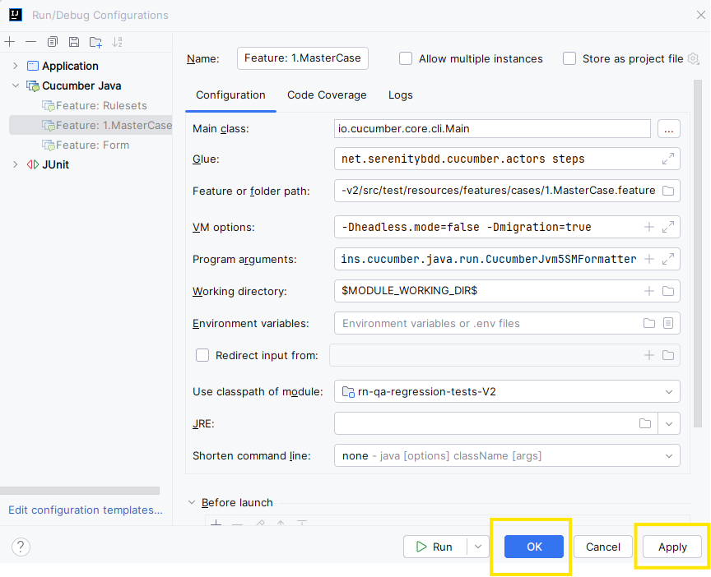
QA Automation
Technical Session
Running Features in Intellij
Update the
Feature Run
Configuration
Apply
OK

Slide 9


QA Automation
Technical Session
Debugging Features in Intellij
We have already created the Run Configuration in previous steps.
No further configuration is necessary for debug.
To debug simply select Debug instead of Run when right-clicking the feature name in the Project Inspector :
or

Slide 10
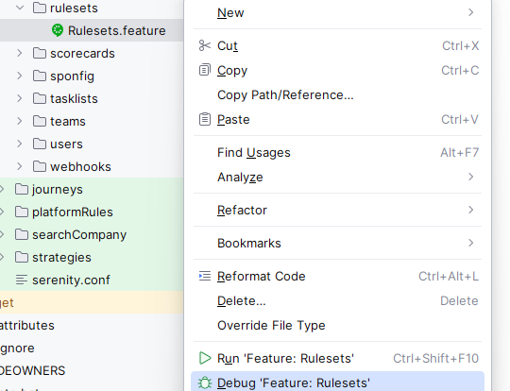
QA Automation
Technical Session
Debugging Features in Intellij

Slide 11
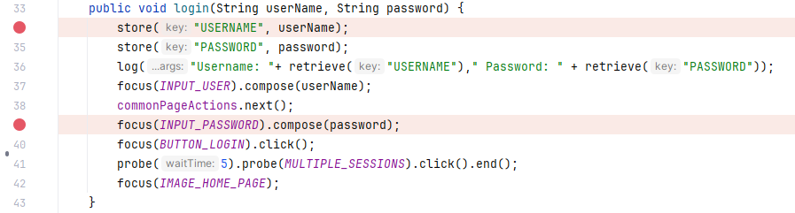
QA Automation
Technical Session
Debugging Features in Intellij
Add Break Points ( BPs ) to stop execution at the required line of code.
BPs can be set by clicking in the column to the left of the editor and on, or to the right of, the line numbers :

Slide 12
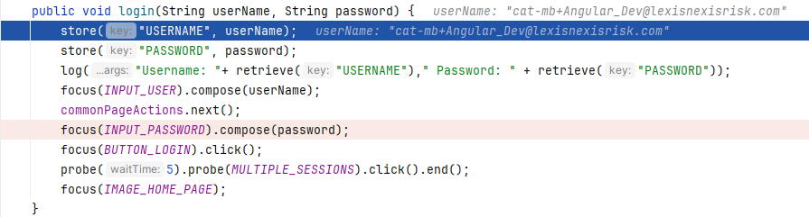
QA Automation
Technical Session
Debugging Features in Intellij
When running under debug, Intellij will stop at the configured line numbers. The current break point will be highlighted in blue.

Slide 13
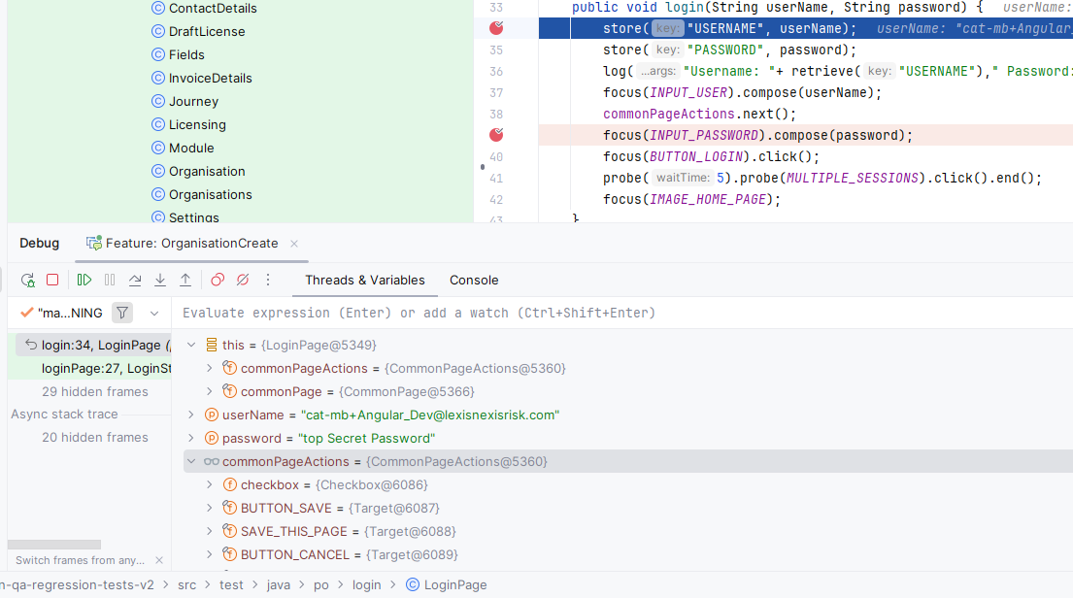
QA Automation
Technical Session
Debugging Features in Intellij
Variables
can
be
in the
debug
variable
inspector

Slide 14
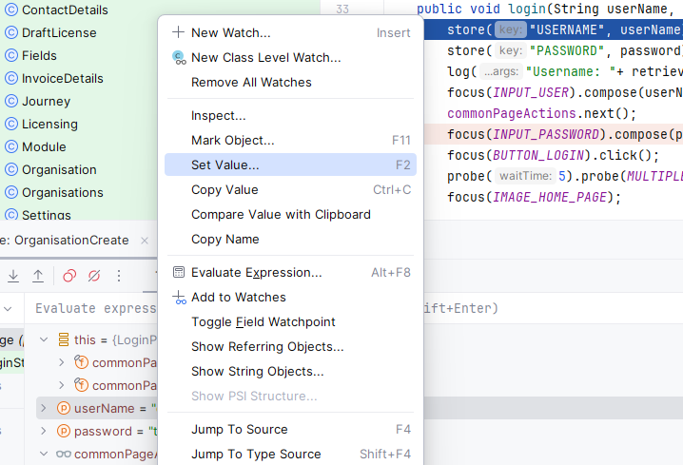
QA Automation
Technical Session
Debugging Features in Intellij
Variables
can
be
updated
by right-clicking
the variable in the
debug variable
inspector

Slide 15
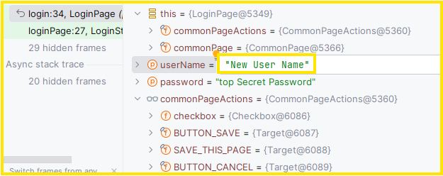
QA Automation
Technical Session
Debugging Features in Intellij
Variables
can
be
updated
after selection
in the debug
variable
inspector

Slide 16


QA Automation
Technical Session
Debugging Features in Intellij
Control of the debugger with the Debug Window Icons
Rerun
Stop

Slide 17



QA Automation
Technical Session
Debugging Features in Intellij
Control of the debugger with the Debug Window Icons
Resume
Resume - to end of the feature or to the next breakpoint :

Slide 18

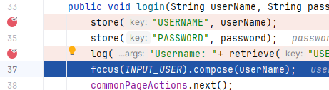
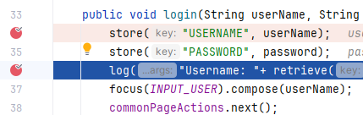
QA Automation
Technical Session
Debugging Features in Intellij
Control of the debugger with the Debug Window Icons
Step Over
Step to next line regardless of whether a breakpoint is present.

Slide 19

QA Automation
Technical Session
Debugging Features in Intellij
Control of the debugger with the Debug Window Icons
View breakpoints :

Slide 20
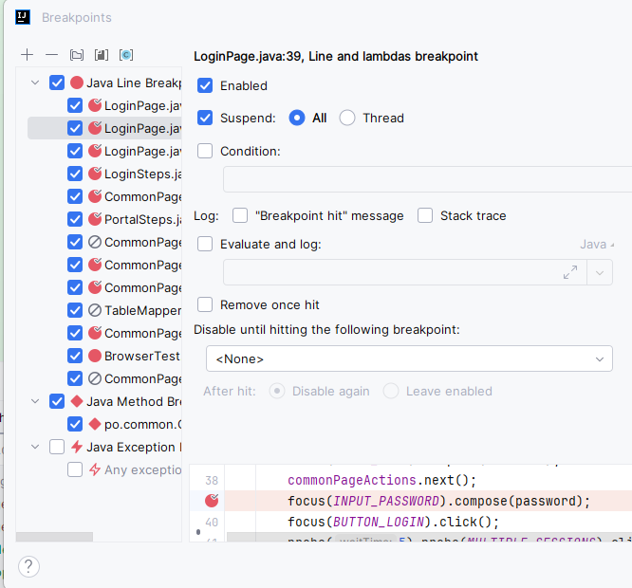
QA Automation
Technical Session
Debugging Features in Intellij
Control of the debugger with
the Debug Window Icon
View breakpoints :

Slide 21
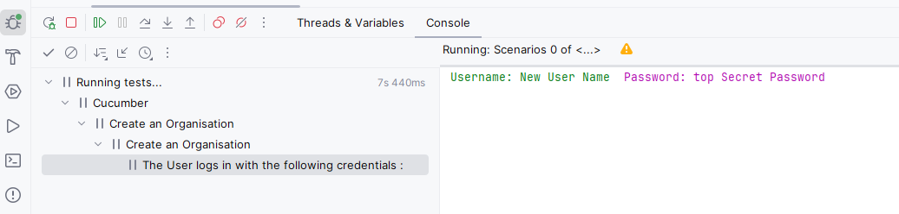
QA Automation
Technical Session
Debugging Features in Intellij
Switch to Console View :

Slide 22
QA Automation
Technical Session
Data Transport Objects
Generic definition
Objects that pass data between subsystems
Automation Specific
Pass data from Cucumber feature files
to
Java Step Files

Slide 23
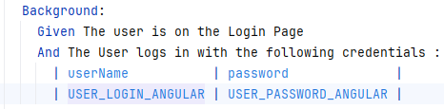
QA Automation
Technical Session
Data Transport Objects
Simple Case : Login Feature
We wish to pass the username and password from the feature file down into the Cucumber Steps Subsystem.
Why ? Because all test parameters should be defined in the feature file and not hard-coded into Java Steps or Page Objects

Slide 24
QA Automation
Technical Session
Data Transport Objects
Simple Case : Login Feature
Table
1 ) Create feature file with tables containing the data to be processed. The table has a header column with camel-case names ( userName & password ) and a data column with values ( USER_LOGIN_ANGULAR & USER_PASSWORD_ANGULAR )

Slide 25
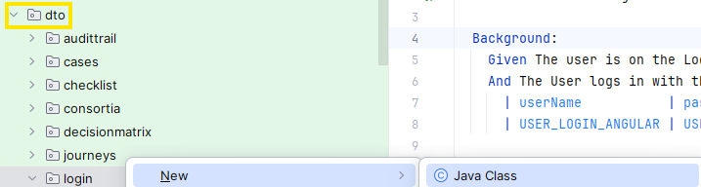
QA Automation
Technical Session
Data Transport Objects
Simple Case : Login Feature
Table
2 ) Create Java file in the dto package that corresponds to the module. In this case dto.login:

Slide 26
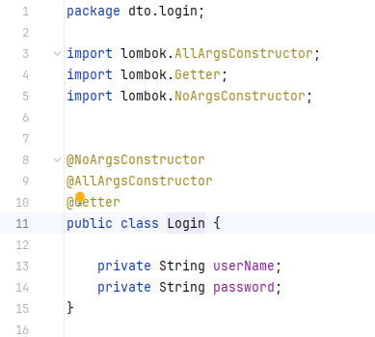
QA Automation
Technical Session
Data Transport Objects
Simple Case : Login Feature
The new DTO will contain the same names as the header table fields in the feature file. The annotations are from the Lombok plugin and will be discussed later. For now just add them verbatim :

Slide 27

QA Automation
Technical Session
Data Transport Objects
Simple Case : Login Feature
3 ) Add a table mapper. The naming conventionis that these files are always named TableMapper. This will be added in the same package as the previously-created DTO. In this case dto.login
The resulting Java files will look like this :

Slide 28
QA Automation
Technical Session
Data Transport Objects
Simple Case : Login Feature
The table mapper will contain a single public method. It will have the naming convention decode followed by the DTO name. In this case : decodeLogin -> decodeLogin
The decodeLogin arguments can be copied verbatim.
public Login decodeLogin(Map<String, String> row)
The method will return an instance of the DTO and have constructor argument that match both the data table header names from the feature file and the DTO itself.

Slide 29
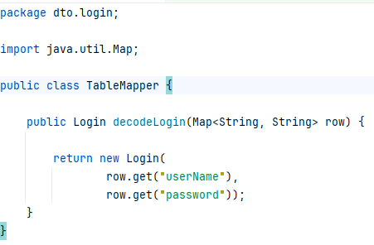
QA Automation
Technical Session
Data Transport Objects
Simple Case : Login Feature
The method will return an instance of the DTO and have constructor arguments that match both the data table header names from the feature file and the fields from the DTO itself.

Slide 30
QA Automation
Technical Session
Data Transport Objects
Simple Case : Login Feature
The new DTO will contain the same names as the header table fields in the feature file. The annotations are from the Lombok plugin and will be discussed later. For now, just add them verbatim :

Slide 31
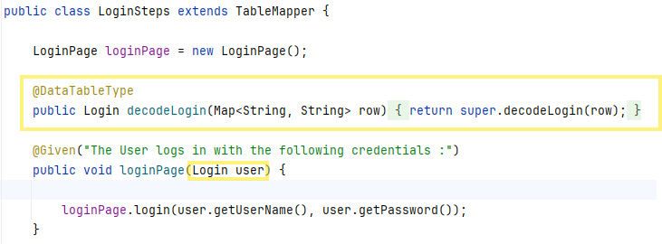
QA Automation
Technical Session
Data Transport Objects
Simple Case : Login Feature
Add the Table Mapper to the Steps file :

Slide 32
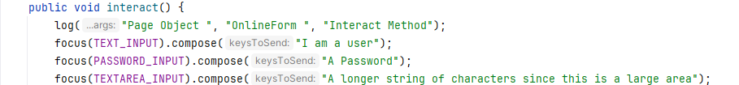
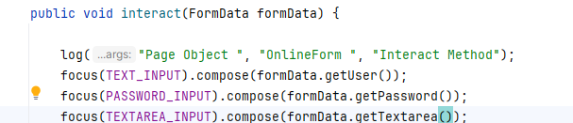
QA Automation
Technical Session
Data Transport Objects
EXAMPLE
Replace harded coded values :
With data from a feature file :

Slide 33
QA Automation
Technical Session
Data Transport Objects
EXAMPLE
FEATURE
Scenario: Locate and interact with form elements
Given I navigate to the online form
And I interact with the form elements
| user | password | textarea |
| The User | A Password | Some random text |
Then I am progressing with Automation

Slide 34
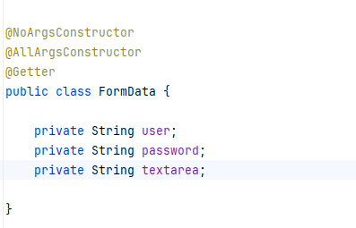
QA Automation
Technical Session
Data Transport Objects
EXAMPLE
DTO

Slide 35
QA Automation
Technical Session
Data Transport Objects
EXAMPLE
TABLE MAPER
public class TableMapper {
public FormData decodeFormData(Map<String, String> row) {
return new FormData(
row.get("user"),
row.get("password"),
row.get("textarea"));
}
}

Slide 36
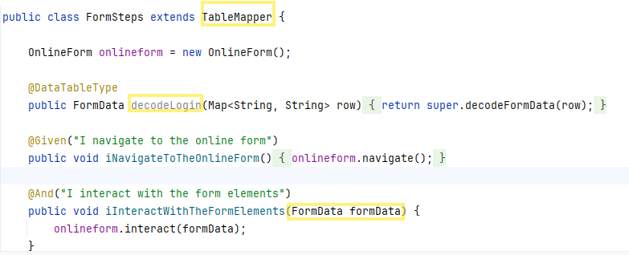
QA Automation
Technical Session
Data Transport Objects
EXAMPLE
STEP

Slide 37
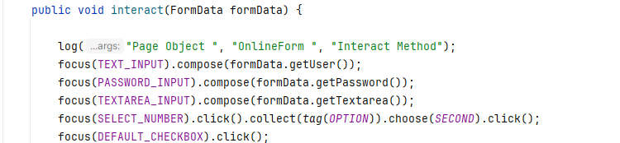
QA Automation
Technical Session
Data Transport Objects
EXAMPLE
Page Object

Slide 38
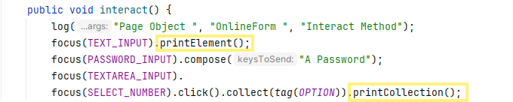

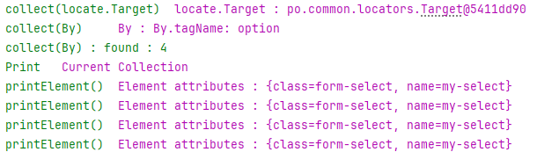
QA Automation
Technical Session
Debug Tip
If a focused element, individually or as part of a collection, is not responding to clicks / input or does not, for example, contain the expected text, use the printElement() and printCollection() toolbox methods to print the element to the console

