Slide 1
RiskNarrative - QA Automation Framework
Playwright

Slide 2
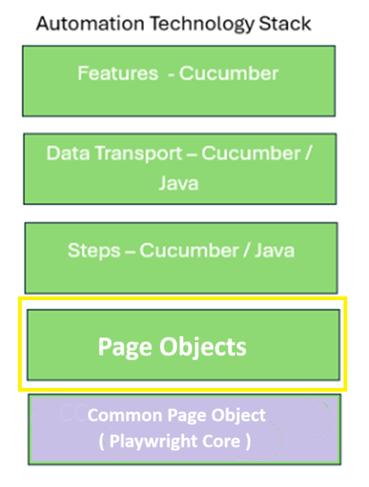

Slide 3
Page Objects
Have minimum 1 to 1 relationship to HTML Page
Can have many to 1 relationship if the HTML Page is complex
All Page Objects extend CommonPageObject
public OrganisationPage extends CommonPageObject {
…
}

Slide 4
Page Objects
public OrganisationPage extends CommonPageObject {
}
public void login() {
…
public void createOrganisation() {
…
}
public void updateAddress() {
…
}
}

Slide 5
Page Objects
public OrganisationPage extends CommonPageObject {
private final Target USER_NAME = id(“user-name);
private final Target PASSWORD = className(“password”);
private final Target LOGIN_BUTTON = tagWithText(BUTTON, “Click to Log In”);
private final String USERNAME = “user”;
private final String PASS = “password”;
public void login() {
focus(USER_NAME).compose(USERNAME);
focus(PASSWORD).compose(PASS);
focus(LOGIN_BUTTON ).click();
}

Slide 6
Step Definitions
Declare instances of Page Objects
Employ services of Page Objects
Do not extend CommonPageObject
public OrganisationSteps {
OrganisationPage organisationPage = new OrganisationPage();
AddressPage addressPage = new AddressPage();
EmployeePage employeePage = new EmployeePage();
public void create() {
organisationPage.login();
organisationPage.createOrganisation();
addressPage.updateAddress();
employePage.upateMobileNumber();
}
}

Slide 7
Playwright Core Methods
Locating elements on the page
focus( Target )
The focus method locates a single element on a page.
collect( Target )
The collect method locates multiple elements on a page.
What are Targets and where do they come from ?

Slide 8

Playwright Core
Locating a elements on the page
The Target Factory
These are ...
Produces Targets with different finders

Slide 9
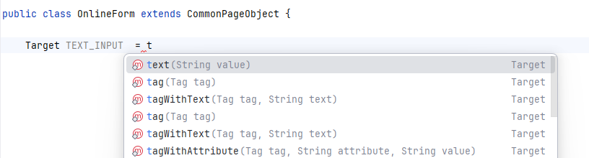
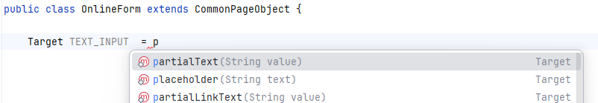
Playwright Core
Locating a elements on the page
Some Target Factory Targets
attribute className classNames data_ci_id
id linkText name partialLinkText
partialText placeholder root tag
tagWithText tagWithAttribute text value
xpath
Q : How do I access the Target Factory and Targets ?
A : When your Page Object extends the CommonPageObject these will become available – just start typing ! Intellij will assist with a drop down. e.g.

Slide 10
Playwright Core
Target Factory - Target Creation
attribute(String attribute, String value)
className(String className )
classNames(String classNames )
data_ci_id(String id ) // Angular
id(String value)
linkText(String linkText)
name(String value)
partialLinkText(String partialLinkText)
partialText(String value)
placeholder(String text)
root()
tag(HTML.Tag tag) // Standard HTML Tags
tag(Angular.Tag tag) // Angular Tags
tagWithAttribute(HTML.Tag tag, String attribute, String value)
tagWithText(HTML.Tag tag, String text) // Standard HTML Tags
tagWithText(Angular.Tag tag, String text) // Angular Tags
text(String value)
value(String value)
xpath(String xpath)

Slide 11
Playwright Core
Target Factory Examples
public LoginPage extends CommonPageObject {
private final Target STATUS_ATTRIBUTE = attribute(“status”, “active”);
private final Target PASSWORD = className(“password”);
private final Target PASSWORD = classNames(“class1 class 2”);
private final Target USER_NAME = data_ci_id(“user-name”);
private final Target USER_NAME = id(“user-name”);
private final Target CLICK_HERE = linkText(“click here ...”);
private final Target USER_TYPE = name(“radio-button1”);
private final Target CLICK_H = partialLinkText (“click h”);
private final Target ADDRESS_LABEL= partialText (”Home Addre”);
private final Target TYPE_HERE = placeholder (”Type name here”);
private final Target DOC_ROOT= root (); // Same can be accomplished with origin() command
private final Target PAGE_TITLE = tag(H1); // HTML
private final Target ANGULAR_CARD = tag(TN_CARD); // Angular
private final Target TITLE_MATCH tagWithAttribute(DIV, “title”, “Matched”);
private final Target NAME_LABEL = tagWithText (SPAN, “First Name); // HTML
private final Target TEAM_SELECTION = tagWithText(MAT_OPTION, “Team 1” ); // Angular
private final Target NAME_TEXT = text (”Home Address”);
private final Target YES_OPTION = value (“Yes”);
private final Target LAST_RESORT = xpath (“Use xpath only if there is no other way”);

Slide 12

Playwright Core
ToolBox

Slide 13
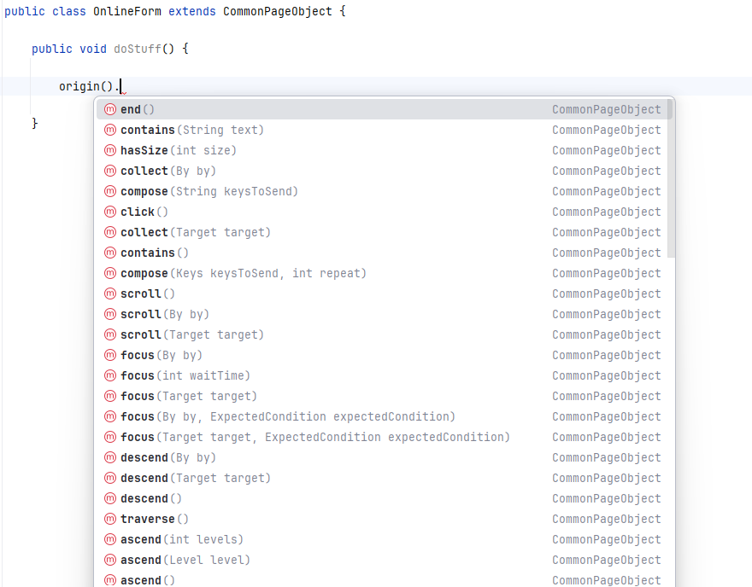
Playwright Core
ToolBox
NCore has a Toolbox of around 50 utility methods.
These will be imported when the Page Object extends CommonPageObject. To see the list of methods, simply type in a command e.g. origin() followed by a full stop. The toolbox utilities are identified by the CommPageObject label on the right-hand side.
OnlineForm

Slide 14
Playwright Core
Toolbox : Element locators
Note : with only a few exceptions, NCore Toolbox methods are chainable.
focus(Target) Locate Element by Target
focus(INPUT_NAME);
The located element becomes the Current Element ( CE )
focus() searches from the document root i.e. <HTML>
focus(TIMEOUT) Update default wait time for an element to appear.
focus(20).focus(THIS_ELEMENT_TAKES_AGES_TO_LOAD);
focus() Reset default wait time and set CE to document root ( see also reset() )
probe(Target) Conditionally Locate Element by Target
probe(ACCEPT_COOKIES_BUTTON).click().end();
The probed element, if present, becomes the CE
No need to follow probe() with focus()
If present, all methods will be executed until end() is encountered.
If not present the probe() will return and the code after end() will be executed.
The code after end() will be executed in both cases.
leave(Target) Locate Departing Element by Target
leave(DEPARTING_ELEMENT).click().end();
The departing element becomes the CE
When departed, all methods will be executed until end() is encountered.
If not present leave() will throw an exception

Slide 15
Playwright Core
Toolbox : Element locators
Note : with only a few exceptions all Toolbox methods are chainable.
ascend() Ascend to the parent of the CE
ascend()
ascend(Level) Ascend to the specified ancestor of the CE
ascend(1) Parent
ascend(2) Grand Parent
ascend(3) Great Grand Parent
descend() Descend to the child of the CE.
descend()
The located element becomes the current element ( CE )
descend(Target) Descend to the child element of the CE specified by the Target. This becomes the CE.
focus(RADIO_BUTTON_GROUP).descend(YES_I_WANT_A_PAY_RISE_OPTION).click();

Slide 16
Playwright Core
Toolbox : Element locators
traverse() CE becomes the next sibling of the CE
traverse()
reverse() CE becomes the previous sibling of the CE
reverse()
origin() Set CE to the root of the DOM - <HTML>
origin()
depart(Target) Wait for an element to depart from the DOM
depart(SPINNER);
Current CE unaffected - he CE is as it was before depart()
depart() will throw an exception if the element is still present after the default wait time.
absent(Target) Check for absence of an element
absent(HEY_YOU_SHOULD_NOT_BE_HERE)
Check is immediate – will not wait like depart()
Current CE unaffected - he CE is as it was before absent()
end() Terminate the probe() and leave() conditionals

Slide 17
Playwright Core
Toolbox : Multiple Elements
collect(Target) Create a list of Elements by Target :
focus(RESULTS_TABLE).collect(TR)
focus(MAT_CARD_TITLE).collect(TN_CARD) // Angular example
Compiles a list starting from and descending from the CE i.e. the children of the CE.
If you want to collect from the document root use origin()
origin().collect(INPUT_ELEMENTS);
The CE is not affected by collect()
choose(Integer) Select an element from the list created by collect()
collect(OPTIONS).choose(0).click()
Java list indexing – first has index 0
choose(Index) Select an element from the list created by collect()
collect(COUNTRIES)
.choose(FIRST).contains(“Amer”).choose(THIRD).matches(FRANCE);
Currently defined indexes FIRST to TENTH

Slide 18
Playwright Core
Toolbox : Multiple Elements - choose
choose(LIST_INDEX) Select an element from the list created by collect()
collect(SOME_MAY_BE_CLICKABLE)
.choose(FIRST).clickable().choose(LAST).enabled()
.choose(PREVIOUS). clickable().
choose(TEXT) Select an element from the list created by collect()
collect(COUNTRIES).choose(INDIA).click();
choose(TEXT) Select an element from the list created by collect()
collect(COUNTRIES).choose(INDIA).click();
choose(PARTIAL_TEXT) Select an element from the list created by collect()
collect(COUNTRIES).choose(“Englan”).click();
choose(VALUE) Select an element from the list created by collect()
collect(COUNTRIES).choose(GIB).click();
Used mainly for SelecT dropdowns

Slide 19
Playwright Core
Toolbox : Element Interaction
All methods operate on Current Element selected by focus(), choose() ...
click() Click the element.
clear() Click the element – input, textareas ...
compose(String) Type in visible characters
compose(“My Name”);
compose(Key) Type in special character ( LF, TAB, ESCAPE, F2 )
compose(Key, Repeat) Type in special character and repeat e.g. compose( DEL, 5 )
dragDrop(Target1,Target2) Drag Target1 to Target2
dragDrop(LEAVES,WHEELY_BIN)
hover() Hover over the CE
focus(HELICOPTER).hover()
scroll() Scroll to CE element if out of viewport

Slide 20
Playwright Core
Toolbox : Element checks
All methods operate on Current Element selected by focus(), choose() ...
contains(TEXT) Does the element contain the TEXT
focus(AMERICA).contains(“eric”);
matches(TEXT) Does the element match the TEXT
focus(AMERICA).contains(“America”);
clickable() Is the CE clickable
enabled() Is the CE enabled
disabled() Is the CE disabled
titleIs(TITLE) Does the current page have the TITLE
urlIs(URL) Does the current page have the URL

Slide 21
Playwright Core
Toolbox : Other Methods
store(key, value ) Session Storage
retrieve(key ) Session Storage Retrieval
frame(Target) Select frame by Target
frame(Index) Select frame by Index
unframe() Return to default DOM
hasSize(Integer) Check size of element list following a collect() has size Integer
size() Return the size of element list following a collect()
open() Open browser – default Chrome
open(Browser) Open browser – Browser
go(URL) Go to URL
go(Direction) Go Direction - BACK, FORWARD, REFRESH
close() Close current window.
quit() Close all windows and browser

