Slide 1

Playwright And Risk Narrative
To Be Or Not To Be

Slide 2

Playwright And Risk Narrative
If It Works, Why Should’st Thou Fix It ?
The Lexis Nexis Core Software is written in Java with Selenium
The V2 / Core project has been a resounding success.
So why consider moving to Playwright ?

Slide 3
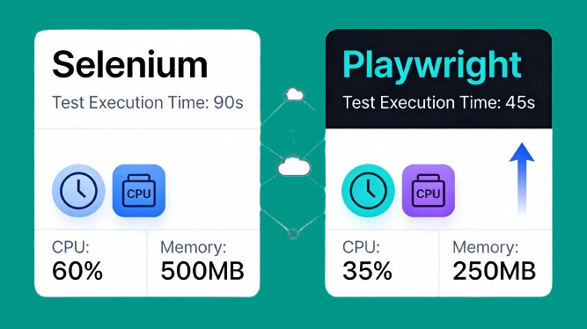
Playwright And Risk Narrative
Haste Ye Now, To Destiny
Speed
Test execution time compounds dramatically across a CI/CD pipeline.
Playwright executes tests 2–3x faster than Selenium, with a single task averaging 290 milliseconds versus Selenium’s 536 milliseconds.

Slide 4

Playwright And Risk Narrative
Tread Thee Carefully, This Rock-Strewn Path
Efficiency
Playwright handles element detection automation without recourse to explicit timers. This means easier to code and more robust Automation.
Currently the largest code blocks of the Core are concerned with timers.
The Core Base code could be reduced by about 40%
Playwright eliminates timing issues with intelligent auto-wait logic. Before executing any action, Playwright
verifies the element is attached to the DOM.
Playwright ensures that elements are visible, stable, receiving pointer events, and enabled. This built-in safety reduces flaky test failures by 60%, according to 2026 benchmarks.

Slide 5
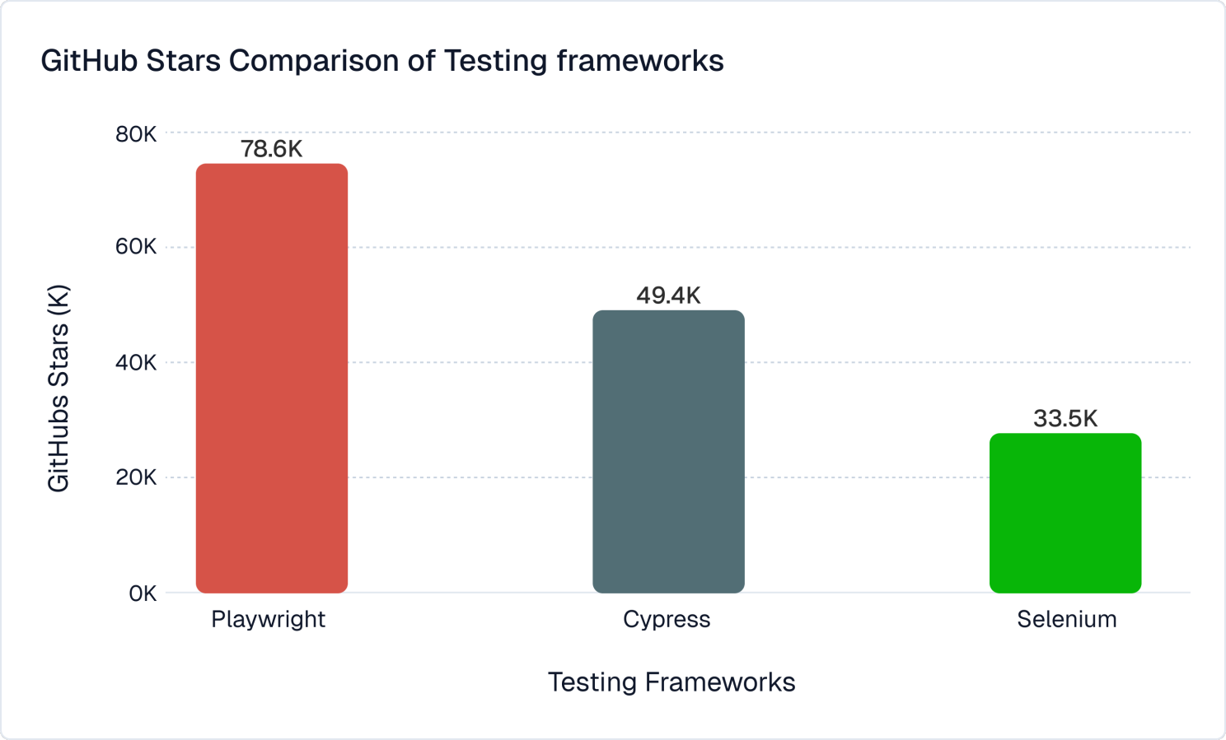
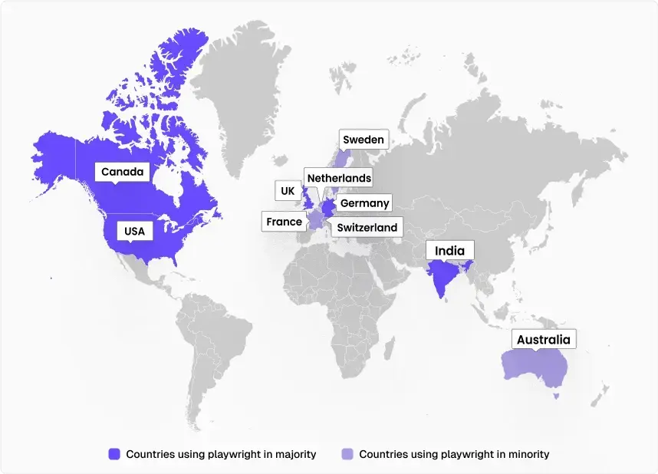
Playwright And Risk Narrative
Hasten Thee To Market, And Behold
Growing Usage
Playwright Is Now the #2 ( 37% v. Selenium 55% ) UI Test Platform and its market share is growing

Slide 6
Playwright And Risk Narrative
Swim Thee Not Against The Tide
Lexis Nexis Corporate Propensity
The company is moving towards Playwright, as evidenced by the Playwright Demos in 2025.
Invitations were extended to all 500+ members of to Team : QA Hub.
Another meeting for Team : QA Hub scheduled for 23 rd March :
“Playwright in the Real World: Pipelines, Secrets, Stability, and Scale”
From the evidence seen, LNRN would be the first in LN to incorporate Playwright into an integrated test framework.

Slide 7

Playwright And Risk Narrative
V2, How Is Thy Earthly Form
Features
V2 Utilities
Steps
Extends
Page Objects
Common Page Object
Implements
Common Page ( Selenium )
Core Interface Declaration

Slide 8
Playwright And Risk Narrative
V2, How Art Thou To Be
Features
V2 Utilities
Steps
Extends
Page Objects
Common Page Object
Implements
Common Page ( Playwright )
Core Interface Declaration

Slide 9
Playwright And Risk Narrative
V2, Shall I Compare Thee
No V2 Changes
Features
V2 Utilities
DTO
Steps
Angular Locators
Page Objects
Common Page Object

Slide 10
Playwright And Risk Narrative
Core, Shall I Compare Thee
Target Factory
( Playwright )
Core Utilities
Core JUnit
Common Page ( Playwright )
Core Interface Declaration

Slide 11
Playwright And Risk Narrative
Once More Unto The Breach
Implementation Strategy : Feasibility
1 ) Implement Playwright Version subset of the following Core methods :
open()
go()
focus()
click()
compose()
collect()
choose()
cognate()
get(TEXT)
2) Write a feature to login to the RN Platform, navigate the menus, display a
page and perform validation

Slide 12

Playwright And Risk Narrative
All the world’s a stage,
And all the men and women merely players;
They have their exits and their entrances;
And one man in his time plays many parts.
DEMO

Slide 13
Playwright And Risk Narrative
Once More Unto The Breach
Implementation Strategy : Strategy
Core Playwright implementation in a separate repository
V2 Automation proceeds normally throughout. Not impacted by Playwright prototype
HTTP Services to be reviewed, standardised, and moved to a separate repository
Core Playwright & Selenium will not co-exist
When complete, Core Playwright will simply be slotted in via maven :
<dependency>
<groupId>com.risknarrative.qa. automation.playwright</groupId>
<artifactId>qa-core</artifactId>
<version>1.0</version>
</dependency>

Slide 14
Playwright And Risk Narrative
Once More Unto The Breach
Implementation Strategy : Projection
Around 2 months with existing Hamilton commitments.
1 day a week solely for Playwright
Team members who wish to be involved will be given tasks, as with the Selenium Core
Kick off date : 2nd March. Use interim period to :
- Create Playwright Epic and create tasks for main components
- Specify Milestones and dates
Aim to give demo to full QA Hub membership ( 500+ ) in May.

Slide 15

Playwright And Risk Narrative
All’s well that ends well.
Questions ?

