Slide 1

Advanced Analytical Theory and Methods: Clustering
Author : FU
Date : Mar-2022

Slide 2
Objectives
After studying this chapter, the student should be able to understand the key concepts:
Centroid
Clustering
K-means
Unsupervised
Within Sum of Squares

Slide 3
Content
Overview of Clustering
K-means
Additional Algorithms

Slide 4
1 Overview of Clustering (1)
The use of unsupervised techniques for grouping similar objects
Unsupervised in the sense that the data scientist does not determine in advance the labels to apply to the clusters
Structure of data describes the objects of interest and determines how best to group objects.
For example, based on customers’ personal income, it is straightforward to divide the customers into three groups depending on arbitrarily selected values. The customers could be divided into three groups as follows:
Earn less than $10,000
Earn between $10,000 and $99,999
Earn $100,000 or more
In this case, the income levels were chosen somewhat subjectively based on easy-to-communicate points of delineation. However, such groupings do not indicate a natural affinity of the customers within each group

Slide 5
1 Overview of Clustering (2)
In other words, no inherent reason to believe that the customer making $90,000 will behave any differently than customer making $110,000.
As additional dimensions are introduced by adding more variables about the customers, the task of finding meaningful groupings becomes more complex.
For instance, suppose variables such as age, years of education, household size, and annual purchase expenditures were considered along with the personal income variable.
What are the natural occurring groupings of customers? This is the type of question that clustering analysis can help answer.
Clustering often used for exploratory analysis of the data. Clustering techniques are utilized in marketing, economics, and various branches of science. A popular clustering method is k-means.

Slide 6
4.2 K-means (1)
k-means is a technique that, for a chosen value of k, identifies k clusters of objects based on the objects’ proximity to the center of the k groups
Center is determined as “mean” of each cluster’s n-dimensional vector of attributes

Slide 7
4.2 K-means (2)
Figure 4-1 illustrates three clusters of objects with two attributes.
Each object n the dataset is represented by a small dot color-coded to the closest large dot, the mean of the cluster.
FIGURE 4-1 Possible k-means clusters for k=3

Slide 8
2.1 Use Cases - Image Processing
Clustering is primarily an exploratory technique to discover hidden structures of the data, prelude to more focused analysis or decision processes
Applications of k-means are image processing, medical, and customer segmentation
Video is one example of the growing volumes of unstructured data being collected. Within each frame of a video, k-means analysis can be used to identify objects in the video
Each frame, the task is to determine which pixels are most similar to each other. Attributes of each pixel can include brightness, color, and location, the x and y coordinates in the frame

Slide 9
2.1 Use Cases - Medical
Patient attributes such as age, height, weight, systolic and diastolic blood pressures, cholesterol level, and other attributes can identify naturally occurring clusters
These clusters could be used to target individuals for specific preventive measures or clinical trial participation.
Clustering is useful in biology for the classification of plants and animals as well as in the field of human genetics.

Slide 10
2.1 Use Cases - Customer Segmentation
Marketing and sales groups use k-means to better identify customers who have similar behaviors and spending patterns
For example, a wireless provider may look at the following customer attributes: monthly bill, number of text messages, data volume consumed, minutes used during various daily periods, and years as a customer.
Wireless company could then look at the naturally occurring clusters and consider tactics to increase sales or reduce the customer churn rate, the proportion of customers who end their relationship with a particular company.

Slide 11
2.2 Overview of the Method (1)
Find k clusters from a collection of M objects with n attributes, examine two dimensional case (n = 2). It is much easier to visualize the k-means method in two dimensions.
In this example, each object has two attributes, consider each object corresponding to the point (x_{i} , y_{i} ) , where x and y denote two attributes and i = 1, 2 … M.
For a given cluster of m points (m ≤M), the point that corresponds to the cluster’s mean is called a centroid.
In mathematics, a centroid refers to a point that corresponds to the center of mass for an object.

Slide 12
2.2 Overview of the Method (2)
Step 1. Choose the value of k and the k initial guesses for the centroids.
In this example, k = 3, and the initial centroids are indicated by the points shaded in red, green, and blue in Figure 4-2.
FIGURE 4-2 Initial starting points for the centroids

Slide 13

2.2 Overview of the Method (3)
Step 2. Compute the distance from each data point (x_{i} , y_{i} ) to each centroid. Assign each point to the closest centroid. This association defines the first k clusters.
In two dimensions, the distance, d, between any two points, (x₁ , y₁ ) and (x₂ , y₂ ), in the Cartesian plane is typically expressed by using the Euclidean distance measure provided in Equation 4-1.
FIGURE 4-3 Points are assigned to the closest centroid

Slide 14
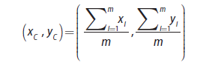
2.2 Overview of the Method (4)
Step 3. Compute the centroid, the center of mass, of each newly defined cluster from Step 2.
In Figure 4-4, the computed centroids in Step 3 are the lightly shaded points of the corresponding color. In two dimensions, the centroid (x_{c} y_{c}) of the m points in a k-means cluster is calculated as follows in Equation
(x_{c} y_{c}) is the ordered pair of the arithmetic means of the coordinates of the m points in the cluster. In this step, a centroid is computed for each of the k clusters.

Slide 15
2.2 Overview of the Method (5)
Step 4: Repeat Steps 2 and 3 until the algorithm converges to an answer
a. Assign each point to the closest centroid computed in Step 3.
b. Compute the centroid of newly defined clusters.
c. Repeat until the algorithm reaches the final answer.
Convergence is reached when the computed centroids do not change or the centroids and the assigned points oscillate back and forth from one iteration to the next. The latter case can occur when there are one or more points that are equal distances from the computed centroid.
FIGURE 4-4 Compute the mean of each cluster

Slide 16
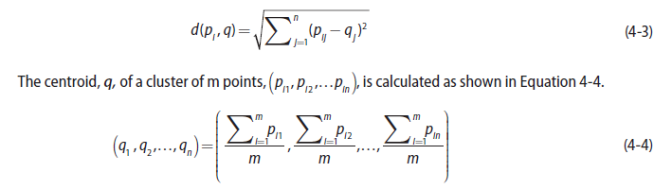
2.2 Overview of the Method (6)
To generalize the prior algorithm to n dimensions, suppose there are M objects, where each object is described by n attributes or property values (p₁, p₂,…,p_{n} ).
Object i is described by (p_{i1} , p_{i2} ,…, p_{in} ) for i = 1,2,…, M.
In other words, there is a matrix with M rows corresponding to the M objects and n columns to store the attribute values.
To find the k clusters in n dimensions, the following equations provide the formulas for calculating the distances and the locations of the centroids for n ≥ 1.
For a given point, pi, at (p_{i1}, p_{i2,}…, p_{in}) and a centroid, q, located at (q1, q2,…, qn), the distance, d, between pi and q, is expressed as shown in Equation 4-3

Slide 17

2.3 Determining the Number of Clusters
With the preceding algorithm, k clusters can be identified in a given dataset, but what value of k should be selected?
Value of k can be chosen based on a reasonable guess or some predefined requirement. However, it would be good to know how much better or worse having k clusters versus k – 1 or k + 1 clusters would be in explaining the structure of the data.
A heuristic using Within Sum of Squares (WSS) metric is examined to determine a reasonably optimal value of k.
Using the distance function given in Equation 4-3, WSS is defined as shown in Equation 4-5.

Slide 18
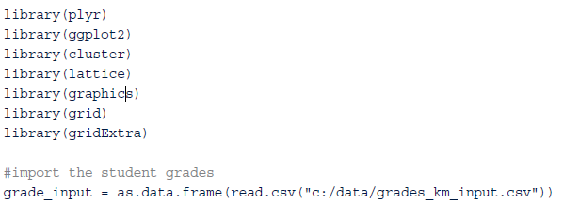
2.3.1 Using R to Perform a K-means Analysis (1)
Task is to group 620 high school seniors based on their grades in three subject areas: English, mathematics, and science
Grades are averaged over their high school career and assume values from 0 to 100
R code establishes R libraries and imports the CSV file containing the grades.

Slide 19
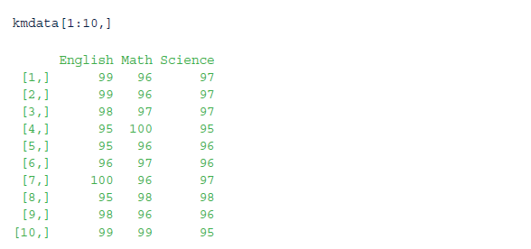
2.3.1 Using R to Perform a K-means Analysis (2)
Following R code formats the grades for processing.
Data file contains four columns. 1st column holds a student identification (ID) number, and the other three columns are for the grades in the three subject areas.
Student ID is not used in the clustering analysis, it is excluded from the k-means input matrix, kmdata.

Slide 20
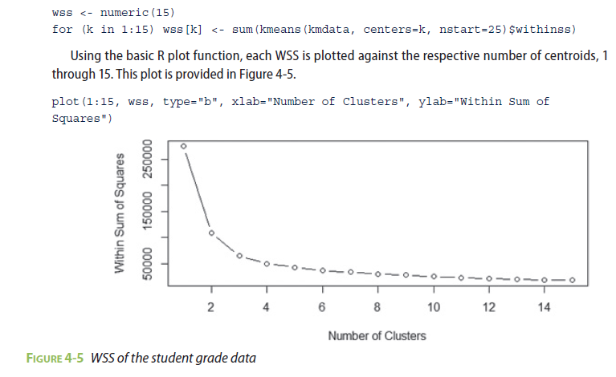
2.3.1 Using R to Perform a K-means Analysis (3)
To determine k, k-means algorithm is used to identify clusters for k = 1, 2, …, 15.
For each value of k, WSS is calculated. If an additional cluster provides a better partitioning of the data points, WSS should be markedly smaller than without the additional cluster.
Following R code loops through several k-means analyses for the number of centroids, k, varying from 1 to 15. For each k, the option nstart=25 specifies that the k-means algorithm will be repeated 25 times, each starting with k random initial centroids. The corresponding value of WSS for each k-mean analysis is stored in the wss vector.

Slide 21
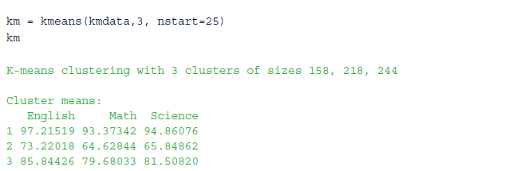
2.3.1 Using R to Perform a K-means Analysis (4)
WSS is greatly reduced when k increases from one to two. Another substantial reduction in WSS occurs at k = 3.
However, the improvement in WSS is fairly linear for k > 3. Therefore, k-means analysis will be conducted for k = 3. The process of identifying the appropriate value of k is referred to as finding the “elbow” of the WSS curve.

Slide 22

2.3.1 Using R to Perform a K-means Analysis (5)
The displayed contents of the variable km include the following:
The location of the cluster means
A clustering vector that defines the membership of each student to a corresponding cluster 1, 2, or 3
The WSS of each cluster
A list of all the available k-means components
Find details on these components and using k-means in R by employing the help facility. We may have wondered whether k-means results stored in km are equivalent to WSS results obtained earlier in generating the plot in Figure 4-5.
The following check verifies that the results are indeed equivalent.

Slide 23
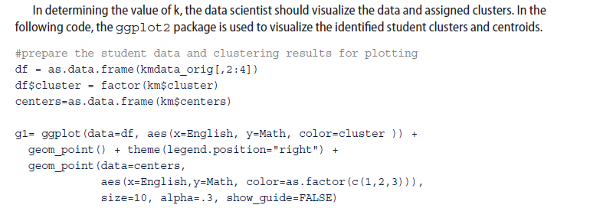
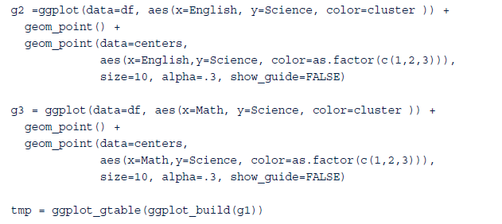
2.3.1 Using R to Perform a K-means Analysis (6)

Slide 24
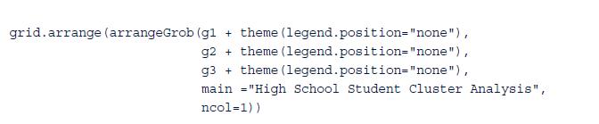
2.3.1 Using R to Perform a K-means Analysis (7)
FIGURE 4-6 Plots of the identified student clusters

Slide 25
2.4 Diagnostics (1)
Heuristic using WSS can provide at least several possible k values to consider.
When the number of attributes is relatively small, a common approach to further refine the choice of k is to plot the data to determine how distinct the identified clusters are from each other.
In general, the following questions should be considered.
Are the clusters well separated from each other?
Do any of the clusters have only a few points?
Do any of the centroids appear to be too close to each other?
FIGURE 4-7 Example of distinct clusters

Slide 26
2.4 Diagnostics (2)
In such cases, it is important to apply some judgment on whether anything different will result by using more clusters.
For example, Figure 4-9 uses six clusters to describe the same dataset as used in Figure 4-8.
If using more clusters does not better distinguish the groups, it is almost certainly better to go with fewer clusters.
FIGURE 4-8 Example of less obvious clusters
FIGURE 4-9 Six clusters applied to the points from Figure 4-8

Slide 27
2.5 Reasons to Choose and Cautions
K-means is a simple and straightforward method for defining clusters.
Once clusters and their associated centroids are identified, it is easy to assign new objects (for example, new customers) to a cluster based on the object’s distance from the closest centroid. Because it is unsupervised, using k-means helps to eliminate subjectivity from the analysis.
Although k-means is considered an unsupervised method, there are still several decisions that the practitioner must make:
What object attributes should be included in the analysis?
What unit of measure (for example, miles or kilometers) should be used for each attribute?
Do the attributes need to be rescaled so that one attribute does not have a is proportionate effect on the results?
What other considerations might apply?

Slide 28
2.5.1Object Attributes
What attributes will be known at the time a new object will be assigned to a cluster? For example, information on existing customers’ satisfaction or purchase frequency may be available, but such information may not be available for potential customers.
Data Scientist may have a choice of a dozen or more attributes to use in the clustering analysis. Too many attributes can minimize the impact of the most important variables. Also, the use of several similar attributes can place too much importance on one type of attribute
For example, if five attributes related to personal wealth are included in a clustering analysis, the wealth attributes dominate the analysis and possibly mask the importance of other attributes, such as age.
When dealing with the problem of too many attributes, one useful approach is to identify any highly correlated attributes and use only one or two of the correlated attributes in the clustering analysis

Slide 29
3.5.2 Units of Measure (1)
From a computational perspective, k-means algorithm is somewhat indifferent to units of measure for a given attribute (for example, meters or centimeters for a patient’s height).
Algorithm identify different clusters depending on the choice of the units of measure.
For example, suppose that k-means is used to cluster patients based on age in years and height in centimeters. For k=2, Figure 4-11 illustrates the two clusters that would be determined for a given dataset.
FIGURE 4-11 Clusters with height expressed in centimeters

Slide 30
3.5.2 Units of Measure (2)
If the height was rescaled from centimeters to meters by dividing by 100, the resulting clusters would be slightly different, as illustrated in Figure 4-12.
When height is expressed in meters, the magnitude of the ages dominates the distance calculation between two points.
The height attribute provides only as much as the square between the difference of the maximum height and the minimum height or (2.0−0)2 =4 to the radicand, the number under the square root symbol in the distance formula given in Equation 4-3. Age can contribute as much as (80−0)² =6,400 to the radicand when measuring the distance.
FIGURE 4-12 Clusters with height expressed in meters

Slide 31
3.5.3Rescaling
Attributes that are expressed in dollars are common in clustering analyses and can differ in magnitude from the other attributes.
For example, if personal income is expressed in dollars and age is expressed in years, the income attribute, often exceeding $10,000, can easily dominate the distance calculation with ages typically less than 100 years.
Although some adjustments could be made by expressing the income in thousands of dollars (for example, 10 for $10,000), a more straightforward method is to divide each attribute by the attribute’s standard deviation.
FIGURE 4-13 Clusters with rescaled attributes
The resulting attributes will each have a standard deviation equal to 1 and will be without units. Returning to the age and height example, the standard deviations are 23.1 years and 36.4 cm, respectively. Dividing each attribute value by the appropriate standard deviation and performing the k-means analysis yields the result shown in Figure 4-13.

Slide 32

3.5.4Additional Considerations
k-means algorithm is sensitive to the starting positions of the initial centroid. Thus, it is important to rerun the k-means analysis several times for a particular value of k to ensure the cluster results provide the overall minimum WSS. This task is accomplished using the nstart option in the kmeans() function
This chapter presented the use of the Euclidean distance function to assign the points to the closest centroids.
Other possible function choices include the cosine similarity and the Manhattan distance functions. The cosine similarity function is often chosen to compare two documents based on the frequency of each word that appears in each of the documents.
For two points, p and q, at (p1, p2,…, pn) and (q1, q2,…, qn ), respectively, Manhattan distance, d1, between p and q is expressed as shown in Equation 4-6.

Slide 33
3 Additional Algorithms 1/3
k-means clustering method is easily applied to numeric data where the concept of distance can naturally be applied.
However, it may be necessary or desirable to use an alternative clustering algorithm.
As discussed, k-means does not handle categorical data. In such cases, k-modes is a commonly used method for clustering categorical data based on the number of differences in the respective components of the attributes.
For example, if each object has four attributes, distance from (a, b, e, d) to (d, d, d, d) is 3. In R, the function kmode() is implemented in the klaR package

Slide 34
3 Additional Algorithms 2/3
k-means and k-modes divide the entire dataset into distinct groups, both approaches are considered partitioning methods.
A third partitioning method: Partitioning around Medoids (PAM).
A medoid is a representative object in a set of objects.
medoids are objects in each cluster that minimize the sum of the distances from the medoid to the other objects in the cluster.
Advantage of using PAM is that the “center” of each cluster is an actual object in the dataset.
PAM implemented in R by pam() function included in cluster R package. fpc R package includes a function pamk(), which uses pam() function to find the optimal value for k.

Slide 35
3 Additional Algorithms 3/3
Other clustering methods: hierarchical agglomerative clustering and density clustering methods
hierarchical agglomerative: each object is initially placed in its own cluster, then clusters combined with the most similar cluster. This process is repeated until one cluster, which includes all the objects, exists. R stats package includes the hclust() function for performing hierarchical agglomerative clustering.
In density-based: clusters are identified by concentration of points. fpc R package includes a function, dbscan(), to perform density-based clustering analysis. Density-based clustering can be useful to identify irregularly shaped clusters.
Notes:
hierarchical agglomerative: sự kết tụ phân cấp
density clustering: phân cụm mật độ

Slide 36
Summary
Clustering analysis groups similar objects based on the objects’ attributes applied in areas such as marketing, economics, biology, and medicine
k-means algorithm and its implementation in R. To use k-means properly, it is important to do the following:
Properly scale the attribute values to prevent certain attributes from dominating the other attributes
Ensure that the concept of distance between the assigned values within an attribute is meaningful
Choose the number of clusters, k, such that the sum of the Within Sum of Squares (WSS) of the distances is reasonably minimized. A plot such as the example in Figure 4-5 can be helpful in this respect
If k-means does not appear to be an appropriate clustering technique for a given dataset, then alternative techniques such as k-modes or PAM should be considered.

