Slide 1

Advanced Analytical Theory and Methods: Regression
Author : Nguyen Van Sang
Date : Mar-2022

Slide 2
Objectives
After studying this chapter, the student should be able to understand the key concepts:
Categorical Variable
Linear Regression
Logistic Regression
Ordinary Least Squares (OLS)
Receiver Operating Characteristic (ROC) Curve
Residuals

Slide 3
Content
Linear Regression
Logistic Regression
Reasons to Choose and Cautions
Additional Regression Models

Slide 4
1 Linear Regression
An analytical technique used to model the relationship between several input variables and a continuous outcome variable.
A key assumption is that the relationship between an input variable and the outcome variable is linear. Well-known linear models, such as Ohm’s Law
A probabilistic one that accounts for the randomness that can affect any particular outcome.
Useful in physical and social science applications where there may be considerable variation in a particular outcome based on a given set of input values

Slide 5
1.1 Use cases
Real estate: be used to model residential home prices as a function of the home’s living area. Such a model helps set or evaluate the list price of a home on the market.
Demand forecasting: Use linear regression models to predict demand for goods and services. For example, restaurant chains can appropriately prepare for the predicted type and quantity of food that customers will consume based upon the weather, the day of the week, whether an item is offered as a special, the time of day, and the reservation volume. Similar models for predicting retail sales, emergency room visits, and ambulance dispatches.
Medical: Used to analyze the effect of a proposed radiation treatment on reducing tumor sizes. Input variables might include duration of a single radiation treatment, frequency of radiation treatment, and patient attributes such as age or weight.
Notes:
tumor : khối u

Slide 6

1.2 Model Description (1)
Assumes that there is a linear relationship between the input variables and the outcome variable expressed in Equation 6-1.
where:
y is the outcome variable
x_{j} are the input variables, for j = 1, 2, …, p – 1
β₀ is the value of y when each x_{j} equals zero
β_{j} is the change in y based on a unit change in x_{j}, for j = 1, 2, …, p – 1
ε is a random error term that represents the difference in the linear model and a particular observed value for y

Slide 7
1.2 Model Description (2)
Suppose to build a linear regression model that estimates a person’s annual income as a function of two variables—age and education—both expressed in years. In this case
Income: outcome variable,
Age and education: input variables.
Although it may be an over generalization, such a model seems intuitively correct in the sense that people’s income should increase as their skill set and experience expand with age.
Also, the employment opportunities and starting salaries would be expected to be greater for those who have attained more education.
However, it is also obvious that there is considerable variation in income levels for a group of people with identical ages and years of education. This variation is represented by ε in the model. So, in this example, the model would be expressed as shown in Equation 6-2.

Slide 8
1.2 Model Description (3)
In the linear model, the β_{j}s represent the unknown p parameters.
Ordinary Least Squares (OLS) is a common technique to estimate the parameters.
To illustrate how OLS works, suppose there is only one input variable, x, for an outcome variable y. Furthermore, n observations of (x,y) are obtained and plotted in Figure 6-1.
FIGURE 6-1 Scatterplot of y versus x

Slide 9

1.2 Model Description (4)
Goal is to find the line that best approximates the relationship between the outcome variable and the input variables.
With OLS, the objective is to find the line through these points that minimizes the sum of the squares of the difference between each point and the line in the vertical direction. In other words, find the values of β0 and β1 such that the summation shown in Equation 6-3 is minimized.
The n individual distances to be squared and then summed are illustrated in Figure 6-2. Vertical lines represent the distance between each observed y value and the line y =β₀ +β₁ x .
FIGURE 6-2 Scatterplot of y versus x with vertical distances from the observed points to a fitted line

Slide 10
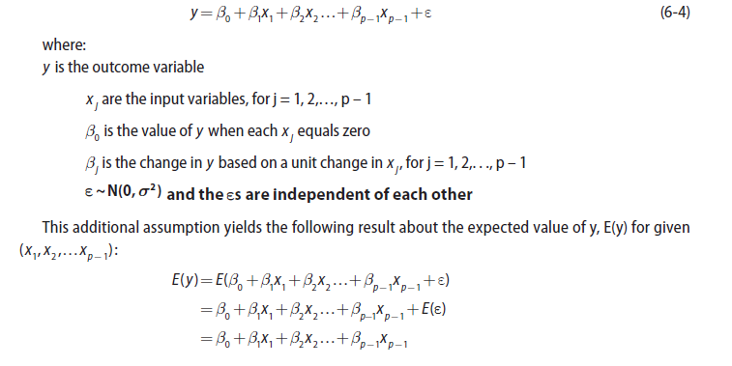
1.2.1 Linear Regression Model (with Normally Distributed Errors) (1)
In most linear regression analyses, it is common to assume that the error term is a normally distributed random variable with mean equal to zero and constant variance.
Thus, the linear regression model is expressed as shown in Equation 6-4.

Slide 11

1.2.1 Linear Regression Model (with Normally Distributed Errors) (2)
Because β_{j} j and x are constants, the E(y) is the value of the linear regression model for the given (x₁, x₂,…, x_{p-1}). Furthermore, the variance of y, V(y), for given (x₁, x₂,…, x_{p-1}) is this:
Thus, for a given (x₁, x₂,…, x_{p-1}), y is normally distributed with mean β₀ + β₁x₁ + β₂x₂ + … + β_{p-1}x_{p-1} and variance σ².
For a regression model with just one input variable, Figure 6-3 illustrates the normality assumption on the error terms and the effect on the outcome variable, y, for a given value of x .

Slide 12
1.2.1 Linear Regression Model (with Normally Distributed Errors) (3)
For x=8, one would expect to observe a value of y near 20, but a value of y from 15 to 25 would appear possible based on the illustrated normal distribution.
Thus, the regression model estimates the expected value of y for the given value of x .
Additionally, the normality assumption on the error term provides some useful properties that can be utilized in performing hypothesis testing on the linear regression model and providing confidence intervals on the parameters and the mean of y given (x₁, x₂,…, x_{p-1}).
The application of these statistical techniques is demonstrated by applying R to the earlier linear regression model on income.
FIGURE 6-3 Normal distribution about y for a given value of x

Slide 13
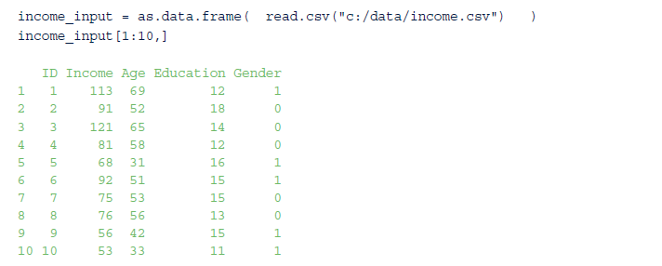
1.2.2 Example in R (1)
In Income example, the variables age and education, the person’s gender, female or male, are input variables.
Following code reads a comma-separated-value (CSV) file of 1,500 people’s incomes, ages, years of education, and gender. The first 10 rows are displayed:

Slide 14

1.2.2 Example in R (2)
Each person in the sample has been assigned an identification number, ID.
Income is expressed in thousands of dollars. (For example, 113 denotes $113,000.)
Age and Education are expressed in years.
For Gender, 0 denotes female and 1 denotes male.
A summary of the imported data reveals that the incomes vary from $14,000 to $134,000.
Ages are between 18 and 70 years.
Education experience for each person varies from a minimum of 10 years to a maximum of 20 years.

Slide 15
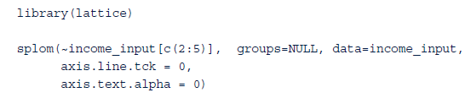
1.2.2 Example in R (3)
Use a scatterplot matrix to view the pair-wise relationships of the variables.
Using the lattice package in R, the scatterplot matrix in Figure 6-4 is generated with the following R code:
FIGURE 6-4 Scatterplot matrix of the variables

Slide 16
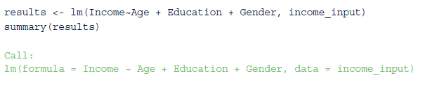
1.2.2 Example in R (4)
Because the dependent variable is typically plotted along the y-axis, examine the set of scatterplots along the bottom of the matrix.
A strong positive linear trend is observed for Income as a function of Age. Against Education, a slight positive trend may exist, but the trend is not quite as obvious as is the case with the Age variable. Lastly, there is no observed effect on Income based on Gender.
With this qualitative understanding of the relationships between Income and the input variables, it seems reasonable to quantitatively evaluate the linear relationships of these variables.
Utilizing the normality assumption applied to the error term, the proposed linear regression model is shown in Equation 6-5.
Using the linear model function, lm(), in R, the income model can be applied to the data as follows:

Slide 17

1.2.2 Example in R (5)
lm() function performs the parameter estimation for the parameters β_{j} (j = 0, 1, 2, 3) using ordinary least squares and provides several useful calculations and results that are stored in the variable called results in this example.
After the stated call to lm(), a few statistics on the residuals are displayed in the output.
The residuals are the observed values of the error term for each of the n observations and are defined for i = 1, 2, n, as shown in Equation 6-6.

Slide 18
1.2.2 Example in R (6)
Residuals vary from approximately –37 to +37, with a median close to 0. Recall that the residuals are assumed to be normally distributed with a mean near zero and a constant variance.
Output provides details about the coefficients. Column Estimate provides the OLS estimates of the coefficients in the fitted linear regression model.
In general, the (Intercept) corresponds to the estimated response variable when all the input variables equal zero.
The intercept corresponds to an estimated income of $7,263 for a newborn female with no education.
minimum age and education in the dataset are 18 and 10 years, respectively. Thus, misleading results may be obtained when using a linear regression model to estimate outcomes for input values not representative within the dataset used to train the model.

Slide 19
1.2.2 Example in R (7)
Coefficient for Age is approximately equal to one. This coefficient is interpreted as follows:
For every one unit increase in a person’s age, the person’s income is expected to increase by $995.
Similarly, for every unit increase in a person’s years of education, person’s income is expected to increase by about $1,758.
Interpreting the Gender coefficient is slightly different.
When Gender is equal to zero, Gender coefficient contributes nothing to the estimate of the expected income.
When Gender is equal to one, the expected Income is decreased by about $934.

Slide 20

1.2.2 Example in R (8)
Because the coefficient values are only estimates based on the observed incomes in the sample, there is some uncertainty or sampling error for the coefficient estimates.
The Std. Error column next to the coefficients provides the sampling error associated with each coefficient and can be used to perform a hypothesis test, using the t-distribution, to determine if each coefficient is statistically different from zero.
In other words, if a coefficient is not statistically different from zero, the coefficient and the associated variable in the model should be excluded from the model.
In this example, associated hypothesis tests’ p-values, Pr(>|t|), are very small for the Intercept, Age, and Education parameters.
As seen in Chapter 3, a small p-value corresponds to a small probability that such a large t value would be observed under the assumptions of the null hypothesis. In this case, for a given j = 0, 1, 2, . . ., p – 1, the null and alternate hypotheses follow:

Slide 21
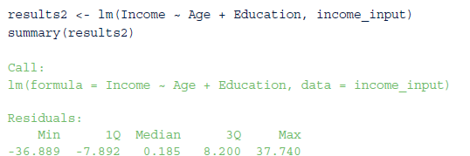
1.2.2 Example in R (9)
For small p-values, as is the case for the Intercept, Age, and Education parameters, the null hypothesis would be rejected.
For Gender parameter, the corresponding p-value is fairly large at 0.13.
In other words, at a 90% confidence level, the null hypothesis would not be rejected. So, dropping the variable Gender from the linear regression model should be considered.
The following R code provides the modified model results:

Slide 22
1.2.2 Example in R (10)
Dropping Gender variable from the model resulted in a minimal change to the estimates of the remaining parameters and their statistical significances.
Last part of displayed results provides some summary statistics and tests on the linear regression model.
Residual standard error is the standard deviation of the observed residuals. This value, along with the associated degrees of freedom, can be used to examine the variance of the assumed normally distributed error terms.
R-squared (R²) is a commonly reported metric that measures the variation in the data that is explained by the regression model.
Possible values of R² vary from 0 to 1, with values closer to 1 indicating that the model is better at explaining the data than values closer to 0.
An R² of exactly 1 indicates that the model explains perfectly the observed data (all the residuals are equal to 0). R² value increased by adding more variables to the model. However, just adding more variables to explain a given dataset but not to improve the explanatory nature of the model is known as overfitting.
To address possibility of overfitting the data, adjusted R² accounts for the number of parameters included in the linear regression model.

Slide 23

1.2.2 Example in R (11)
F-statistic provides a method for testing the entire regression model.
In t-tests, individual tests were conducted to determine the statistical significance of each parameter. F-statistic and corresponding p-value enable the analyst to test following hypotheses:
In this example, the p-value of 2.2e – 16 is small, which indicates that the null hypothesis should be rejected.

Slide 24
1.2.3 Categorical Variables (1)
In previous example, variable Gender was a simple binary variable that indicated whether a person is female or male. In general, these variables are known as categorical variables.
To illustrate how to use categorical variables properly, suppose it was decided in earlier Income example to include an additional variable, State, to represent the U.S. state where the person resides.
Similar to the use of the Gender variable, one possible, but incorrect, approach would be to include a State variable that would take a value of 0 for Alabama, 1 for Alaska, 2 for Arizona, and so on.
The problem with this approach is that such a numeric assignment based on an alphabetical ordering of the states does not provide a meaningful measure of the difference in the states.
For example, is it useful or proper to consider Arizona to be one unit greater than Alaska and two units greater that Alabama?

Slide 25
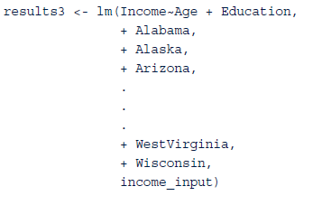
1.2.3 Categorical Variables (2)
In regression, a proper way to implement a categorical variable that can take on m different values is to add m-1 binary variables to the regression model.
To illustrate with the Income example, a binary variable for each of 49 states, excluding Wyoming (arbitrarily chosen as the last of 50 states in an alphabetically sorted list), could be added to the model.
Input file would have 49 columns added for these variables representing each of the first 49 states. If a person was from Alabama, Alabama variable would be equal to 1, and other 48 variables would be set to 0.
This process would be applied for the other state variables. So, a person from Wyoming, the one state not explicitly stated in the model, would be identified by setting all 49 state variables equal to 0.
In this representation, Wyoming would be considered the reference case, and the regression coefficients of the other state variables would represent the difference in income between Wyoming and a particular state.

Slide 26
1.2.4 Confidence Intervals on the Parameters (1)
Once an acceptable linear regression model is developed, it is often helpful to use it to draw some inferences about the model and the population from which the observations were drawn.
Earlier, t-tests could be used to perform hypothesis tests on the individual model parameters, βj, j = 0, 1, …, p – 1.
Alternatively, these t-tests could be expressed in terms of confidence intervals on the parameters.
R simplifies computation of confidence intervals on parameters with confint() function.
From the Income example, following R command provides 95% confidence intervals on the intercept and coefficients for the two variables, Age and Education.

Slide 27
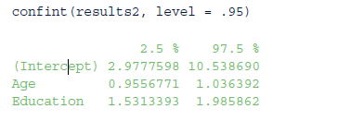
1.2.4 Confidence Intervals on the Parameters (2)
Based on the data, the earlier estimated value of the Education coefficient was 1.76.
Using confint(), the corresponding 95% confidence interval is (1.53, 1.99), which provides the amount of uncertainty in the estimate.
In other words, in repeated random sampling, the computed confidence interval straddles the true but unknown coefficient 95% of the time.
As expected from the earlier t-test results, none of these confidence intervals straddles zero.

Slide 28
1.2.5 Confidence Interval on the Expected Outcome (1)
In addition to obtaining confidence intervals on the model parameters, it is often desirable to obtain a confidence interval on the expected outcome.
In Income example, the fitted linear regression provides expected income for a given Age and Education. However, that particular point estimate does not provide information on the amount of uncertainty in that estimate.
Using predict() function in R to obtain a confidence interval on the expected for a given set of input variable values.
In this illustration, a built data frame containing a specific age and education value.
Using this set of input variable values, predict() function provides a 95% confidence interval on the expected Income for a 41-year-old person with 12 years of education.

Slide 29
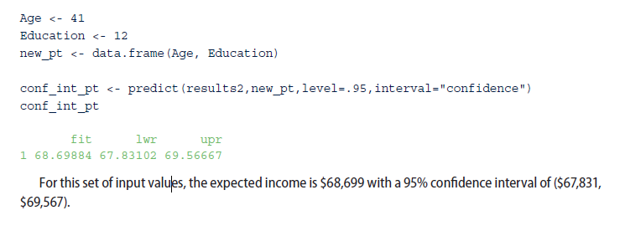
1.2.5 Confidence Interval on the Expected Outcome (2)

Slide 30
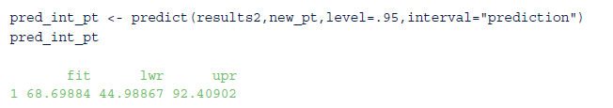
1.2.6 Prediction Interval on a Particular Outcome
The previous confidence interval was relatively close (+/– approximately $900) to the fitted value. However, this confidence interval should not be considered as representing the uncertainty in estimating a particular person’s income.
predict() function in R also calculate upper and lower bounds on a particular outcome. Such bounds provide what are referred to as prediction intervals.
In Income example, in R the 95% prediction interval on Income for a 41-year-old person with 12 years of education is obtained as follows:

Slide 31
2 Logistic Regression
In the earlier Income example, linear regression can be used to model relationship between age and education to income.
Suppose a person’s actual income was not of interest, but rather whether someone was wealthy or poor. In such a case, when the outcome variable is categorical in nature, logistic regression can be used to predict the likelihood of an outcome based on the input variables

Slide 32
2.1 Use Cases
Common ways that the logistic regression model is used include
Medical: Develop a model to determine likelihood of a patient’s successful response to a specific medical treatment or procedure.
Finance: Using a loan applicant’s credit history and details on the loan, determine the probability that an applicant will default on the loan.
Marketing: Determine a wireless customer’s probability of switching carriers (known as churning) based on age, number of family members on the plan, months remaining on the existing contract, and social network contacts.
Engineering: Based on operating conditions and various diagnostic measurements, determine the probability of a mechanical part experiencing a malfunction or failure..

Slide 33


2.2 Model Description (1)
Logistic regression is based on the logistic function f (y), as given in Equation 6-7.
Note that as y→∞, f (y)→1, and as y→−∞, f (y)→0.
Figure 6-14 illustrates value of the logistic function f (y) varies from 0 to 1 as y increases.
FIGURE 6-14 The logistic function

Slide 34
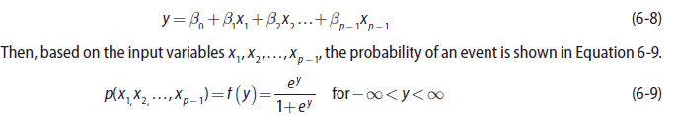
2.2 Model Description (2)
Because f (y) range in (0, 1), logistic function appears to be an appropriate function to model the probability of a particular outcome occurring.
y increases, probability of the outcome occurring increases. In any proposed model, to predict the likelihood of an outcome, y needs to be a function f the input variables.
In logistic regression, y is expressed as a linear function of the input variables. In other words, formula shown in Equation 6-8 applies.

Slide 35

2.2 Model Description (3)
Equation 6-8 is comparable to Equation 6-1 used in linear regression modeling. However, one difference is that the values of y are not directly observed.
Only the value of f (y) in terms of success or failure (typically expressed as 1 or 0, respectively) is observed.
Using p to denote f (y), Equation 6-9 can be rewritten in the form provided in Equation 6-10.
quantity ln(p/(1−p)), in Equation 6-10 is known as the log odds ratio, or the logit of p. Techniques such as Maximum Likelihood Estimation (MLE) are used to estimate the model parameters.
MLE determines the values of the model parameters that maximize the chances of observing the given dataset.

Slide 36
2.2 Model Description - Customer Churn Example (1)
A wireless telecommunications company wants to estimate the probability that a customer will churn (switch to a different company) in the next six months.
With a reasonably accurate prediction of a person’s likelihood of churning, the sales and marketing groups can attempt to retain the customer by offering various incentives. Data on 8,000 current and prior customers was obtained.
The variables collected for each customer follow:
Age (years)
Married (true/false)
Duration as a customer (years)
Churned_contacts (count)—Number of the customer’s contacts that have churned (count)
Churned (true/false)—Whether the customer churned

Slide 37
2.2 Model Description - Customer Churn Example (2)
After analyzing data and fitting a logistic regression model, Age and Churned_contacts were selected as the best predictor variables. Equation 6-11 provides the estimated model parameters.
Using fitted model from Equation 6-11, Table 6-1 provides the probability of a customer churning based on the customer’s age and the number of churned contacts.
Computed values of y are also provided in the table. Recalling the previous discussion of the logistic function, as the value of y increases, so does the probability of churning.

Slide 38
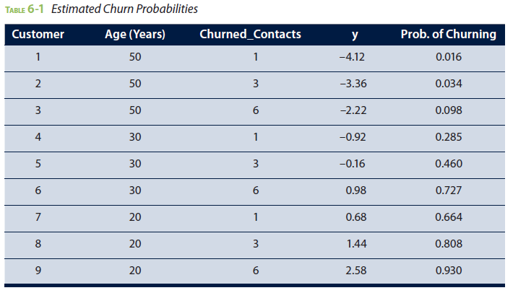
2.2 Model Description - Customer Churn Example (3)
Based on fitted model, there is a 93% chance that a 20-year-old customer who has had six contacts churn will also churn. (See the last row of Table 6-1.)
Examining the sign and values of the estimated coefficients in Equation 6-11, it is observed that as the value of Age increases, the value of y decreases.
Negative Age coefficient indicates that the probability of churning decreases for an older customer.
Based on the positive sign of the Churned_Contacts coefficient, value of y and subsequently the probability of churning increases as the number of churned contacts increases.

Slide 39
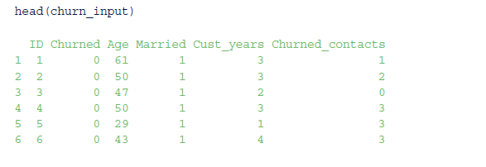

2.3 Diagnostics (1)
This section examines the steps to develop a logistic regression model and evaluate the model’s effectiveness.
For this example, the churn_input data frame is structured as follows:
A Churned value of 1 indicates that the customer churned. A Churned value of 0 indicates that the customer remained as a subscriber.
Out of the 8,000 customer records in this dataset, 1,743 customers (~22%) churned.

Slide 40
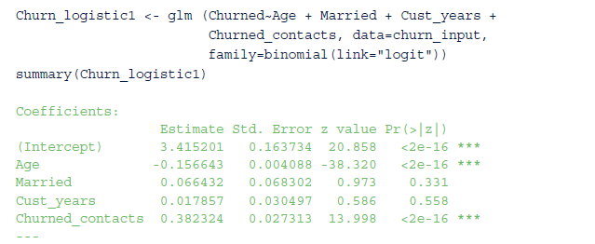
2.3 Diagnostics (2)
Using Generalized Linear Model function, glm(), in R and the specified family/link, a logistic regression model can be applied to the variables in the dataset and examined as follows:

Slide 41
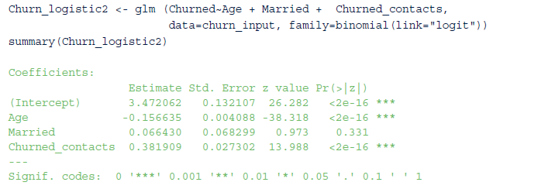
2.3 Diagnostics (3)
As in the linear regression case, there are tests to determine if the coefficients are significantly different from zero.
Such significant coefficients correspond to small values of Pr(>|z|), which denote the p-value for the hypothesis test to determine if the estimated model parameter is significantly different from zero.
Rerunning this analysis without the Cust_years variable, which had the largest corresponding p-value, yields the following:

Slide 42
2.3 Diagnostics (4)
Because the p-value for the Married coefficient remains quite large, the Married variable is dropped from the model.
Following R code provides the third and final model, which includes only the Age and Churned_contacts variables:
For this final model, the entire summary output is provided. The output offers several values that can be used to evaluate the fitted model.
Noted that the model parameter estimates correspond to the values provided in Equation 6-11 that were used to construct Table 6-1.

Slide 43
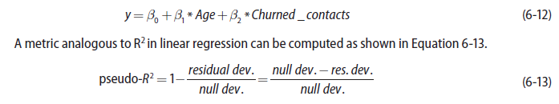
2.3.1 Deviance and the Pseudo-R²
In logistic regression, deviance is defined to be −2* logL, where L is the maximized value of the likelihood function that was used to obtain the parameter estimates.
In the R output, two deviance values provided.
null deviance: value where the likelihood function is based only on the intercept term (y =β0).
residual deviance: value where the likelihood function is based on the parameters in the specified logistic model, shown in Equation 6-12.
pseudo-R² is a measure of how well the fitted model explains the data as compared to default model of no predictor variables and only an intercept term.
A pseudo−R² value near 1 indicates a good fit over the simple null model.

Slide 44
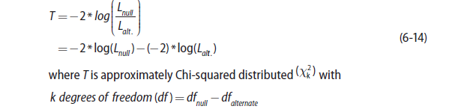

2.3.2 Deviance and the Log-Likelihood Ratio Test (1)
In the pseudo−R² calculation, the –2 multipliers simply divide out. So, it may appear that including such a multiplier does not provide a benefit.
The multiplier in the deviance definition is based on the log-likelihood test statistic shown in Equation 6-14:
The previous description of the log-likelihood test statistic applies to any estimation using MLE. As can be seen in Equation 6-15, in the logistic regression case,

Slide 45
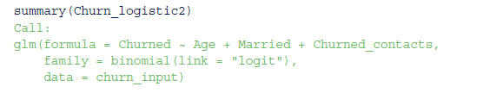
2.3.2 Deviance and the Log-Likelihood Ratio Test (2)
In a hypothesis test, a large value of T would indicate that the fitted model is significantly better than the null model that uses only the intercept term.
In the churn example, the log-likelihood ratio statistic would be this:
T =8387.3−5359.2=3028.1 with 2 degrees of freedom
and a corresponding p-value that is essentially zero.
So far, the log-likelihood ratio test discussion has focused on comparing a fitted model to the default model of using only the intercept. However, the log-likelihood ratio test can also compare one fitted model to another.
For example, consider the logistic regression model when the categorical variable Married is included with Age and Churned_contacts in the list of input variables. The partial R output for such a model is provided here:

Slide 46
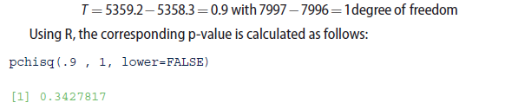
2.3.2 Deviance and the Log-Likelihood Ratio Test (3)
Residual deviances from each model can be used to perform a hypothesis test where H₀ : β_{Married} =0 against H_{A} : β_{Married} ≠0 using the base model that includes the Age and Churned_contacts variables. The test statistic follows:
Thus, at a 66% or higher confidence level, the null hypothesis, H₀: β_{Married} =0 , would not be rejected. Thus, it seems reasonable to exclude the variable Married from the logistic regression model.
In general, this log-likelihood ratio test is particularly useful for forward and backward step-wise methods to add variables to or remove them from the proposed logistic regression model.

Slide 47
2.3.3 Receiver Operating Characteristic (ROC) Curve (1)
Logistic regression is often used as a classifier to assign class labels to a person, item, or transaction based on predicted probability provided by the model.
In the Churn example, a customer can be classified with the label called Churn if the logistic model predicts a high probability that the customer will churn.
Otherwise, a Remain label is assigned to the customer. Commonly, 0.5 is used as the default probability threshold to distinguish between any two class labels.
However, any threshold value can be used depending on the preference to avoid
false positives (for example, to predict Churn when actually customer will Remain)
or false negatives (for example, to predict Remain when the customer will actually Churn).

Slide 48
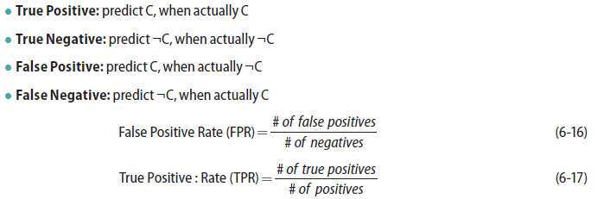
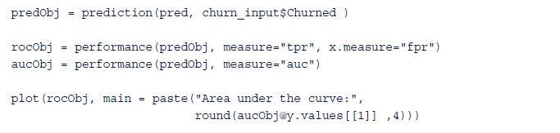

2.3.3 Receiver Operating Characteristic (ROC) Curve (2)
In general, for two class labels, C and ¬C, where “¬C” denotes “not C,” some working definitions and formulas follow:
Receiver Operating Characteristic (ROC) curve is the plot of the True Positive Rate (TPR) against the False Positive Rate (FPR)
Using the ROCR package, the following R commands generate the ROC curve for the Churn example:

Slide 49
2.3.3 Receiver Operating Characteristic (ROC) Curve (3)
Usefulness of this plot in Figure 6-15 is that the preferred outcome of a classifier is to have a low FPR and a high TPR.
So, when moving from left to right on the FPR axis, a good model/classifier has the TPR rapidly approach values near 1, with only a small change in FPR.
The closer the ROC curve tracks along the vertical axis and approaches the upper-left hand of the plot, near the point (0,1), the better the model/classifier performs.
Thus, a useful metric is to compute the area under the ROC curve (AUC). By examining the axes, it can be seen that the theoretical maximum for the area is 1.
FIGURE 6-15 ROC curve for the churn example

Slide 50
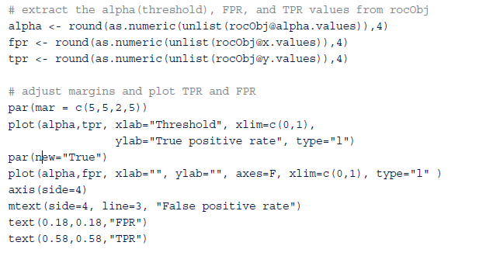
2.3.3 Receiver Operating Characteristic (ROC) Curve (4)
To illustrate how the FPR and TPR values are dependent on the threshold value used for the classifier, the plot in Figure 6-16 was constructed using the following R code:
FIGURE 6-16 The effect of the threshold value in the churn example

Slide 51

2.3.3 Receiver Operating Characteristic (ROC) Curve (5)
For a threshold value of 0, every item is classified as a positive outcome. Thus, the TPR value is 1.
However, all the negatives are also classified as a positive, and the FPR value is also 1. As the threshold value increases, more and more negative class labels are assigned.
Thus, the FPR and TPR values decrease. When the threshold reaches 1, no positive labels are assigned, and the FPR and TPR values are both 0.
For the purposes of a classifier, a commonly used threshold value is 0.5. A positive label is assigned for any probability of 0.5 or greater. Otherwise, a negative label is assigned.
the following R code illustrates, in the analysis of the Churn dataset, the 0.5 threshold corresponds to a TPR value of 0.56 and a FPR value of 0.08.

Slide 52
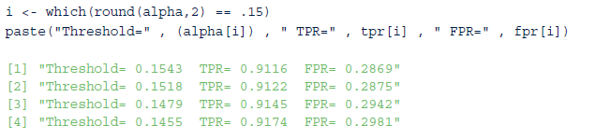
2.3.3 Receiver Operating Characteristic (ROC) Curve (6)
Thus, 56% of customers who will churn are properly classified with the Churn label, and 8% of the customers who will remain as customers are improperly labeled as Churn.
If identifying only 56% of the churners is not acceptable, then the threshold could be lowered.
For example, suppose it was decided to classify with a Churn label any customer with a probability of churning greater than 0.15. Then the following R code indicates that the corresponding TPR and FPR values are 0.91 and 0.29, respectively.
Thus, 91% of the customers who will churn are properly identified, but at a cost of misclassifying 29% of the customers who will remain.
The ROC curve is useful for evaluating other classifiers and will be utilized again in Chapter 7, “Advanced Analytical Theory and Methods: Classification.”

Slide 53
2.3.4 Histogram of the Probabilities
It can be useful to visualize the observed responses against the estimated probabilities provided by the logistic regression.
Figure 6-17 provides overlaying histograms for the customers who churned and for the customers who remained as customers.
With a proper fitting logistic model, the customers who remained tend to have a low probability of churning. Conversely, the customers who churned have a high probability of churning again.
This histogram plot helps visualize the number of items to be properly classified or misclassified.
In the Churn example, an ideal histogram plot would have the remaining customers grouped at the left side of the plot, the customers who churned at the right side of the plot, and no overlap of these two groups.
FIGURE 6-17 Customer counts versus estimated churn probability

Slide 54
3 Reasons to Choose and Cautions (1)
Linear regression is suitable when the input variables are continuous or discrete, including categorical data types, but the outcome variable is continuous.
If the outcome variable is categorical, logistic regression is a better choice.
Both models assume a linear additive function of the input variables. If such an assumption does not hold true, both regression techniques perform poorly.
Furthermore, in linear regression, the assumption of normally distributed error terms with a constant variance is important for many of the statistical inferences that can be considered.
If the various assumptions do not appear to hold, the appropriate transformations need to be applied to the data.

Slide 55
3 Reasons to Choose and Cautions (2)
Although a collection of input variables may be a good predictor for the outcome variable, the analyst should not infer that the input variables directly cause an outcome.
For example, it may be identified that those individuals who have regular dentist visits may have a reduced risk of heart attacks. However, simply sending someone to the dentist almost certainly has no effect on that person’s chance of having a heart attack.
It is possible that regular dentist visits may indicate a person’s overall health and dietary choices, which may have a more direct impact on a person’s health. This example illustrates the commonly known expression, “Correlation does not imply causation.”
Use caution when applying an already fitted model to data that falls outside the dataset used to train the model. The linear relationship in a regression model may no longer hold at values outside the training dataset.
For example, if income was an input variable and the values of income ranged from $35,000 to $90,000, applying the model to incomes well outside those incomes could result in inaccurate estimates and predictions.

Slide 56

3 Reasons to Choose and Cautions (3)
The income regression example in Section 1.2 mentioned the possibility of using categorical variables to represent the 50 U.S. states.
In a linear regression model, the state of residence would provide a simple additive term to the income model but no other impact on the coefficients of the other input variables, such as Age and Education.
However, if state does influence the other variables’ impact to the income model, an alternative approach would be to build 50 separate linear regression models: one model for each state. Such an approach is an example of the options and decisions that the data scientist must be willing to consider.
If several of the input variables are highly correlated to each other, the condition is known as multicollinearity. Multicollinearity can often lead to coefficient estimates that are relatively large in absolute magnitude and may be of inappropriate direction (negative or positive sign).
When possible, the majority of these correlated variables should be removed from the model or replaced by a new variable that is a function of the correlated variables.
For example, in a medical application of regression, height and weight may be considered important input variables, but these variables tend to be correlated. In this case, it may be useful to use the Body Mass Index (BMI), which is a function of a person’s height and weight.

Slide 57
4 Additional Regression Models
In the case of multicollinearity, it may make sense to place some restrictions on the magnitudes of the estimated coefficients.
Ridge regression, which applies a penalty based on the size of the coefficients, is one technique that can be applied. In fitting a linear regression model, the objective is to find the values of the coefficients that minimize the sum of the residuals squared. In ridge regression, a penalty term proportional to the sum of the squares of the coefficients is added to the sum of the residuals squared.
Lasso regression is a related modeling technique in which the penalty is proportional to the sum of the absolute values of the coefficients.
Only binary outcome variables were examined in the use of logistic regression. If the outcome variable can assume more than two states, multinomial logistic regression can be used

Slide 58
Summary
Discussed the use of linear regression and logistic regression to model historical data and to predict future outcomes
Using R, examples of each regression technique were presented. Several diagnostics to evaluate the models and the underlying assumptions were covered.
Although regression analysis is relatively straightforward to perform using many existing software packages, considerable care must be taken in performing and interpreting a regression analysis.
Data scientist needs to do the following
Determine the best input variables and their relationship to the outcome variable .
Understand the underlying assumptions and their impact on the modeling results.
Transform the variables, as appropriate, to achieve adherence to the model assumptions.
Decide whether building one comprehensive model is the best choice or consider building many models on partitions of the data.

