Slide 1

Advanced Analytical Theory and Methods: classification
Author : Nguyen Van Sang
Date : Mar-2022

Slide 2
Objectives
After studying this chapter, the student should be able to understand the key concepts:
Classification learning
Naïve Bayes
Decision tree
ROC curve
Confusion matrix

Slide 3
Content
Decision Trees
Naive Bayes
Diagnostics of Classifiers
Additional Classification Methods

Slide 4
1.1 Decision Trees 1/9
A decision tree (also called prediction tree) uses a tree structure to specify sequences of decisions and consequences
Given input X ={x₁, x₂,...,x_{n} } , the goal is to predict a response or output variable Y . Each member of the set {x₁, x₂,...,x_{n} } is called an input variable.
Prediction can be achieved by constructing a decision tree with test points and branches
At each test point, a decision is made to pick a specific branch and traverse down the tree. Eventually, a final point is reached, and a prediction can be made
Each test point in a decision tree involves testing a particular input variable (or attribute), and each branch represents the decision being made.
Input values of a decision tree can be categorical or continuous

Slide 5
1.1 Decision Trees 2/9
A decision tree employs a structure of test points (called nodes) and branches, which represent the decision being made
A leaf node : A node without further branches. The leaf nodes return class labels and, in some implementations, they return the probability scores.

Slide 6

1.1 Decision Trees 3/9
A decision tree can be converted into a set of decision rules. For example, income and mortgage_amount are input variables, and the response is the output variable default with a probability score.
Decision trees have two varieties: classification trees and regression trees
Classification trees usually apply to output variables that are categorical—often binary—in nature, such as yes or no, purchase or not purchase, and so on.
Regression trees can apply to output variables that are numeric or continuous, such as the predicted price of a consumer good or the likelihood a subscription will be purchased

Slide 7
1.1 Decision Trees 4/9
branch refers to the outcome of a decision and is visualized as a line connecting two nodes
Internal nodes are the decision or test points
depth of a node is the minimum number of steps required to reach the node from the root
Leaf nodes are at the end of the last branches on the tree
FIGURE 7-1 Example of a decision tree

Slide 8
1.1 Decision Trees 5/9
A short tree can be created by limiting the number of splits. Short trees are often used as components (also called weak learners or base learners) in ensemble methods
Ensemble methods (random forest, bagging, and boosting) use multiple predictive models to vote, and decisions can be made based on the combination of the votes
A decision stump is the simplest short tree, which is a decision tree with the root immediately connected to the leaf nodes
A decision stump makes a prediction based on the value of just a single input variable

Slide 9
1.1 Decision Trees 6/9
Figure 7-2 shows a decision stump to classify two species of an iris flower based on the petal width
Figure shows that, if the petal width is smaller than 1.75 centimeters, it’s Iris versicolor; otherwise, it’s Iris virginica.
FIGURE 7-2 Example of a decision stump

Slide 10
1.1 Decision Trees 7/9
Given the demographics of clients and their reactions to previous campaign phone calls, the bank’s goal is to predict which clients would subscribe to a term deposit
The dataset used here is based on the original dataset collected from a Portuguese bank on directed marketing campaigns as stated in the work by Moro et al.
Figure 7-3 shows a subset of the modified bank marketing dataset. This dataset includes 2,000 instances randomly drawn from the original dataset, and each instance corresponds to a customer.
FIGURE 7-3 A subset of the bank marketing dataset

Slide 11
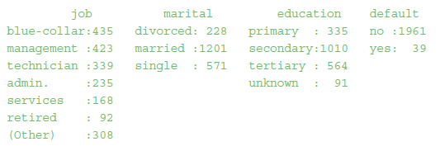
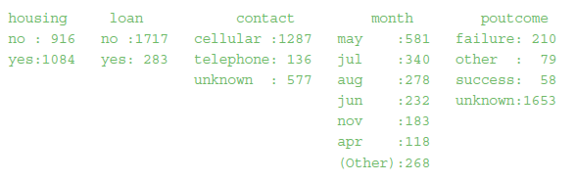

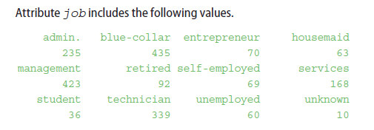
1.1 Decision Trees 8/9
A summary of the dataset shows the following statistics.

Slide 12
1.1 Decision Trees 9/9
Figure 7-4 shows a decision tree built over the bank marketing dataset. The root of the tree shows that the overall fraction of the clients who have not subscribed to the term deposit is 1,789 out of the total population of 2,000.
FIGURE 7-4 Using a decision tree to predict if a client will subscribe to a term deposit

Slide 13
1.2 The General Algorithm 1/8
Objective of a decision tree algorithm is to construct a tree T from a training set S.
If all the records in S belong to some class C (subscribed = yes, for example), or if S is sufficiently pure (greater than a preset threshold), then that node is considered a leaf node and assigned the label C
purity of a node is defined as its probability of the corresponding class
For example, in Figure 7-4, the root P(subscribed=yes) =(1− 1789/2000)= 10.55%; therefore, the root is only 10.55% pure on the subscribed=yes class. Conversely, it is 89.45% pure on the subscribed=no class.

Slide 14
1.2 The General Algorithm 2/8
If not all the records in S belong to class C or if S is not sufficiently pure, the algorithm selects the next most informative attribute A (duration, marital, and so on) and partitions S according to A’s values.
Algorithm constructs subtrees T1, T2 … for the subsets of S recursively until one of the following criteria is met:
All the leaf nodes in the tree satisfy the minimum purity threshold
The tree cannot be further split with the preset minimum purity threshold
Any other stopping criterion is satisfied (such as the maximum depth of the tree).
First step in constructing a decision tree is to choose the most informative attribute. A common way to identify the most informative attribute is to use entropy-based methods - decision tree earning algorithms such as ID3 (or Iterative Dichotomiser 3) and C4.5. Entropy methods select he most informative attribute based on two basic measures:
Entropy, which measures the impurity of an attribute
Information gain, which measures the purity of an attribute

Slide 15

1.2 The General Algorithm 3/8
Given a class X and its label x ∈ X , let P(x) be the probability of x . H_{x}, the entropy of X , is defined as shown in Equation 7-1.
In Equation 7-1 shows that
entropy H_{X} becomes 0 when all P(x) is 0 or 1.
For a binary classification (true or false), H_{X} is zero if P(x) the probability of each label x is either zero or one.
On the other hand, H_{X} achieves the maximum entropy when all the class labels are equally probable.
For a binary classification, H_{X} =1 if the probability of all class labels is 50/50. The maximum entropy increases as the number of possible outcomes increases.

Slide 16
1.2 The General Algorithm 4/8
Entropy graph is shown in Figure 7-5. Let x =1 represent heads and x =0 represent tails. The entropy of the unknown result of the next toss is maximized when the coin is fair.
That is, when heads and tails have equal probability P(x =1)=P(x =0)=0.5, entropy H_{X} =−(0.5×log₂0.5+0.5×log₂ 0.5)=1. On the other hand, if the coin is not fair, the probabilities of heads and tails would not be equal and there would be less uncertainty.
As an extreme case, when the probability of tossing a head is equal to 0 or 1, the entropy is minimized to 0. Therefore, the entropy for a completely pure variable is 0 and is 1 for a set with equal occurrences for both the classes (head and tail, or yes and no).
FIGURE 7-5 Entropy of coin flips, where X=1 represents heads

Slide 17
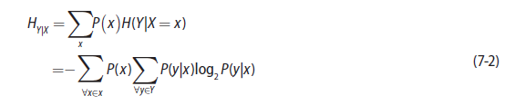
1.2 The General Algorithm 5/8
For the bank marketing scenario previously presented, the output variable is subscribed. The base entropy is defined as entropy of the output variable, that is H_{subscribed} .
As seen previously, P(subscribed=yes)=0.1055 and P(subscribed=no)=0.8945. According to Equation 7-1, the base entropy
H_{subscribed} =−0.1055⋅log₂0.1055−0.8945⋅log₂0.8945≈0.4862
The next step is to identify the conditional entropy for each attribute. Given an attribute X, its value x , its outcome Y, and its value y, conditional entropy H_{Y|X} is the remaining entropy of Y given X , formally defined as shown in Equation 7-2.

Slide 18
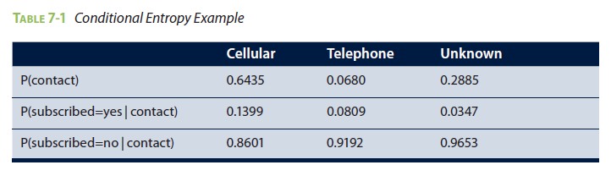
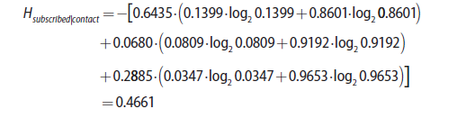
1.2 The General Algorithm 6/8
Consider the banking marketing scenario, if the attribute contact is chosen, X = {cellular, telephone, unknown}. The conditional entropy of contact considers all three values.
Table 7-1 lists the probabilities related to the contact attribute. The top row of the table displays probabilities of each value of the attribute. The next two rows contain the probabilities of the class labels conditioned on the contact.
The conditional entropy of the contact attribute is computed as shown here.

Slide 19


1.2 The General Algorithm 7/8
Computation inside the parentheses is on the entropy of the class labels within a single contact value.
Conditional entropy is always less than or equal to the base entropy—H_{subscribed |marital} ≤ H_{subscribed .} conditional entropy is smaller than the base entropy when the attribute and the outcome are correlated. In the worst case, when the attribute is uncorrelated with the outcome, the conditional entropy equals the base entropy
Information gain of an attribute A is defined as the difference between the base entropy and the conditional entropy of the attribute, as shown in Equation 7-3.
In the bank marketing example, the information gain of the contact attribute is shown in Equation 7-4.

Slide 20
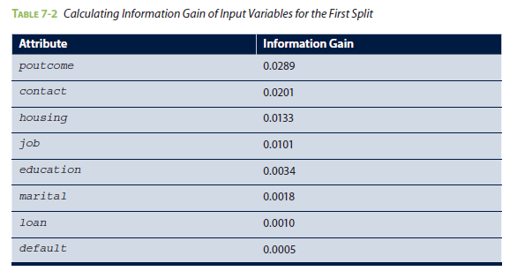
1.2 The General Algorithm 8/8

Slide 21

Detecting Significant Splits 1/4
Quite often it is necessary to measure the significance of a split in a decision tree, especially when the information gain is small, like in Table 7-2.
Let N_{A} and N_{B} be the number of class A and class B in the parent node. Let N_{AL} represent the number of class A going to the left child node, N_{BL} represent the number of class B going to the left child node, N_{AR} represent the number of class B going to the right child node, and N_{BR} represent the number of class B going to the right child node.
Let p_{L}and p_{R} denote the proportion of data going to the left and right node, respectively.
Notes:
Detecting Significant Splits – Tim các điểm tách (Phân nhánh) hợp lý

Slide 22
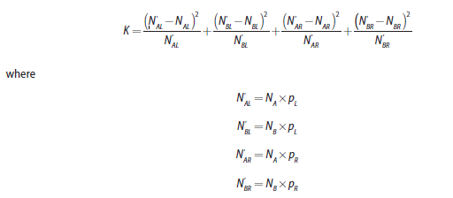
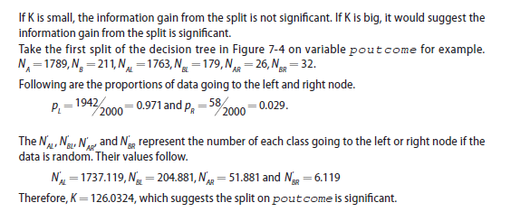
Detecting Significant Splits 2/4
The following measure computes the significance of a split. In other words, it measures how much the split deviates from what would be expected in the random data.

Slide 23
Detecting Significant Splits 3/4
FIGURE 7-6 Decision tree with attribute duration

Slide 24
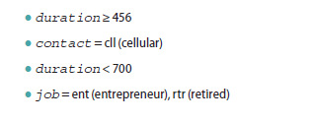
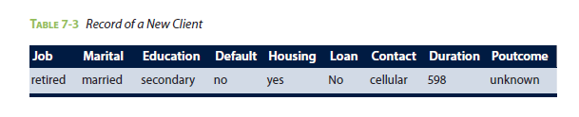
Detecting Significant Splits 4/4
With the decision tree in Figure 7-6, it becomes trivial to predict if a new client is going to subscribe to the term deposit.
For example, given the record of a new client shown in Table 7-3, the prediction is that this client will subscribe to the term deposit. The traversed paths in the decision tree are as follows.

Slide 25
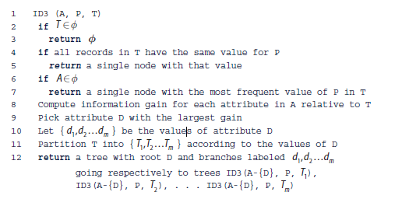
1.3 Decision Tree Algorithms
Methods of tree construction vary with different algorithms. Some popular algorithms include ID3, C4.5, and CART.
ID3 Algorithm
ID3 (or Iterative Dichotomiser 3) is one of the first decision tree algorithms, developed by John Ross Quinlan.
Let A be a set of categorical input variables,
P be the output variable (or the predicted class),
and T be the training set.

Slide 26
1.3 Decision Tree Algorithms - C4.5
Introduces a number of improvements over the original ID3 algorithm.
Can handle missing data. If the training records contain unknown attribute values, C4.5 evaluates the gain for an attribute by considering only the records where the attribute is defined.
Both categorical and continuous attributes are supported by C4.5. Values of a continuous variable are sorted and partitioned. For the corresponding records of each partition, the gain is calculated, and the partition that maximizes the gain is chosen for the next split.
ID3 algorithm may construct a deep and complex tree, cause overfitting (Section 7.1.4). C4.5 algorithm addresses the overfitting problem in ID3 by using a bottom-up technique called pruning to simplify the tree by removing the least visited nodes and branches

Slide 27

1.3 Decision Tree Algorithms - CART
CART (or Classification And Regression Trees) is often used as a generic acronym for the decision tree, although it is a specific implementation.
Similar to C4.5, CART can handle continuous attributes. Whereas C4.5 uses entropy-based criteria to rank tests, CART uses the Gini diversity index defined in Equation 7-5.
Whereas C4.5 employs stopping rules, CART constructs a sequence of subtrees, uses cross-validation to estimate the misclassification cost of each subtree, and chooses the one with the lowest cost.

Slide 28
1.4 Evaluating a Decision Tree 1/3
Use greedy algorithms, in that they always choose the option that seems the best available that moment.
At each step, the algorithm selects which attribute to use for splitting the remaining records. not be the best overall, but to be the best at that step.
Reinforces the efficiency of decision trees.
once a bad split is taken, it is propagated through the rest of the tree.
To address this problem, an ensemble technique (such as random forest) may randomize the splitting or even randomize data and come up with a multiple tree structure.
There are a few ways to evaluate a decision tree. First, evaluate whether the splits of the tree make sense. Conduct sanity checks by validating the decision rules with domain experts, and determine if the decision rules are sound.

Slide 29
1.4 Evaluating a Decision Tree 2/3
Next, look at the depth and nodes of the tree. Having too many layers and obtaining nodes with few members might be signs of overfitting.
In overfitting, the model fits the training set well, but it performs poorly on the new samples in the testing set. Figure 7-7 illustrates the performance of an overfit model.
Last, many standard diagnostics tools that apply to classifiers can help evaluate overfitting. These tools are further discussed in Section 7.3
FIGURE 7-7 An overfit model describes the training data well but predicts poorly on unseen data

Slide 30
1.4 Evaluating a Decision Tree 3/3
FIGURE 7-8 Decision surfaces can only be axis-aligned
Structure of a decision tree is sensitive to small variations in the training data
If a tree is too deep, overfitting may occur, because each split reduces the training data for subsequent splits

Slide 31
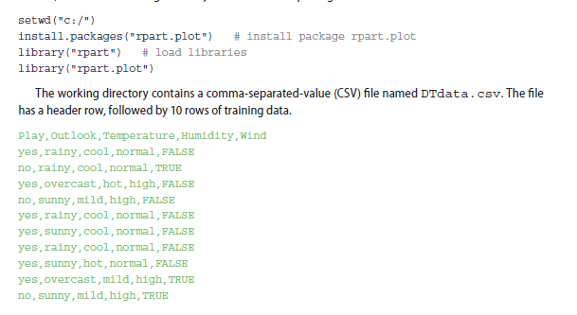
1.5 Decision Trees in R 1/7
rpart is for modeling decision trees,
rpart.plot enables the plotting of a tree.
The rest of this section shows an example of how to use decision trees in R with rpart.plot to predict whether to play golf given factors such as weather outlook, temperature, humidity, and wind.
In R, first set the working directory and initialize the packages.

Slide 32
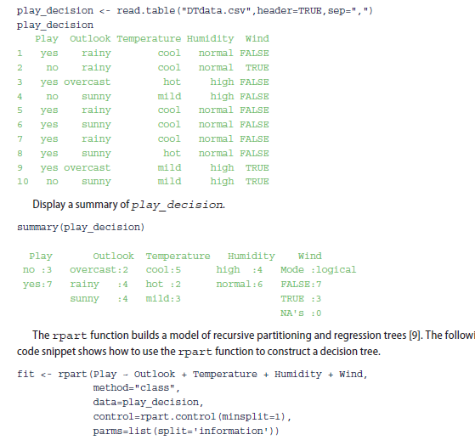
1.5 Decision Trees in R 2/7
The CSV file contains five attributes:
output variable: Play, Outlook, Temperature, Humidity, and Wind. Play (or the predicted class)
input variables: Outlook, Temperature, Humidity, and Wind.
In R, read the data from the CSV file in the working directory and display the content.

Slide 33
1.5 Decision Trees in R 3/7
rpart function has four parameters.
first, Play ~ Outlook + Temperature + Humidity + Wind, is the model indicating that attribute Play can be predicted based on attributes Outlook, Temperature, Humidity, and Wind.
second, method, is set to “class,” telling R it is building a classification tree.
third, data, specifies the dataframe containing those attributes mentioned in the formula.
fourth, control, is optional and controls the tree growth.
In the preceding example,
control=rpart.control(minsplit=1) requires that each node have at least one observation before attempting a split.
minsplit=1 makes sense for the small dataset, but for larger datasets minsplit could be set to 10% of the dataset size to combat overfitting.
Besides minsplit, other parameters are available to control the construction of the decision tree. For example, rpart.control(maxdepth=10,cp=0.001) limits the depth of the

Slide 34
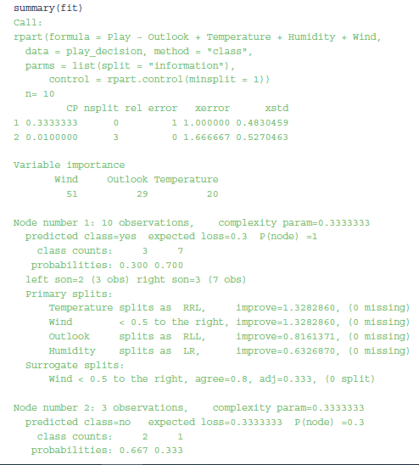
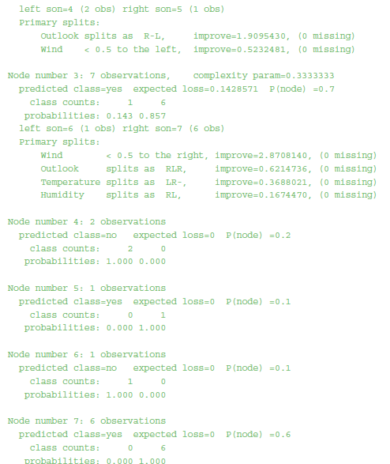
1.5 Decision Trees in R 4/7

Slide 35
1.5 Decision Trees in R 5/7
The output produced by the summary is difficult to read and comprehend.
rpart.plot() function from the rpart.plot package can visually represent the output in a decision tree. see the help file of rpart.plot by:
?rpart.plot
Following R code to plot the tree based on the model being built. The resulting tree is shown in Figure 7-9.
Each node of the tree is labeled as either yes or no referring to the Play action of whether to play outside.
Note that, by default, R has converted the values of Wind (True/False) into numbers.
FIGURE 7-9 A decision tree built from DTdata.csv
rpart.plot(fit, type=4, extra=1)

Slide 36

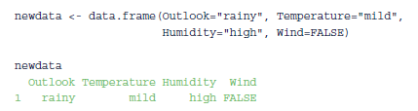
1.5 Decision Trees in R 6/7
The decisions in Figure 7-9 are abbreviated. Use the following command to spell out the full names and display the classification rate at each node.
The decision tree can be used to predict outcomes for new datasets. Consider a testing set that contains the following record.
The following code loads the data into R as a data frame newdata.

Slide 37

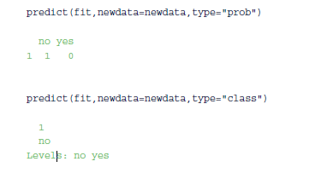
1.5 Decision Trees in R 7/7
Next, use the predict function to generate predictions from a fitted rpart object. The format of the predict function follows.
Parameter type is a character string denoting the type of the predicted value.
Output shows that one instance is classified as Play=no, and zero instances are classified as Play=yes.

Slide 38
2 Naive Bayes 1/2
Naïve Bayes is a probabilistic classification method based on Bayes’ theorem (or Bayes’ law) with a few tweaks. Bayes’ theorem gives the relationship between the probabilities of two events and their conditional probabilities.
A naïve Bayes classifier assumes that the presence or absence of a particular feature of a class is unrelated to the presence or absence of other features.
For example, an object can be classified based on its attributes such as shape, color, and weight. A reasonable classification for an object that is spherical, yellow, and less than 60 grams in weight may be a tennis ball. Even if these features depend on each other or upon the existence of the other features, a naïve Bayes classifier considers all these properties to contribute independently to the probability that the object is a tennis ball.

Slide 39
2 Naive Bayes 2/2
The input variables are generally categorical, but variations of the algorithm can accept continuous variables.
Some ways to convert continuous variables into categorical ones, often referred to as the discretization of continuous variables.
For an attribute such as income, the attribute can be converted into categorical values as shown below.
Low Income: income < $10,000
Working Class: $10,000 ≤ income < $50,000
Middle Class: $50,000 ≤ income < $1,000,000
Upper Class: income ≥ $1,000,000

Slide 40

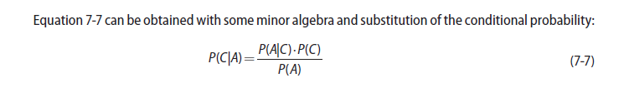
2.1 Bayes’ Theorem 1/5
conditional probability of event C occurring when event A has already occurred, is denoted as P(C|A) , which can be found using the formula in Equation 7-6.
where C is the class label C ∈{ c₁,c₂,…c_{n} } and A is the observed attributes A ={a₁, a₂,… a_{n}} . Equation 7-7 is the most common form of the Bayes’ theorem.
Mathematically, relationship between the probabilities of C and A, P(C) and P(A), and the conditional probabilities of C given A and A given C, namely P(C|A) and P(A|C).
Bayes’ theorem is significant because quite often P(C | A) is much more difficult to compute than
P(A|C) and P(C) from the training data. By using Bayes’ theorem, this problem can be circumvented.

Slide 41
2.1 Bayes’ Theorem 2/5
An example, John flies frequently and likes to upgrade his seat to first class. He has determined that
if he checks in for his flight at least two hours early, the probability that he will get an upgrade is 0.75;
otherwise, the probability that he will get an upgrade is 0.35.
With his busy schedule, he checks in at least two hours before his flight only 40% of the time.
Suppose John did not receive an upgrade on his most recent attempt.
What is the probability that he did not arrive two hours early?
Let C = {John arrived at least two hours early}, and A = {John received an upgrade}, then ¬C = {John did not arrive two hours early}, and ¬A = {John did not receive an upgrade}.
John checked in at least two hours early only 40% of the time, or P(C)=0.4. Therefore, P(￢C)=1−P(C)=0.6.
The probability that John received an upgrade given that he checked in early is 0.75, or P(A|C)=0.75. The probability that John received an upgrade given that he did not arrive two hours early is 0.35, or P(A|￢C)=0.35. Therefore, P(￢A|￢C)=0.65.

Slide 42
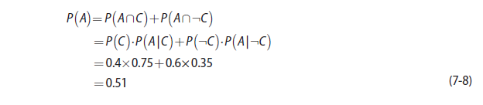

2.1 Bayes’ Theorem 3/5
Probability that John received an upgrade P(A) can be computed as shown in Equation 7-8.
Probability that John did not receive an upgrade P(￢A)=0.49. Using Bayes’ theorem,
Probability that John did not arrive two hours early given that he did not receive his upgrade is shown in Equation 7-9.

Slide 43

2.1 Bayes’ Theorem 4/5
Assume that a patient named Mary took a lab test for a certain disease and the result came back positive.
The test returns a positive result in 95% of the cases in which the disease is actually present, and it returns a positive result in 6% of the cases in which the disease is not present. Furthermore, 1% of the entire population has this disease.
What is the probability that Mary actually has the disease, given that the test is positive?
Let C = {having the disease} and A = {testing positive}. The goal is to solve the probability of having the disease, given that Mary has a positive test result, P(C|A). From the problem description, P(C)=0.01, P(￢C)=0.99, P(A|C)=0.95 and P(A|￢C)=0.06.
Bayes’ theorem defines P(C | A)=P(A|C)P(C)/ P(A). The probability of testing positive, that is P(A), needs to be computed first. That computation is shown in Equation 7-10.

Slide 44


2.1 Bayes’ Theorem 5/5
According to Bayes’ theorem, the probability of having the disease, given that Mary has a positive test result, is shown in Equation 7-11.
A more general form of Bayes’ theorem assigns a classified label to an object with multiple attributes A ={a₁ ,a₂ ,…,a_{m} } such that the label corresponds to the largest value of P (Ci |A ).
probability that a set of attribute values A (composed of m variables a₁ ,a₂ ,…,a_{m}) should be labeled with a classification label c_{i} equals the probability that the set of variables a₁ ,a₂ ,…,a_{m} given ci is true, times the probability of ci divided by the probability of a₁ ,a₂ ,…,a_{m}. (Equation 7-12)

Slide 45


2.2 Naïve Bayes Classifier 1/7
With two simplifications, Bayes’ theorem can be extended to become a naïve Bayes classifier.
The first simplification is to use the conditional independence assumption. That is, each attribute is conditionally independent of every other attribute given a class label ci. See Equation 7-13.
Therefore, this naïve assumption simplifies the computation of P (a₁ ,a₂ ,…,a_{m} | C_{i}) .
The second simplification is to ignore the denominator P (a₁ ,a₂ ,…,a_{m)}. Because P (a₁ ,a₂ ,…,a_{m} ) appears in the denominator of P(ci | A) for all values of i, removing the denominator will have no impact on the relative probability scores and will simplify calculations.
Naïve Bayes classification applies the two simplifications mentioned earlier and, as a result,
P(a₁ ,a₂ ,…,a_{m}) is proportional to the product of P( ai | cj) times P (ci). This is shown in Equation 7-14.

Slide 46
2.2 Naïve Bayes Classifier 2/7
Mathematical symbol ∝ indicates that the LHS P(c_{i}|A) is directly proportional to the RHS.
Building a naïve Bayes classifier requires knowing certain statistics, all calculated from the training set. The first requirement is to collect the probabilities of all class labels, P (c_{i}).
The second thing the naïve Bayes classifier needs to know is the conditional probabilities of each attribute a_{j} given each class label ci, namely P(a_{j} |c_{i}).

Slide 47
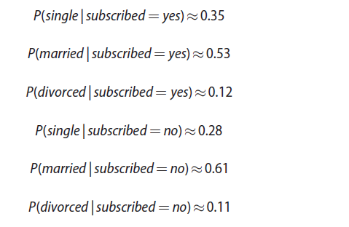
2.2 Naïve Bayes Classifier 3/7
Training set contains several attributes: job, marital, education, default, housing, loan, contact, and poutcome.
For each attribute and its possible values, computing the conditional probabilities given subscribed=yes or subscribed=no is required. For example, relative to the marital attribute, the following conditional probabilities are calculated.

Slide 48


2.2 Naïve Bayes Classifier 4/7
After training the classifier and computing all the required statistics, the naïve Bayes classifier can be tested over the testing set. For each record in the testing set, the naïve Bayes classifier assigns the classifier

Slide 49
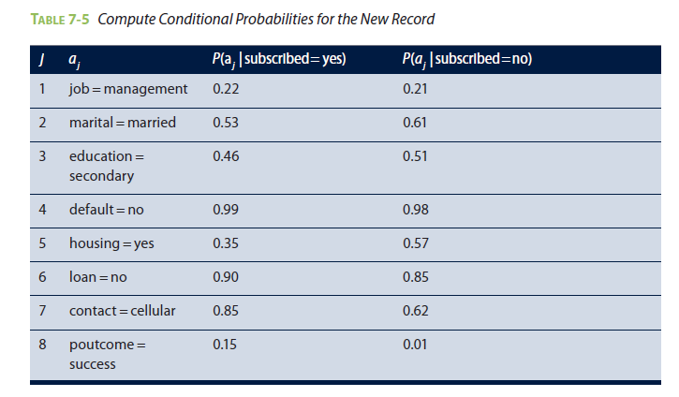
2.2 Naïve Bayes Classifier 5/7
Conditional probabilities shown in Table 7-5 can be calculated after building the classifier with the training set.

Slide 50
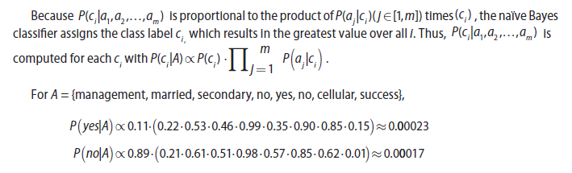
2.2 Naïve Bayes Classifier 6/7
Because P(subscribed= yes|A)>P(subscribed=no|A), the client shown in Table 7-4 is assigned with the label subscribed= yes. That is, the client is classified as likely to subscribe to the term deposit.
Although the scores are small in magnitude, it is the ratio of P(yes|A) and P(no|A) that matters. In fact, the scores of P(yes|A) and P(no|A) are not the true probabilities but are only proportional to the true probabilities, as shown in Equation 7-14.

Slide 51

2.2 Naïve Bayes Classifier 7/7
After all, if the scores were indeed the true probabilities, the sum of P(yes|A) and P(no|A) would be equal to one.
When looking at problems with a large number of attributes, or attributes with a high number of levels, these values can become very small in magnitude (close to zero), resulting in even smaller differences of the scores. This is the problem of numerical underflow, caused by multiplying several probability values that are close to zero.
A way to alleviate the problem is to compute the logarithm of the products, which is equivalent to the summation of the logarithm of the probabilities. Thus, the naïve Bayes formula can be rewritten as shown in Equation 7-15.

Slide 52

2.3 Smoothing 1/2
If one of the attribute values does not appear with one of the class labels within the training set, the corresponding P(a_{j} | c_{i}) will equal zero.
When this happens, the resulting P(a_{j}|c_{i}) from multiplying all the P(a_{j} | c_{i})(j ∈[1, m]) immediately becomes zero regardless of how large some of the conditional probabilities are. Therefore overfitting occurs.
Smoothing techniques can be employed to adjust the probabilities of P(a_{j}|c_{i}) and to ensure a nonzero value of P(c_{i} | A). A smoothing technique assigns a small nonzero probability to rare events not included in the training dataset. Also, the smoothing addresses the possibility of taking the logarithm of zero that may occur in Equation 7-15.
There are various smoothing techniques. Among them is the Laplace smoothing (or add-one) technique that pretends to see every outcome once more than it actually appears. This technique is shown in Equation 7-16.

Slide 53

2.3 Smoothing 2/2
For example, say that 100 clients subscribe to the term deposit, with 20 of them single, 70 married, and 10 divorced.
The “raw” probability is P(single | subscribed= yes)=20/100=0.2. With Laplace smoothing adding one to the counts, the adjusted probability becomes P’(single | subscribed= yes)=(20+1)/[(20+1)+(70+1)+(10+1)]≈0.2039.
One problem of the Laplace smoothing is that it may assign too much probability to unseen events. To address this problem, Laplace smoothing can be generalized to use ε instead of 1, where typically ε∈[0,1]. See Equation 7-17.
Smoothing techniques are available in most standard software packages for naïve Bayes classifiers.
However, if for some reason (like performance concerns) the naïve Bayes classifier needs to be coded
directly into an application, the smoothing and logarithm calculations should be incorporated into the
implementation.

Slide 54
2.4 Diagnostics - Advantages 1/2
Handle missing values, robust to irrelevant variables—variables that are distributed among all the classes whose effects are not pronounced.
Simple to implement even without using libraries. The prediction is based on counting the occurrences of events, making the classifier efficient to run, computationally efficient, and handle high-dimensional data efficiently.
Competitive with other learning algorithms, including decision trees and neural networks. In some cases naïve Bayes even outperforms other methods.
Bayes classifier can handle categorical variables with many levels
Overall performs better than decision trees on categorical values with many levels. Compared to decision trees, it is more resistant to overfitting, especially with the presence of a smoothing technique.

Slide 55
2.4 Diagnostics - Disadvantages 2/2
Assumes the variables in the data are conditionally independent. Therefore, it is sensitive to correlated variables because the algorithm may double count the effects.
Although probabilities are provided as part of the output for the prediction, in general are not very reliable for probability estimation and should be used only for assigning class labels.
Used only with categorical variables, any continuous variables should be converted into a categorical variable with the process known as discretization.
In common statistical software packages, naïve Bayes is implemented in a way that enables it to handle continuous variables as well.

Slide 56

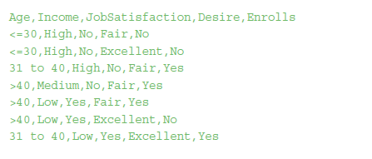
2.5 Naïve Bayes in R 1/9
Examples show how to use naïve Bayes to predict whether employees would enroll in an onsite educational program.

Slide 57
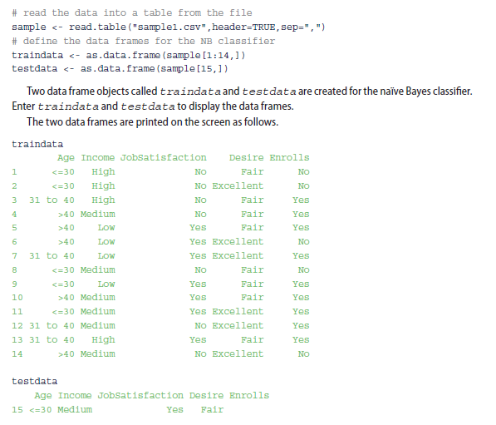
2.5 Naïve Bayes in R 2/9
The last record of the CSV is used later for illustrative purposes as a test case.
It does not include a value for the output variable Enrolls, which should be predicted using the naïve Bayes classifier built from the training set.

Slide 58
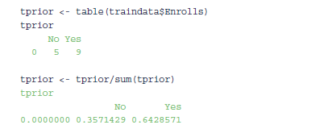
2.5 Naïve Bayes in R 3/9
First method shown here is to build a naïve Bayes classifier from scratch by manually computing the probability scores.
First step in building a classifier is to compute the prior probabilities of the attributes, including Age, Income, JobSatisfaction, and Desire. According to the naïve Bayes classifier, these attributes are conditionally independent. The dependent variable (output variable) is Enrolls.
Compute the prior probabilities P (ci ) for Enrolls, where ci ∈C and C ={Yes,No}.
Next step is to compute conditional probabilities P(A|C),
where A={Age,Income, JobSatisfaction,Desire} and C ={Yes,No}.

Slide 59
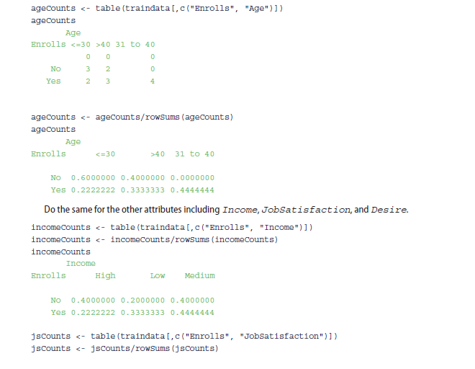
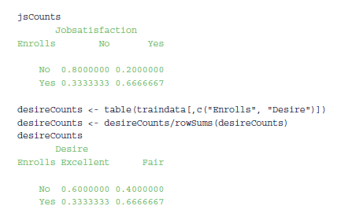
2.5 Naïve Bayes in R 4/9
continue

Slide 60
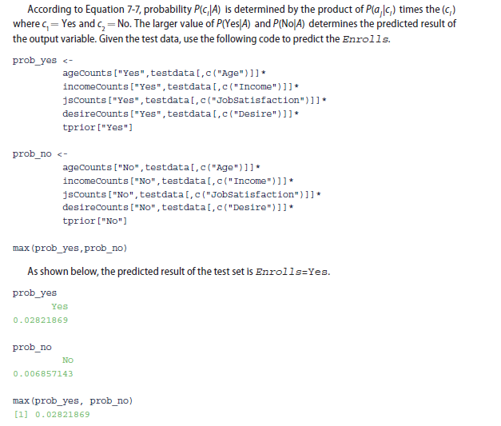
2.5 Naïve Bayes in R 5/9

Slide 61

2.5 Naïve Bayes in R 6/9
Function takes the form of naiveBayes(formula, data,...), where the arguments are defined as follows.
formula: A formula of the form class ~ x1 + x2 + ... assuming x1, x2… are conditionally independent
data: A data frame of factors
Use the following code snippet to execute the model and display the results.
The output that follows shows that the probabilities of model match the probabilities from the
previous method.

Slide 62
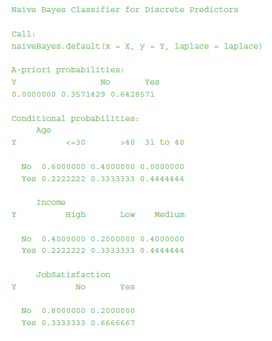
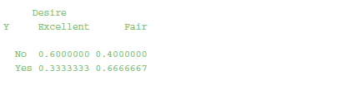
2.5 Naïve Bayes in R 7/9

Slide 63
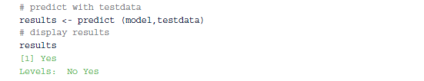
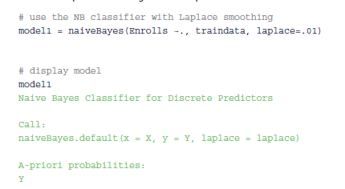
2.5 Naïve Bayes in R 8/9
Next, predicting the outcome of Enrolls with the testdata shows the result is Enrolls=Yes.
The naiveBayes function accepts a Laplace parameter that allows the customization of the ε value of Equation 7-17 for the Laplace smoothing.
The code shows with Laplace smoothing ε=0.01 for prediction

Slide 64
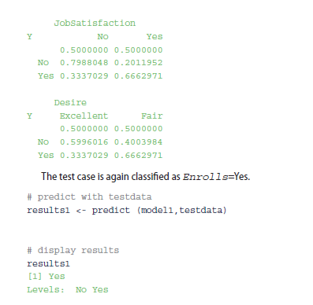
2.5 Naïve Bayes in R 9/9

Slide 65
3 Diagnostics of Classifiers 1/8
Few tools designed to evaluate the performance of a classifier.
A confusion matrix is a specific table layout that allows visualization of the performance of a classifier. Table 7-6 shows the confusion matrix for a two-class classifier.
True positives (TP) are the number of positive instances the classifier correctly identified as positive.
False positives (FP) are the number of instances in which the classifier identified as positive but in reality are negative
True negatives (TN) are the number of negative instances the classifier correctly identified as negative.
False negatives (FN) are the number of instances classified as negative but in reality are positive.
In a two-class classification, a preset threshold may be used to separate positives from negatives. TP and TN are the correct guesses.
A good classifier should have large TP and TN and small (ideally zero) numbers for FP and FN.

Slide 66
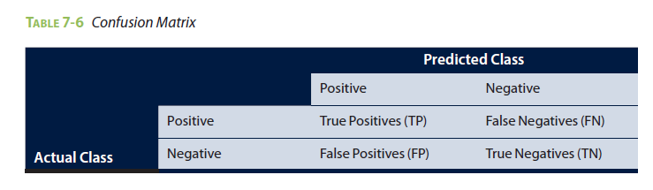
3 Diagnostics of Classifiers 2/8

Slide 67
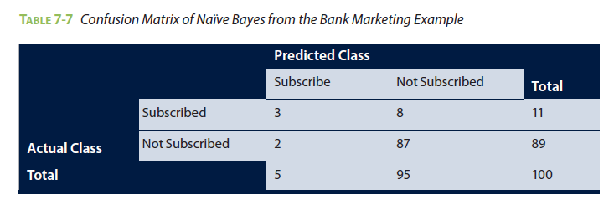

3 Diagnostics of Classifiers 3/8
accuracy (or the overall success rate) is a metric defining the rate at which a model has classified the records correctly.
It is defined as the sum of TP and TN divided by the total number of instances, as shown in Equation 7-18.

Slide 68
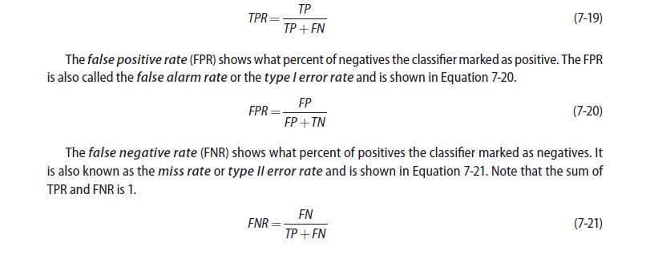
3 Diagnostics of Classifiers 4/8
A good model should have a high accuracy score, but having a high accuracy score alone does not guarantee the model is well established.
true positive rate (TPR) shows what percent of positive instances the classifier correctly identified. (illustrated in Equation 7-19)

Slide 69

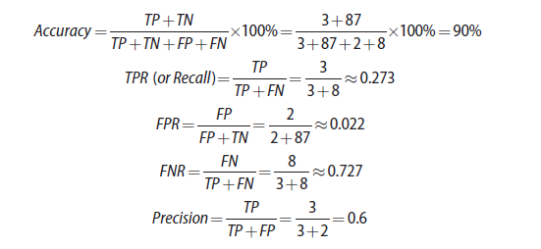
3 Diagnostics of Classifiers 5/8
Precision is the percentage of instances marked positive that really are positive shown in Equation 7-22.
Recall is the percentage of positive instances that were correctly. Given the confusion matrix from Table 7-7, the metrics can be calculated as follows:

Slide 70
3 Diagnostics of Classifiers 6/8
In the bank marketing example, the naïve Bayes classifier performs well with accuracy and FPR measures and relatively well on precision.
However, it performs poorly on TPR and FNR. To improve the performance, try to include more attributes in the datasets to better distinguish the characteristics of the records. There are other ways to evaluate the performance of a classifier in general, such as N-fold cross validation or bootstrap
ROC(receiver operating characteristic) curve is a common tool to evaluate classifiers.
The vertical axis is the True Positive Rate (TPR), and the horizontal axis is the False Positive Rate (FPR).

Slide 71
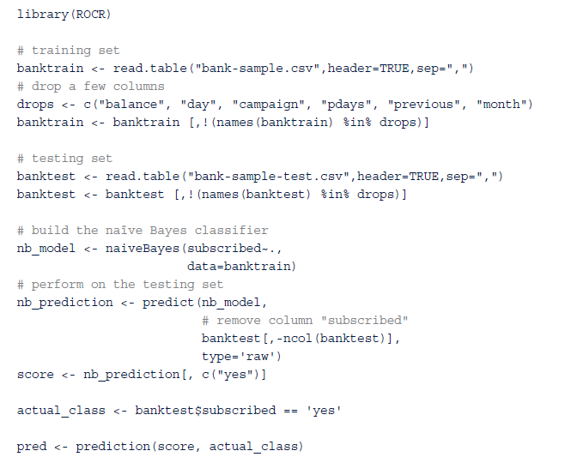
3 Diagnostics of Classifiers 7/8

Slide 72
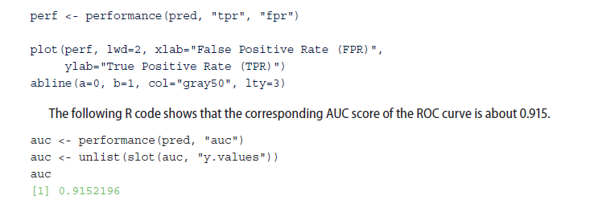
3 Diagnostics of Classifiers 8/8
FIGURE 7-10 ROC curve of the naive Bayes classifier on the bank marketing dataset

Slide 73
4 Additional Classification Methods 1/2
Besides the two classifiers introduced, several other methods are commonly used for classification, including bagging, boosting , random forest, and support vector machines (SVM).
Bagging, boosting, and random forest are all examples of ensemble methods that use multiple models to obtain better predictive performance than can be obtained from any of the constituent models.
Bagging (or bootstrap aggregating) uses the bootstrap technique that repeatedly samples with replacement from a dataset according to a uniform probability distribution.
A model or base classifier is trained separately on ach bootstrap sample, and a test sample is assigned to the class that received the highest number of votes.

Slide 74
4 Additional Classification Methods 2/2
Boosting (or AdaBoost) uses votes for classification to combine the output of individual models. Bagging and boosting have been shown to have better performances than a decision tree.
Random forest is a class of ensemble methods using decision tree classifiers.
SVM is another common classification method that combines linear models with instance-based learning techniques.

Slide 75
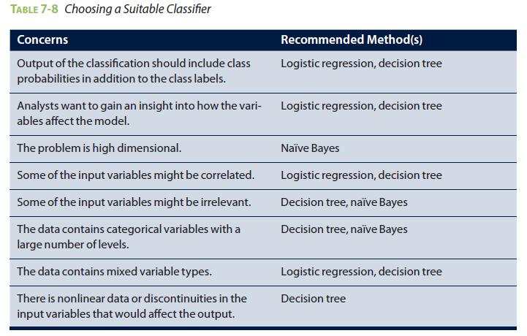
Summary
Focused on two classification methods: decision trees and naïve Bayes
It discussed the theory behind these classifiers and used a bank marketing example to explain how the methods work in practice
Each of these methods has its own advantages and disadvantages. How does one pick the most suitable method for a given classification problem?

