Slide 1

Concepts in Enterprise Resource Planning
Fourth Edition
Chapter One
Business Functions and Business Processes

Slide 2
Objectives
After completing this chapter, you will be able to:
Name the main functional areas of operation used in business
Differentiate between a business process and a business function
Identify the kinds of data each main functional area produces (output data)
Identify the kinds of data each main functional area needs (input data)
Define integrated information systems, and explain why they are essential in today’s globally competitive business environment.
Concepts in Enterprise Resource Planning, Fourth Edition

Slide 3
Introduction
Enterprise Resource Planning (ERP) programs: Core software used by companies to coordinate information in every area of business
  Help manage companywide business processes
  Use common database and shared management reporting tools
Business process: Collection of activities that takes some input and creates an output that is of value to the customer
Concepts in Enterprise Resource Planning, Fourth Edition

Slide 4
The Functional Organization Structure
The most common organizational structure you are likely to encounter is the functional structure.
Organizations that utilize a functional structure are divided into functions, or departments, each of which is responsible for a set of closely related activities.
Typical functions or departments found in a modern organization include purchasing, operations, warehouse, sales and marketing, research and development, finance and accounting, human resources, and information systems.
Concepts in Enterprise Resource Planning, Fourth Edition

Slide 5
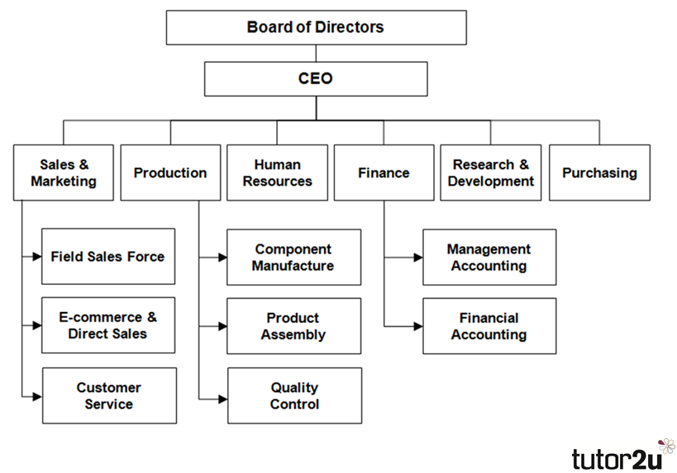
The Functional Organization Structure
Concepts in Enterprise Resource Planning, Fourth Edition

Slide 6
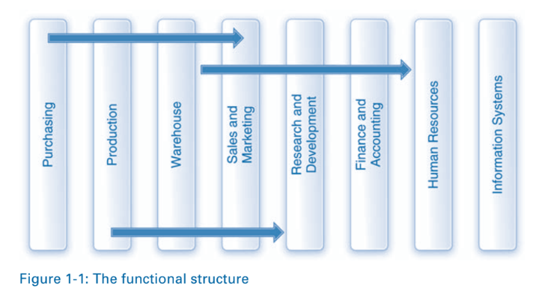
The Functional Organization Structure
Concepts in Enterprise Resource Planning, Fourth Edition

Slide 7
The Silo Effect
The functional structure served organizations well for a number of years. Over time, however, this system developed a serious drawback
People in the different functional areas came to perform their steps in the process in isolation, without fully understanding which steps happen before and which steps happen next.
They essentially complete their part of the process, hand it off to the next person, and then proceed to the next task.
This tendency is commonly referred to as the silo effect because workers complete their tasks in their functional “silos” without regard to the consequences for the other components in the process.
Concepts in Enterprise Resource Planning, Fourth Edition

Slide 8
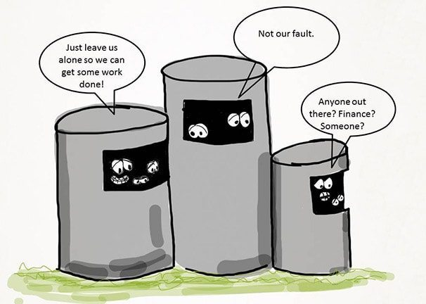
The Silo Effect
Concepts in Enterprise Resource Planning, Fourth Edition

Slide 9
The Silo Effect
A key point here is that the silo nature of the functional organizational structure and the cross-functional nature of processes are at odds with each other.
A major challenge facing organizations, then, is to coordinate activities among the different functional areas.
Viewing a company from a process perspective requires employees to “think sideways”—in other words, to view the business across functional boundaries and focus on the end-to-end nature of the process and its intended outcomes.
Concepts in Enterprise Resource Planning, Fourth Edition

Slide 10
Enterprise System
A company will manufacture its products in different countries, acquire the materials to make these products from different locations, sell the products in many countries.
For example, An automobile manufacturer may buy the design from Italy, purchase components from China, produce some components and produce car in Vietnam, and sell those cars in the United States (What’s company?).
The steps in business processes are performed in locations that are geographically dispersed, it is impossible to manage such processes effectively without the use of modern information systems.
Concepts in Enterprise Resource Planning, Fourth Edition

Slide 11
Enterprise System
Systems that support end-to-end processes are called enterprise systems (ES)
They are essential to the efficient and effective execution and management of business process
Companies have invested enormous sums of capital and effort to plan, implement, and continuously improve enterprise systems over the past 40-plus years.
A great deal of research has confirmed that investments in information technology (IT)
Concepts in Enterprise Resource Planning, Fourth Edition

Slide 12
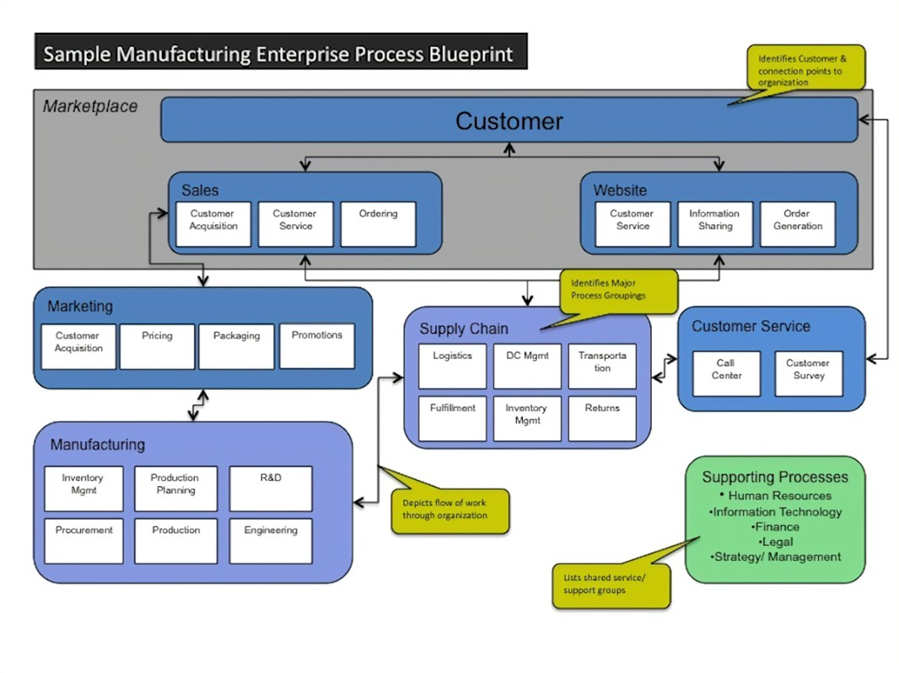
Enterprise System
Concepts in Enterprise Resource Planning, Fourth Edition

Slide 13
Functional Areas and Business Processes
To understand ERP, you must understand how a business works
  Functional areas of operation
  Business processes
Concepts in Enterprise Resource Planning, Fourth Edition

Slide 14
Functional Areas and Business Processes
Organizations exist either to serve some commercial purpose or to achieve some social objective
Organizations create and deliver products or services to customers to make a profit For example: Auto manufacturer Vinfast
Although organizations exist for many different purposes, vary greatly in size and complexity, and operate in many different industries, they all exhibit similarities in the ways that they operate.
Regardless of their type or size, successful organizations and industries use processes and enterprise systems to complete the work needed to achieve their goals
Concepts in Enterprise Resource Planning, Fourth Edition

Slide 15
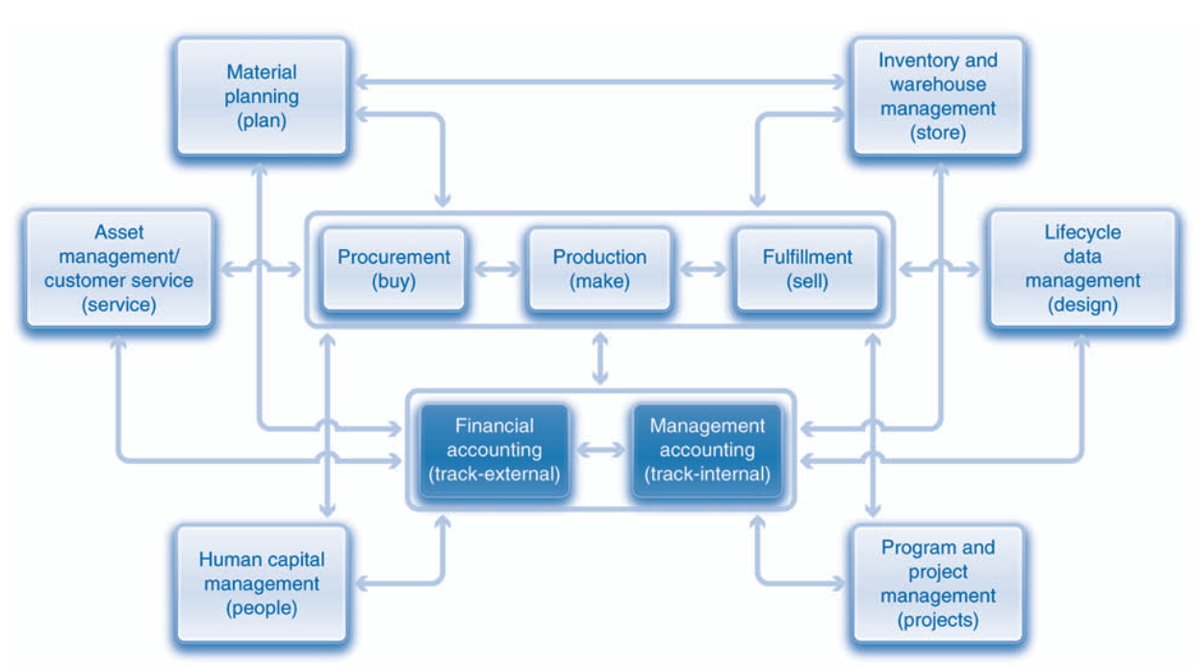

Functional Areas and Business Processes
Concepts in Enterprise Resource Planning, Fourth Edition
Notes:
Figure 1-3. Three processes are directly related to creating and delivering products and services. They are buy, make, and sell

Slide 16
Functional Areas of Operation (cont’d.)
Marketing and Sales (M/S)
Supply Chain Management (SCM)
Accounting and Finance (A/F)
Human Resources (HR)
Purchasing
Production
Business functions: Activities specific to a functional area of operation
Concepts in Enterprise Resource Planning, Fourth Edition

Slide 17
Functional Areas of Operation (cont’d.)
Functional areas are interdependent and each requires data from the others.
Better integration of functional areas leads to improvements in communication, workflow, and success of company
Information system (IS): Computers, people, procedures, and software that store, organize, and deliver information
Concepts in Enterprise Resource Planning, Fourth Edition

Slide 18
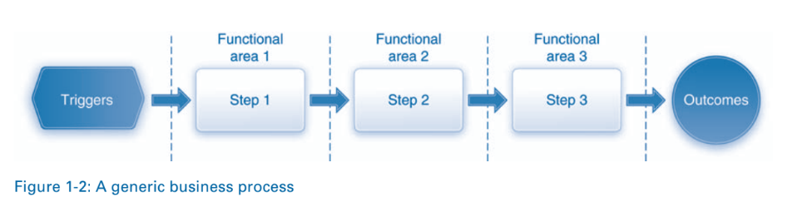
Business Processes
Collection of activities that takes one or more kinds of input and creates an output that is of value to customer
  Customer can be traditional external customer or internal customer
Thinking in terms of business processes helps managers to look at their organization from the customer’s perspective
Concepts in Enterprise Resource Planning, Fourth Edition

Slide 19
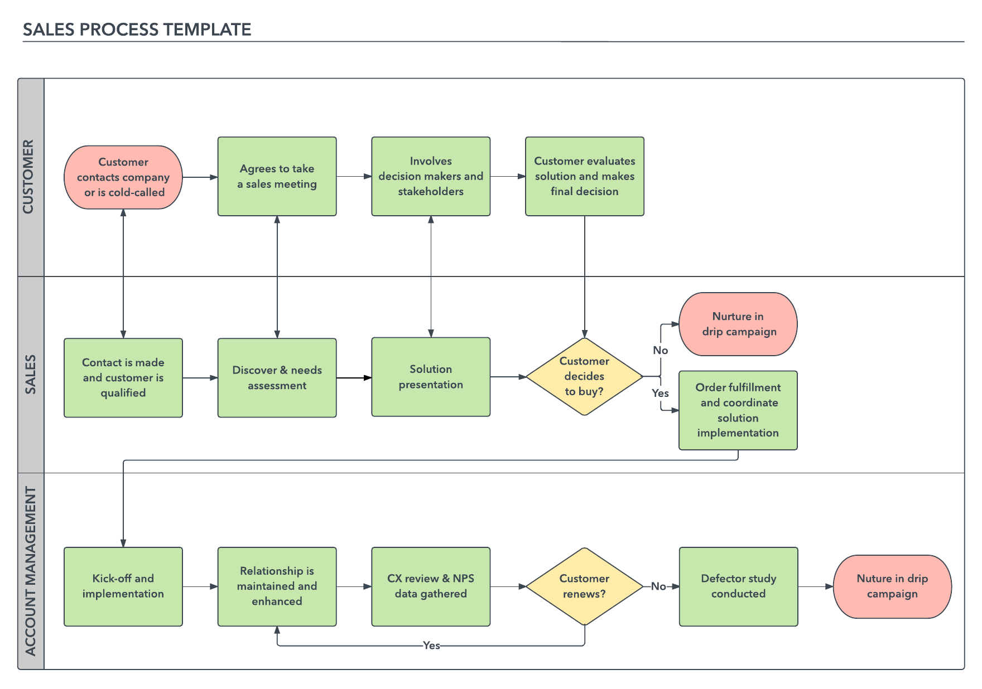
Business Processes
Concepts in Enterprise Resource Planning, Fourth Edition

Slide 20
Business Processes (cont’d.)
The procurement process (buy) refers to all of the activities involved in buying or acquiring the materials used by the organization, such as raw materials needed to make products.
The production process (make) involves the actual creation of the products within the organization. Whereas the production process is concerned with acquiring needed materials internally (by making them), the procurement process is concerned with obtaining needed materials externally (by buying them)
The fulfillment process (sell) consists of all the steps involved in selling and delivering the products to the organization’s customers.
Concepts in Enterprise Resource Planning, Fourth Edition

Slide 21
Business Processes (cont’d.)
The lifecycle data management process (design) supports the design and development of products from the initial product idea stage through the discontinuation of the product.
The material planning process (plan) uses historical data and sales forecasts to plan which materials will be procured and produced and in what quantities.
The inventory and warehouse management (IWM) process (store) is used to store and track the materials.
The asset management and customer service processes (service) are used to maintain internal assets such as machinery and to deliver after-sales customer service such as repairs.
Concepts in Enterprise Resource Planning, Fourth Edition

Slide 22
Business Processes (cont’d.)
Human capital management (HCM) processes (people) focus on the people within the organization and include functions such as recruiting, hiring, training, and benefits management.
Project management processes (projects) are used to plan and execute large projects such as the construction of a new factory or the production of complex products such as airplanes.
Concepts in Enterprise Resource Planning, Fourth Edition

Slide 23
Business Processes (cont’d.)
Financial accounting (FI) processes (track–external ) track the financial impacts of process steps with the goal of meeting legal reporting requirements—for example, the Internal Revenue Service (IRS) or the Securities and Exchange Commission ( SEC)
Management accounting or controlling (CO) processes (track–internal) focus on internal reporting to manage costs and revenues.
Concepts in Enterprise Resource Planning, Fourth Edition

Slide 24
Business Processes (cont’d.)
Businesses must always consider customer’s viewpoint in any transaction
Successful customer interaction
  Customer (either internal or external) is not required to interact with each business function involved in the process
Successful business managers view business operations from the perspective of a satisfied customer
Concepts in Enterprise Resource Planning, Fourth Edition

Slide 25
Business Processes (cont’d.)
Sharing data effectively and efficiently between and within functional areas leads to more efficient business processes
Integrated information systems: Systems in which functional areas share data
Concepts in Enterprise Resource Planning, Fourth Edition

Slide 26
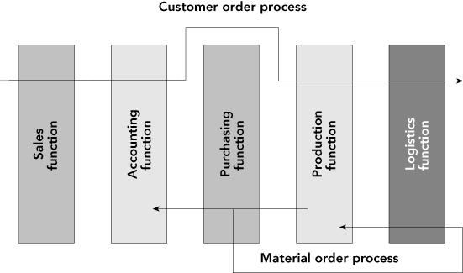
Business Processes (cont’d.)
Figure 1-3 A process view of business
Concepts in Enterprise Resource Planning, Fourth Edition

Slide 27
Business Processes (cont’d.)
Businesses take inputs (resources) and transform these inputs into goods and services for customers
  Inputs: Material, people, equipment
Managing inputs and business processes effectively requires accurate and up-to-date information
Concepts in Enterprise Resource Planning, Fourth Edition

Slide 28
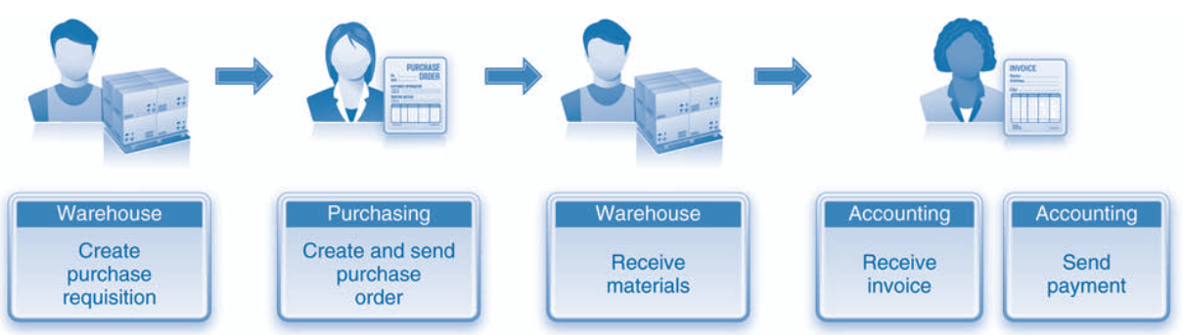
PROCUREMENT—BUY
The procurement process includes all of the tasks involved in acquiring needed materials externally from a vendor.
Concepts in Enterprise Resource Planning, Fourth Edition

Slide 29
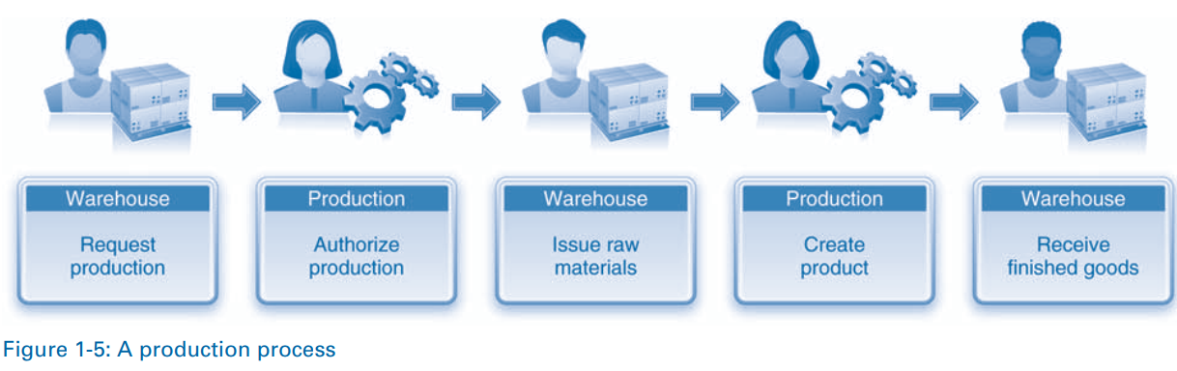
PRODUCTION—MAKE
Concepts in Enterprise Resource Planning, Fourth Edition

Slide 30
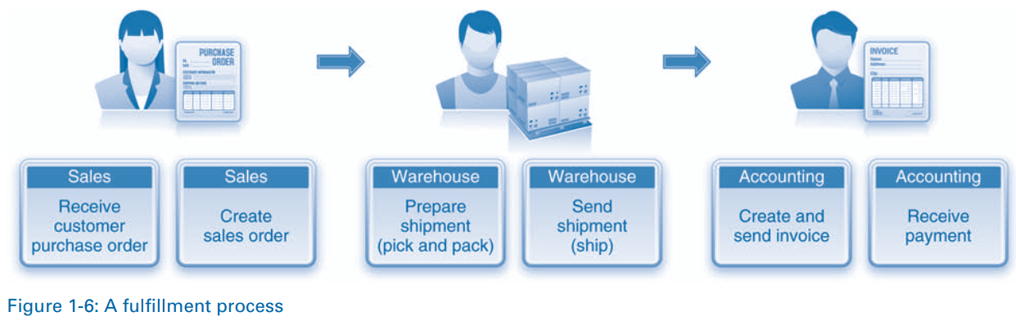
FULFILLMENT—SELL
Concepts in Enterprise Resource Planning, Fourth Edition

Slide 31
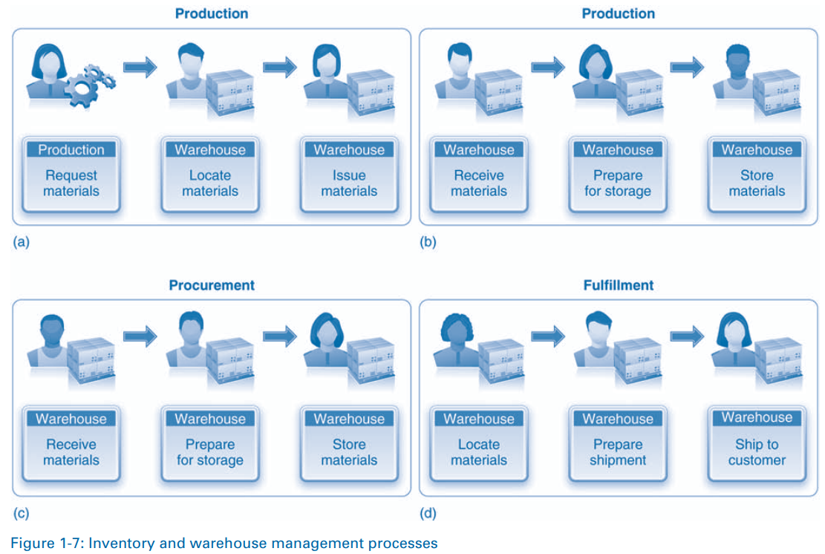
INVENTORY AND WAREHOUSE MANAGEMENT—STORE
Concepts in Enterprise Resource Planning, Fourth Edition

Slide 32
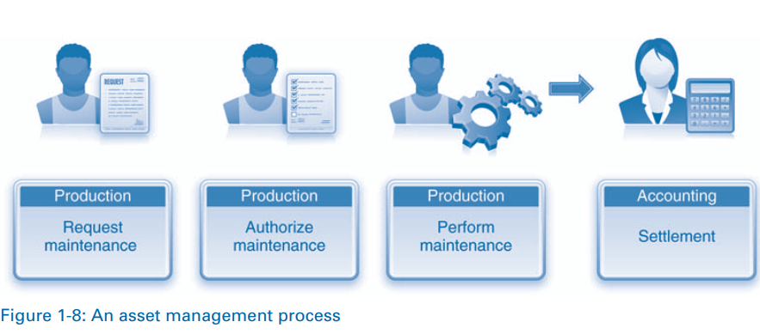
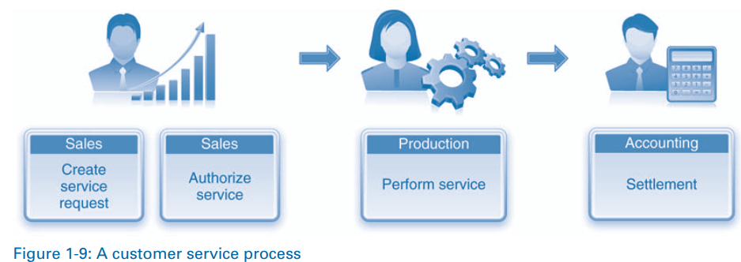
ASSET MANAGEMENT AND CUSTOMER SERVICE—SERVICE
Concepts in Enterprise Resource Planning, Fourth Edition

Slide 33
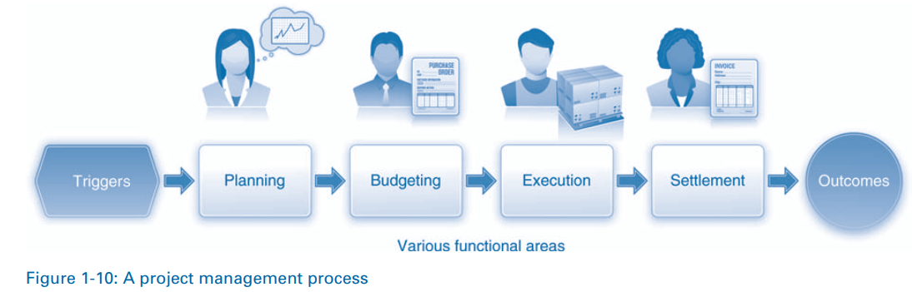
PROJECT MANAGEMENT—PROJECTS
Concepts in Enterprise Resource Planning, Fourth Edition

Slide 34
Functional Areas and Business Processes of a Very Small Business
Example: A fictitious coffee shop
  Examine business processes of the coffee shop
  See why coordination of functional areas helps achieve efficient and effective business processes
  Look at how integration of the information system improves the business
Concepts in Enterprise Resource Planning, Fourth Edition

Slide 35
Marketing and Sales (M/S)
Functions of Marketing and Sales
  Developing products
  Determining pricing
  Promoting products to customers
  Taking customers’ orders
  Helping create a sales forecast
Concepts in Enterprise Resource Planning, Fourth Edition

Slide 36
Marketing and Sales (cont’d.)
Marketing and Sales tasks for the coffee shop
  Formal recordkeeping not required
  Need to keep track of customers
  Product development can be done informally
  Good repeat customers allowed to charge purchases—up to a point
    Records must show how much each customer owes and his or her available credit
Concepts in Enterprise Resource Planning, Fourth Edition

Slide 37
Supply Chain Management (SCM)
Functions within Supply Chain Management
  Developing production plans (manufacturing/production): making the coffee
  Buying raw materials (purchasing)
Production planning requires sales forecasts from M/S (marketing/sale) functional area
  Sales forecasts: Analyses that attempt to predict the future sales of a product
Concepts in Enterprise Resource Planning, Fourth Edition

Slide 38
Supply Chain Management (cont’d.)
Production plans used to develop requirements for raw materials and packaging
  Raw materials: Bottled spring water, fresh lemons, artificial sweetener, raw sugar
  Packaging: Cups, straws, napkins
SCM and M/S must choose a recipe for each coffee product sold
Concepts in Enterprise Resource Planning, Fourth Edition

Slide 39
Accounting and Finance (A/F)
Functions within Accounting and Finance
  Recording raw data about transactions (including sales);
  Raw material purchases;
  Payroll;
  And receipt of cash from customers
Raw data: Numbers collected from sales, manufacturing and other operations, without any manipulation, calculation, or arrangement for presentation
Concepts in Enterprise Resource Planning, Fourth Edition

Slide 40
Accounting and Finance (cont’d.)
Data from Accounting and Finance used by Marketing and Sales and Supply Chain Management
  Sales records are important component of sales forecast
  Sales forecast is used in making staffing decisions and in production planning
  Records from accounts receivable used to monitor the overall credit-granting policy of the coffee shop
Concepts in Enterprise Resource Planning, Fourth Edition

Slide 41
Human Resources
Functions of Human Resources
  Recruit, train, evaluate, and compensate employees
HR uses sales forecasts developed by the individual departments to plan personnel needs
Concepts in Enterprise Resource Planning, Fourth Edition

Slide 42
Functional Area Information Systems
Systems integrated using ERP software provide the data sharing necessary between functional areas
Potential inputs and outputs for each functional area described
Note the kinds of data needed by each area and how people use the data
Information systems maintain relationships between all functional areas and processes
Concepts in Enterprise Resource Planning, Fourth Edition

Slide 43
Marketing and Sales
Needs information from all other functional areas
Customers communicate orders to M/S in person or by telephone, e-mail, fax, the Web, etc.
M/S has a role in determining product prices
  Pricing might be determined based on a product’s unit cost, plus some percentage markup
  Requires information from Accounting and Finance, and Supply Chain Management data
Concepts in Enterprise Resource Planning, Fourth Edition

Slide 44
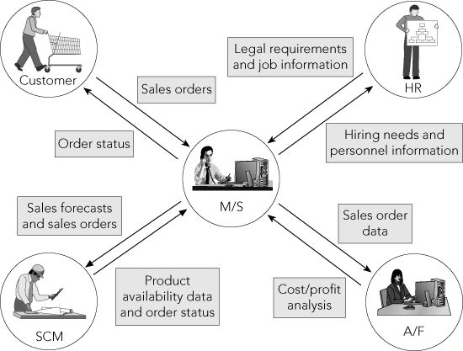
Marketing and Sales (cont’d.)
Figure 1-4 The Marketing and Sales functional area exchanges data with customers and with the Human Resources, Accounting and Finance, and Supply Chain Management functional areas
Concepts in Enterprise Resource Planning, Fourth Edition

Slide 45
Marketing and Sales (cont’d.)
M/S needs to interact with Human Resources to exchange information on hiring needs, legal requirements, etc.
Inputs for M/S
  Customer data
  Order data
  Sales trend data
  Per-unit cost
  Company travel expense policy
Concepts in Enterprise Resource Planning, Fourth Edition

Slide 46
Marketing and Sales (cont’d.)
Outputs for M/S
  Sales strategies
  Product pricing
  Employment needs
Concepts in Enterprise Resource Planning, Fourth Edition

Slide 47
Supply Chain Management
Needs information from various functional areas
Production plans based on information about product sales (actual and projected) that comes from Marketing and Sales
With accurate data about required production levels:
  Raw material and packaging can be ordered as needed
  Inventory levels can be kept low, saving money
Concepts in Enterprise Resource Planning, Fourth Edition

Slide 48
Supply Chain Management (cont’d.)
Supply Chain Management data and records can:
  Provide data needed by Accounting and Finance to determine how much of each resource was used
  Support the M/S function by providing information about what has been produced and shipped
Supply Chain Management interacts in some ways with Human Resources
Concepts in Enterprise Resource Planning, Fourth Edition

Slide 49
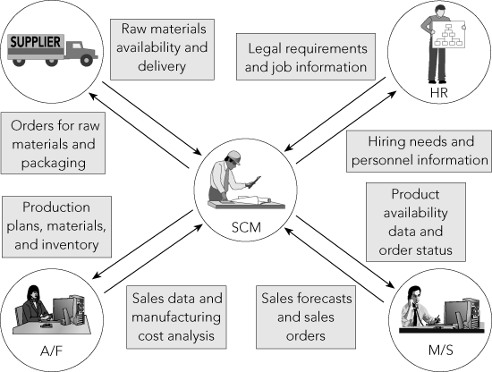
Supply Chain Management (cont’d.)
Figure 1-5 The Supply Chain Management functional area exchanges data with suppliers and with the Human Resources, Marketing and Sales, and Accounting and Finance functional areas
Concepts in Enterprise Resource Planning, Fourth Edition

Slide 50
Supply Chain Management (cont’d.)
Inputs for SCM
  Product sales data
  Production plans
  Inventory levels
  Layoff and recall company policy
Concepts in Enterprise Resource Planning, Fourth Edition

Slide 51
Supply Chain Management (cont’d.)
Outputs for SCM
  Raw material orders
  Packaging orders
  Resource expenditure data
  Production and inventory reports
  Hiring information
Concepts in Enterprise Resource Planning, Fourth Edition

Slide 52
Accounting and Finance
Needs information from all other functional areas
A/F personnel:
  Record company’s transactions in the books of account
  Record accounts payable when raw materials are purchased and cash outflows when they pay for materials
  Summarize transaction data to prepare reports about company’s financial position and profitability
Concepts in Enterprise Resource Planning, Fourth Edition

Slide 53
Accounting and Finance (cont’d.)
People in other functional areas provide data to A/F
  M/S provides sales data
  SCM provides production and inventory data
  HR provides payroll and benefit expense data
M/S personnel require data from A/F to evaluate customer credit
Concepts in Enterprise Resource Planning, Fourth Edition

Slide 54
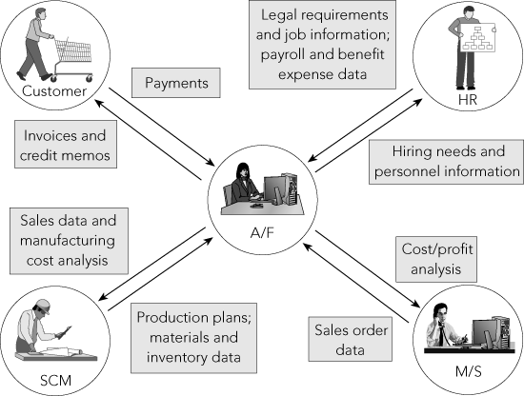
Accounting and Finance (cont’d.)
Figure 1-6 The Accounting and Finance functional area exchanges data with customers and with the Human Resources, Marketing and Sales, and Supply Chain Management functional areas
Concepts in Enterprise Resource Planning, Fourth Edition

Slide 55
Accounting and Finance (cont’d.)
Inputs for A/F
  Payments from customers
  Accounts receivable data
  Accounts payable data
  Sales data
  Production and inventory data
  Payroll and expense data
Concepts in Enterprise Resource Planning, Fourth Edition

Slide 56
Accounting and Finance (cont’d.)
Outputs for A/F
  Payments to suppliers
  Financial reports
  Customer credit data
Concepts in Enterprise Resource Planning, Fourth Edition

Slide 57
Human Resources
HR needs information from the other departments
Tasks related to employee hiring, benefits, training, and government compliance are all responsibilities of HR
HR needs accurate forecasts of personnel needs from all functional units
HR needs to know what skills are needed to perform a particular job and how much the company can afford to pay employees
Concepts in Enterprise Resource Planning, Fourth Edition

Slide 58
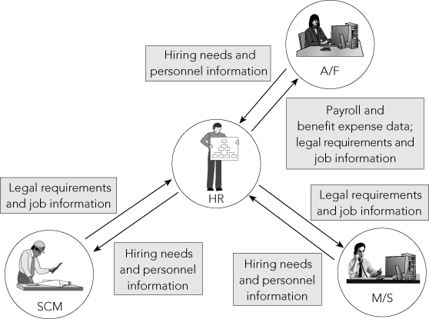
Human Resources (cont’d.)
Figure 1-7 The Human Resources functional area exchanges data with the Accounting and Finance, Marketing and Sales, and Supply Chain Management functional areas
Concepts in Enterprise Resource Planning, Fourth Edition

Slide 59
Human Resources (cont’d.)
Observing governmental regulations in recruiting, training, compensating, promoting, and terminating employees
Inputs for HR
  Personnel forecasts
  Skills data
Concepts in Enterprise Resource Planning, Fourth Edition

Slide 60
Human Resources (cont’d.)
Outputs for HR
  Regulation compliance
  Employee training and certification
  Skills database
  Employee evaluation and compensation
Concepts in Enterprise Resource Planning, Fourth Edition

Slide 61
Human Resources (cont’d.)
Significant amount of data is maintained by and shared among the functional areas
Timeliness and accuracy of these data critical to each area’s success and to company’s ability to make a profit and generate future growth
ERP software allows all functional areas to share a common database
  Allows accurate, real-time information to be available
Concepts in Enterprise Resource Planning, Fourth Edition

Slide 62
Summary
Basic functional areas: Marketing and Sales, Supply Chain Management, Accounting and Finance, and Human Resources
Marketing and Sales: Sets product prices, promotes products through advertising and marketing, takes customer orders, supports customers, and creates sales forecasts
Supply Chain Management: Develops production plans, orders raw materials from suppliers, receives raw material, manufactures products, maintains facilities, and ships products to customers
Concepts in Enterprise Resource Planning, Fourth Edition

Slide 63
Summary (cont’d.)
Accounting and Finance: Financial accounting to provide summaries of operational data in managerial reports, controlling accounts, planning and budgeting, and cash-flow management
Human Resources: Recruits, hires, trains, and compensates employees, ensures compliance with government regulations, and oversees the evaluation of employees
Information systems capture, process, and store data to provide information needed for decision making
Concepts in Enterprise Resource Planning, Fourth Edition

Slide 64
Summary (cont’d.)
Employees working in one functional area need data from employees in other functional areas
  Functional area information systems should be integrated, so shared data are accurate and timely
Managers think in terms of business processes that integrate the functional areas
  Need to share information between functions and functional areas
  ERP software provides this capability by means of a single common database
Concepts in Enterprise Resource Planning, Fourth Edition

