Slide 1

Concepts in Enterprise Resource Planning
Fourth Edition
Chapter Two
The Development of Enterprise Resource Planning Systems

Slide 2
Objectives
After completing this chapter, you will be able to:
Identify the factors that led to the development of Enterprise Resource Planning (ERP) systems
Describe the distinguishing modular characteristics of ERP software
Discuss the pros and cons of implementing an ERP system
Summarize ongoing developments in ERP
Concepts in Enterprise Resource Planning, Fourth Edition
Concepts in Enterprise Resource Planning, Fourth Edition

Slide 3
Introduction
Efficient, integrated information systems are very important for companies to be competitive
An Enterprise Resource Planning (ERP) system can help integrate a company’s operations
  Acts as a company-wide computing environment
  Includes a database that is shared by all functional areas
  Can deliver consistent data across all business functions in real time
Concepts in Enterprise Resource Planning, Fourth Edition
Concepts in Enterprise Resource Planning, Fourth Edition

Slide 4
The Evolution of Information Systems
Silos
  Information systems configuration used until recently
  Companies had unintegrated information systems that supported only the activities of individual business functional areas
Current ERP systems evolved as a result of:
  Advancement of hardware and software technology
  Development of a vision of integrated information systems
  Reengineering of companies to shift from a functional focus to a business process focus
Concepts in Enterprise Resource Planning, Fourth Edition

Slide 5
Computer Hardware and Software Development
Computer hardware and software developed rapidly in the 1960s and 1970s
First practical business computers were the mainframe computers of the 1960s
Over time, computers got faster, smaller, and cheaper
Moore’s Law
  Number of transistors that could be built into a computer chip doubled every 18 months
Concepts in Enterprise Resource Planning, Fourth Edition

Slide 6
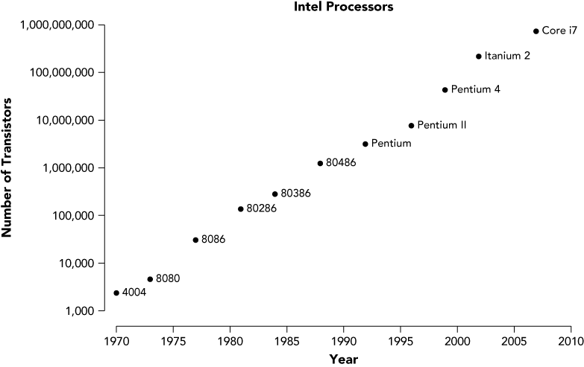
Computer Hardware and Software Development
Figure 2-1 The actual increase in transistors on a chip approximates Moore’s Law
Concepts in Enterprise Resource Planning, Fourth Edition

Slide 7
Computer Hardware and Software Development (cont’d.)
Advancements in computer software
  1970s: relational database software developed
    Provide businesses the ability to store, retrieve, and analyze large volumes of data
  1980s: spreadsheet software became popular
    Managers can easily perform complex business analyses
Concepts in Enterprise Resource Planning, Fourth Edition

Slide 8
Early Attempts to Share Resources
By the mid-1980s, telecommunications developments allowed users to share data and peripherals on local networks
  Client-server architecture
By the end of the 1980s, the hardware needed to support development of ERP systems was in place
By the mid-1980s, database management system (DBMS) required to manage development of complex ERP software existed
Concepts in Enterprise Resource Planning, Fourth Edition

Slide 9
The Manufacturing Roots of ERP
Manufacturing software developed during the 1960s and 1970s
  Evolved from simple inventory-tracking systems to material requirements planning (MRP) software
Electronic data interchange (EDI)
  Direct computer-to-computer exchange of standard business documents
  Allowed companies to handle the purchasing process electronically
Concepts in Enterprise Resource Planning, Fourth Edition

Slide 10
Management’s Impetus to Adopt ERP
Hard economic times of the late 1980s and early 1990s caused many companies to downsize and reorganize
  Stimulus to ERP development
Inefficiencies caused by the functional model of business organization
  Silos of information
  Limits the exchange of information between the lower operating levels
Concepts in Enterprise Resource Planning, Fourth Edition

Slide 11
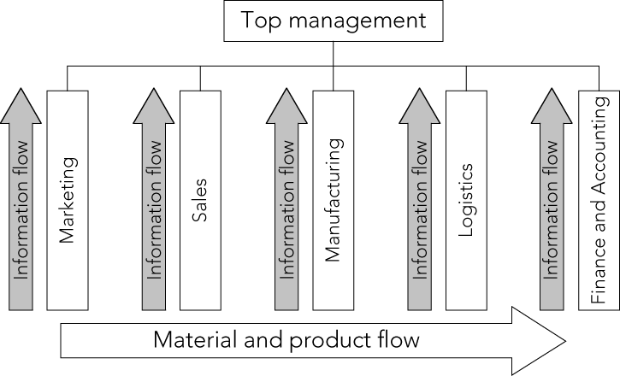
Management’s Impetus to Adopt ERP (cont’d.)
Figure 2-2 Information and material flows in a functional business model
Concepts in Enterprise Resource Planning, Fourth Edition

Slide 12
Management’s Impetus to Adopt ERP (cont’d.)
Functional model led to top-heavy and overstaffed organizations incapable of reacting quickly to change
Process business model
  Information flows between the operating levels without top management’s involvement
Further impetus for adopting ERP systems has come from compliance with the Sarbanes-Oxley Act of 2002
  Requires companies to substantiate internal controls on all information
Concepts in Enterprise Resource Planning, Fourth Edition

Slide 13
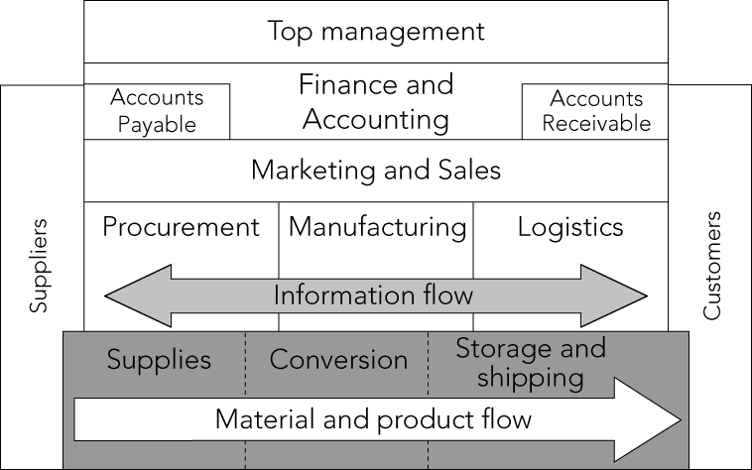
Management’s Impetus to Adopt ERP (cont’d.)
Figure 2-3 Information and material flows in a process business model
Concepts in Enterprise Resource Planning, Fourth Edition

Slide 14
ERP Software Emerges: SAP and R/3
1972: five former IBM systems analysts in Mannheim, Germany formed Systemanalyse und Programmentwicklung (Systems Analysis and Program Development, or SAP)
SAP’s goals:
  Develop a standard software product that could be configured to meet the needs of each company
  Data available in real time
  Users working on computer screens, rather than with voluminous printed output
Concepts in Enterprise Resource Planning, Fourth Edition

Slide 15
SAP Begins Developing Software Modules
During their work for German chemical company ICI, Plattner and Hopp had developed the idea of modular software development
Software modules: individual programs that can be purchased, installed, and run separately, but that all extract data from the common database
1982: SAP released its R/2 mainframe ERP software package
Concepts in Enterprise Resource Planning, Fourth Edition
Notes:
-

Slide 16
SAP Begins Developing Software Modules (cont’d.)
1980s: sales grew rapidly; SAP extended its software’s capabilities and expanded into international markets
By 1988, SAP had established subsidiaries in numerous foreign countries
Concepts in Enterprise Resource Planning, Fourth Edition

Slide 17
SAP R/3
1988: SAP began development of its R/3 system to take advantage of client-server technology
1992: first version of SAP R/3 released
SAP R/3 system was designed using an open architecture approach
Open architecture: third-party software companies encouraged to develop add-on software products that can be integrated with existing software
Concepts in Enterprise Resource Planning, Fourth Edition

Slide 18
New Directions in ERP
Late 1990s: Year 2000 (or Y2K) problem motivated many companies to move to ERP systems
By 2000, SAP AG had 22,000 employees in 50 countries and 10 million users at 30,000 installations around the world
By 2000, SAP’s competition in the ERP market:
  Oracle
  PeopleSoft
Late 2004: Oracle succeeded in its bid to take over PeopleSoft
Concepts in Enterprise Resource Planning, Fourth Edition

Slide 19
New Directions in ERP (cont’d.)
PeopleSoft
  Founded by David Duffield, a former IBM employee
  Today, PeopleSoft, under Oracle, is a popular software choice for managing human resources and financial activities at universities
Oracle
  SAP’s biggest competitor
  Began in 1977 as Software Development Laboratories (SDL)
  Founders: Larry Ellison, Bob Miner, and Ed Oates
Concepts in Enterprise Resource Planning, Fourth Edition

Slide 20
New Directions in ERP (cont’d.)
SAP ERP
  Latest versions of ERP systems by SAP and other companies allow:
    All business areas to access the same database
    Elimination of redundant data and communications lags
    Data to be entered once and then used throughout the organization
Concepts in Enterprise Resource Planning, Fourth Edition

Slide 21
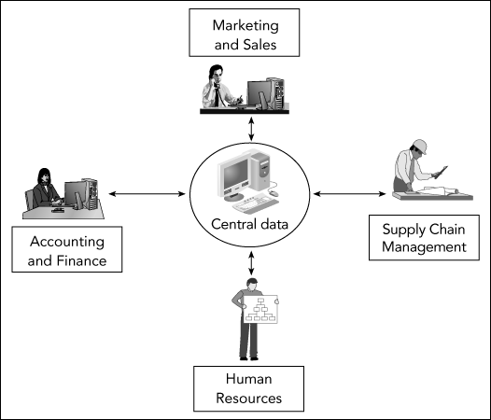
New Directions in ERP (cont’d.)
Figure 2-4 Data flow within an integrated information system
Concepts in Enterprise Resource Planning, Fourth Edition

Slide 22
New Directions in ERP (cont’d.)
Current SAP ERP system: SAP ECC 6.0 (Enterprise Central Component 6.0)
  Sales and Distribution (SD) module
  Materials Management (MM) module
  Production Planning (PP) module
  Quality Management (QM) module
  Plant Maintenance (PM) module
  Asset Management (AM) module
Concepts in Enterprise Resource Planning, Fourth Edition

Slide 23
New Directions in ERP (cont’d.)
Current SAP ERP system: SAP ECC 6.0 (Enterprise Central Component 6.0) (cont’d.)
  Human Resources (HR) module
  Project System (PS) module
  Financial Accounting (FI) module
  Controlling (CO) module
  Workflow (WF) module
Concepts in Enterprise Resource Planning, Fourth Edition

Slide 24
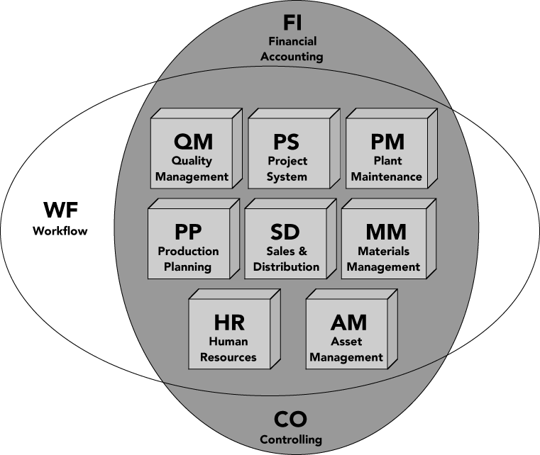
New Directions in ERP (cont’d.)
Figure 2-5 Modules within the SAP ERP integrated information systems environment (Courtesy of SAP AG)
Concepts in Enterprise Resource Planning, Fourth Edition

Slide 25
SAP ERP Software Implementation
Not all companies that use SAP use all of the SAP ERP modules
Company’s level of data integration is highest when it uses one vendor to supply all of its modules
Configuration options allow the company to customize the modules it has chosen to fit the company’s needs
Concepts in Enterprise Resource Planning, Fourth Edition

Slide 26
SAP ERP Software Implementation (cont’d.)
Tolerance groups
  Specific ranges that define transaction limits
  SAP has defined the tolerance group methodology as its method for placing limits on an employee
  Configuration allows the company to further tailor tolerance group methodology
Concepts in Enterprise Resource Planning, Fourth Edition

Slide 27
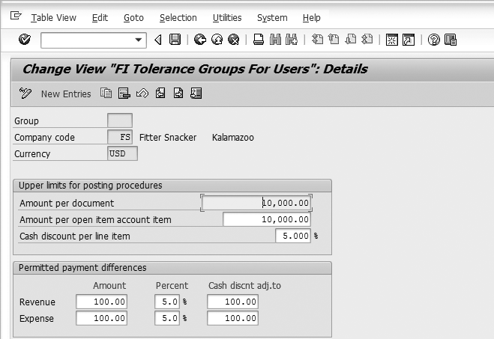
SAP ERP Software Implementation (cont’d.)
Figure 2-6 A customization example: tolerance groups to set transaction limits
Concepts in Enterprise Resource Planning, Fourth Edition

Slide 28
SAP ERP Software Implementation (cont’d.)
Features of SAP ERP
  First software that could deliver real-time ERP integration
  Usability by large companies
  High cost
  Automation of data updates
  Applicability of best practices
    Best practices: SAP’s software designers choose the best, most efficient ways in which business processes should be handled
Concepts in Enterprise Resource Planning, Fourth Edition

Slide 29
ERP for Midsized Companies
By 1998
  Most of the Fortune 500 companies had already installed ERP systems
  ERP vendors refocused their marketing efforts on midsized companies
SAP All-in-One
  Single package containing specific, preconfigured bundles of SAP ERP tailored for particular industries
  Can be installed more quickly than the standard ERP product
Concepts in Enterprise Resource Planning, Fourth Edition

Slide 30
ERP for Midsized Companies (cont’d.)
Application hosting
  Third-party company provides the hardware and software support
  Makes ERP systems like SAP more appealing to midsized companies
SAP and Oracle are facing competition from smaller providers of ERP software
Concepts in Enterprise Resource Planning, Fourth Edition

Slide 31
Responses of the Software to the Changing Market
In mid-1990s, many companies complained about the difficulty of implementing SAP R/3 system
SAP responded by developing Accelerated SAP (ASAP) implementation methodology
  Eases the implementation process
SAP continues to extend capabilities of SAP ERP with additional, separate products that run on separate hardware and extract data from the SAP ERP system
Concepts in Enterprise Resource Planning, Fourth Edition

Slide 32
Choosing Consultants and Vendors
One person cannot fully understand a single ERP system
Before choosing a software vendor, most companies:
  Study their needs
  Hire an external team of software consultants to help choose the right software vendor(s) and the best approach to implementing ERP
Concepts in Enterprise Resource Planning, Fourth Edition

Slide 33
The Significance and Benefits of ERP Software and Systems
More efficient business processes that cost less than those in unintegrated systems
Easier global integration
Integrates people and data while eliminating the need to update and repair many separate computer systems
Allows management to manage operations, not just monitor them
Can dramatically reduce costs and improve operational efficiency
Concepts in Enterprise Resource Planning, Fourth Edition

Slide 34
Questions About ERP
How much does an ERP system cost?
Should every business buy an ERP package?
Is ERP software inflexible?
What return can a company expect from its ERP investment?
How long does it take to see a return on an ERP investment?
Why do some companies have more success with ERP than others?
Concepts in Enterprise Resource Planning, Fourth Edition

Slide 35
How Much Does an ERP System Cost?
Size of the ERP software
  Corresponds to the size of the company it serves
Need for new hardware that is capable of running complex ERP software
Consultants’ and analysts’ fees
Time for implementation
  Causes disruption of business
Training
  Costs both time and money
Concepts in Enterprise Resource Planning, Fourth Edition

Slide 36
Should Every Business Buy an ERP Package?
Some of a business’s operations, and some segments of its operations, might not be a good match with the constraints of ERP
Sometimes, a company is not ready for ERP
ERP implementation difficulties result when management does not fully understand its current business processes and cannot make implementation decisions in a timely manner
Concepts in Enterprise Resource Planning, Fourth Edition

Slide 37
Is ERP Software Inflexible?
Many people claim that ERP systems, especially the SAP ERP system, are rigid
Options for customization offered by SAP ERP
  Numerous configuration options that help businesses customize the software to fit their needs
  Programmers can write specific routines using Advanced Business Application Programming (ABAP)
Once an ERP system is in place, trying to reconfigure it while retaining data integrity is expensive and time-consuming
Concepts in Enterprise Resource Planning, Fourth Edition

Slide 38
What Return Can a Company Expect from Its ERP Investment?
ERP eliminates redundant efforts and duplicated data; can generate savings in operations expense
ERP system can help produce goods and services more quickly
Company that doesn’t implement an ERP system might be forced out of business by competitors that have an ERP system
Smoothly running ERP system can save a company’s personnel, suppliers, distributors, and customers much frustration
Concepts in Enterprise Resource Planning, Fourth Edition

Slide 39
What Return Can a Company Expect from Its ERP Investment? (cont’d.)
Cost savings and increased revenues occur over many years
  Difficult to put an exact dollar figure to the amount accrued from the original ERP investment
ERP implementations take time
  Other business factors may be affecting the company’s costs and profitability
  Difficult to isolate the impact of the ERP system alone
ERP systems provide real-time data
  Improve external customer communications
Concepts in Enterprise Resource Planning, Fourth Edition

Slide 40
How Long Does It Take to See a Return on an ERP Investment?
Return on investment (ROI): assessment of an investment project’s value
  Calculated by dividing the value of the project’s benefits by the project’s cost
ERP system’s ROI can be difficult to calculate
Peerstone Research study
  63 percent of companies that performed the calculation reported a positive ROI for ERP
  Most companies felt that nonfinancial goals were the reason behind their ERP installations
Concepts in Enterprise Resource Planning, Fourth Edition

Slide 41
Why Do Some Companies Have More Success with ERP Than Others?
Usually, a bumpy rollout and low ROI are caused by people problems and misguided expectations, not computer malfunctions
  Executives blindly hoping that new software will cure fundamental business problems that are not curable by any software
  Executives and IT managers not taking enough time for a proper analysis during planning and implementation phase
  Executives and IT managers skimping on employee education and training
Concepts in Enterprise Resource Planning, Fourth Edition

Slide 42
Why Do Some Companies Have More Success with ERP Than Others? (cont’d.)
Usually, a bumpy rollout and low ROI are caused by people problems and misguided expectations, not computer malfunctions (cont’d.)
  Companies not placing ownership or accountability for the implementation project on the personnel who will operate the system
  Unless a large project such as an ERP installation is promoted from the top down, it is doomed to fail
  ERP implementation brings a tremendous amount of change for users
Concepts in Enterprise Resource Planning, Fourth Edition

Slide 43
Why Do Some Companies Have More Success with ERP Than Others? (cont’d.)
For many users, it takes years before they can take advantage of many of an ERP system’s capabilities
Most ERP installations do generate returns
Concepts in Enterprise Resource Planning, Fourth Edition

Slide 44
The Continuing Evolution of ERP
Understanding the social and business implications of new technologies is not easy
ERP systems have been in common use only since the mid-1990s
ERP vendors are working to solve adaptability problems that plague customers
Concepts in Enterprise Resource Planning, Fourth Edition

Slide 45
Odoo - The #1 Open Source ERP & CRM
Odoo is basically a comprehensive business management software. In other words, we can say that it is a complete suite of open source business apps.
Odoo lets the user deal with different functionalities like CRM, sales, inventory, reporting, accounting, sending invoices, etc.
Concepts in Enterprise Resource Planning, Fourth Edition

Slide 46
FEATURES OF ODOO
It is open source software;
Integrated Scalability; which means you can use the variety of modules in Odoo as per your business growth
Easy to learn;
It is flexible and easy to customize;
Can help to manage a range of industries
Concepts in Enterprise Resource Planning, Fourth Edition

Slide 47
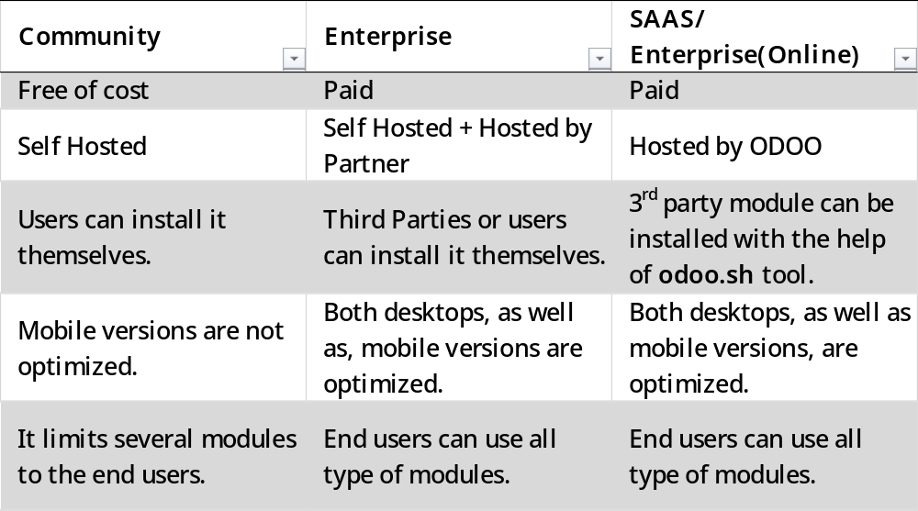
DIFFERENT EDITIONS IN ODOO
Concepts in Enterprise Resource Planning, Fourth Edition

Slide 48
SIGNIFICANT UPDATES IN DIFFERENT VERSIONS OF ODOO
In 2005, there was the launch of Tiny ERP; which is the first release of Odoo
From the launch of version 5, its name turned into Open ERP till version 7. Additionally, it came up with improved web client and usability
ODOO 8 came with e-commerce which is one of the most popular modules.
With the launch of Odoo Version 9, it got split into different editions.
In 2017, ODOO 11 came up with a wonder like ODOO Studio which helps to create the apps.
ODOO 12 is the most recent version of Odoo and version 13 is expected to come by October 2019.
Concepts in Enterprise Resource Planning, Fourth Edition

Slide 49
POPULARITY OF ODOO
More than 2 million active users
Available in more than 32 languages
1000 installs per day.
1457% user growth
Used in various types of industries
Concepts in Enterprise Resource Planning, Fourth Edition

Slide 50
TOP 10 REASONS THAT ODOO IS A BOON FOR YOUR BUSINESS
One solution for your entire business
Low cost of implementation
Customizable
Easy integration
Easy to implement
Multiple options to choose from; i.e., three editions in Odoo
Scalable
Powerful Community
Security
Intuitive user interface
Concepts in Enterprise Resource Planning, Fourth Edition

Slide 51
Summary
Speed and power of computing hardware increased exponentially, while cost and size decreased
Early client-server architecture provided the conceptual framework for multiple users sharing common data
Increasingly sophisticated software facilitated integration, especially in two areas: A/F and manufacturing resource planning
Concepts in Enterprise Resource Planning, Fourth Edition

Slide 52
Summary (cont’d.)
Growth of business size, complexity, and competition made business managers demand more efficient and competitive information systems
SAP AG produced a complex, modular ERP program called R/3
  Could integrate a company’s entire business by using a common database that linked all operations
SAP R/3, now called SAP ERP, is modular software offering modules for Sales and Distribution, Materials Management, Production Planning, Quality Management, and other areas
Concepts in Enterprise Resource Planning, Fourth Edition

Slide 53
Summary (cont’d.)
ERP software is expensive to purchase and time-consuming to implement, and it requires significant employee training—but the payoffs can be spectacular
  For some companies, ROI may not be immediate or even calculable
Experts anticipate that ERP’s future focus will be on managing customer relationships, improving planning and decision making, and linking operations to the Internet and other applications through service-oriented architecture
Concepts in Enterprise Resource Planning, Fourth Edition

